Slide 1
A Flash-Friendly Persistent Burst Buffer File System
Team Name: ThanOS
Members: Subhadeep Bhattacharya
Fahim Tahmid Chowdhury
Shaeke Salman

Slide 2
Overview
Background
Motivation
Design and Implementation
Experimental Results
Future Work

Slide 3
Overview
Background
Hardware Level
Motivation
Design and Implementation
Experimental Results
Future Work

Slide 4
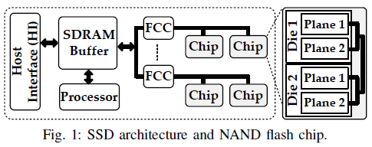
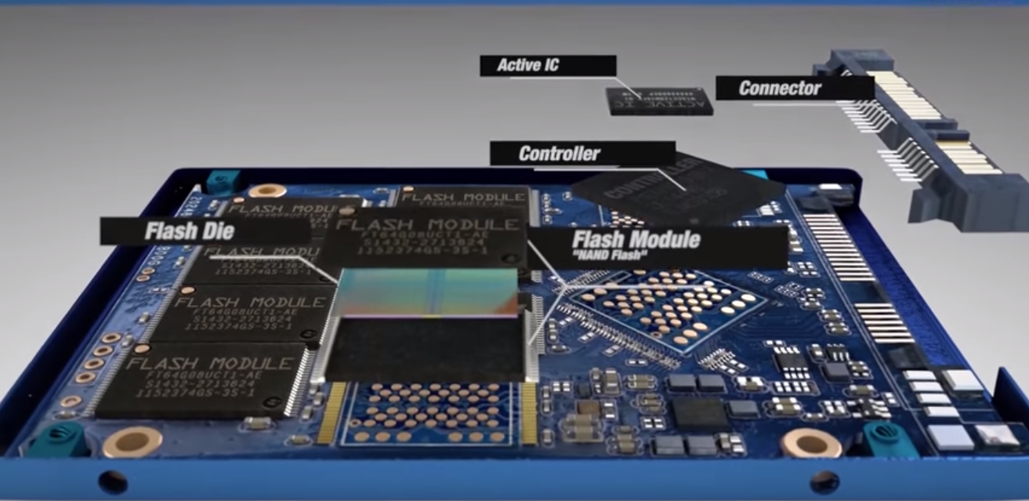
Solid State Disk (SSD)
Host Interface
Processor to execute Flash Translation Layer (FTL) firmware
FCC (Flash Chip Controllers)
Flash Chips
Notes:
Host Interface: Provides communication with the host (Computer), Queues I/O requests and sends response back to host
Processor: Process I/O requests, Execute Flash Translation Layer (FTL) firmware
FCC: Command and Data Transfer between the processor and flash chips
Flash Chips: Provide storage, Connected to FCC through multiple I/O channels

Slide 5
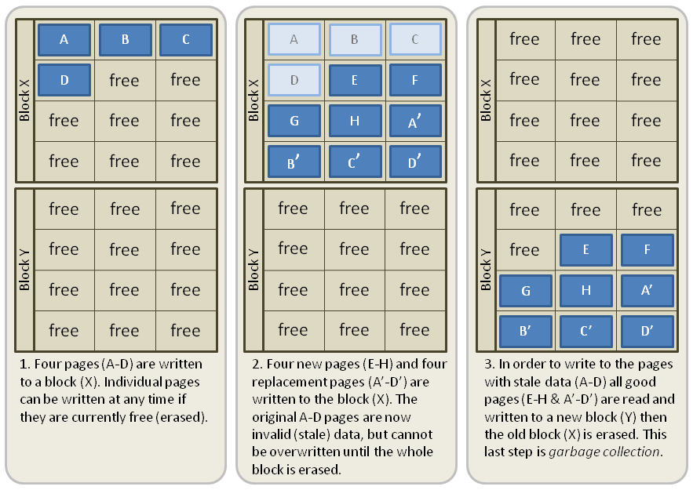
Garbage Collection (GC)

Slide 6
Overview
Background
Kernel Level
Motivation
Design and Implementation
Experimental Results
Future Work

Slide 7
Unix File Systems
Ext4
Extents instead of traditional fixed blocks
Improves large file performance
reduces metadata overhead for large files
Persistent pre-allocation, Delayed & Multi-block allocation
Notes:
Extents: The commonly used file systems of Unix/Linux like ext2 and ext3 use direct, indirect, double indirect, and triple indirect block mapping scheme to map file offsets to on-disk blocks. This is ideal for small files. However, in the case of large files, there will be a large number of mappings which will reduce performance, especially while seeking and deleting data.
So extents were introduced to replace the block mapping scheme. The concept extent means “a contiguous sequence of physical blocks”. Large files are split into several “extents”. The files are allocated to a ‘single extent’ instead of a particular size, thus avoiding the indirect mapping of blocks.
Persistent preallocation: allows the application to allocate contiguous blocks with a fixed size, before writing the data. This will ensure the following: Lesser fragmentation (because blocks are allocated as contiguously as possible). Ensure that applications have enough space to work.
Delayed allocation: ext4 delays block allocation until data are flushed to disk.
Multiblock allocation: allocates multiple blocks for a file in a single operation, instead of allocating it one by one, as is the case in ext3. This will reduce the overhead of calling the “block allocator” several times and will optimize the allocation of memory.
Journaling: is a capability which ensures consistency of data in the file system, despite any power outages or system crash that may occur. XFS provides journaling for file system metadata, where file system updates are first written to a serial journal before the actual disk blocks are updated. The journal is a circular buffer of disk blocks that is not read in normal file system operation.
Allocation group: Each allocation group manages its own inodes and free space separately, providing scalability and parallelism so multiple threads and processes can perform I/O operations on the same file system simultaneously.

Slide 8
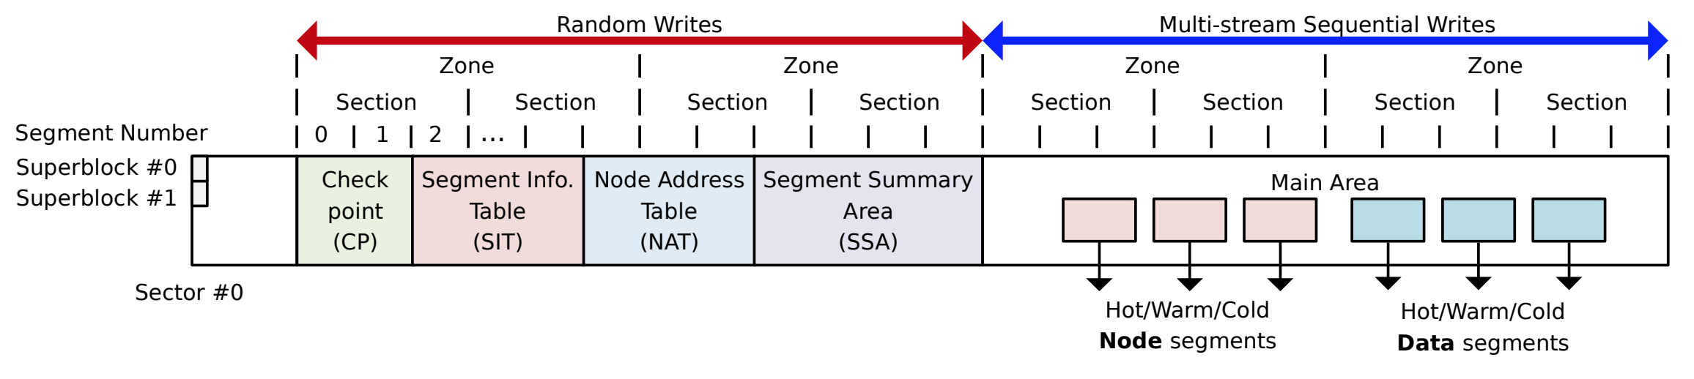
Flash-Friendly File Systems
F2FS
Exploits NAND flash memory-based storage devices
Based on Log-structured File System (LFS)
Flash-friendly on-disk layout: aligned FS GC and FTL GC unit
Cost effective index structure: restrain write propagation using NAT
Cleaning cost reduction using multi-head logging reduces metadata overhead for large files

Slide 9
Overview
Background
User Level
Motivation
Design and Implementation
Experimental Results
Future Work

Slide 10
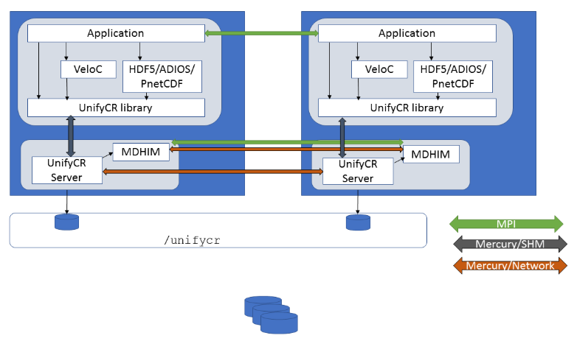
UnifyCR – A Burst Buffer File System
User level burst buffer file system
Handles array of node-local SSDs on HPC systems
Components:
UnifyCR Library: Handles client I/O requests
UnifyCR Server: Handles library I/O request

Slide 11
Overview
Background
Motivation
Design and Implementation
Experimental Results
Future Work

Slide 12
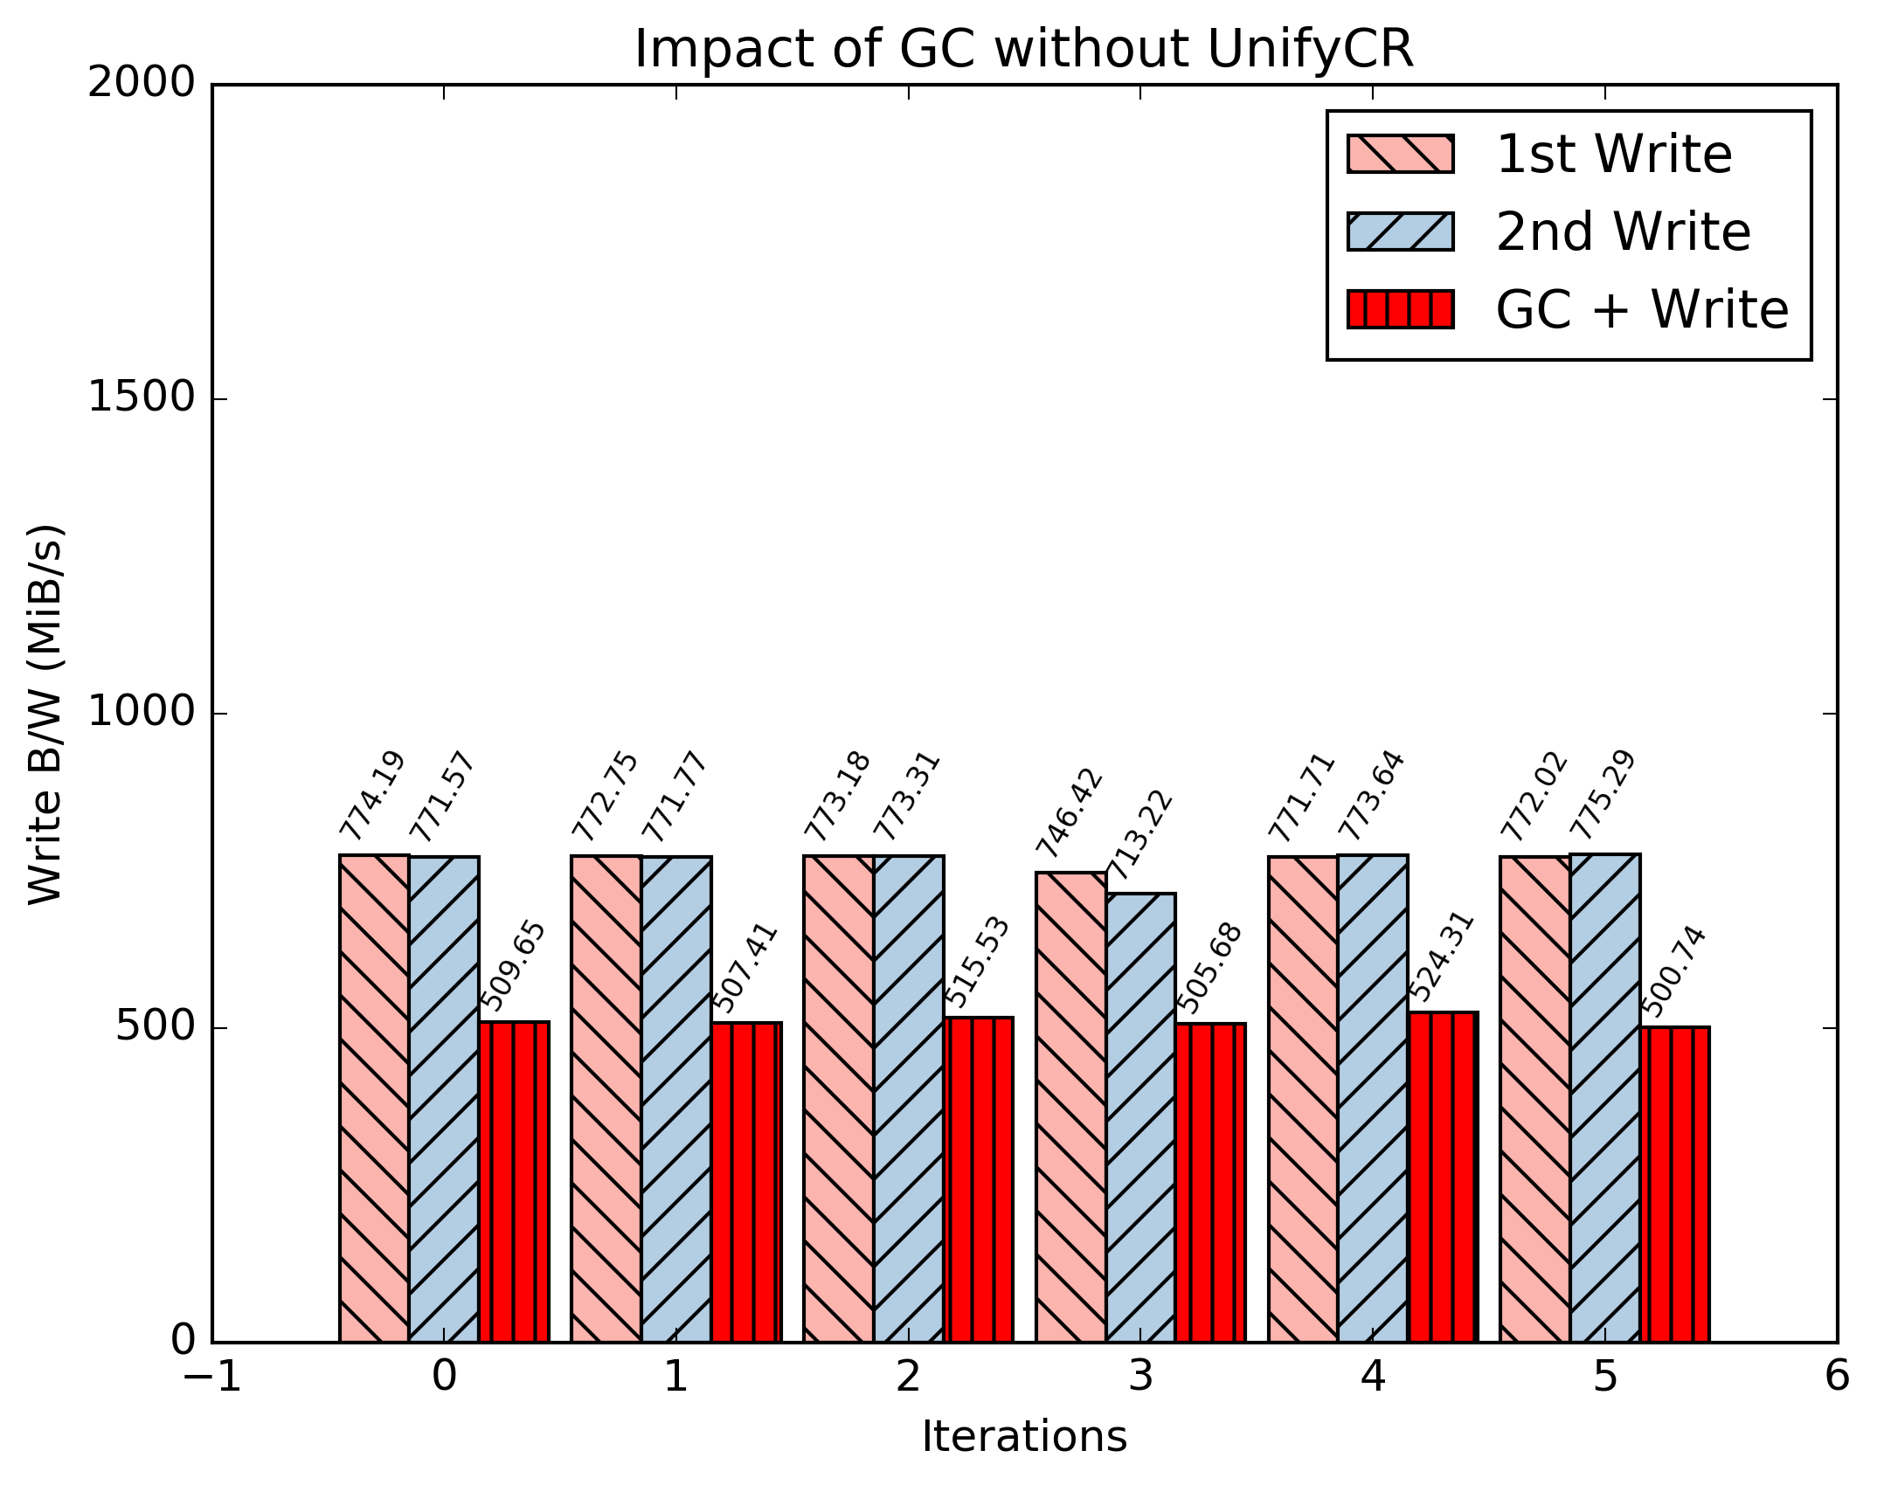
Importance of Efficient GC Handling
Single Node
File1 write b/w
~770 MiB/s
File1 overwrite b/w
~770 MiB/s
File2 Write b/w
Invokes GC
~510 MiB/s

Slide 13
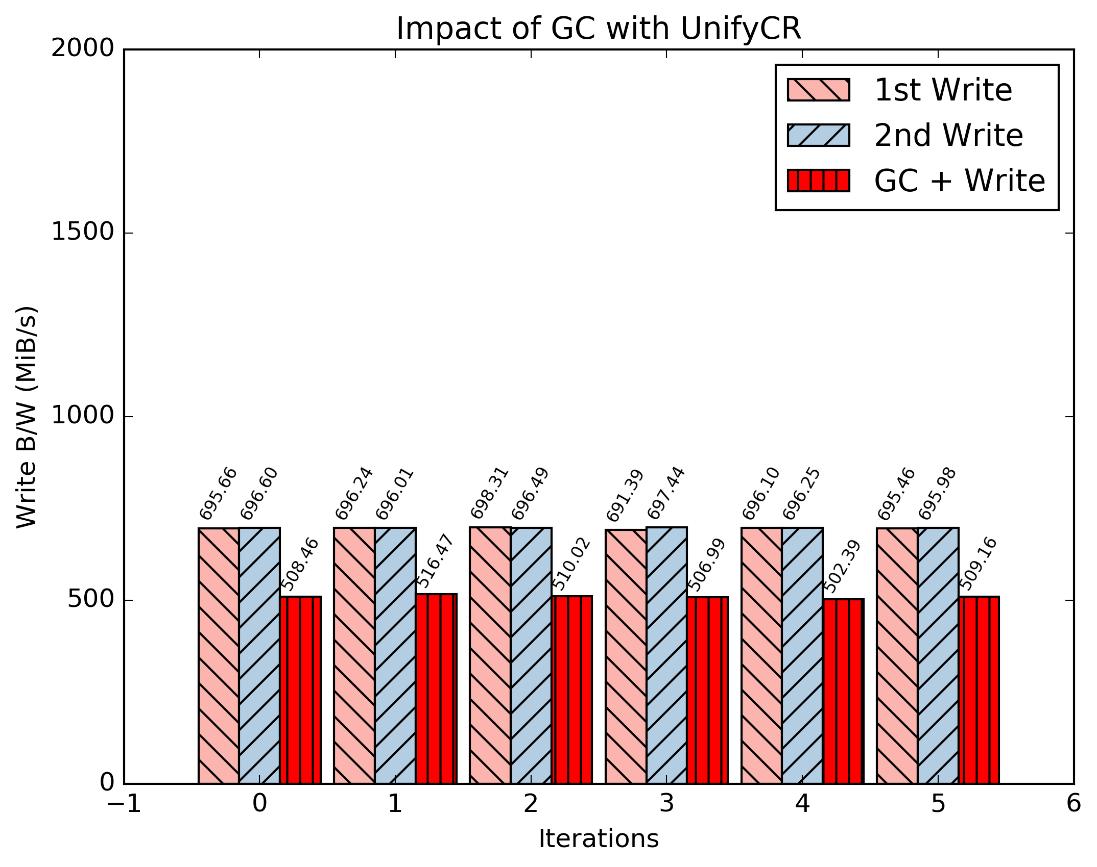
Importance of Efficient GC Handling
Single Node
File1 write b/w
~700 MiB/s
File1 overwrite b/w
~700 MiB/s
File2 Write b/w
Invokes GC
~507 MiB/s

Slide 14

Importance of Efficient GC Handling
2 Nodes
File1 write b/w
~700 MiB/s
File1 overwrite b/w
~700 MiB/s
File2 Write b/w
Invokes GC
~520 MiB/s

Slide 15
Importance of Persistence
For ensuring fail-safety
For checkpointing application status
Fail-safety
Debug
For archiving important information
Persistence comes with some opportunity cost
Trivial: affects I/O throughput of application

Slide 16
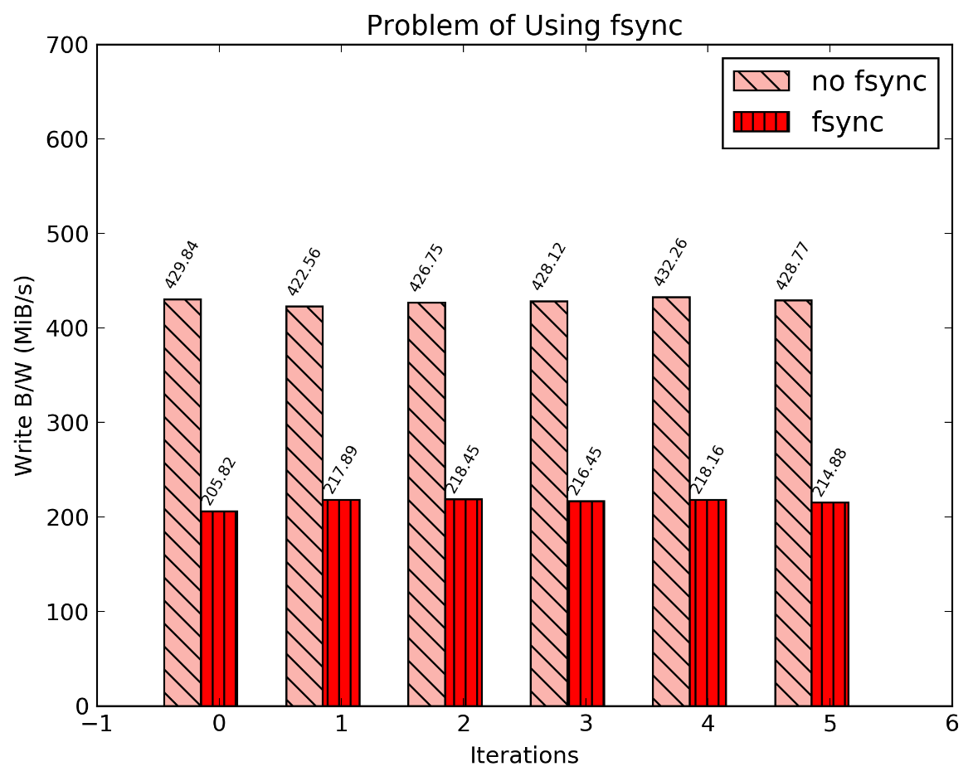
Impact of Adding Persistence
No persistence on unmount
~430 MiB/s
Synchronous persistence on unmount
~215 MiB/s

Slide 17
Project Goals
UnifyCR has no built-in flash-friendly GC handling mechanism
Leverage efficiency of F2FS
UnifyCR is ephemeral with no flushing pipeline for SSD to HDD
Add persistence in the system by fsync while unmount
Try to minimize the “opportunity cost” by “intuitively” invoking asynchronous fsync

Slide 18
Overview
Background
Motivation
Design and Implementation
Experimental Results
Future Work

Slide 19
System Architecture
Application
SSD
HDD
Buffer
UnifyCR
Pipel
ine
f2fs
f2fs
f2fs
f2fs
f2fs
…
Persistent Parallel File System
Flush
ext4
ext4
xfs
ext4
xfs
…
Nodes
1
2
3
4
5

Slide 20
Incorporating F2FS in UnifyCR
Flash-friendly Optimization
System Configuration
Build f2fs-tools from source on the system
Update kernel version to 4.19 to support f2fs mounting
UnifyCR Modification
Add configuration entries to indicate metadata and data location

Slide 21
Implementing Persistence
Asynchronous Persistence
UnifyCR modification
Add flushing mechanism on unmount through aio_fsync
Maintain a application wide aiocb (asynchronous I/O control block)
Update file descriptor of a file in persistent location
Write data in the buffer of aiocb structure
Asynchronously fsync data through aio_fsync on unmount

Slide 22
Miscellaneous Development
Interleaved Or Random (IOR) Modification
Add custom verbosity level: VERBOSE_CUSTOM to show customized output format
Use unifycr library from IOR
Python scripts to analyze and plot results

Slide 23
Overview
Background
Motivation
Design and Implementation
Experimental Results
Flash-friendly Optimization
Future Work

Slide 24
Test Environment
Impact Cluster
No of Nodes: 2
Node Configuration:
Storage:
SSD: 256 GB
HDD: 1 TB
Memory: 8 GB
Processor: Intel(R) Core(TM) i5-4690 CPU @ 3.50GHz
Interconnect: 1GbE Intel Corporation Ethernet Connection I217-LM
Linux Kernel version: Linux 4.19.6-1.el7.elrepo.x86_64
Benchmarks
IOR for mpiio and sysio-writeread app for posix

Slide 25
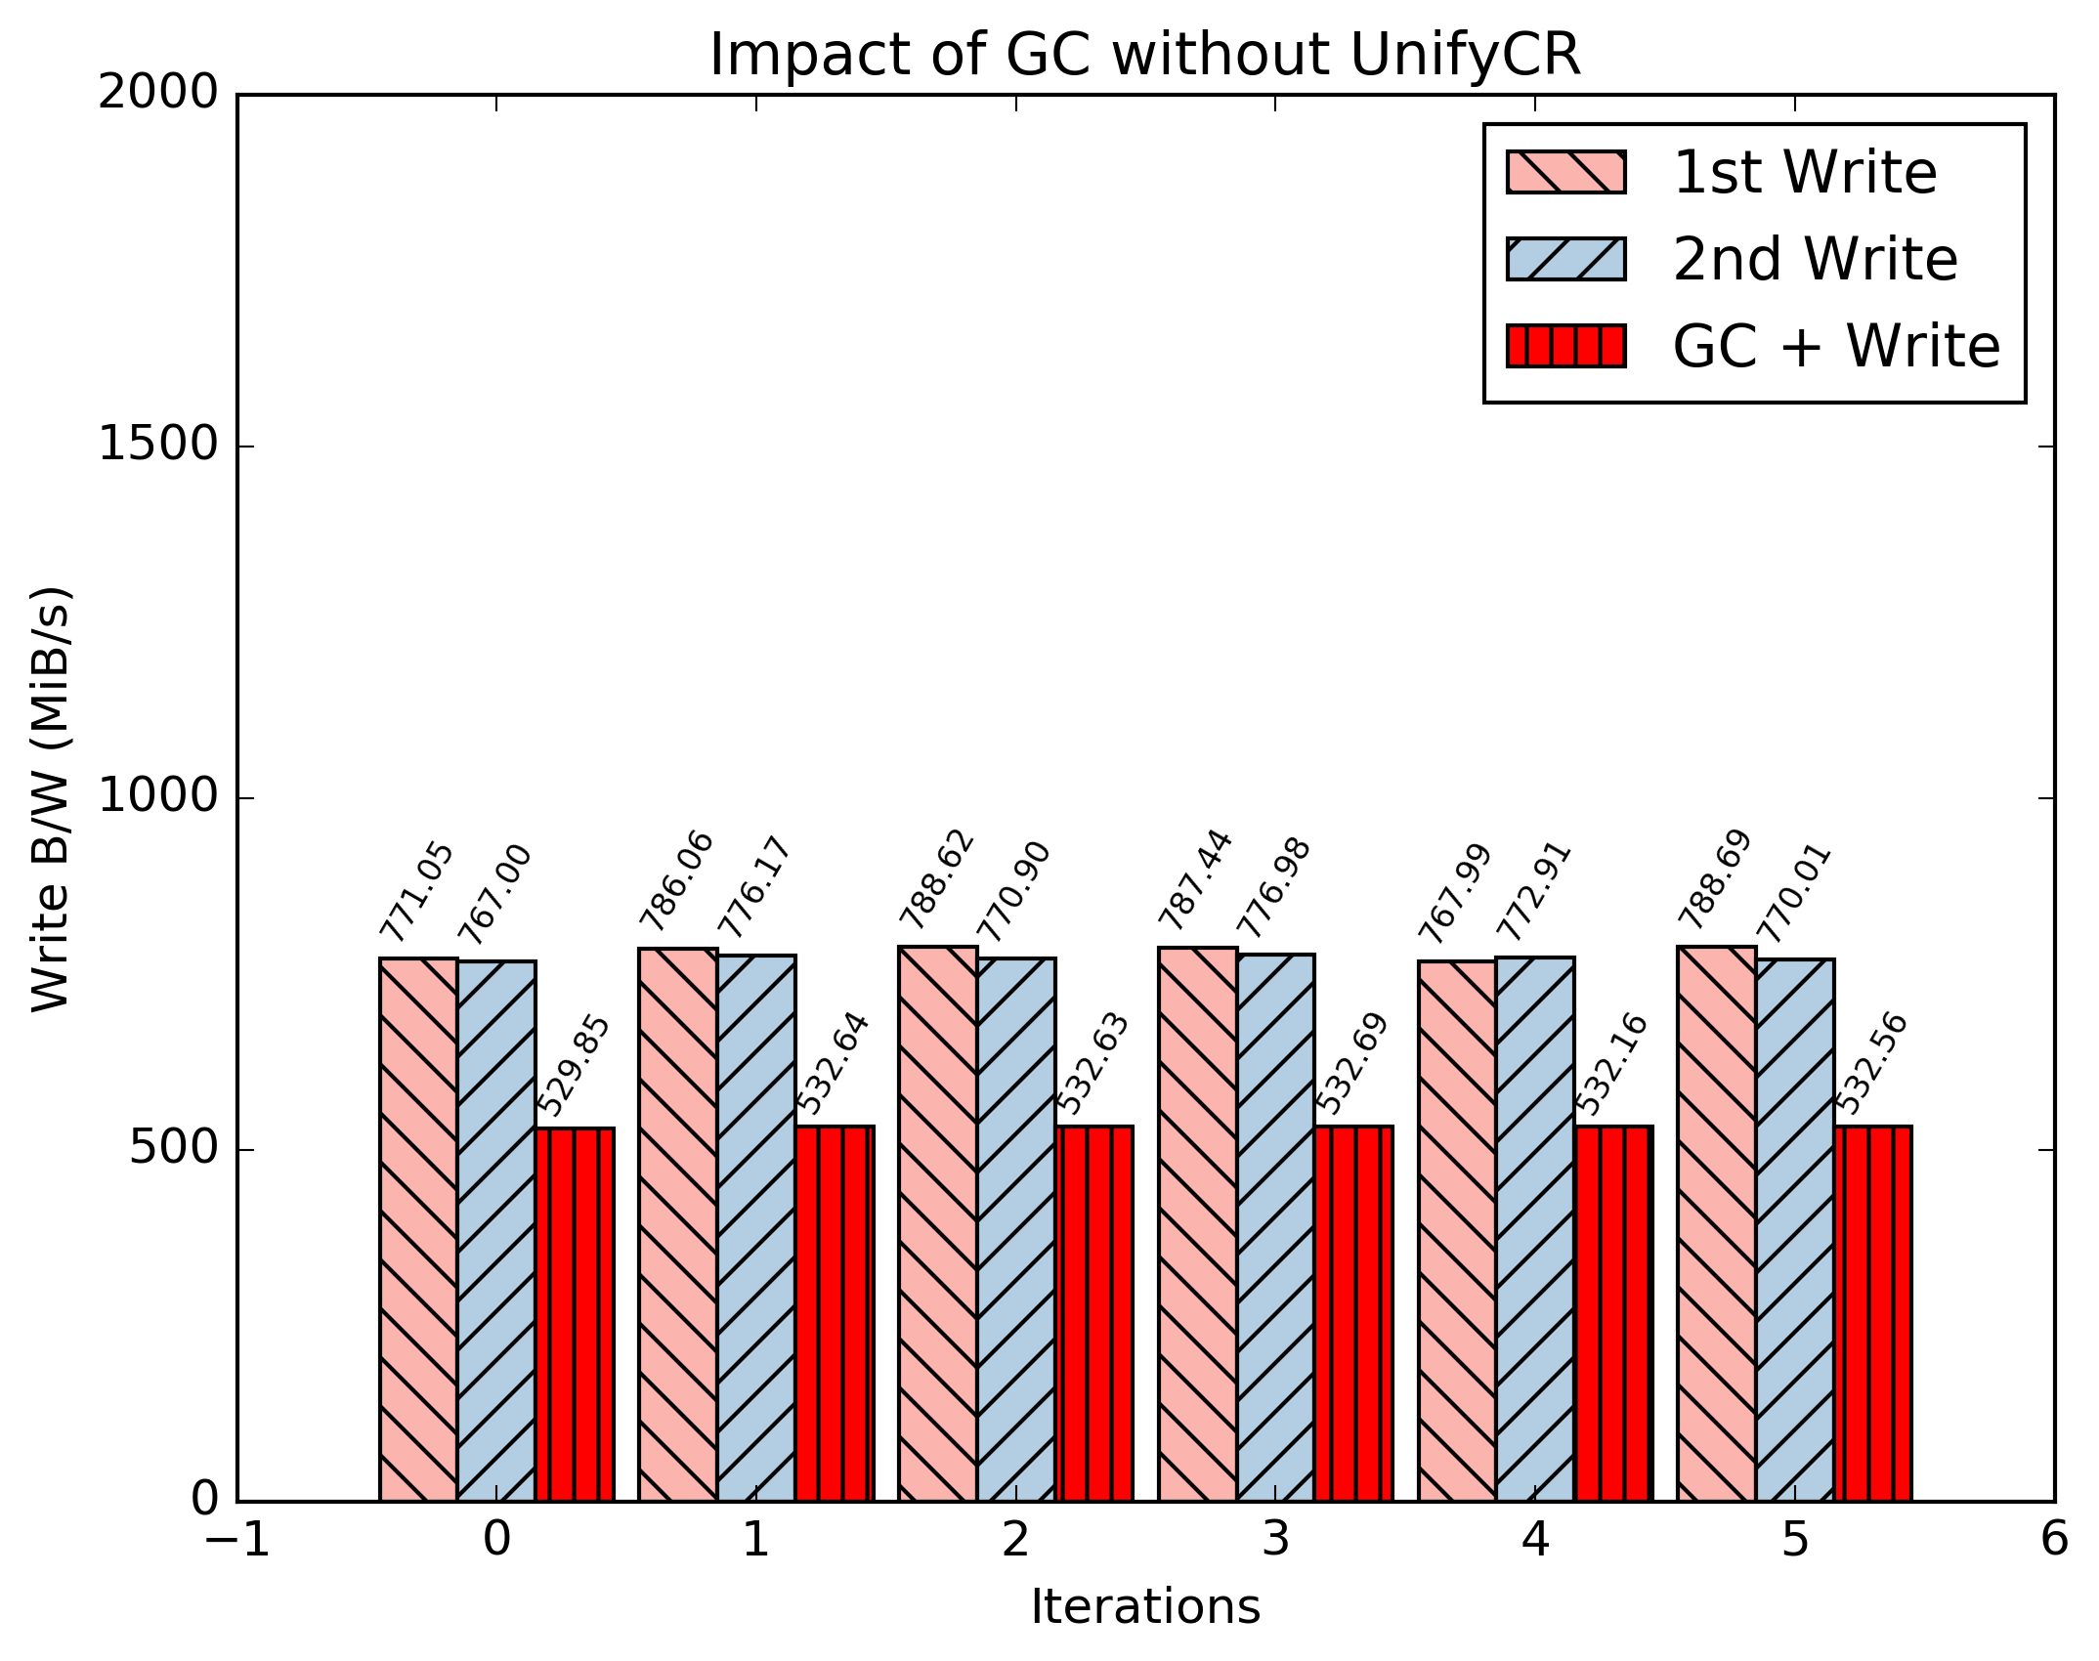
Data: F2FS Metadata: F2FS
Single Node
File1 write b/w
~770 MiB/s
File1 overwrite b/w
~770 MiB/s
File2 Write b/w
Invokes GC
~530 MiB/s
ext4: ~510 MiB/s

Slide 26
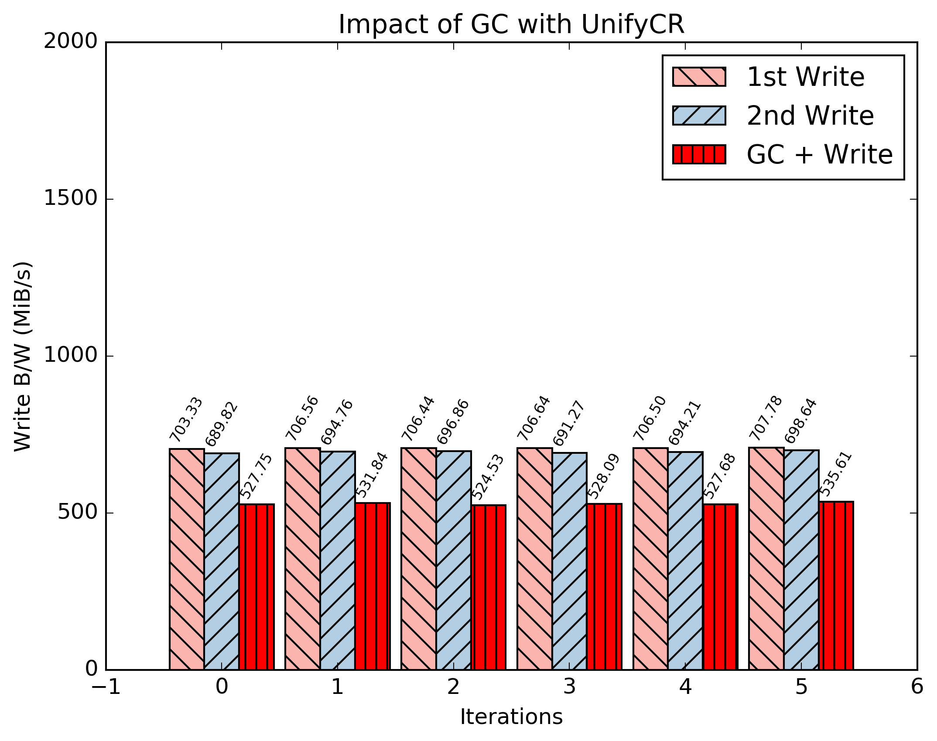
Data: F2FS Metadata: F2FS
Single Node
File1 write b/w
~700 MiB/s
File1 overwrite b/w
~700 MiB/s
File2 Write b/w
Invokes GC
~528 MiB/s
ext4: ~507 MiB/s

Slide 27

Data: F2FS Metadata: F2FS
2 Nodes
File1 write b/w
~700 MiB/s
File1 overwrite b/w
~700 MiB/s
File2 Write b/w
Invokes GC
~528 MiB/s
ext4: ~520 MiB/s

Slide 28

Data: ext4 Metadata: F2FS
2 Nodes
File1 write b/w
~700 MiB/s
File1 overwrite b/w
~700 MiB/s
File2 Write b/w
Invokes GC
~515 MiB/s

Slide 29
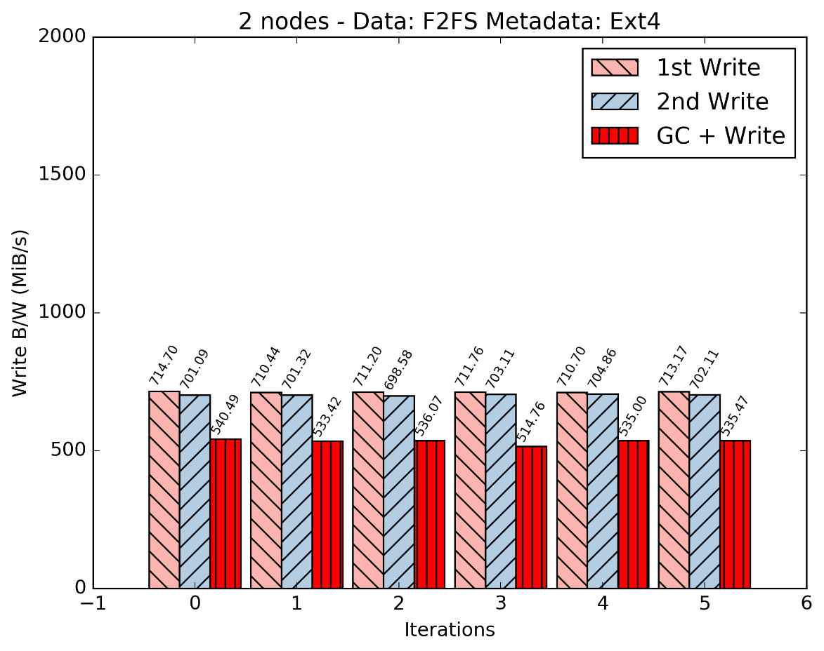
Data: F2FS Metadata: ext4
2 Nodes
File1 write b/w
~710 MiB/s
File1 overwrite b/w
~700 MiB/s
File2 Write b/w
Invokes GC
~535 MiB/s

Slide 30
Overview
Background
Motivation
Design and Implementation
Experimental Results
Asynchronous Persistence
Future Work

Slide 31
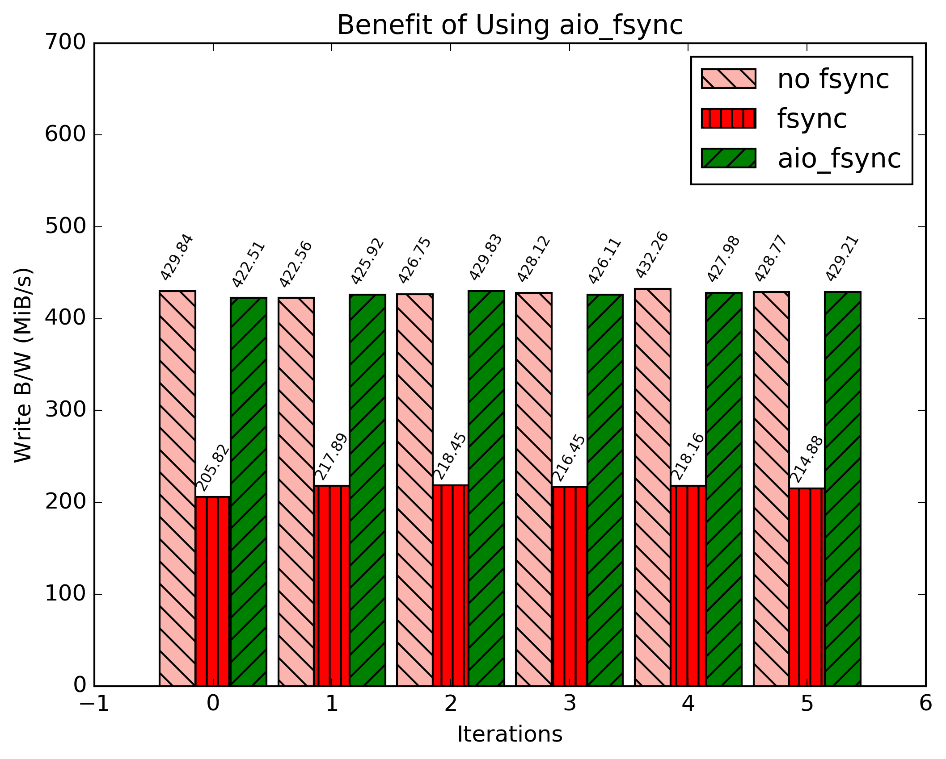
Asynchronous Persistence
No persistence on unmount
~430 MiB/s
Synchronous persistence on unmount
~215 MiB/s
Asynchronous persistence on unmount
~428 MiB/s

Slide 32
Overview
Background
Motivation
Design and Implementation
Experimental Results
Future Work

Slide 33
Future Work
Cost-effective write pipelining mechanism for random writes
Dynamically detect I/O pattern
Direct flushing of sequential data into HDD
Store random data to SSD and flush sequentially to HDD
Periodically flush data to persistent storage via background thread
Try other flash-friendly file systems, e.g. btrfs

Slide 34
Questions?

Slide 35
Thank You

