Slide 1


Institute of Information Technology, University of Dhaka
SE 305 : Software Project Lab I
Midterm Presentation
Project Title: Teach Manager
Name: Fahim Mahmud
BSSE 12th Batch
Roll : 1213
Supervised By,
Dr. Md. Shariful Islam
Professor, IITDU

Slide 2


What is Teach Manager ?
Teach Manager is a terminal and file-based tool to handle for academic institutions. This tool is consist of 3 kinds of roles :
The Admin
The Teachers and
The Students
As this tool is mainly for maintaining and evaluating the students, both the admin and the teachers can control the students. But the admin is empowered to control all the things about students and teachers.

Slide 3

The key challenge to this project..
Data Management
There will be interactions among the types of persons. Also, the evaluating system of the students can be divided into semesters, courses, continuous improvement, midterm, final exam mark, and attendance.
Using No database
without using the database tool, using file management (text files and directory) is the main challenge to this project. Admin will create/remove directory folder or file for adding/removing any person.
Interactive Terminal
Also without using any graphics work, to make a quite interactive tool is another point. X-Y coordinator is being used to make the terminal quite interesting.

Slide 4
Project
Structure
Implementation of OOP concepts
Class : Person
Class : Admin
Class : Teacher
Class : Student
Class : Academic
Class : Semester
Class : Course

Slide 5
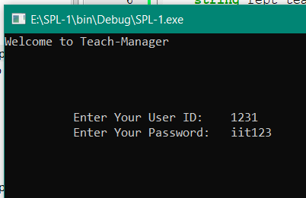
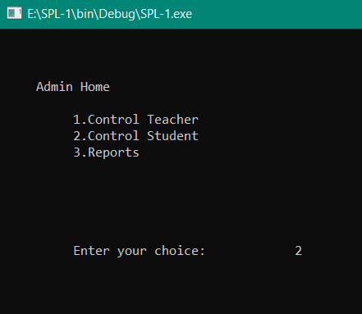
Login
At first there will be a login part.
User Identification
The program will automatically detect the type of user based on the user ID and password from “userloginInfo.txt” file.
Functions for the particular user
After Logging as the admin, the admin can control the teacher, the students or review the reports.
User will input his/her unique ID and password to login
Working
Procedure

Slide 6
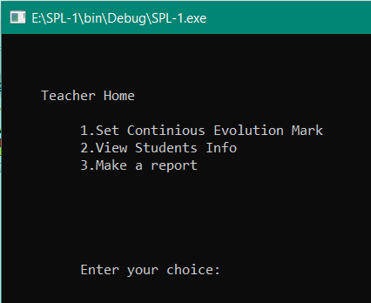
Set Marks
After logging as a teacher, the teacher can set marks for continuous evolution for his/her students.
He/she can also count the attendance of the students.
Progress Check
He/she can check conditions of his/her students till the day.
Make Report
A teacher can make report to the admin against any student for any unwanted situation.
Teacher
Section

Slide 7
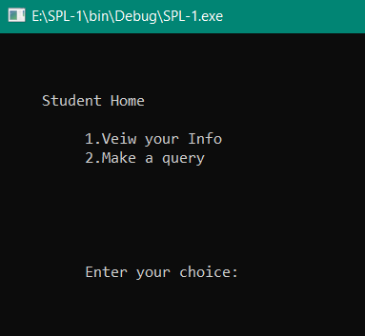
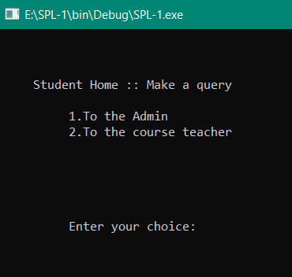
Student will login with the student ID and password
After successful login, a student can check the condition of his/her present semester or courses, provided by the course teacher or admin.
He/she can send messages to the admin or particular course teacher for any query or report.
Student
Section

Slide 8
Project Progress
Done
Made Structure
Remaining
In addition, Printing menu of sections and subsections have been done.
The implementation of yellow areas, work of black areas and overall bug fixation and improvement is remaining
1. The Admin: The admin is the head of the organization. He can add, modify or
remove any teacher, any student personally or batch-wise. The admin can
add/remove a full batch, entry mark of particular course and make a result sheet
for students, view the progress of any student or batch. Also able to supervise the
teachers.
2. The Teacher: In the teacher section, a teacher can set assignments, marks, and
attendance of his/her students. Also can see the progress of his/her course and
condition of students. He/she will be able to report any untoward incident to the
admin against his/her student to inform the admin for punishment or to take the
next appropriate step.
3. The Student: After logging in as a student, a student can view his progress,
obtained marks in particular course, and other information provided by admin
or teachers through a profile.

Slide 9
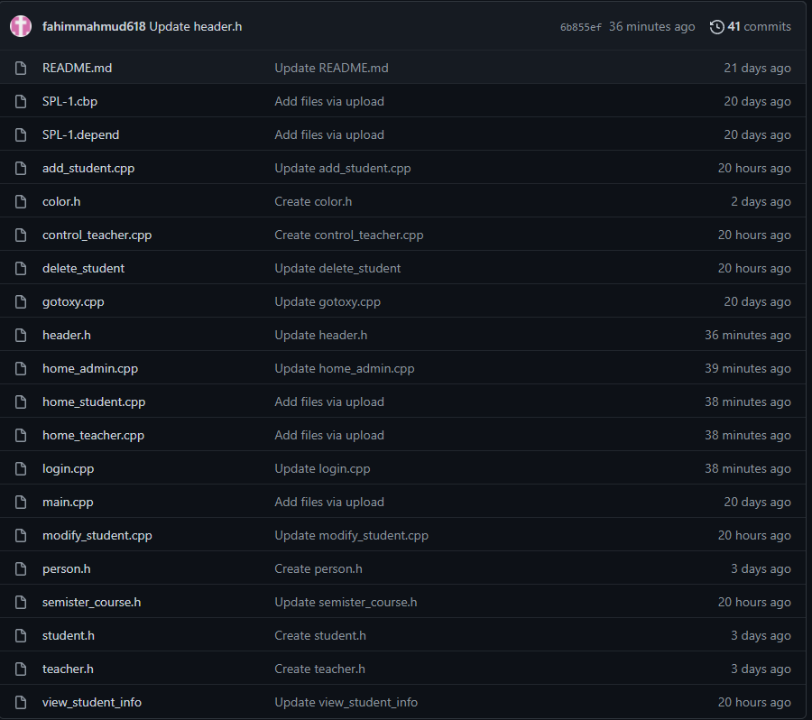
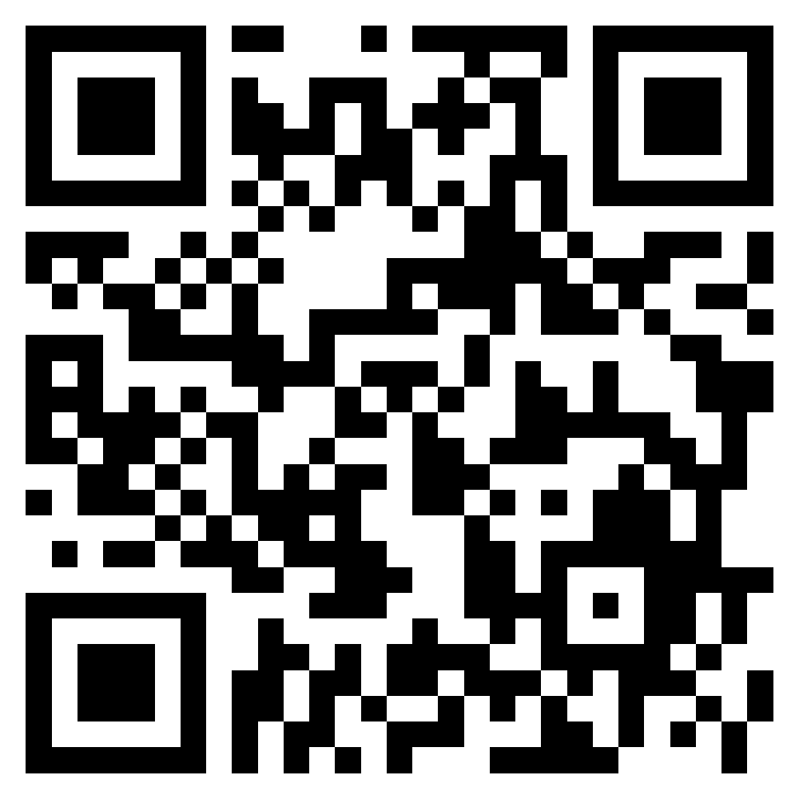
Files in repository
Line of codes in github repositories : 906
Repository link : https://github.com/fahimmahmud618/SPL-1
Or QR code:

Slide 10
Thank you
Fahim Mahmud
BSSE 1231

