Slide 1


Institute of Information Technology, University of Dhaka
SE 305 : Software Project Lab I
Final Presentation
Roll: 60925
Registration number: 2019216874
Project Title: Teach Manager
Name: Fahim Mahmud
BSSE 12th Batch
Roll : 1213
Supervised By,
Dr. Md. Shariful Islam
Professor, IITDU

Slide 2


What is Teach Manager ?
Teach Manager is a terminal and file-based tool to handle for academic institutions. This tool is consist of 3 kinds of roles :
The Admin
The Teachers and
The Students
As this tool is mainly for maintaining and evaluating the students, both the admin and the teachers can control the students. But the admin is empowered to control all the things about students and teachers.
1

Slide 3

The key challenge to this project..
Data Management
There will be interactions among the types of persons. Also, the evaluating system of the students can be divided into semesters, courses, continuous improvement, midterm, final exam mark, and attendance.
Using No database
without using the database tool, using file management (text files and directory) is the main challenge to this project. Admin will create/remove directory folder or file for adding/removing any person.
Interactive Terminal
Also without using any graphics work, to make a quite interactive tool is another point. X-Y coordinator is being used to make the terminal quite interesting.
2

Slide 4
Project
Structure
Functional Structure of the Project
Admin
Control
Start
Login
Teacher
Student
3

Slide 5
Project
Structure
Implementation of OOP concepts
Class : Person
Class : Admin
Class : Teacher
Class : Student
Class : Academic
Class : Semester
Class : Course
4

Slide 6
Algorithm
And
Special Methods
B+ tree
Polynomial String Hashing
EBCDIC 8-Bit binary Encryption-Decryption
Ceaser-cipher Encryption-Decryption
LIS (Longest Increasing Subsequence)
5

Slide 7
Other Programing
Concepts
Inheritance
Polymorphism
File Handling
Class & structure
Folder Handling
Serialization
Exception Handling
Number system convert
6

Slide 8
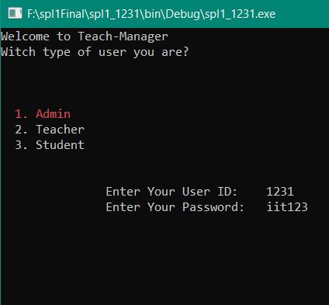
Login
At first there will be a login part.
User Identification
The program will automatically detect the type of user based on the user ID and password from “userloginInfo.txt” file.
Functions for the particular user
After Logging as the admin, the admin can control the teacher, the students or review the reports.
User will input his/her unique ID and password to login
Working
Procedure
7

Slide 9
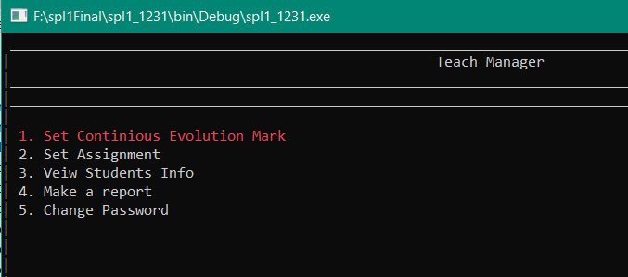
Set Marks
After logging as a teacher, the teacher can set marks for continuous evolution for his/her students.
He/she can also count the attendance of the students.
Progress Check
He/she can check conditions of his/her students till the day.
Make Report
A teacher can make report to the admin against any student for any unwanted situation.
Teacher
Section
8

Slide 10
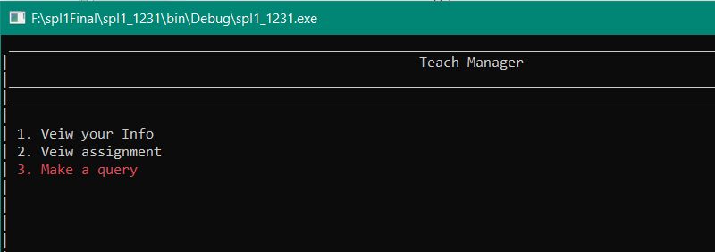
Student will login with the student ID and password
After successful login, a student can check the condition of his/her present semester or courses, provided by the course teacher or admin.
He/she can send messages to the admin or particular course teacher for any query or report.
Student
Section
9

Slide 11
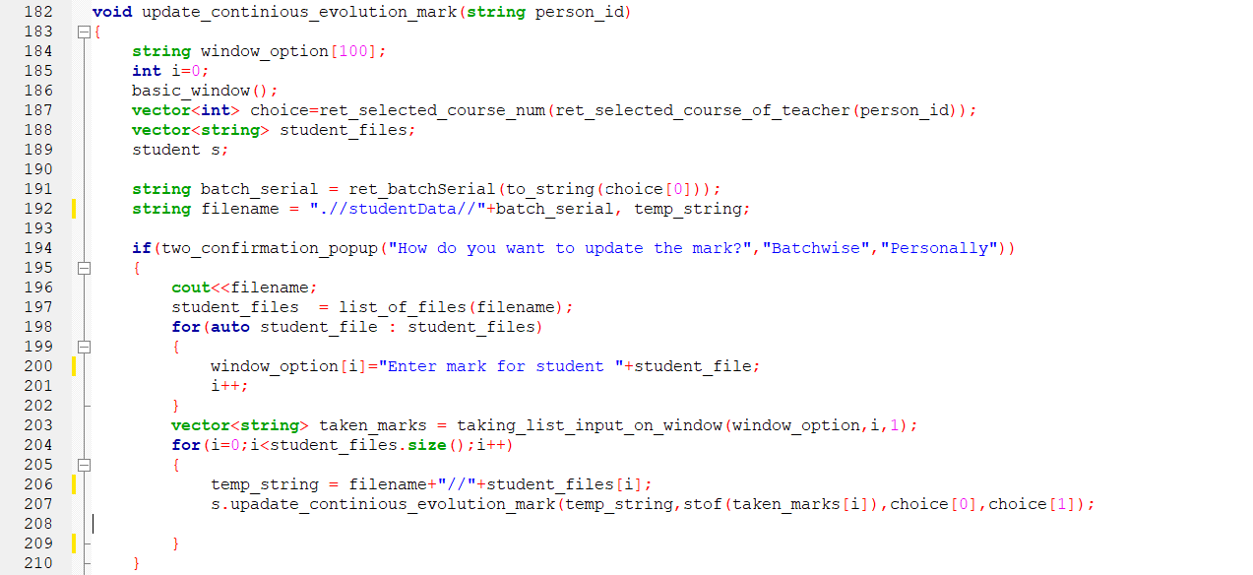
Example of Implementation
Setting continuous evolution mark: The admin or teacher enter the batch serial and then he may enter mark to all of the batch or personally to update the mark. Directory file listing is used in this case to find valid students.
10

Slide 12
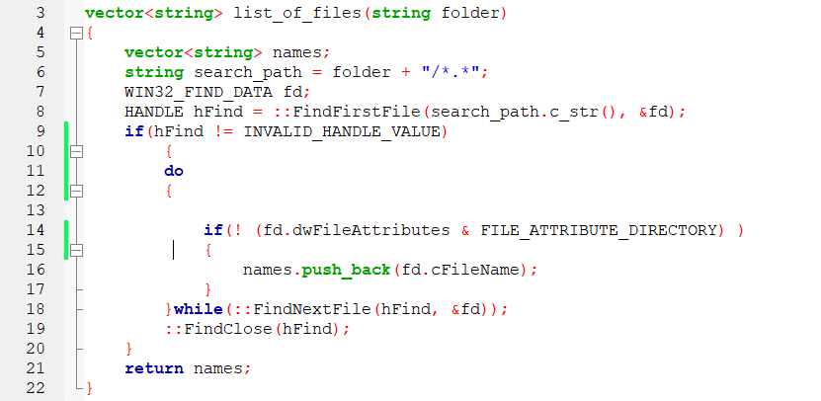
Example of Implementation
Listing of files: The function named “list_of_files” takes the folder name as parameter and returns the files in the folder in a string type of vector.
11

Slide 13
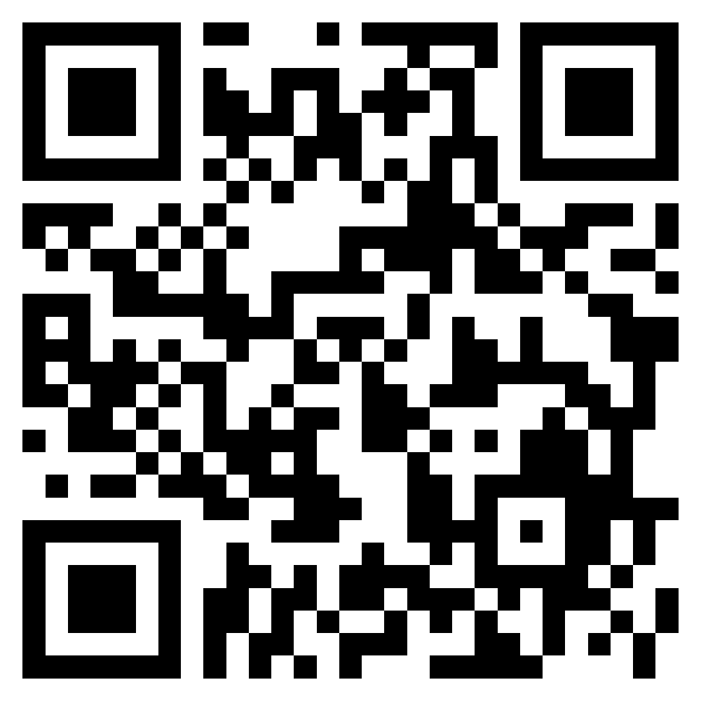
Line of codes in github repositories : 2432
Repository link : https://github.com/fahimmahmud618/SPL-1
Or QR code:
12

Slide 14
Thank you
Fahim Mahmud
BSSE 1231

