Slide 1
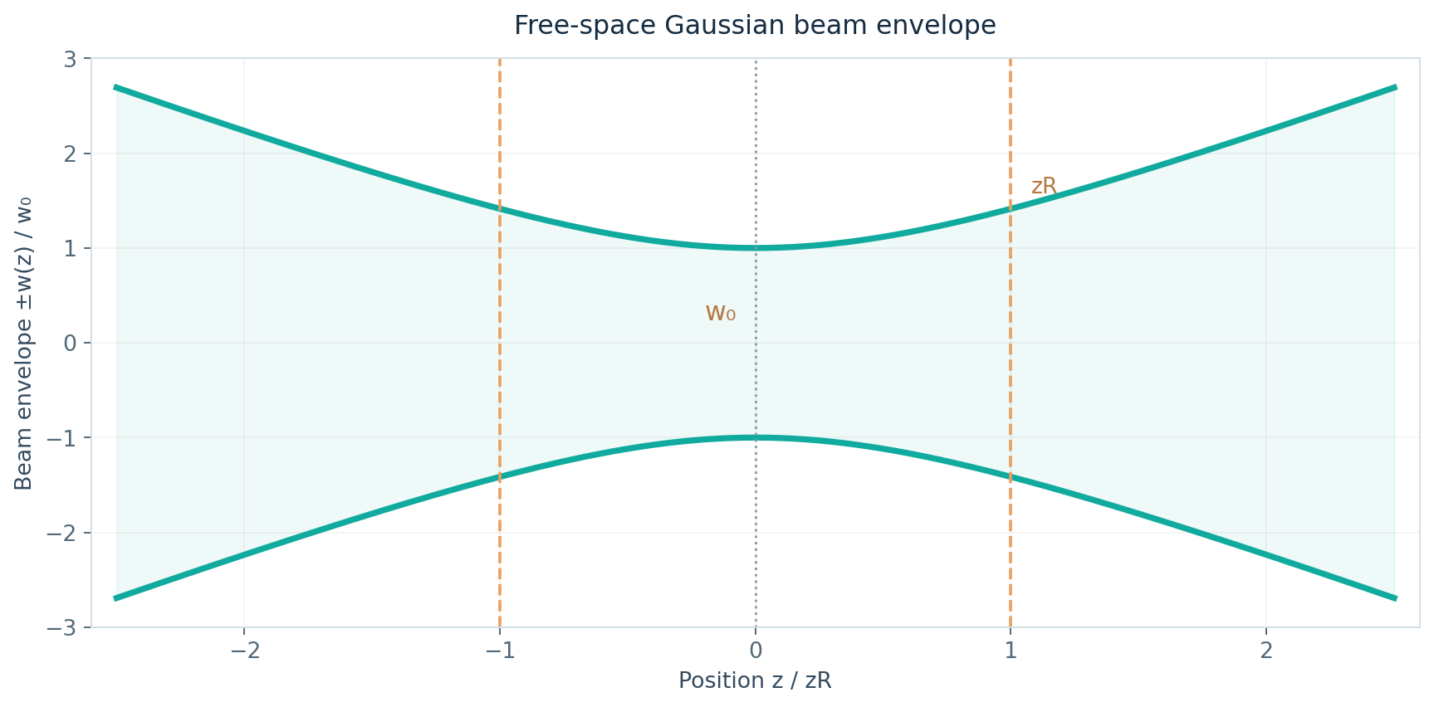
PRINCIPLE OF LASER
Gaussian Beam
Propagation and Focusing
Principles and Applications
Presented by MUNTASIR MD FAHIM (王一然)
Information and Communication Engineering
Teacher: Wang Yang (王样) • November 2026
Two studies · theory and image analysis
FINAL COURSE PRESENTATION
PHYSICS → NUMERICAL STUDY → IMAGE FITTING
Notes:
Good evening, professor and classmates. Today I will present my final course dissertation on Gaussian beam propagation and focusing. I combined ideal Gaussian-beam calculations with analysis of 14 published laser-beam images. I will explain what the two studies show and where their limitations are.

Slide 2
RESEARCH OBJECTIVE · CH. 1
One question, two complementary studies
How do Gaussian beam parameters control propagation and focusing, and what can Gaussian fitting tell us about recorded intensity profiles?
01
02
Numerical simulation
Image-based analysis
Selected wavelengths, waists and thin lenses; predicts propagation and focused spot size.
Fourteen published DataLab images; estimates Gaussian profile radii and fit quality.
The studies are related, but they use different data and must be interpreted separately.
GAUSSIAN BEAMS / PRINCIPLE OF LASER
02
Notes:
My dissertation answers two related questions using different kinds of data. In the first study, I chose optical parameters and calculated ideal Gaussian-beam behavior. In the second, I fitted Gaussian curves to intensity profiles from existing laser images. I keep the theoretical results and image measurements separate because they do not have the same units or calibration.

Slide 3
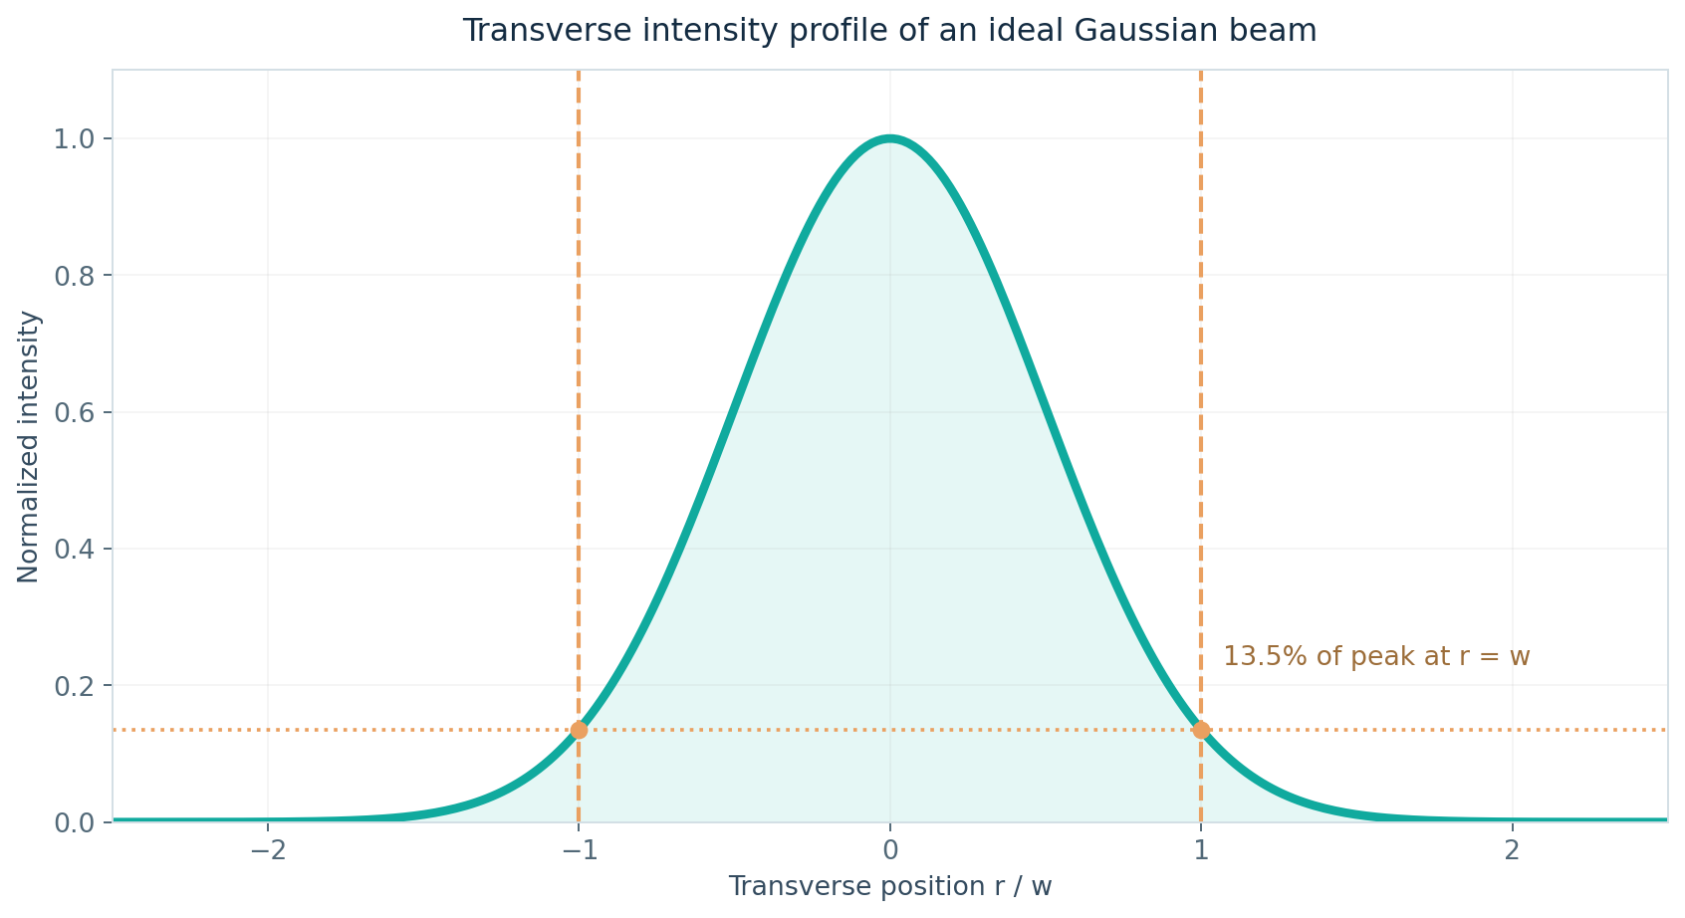



BEAM MODEL · CH. 3
What makes a beam Gaussian?
$$I(r,z) = I₀(z) exp⁡[−2r²/w²(z)]$$
Peak at the beam center
Intensity decreases smoothly away from the optical axis.
$w(z)$: the $1/e²$radius
At $r = w(z)$, intensity is 13.5% of its central value.
GAUSSIAN BEAMS / PRINCIPLE OF LASER
03
Notes:
A fundamental Gaussian beam is brightest at its center and gets dimmer toward the sides. I define the radius at the point where intensity falls to about 13.5 percent of the central value. This definition gives a consistent way to compare beam sizes at different positions. It is also the radius definition used in both parts of my dissertation.

Slide 4


PROPAGATION · CH. 4
Waist, Rayleigh range and divergence
$$w(z) = w₀ √[1 + (z/zR)²]$$
Rayleigh range
$$zR = πw₀²/λ$$
At z = zR, the beam radius is √2 w₀.
Divergence half-angle
$$θ = λ/(πw₀)$$
A smaller waist causes greater spreading.
Design trade-off
Tighter focus ↔ shorter depth of focus.
GAUSSIAN BEAMS / PRINCIPLE OF LASER
04
Notes:
The waist w zero is the smallest beam radius, and the beam expands as it travels away from that point. The Rayleigh range indicates the characteristic region over which the radius remains relatively small. For an ideal Gaussian beam, the divergence is inversely proportional to the waist radius. This is why tighter focusing also gives a shorter region of low beam spread.

Slide 5
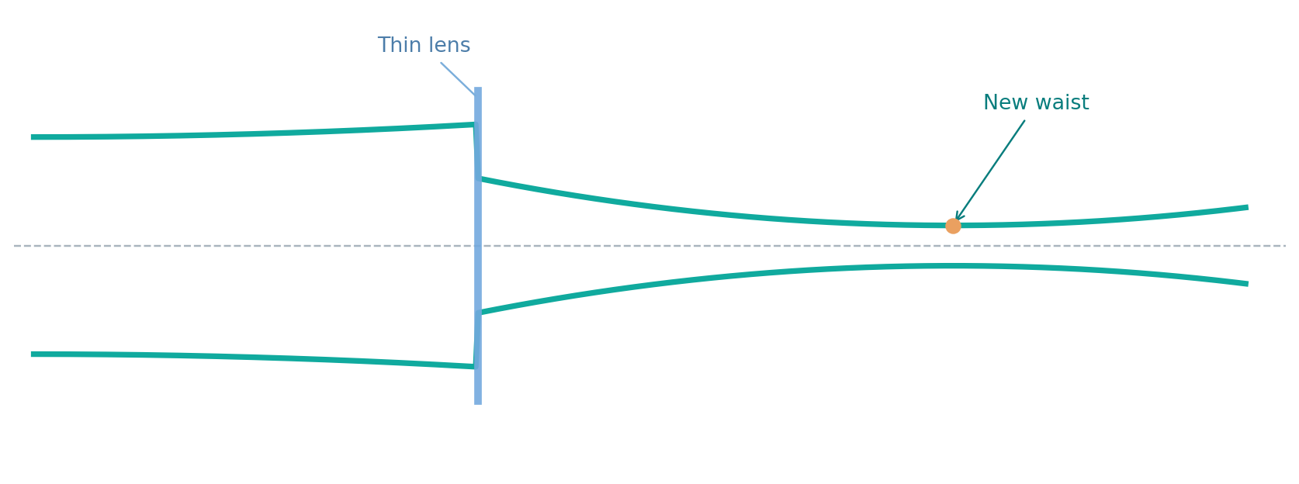
FOCUSING THEORY · CH. 5
How an ideal thin lens changes the beam
$$qout = (Aqin + B) / (Cqin + D)$$
$$q represents size + wavefront curvature$$
Free space: $[ 1 L ; 0 1 ]$
Thin lens: $[ 1 0 ; −1/f 1 ]$
GAUSSIAN BEAMS / PRINCIPLE OF LASER
05
Notes:
A thin lens changes the wavefront curvature, but the beam radius does not jump at the lens itself. The complex q parameter lets me calculate the new waist position and its radius through optical elements. I used the standard ABCD matrices for free space and for a thin lens. The new Gaussian waist does not always coincide exactly with the geometric focal plane.

Slide 6
EXPERIMENT 1 · CH. 6
Python numerical study: three parameter sweeps
A
B
C
Wavelength
Starting waist
Thin-lens focusing
Fixed waist w₀ = 0.50 mm; compare 532, 1064 and 1550 nm.
Fixed λ = 1064 nm; compare w₀ = 0.25, 0.50 and 1.00 mm.
At λ = 1064 nm, vary focal length and incident waist radius.
Beam spread and divergence
Rayleigh range and radius
Focused size and position
Outputs: five numerical figures + four CSV tables; all cases are model predictions, not laboratory data.
GAUSSIAN BEAMS / PRINCIPLE OF LASER
06
Notes:
I used Python to calculate three sets of cases from the ideal Gaussian equations. Study A changes wavelength while keeping the beam waist fixed; Study B changes the waist at one wavelength. Study C applies the thin-lens formula to different focal lengths and incident radii. These are deterministic calculations with selected inputs, so they should not be described as experimental laser measurements.

Slide 7
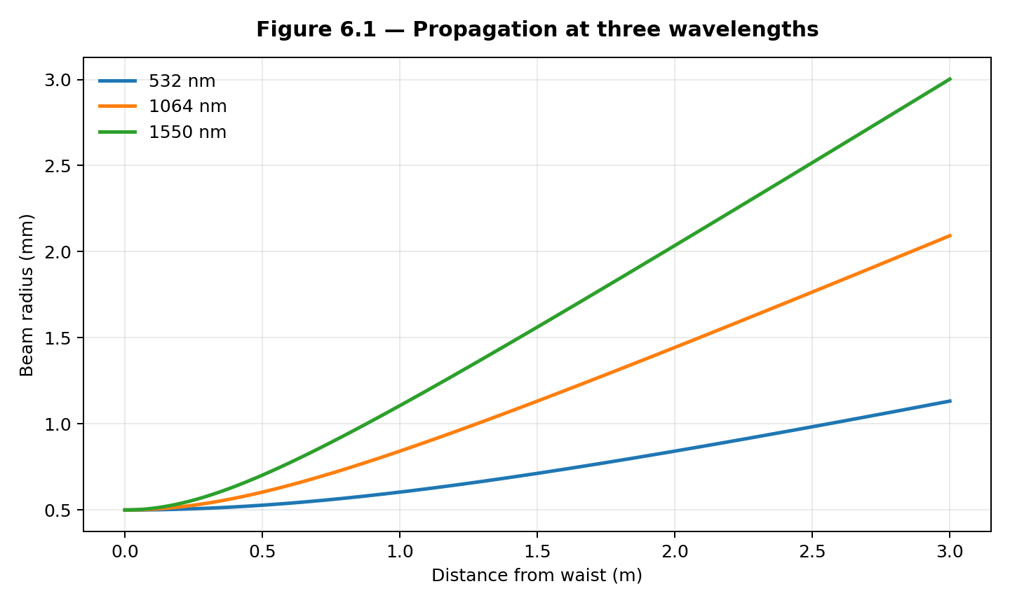
EXPERIMENT 1 · STUDY A
Wavelength controls free-space spreading
At z = 1 m, w₀ = 0.50 mm
532 nm
0.604 mm
1064 nm
0.842 mm
1550 nm
1.106 mm
Longer λ gives greater diffraction-driven spread at a fixed waist.
GAUSSIAN BEAMS / PRINCIPLE OF LASER
07
Notes:
For this comparison, I fixed the initial waist at 0.50 millimeters and changed only the wavelength. The one-meter radii are 0.604, 0.842, and 1.106 millimeters for 532, 1064, and 1550 nanometers. The longer wavelength spreads more in the ideal model. This is a controlled theoretical comparison, not a test of three physical laser sources.

Slide 8
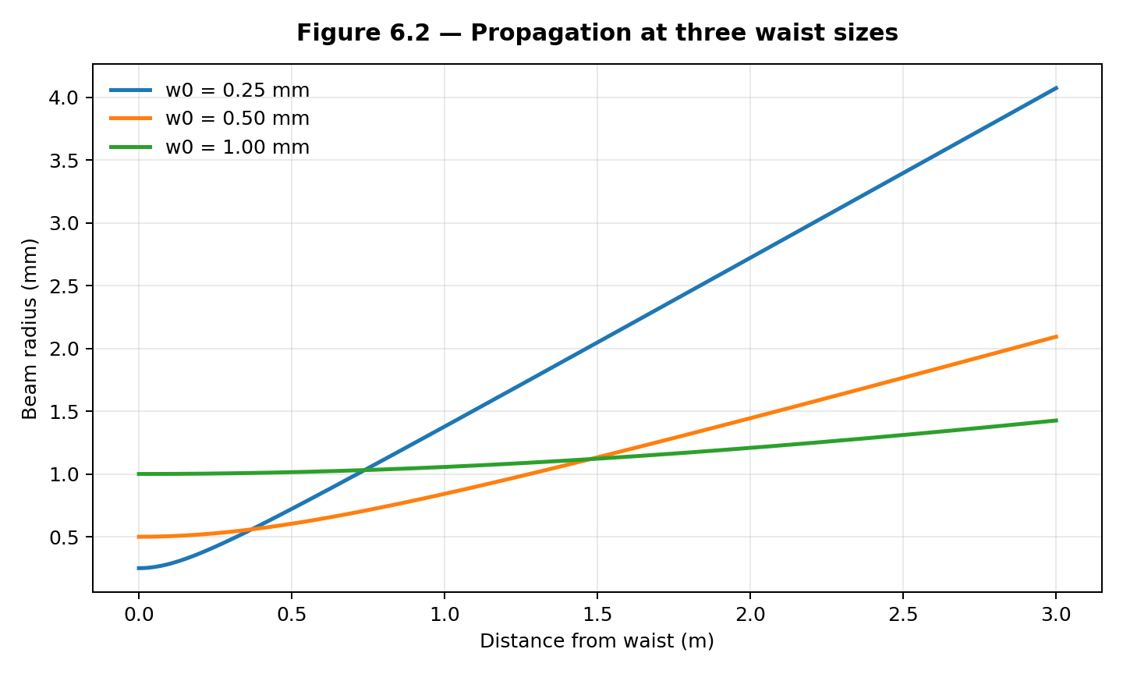
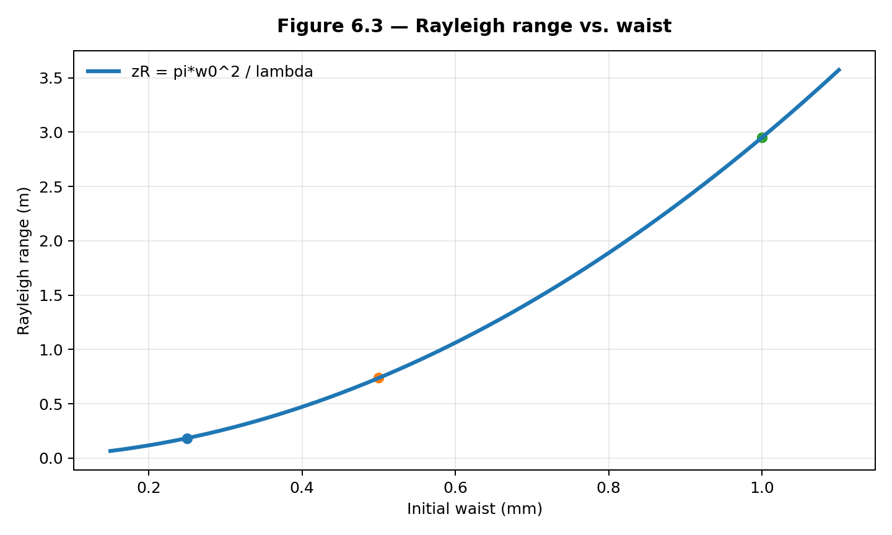
EXPERIMENT 1 · STUDY B
Starting waist controls Rayleigh range
At fixed wavelength: doubling w₀ → 4× Rayleigh range and ½ divergence.
GAUSSIAN BEAMS / PRINCIPLE OF LASER
08
Notes:
Next, I fixed the wavelength at 1064 nanometers and changed the initial waist radius. A smaller waist begins narrow but expands more quickly as the beam travels. The Rayleigh range grows with the square of the waist, while divergence decreases as the waist increases. Doubling the waist gives four times the Rayleigh range and half the far-field divergence.

Slide 9
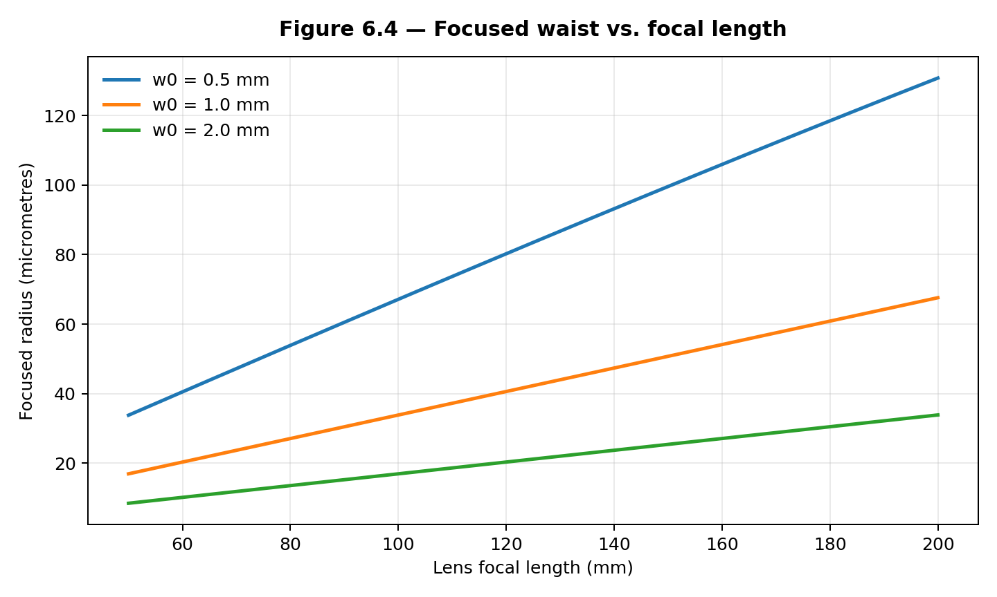
EXPERIMENT 1 · STUDY C
Exact Gaussian focusing through a thin lens
Example: f = 100 mm
λ = 1064 nm; input waist at the lens
0.50 mm
67.12 μm
1.00 mm
33.85 μm
2.00 mm
16.93 μm
Input waist → focused radius
GAUSSIAN BEAMS / PRINCIPLE OF LASER
09
Notes:
The third numerical study calculates the focused waist for an ideal thin lens. With a 100-millimeter focal length, larger incident radii give smaller focused radii in this model. For example, a 0.50-millimeter input waist gives a focus of about 67.12 micrometers, while 2.00 millimeters gives about 16.93 micrometers. In practice, lens aperture and aberrations can limit this improvement.

Slide 10
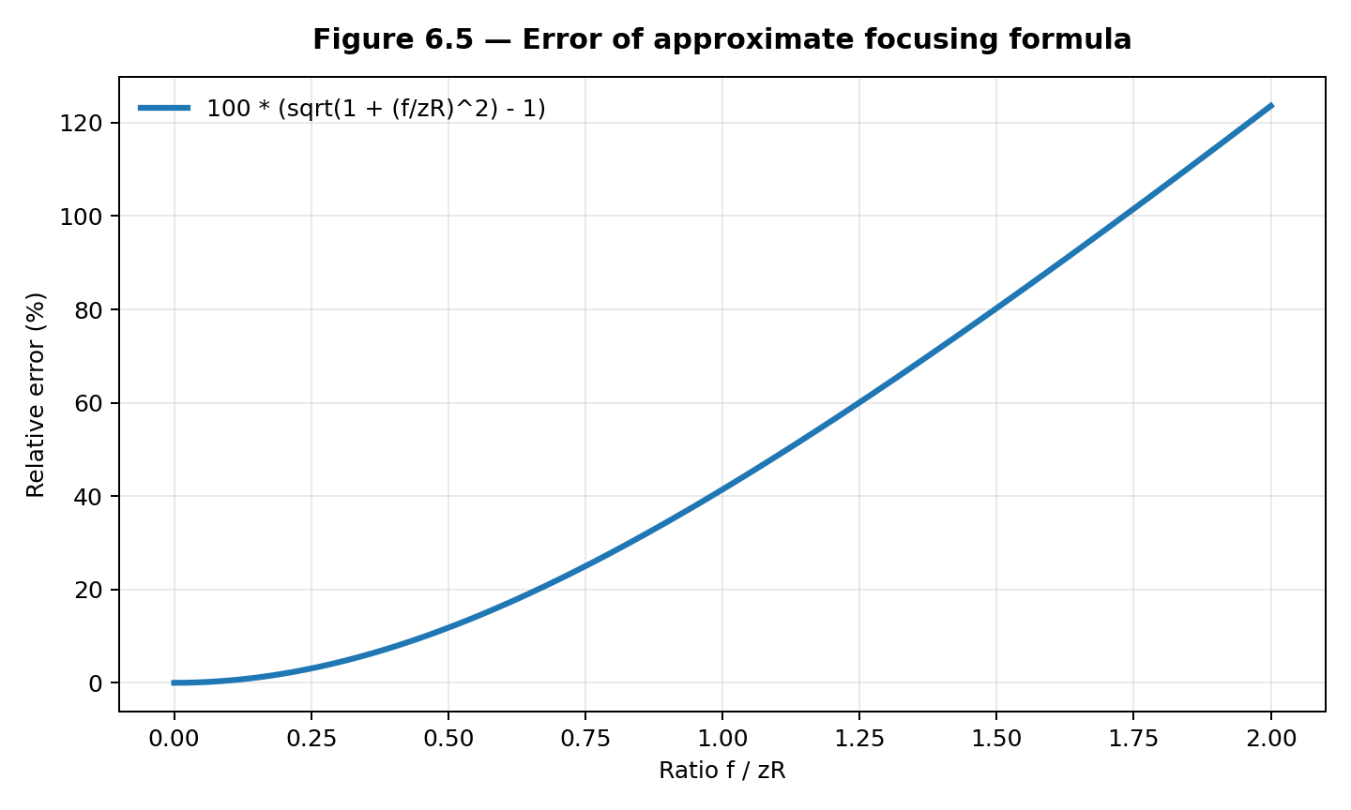



EXPERIMENT 1 · MODEL ACCURACY
When the focusing shortcut becomes inaccurate
Waist-radius overestimate
$$f/zR = 0.10$$
0.50%
$$f/zR = 0.50$$
11.80%
$$f/zR = 1.00$$
41.42%
Approximate: $w′ ≈ λf/(πw₀)$when $f ≪ zR$.
GAUSSIAN BEAMS / PRINCIPLE OF LASER
10
Notes:
I also compared the exact focused radius with the common approximation. The simple expression works well when the focal length is much smaller than the incident Rayleigh range. Its overestimate increases from 0.50 percent at f over zR of 0.10 to 41.42 percent when that ratio reaches one. So I use the exact Gaussian calculation when the approximation assumptions are not satisfied.

Slide 11
EXPERIMENT 2 · CH. 6
Published images and Gaussian fitting workflow
Dataset: 14 TEM00_z_*.jpg images from the DataLab laser-beam tutorial
Third-party example images · no original laboratory acquisition
01 Read images
02 Find beam centre
03 Extract profiles
04 Fit Gaussian
Convert JPEG files to grayscale intensity arrays.
Estimate background and locate the bright region.
Average 11 rows and 11 columns at the centre.
Nonlinear least squares for A, x₀, w and B.
$$I(x) = A exp⁡\{−2[(x − x₀)/w]²\} + B$$
Outputs: $horizontal/vertical 1/e² radii (px)$, $FWHM (px)$, and $profile R²$.
GAUSSIAN BEAMS / PRINCIPLE OF LASER
11
Notes:
The second experiment uses 14 images published in the DataLab laser-beam tutorial, not photographs I collected in a laboratory. My Python code converts each image to grayscale, estimates the background and center, and extracts averaged horizontal and vertical intensity profiles. It then fits a Gaussian curve with amplitude, center, width, and background parameters. The output gives widths in pixels and an R-squared score for each one-dimensional fit.

Slide 12
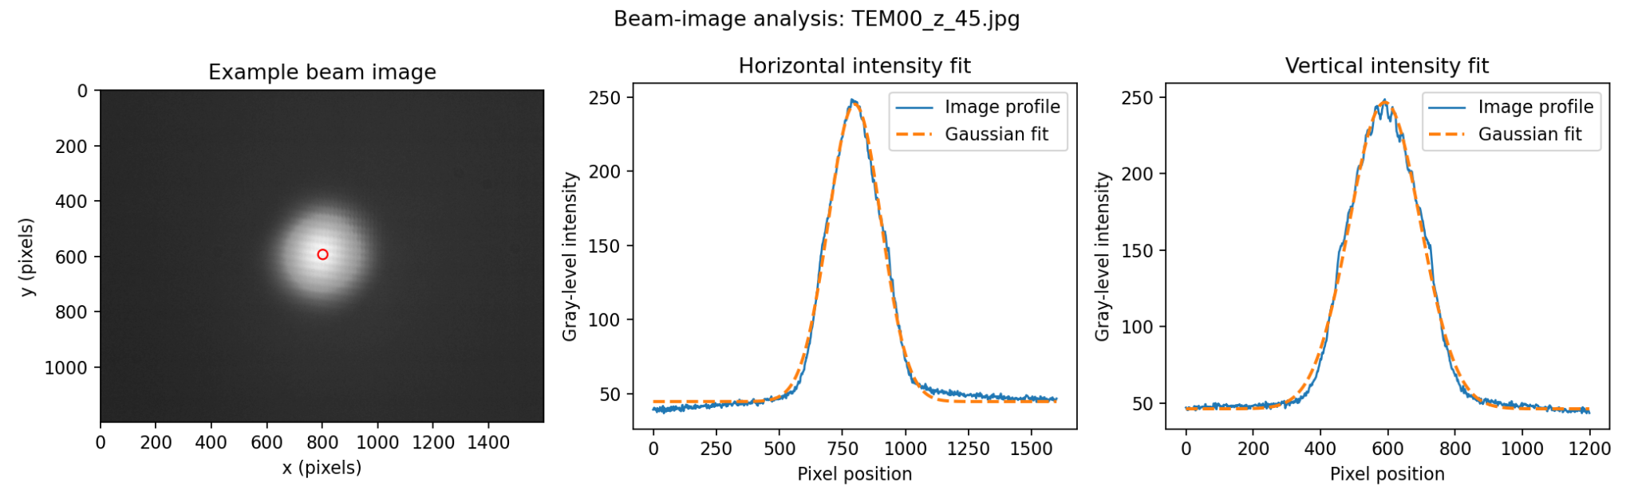
EXPERIMENT 2 · GAUSSIAN FIT
Example: one recorded beam and two fitted sections
Image
TEM00_z_45.jpg
Horizontal radius
209.55 px
Vertical radius
211.93 px
GAUSSIAN BEAMS / PRINCIPLE OF LASER
12
Notes:
This example is the image labeled TEM00_z_45.jpg. The figure shows the original grayscale beam pattern and the fitted horizontal and vertical intensity profiles. The fitted radii are about 209.55 and 211.93 pixels, and both fits have R-squared values above 0.995. The close shape agreement describes these sampled image sections, not a full physical beam-quality measurement.

Slide 13
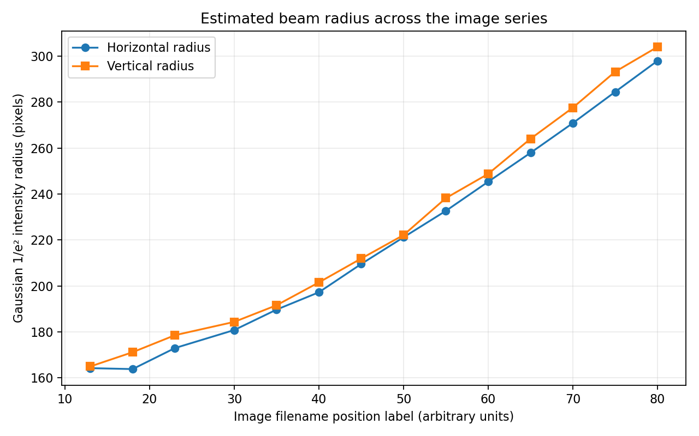
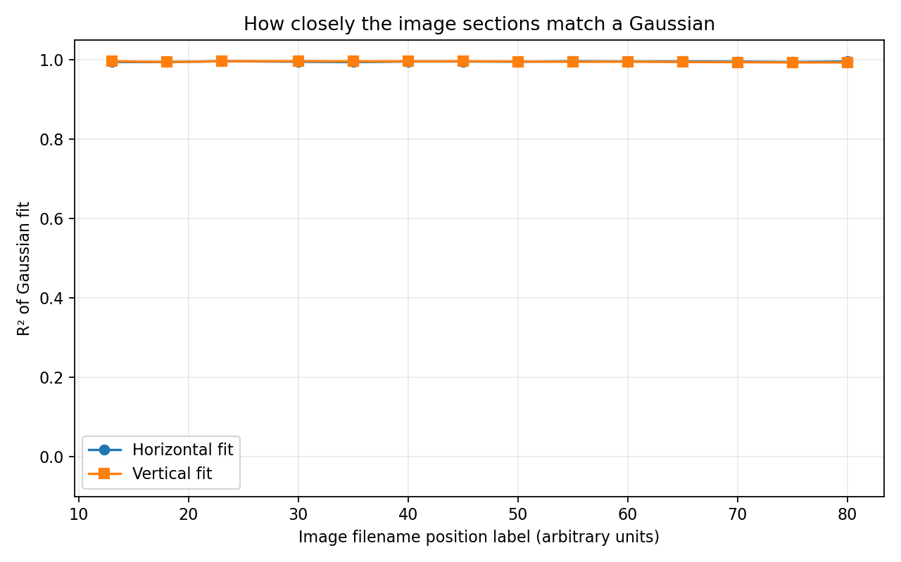
EXPERIMENT 2 · 14 IMAGES
Broadening trend and consistently high fit quality
Across 14 images / 28 profiles
$$R² = 0.9927–0.9959$$
$$wₓ: 163.83–297.96 px | wᵧ: 164.97–304.00 px$$
GAUSSIAN BEAMS / PRINCIPLE OF LASER
13
Notes:
Across the 14 images, the fitted beam radius generally increases toward the end of the sequence. The horizontal values range from 163.83 to 297.96 pixels and the vertical values from 164.97 to 304.00 pixels. All 28 profile fits have R-squared values between 0.9927 and 0.9959. These are image measurements in pixels, and the filename labels do not provide calibrated physical distances.

Slide 14
SUMMARY · CHS. 7–8
What the two studies establish
Ideal beam prediction
Image profile evidence
Limits of comparison
Wavelength, waist and lens geometry control Rayleigh range, divergence and focused radius.
Published beam images show an overall increase in fitted pixel width and high Gaussian-fit R².
Pixel widths cannot establish physical Rayleigh range or M² without calibrated scales and axial positions.
Engineering applications
Laser processing • Free-space optical links • Beam profiling and imaging
GAUSSIAN BEAMS / PRINCIPLE OF LASER
14
Notes:
The first study predicts how an ideal Gaussian beam responds to wavelength, waist size, and focusing optics. The second shows that the transverse profiles in the published image set can be fitted well by Gaussian curves. I cannot convert their widths to millimeters or determine Rayleigh range or M squared without calibration and additional measurements. These ideas are useful for laser processing, optical communication, imaging, and beam diagnostics.

Slide 15
PRINCIPLE OF LASER
Thank you.
Gaussian beam propagation · focusing · image analysis
Two studies — one Gaussian-beam framework, two distinct kinds of evidence.
MUNTASIR MD FAHIM · Changchun University of Science and Technology
GAUSSIAN BEAMS / FINAL COURSE PRESENTATION
Notes:
The main conclusion is that Gaussian theory provides a useful model for predicting beam propagation and focusing. My image analysis adds a separate view of how well recorded intensity sections follow the Gaussian shape. I have presented the calculations and the image results with their different assumptions and units. Thank you for your attention.

