Slide 1
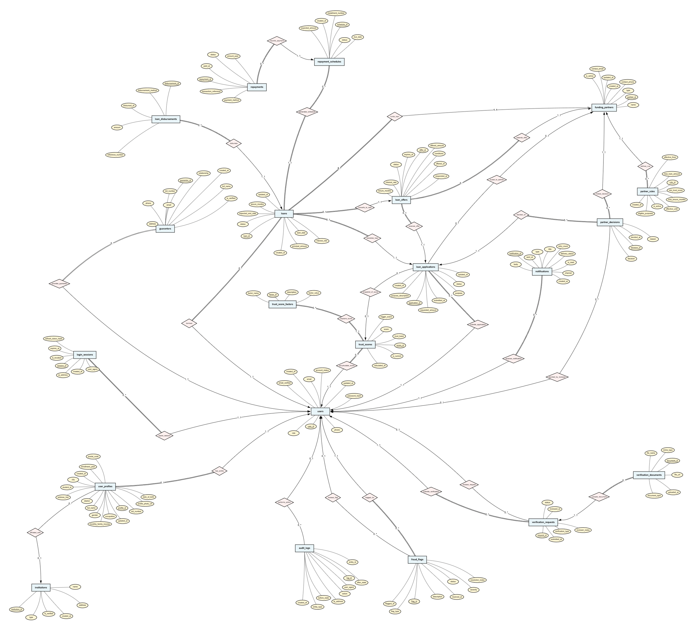
ShohojRin ER Diagram
Trust-Based Verification & Loan Orchestration Platform |
21 Entities
29 Relationships
Chen's Notation

Slide 2
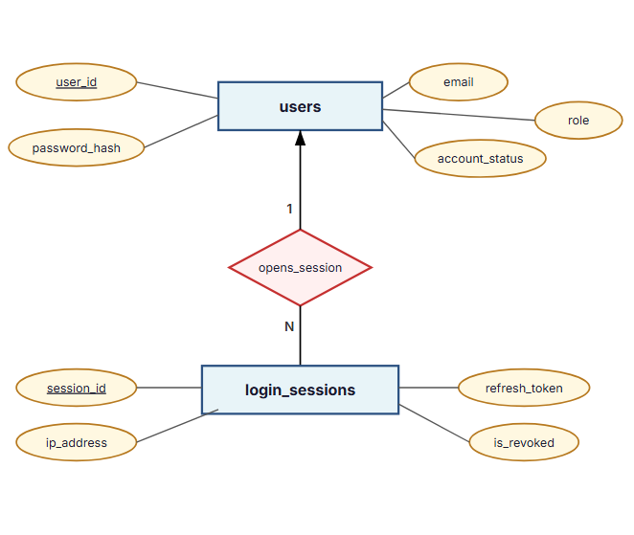
Module 1 — Authentication & User Management
Core identity, credentials, and session control
Purpose
Manages authentication identity separately from profile data
Supports multi-device sessions with server-side revocation
Follows 3NF — credentials change independently from biographical data
Entities
users, login_sessions
Key Relationships
users → login_sessions (1:N) — one user opens many sessions
Sessions can be individually revoked without affecting the user record
Design Rationale
JWT alone cannot support forced logout; sessions enable revocation
User table is kept lean — only credentials and role

Slide 3
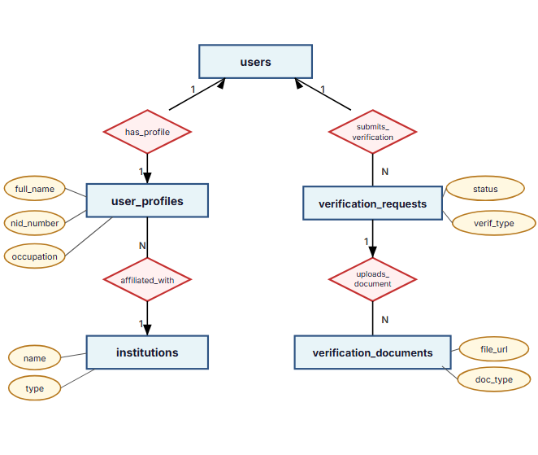
Module 2 — User Profile & Verification
Profile data, institution normalization, document verification workflow
Purpose
Separates profile data from authentication for normalization
Institutions are normalized — avoids repeating "BUET" across thousands of profiles
Verification is a workflow, not a boolean flag
Entities
user_profiles, institutions, verification_requests, verification_documents
Key Relationships
users → user_profiles (1:1) — separates identity from biography
user_profiles → institutions (N:1) — eliminates redundancy
users → verification_requests (1:N) — supports re-verification
verification_requests → documents (1:N) — multiple docs per request

Slide 4
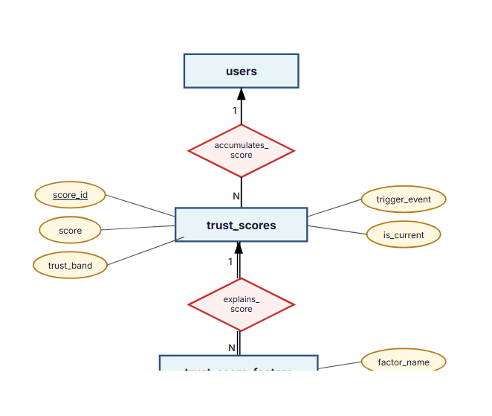
Module 3 — Trust Engine
Explainable, historical trust scoring — the platform's core innovation
Purpose
Generates an explainable trust score for each borrower
Each recalculation creates a new immutable snapshot — history is never overwritten
Factors detail why a score was assigned (e.g., +20 for identity verified)
Entities
trust_scores, trust_score_factors
Key Relationships
users → trust_scores (1:N) — accumulates historical snapshots
trust_scores → factors (1:N, total–total) — every score must have factors; every factor belongs to a score
Design Rationale
Evaluators must understand why a borrower scored 72, not just see "72"
is_current flag enables fast lookup without subqueries
Supports trend analysis, auditing, and fairness verification
trust_based_factors
factor_name

Slide 5
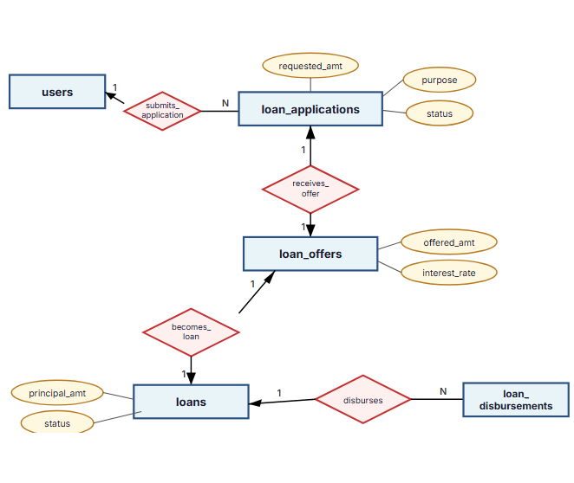
Module 4 — Loan Application & Loan Lifecycle
Application → Offer → Loan → Disbursement — four distinct lifecycle stages
Purpose
Application, Offer, Loan, and Disbursement are four distinct entities representing different lifecycle stages
A request may never become a loan — rejected applications
must persist
Partner may offer different terms than requested
Entities
loan_applications, loan_offers, loans, loan_disbursements
Key Relationships
application → offer (1:1) — partner counter-offer preserves original request
application → loan (1:1) — loan exists only after approval
loan → disbursements (1:N) — approval ≠ money transferred
Design Rationale
Mixing lifecycle stages would create NULL-heavy records and complex status logic
trust_score_id on application captures the score snapshot at submission time
status

Slide 6
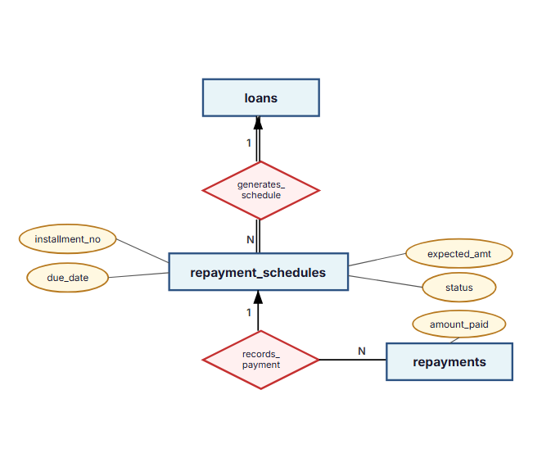
Module 5 — Repayment System
Expected installments vs. actual payments — never overwrite financial records
Purpose
Expected installments (the plan) are separate from actual payments
Supports partial payments, failed attempts, and late payments
Financial records are append-only — never overwritten
Entities
repayment_schedules, repayments
Key Relationships
loans → repayment_schedules (1:N, total–total) — every loan generates a schedule
repayment_schedules → repayments (1:N) — multiple payments per installment
Design Rationale
Enables overdue detection by comparing due_date with actual payments
Supports trust score recalculation triggers on repayment events
Outstanding balance is calculated, not stored (avoids derived-data issues)

Slide 7
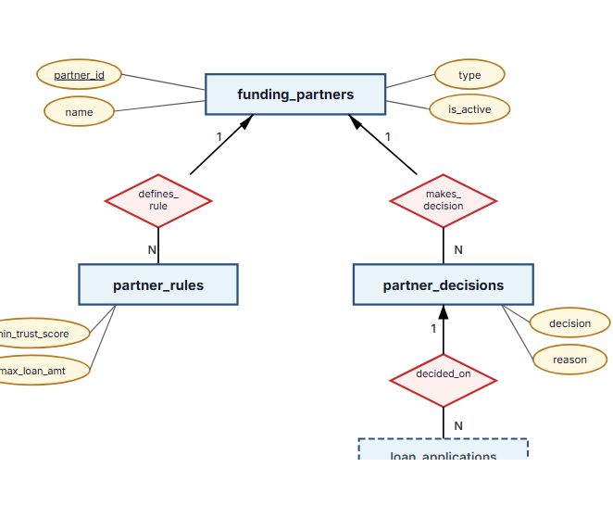
Module 6 — Partner Integration
ShohojRin is not a lender — partners are. Rules, decisions, and evaluations.
Purpose
Partners (banks, NGOs, MFIs) define their own lending criteria as data, not code
Decisions are stored separately from applications — an application may receive multiple evaluations
Entities
funding_partners, partner_rules, partner_decisions
Key Relationships
funding_partners → partner_rules (1:N) — each partner has configurable criteria
funding_partners → partner_decisions (1:N) — decision history per partner
loan_applications → partner_decisions (1:N) — multiple partners may evaluate one application
Design Rationale
Adding a new partner requires no schema changes — only data insertion
Rules support effective-dating for versioning
Preserves full decision history for audit and partner analytics
min_trust_score
max_loan_amnt
loan_applications

Slide 8
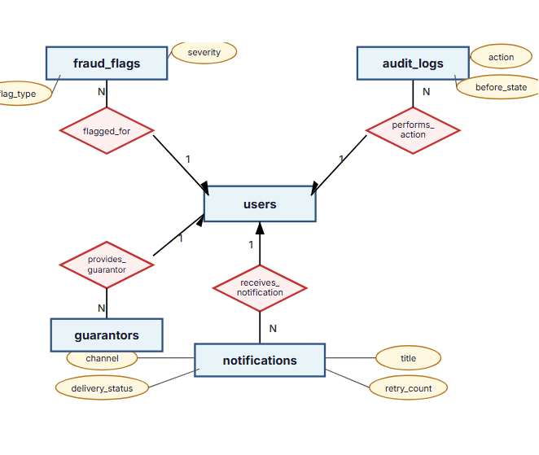
Module 7 — Fraud Detection, Audit Logs & Notifications
Cross-cutting concerns — security, compliance, and communication
Purpose
Fraud flags — event-based suspicious activity records; never auto-deleted
Audit logs — immutable, append-only records of all sensitive operations
Notifications — multi-channel delivery with retry support
Entities
fraud_flags, audit_logs, notifications, guarantors
Key Relationships
users → fraud_flags (1:N) — user may be flagged multiple times
users → audit_logs (1:N) — tracks who, when, what, before/after
users → notifications (1:N) — supports email, SMS, in-app
users → guarantors (1:N) — borrower lists guarantor references
Design Rationale
Audit logs use JSONB for before/after state — flexible across all entity types
Fraud flags support admin review workflow with severity levels
All three tables are cross-cutting — they reference users but serve independent concerns
severity
flag_type
channel

Slide 9
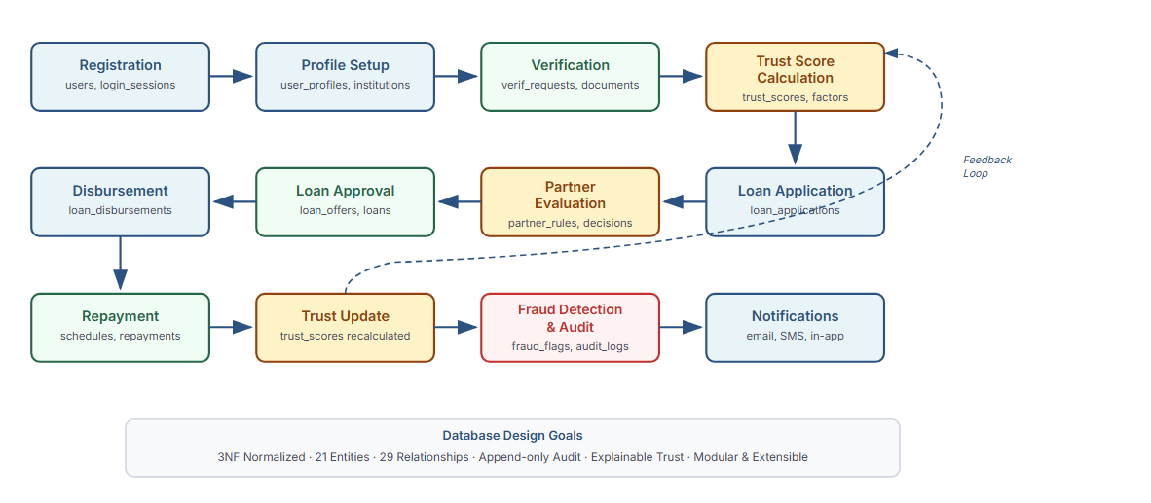
System Workflow — End-to-End Process
From registration to repayment — how the complete ShohojRin system operates

