Slide 1

AMERICAN INTERNATIONAL UNIVERSITY BANGLADESH(AIUB)
Microprocessor & Embedded System
Topic: Home Automation System
SUBMITTED TO
SUJAN HOWLADER
FACULTY OF ENGINEERING,
DEPARTMENT OF EEE
SUBMITTED BY
Group: 01
Section: I

Slide 2

Member List
Serial No. | Name | ID
19 | Hoque, Fahmeda | 18-36767-1
20 | Hassan, Sadik | 18-36843-1
22 | Shovon, Sumit Chandra | 18-37115-1
24 | Mizan, Md. Hasibul | 18-37527-1
26 | Sadat, S.M. Shahriar | 18-37552-1
28 | Tabassum, Sumaiya | 18-37764-1
30 | Chowdhury, Ashmita | 18-38264-2
38 | Jim, Jamiul Fariyah Jasim | 18-38540-2
45 | Islam, Md. Rashedul | 19-40559-1

Slide 3
Content’s
Introduction
Historical Background
Literature Review
Motivation
Component
Cost Analysis
Survey Analysis
Simulation
Novelty Of the Project
Limitation
Conclusion

Slide 4

Introduction
Home automation is building automation for a home, called a smart home or smart house.
Monitor and/or control home attributes such as lighting, climate, entertainment systems, and appliances.
Include home security such as access control ,sanitization and fire alarm systems.
Has high potential for sharing data between family members or trusted individuals for personal security and could lead to energy saving measures with a positive environmental impact in the future.
Relatively new technology

Slide 5
Historical Background
In 1966, Westinghouse engineer Jim Sutherland created the ECHO IV, which was the first true home automation device, controlling temperature and appliances, and allowing for inputting and later retrieval of shopping lists, recipes, and other family memos.
The 1980s: Home automation becomes commonplace, in the form of garage doors, home security systems, motion-sensing lights, fiber optics, thermostat controls, and other technology.
1998-2000s: Smart homes became a thing. Throughout the late 1990s and early 2000s, smart technologies emerged, with gadgets and devices becoming more common and more affordable.

Slide 6
Literature Review
Yadnya Adhiya, Shriya Ghuge, H.D Gadade were worked on Bluetooth base home automation system using cell phone and their project title is “ A survey on home automation system using IOT”.
Kim Baraka, Marc Ghobril, Sami Malek, RouwaidaKanj, AymanKayssi were worked with zigbee module and there project title was “Low cost Arduino/Android-based Energy-Efficient Home Automation System with Smart Task Scheduling”
Kim Baraka, Marc Ghobril, Sami Malek, RouwaidaKanj, AymanKayssi worked with Wi-Fi module and their project title was “SmartPower Management System For Home Appliances And Wellness Based On Wireless Sensors Network And Mobile Technology”
HayetLamine and HafedhAbid, were worked with RF module and their project title was “Remote control of a domestic equipment from an Android application based on Raspberry pi card”

Slide 7
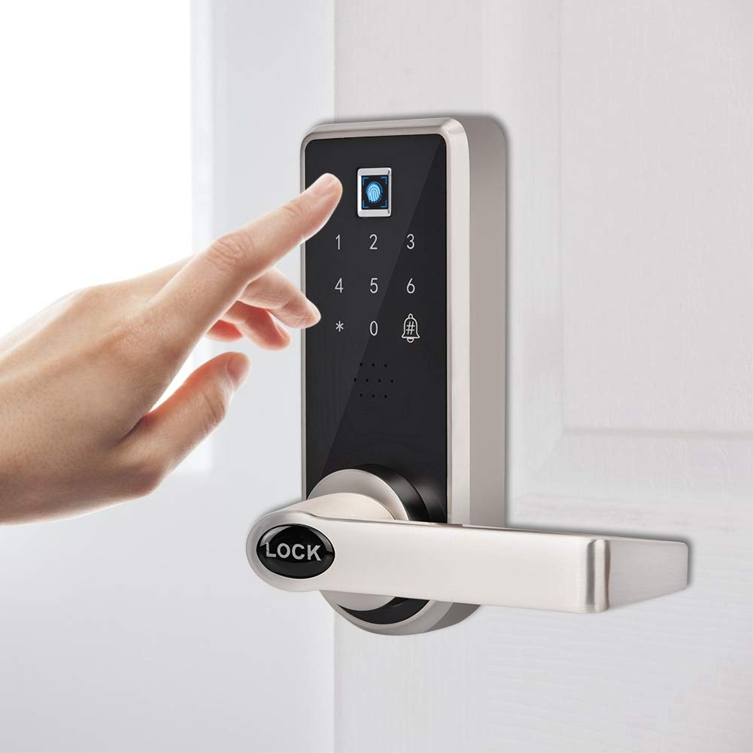
Password Based Door lock
This simple circuit can be used at residential places to ensure better safety.
It can be used at organizations to ensure authorized access to highly secured places.
With a slight modification this Project can be used to control the switching of loads through password.
Maximize the security system in home.
It can be more advanced by adding some security and safety features.

Slide 8
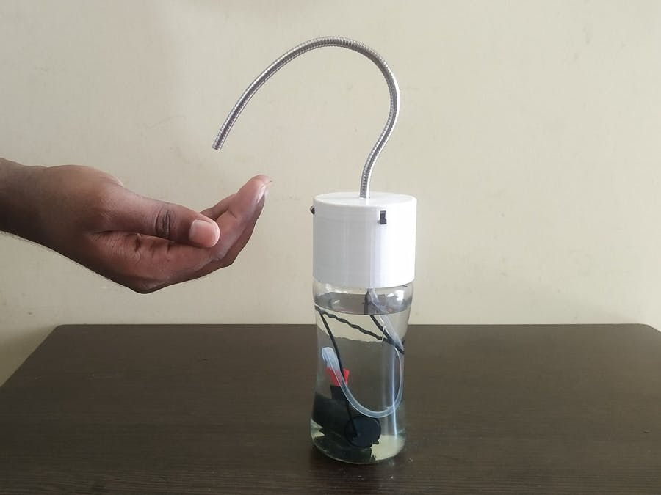
Automatic Hand Sanitizer
The infrared sensors of the automatic hand sanitizer dispenser detect the infrared energy that is emitted by one's body heat .
An automatic hand sanitizer dispenser is a device dispensing a controlled amount of sanitizer.
They are often used in the conjunction with automatic faucets in home.
They help conserve the amount of sanitizer used and stem infectious disease transmission.
Keep the home environment safe during covid-19 pandemic.

Slide 9
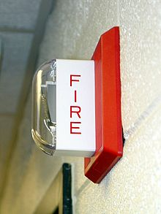
Fire Alarm
The most critical elements in a smart home are a well-designed alarm system and fire safety system.
A fire alarm system warns people when smoke, fire, carbon monoxide or other fire-related emergencies are detected
The indicating appliances should sound the alarm, notifying everyone in the building of the danger.

Slide 10
Motivation
In modern society, our daily lives are surrounded with technology.
IoT is fast becoming an indispensable part of our lives.
Our home is where our day starts and ends.
Smart Home systems are one of the newer areas of research that have not been fully integrated into our society.
People have the mindset that home automation is expensive We want to change that by creating cost efficient home automation system.
home automation need to be implemented in order to match our busy lifestyles to enjoy life at the comfort of our home.

Slide 11
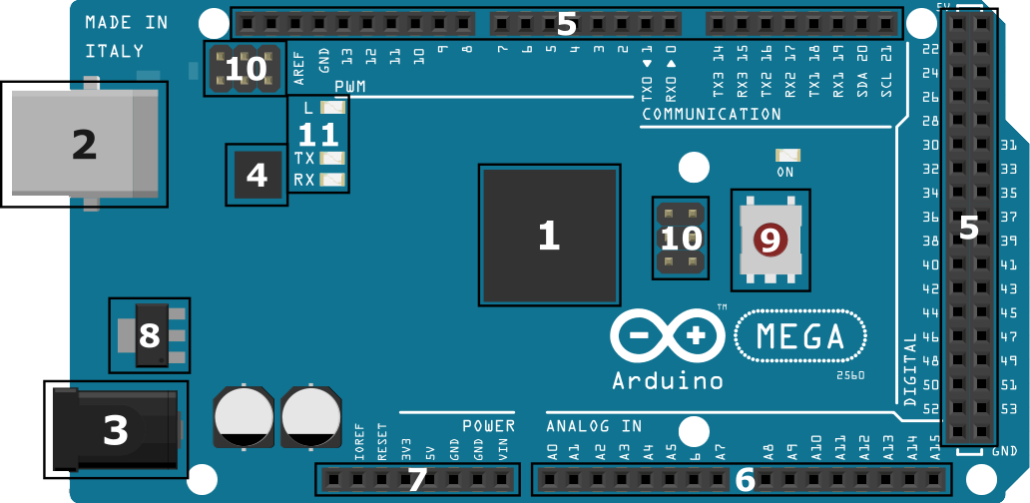
Arduino Mega 2560
Component’s
The Arduino Mega is like the UNO’s big brother, it is mostly used in projects require digital i/o pins. It has lots (54) of digital input/output pins (14 can be used as PWM outputs), 16 analog inputs, a USB connection, a power jack, and a reset button. It contains everything needed to support the microcontroller; simply connect it to a computer with a USB cable or power it with a AC-to DC adapter or battery to get started. The Mega 2560 employs an ATMega 2560 as the main MCU, which has 54 general I/Os to enable you to interface with many more devices. The Mega also has more ADC channels, and has four hardware serial interfaces (unlike the one serial interface found on the Uno).
Arduino Mega 2560

Slide 12
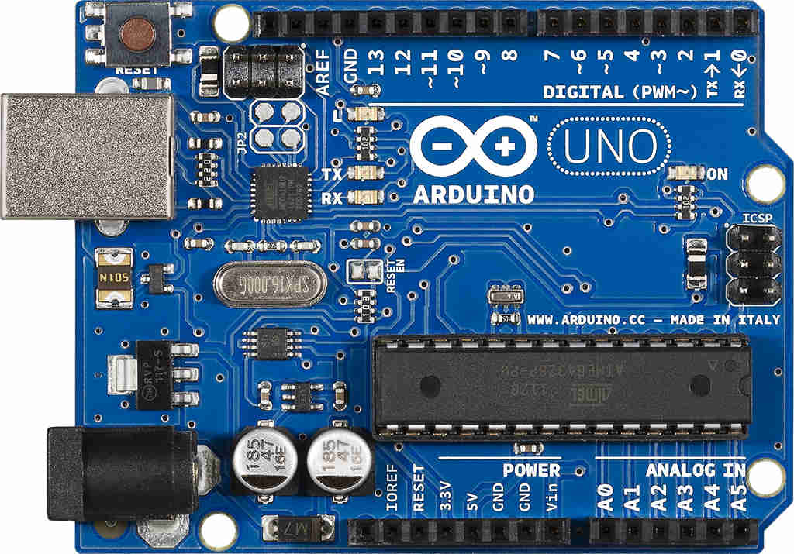
Arduino Uno
The Uno is a great choice for your first Arduino. It’s got everything you need to get started, and nothing you don’t. It has 14 digital input/output pins (of which 6 can be used as PWM outputs), 6 analog inputs, a USB connection, a power jack, a reset button and more. It contains everything needed to support the microcontroller; simply connect it to a computer with a USB cable or power it with a AC-to-DC adapter or battery to get started.
Arduino Uno

Slide 13
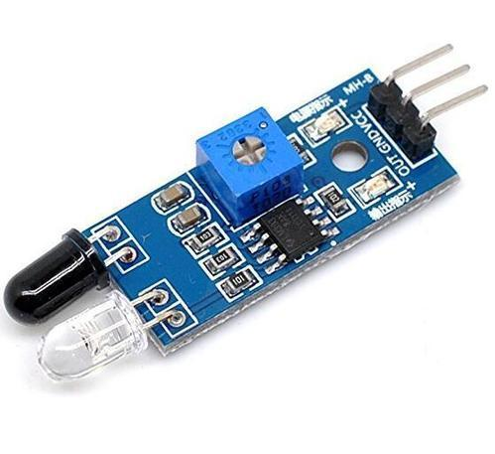
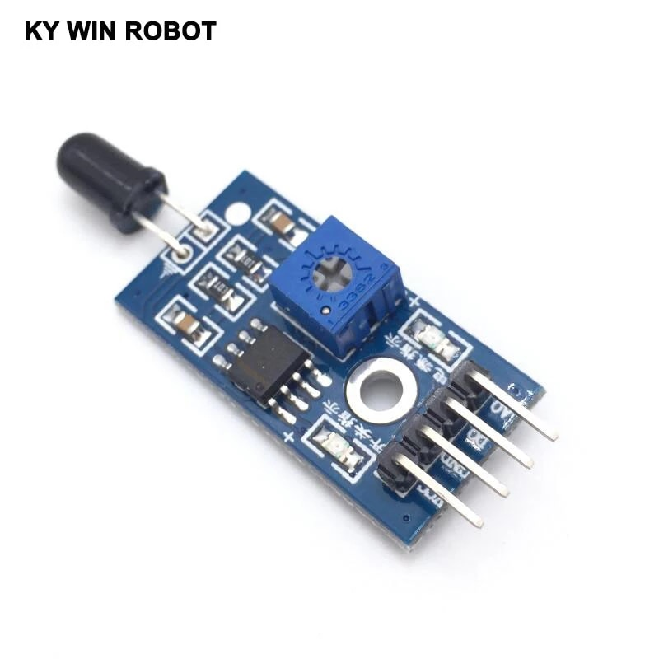
Infrared Sensor
Flame Sensor
An infrared (IR) sensor is an electronic device that measures and detects infrared radiation in its surrounding environment. When an object comes close to the sensor, the infrared light from the LED reflects off of the object and is detected by the receiver. Active IR sensors act as proximity sensors, and they are commonly used in obstacle detection systems
A sensor which is most sensitive to a normal light is known as a flame sensor. This sensor detects flame otherwise wavelength within the range of 760 nm – 1100 nm from the light source. The output of this sensor is an analog signal or digital signal.

Slide 14
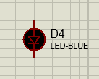
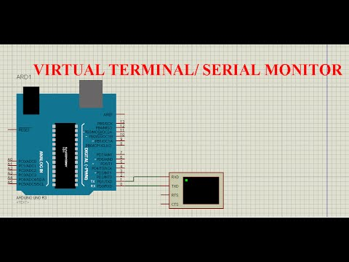

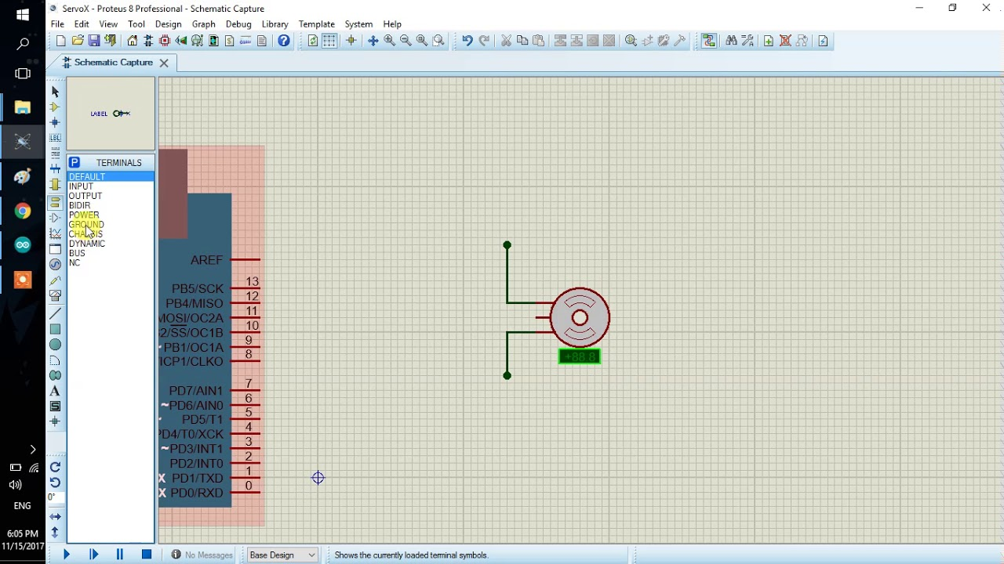
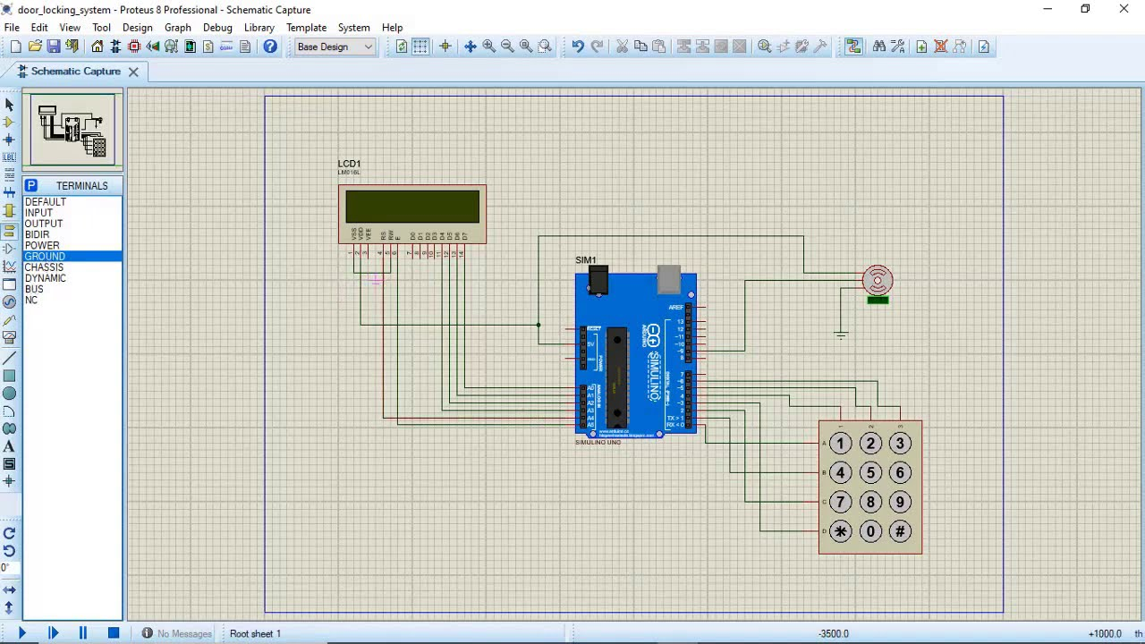
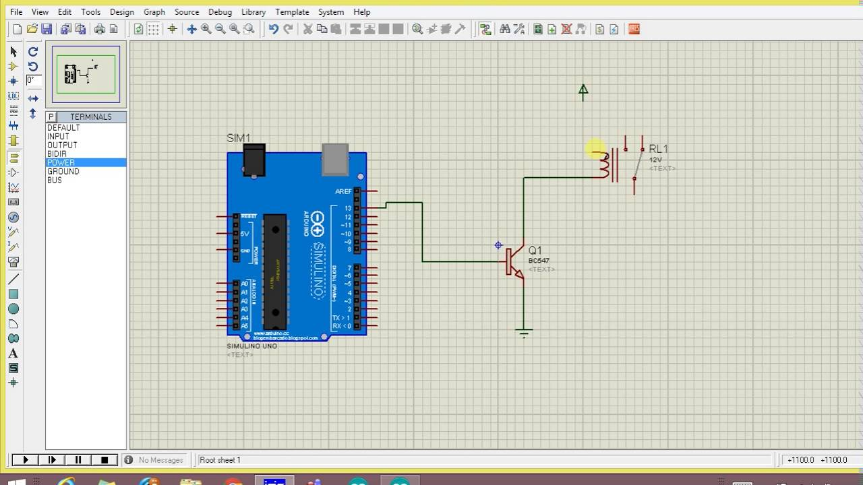
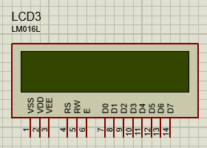
Other Component’s
Virtual Terminal:
Keypad for door Password:
LED:
LOGICSTATE:
MOTOR:
RELAY:
DISPLAY:

Slide 15
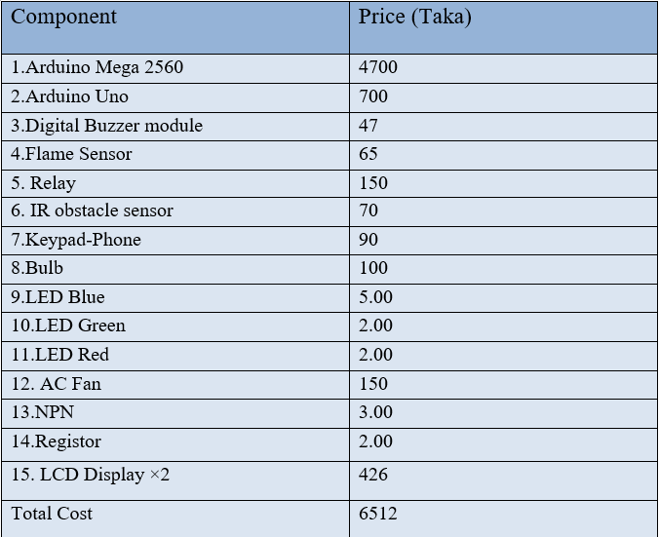
Cost Analysis

Slide 16
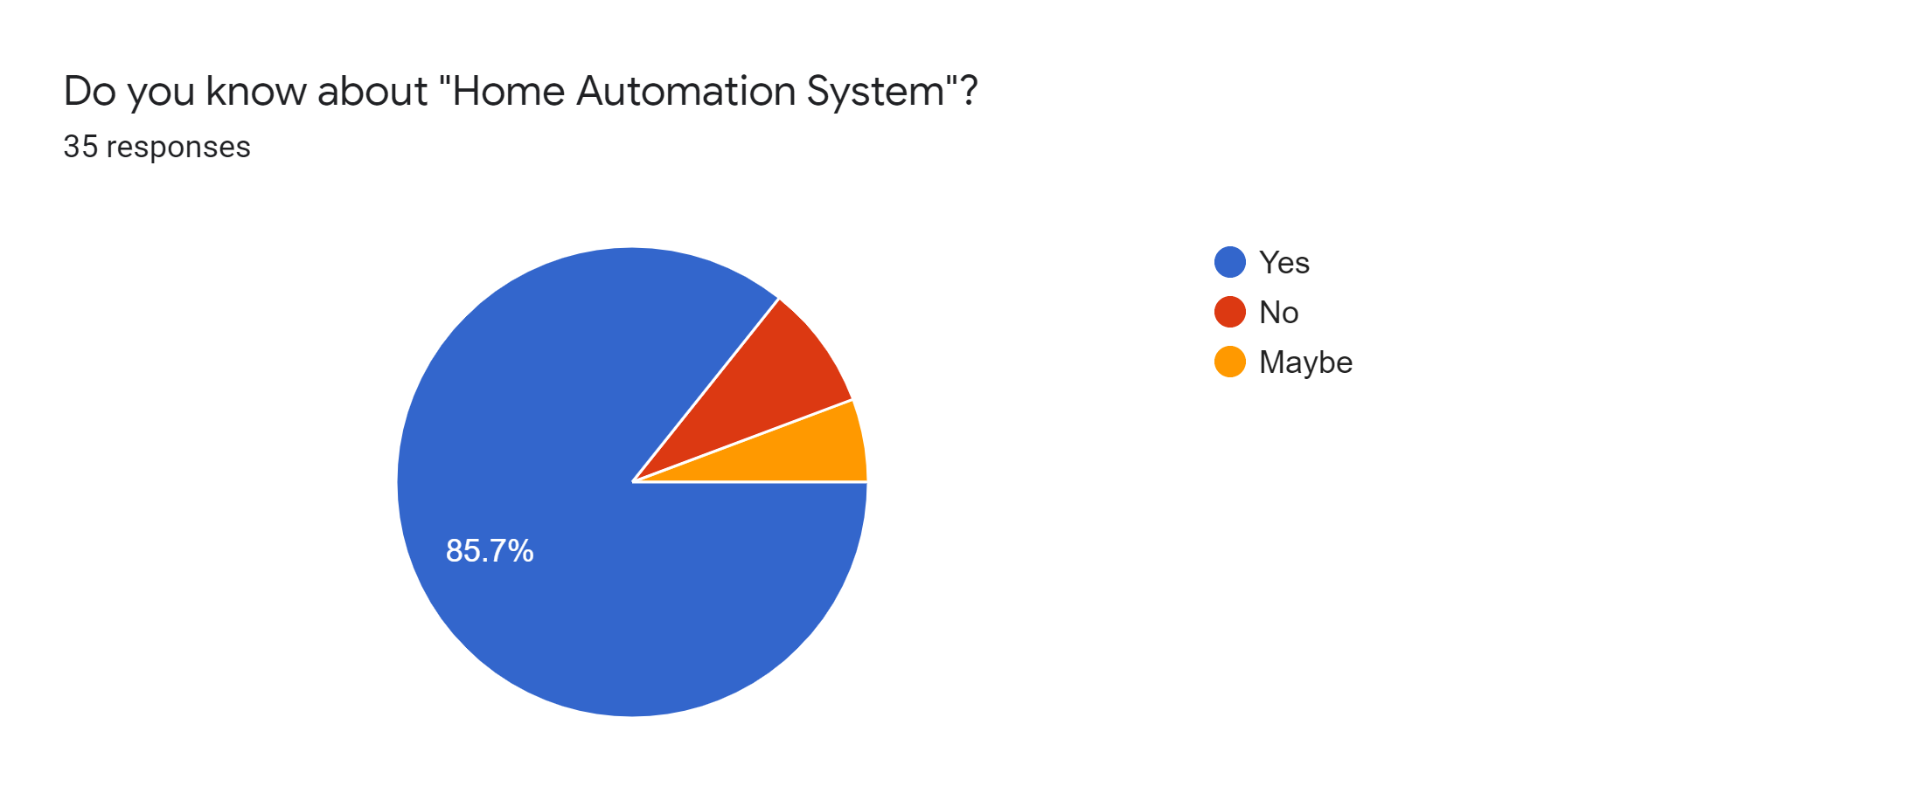
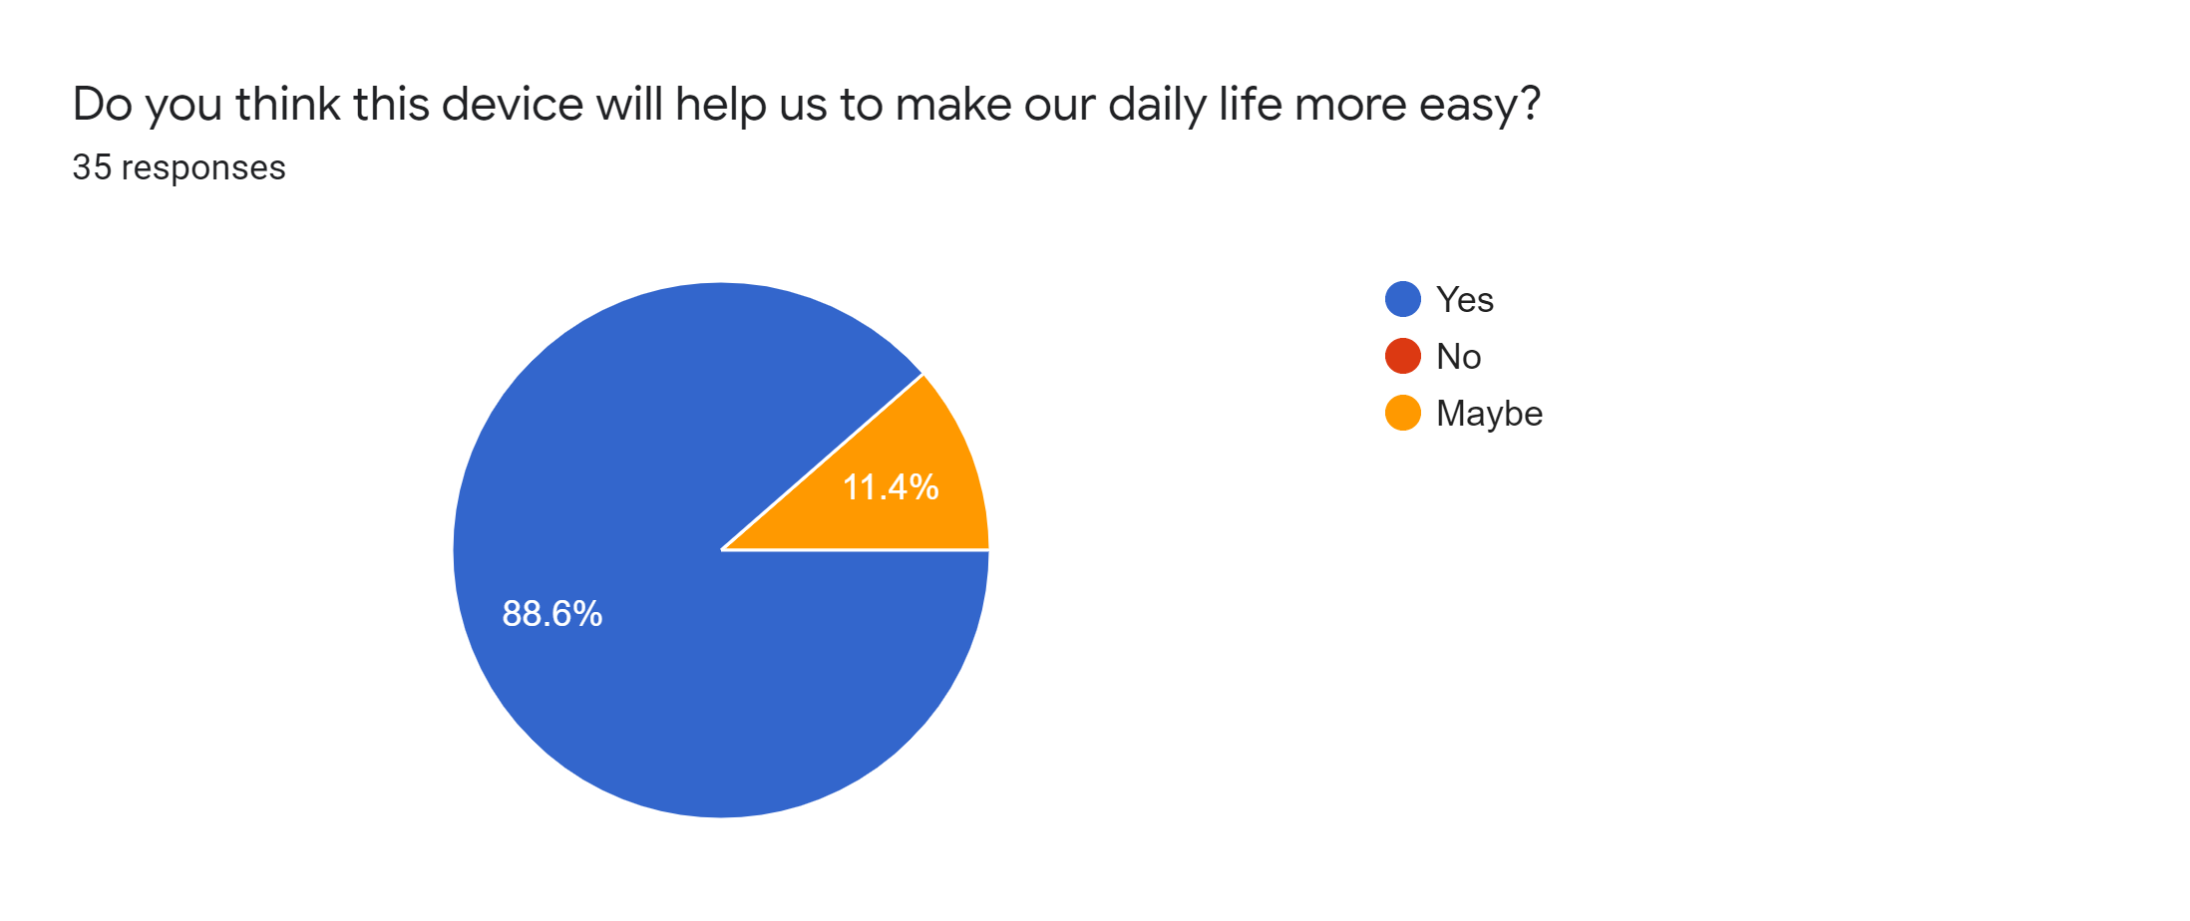
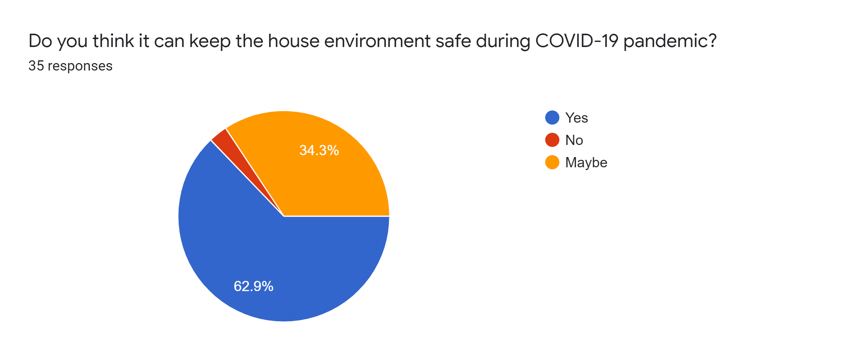
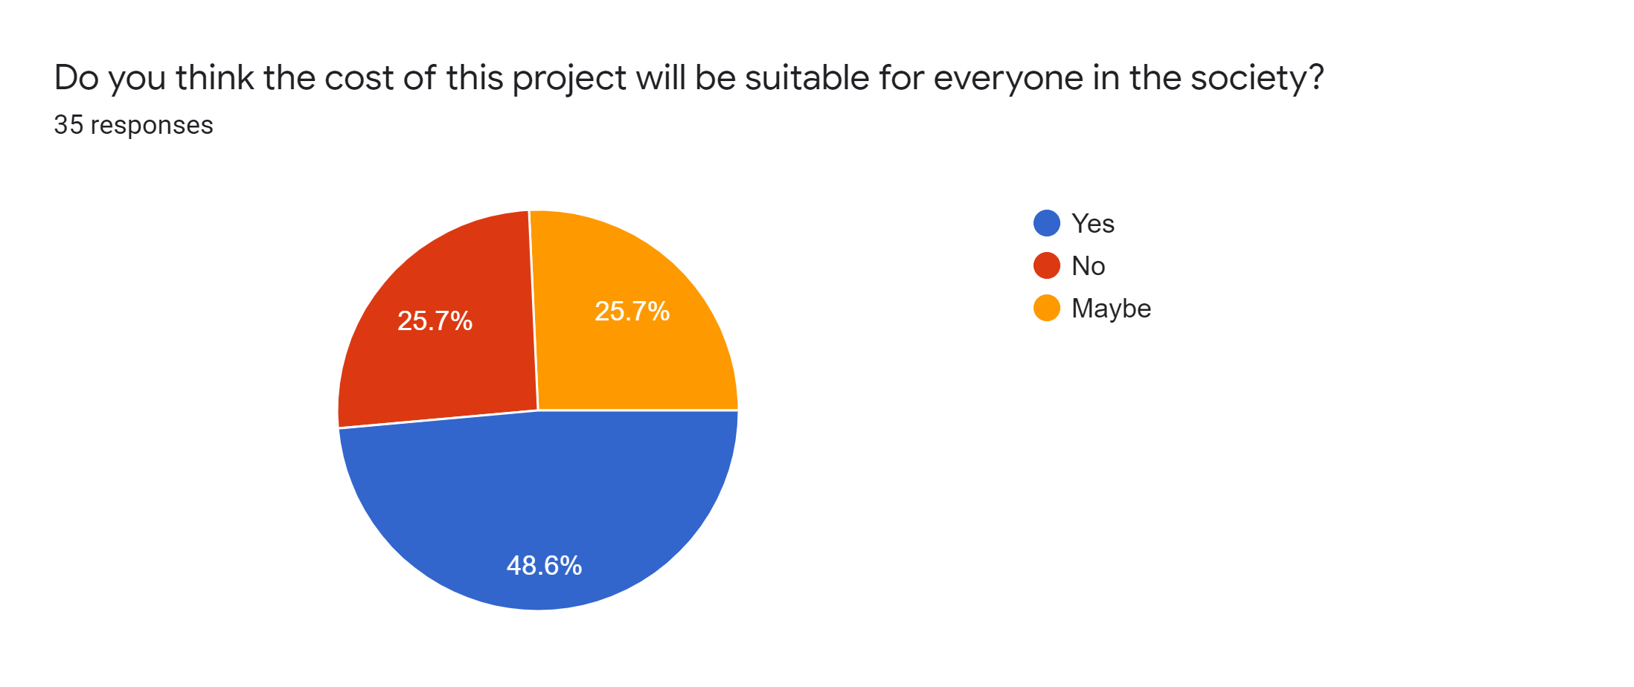
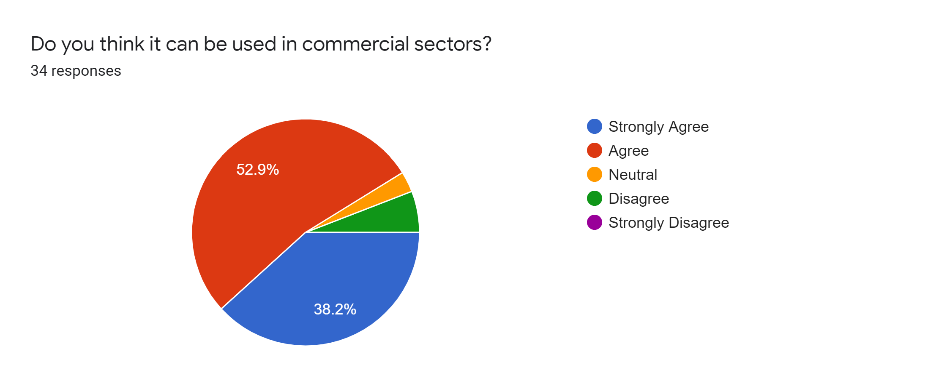
Survey Analysis

Slide 17
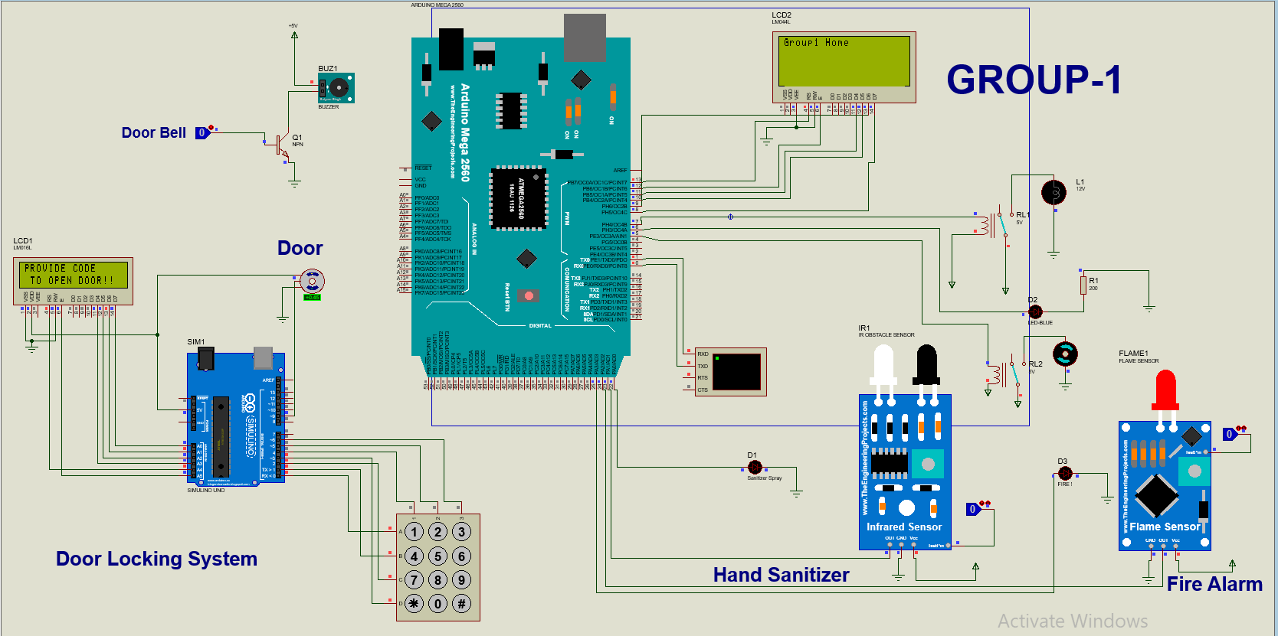
Full Project Simulation

Slide 18
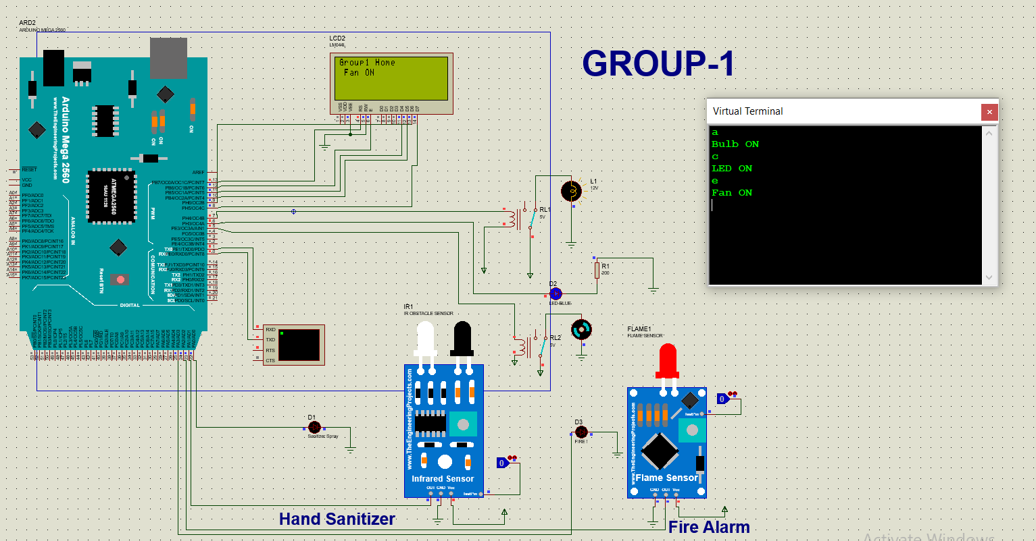
Home Appliance Control

Slide 19
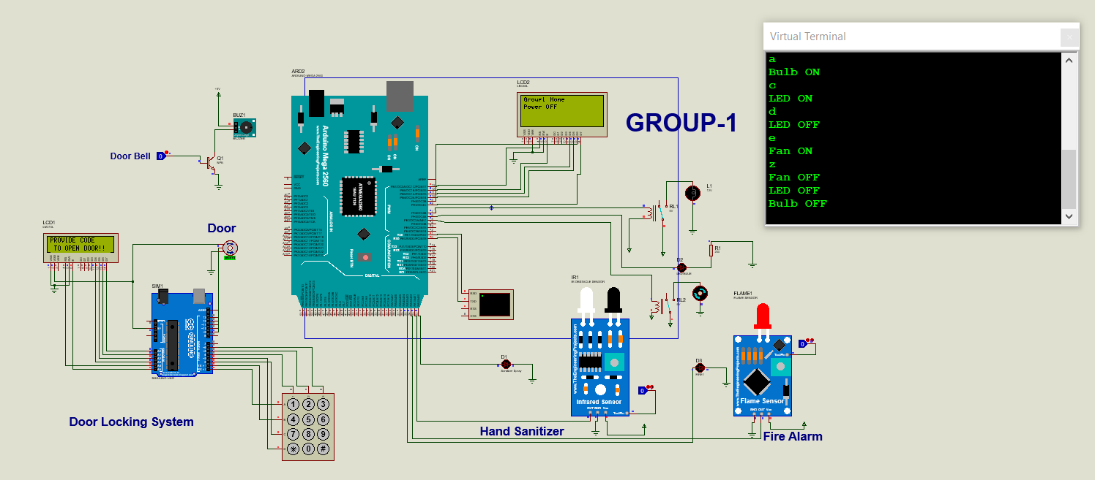
Home Appliance Control

Slide 20
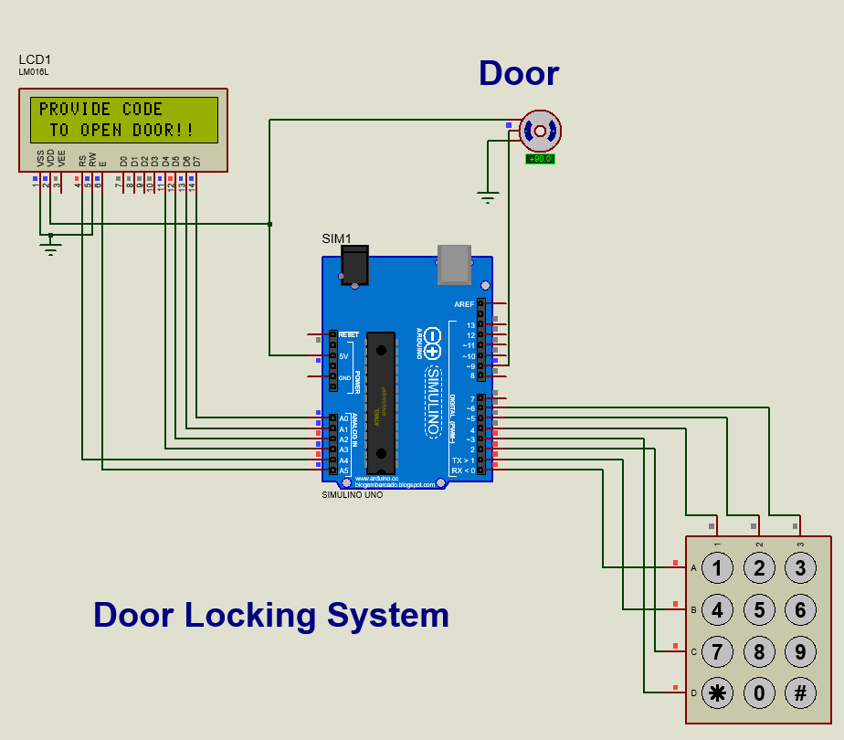
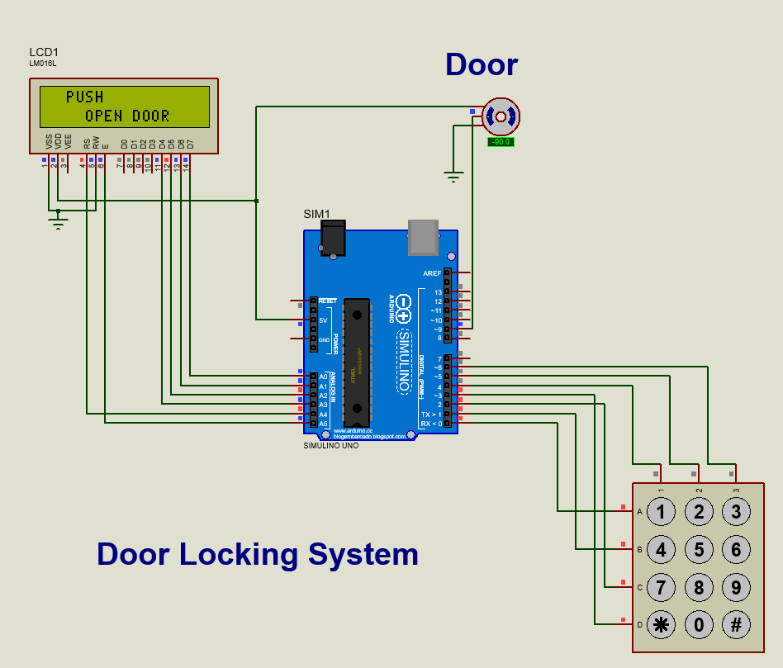
Password Base Door lock

Slide 21
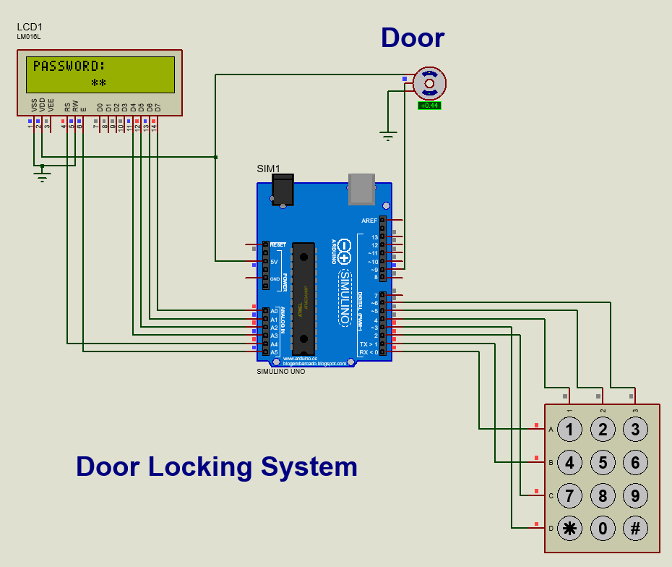
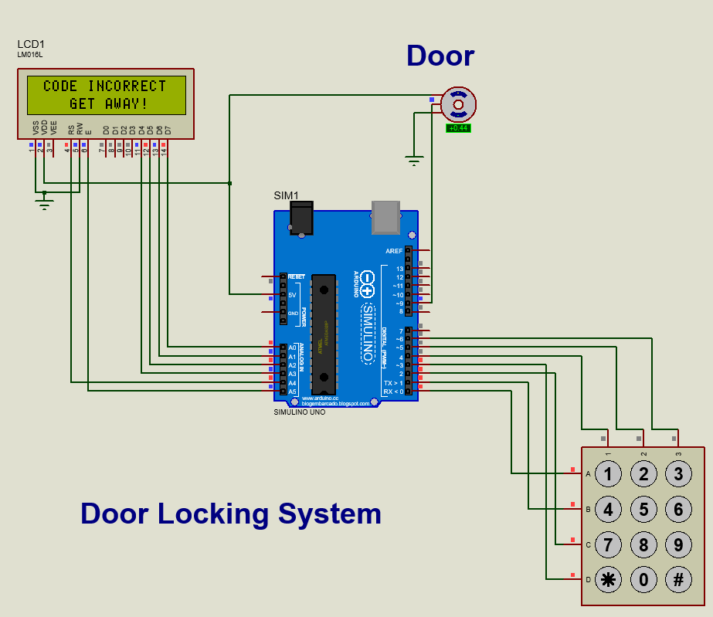
Password Base Door lock

Slide 22
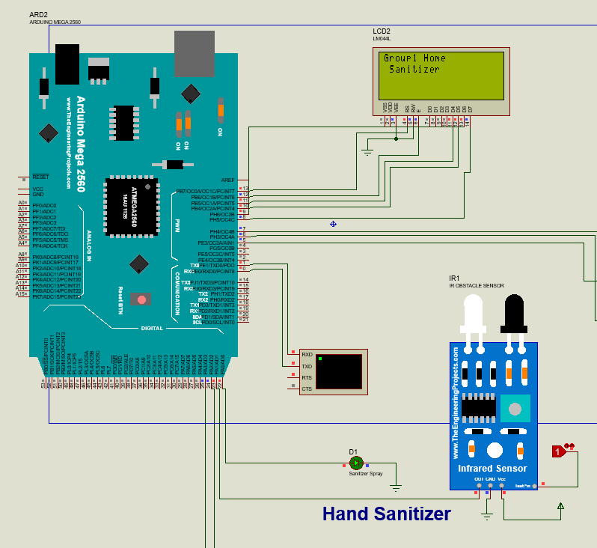
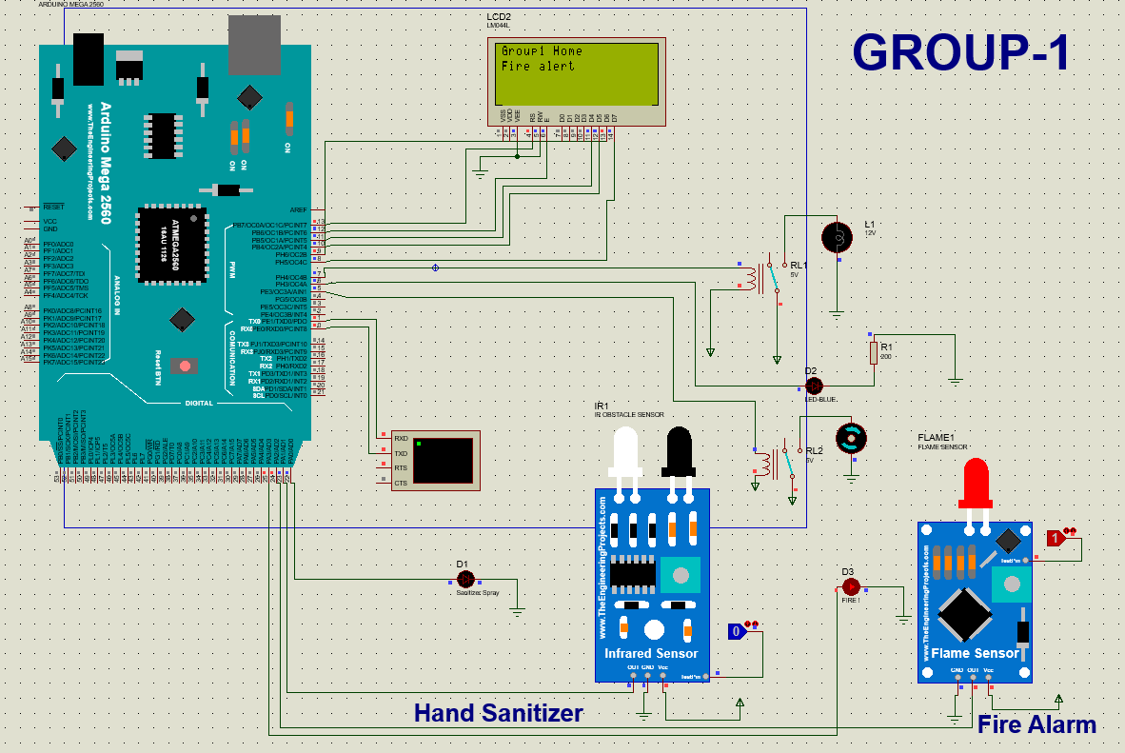
Automatic Hand Sanitizer
Fire Alarm

Slide 23
Novelty Of the Project
Make life more easy
Automatically protect the house
Make home environment safe during COVID-19 pandemic
Fire detection can save our life
In this covid situation cleaning hand before inter house has more priority so we add hand sanitizer in our project

Slide 24
Limitation’s
Hardware implementation was not possible.
Buzzer is not connected with the Automatic system.
Bluetooth module is not connected.
Couldn’t attach the door locking system in the Arduino Mega.
Fire alarm system is not smart enough to send immediate notifications to the concerned individual.

Slide 25
Conclusion
Automating home can’t be done in a day.
So many new IoT devices being put on the market every day,
There’s truly no limit to what you can automate, making your life safer and more convenient than ever before.
In our full presentation , component description, historical background, survey chart, simulation process are explain.

Slide 26
Reference
"A digital security system with door lock system using RFID technology.",Verma, Gyanendra K., and Pawan Tripathi. International Journal of Computer Applications (IJCA)(0975–8887) . Issue : May 2020
Smart Home Automation System using Arduino and Android Application, 1Md. Abdullah Al Mamun, 2*Mohammad Alamgir Hossain, 2Md. Atiqur Rahman, 3Md. Ibrahim Abdullah, 2Md. Shamim Hossain, Journal of Computer Science Engineering and Software Testing. e-ISSN: 2581-6969 Volume-6, Issue-2 (May-August, 2020)
Smart home automation system using Arduino microcontrollers, Dan-Ioan Gota1,Adela Puscasiu2,Alexandra Fanca3,Liviu Miclea4,
Honoriu Valean5, 2020 IEEE International Conference on Automation, Quality and Testing, Robotics (AQTR) Issue: 23 May 2020
“ What is home automation and how does it work ”, Available at: https://www.security.org/home-automation/
“Alarm and fire safety systems for smart home” ,Available at : https://www.asmag.com/showpost/16499.aspx

Slide 27


