Slide 2
How does the web work?
Have you ever wondered what happens when you browse your favourite websites?
How those attractive websites get to load up in your browser within a fraction of a second.
There is an epic journey happening every time you clicked that search button on your browser.
In this article, you and I are going to shift from an average internet user to the person who still uses the internet all the time but knows a little bit about what’s going on behind the scenes.

Slide 3
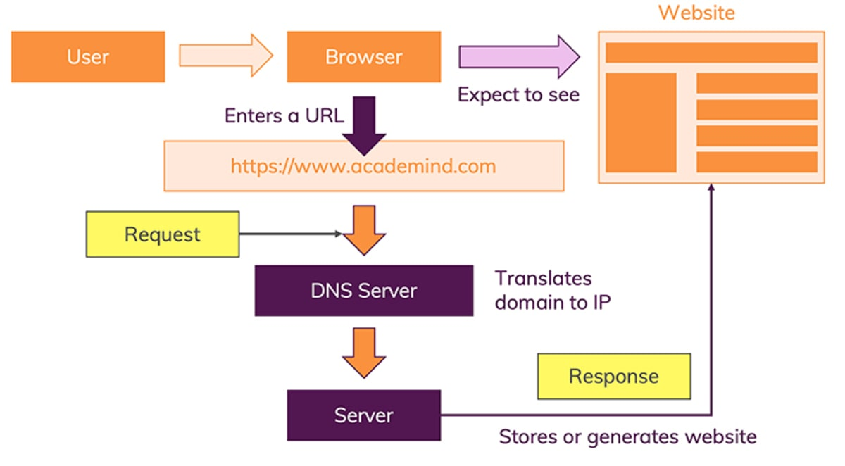

Slide 4
What do you need to be a web developer?
User experience (UX)
User interface (UI)
Visual design.
Coding languages including HTML and CSS.
Frontend web programing languages and skills such as JavaScript, Ajax and web animation techniques.
Backend web programing languages such as C# or Java, PHP and Ruby.

Slide 5


Slide 6
What is the role of a web developer
A web developer is responsible for programming the code that “tells” a website how to function. A developer builds a website from the bottom up, which means designing it in such a way that end users have no difficulty navigating the site. ... Large-scale web projects often divide these tasks among multiple web developers.

Slide 7
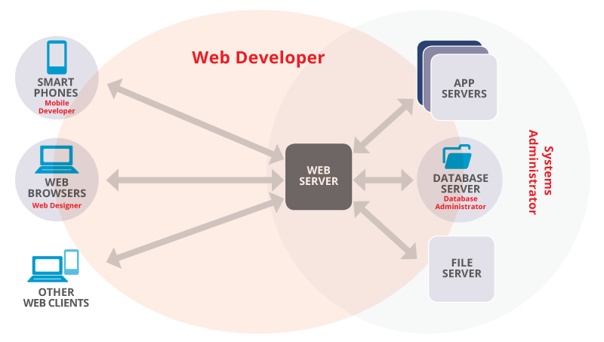
Developer by
fehmi Benjeddou

