Slide 1
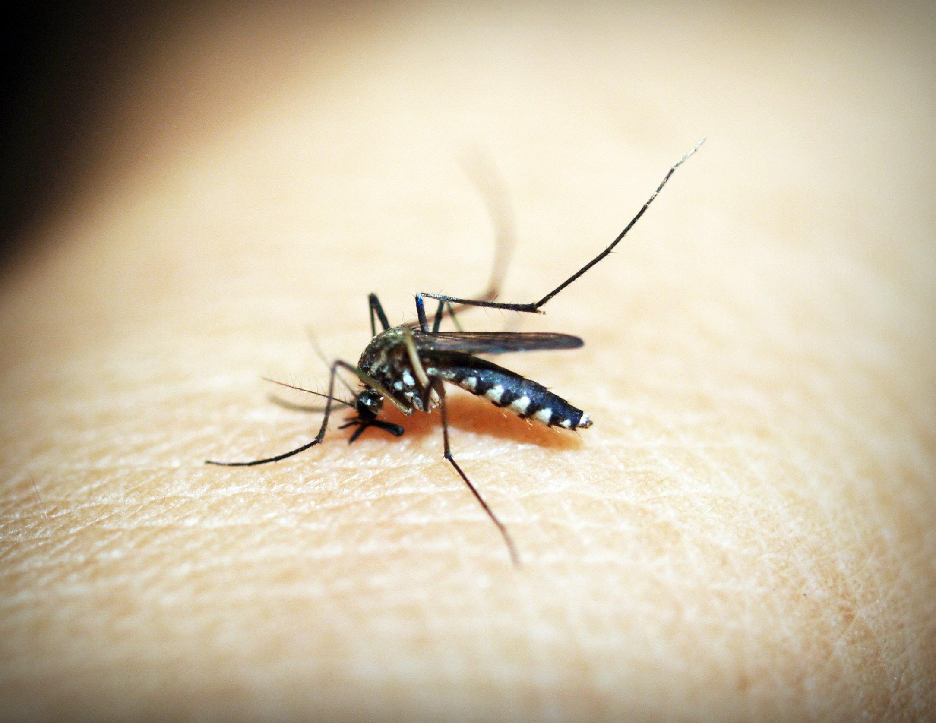
Malaria Prediction
Using Deep Learning
Team Members
Shrestha Datta (2018331030)
Zhalok Rahman (2018331046)
Joydip Saha (2018331108)
Fahmida Akter (2018331122)
Suraiya Eva (2018331048)
Supervised By
Md. Enamul Hassan
Associate Professor
Dept. of CSE

Slide 2
Introduction
A deadly disease in the earth and big hectic work for the health department.
Proposes a method to detect malaria by using Transfer Learning Model-VGG19 & Custom CNN models.
Keyword: CNN Model

Slide 3
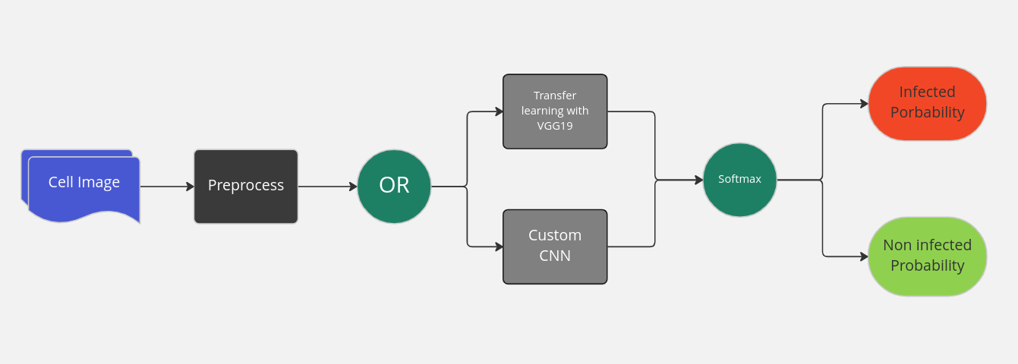
Overview

Slide 4
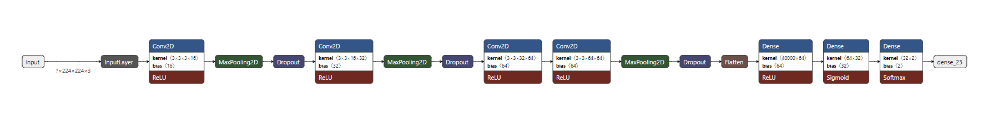
Custom CNN model
Figure : Custom CNN Model Diagram
Convolution layers: 2nd, 5th, 8th and 9th layers
Filters: 16, 32, 64 and 128 filters respectively
Window size 3 by 3
Max Pooling layers: 3rd, 6th and 10th layers. Window size: 2 by 2
Dropout Layers: 4th, 7th and 11th layers with dropout rates 0.2, 0.3 and 0.3 respectively

Slide 5
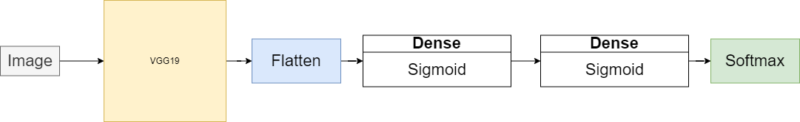
Transfer Learning Model with VGG19
Frozen all VGG19 convolution layers’ weights
Flattened the output
Added two trainable fully connected dense layers
Classified with softmax classifier
Figure : Transfer learning Model using VGG19

Slide 6





Application Tech-Stack
Front-end: Next.JS
Back-end: Flask
Environment: Google Colab
Deep Learning Framework: Tensorflow and Keras
Proxy Server: Ngrok

Slide 7
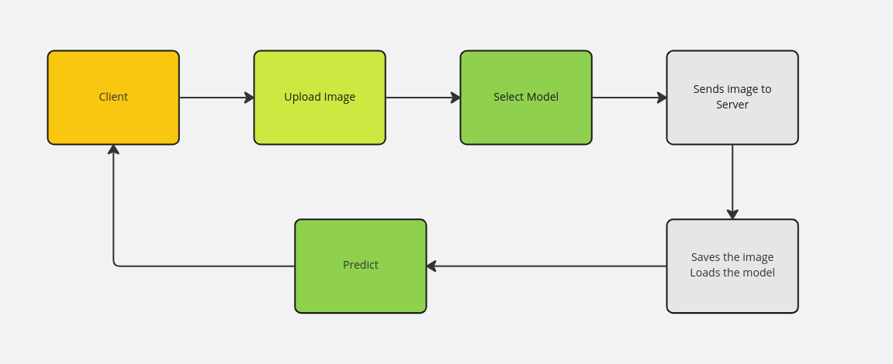
How it works

Slide 8
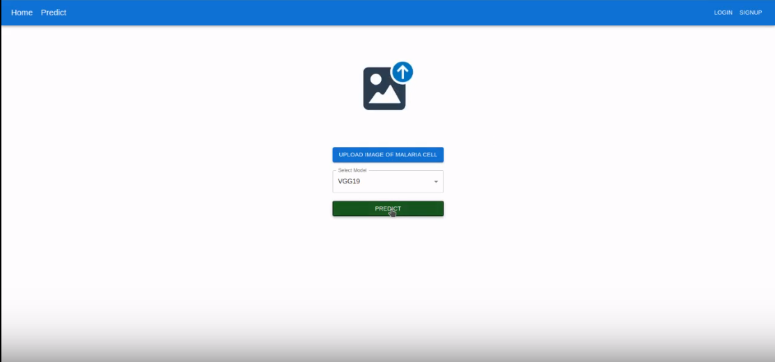
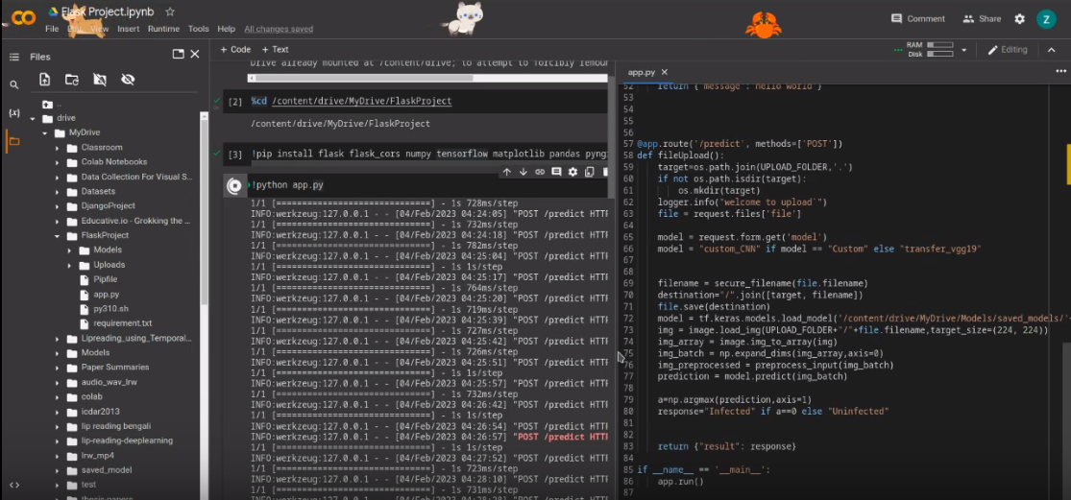
Demonstration
Client Side
Server Side
See our workflow → https://www.loom.com/share/ab43e675fb1b49cb9aeba9b5742340c1

Slide 9
Related Work
New genotypic signature to detect the malarial cell by Peter et al.
Real-time identification of malarial cells using a mobile phone by Dallet et al.
The concept of forming the artificial microscopic slide of plasmodium falciparum cell introduced by Gopalakrishna et al.

Slide 10
Dataset
Source: Kaggle
Link: https://www.kaggle.com/datasets/iarunava/cell-images-for-detecting-malaria
A total of 27558 images collected from kaggle dataset.
Image categories: a. Parasitized(Infected) b. Uninfected
Data is balanced among categories

Slide 11
Data Preparation
Resizing all images to 224 by 224 pixels
Splitted the whole data into:
Training Dataset: 70%
Validation Dataset: 20%
Test Dataset: 10%
Image Augmentation randomly applied to Training Dataset:
Horizontal Flipping
Shearing
Positive Scaling
No augmentation applied to validation and test dataset

Slide 12
Common attributes for both models
Loss function used: Categorical crossentropy
Optimizer: Adam Optimizer
Training Batch Size: 32

Slide 13
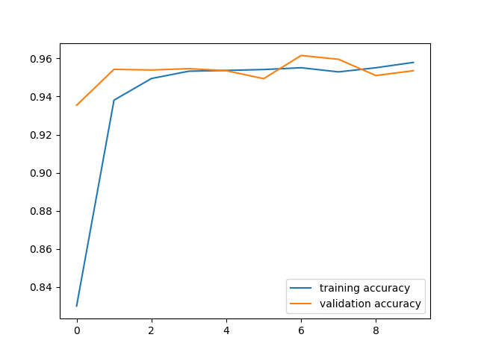
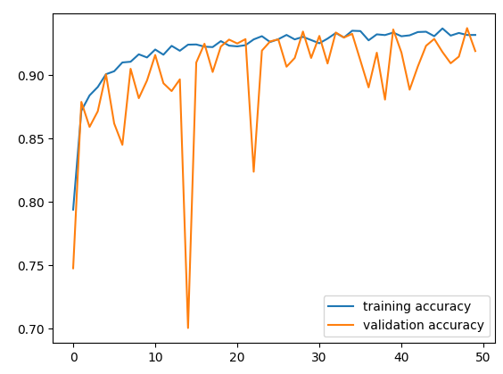
Results And Discussion
The Accuracy vs Epoch graph starts from the left is the Custom CNN Model, and Right is the Transfer Learning Model

Slide 14
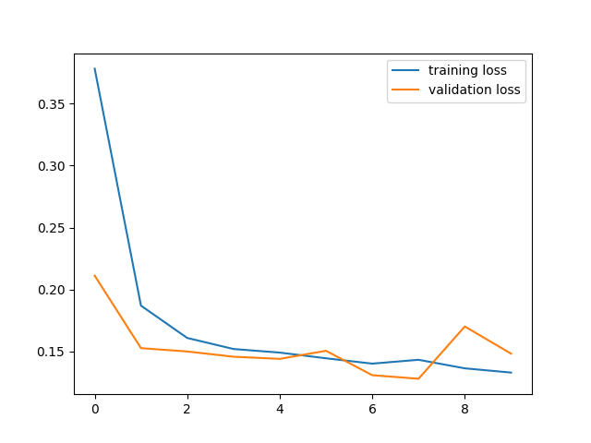
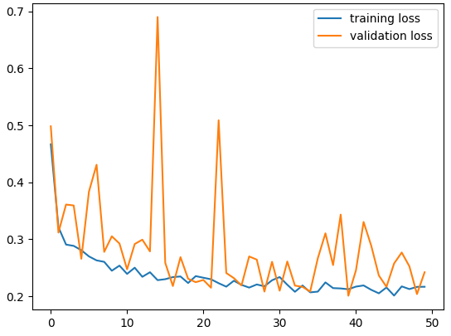
Results And Discussion(Contd.)
The Loss vs Epoch graph starts from the left is the Custom CNN Model, and Right is the Transfer Learning Model

Slide 15
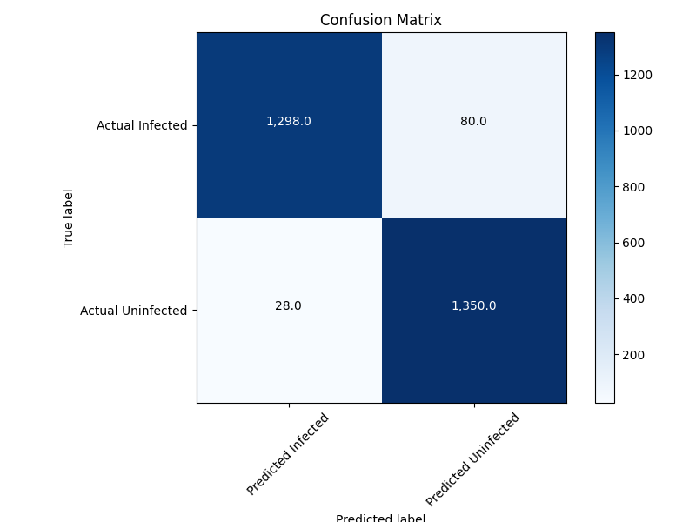
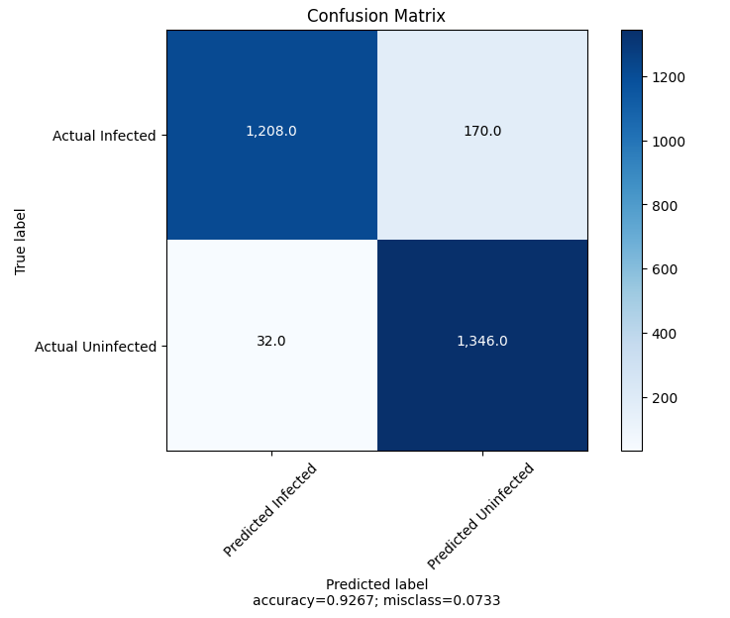
Confusion Matrices
Confusion Matrix for testing Custom CNN model
Confusion Matrix for testing Transfer Learning model

Slide 16
Results And Discussion(Contd.)
Model | Accuracy | Precision | Recall
Custom CNN Model | 0.96081275 | 0.97888386 | 0.94194484
Transfer Learning Model using VGG19 | 0.92670536 | 0.9741936 | 0.8766328.
Custom CNN Model, vs Transfer Learning Model

Slide 17
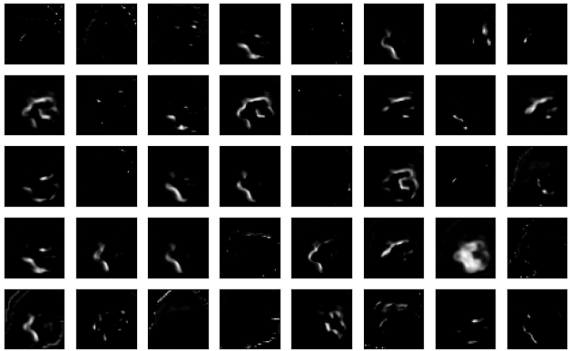
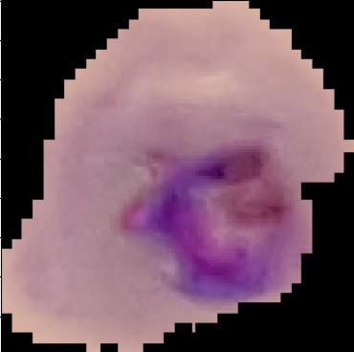
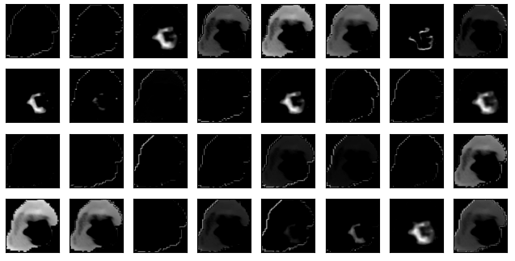
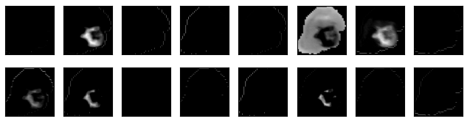
Visualizing Filters of custom CNN model
Some Filters at 4th convolution layer
Original Infected Image
Visualizing Filters at 1st convolution layer
Visualizing filters at 2nd convolution layers

Slide 18
Conclusion
System can predict whether the cell is malaria-infected or not.
Two types of models were evaluated.
Custom CNN Model showed the highest accuracy, precision and recall

Slide 19


