Slide 1
Angular
Rana De

Slide 2


Slide 3
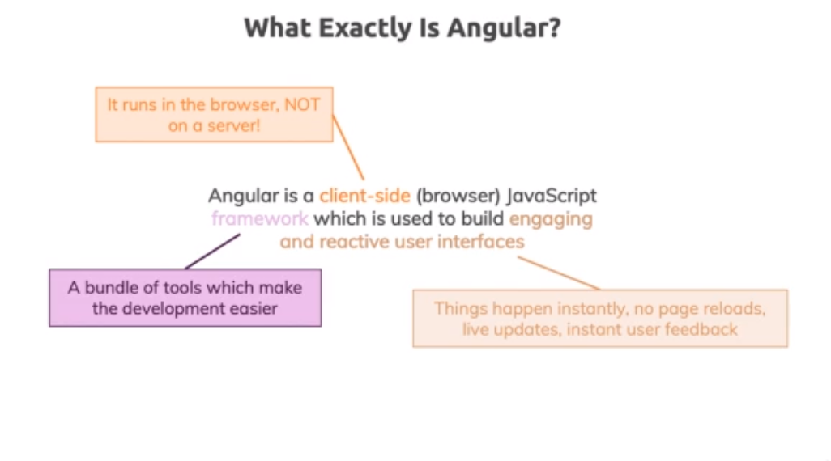
What Angular

Slide 4
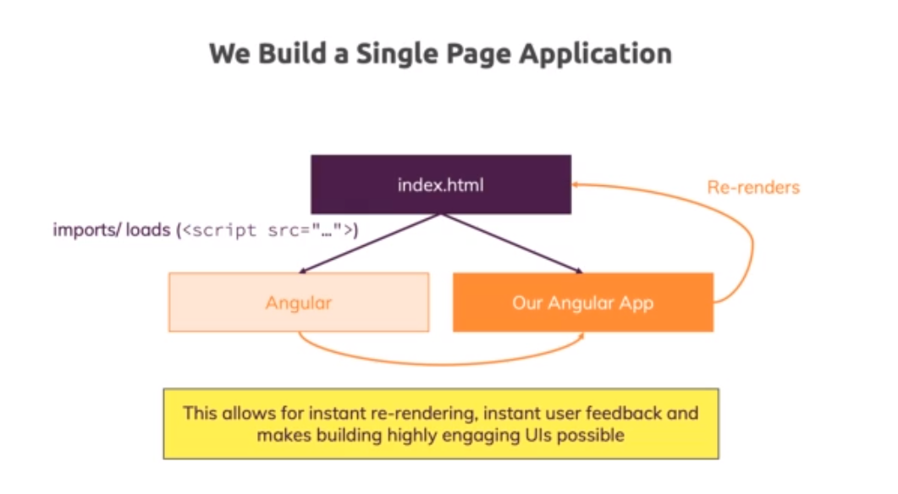
SPA

Slide 5
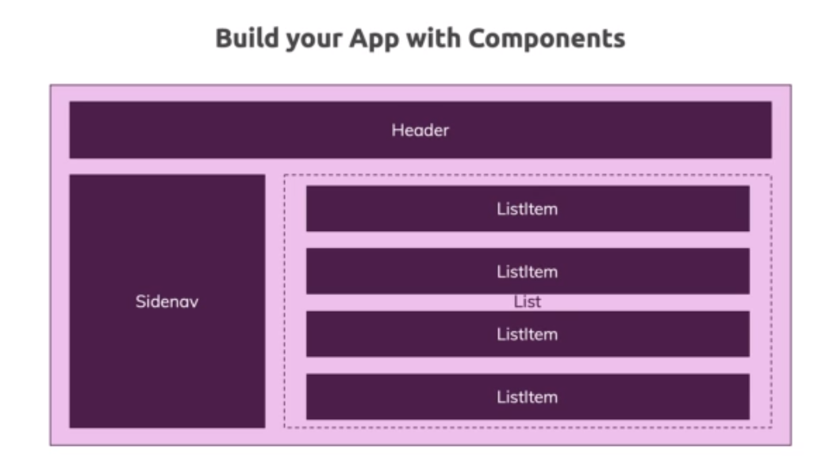
Angular Components

Slide 6
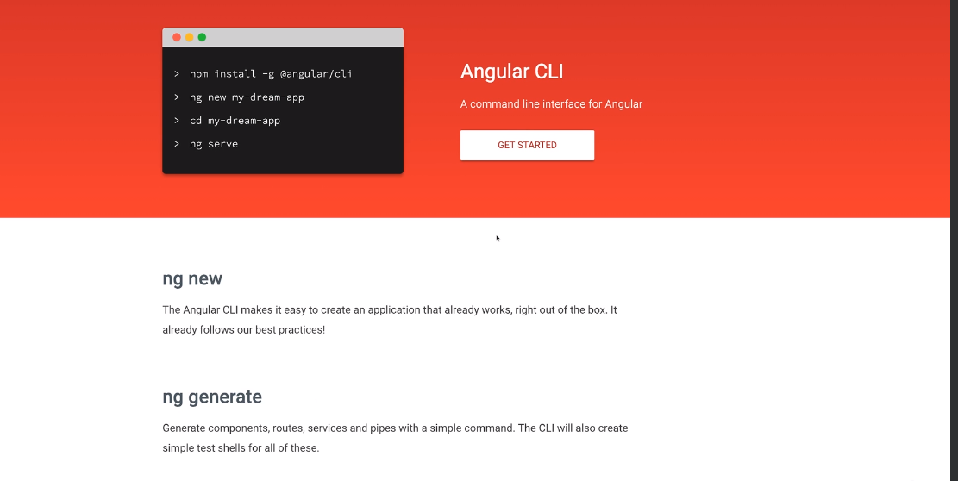
Angular CLI

Slide 7
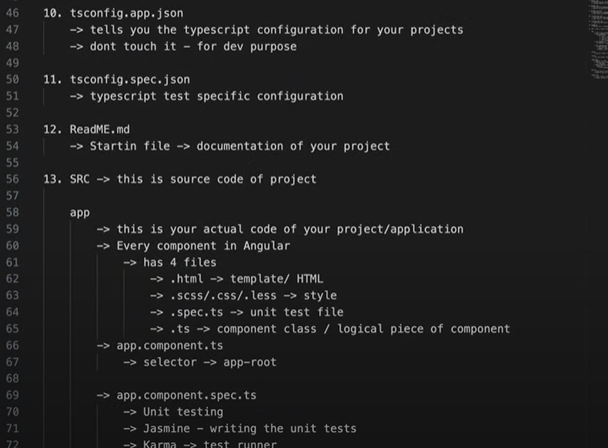
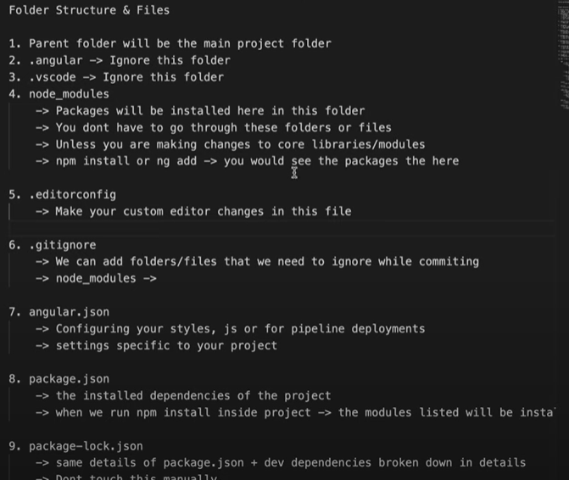
Folder Structure

Slide 8
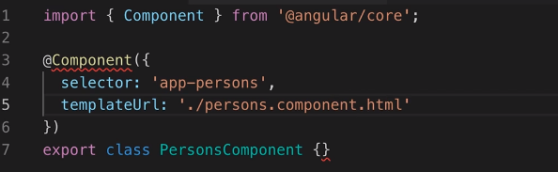
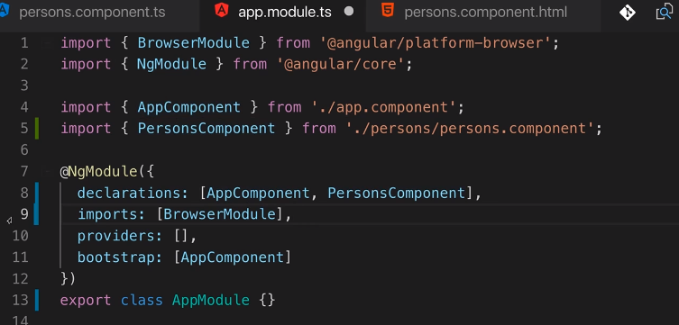

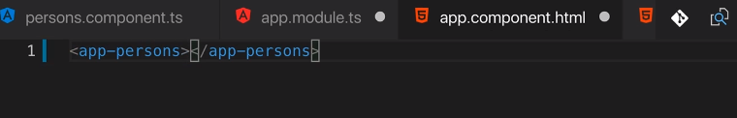
Own Component

Slide 9
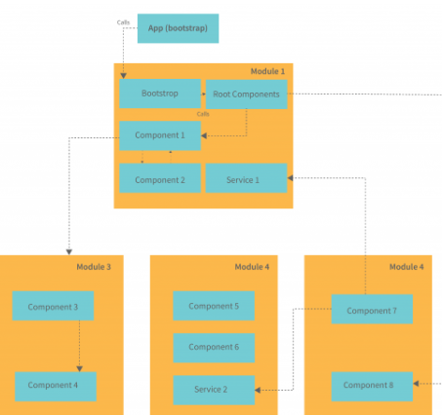
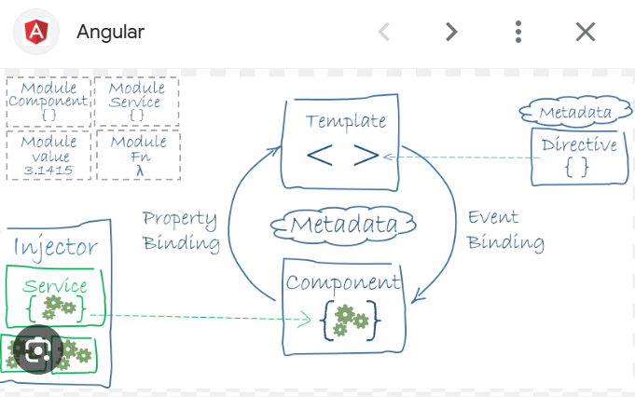
Architecture

Slide 10
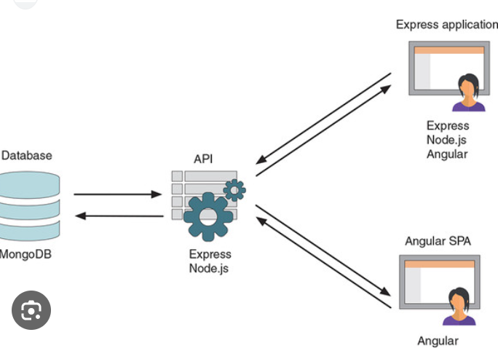
MEAN

Slide 11
About Angular
Default or root component
Folder structure
Own Component
NgFor and NgIf
Input property binding
User input with local ref
ngModel
Unit test

Slide 12
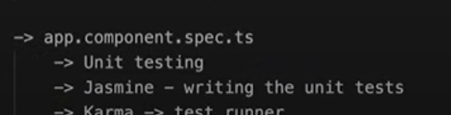
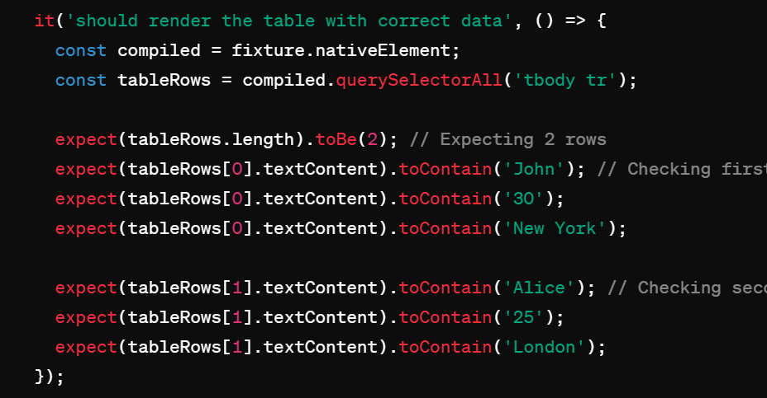
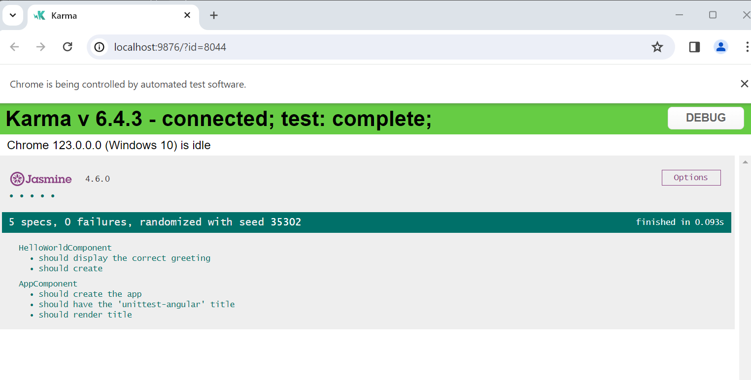
Unit Test

Slide 13
Continue Unit Test
We import TestBed and ComponentFixture from @angular/core/testing.
We import the HelloComponent to test.
We use the beforeEach function to set up the testing environment. TestBed.configureTestingModule is used to configure the testing module with the necessary declarations.
compileComponents() is an asynchronous function that compiles all components in the TestBed's module.
In the second beforeEach, we create a fixture for the HelloComponent and obtain its instance.
In the first test, we simply check if the component is created.
In the second test, we set a name for the component, trigger change detection, and then assert that the rendered HTML contains the correct greeting.
Ng test
ng test --include='src/app/app.component.spec.ts'

Slide 14
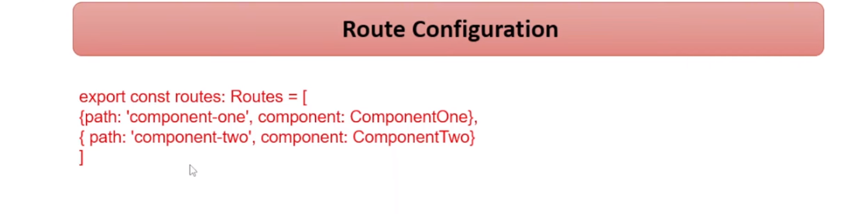
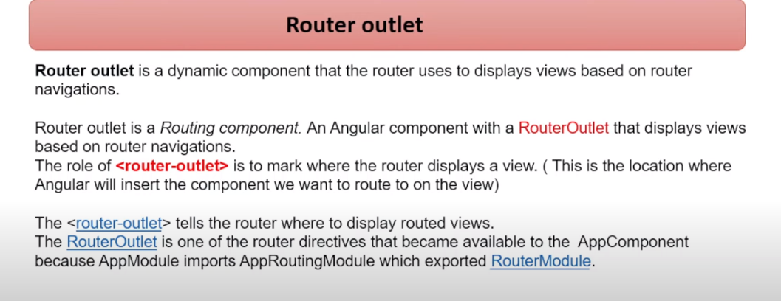
Route Configuration

Slide 15
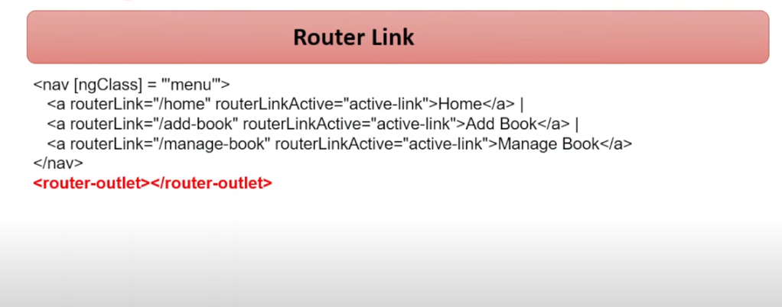
Router Link

