Slide 1

OCUVISION
Detect Early. Protect Vision. Empower Healthcare.
Product walkthrough of the live webapp
https://myvision-dev.calisto.co/ · Calisto VisionCare instance
OcuVision · myvision-dev.calisto.co
1 / 12

Slide 2
What is OcuVision?
A Calisto clinical web platform for AI-driven retinal screening — from fundus capture to diagnostic report and patient registry.
Brand
Users
Core job
Live URL
OcuVision by Calisto Sdn. Bhd.
Instance: Calisto VisionCare
Doctors, nurses, optometrists,
opticians, and clinic staff
Upload / capture fundus →
AI diagnosis → save & review
myvision-dev.calisto.co
Premium Ophthalmic Intelligence
OcuVision · myvision-dev.calisto.co
2 / 12

Slide 3
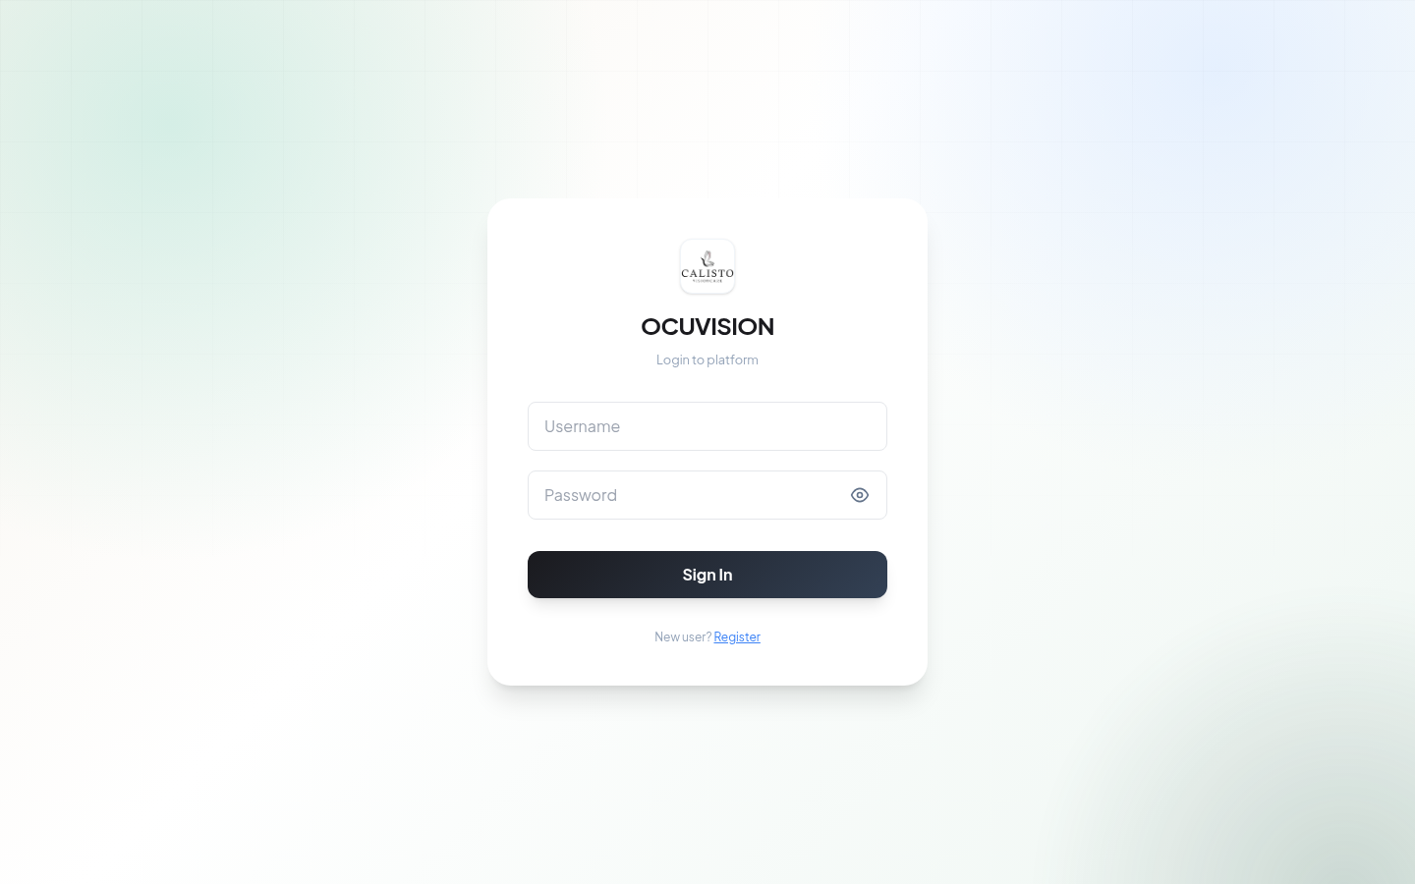
Sign-in Experience
• Calisto-branded login card
• Username + password auth
• Register flow for new staff
• Role titles: Doctor, Nurse,
Optometrist, Optician, Admin…
• Session tied to Calisto VisionCare
OcuVision · myvision-dev.calisto.co
3 / 12

Slide 4
Platform Map
Five modules in the glass sidebar — the clinician’s daily workspace.
01
Overview
Live Clinical Console, KPIs, screening volume, quick actions
02
Diagnostics
Fundus upload / camera import + AI engine + screening report
03
Patient Registry
Search, filter, sort, view / edit / delete diagnostic records
04
Insights
Case distribution, AI efficiency, demographics analytics
05
Settings
Account, device link (fundus camera), AI core / model library
OcuVision · myvision-dev.calisto.co
4 / 12

Slide 5
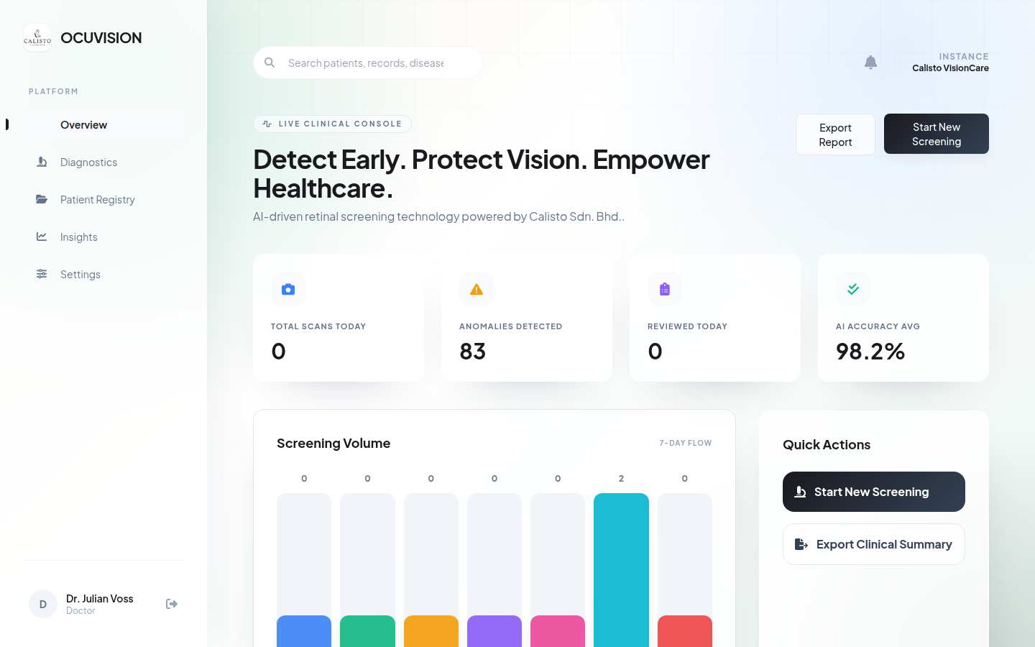
Overview — Live Clinical Console
“Detect Early. Protect Vision. Empower Healthcare.” · KPIs, 7-day screening volume, Start New Screening
OcuVision · myvision-dev.calisto.co
5 / 12

Slide 6
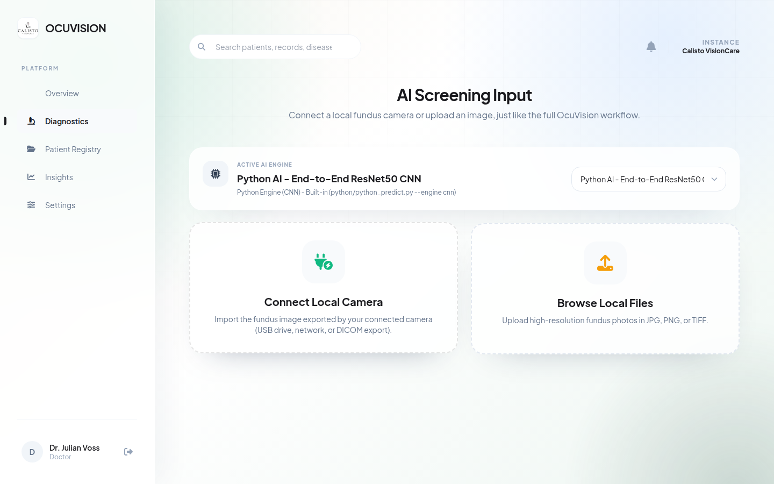
Diagnostics — AI Screening Input
Active AI engine picker · Connect local camera · Browse JPG / PNG / TIFF fundus photos
OcuVision · myvision-dev.calisto.co
6 / 12

Slide 7
Screening Workflow
1
Input
2
Engine
3
Pipeline
Connect fundus camera or upload high-res photo
Pick AI model (e.g. ResNet50 CNN / MATLAB)
Pre-process · CLAHE · feature / CNN inference
4
Report
5
Save
6
Share
Diagnosis, severity, notes, feature profiles
Auto-save to Patient Registry (OCU-####)
Print / Export Diagnostic Report
OcuVision · myvision-dev.calisto.co
7 / 12

Slide 8
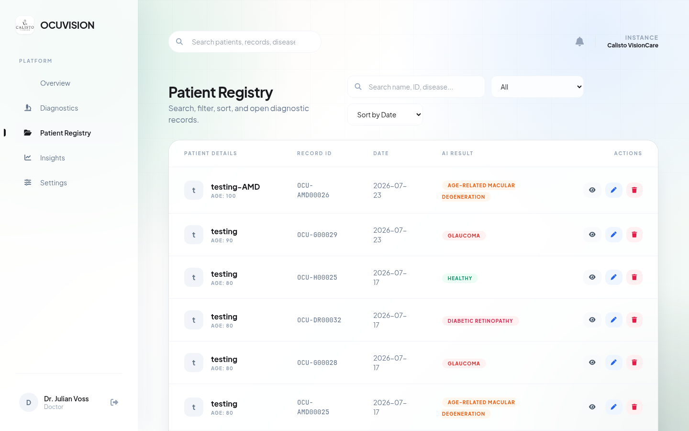
Patient Registry
Search · filter · sort · color-coded AI results (Healthy / AMD / Glaucoma / DR) · view / edit / delete
OcuVision · myvision-dev.calisto.co
8 / 12

Slide 9
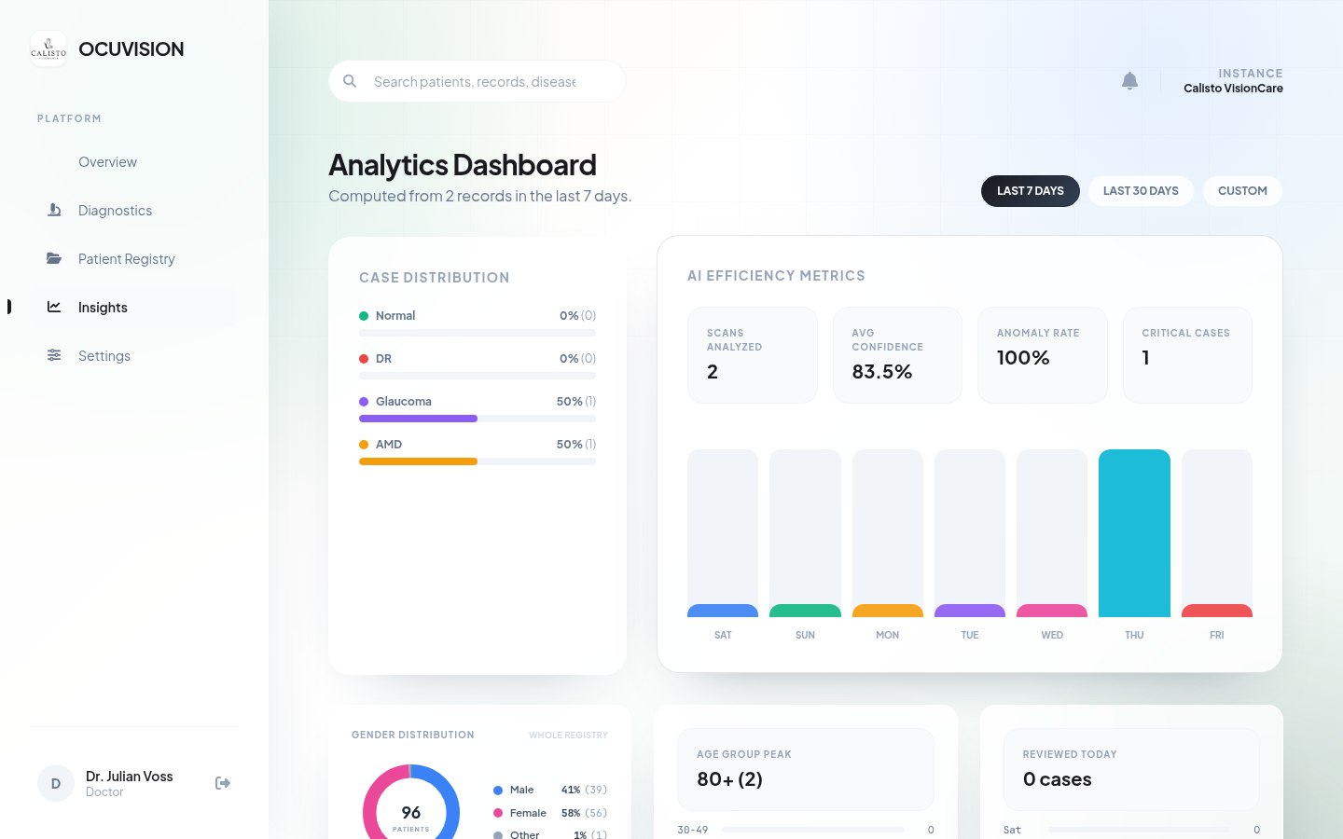
Insights — Analytics Dashboard
Case mix · AI efficiency · gender/age demographics · 7-day / 30-day / custom windows
OcuVision · myvision-dev.calisto.co
9 / 12

Slide 10
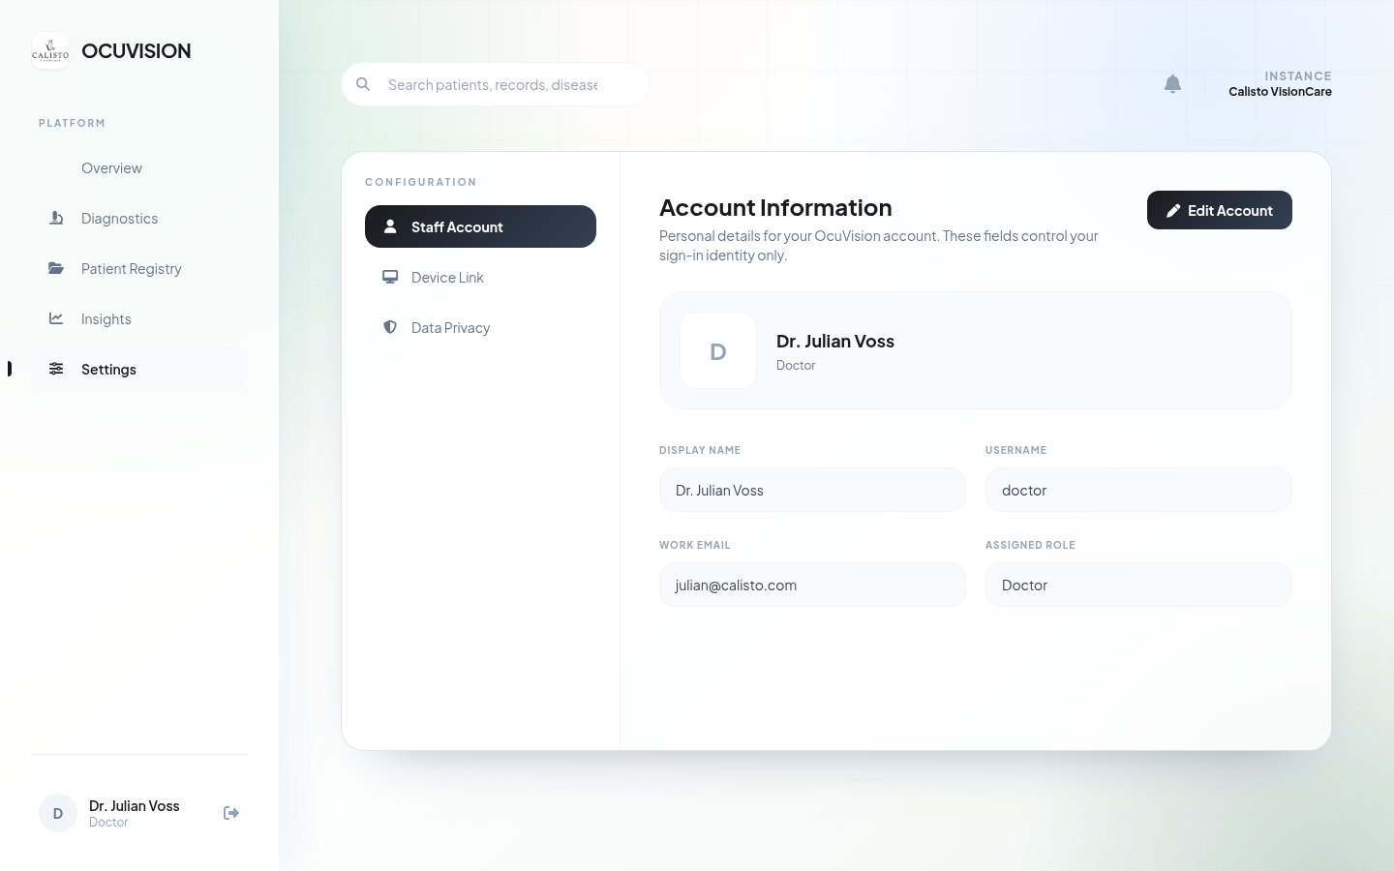
Settings & Configuration
Staff Account · Device Link (fundus camera) · Data Privacy · AI Core / Model Library
OcuVision · myvision-dev.calisto.co
10 / 12

Slide 11
AI Capabilities in the App
Engines & outputs
Conditions & clinical extras
Engines
• Python ResNet50 CNN (built-in)
• MATLAB Classification Learner
Bagged Trees (.mat uploads)
• Demo / selectable active model
Outputs
• Diagnosis + severity banding
• Confidence / clinical notes
• Feature profiles (intensity,
optic nerve, vascular, macular)
Conditions surfaced
• Healthy
• Diabetic Retinopathy
• Glaucoma / Early Glaucoma
• Age-related Macular Degeneration
Clinical extras
• Printable Diagnostic Report
• Referral / next-step guidance
• Password-gated edit & delete
OcuVision · myvision-dev.calisto.co
11 / 12

Slide 12
OcuVision
Detect Early. Protect Vision. Empower Healthcare.
Live product: https://myvision-dev.calisto.co/
Powered by Calisto Sdn. Bhd. · Calisto VisionCare
Thank you
OcuVision · myvision-dev.calisto.co
12 / 12

