Slide 1
LINGKAR TEMU KABUPATEN LESTARI
Your website,
in your hands
A quick tour of the CMS behind kabupatenlestari.org
Client presentation · September 2026
Notes:
Welcome. Today we walk through the content management system that powers kabupatenlestari.org — what it does, how it is organised, and how your team will use it day to day.

Slide 2
THE BIG PICTURE
One place for everything on the website
01
02
03
04
Pages
Posts
Kabupaten
Settings
Every page and the menus that lead to it
News, videos, events, library and press
Member profiles, pillars, jobs and team
Logo, footer, social links, SEO
LTKL CMS · 02
Notes:
Everything a visitor sees on kabupatenlestari.org is entered here: pages and menus, posts, the kabupaten and other reference data, and global settings.

Slide 3
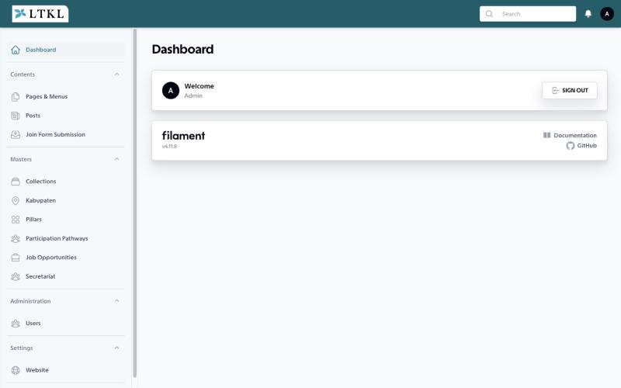
GETTING IN
Sign in and find your way
1 · Open
cms.kabupatenlestari.org/administrator
2 · Sign in
With your own email and password
3 · Use the sidebar
Contents, Masters, Administration, Settings
LTKL CMS · 03
Notes:
Each team member gets their own account. The sidebar is grouped: Contents for pages and posts, Masters for reference data, Administration for users, Settings for the website.

Slide 4
THREE IDEAS TO REMEMBER
Simple rules, everywhere
ID · EN
✓
↺
Bilingual
Draft or live
Safe to delete
Every form has an Indonesian and an English tab
One switch: “Set as published”
Deleted items go to trash and can be restored
LTKL CMS · 04
Notes:
Content is always entered in both languages. Anything can be saved as a draft and published later. Deleting is reversible — items go to the trash first. Web addresses are created automatically from the title.

Slide 5
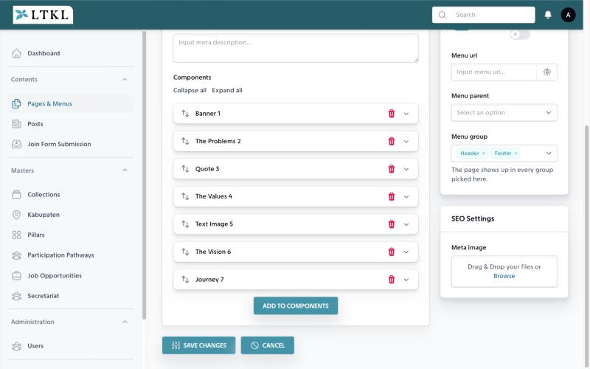
PAGES
Build pages like stacking blocks
Pick a block
Banner, text, image, statistics, timeline, map…
Fill it in
Only the fields that block needs
Drag to reorder
The page follows the list, top to bottom
LTKL CMS · 05
Notes:
Pages are built from about twenty ready-made blocks, including live collections such as the kabupaten map or job list. The design stays consistent because each block has a fixed look.

Slide 6
MENUS
The menu builds itself from your pages
1
2
3
4
Publish the page
Pick where
Nest it
Drag to order
Main, Header or Footer
Choose a parent page
In the page list
Bonus: any block can become a jump link under its page with “Add as submenu”.
LTKL CMS · 06
Notes:
No separate menu editor to maintain. Each page's Menu Settings decide whether it appears, in which menu, and under which parent. A page can also be a link to another website.

Slide 7
POSTS
Five kinds of post, one simple form
Article
Video
Event
Library
Media
News and stories
YouTube or Vimeo link
Dates, place, sign-up
Reports to download
Press coverage elsewhere
Pick the type — the form shows only the extra fields it needs.
LTKL CMS · 07
Notes:
All dated content is a post. Choosing the type reveals the right extra fields: event dates and registration link, a video URL, a downloadable document, or the publisher of a media article.

Slide 8
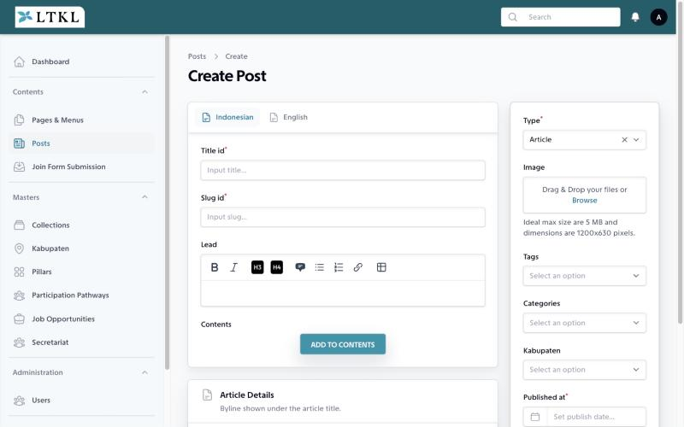
POSTS
Write left, settings right
Left: the words
Title, lead and content in both languages
Right: the details
Type, image, tags, kabupaten, date
Helpful hints
Ideal image sizes shown under each upload
LTKL CMS · 08
Notes:
Every form in the CMS follows this layout, so once the team learns posts, the rest feels familiar.

Slide 9
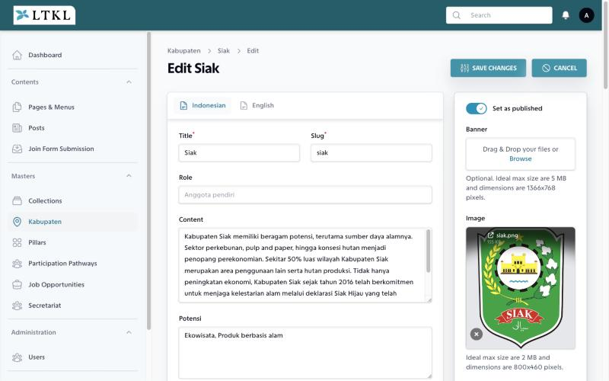
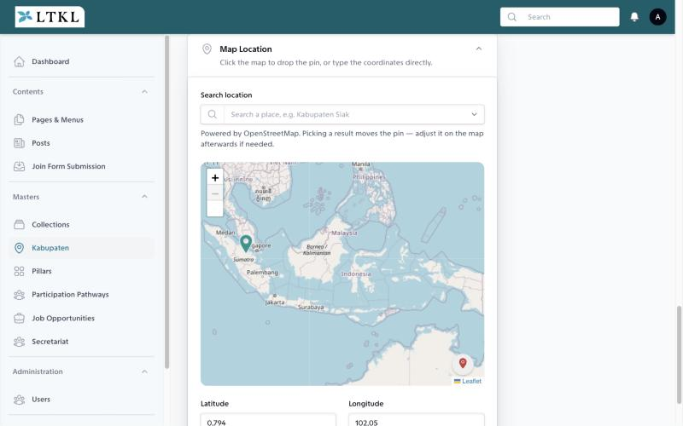
KABUPATEN
A full profile for every member
Story · role, potential, commodities, impacts
Map · search a place, drop the pin
LTKL CMS · 09
Notes:
Each kabupaten has a banner, logo, landscape figures, commodities, impact stories and linked posts. The map pin is set by searching the place name. Once published, it appears automatically on the map and list pages.

Slide 10
MASTERS
Update once, it shows everywhere
Pillars
Job Opportunities
Secretariat
Results and field examples
Open or closed vacancies
The team and org chart
Participation
Categories & Tags
Join form inbox
Ways to get involved
To organise posts
Every sign-up, also by email
LTKL CMS · 10
Notes:
This reference data feeds the website automatically. Add a pillar or a vacancy here and every page that lists them updates on its own.

Slide 11
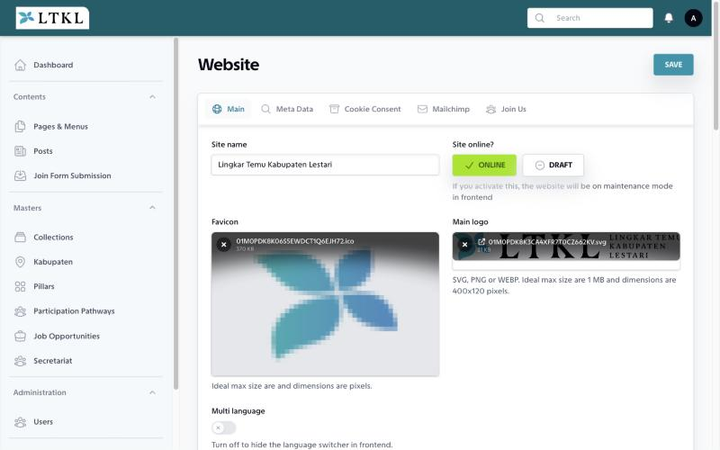
SETTINGS
Site-wide details in one screen
Brand
Name, logos, footer, social links
Search & sharing
Default descriptions and share image
Online switch
Take the site offline for maintenance
LTKL CMS · 11
Notes:
Settings also hold the cookie notice, the newsletter connection and the email that receives join-form messages. The online switch affects the whole public site.

Slide 12
DAY TO DAY
From idea to live in four steps
1
2
3
4
Write
Translate
Review
Publish
In Indonesian
English tab
Saved as draft
One switch
LTKL CMS · 12
Notes:
Draft in Indonesian, add the English version, keep it unpublished while a colleague reviews, then switch it live.

Slide 13
GOOD HABITS
Four tips for a tidy website
1
Fill both languages
2
Use the right image size
Before you publish
Shown under each upload
3
Close what has ended
4
Own account each
Vacancies and event sign-ups
Never share passwords
LTKL CMS · 13
Notes:
Note: a vacancy deadline is only displayed. A vacancy stays open until someone sets it to Closed. Same for event registration.

Slide 14
Questions?
ADMIN PANEL
cms.kabupatenlestari.org/administrator
STEP-BY-STEP GUIDE
LTKL CMS Administrator Guide (PDF)
Notes:
Thank you. The full administrator guide covers every screen and field step by step. Happy to schedule a hands-on training session.

