Slide 1
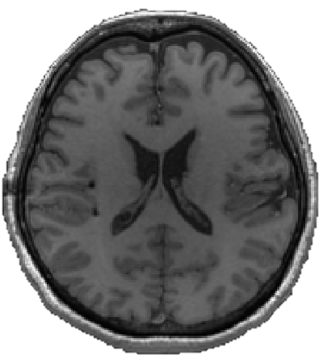
Subject 1
Tal/MNI
Scanner
RAS
Volume
CRS
Surface
RAS
T_{Tal}
T_{vox2ras}
T⁻¹_{tkrvox2ras}
T⁻¹_{reg}
Subject 2
Tal/MNI
Scanner
RAS
Volume
CRS
Surface
RAS

