Slide 1


Slide 2

Hardwire and Wireless Takeovers
Training

Slide 3
Section 1
Overview
Two types of Takeovers
Hardwire Takeovers
  Uses the customer’s existing system without modification
  System must be fully functional
  Converts to Cellular Monitoring
  Requires a Cellular Conversion Device
Wireless Takeovers
  Existing panel changed to GE Simon XT
  Uses existing sensors
  Standard phone line, Broadband, and Cellular available
  Requires a Translator

Slide 4
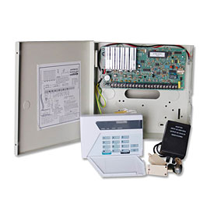
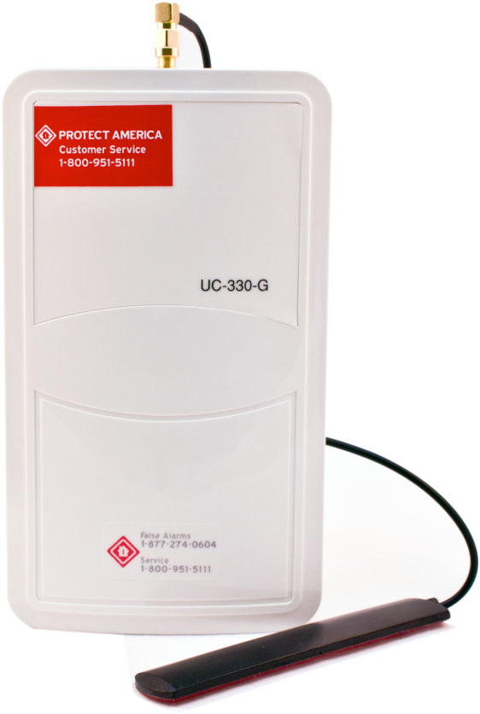
Existing Hardwire Systems
Cellular Conversion Device
Compatible with nearly all existing hardwired home security systems (Except Brinks).
Cellular connection eliminates the risk of a burglar disconnecting exterior phone lines prior to breaking into home.
Easy to install device. Can be installed in less than fifteen minutes, regardless of experience.
Utilizes the wide-spread AT&T cellular network. Not Interactive
Monitors Smoke and CO2 detectors
Takeover Solutions Tool required

Slide 5
Existing Hardwire Systems
Cellular Conversion Device
Takeover Solutions Tool
Instructions:
Answer the following questions with your customer. Make a selection in the drop down menu by clicking on the arrow. Copy the fields in the box below and paste them into the body of an email. Send the email to 'DATA PROCESSING' with the customer's name and Agreement ID in the SUBJECT LINE.
Existing System Information
Customer Name: | Peter Roman, 1477619
Manufacturer: | HONEYWELL ADEMCO
Model: | VISTA 20
Does customer Know master code?: | Yes
Prior Monitoring Company | ADT
Does the Keypad have power?: | Yes
Smoke/Carbon detectors?: | Yes | Smoke Forms Required
Wireless or Hardwired?: | Hardwired
Solution Required: | UHS
Reminder: If a system is not listed in the model list, then we cannot take it over without approval from a L2 technician.
Identifying a Panel
1. Locate Master Control Panel (not keypad). Usually located in master bedroom closet and tan colored.
2. If the control panel is LOCKED, check if there is a key located on top of the panel. Check to see if the panel is screwed shut, if so it needs to be unscrewed. If the key cannot be located, the panel may need to be pried open by inserting a flat head screw driver behind the lid at the lock and pulling toward the customer.
3. Once the door is open, there will be a CHART or GRAPH on the inside of the door. Have the customer read what is written around the edge of the image. This should tell you the MANUFACTURER of the system (Ademco, DSC, FBII, Moose, etc.).
a. If the manufacturer cannot be identified on the door, then check the mother board. The largest chip on the board should have the manufacturer's name on it.
If your customer cannot identify the panel, get with a L2 technician

Slide 6
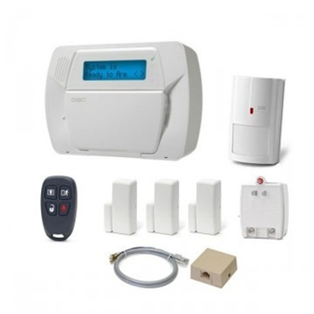
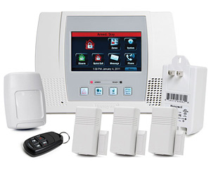
Existing Wireless Systems
Translators
Converts Ademco, Honeywell, DSC, and 2GIG wireless devices to GE format
Standard phone line, Broadband and Cellular Interactive monitoring available
Smoke and CO2 detectors are not monitored
Takeover Solutions Tool required

Slide 7
Existing Wireless Systems
Translators
Trans A
Converts signals from Ademco Honeywell wireless sensors to GE format
  Existing sensors must be taken down and relearned into GE Simon XT.
  Smoke Detectors and CO2 Detectors are not monitored
  Translator is mounted inside the GE XT panel

Slide 8
Existing Wireless Systems
Translator A
Takeover Solutions Tool
Instructions:
Answer the following questions with your customer. Make a selection in the drop down menu by clicking on the arrow. Copy the fields in the box below and paste them into the body of an email. Send the email to 'DATA PROCESSING' with the customer's name and Agreement ID in the SUBJECT LINE.
Existing System Information
Customer Name: | Peter Roman, 1477619
Manufacturer: | HONEYWELL ADEMCO
Model: | LYNX/LYNX-R/LYNX-REN | Note:Cannot use Customers Smoke Detectors, they do not add-in
Does customer Know master code?: | Yes
Prior Monitoring Company | ADT
Does the Keypad have power?: | Yes
Smoke/Carbon detectors?: | Yes | Smoke Forms Required
Wireless or Hardwired?: | Wireless
Solution Required: | TRANSLATOR A OR TAKEOVER LANDLINE
Reminder: If a system is not listed in the model list, then we cannot take it over without approval from a L2 technician.
Identifying a Panel
1. Locate Master Control Panel (not keypad). Usually located in master bedroom closet and tan colored.
2. If the control panel is LOCKED, check if there is a key located on top of the panel. Check to see if the panel is screwed shut, if so it needs to be unscrewed. If the key cannot be located, the panel may need to be pried open by inserting a flat head screw driver behind the lid at the lock and pulling toward the customer.
3. Once the door is open, there will be a CHART or GRAPH on the inside of the door. Have the customer read what is written around the edge of the image. This should tell you the MANUFACTURER of the system (Ademco, DSC, FBII, Moose, etc.).
a. If the manufacturer cannot be identified on the door, then check the mother board. The largest chip on the board should have the manufacturer's name on it.
If your customer cannot identify the panel, get with a L2 technician

Slide 9
Existing Wireless Systems
Translators
Trans D
Converts signals from DSC wireless sensors to GE format
    Existing sensors must be taken down and relearned into GE Simon XT
    Smoke Detectors and CO2 Detectors are not monitored
    Translator is mounted inside the GE XT panel

Slide 10
Existing Wireless Systems
Translator D
Takeover Solutions Tool
Instructions:
Answer the following questions with your customer. Make a selection in the drop down menu by clicking on the arrow. Copy the fields in the box below and paste them into the body of an email. Send the email to 'DATA PROCESSING' with the customer's name and Agreement ID in the SUBJECT LINE.
Existing System Information
Customer Name: | Peter Roman, 1477619
Manufacturer: | DSC
Model: | POWER SERIES 9047
 |  | Note:Cannot use Customers Smoke Detectors, they do not add-in
Does customer Know master code?: | Yes
Prior Monitoring Company | ADT
Does the Keypad have power?: | Yes
Smoke/Carbon detectors?: | Yes | Smoke Forms Required
Wireless or Hardwired?: | Wireless
Solution Required: | TRANSLATOR D OR TAKEOVER LANDLINE
Reminder: If a system is not listed in the model list, then we cannot take it over without approval from a L2 technician.
Identifying a Panel
1. Locate Master Control Panel (not keypad). Usually located in master bedroom closet and tan colored.
2. If the control panel is LOCKED, check if there is a key located on top of the panel. Check to see if the panel is screwed shut, if so it needs to be unscrewed. If the key cannot be located, the panel may need to be pried open by inserting a flat head screw driver behind the lid at the lock and pulling toward the customer.
3. Once the door is open, there will be a CHART or GRAPH on the inside of the door. Have the customer read what is written around the edge of the image. This should tell you the MANUFACTURER of the system (Ademco, DSC, FBII, Moose, etc.).
a. If the manufacturer cannot be identified on the door, then check the mother board. The largest chip on the board should have the manufacturer's name on it.
If your customer cannot identify the panel, get with a L2 technician

Slide 11
Existing Wireless Systems
Translators
Trans G
Converts signals from 2GIG wireless sensors to GE format
    Existing sensors must be taken down and relearned into GE Simon XT
    Smoke Detectors and CO2 Detectors are not monitored
    Translator is mounted beside the GE XT panel

Slide 12
Existing Wireless Systems
Translator G
Takeover Solutions Tool
Instructions:
Answer the following questions with your customer. Make a selection in the drop down menu by clicking on the arrow. Copy the fields in the box below and paste them into the body of an email. Send the email to 'DATA PROCESSING' with the customer's name and Agreement ID in the SUBJECT LINE.
Existing System Information
Customer Name: | Peter Roman, 1477619
Manufacturer: | 2GIG
Model: | CNTRL2-345
Does customer Know master code?: | Yes
Prior Monitoring Company | ADT
Does the Keypad have power?: | Yes
Smoke/Carbon detectors?: | Yes | Smoke Forms Required
Wireless or Hardwired?: | Wireless
Solution Required: | TRANSLATOR G
Reminder: If a system is not listed in the model list, then we cannot take it over without approval from a L2 technician.
Identifying a Panel
1. Locate Master Control Panel (not keypad). Usually located in master bedroom closet and tan colored.
2. If the control panel is LOCKED, check if there is a key located on top of the panel. Check to see if the panel is screwed shut, if so it needs to be unscrewed. If the key cannot be located, the panel may need to be pried open by inserting a flat head screw driver behind the lid at the lock and pulling toward the customer.
3. Once the door is open, there will be a CHART or GRAPH on the inside of the door. Have the customer read what is written around the edge of the image. This should tell you the MANUFACTURER of the system (Ademco, DSC, FBII, Moose, etc.).
a. If the manufacturer cannot be identified on the door, then check the mother board. The largest chip on the board should have the manufacturer's name on it.
If your customer cannot identify the panel, get with a L2 technician

