Slide 1
PROTECT AMERICA | CREDIT CARD AT POS SALES TRAINING
LAUNCH: January 20, 2014

Slide 2

PROJECT AND PROCESS OVERVIEW
Project and Process Overview
Credit Cards processed at Point of Sale
Immediate awareness of customer’s credit card status during sales process
Opportunity to:
Verify data for accuracy (Billing address, Name on Card for example)
Make sure we have valid expiration dates
Use Another Card if card limit is an issue
Close the sale now, avoid call backs!
Launch Date: January 20, 2014
Who’s Impacted?
Customers who go through the online application process
Inside Sales Team
Agents

Slide 3
CREDIT CARD DECLINE CODES
Below are the most common decline codes
Code | Reason | Solution
101 | One or more missing fields | Check the data
201 | The issuing bank has questions about the request | Have customer contact their bank
202 | Expired Card | Verify expiration/payment info
203 | General decline of the card | Get new payment info
204 | Insufficient funds | Get new payment info
210 | Card has reached his limit | Get new payment info
211 | Invalid card verification number | Verify payment info
233 | General Decline by processor | Get new payment info
If customer asks about a decline code reason that you need help explaining, please contact your PAI Manager/Business Contact

Slide 4
PENDING CHARGES VS. SETTLEMENT CHARGE
Once Agreement is completed -
A pending charge (pre-authorization) from Protect America, Inc. will appear on Customers Bankcard statement/account.
Once Agreement is fully processed by Protect America the customer will see the pending charges become a settled charge (actual charge) against their credit card.
Note: The pending amount is not necessarily the amount that will be settled on the account. Sometimes the differences can be due to taxes and fees for example.
Example:
If Agreement is not correct, the pending charges will equal the amount that the agreement actually shows.
Actual charge will reflect correct amount once reconciliation occurs.

Slide 5
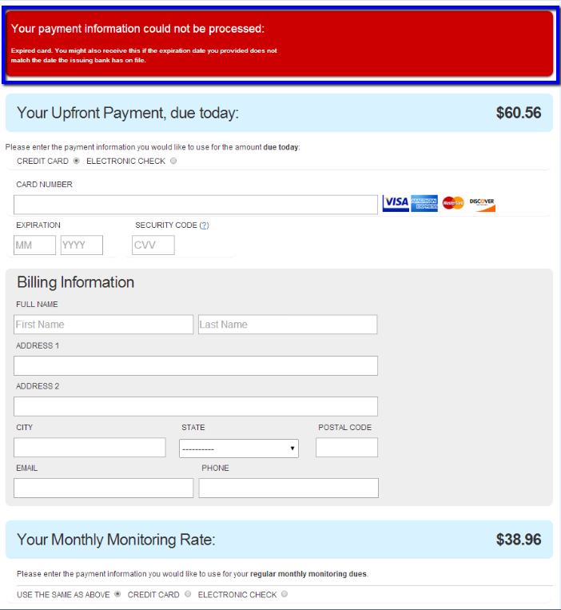
EXAMPLE

Slide 6

RE-WALKS
Re-walks occur when the original agreement needs to be changed and the order has not already shipped.
Some Examples are:
Customer decides on a different package
Customer wants to add additional equipment
In the event a re-walk is necessary, the customer may see an additional pending charge on their account.

Slide 7

QUESTIONS

