Slide 2
Z-Wave Equipment Training

Slide 3
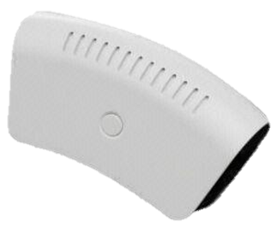
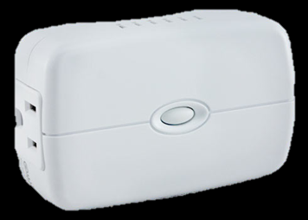
Z-Wave Equipment Overview
Z-Wave is wireless communication, which operates at a low power radio frequency (roughly 900 MHz), that allows for home automation control through remote control applications.
In this training course, we will examine two Z-Wave devices currently offered at Protect America, Inc.
Z-Wave Fluorescent & Appliance Module
Z-Wave Dimmer Lamp Module

Slide 4
Z-Wave Fluorescent & Appliance Module
“Extension device added to an appliance allowing the customer to control the on/off mode remotely.”
Specifications:
Model Number: ZW4101-WCS
Power: 120V AC
Distance Range: 25 meters/82 feet (depending on the environment)
Size (LxWxD): 8.2’” x 7.5” x 2.5”
Weight: 0.45lb
Operating Temperature: 32°F – 104°F

Slide 5
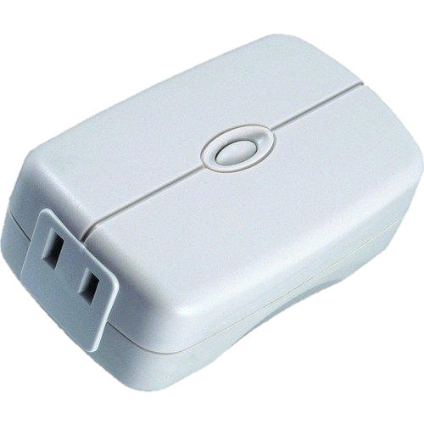
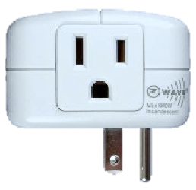
Anatomy of Z-Wave Fluorescent & Appliance Module
Z-Wave Controlled Outlet
Outlet
On/Off Push Button
The Z-Wave Fluorescent and Appliance Module is capable of controlling the on/off mode of everyday appliances such as crock pots, coffee makers, TVs, etc...
This device is capable of supporting incandescent lamps, however it does NOT provide dimmer capabilities.

Slide 6
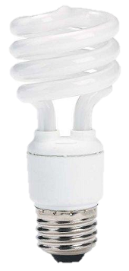
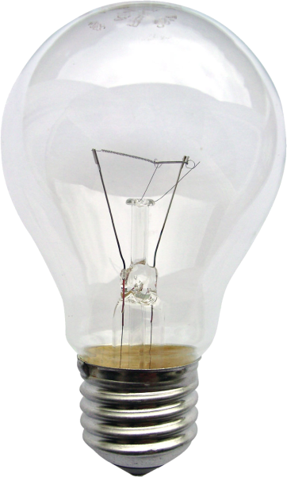
Fluorescent Light Bulbs vs. Incandescent Light Bulbs
Fluorescent Light Bulb
A light bulb that uses the process of “fluorescence” (absorption of light and other electromagnetic radiation) to produce visible light.
Incandescent Light Bulb
A light bulb that produces light with a filament wire heated to a high temperature by an electric current passing through it, until it glows.

Slide 7
Z-Wave Dimmer Lamp Module
“Extension device added to a lamp allowing the customer to control the on/off mode of the lights remotely.”
Specifications:
Model Number: ZDS-100US
Power: 120V AC
Distance Range: 65 feet (depending on the environment)
Size (LxWxH): 4.5” x 2.7” x 1.6”
Weight: 0.40lb
Operating Temperature: 32°F – 104°F

Slide 8
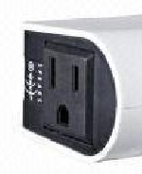
Anatomy of Z-Wave Dimmer Lamp Module
Outlet
Z-Wave Controlled Outlet
On/Off Push Button
The Z-Wave Dimmer Lamp Module does not support any fluorescent or LED lamps.
Let’s program these Z-Wave products into the Interactive Platform!

Slide 9
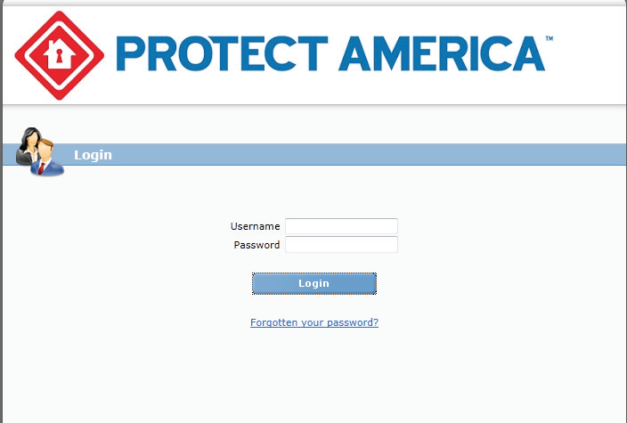
Z-Wave Equipment Installation
Important Prerequisite Information:
Customer must have Interactive Services with a Z-Wave enabled Resolution module.
Ensure the customer’s Interactive account has been created.
Z-Wave Fluorescent Light & Appliance Module does not support the dimmer feature.
Step 1:
Plug the Module into an electrical outlet that is
not controlled by a switch.
Step 2:
Have the customer visit
www.protectamericainteractive.com
and log into the webpage.

Slide 10
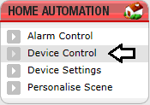
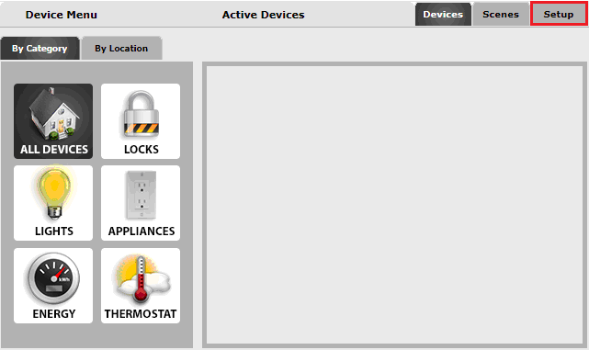
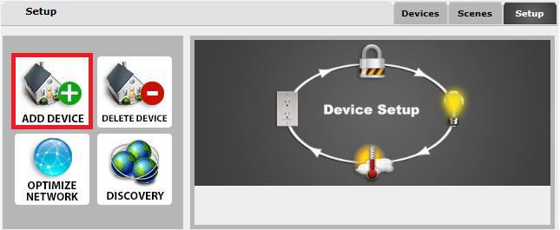
Z-Wave Equipment Installation
Step 3:
After logging into the webpage,
the customer will select Device Control.
Step 4:
The customer will then select Set Up,
then Add Device.

Slide 11
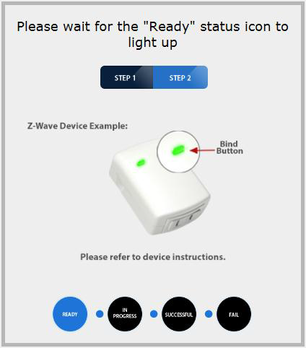
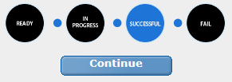
Z-Wave Equipment Installation
Step 5:
Once the system is Ready (turns blue),
trip the sensor by hitting the button twice quickly
on the face of the sensor
Step 6:
When prompted to continue,
select the Continue button on the webpage.

Slide 12
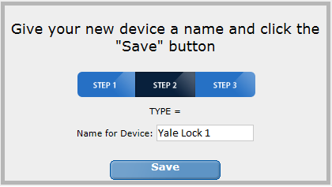
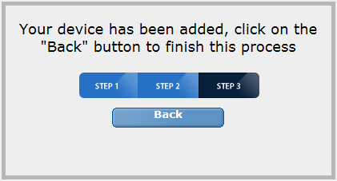
Z-Wave Equipment Installation
Step 7:
Name the Module the appropriate device name and select Save.
Step 8:
Select Back to exit or start a new device.
Congratulations, you have successfully installed a Z-Wave Equipment!

Slide 13
Managing the Z-Wave Fluorescent & Appliance Module
Under Devices on the Interactive Platform, the customer can manage the On/Off status of the lights.
Have the customer plug a fluorescent lamp into the module ensuring the lamp is in the On position.
On the Interactive Platform, select Off to turn the lamp On,
and On to turn the lamp Off.
Pressing the button on the module gives manual control over the lamp’s On/Off feature.

Slide 14
Managing the Z-Wave Dimmer Lamp Module
Under Devices on the Interactive Platform, the customer can manage the On/Off status of the lights as well as the dimmer capabilities.
Have the customer plug an incandescent lamp into the module ensuring the lamp is in the On position.
On the Interactive Platform, select Off to turn the lamp On,
and On to turn the lamp Off.
The customer can use the Slide feature to customize the dimmer feature.
Pressing the button on the module gives manual control over the lamp’s On/Off feature.

Slide 15
CMS Connect Training
Any Questions?

