Slide 1
PIP4004 - INTERNSHIP Final Review Presentation PRODUCT & ECOSYSTEM DEVELOPMENT LEAD AT CUBANE (A PRODUCT OF JITOSHI TECHNOLOGY PVT LTD)
Student Details
Name | MOHAMMED FAIZAN
Roll No | 20211CCS0041
Section | 8-CCS-02
Batch No.
Under the Supervision of,
Dr. Syed Siraj Ahmed
Associate Professor
School of Computer Science and Engineering
Presidency University
Name of the Program: B.Tech Computer Science and Engineering (Cyber Security)
Name of the HoD: Dr. S P Anandraj
Name of the Program Project Coordinator: Dr. Sharmasth Vali Y
Name of the School Internship/Project Coordinators: Mr. Md Ziaur Rahman /
Dr. Sampath A K / Dr. Abdul Khadar A

Slide 2
Content
About Company or Organization
Working domain or the technology
About your team and reporting Manager
Challenges Faced in Internship
Objectives of the work
Problem Statement
Proposed System
Advantages of Proposed System/Work
Internship Roadmap
Github Link

Slide 3
About Company
Company Name : Cubane (Product of Jitoshi Technology Pvt Ltd)
Cubane is transforming SaaS infrastructure with its innovative Layer-1 blockchain, designed to address the unique challenges faced by industries such as insurance, media intellectual property rights (IPR), and beyond.
Distinct from traditional blockchains, Cubane integrates a SaaS-like model, providing modular tools that allow businesses to easily adopt decentralized technology. At its core is the Cubic Consensus Mechanism (CCCM), a cutting-edge architecture that combines parallel transaction validation with advanced privacy features, including Fully Homomorphic Encryption (FHE) and Zero-Knowledge Proofs (ZKPs).
This powerful combination ensures unparalleled scalability, fault tolerance, and security, enabling the processing of thousands of transactions per second with minimal latency. Cubane’s no-code platform and multi-language support also make decentralized app development accessible to everyone, bridging the gap between blockchain complexity and enterprise needs.
By enabling industries to tap into the trust and transparency of blockchain technology without compromising on usability or performance, Cubane is redefining the intersection of SaaS and blockchain.

Slide 4
Cubane’s Beginnings
Cubane originally began as Chatbuck, a messaging dApp designed to push the boundaries of decentralized communication. The goal was simple: to create a platform where privacy and security were at the forefront, leveraging blockchain to ensure users’ conversations were protected from centralized control. However, as the project progressed, it quickly became clear that the challenges went beyond the app itself.
Scalability issues, a fragmented developer ecosystem, and a lack of infrastructure made it difficult to bring the vision to life. The more the team dug into the problem, the more they realized that the root issue wasn’t just about building a messaging app—it was about creating the foundational infrastructure to support decentralized applications on a larger scale.
This realization led to a shift in direction. Instead of focusing solely on the messaging app, the team decided to build something bigger: a Layer-1 blockchain that would be scalable, developer-friendly, and versatile enough to solve real-world problems across various industries. And so, Chatbuck evolved into what is now Cubane—a robust blockchain solution designed to empower developers and unlock the true potential of decentralization.

Slide 5
Cubane’s Presence in Web3 Ecosystem
Cubane launched its Web3 community, Ubiqwity, in August 2022, with WhatsApp as the primary community channel. The goal was to simplify Web3 for beginners and encourage blockchain adoption.
Ubiqwity was one of the first communities to leverage Whatsapp as a medium before Community feature was even introduced in Whatsapp
Ubiqwity was recognised by Nas Daily in March 2023 as one of India’s Top Performing Whatsapp Communities and invited to Mumbai for Nas.io Launch Event
Ubiqwity has been invited to many events as Official Community Partner like India Blockchain Week 2024, Web3 Carnival and hackathons like ScrollHacks by Devfolio and in Web3 Events in 2025 IIT Delhi Web3 Entrepreneurship, Web3 Enclave in Govt Engineering College Wayanad
Cubane has an active Web3 Ecosystem of 5K+ active users

Slide 6
Working domain or the technology
Job Role : Product & Ecosystem Development Intern
Responsibilities :
Assist in researching and analyzing emerging technologies, protocols, and tools relevant to Cubane’s product development. •
Work with the technical team to brainstorm, implement, and optimize technical solutions for product challenges. •
Contribute to technical documentation, including writing user guides, FAQs, and internal reports on product development progress. •
Assist in the development and maintenance of user interfaces for Cubane products.
Assist in identifying and building relationships with potential partners, investors, and backers to expand Cubane's network and opportunities.
Contribute to community building and engagement strategies.

Slide 7
About your team and reporting Manager
Cubane’s Tech Team is dedicated to innovating and optimizing decentralized solutions in the SaaS and blockchain space. Each team member brings specialized expertise, ensuring scalable, secure, and high-performance solutions.

Slide 8
About my team and reporting Manager
Supervisor:
Mr. Tuphan Banerjee (Co-Founder & CMO): Spearheading Cubane’s vision and business strategy, guiding product-market fit and expanding Cubane's presence. Tech Team Core Members :
1. Amit Sagar (Blockchain Architect & CCM Advisor): Designing and advising on Cubane's Cubic Consensus Mechanism to ensure scalability and security.
2. Utkarsh Mahajan (Blockchain Developer): Developing and optimizing blockchain solutions, ensuring secure and scalable blockchain infrastructure.
3. Dr. Rahat Khan (Cryptography and FHE Advisor): Providing expert guidance on cryptographic innovations, including Fully Homomorphic Encryption (FHE) and advanced privacy protocols.

Slide 9
Challenges Faced in Internship
Understanding Tech Stack
Team Communication
Imposter Syndrome & Adjusting to Fast Paced Work Environment

Slide 10
Objectives of the work
Assist in researching and analyzing emerging technologies, protocols, and tools relevant to Cubane’s product development. •
Work with the technical team to brainstorm, implement, and optimize technical solutions for product challenges. •
Contribute to technical documentation, including writing user guides, FAQs, and internal reports on product development progress. •
Assist in identifying and building relationships with potential partners, investors, and backers to expand Cubane's network and opportunities.
Contribute to community building and engagement strategies.

Slide 11
Problem Statement
As blockchain technology continues to gain widespread adoption, there is a growing need for scalable, privacy-preserving, and flexible consensus mechanisms that can handle high-performance requirements. Existing blockchain solutions face challenges in maintaining efficiency and reducing bottlenecks when validating large volumes of transactions, particularly in industries like insurance, communication, and SaaS development, where performance, privacy, and adaptability are critical.
The current landscape of consensus algorithms is often limited by slow transaction throughput and centralized points of failure, which hinder the overall scalability and flexibility of the blockchain. Therefore, there is a need for a novel consensus mechanism that addresses these challenges while enabling faster, more efficient transaction validation, and ensuring that privacy requirements are met.

Slide 12
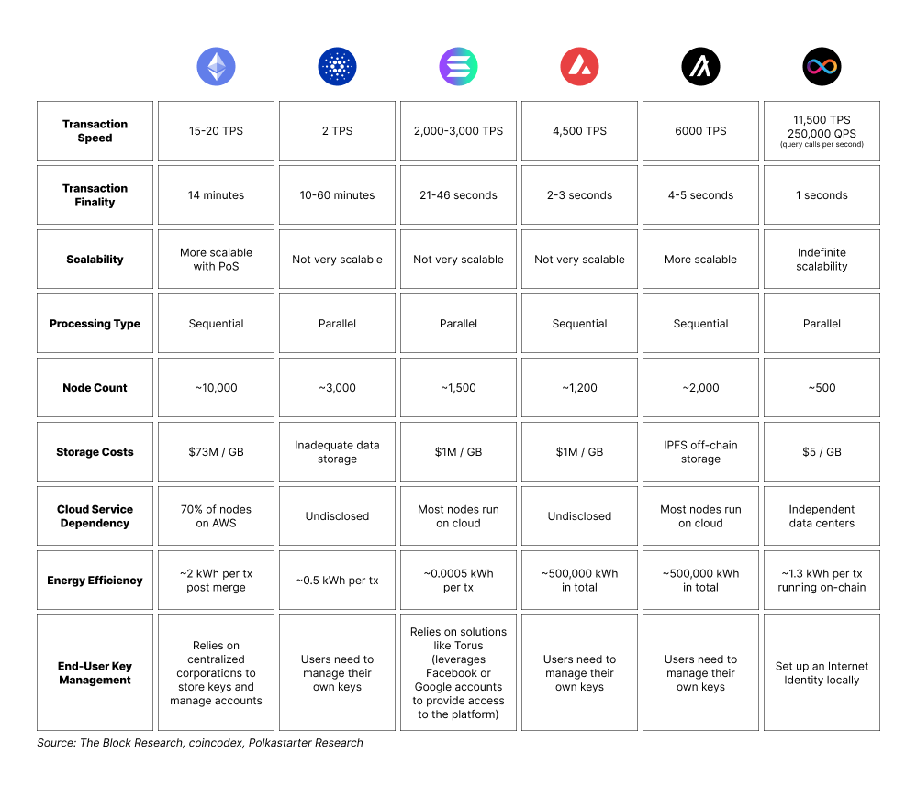

Slide 13
Proposed System / Work
Cubane Cubic Consensus Mechanism : The Cubane Cubic Consensus Mechanism (CCCM) offers a unique solution by integrating parallel transaction validation across modular "Cubes" within the Cubane Layer-1 blockchain. This approach enhances scalability and throughput while reducing bottlenecks. By involving Coordinator Nodes for final block validation, CCCM ensures network-wide consensus without sacrificing security or privacy. CCCM is designed to cater to high-performance industries, such as insurance, communication, and SaaS development, providing an innovative solution for blockchain applications requiring scalability, privacy, and flexibility.

Slide 14
Proposed System / Work
ZKP Integration for Privacy: CCCM incorporates Zero-Knowledge Proofs (ZKPs) to enable privacy-preserving transaction validation. ZKPs allow validators to verify the correctness of transactions, such as balance transfers, without exposing sensitive information. This feature makes CCCM particularly well-suited for sectors where confidentiality is critical, such as SaaS solutions handling sensitive financial or healthcare data.

Slide 15
Proposed System / Work
Coordinator Nodes for Finalization: After validation within the Cubes, the Coordinator Nodes handle block finalization. These nodes ensure the correct final state of the blockchain is broadcasted to the network while maintaining modularity, allowing the consensus logic to evolve without overhauling the entire system.

Slide 16
Advantages of Proposed System/Work
Parallelization: CCCM’s ability to validate transactions across multiple Cubes in parallel vastly improves throughput, addressing one of the main limitations of PoW and PoS, where transaction validation is sequential.
ZKP for Privacy: CCCM’s built-in Zero-Knowledge Proofs ensure privacy without sacrificing security, which PoW and PoS lack by default. This privacy is critical for SaaS platforms handling sensitive data.

Slide 17
Advantages of CCCM for SaaS Development
High Transaction Throughput & Scalability: CCCM supports parallel transaction validation, enabling SaaS applications to handle large volumes of transactions efficiently, even in high-traffic environments.
Privacy-Preserving Capabilities: With Zero-Knowledge Proofs (ZKPs), CCCM ensures that sensitive transaction data remains confidential, making it ideal for SaaS in sectors like finance, healthcare, and legal.
Modularity for Customization: CCCM's modular structure allows SaaS developers to easily customize or replace system components, enabling rapid innovation without a complete system overhaul.

Slide 18
Advantages of CCCM for SaaS Development
Transparent Auditing & Compliance: CCCM provides an immutable transaction record, facilitating easier audits and regulatory compliance, building trust with customers in regulated industries.
Cost Efficiency & Micropayments: CCCM supports smart contracts for automated payment models (e.g., pay-per-use or subscriptions), reducing intermediary costs and enhancing cost-efficiency for SaaS providers and users.

Slide 19
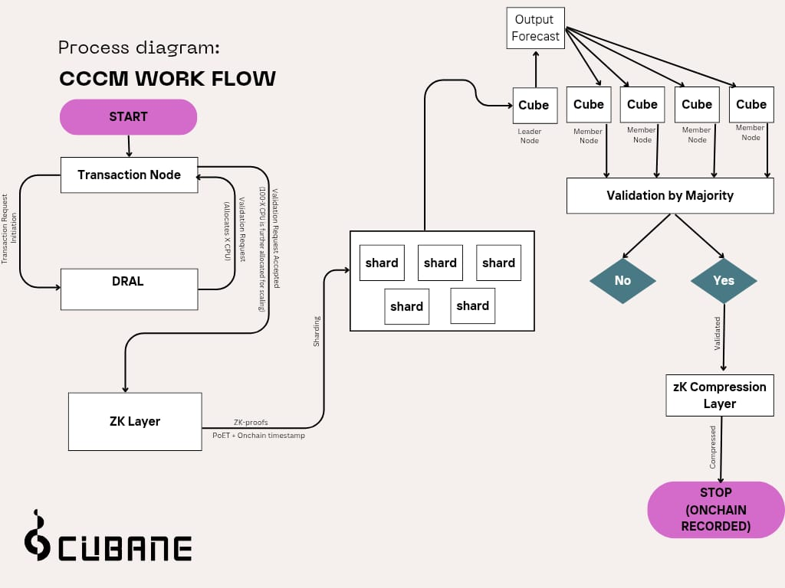
CCCM Flow Diagram

Slide 20
Other Tasks in Internships
Part of Team responsible for Writing smart contract for CUBS Token Smart Contract and deployment
Part of Team in forming strategic partnerships with Technology companies

Slide 21
Internship Road Map
Note: Please note that the roadmap is subject to change based on evolving priorities, new developments, or feedback from the team and stakeholders. Adjustments may be made to ensure alignment with the company’s strategic goals and product development needs.
Review 0
Review 1
Review 2
Review 3
Understanding Cubane's blockchain technology and SaaS integration. Foundational understanding of the company’s direction, product offerings, and internal workflows.
Applying knowledge and assist in research tasks, documentation, and understanding emerging technologies relevant to Cubane’s growth.
Assist in finalizing the CCCM concept note and whitepaper v2, while collaborating with stakeholders to refine Cubane’s vision and strategy, demonstrating skills in strategic planning and tech communication.
Working on the Website rebranding and deployment of CUBS and working towards the next phase of CCCM

Slide 22
Github Link
https://github.com/fai2an/CubaneInternship

Slide 23
Other Links
https://cubane.notion.site/CCCM-Concept-Note-0f96ffa4275d4e57a39ef15e9bfb38c1

Slide 24
Thank you !!

