Slide 1
Memory Management/Allocation
Teams are ALLOWED
Max 2 (from OS course, any section)
Nov 12th (2 weeks)
First Fit, Best Fit, Next Fit
Capturing statistics on the state of the memory
Deliverable consists of a brief 1-2 page write-up showing the statistics, along with the source code files

Slide 2
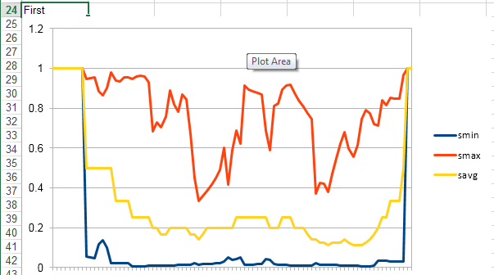
First Fit Example Trace

Slide 3
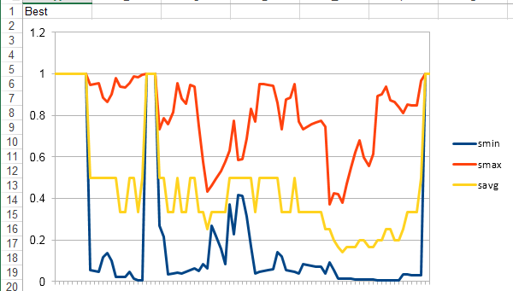
Best Fit Example Trace

