Slide 1
AUDIO PATTERN RECOGNITION
A Real-Time Music
Identification System
Complex Engineering Project — Signals and Systems
ISLAMIC UNIVERSITY OF TECHNOLOGY (IUT)
Presented by:
M Faiad Faisal Sarthok (220021116) • Abdullah Al Jubayer (220021151)
Md. Fardin Jahan (220021235) • Modou Barrow (220021165)
Notes:
[~15 sec]
Assalamu Alaikum / Good morning. I'm [name], and I'll be presenting our Complex Engineering Project — a real-time audio recognition system, built entirely in MATLAB, that identifies a song from a short microphone recording.

Slide 2
Our Goal
Given a 52-song reference playlist, identify any song from a short, live microphone recording — in real time, despite background noise.
01
Build a fingerprint database
02
Match live audio in real time
From 52 reference songs — 51 successfully processed.
Robust to noise, room acoustics, and mic quality.
03
Deliver a working GUI
04
Evaluate honestly
Recording, matching, playback — end to end.
Controlled tests and real-world microphone tests.
Audio Pattern Recognition System
2
Notes:
[~30 sec]
The brief was simple to state, hard to build: given a 52-song playlist, identify any song from a short live mic recording, in real time. That meant four things — build a fingerprint database, match live audio reliably, wrap it in a working interface, and actually test it honestly, not just assume it works.

Slide 3
Step 1 — Acquiring the Reference Database
yt-dlp + ffmpeg
The first task was building a reference database from 51 songs (of the 52 given — one was blocked by a copyright claim). We used automated scripts to download each track and convert it directly to .WAV.
yt-dlp
ffmpeg
51 songs
Extracts audio
from YouTube
Converts to
.WAV format
Ready for
fingerprinting
WHY .WAV, NOT .MP3?
WAV is lossless and uncompressed. MP3 compression discards frequency information the human ear barely notices — but our peak-extraction algorithm depends on exactly that information. Compression artifacts would distort the spectrum and quietly ruin fingerprinting accuracy before we even began.
Audio Pattern Recognition System
3
Notes:
[~50 sec]
First task: acquiring the database. We wrote automated scripts using yt-dlp to pull audio directly from the reference playlist, then ffmpeg to convert everything to WAV — not MP3. This mattered: WAV is lossless and uncompressed. If we'd used MP3, the compression would strip out exactly the frequency detail our peak-extraction depends on — we'd be quietly damaging our own data before the algorithm even ran. 51 of the 52 songs made it through; one was blocked by a copyright claim on the source video.

Slide 4
Step 2 — Offline Signal Processing Pipeline
Every WAV file goes through the same five-stage pipeline before it becomes a fingerprint.
Mono
8000 Hz
Pre-emphasis
Spectrogram
Hash Key
PRE-EMPHASIS FILTER
Boosts high-frequency detail before the spectrogram is computed — otherwise sparse instrumental content gets buried under bass-heavy energy.
y[n] = x[n] − 0.95 x[n−1]
Downsampling to 8 kHz cuts computation by 6× with no real loss — music's identifying content lives well under the 4 kHz Nyquist limit anyway.
Audio Pattern Recognition System
4
Notes:
[~55 sec]
Once we have the WAV files, they go through five stages. First, convert to mono and downsample to 8000 Hz — that alone cuts our computation by a factor of six, since the frequencies that matter for identifying music sit well below that range anyway. Then we apply a pre-emphasis filter — this exact equation, y[n] equals x[n] minus 0.95 times the previous sample — which boosts high frequencies so quieter instrumental detail doesn't get buried under bass. Then we generate a spectrogram, and finally extract the loudest peaks and turn them into a hash key — which is what the next slide is about.

Slide 5
What Is a “Hash”, Exactly?
The spectrogram gives us hundreds of loud “landmark” peaks. We don't hash them one at a time — we pair each peak with a nearby one that follows it in time.
frequency ↑
f₂ (target)
H(f₁, f₂, Δt)
Δt
= f₁×10⁶ + f₂×10³ + Δt
one 64-bit number, unique to this exact peak pair
f₁ (anchor)
time →
Why pairs, not single peaks? Two unrelated songs sharing one frequency by coincidence is common. Two songs sharing an entire frequency pair and exact timing gap is extremely unlikely — that's what makes each hash specific.
Audio Pattern Recognition System
5
Notes:
[~40 sec]
So what is a hash, exactly? Every song's spectrogram gives us hundreds of loud peaks. We take each peak, pair it with a nearby one that comes shortly after it in time, and encode that pair — both frequencies plus the time gap between them — into a single number. Why pairs and not single peaks? Because two unrelated songs sharing one frequency by coincidence happens all the time. Two songs sharing an entire frequency pair AND the exact same timing gap is extremely unlikely. That's what makes each hash specific enough to be useful.

Slide 6
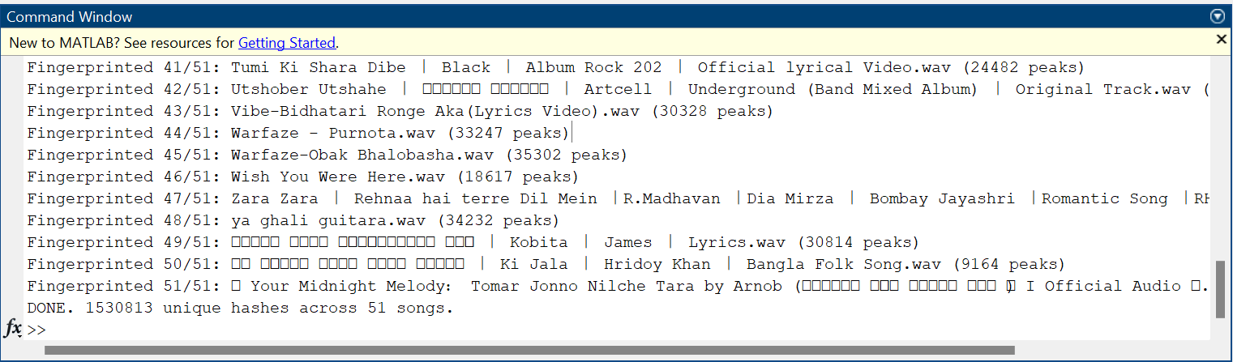
Console Output of our database construction process
Showing the per song peak count & total unique hash count :
→
Audio Pattern Recognition System
5
Notes:
[~40 sec]
So what is a hash, exactly? Every song's spectrogram gives us hundreds of loud peaks. We take each peak, pair it with a nearby one that comes shortly after it in time, and encode that pair — both frequencies plus the time gap between them — into a single number. Why pairs and not single peaks? Because two unrelated songs sharing one frequency by coincidence happens all the time. Two songs sharing an entire frequency pair AND the exact same timing gap is extremely unlikely. That's what makes each hash specific enough to be useful.

Slide 7
How Matching Actually Works
The core of the whole system
Every hash from the live recording is looked up in the database. A random shared hash isn't proof of a match — so for each hit, we calculate the time offset between the live peak and the database peak.
votes ↑
CONFIDENCE SCORE
time offset →
True matches share ONE consistent time offset — every correct hash “votes” for the same bar, creating a massive spike. Coincidental matches scatter randomly across every offset. The height of the tallest spike is the confidence score you see on screen.
Audio Pattern Recognition System
6
Notes:
[~80 sec — take your time here, this is the slide they'll remember]
This is the most important part of the whole system, so let me slow down. Every hash from what you just recorded gets looked up in our database. But a shared hash alone isn't proof — hash collisions happen by chance too. So for every single match, we calculate the time offset: how far apart is this peak in the live recording versus where it sits in the candidate song. Here's the key insight: if it's a genuine match, EVERY correct hash agrees on the same offset — because the live clip is just a time-shifted slice of the original recording. That creates this massive spike you see here. Coincidental, wrong matches don't share that agreement — they scatter randomly across every possible offset, staying low. So we just pick whichever offset has the tallest spike. And that spike's height is literally the confidence score displayed on our app. This is the same core idea real Shazam uses.

Slide 8
A Quick Word on Recommendations
Once a song is identified, we also suggest three acoustically similar tracks — a lightweight bonus feature.
01
Two simple features per song
02
Nearest 3 by distance
Spectral centroid (brightness) and zero-crossing rate (percussiveness) — computed once, during database building.
Euclidean distance between feature values — the 3 closest songs become the recommendations.
No genre labels needed — just numbers computed directly from the audio itself.
Audio Pattern Recognition System
7
Notes:
[~25 sec]
One small bonus feature: once a song is identified, we recommend three similar tracks. Nothing fancy — we compute two simple numbers per song when we build the database, brightness and percussiveness, and just pick whichever three songs are numerically closest to the one you found. No genre data needed.

Slide 9
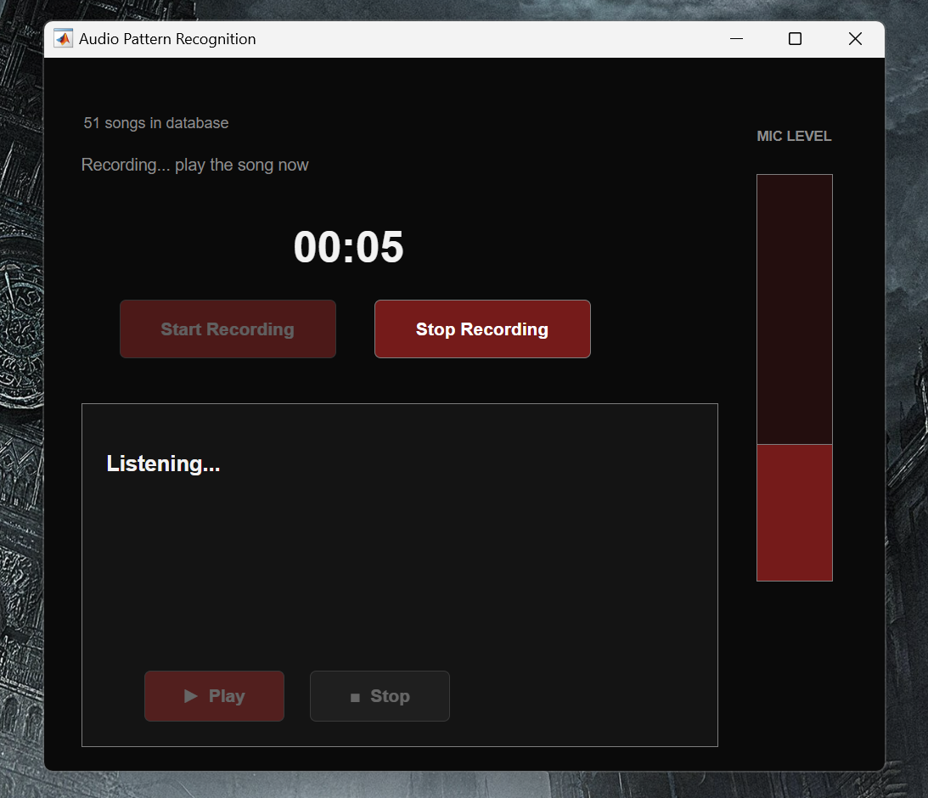
How Our GUI Looks
Graphical Interface during active recording, with the live mic level:Graphical interface showing a successful match, confidence score, and recommended tracks
Audio Pattern Recognition System
7
Notes:
[~25 sec]
One small bonus feature: once a song is identified, we recommend three similar tracks. Nothing fancy — we compute two simple numbers per song when we build the database, brightness and percussiveness, and just pick whichever three songs are numerically closest to the one you found. No genre data needed.

Slide 10
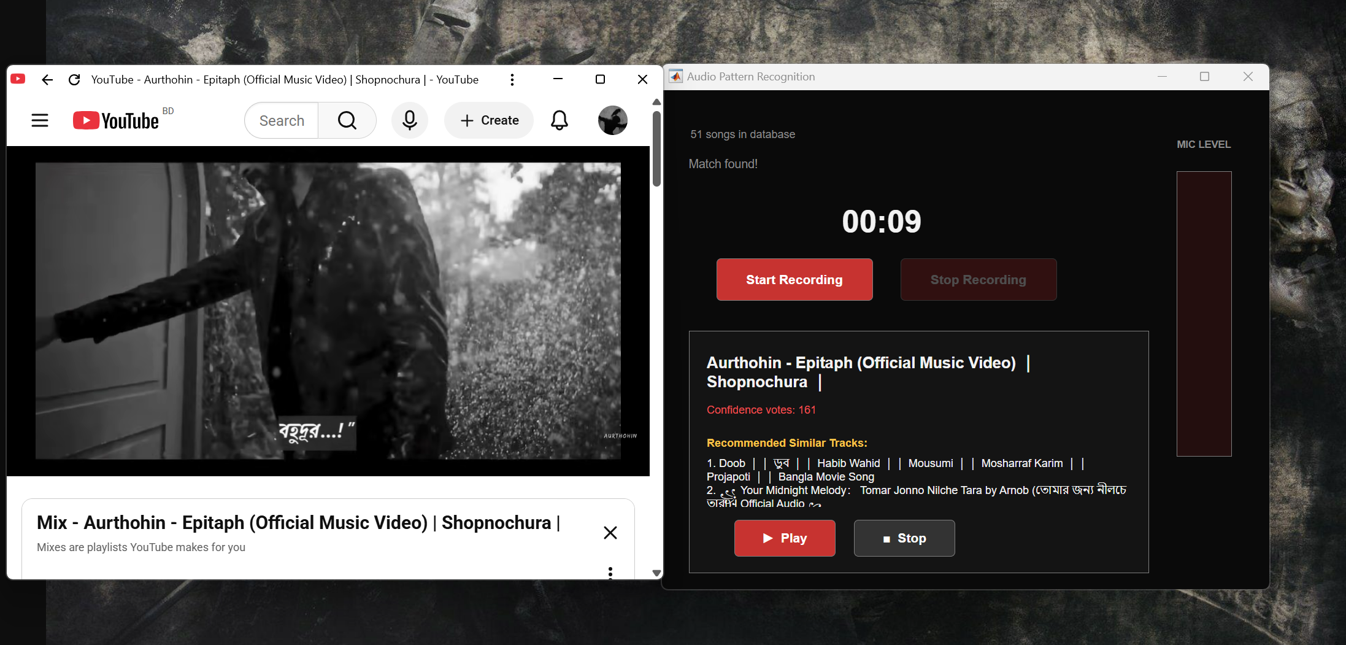
How The Whole Thing Looks
Graphical Interface showing a successful match, Succeessful match & Confidence Score :Graphical interface showing a successful match, confidence score, and recommended tracks
Audio Pattern Recognition System
7
Notes:
[~25 sec]
One small bonus feature: once a song is identified, we recommend three similar tracks. Nothing fancy — we compute two simple numbers per song when we build the database, brightness and percussiveness, and just pick whichever three songs are numerically closest to the one you found. No genre data needed.

Slide 11
Why Doesn't It Work for Humming?
A limitation we chose deliberately
01
Our hashing needs dense, layered peaks
Constellation hashing works because a real recording is polyphonic — vocals plus multiple instruments stacked together, giving hundreds of strong, stable peaks per second.
02
Humming is monophonic and inconsistent
A single hummed note carries far fewer peaks — and no two humans hum the same melody at the same pitch or tempo twice.
03
The real fix (DTW) is too slow for this
Matching hummed melodies needs Dynamic Time Warping over pitch contours — accurate, but far too computationally heavy for real-time MATLAB.
We chose accuracy and real-time speed over humming support — a deliberate, documented engineering trade-off, not an oversight.
Audio Pattern Recognition System
8
Notes:
[~55 sec — answer this confidently if asked, it shows you understand the trade-off]
A fair question: why doesn't this work if I hum the tune instead of playing the song? Our hashing method needs dense, layered peaks — a real recording is polyphonic, vocals and instruments stacked together, giving hundreds of strong peaks. Humming is monophonic, one note at a time, and no two people hum the same melody at exactly the same pitch or tempo twice — so the peaks wouldn't line up at all. The actual fix for humming is a completely different technique — Dynamic Time Warping over pitch contours — but that's far too computationally heavy to run in real time in MATLAB. So this wasn't something we missed — we deliberately chose accuracy and speed for the primary use case over supporting humming.

Slide 12
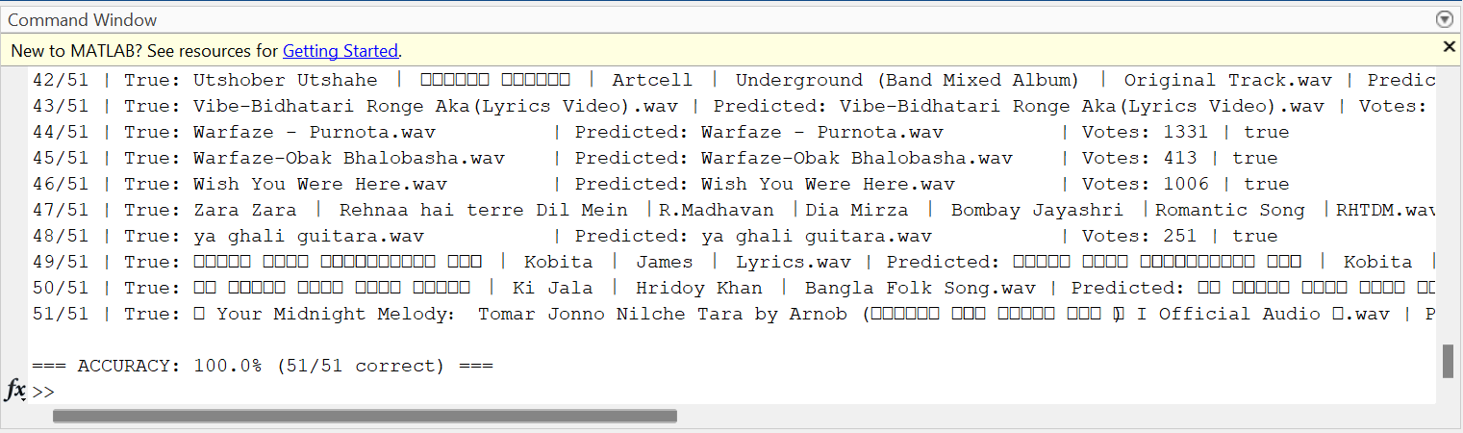
Results
100%
✓
Vocal segments: reliable
Identified consistently within 5–10 seconds — real-world, not just lab conditions.
CONTROLLED-TEST ACCURACY
!
Instrumental-only: harder, and we know why
51 / 51 songs correctly identified
Confirmed with two different microphones — traced to vocal-forward mixing in commercial music, not a system flaw.
Full output of the automated accuracy test:a successful match, confidence score, and recommended tracks
Insert fig6_accuracy_console.png here
(full automated test output — optional)
Audio Pattern Recognition System
9
Notes:
[~45 sec]
On results: an automated test using clean clips pulled directly from our own database — no mic involved — got 100%, 51 out of 51. That confirms the core algorithm is correct. Real-world microphone testing was reliably strong on anything with vocals. Instrumental-only sections were harder — but we actually investigated why, tested it with two completely different microphones, and traced it to how music is mixed, not a bug in our system.

Slide 13
THANK YOU
Questions?
51 songs · 100% controlled accuracy · real-time matching · built end-to-end in MATLAB
Notes:
[~20 sec]
That's the system — a complete pipeline from a 52-song playlist to real-time identification, 100% accurate under controlled testing, and honest about exactly where and why it's weaker in the real world. Thank you — happy to take questions. If you're unsure of an answer, it's fine to pause and think rather than rush.

