Slide 1
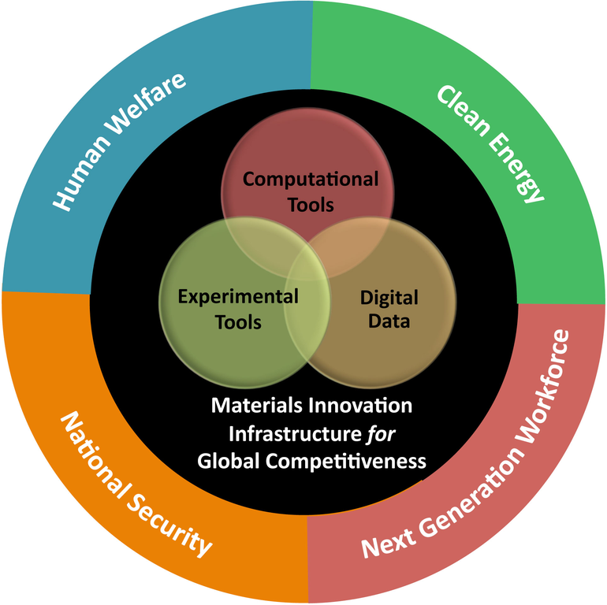


A Cloud Service to Record Simulation Metadata
Faical Yannick Palingwende Congo
July 8, 2015

Slide 2
Reproducible Research
Terminology:
  Reproducible
  Repeatable
  Replicable
Recording requirements & approaches:
  Workflows
  Libraries
  Event Control

Slide 3
Motivation
Reproducible Record Atom
  Record metadata is not enough.
  Not easy to go from metadata to a repeat.
  Not always easy to get all the metadata.
  Record Atom: Easy repeats and reproductions.
Cloud Service for record atoms
  Record metadata need easy sharing.
  Cloud arena for research collaborations.

Slide 4
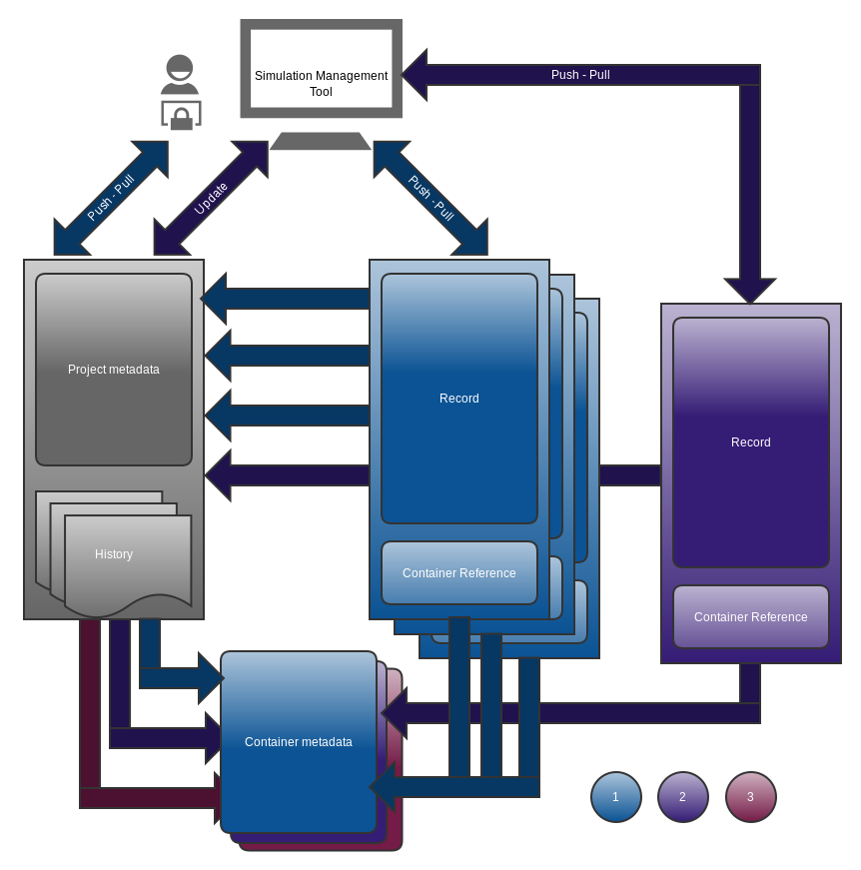
Project-Container-Record
Project Management
  Metadata push on creation.
  Versioning through history of containers per each major updates on sync.
  Relation one to many with the Record and Container.
Record Management
  Meta data push on creation.
  Related to a project and a container in the history.
  Relation many to one with Project and Container.

Slide 5
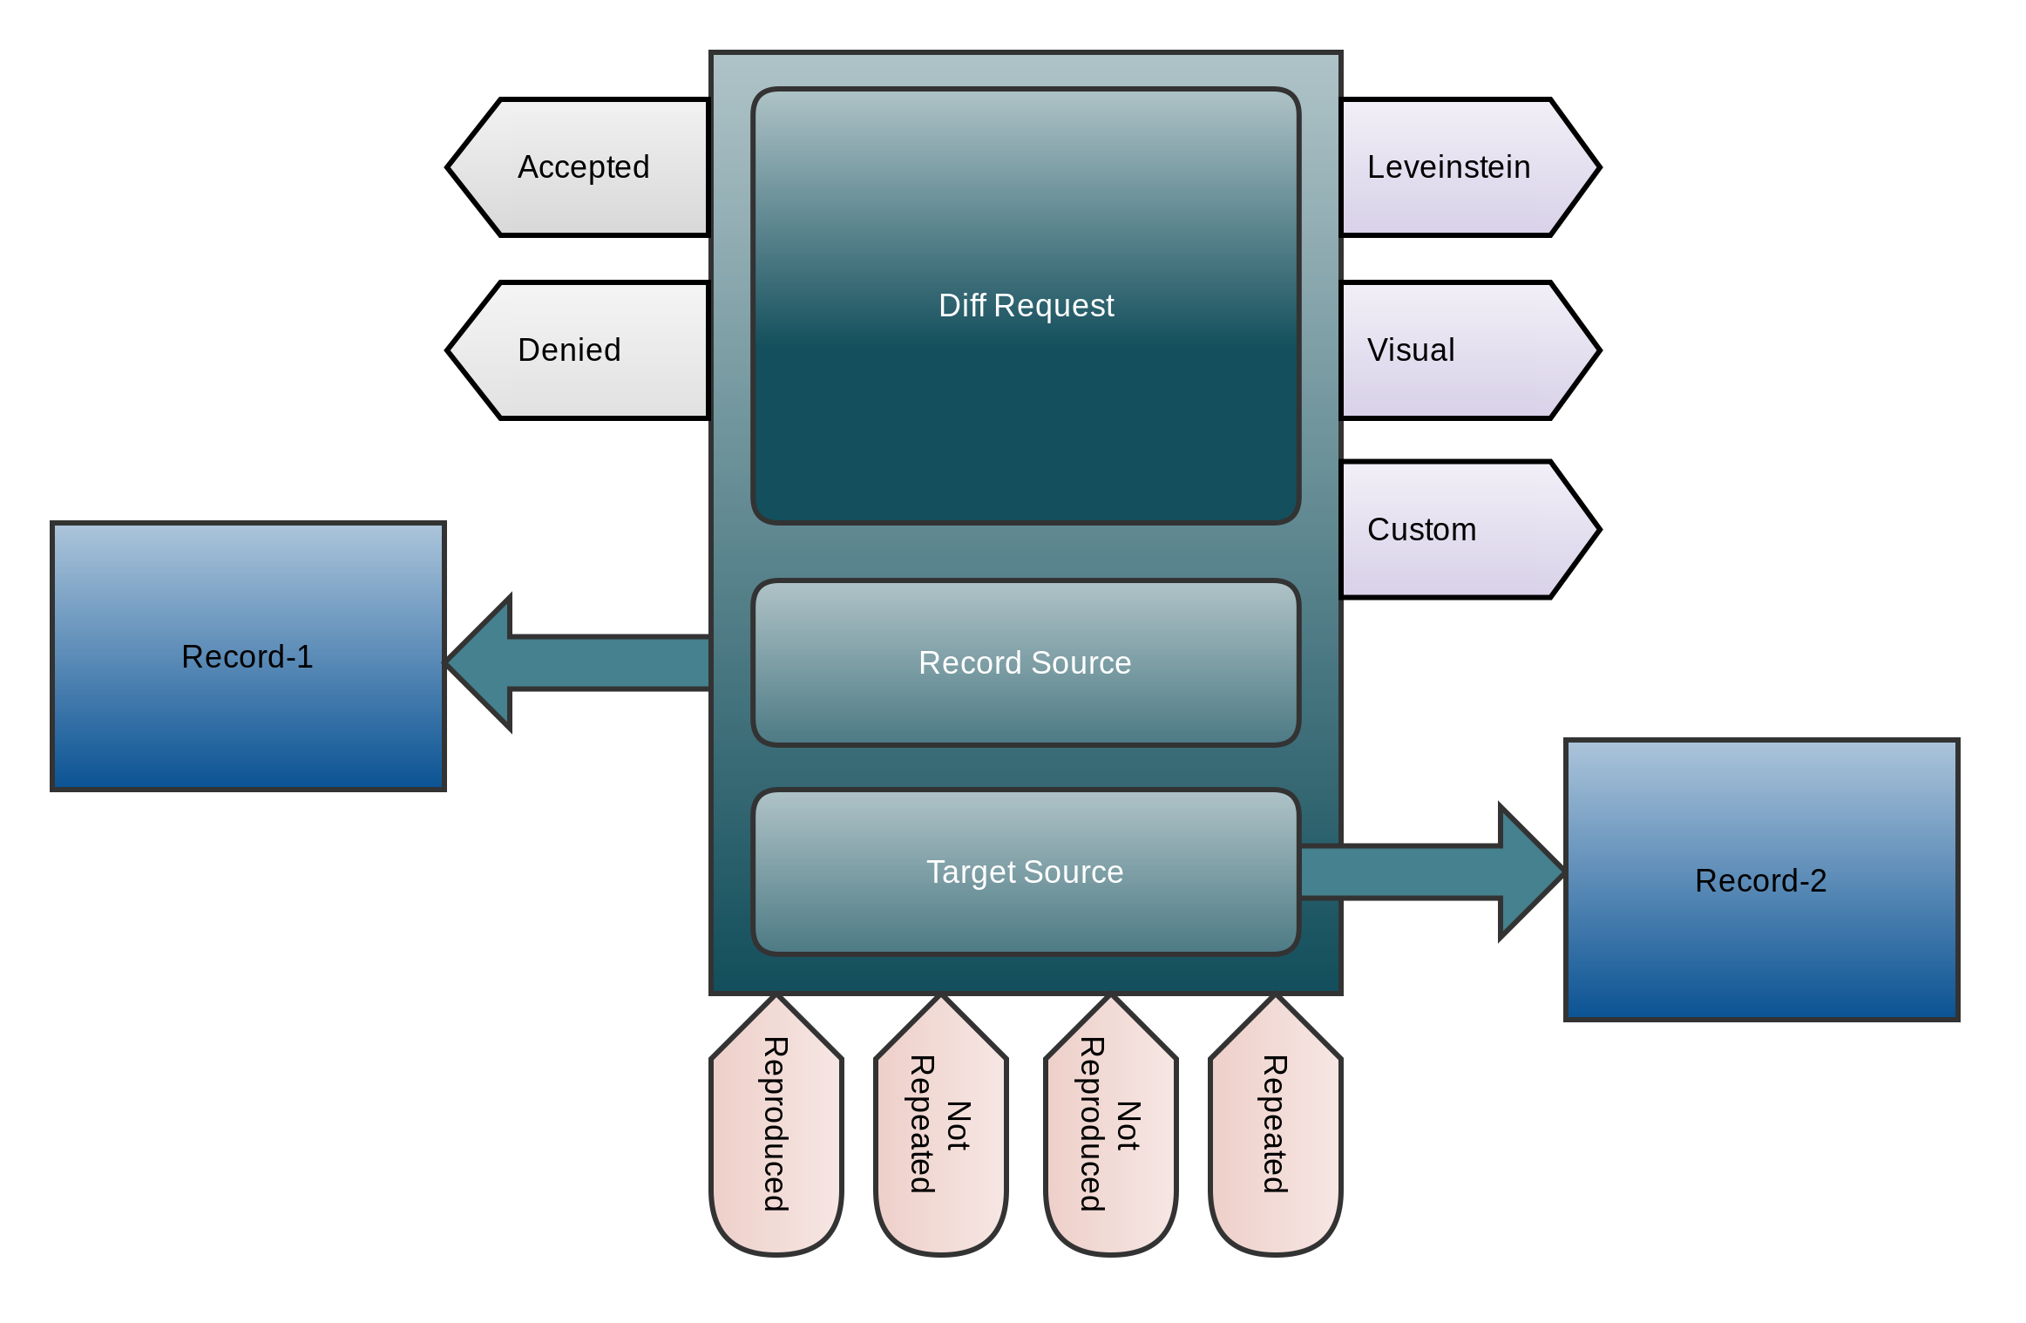
Collaboration Entity
Status:
  Accepted
  Denied
Method:
  Leveinstein
  Visual
  Custom
Assessment:
  Repeated
  Reproduced
  Not Repeated
  Not Reproduced
Record and Project Reproducibility assessment
Cloud interaction on Project from record atoms

Slide 6
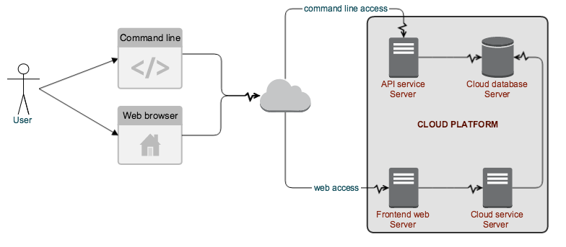
Reproducible Record Atom Cloud Service
Record and Project Reproducibility assessment
Cloud interaction on Project from record atoms

Slide 7
Usage Requirements
Simulation Management Tool
  Implement the API access to the platform.
  Container generation and push during runs.
  On the fly updates on execution state.
Scientist Simulation
  Create an account and get API key.
  Wrap simulation in Container.
  Use a supported simulation management tool.

Slide 8
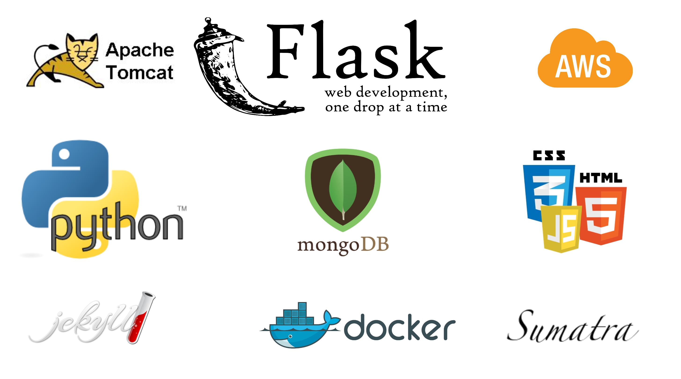
Platform Status and Technologies

Slide 9
Project Instrumentation Demo
Step1: Create a user account and login.
Step2: Retrieve the API key and check dashboard.
Step3: Clone the github ddsm-demo code.
Step4: Update Dockerfile.
Step5: Update the manage script.
Step6: Build the first Project image.
Step7: Run the simulation the first time.
Step8: Check personal online dashboard.
Step9: Run the simulation a second time.
Step10: Pull a record.

Slide 10
Perspectives
Command line executer from a pull
Frontend improvement
Platform features:
  Automatic container image generation from Record metadata.
  On the cloud execution of a record atom capability with Kubernetes.
  Reproducible Project Record Atom Identification: RPRAI
More container systems:
  Rocket
More simulation Management systems:
  workflow, library and event control based.

Slide 11
Acknowledgement
PhD supervisors:
  Dr. David Hill
  Dr. Jonathan Guyer
NIST colleagues:
  Dr. Andrew Reid
  Dr. Stephen Langer
Early collaborator:
  Dr. Daniel Wheeler

Slide 12
Research-Implement-Run&Share-Collaborate
Thank you
Demo:
  Source: https://github.com/faical-yannick-congo/ddsm-demo
  Data: https://github.com/faical-yannick-congo/ddsm-demo-data
Presentation:
  slides: https://github.com/faical-yannick-congo/scipy2015-talk

