Slide 1

SEIIIS – Seminario Internacional en Investigación en Ingeniería de Software
Data Analytics Medellín

Slide 2
Taller Big Data
Faider Florez Valencia
faiderfl@gmail.com
@faiderfl
https://www.linkedin.com/in/faiderflorezvalencia/

Slide 3



Slide 4
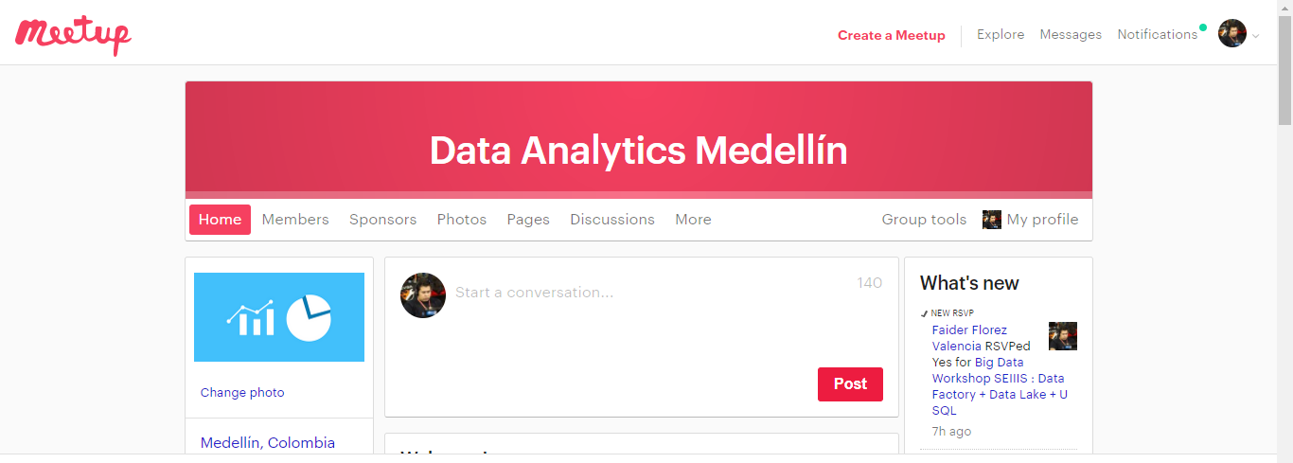
Invitaciones
https://www.meetup.com/data-analytics-medellin/
Semillero de Data analytics TdeA: Sabados 2-4 pm

Slide 5
Data Analytics Medellín
SQL Server Management Studio: Relational Models – Massive charge of dataset
- SQL Server Integration Services: ETLs
- SQL Server Analysis Server: Cubes
- Data Mining on SSAS
- Document –Oriented Databases: MongoDB – DocumentDB – Cassandra
- Distributed computing

Slide 6
Data Analytics Medellín
- Azure Analysis Services:
SQL Databases
SQL Data Warehouse
SQL Data Lakes
HDInsight: Hadoop
Machine Learning: Models – Algorithms
Stream Analysis
Cognitive Services
Bot Services
- Artificial Intelligence
- Neural Networks - Deep Learning
- IoT
- Visualization: Power BI

Slide 7
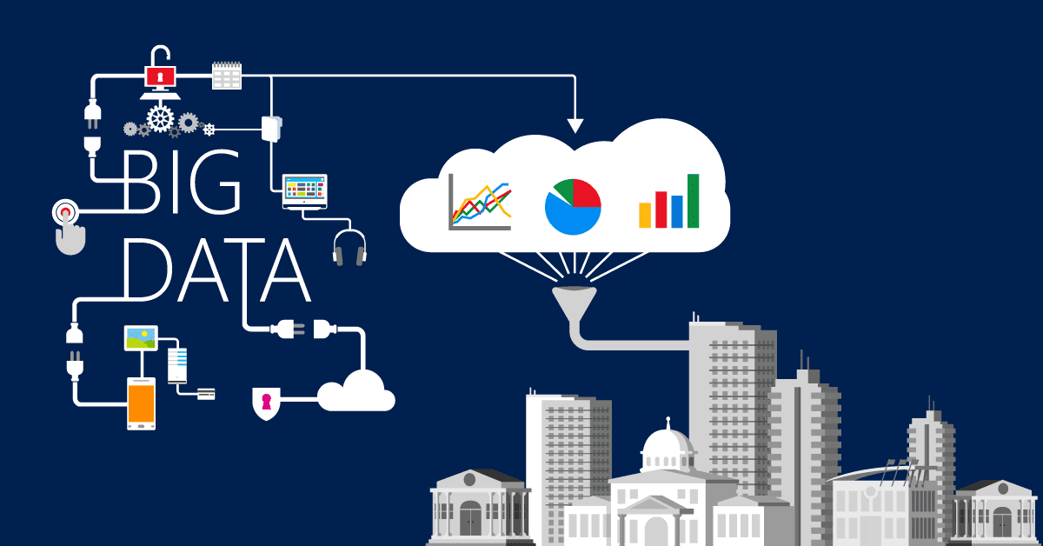

Slide 8
Vs' del Big Data
Volumen
Variedad
Velocidad (3Vs).
Veracidad
Valor del dato (5Vs)
http://www.eleconomista.es/tecnologia/noticias/5578707/02/14/La-moda-del-Big-Data-En-que-consiste-en-realidad.html

Slide 9
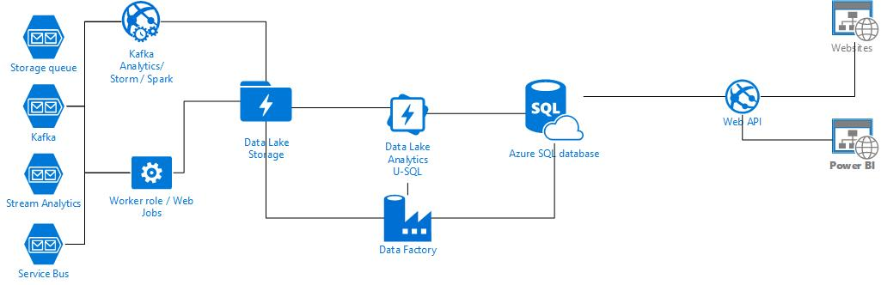
Arquitectura

Slide 10
DEMO
https://github.com/faiderfl/Data-Analytics

