Slide 1
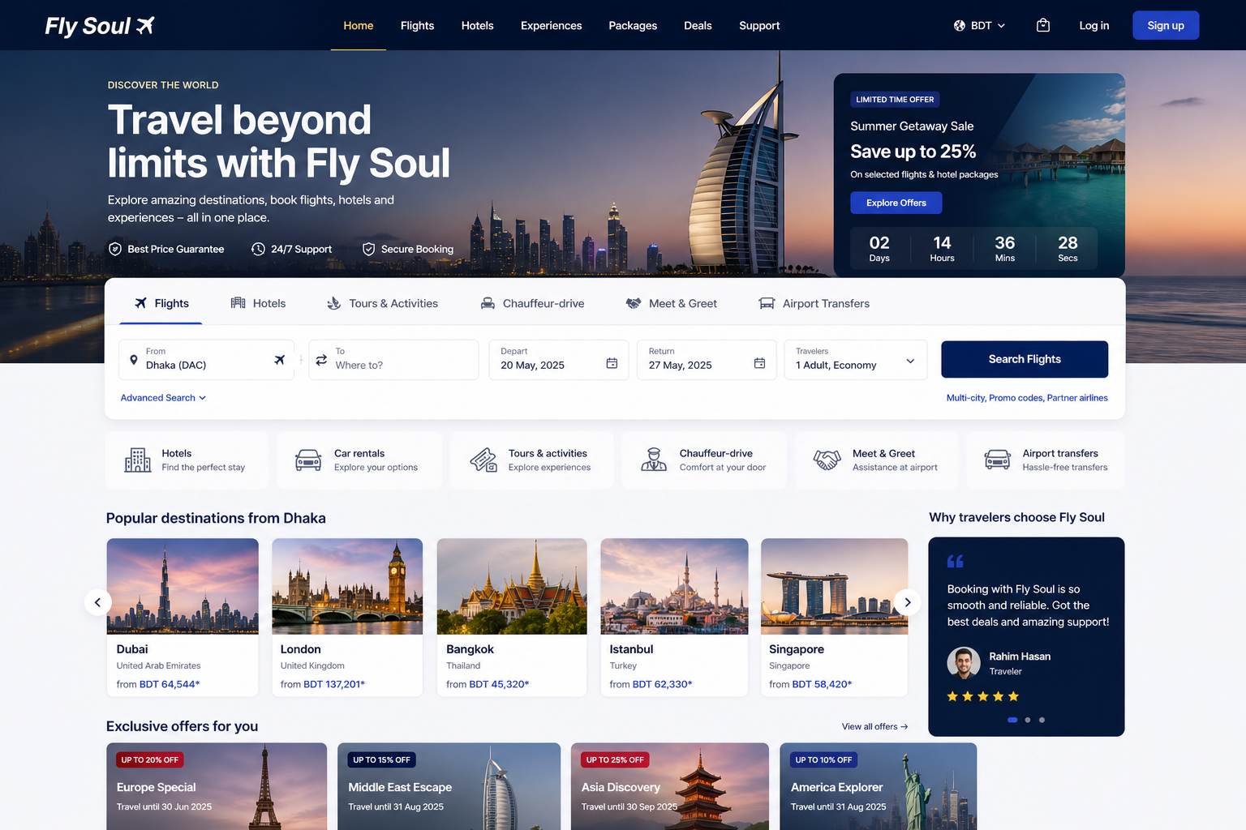
Aurelia Travel Project
Aurelia Travel Website Presentation
Prepared from the uploaded project ZIP and ERD image
Website
PHP + Bootstrap
Booking
JSON + SQLite
Admin
CRUD + dashboard

Slide 2
Project Overview
A premium tourism booking platform
Built with HTML, Bootstrap 5, CSS3, JavaScript, and PHP.
Lets visitors explore destinations, packages, and global travel content.
Includes authentication, booking submission, and an admin dashboard.
Supports image uploads and structured booking storage.
Main goal
Turn a beautiful travel website into a usable booking system.
Audience
Travel customers, registered users, and site administrators.
Design style
Luxury, modern, clean, and image-driven.
Aurelia Travel
2

Slide 3
What is inside the website?
Key pages and folders found in the project
Public pages: index.php, destinations.php, packages.php, world.php, booking.php.
Authentication: login.php, register.php, logout.php.
Admin area: add-package.php, edit-package.php, delete-package.php, bookings.php, booking-view.php.
Shared code: includes/header.php, footer.php, functions.php, travel-data.php.
Storage: data/users.json, data/packages.json, data/bookings.json.
Assets and uploads: CSS, JavaScript, and uploaded images.
Aurelia Travel
3

Slide 4
Database and Data Model
The ERD shows a structured booking ecosystem
Core entities
users, user_roles, addresses, destinations, packages, bookings, payments, coupons, reviews, gallery.
Relationship highlights
• One role can be assigned to many users. • One destination can contain many packages. • One package can have bookings, reviews, and gallery images. • One booking can have guests, payments, and coupon usage. • Users can store addresses, notifications, and activity logs.
Support entities
services, contact_messages, payment_methods, booking_guests, booking_coupons, notifications, activity_logs.
Aurelia Travel
4

Slide 5
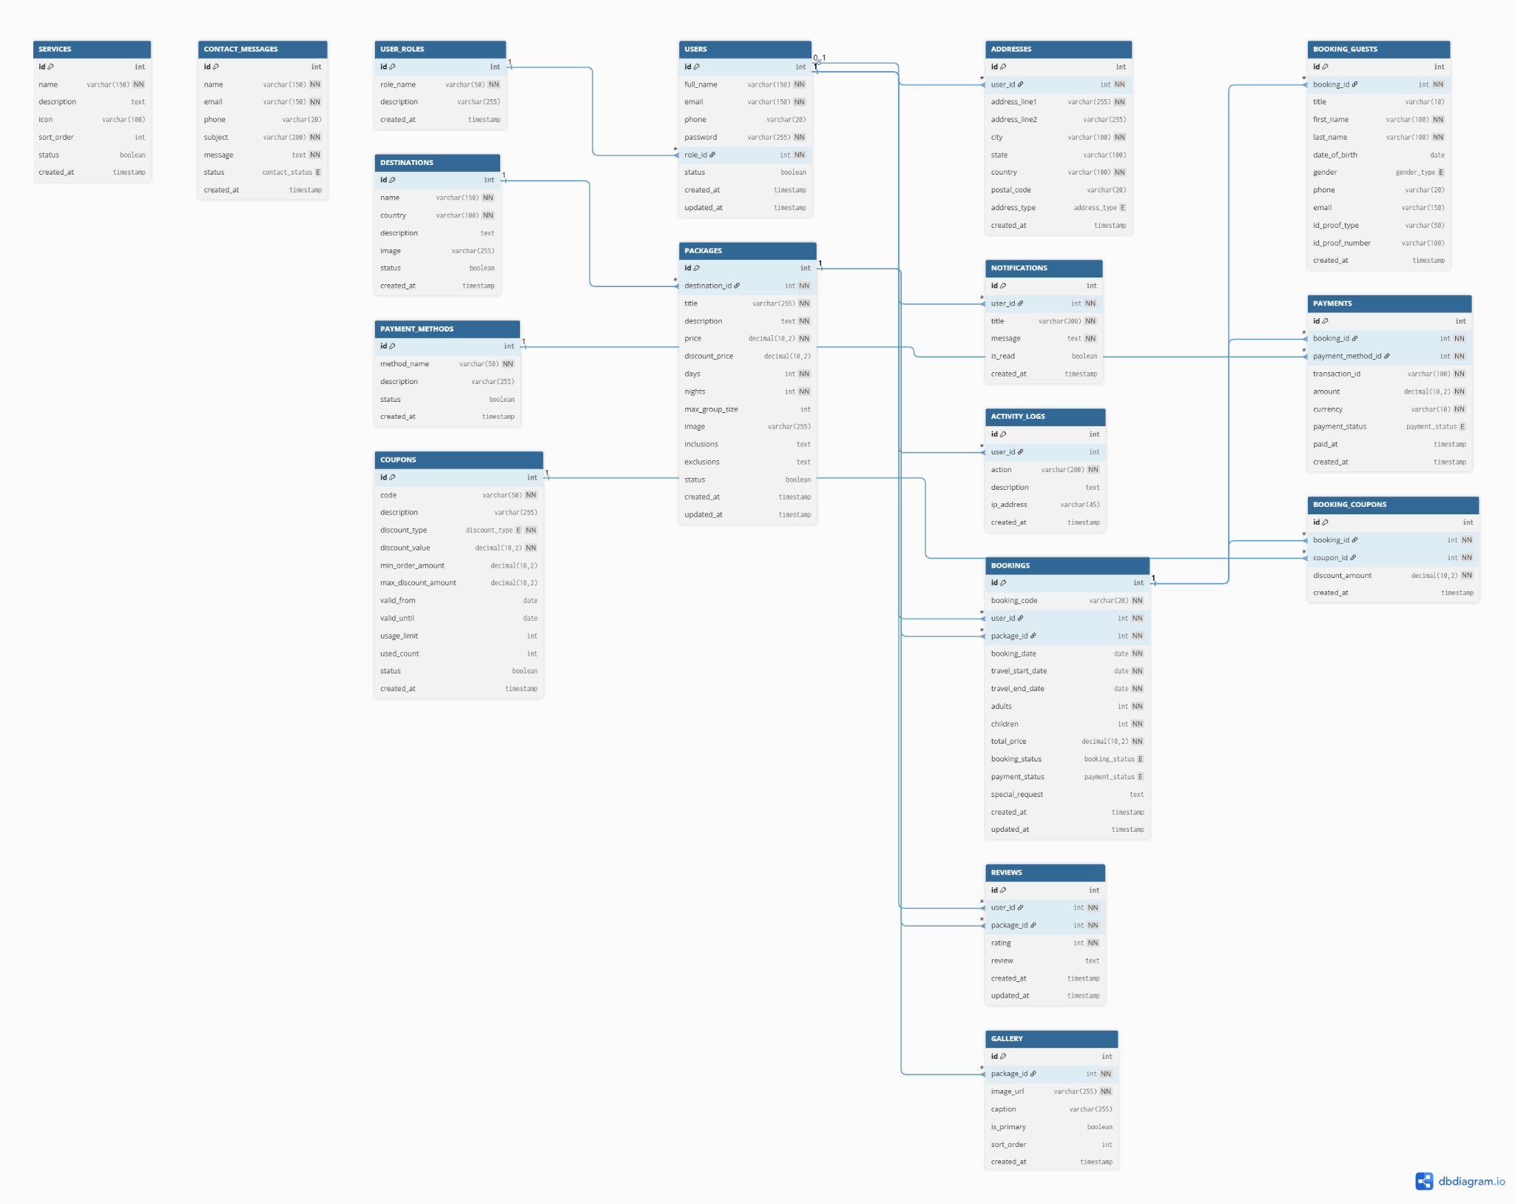
ERD Diagram
Full schema view from the uploaded image
What it shows
A normalized tourism database with user, booking, payment, and content tables.
Why it matters
It reduces duplication and keeps bookings, guests, and payments linked.
Presentation note
This diagram is the base for future MySQL implementation.
Aurelia Travel
5

Slide 6
Booking Workflow
How the website handles a reservation
1
Visitor selects a package and opens the booking form.
2
Customer enters travel dates, guests, contact, and payment details.
3
System stores the booking and generates status values.
4
Admin reviews the booking, updates payment, and manages the record.
Booking data captured
Booking reference, package, customer details, departure, destination, guests, payment method, booking status, payment status, IP address, and timestamps.
Aurelia Travel
6

Slide 7
Admin Panel and Benefits
What the dashboard helps the site owner do
Admin panel
Login-protected dashboard for managing the system.
Business value
The project combines a polished travel UI with usable back-office tools. It supports better customer handling, faster booking review, and a foundation for future MySQL expansion.
Booking control
View, filter, inspect, update, and delete bookings.
Package CRUD
Create, edit, and remove tour package records.
Aurelia Travel
7

Slide 8
Conclusion
A solid base for a tourism platform
Summary
The ZIP file contains a complete travel website with public pages, authentication, booking logic, admin tools, and a structured data model shown in the ERD.
Next step
Connect the current project to MySQL and deploy it with your preferred hosting setup.
Aurelia Travel
8

