Slide 1


Environment Set-Up
Copyright © 2020 Accenture. All rights reserved.

Slide 2
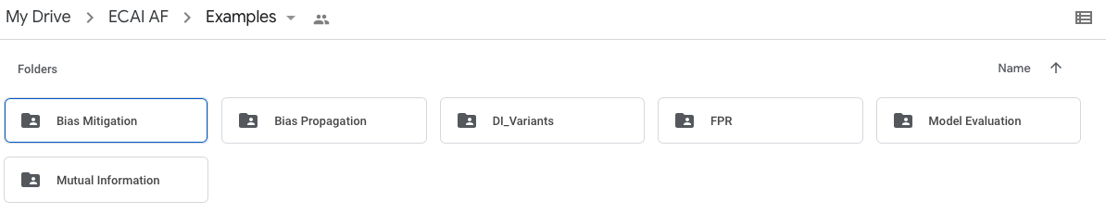
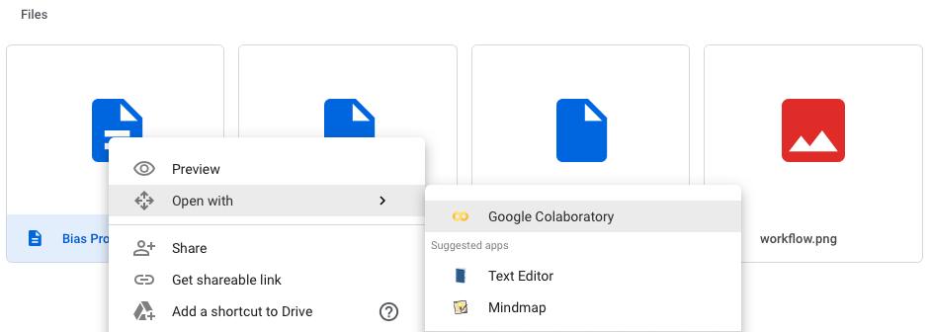
How to get started?
Algorithmic Fairness | Environment Set-up
Pre-requisites: gmail account
Notebooks Folder Link: https://bit.ly/2EvRcQy
Notes:
Google colab: allows to write and execute Python in your browser. No configuration is required.
To execute code in the cell, select it with a click and then either press the play button to the left of the code, or use the keyboard shortcut “Command/Ctrl+Enter”.
Colab notebooks are Jupyter notebooks that are hosted by Colab.

Slide 3
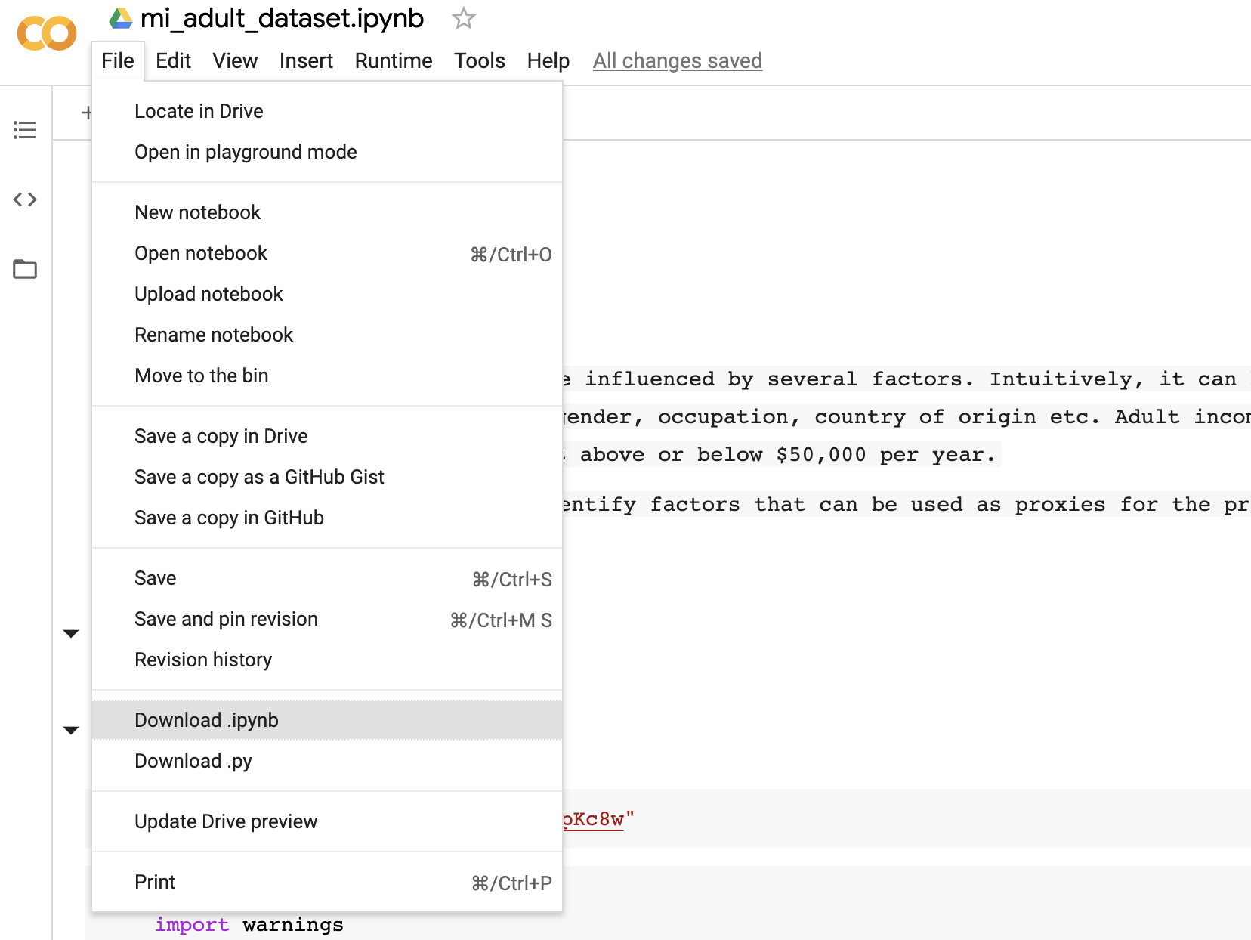
How to get started?
Algorithmic Fairness | Environment Set-up
Pre-requisites: gmail account
Notebooks Folder Link: https://bit.ly/2EvRcQy
Notes:
Google colab: allows to write and execute Python in your browser. No configuration is required.
To execute code in the cell, select it with a click and then either press the play button to the left of the code, or use the keyboard shortcut “Command/Ctrl+Enter”.
Colab notebooks are Jupyter notebooks that are hosted by Colab.

Slide 4
Experiments Details
Algorithmic Fairness | Datasets
a) Census Adult Dataset
The dataset was drawn from 1994 U.S. Census Bureau data and involves the prediction of whether an individual makes more than 50.000K a year, based on personal details such as education, hours of work per week, age etc.
b) German Dataset
Dataset providing information on 1000 loan applications with labels on whether the applicant has been identified as good or bad credit risk. The German Credit dataset is publicly available at UCI Machine Learning Repository.
c) COMPAS Dataset
COMPAS (Correctional Offender Management Profiling for Alternative Sanctions). Data contains information on attributes used by COMPAS algorithm in scoring defendants, along with their labels within 2 years of the decision for around 10 000 criminal defendants in Broward County, Florida.
d) Diabetes Dataset
Data recorded on diabetes patients (Several weeks’ to months worth of glucose, insulin, and lifestyle data per patient).

