Slide 1
Data Documentation

Slide 2

What is Documentation?
“Document or documents included with your data that describe(s) the details of the data and how it was generated” [KU Leuven 2022].
Illustration: “definition” by Dewi Novita Sari is licensed under CC BY 3.0
Notes:
slide content:
Definition of data documentation:
“Document or documents included with your data that describe(s) the details of the data and how it was generated” [KU Leuven 2022].

Slide 3
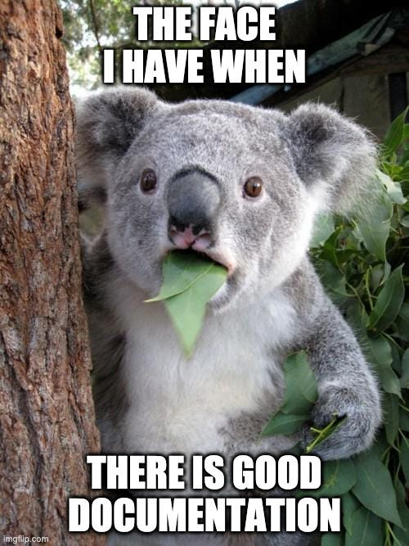
Importance of data documentation
For reusing research data, it must be described in a meaningful way and in as much detail as possible:
for other researchers
for other team members
for your future self
It is good to document how, when and for what purpose the data was created as soon as it is created.
Source: forschungsdaten.info, Illustration: image from imgflip.com - free to use acc. to copyright exeptions
Notes:
slide content:
Why is data documentation important for data re-use? → reproducibility, comprehensibility
How to document? → in a meaningful way, in as much detail as possible
For whom? → other researchers or team members and you future self
The documentation of the “how”, “when” and “for what purpose” is a lot easier to do as soon as data is created instead of waiting until the end of the project
This slide highlights the importance of documentation for data re-use.

Slide 4
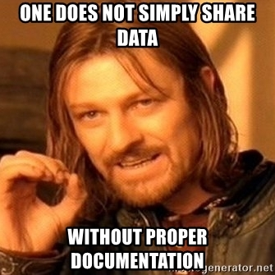
Importance of data documentation
Without documentation, you risk:
Not being able to find data again
No longer being able to trace the origin of data
No longer being able to interpret data due to missing context information
Mixing up files (outdated or competing versions)
Not being able to exchange data with other people or merge it with data from other sources
<Foliennummer>
Source: forschungsdaten.info, Illustration: image from Meme Generator- free to use acc. to copyright exeptions
Notes:
silde content:
Why is data documentation important? What do you loose without it? Some of the risks are listed on this slide.

Slide 5
Benefits of Documentation
Making data:
  understandable
  reusable
Guarantee the reproducibility of research
!! Adequate documentation is part of
good scientific practice!
(Guideline 12, Guidelines for Safeguarding Good Research Practice, DFG)
Source: Modified from Engelhardt et al. 2022 and KU Leuven 2022 by ZB MED 2023,; Illustration: image from Meme Generator - free to use acc. to copyright exeptions
Notes:
Slide Content:
Without documentation, you run the risk of not being able to retrieve data:
no longer being able to trace the origin of data,
no longer being able to interpret data due to a lack of contextual information,
confusing files (outdated or competing versions),
not being able to exchange data with other people or merge it with data from other sources
🡪🡪Adequate documentation is part of good scientific practice!

Slide 6

Content of Documentation
Description of the research project
Project goals
Hypotheses
Information on data collection
Measures for data cleaning and steps of data processing
Structure of the data and relationship of files to each other
Explanation of variables, labels and codes
Differences between different versions
Information on access and terms of use
Source: Modified from Biernacka et al. 2022 by ZB MED 2022,; Illustration: icon from Kücklich 2020 is licensed under CC0
Notes:
slide content:
What is the content of (good) data documentation? There are several elements that should be considered for good documentation. Some may also differ with different context.

Slide 7
Levels of data documentation
Study-level documentation
overall context of the research
1
Data-level documentation
describes individual data files
2
Metadata
standardised, structured data about the data
3
Source: Wolff, Musloff 2024 (FDM-BB Zertifikatskurs) modified by FAIRagro 2024
Notes:
Slide content:
Study-level documentation, which provides the overall context of the research.
At the first level, basic information about a study is collected to provide context to the methodology and data collection.
Data-level documentation, which describes individual data files.
The second level includes further descriptions of individual data files or folders within the data collection and provides detailed information about individual data at a glance (e.g. collected characteristics, variables).
Metadata
Metadata, i.e. standardised, structured data about the collection, which is often used to catalogue and locate objects in the collection.

Slide 8
Study-level Documentation
1
WHY was the data generated?
  Research project description, goals, hypotheses…
WHAT is the content of the data?
  Structure & relationship of the files to each other
HOW, WHERE and WHEN was the data generated? & WHO generated the data?
  Data collection information
HOW was the data processed?
  Describe data processing
  Versioning
Information on access and terms of use.
2
3
Tools to use:
  DMP
  Lab/Field Notebooks
  README file
  SOPs
  Lab Protocols
  User Guides
Source: UK Data Service and Wolff, Musloff (FDM-BB Zertifikatskurs) 2024 modified by FAIRagro
Notes:
Note: The illustration refers to the overview of the level of data documentation (06-02-02)
Slide Content:
Study-level documentation for a data collection or dataset provides high-level information on the research context and design, the data collection methods used, any data preparations and manipulations, plus summaries of findings based on the data.
Purpose for which data was created: Project history, aims, objectives and hypotheses, investigators, funders and publications from the data.
Content of the dataset: Kind of data (e.g. interviews, images, survey responses), the structure of data files, with the number of cases, records, files and variables, as well as any relationships among such items
How the data was collected: Data collection methodology and protocols, sampling design, sample structure and representation, workflows, instruments used, hardware and software used, data scale and resolution, digitisation or transcription methods used, secondary data sources used.
Who collected the data, where and when: Data collectors, geographic coverage of the data collection, date of data collection (temporal coverage).
How data was processed: Tools, instruments, procedures, hardware/software or protocols used to edit, clean, code and classify the data.
Any modifications done to the data: Anonymisation, for time series or longitudinal surveys changes made to methodology, variable content, question text, variable labelling, measurements or sampling.
Quality assurance procedures: Data validation, checking, proofing, cleaning and other quality assurance procedures carried out, such as checking for equipment and transcription errors, calibration procedures, data capture resolution and repetitions, or editing, proofing or quality control of materials.
How can data be accessed: Where is the dataset available from, persistent identifier, access conditions, use conditions, licence, copyright, information on data confidentiality, citation
Source: UK Data Service https://ukdataservice.ac.uk/learning-hub/research-data-management/document-your-data/study-level-documentation/

Slide 9
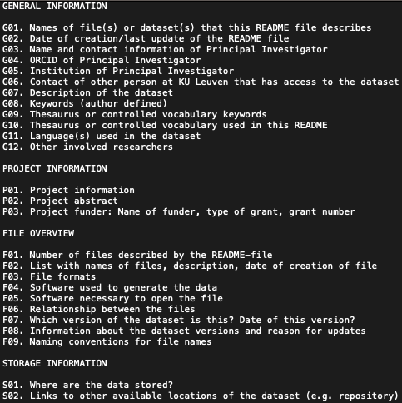
Data-level Documentation
1
Information on the data files:
  Data & file type, format, size, data processing scripts ...
Explanation of variables, labels and codes:
  Names, labels, values …
Tools to use:
  README file
  Data dictionary
  Codebooks
  Commented Code
  Lab/ Field Notebooks
2
3
Source: UK Data Service and CESSDA Training Team (2017 - 2022) modified by FAIRagro 2024,; Illustration: Screenshot template from KU Leuven 2024 (public domain)
Notes:
Note: The upper illustration refers to the overview of the level of data documentation (06-02-02).
Slide content:
Data-level documentation provides information about individual databases or data files. This could be, for example, interview transcripts or pictures, as well as documentation for elements within the files, for example describing variables within an SPSS file.
Source: https://ukdataservice.ac.uk/learning-hub/research-data-management/document-your-data/data-level/
Information about the data file: Data type, file type, and format, size, data processing scripts.
Information about the variables in the file: The names, labels and descriptions of variables, their values, a description of derived variables or, if applicable, frequencies, basic contingencies etc.
Source: https://dmeg.cessda.eu/Data-Management-Expert-Guide/2.-Organise-Document/Documentation-and-metadata

Slide 10

Types of Documentation
Metadata
Data dictionary
Codebook
Lab/ Field Notebooks
Commented Code
README file
Standard Operating Procedures (SOPs)
Lab Protocols
User Guides
<Foliennummer>
Source: Modified from KU Leuven 2022 by ZB MED 2023;, Illustration: Photo by Hannah Olinger licensed under the Unsplash license
Notes:
slide content:
What types of data documentation do exist? → highlight some of the given list

Slide 11

How to attach Documentation to my data
Within the data file or database
In a README file
In file headers
In a codebook
In a lab notebook
GitLab or OSF to document data processing and for versioning files
In a peer-reviewed data journal
In a wiki
Source: Modified from KU Leuven 2022 by ZB MED 2023,; Illustration:“attach“” by iconixar is licensed under CC BY 3.0
Notes:
slide content:
How to attach documentation to data? There are multiple ways to do so. Highlight common ones like eg. README files

Slide 12
Metadata
Notes:
Data Documentation

Slide 13
Metadata
1
"Data about data" -> differentiation from primary data!
Standardised & structured information
Human- and machine-readable
Goals:
  describes, explains, locates
  makes it easier to retrieve, use & manage
2
3
Source: Wolff, Musloff 2024 (FDM-BB Zertifikatskurs) modified by FAIRagro 2024
Notes:
Note: The illustration refers to the overview of the level of data documentation (06-02-02); alternatively could the next slides illustration be used for this one as well.
Slide content:
Metadata is “data about data”
Standardised and Structured information
Subset of documentation :
describes, explains, locates an information resources
makes it easier to retrieve, use, manage the resource
Human- and machine-readable (enhancing the “I” in FAIR)

Slide 14

Examples of Metadata Elements
Title
Topic
Description of input and output
Address/geospatial information
Licensing information
Source: Bres et al. 2022, RfII and Voigt et al. 2022 modified by ZB MED 2023,; Illustration: “meta tag“” by Vectors Market is licensed under CC BY 3.0
Notes:
Slide content:
Some examples of common metadata elements are listed on this slide.

Slide 15
Lego Game

