Slide 1
Data Sharing
Enhancing Knowledge through Open Data

Slide 2

What are the Benefits of Sharing Your Data?
Think about your own research experience…..
What advantages do you see in sharing data openly with the scientific community?
Illustration: photo by John licensed under the Unsplash license
Notes:
Note: Register for a free account on mentimeter.com (or choose a similar tool) and create a word cloud with the question "What are the Benefits of Sharing Your Data?". Generate a QR Code to your menti and add it, together with the Menti Code, into this slide.
Slide content:
Let’s think together: What are some benefits of sharing your data? ………………………………………
You might be thinking of things like:
Enabling reproducibility and transparency,
Getting more visibility and citations,
Supporting collaboration and innovation.
These are just a few reasons why data publication is becoming more and more important in research practice.

Slide 3

Benefits of Sharing Your Research Data
Focus: Scientific Value & Collaboration
First-mover Advantage: Claim your ideas and receive early feedback from the research community.
Enable New Research: Inspire new hypotheses and enable large-scale meta-analyses.
Foster Collaboration: Encourage international collaboration and inclusiveness
Promote Open Science: Strengthen scientific integrity and transparency
Build Trust: Increase confidence in science through reproducibility
Illustration: icon from Kücklich 2020 is licensed under CC 0
Notes:
Slide content:
What do we gain by sharing our research data?
It gives a first-mover advantage.
It helps claim ideas early.
It invites early feedback.
It enables new research.
It supports meta-analyses.
It fosters collaboration.
It promotes open science.
It strengthens transparency.
It builds trust through reproducibility.

Slide 4
Data Publication

Slide 5
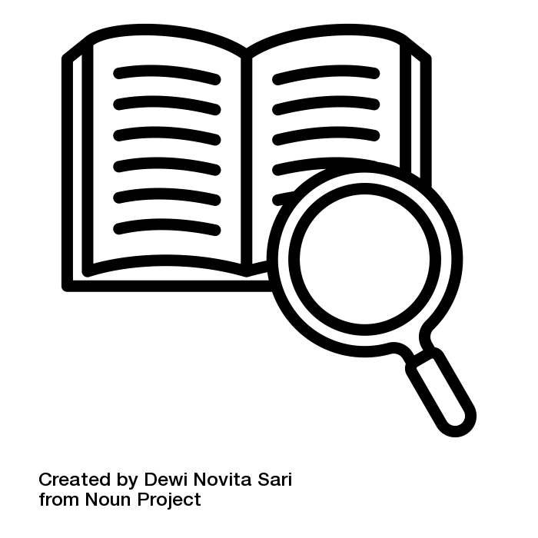
What is Data Publication?
Is the citable documentation of a dataset that makes it generally accessible.
Through data publication, research data and their descriptive metadata are publicly accessible and can be clearly referenced by assigning a persistent identifier such as a DOI or handle.
[translated from forschungsdaten.org]
Sources: forschungsdaten.org modified by FAIRagro 2025; “Definition” by Dewi Novita Sari fron Noun Project licensed under CC BY 3.0
Notes:
Slide content:
When we talk about data publication, we mean more than just uploading data somewhere. It means making a dataset publicly available in a citable and structured way.
That includes good metadata, and a persistent identifier like a DOI, so others can find, reference, and reuse your data.

Slide 6
Key Features of Sharing Data as Data Publication
Persistent Identifier (DOI): Data can be cited and tracked
Long-term Availability: Guaranteed preservation for future research
Structured Metadata: Complete, standardized documentation required
Formal Recognition: Treated as independent scientific output
Sources: forschungsdaten.org modified by FAIRagro 2025, “Definition” by Dewi Novita Sari from Noun Project licensed under CC BY 3.0
Notes:
Slide content:
From our perspective, the most recommended option for sharing data is to publish it in a data repository.
This slide illustrates the key features of proper data publication in contrast to an unstructured approach to data sharing.

Slide 7


Benefits and concerns of publishing data
please go to menti.com
enter Code: XXX XXX
or scan the QR Code
replace me!
Illustration: “discussion” by Becris from Noun Project is licensed under CC BY 3.0
Notes:
Note: Register for a free account on mentimeter.com or an similar tool and create two slides with the questions "What are the benefits of publishing your data?" and “What are your concerns about publishing your data?”. Generate a QR Code to your menti and add it, together with the Menti Code, into this slide.
Slide content:
Let's talk about your own experience and perspective:
What advantages do you see in publishing your data?
Benefits Visibility, long-term access, citations, meeting requirements, Enables reuse and meta-analysis, Supports transparency and scientific integrity
And on the other hand: What concerns or challenges come to mind?
Concerns Misuse or misinterpretation, legal or ethical restrictions, time, preparation effort, Misuse

Slide 8

Benefits of publishing your research data
Focus: Sustainability, Reuse & Recognition
Making data available over the long-term, reusable, citable
Making data an independent scientific result
Giving the possibility for meta-analyses
Increasing visibility, transparency, accountability
Source: Rathmann et al. 2021 modified by ZB MED 2023 and FAIRagro 2025; Illustration: Photo by Sara Kurfeß licensed under the Unsplash license
Notes:
Slide content: Why should we publish our research data?
Sustainability & Reuse: Long-term access and reuse of data
Recognition: Citation and acknowledgment as a research output
Scientific Value: Basis for meta-analyses and new discoveries
Integrity: Greater visibility, transparency, and accountability

Slide 9
Benefits of publishing your research data
Making data available over the long-term, reusable, citable
Making data an independent scientific result
Giving the possibility for meta-analyses
Increasing visibility, transparency, accountability
Once published, no further effort is needed: the dataset is available with clear rights and metadata, eliminating concerns about inquiries or licensing - it’s all set!
Source: Jordan 2025; Illustration: Photo by Sara Kurfeß licensed under the Unsplash license
Notes:
Slide content:
Once the data is published, access, rights, and documentation are already clarified. So you don’t have to deal with repeated requests.
Reduces follow-up effort
Provides clear rights and licensing
Ensures proper documentation through metadata
Makes data readily accessible for others

Slide 10
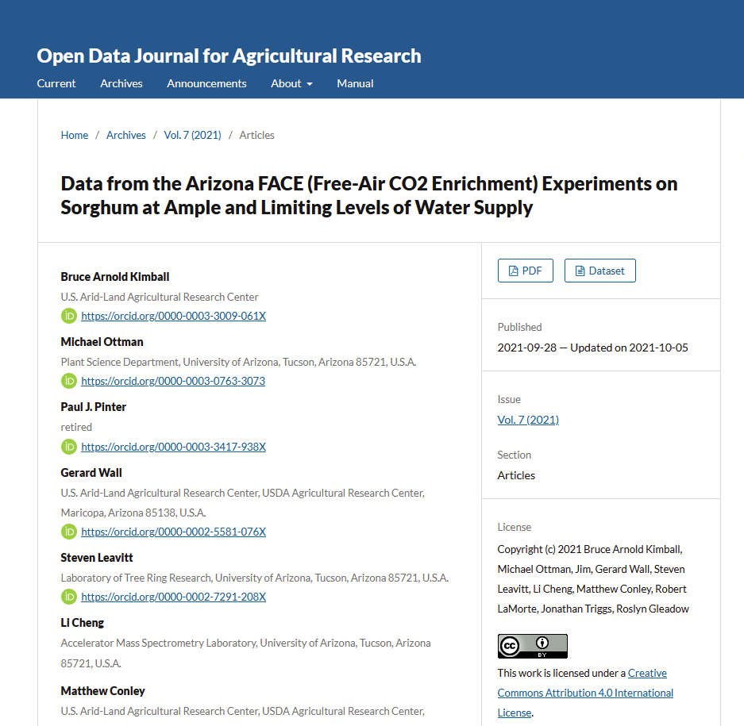
Publishing Options for Research Data
Data Supplements to Articles
  Appendix to peer-reviewed articles
  Nature, Science
Data Journals / Data Paper (Liste)
  Scientific Data (Nature), Earth System Science Data, Open Data Journal for Agricultural Research
Independent Publication in Repositories
  Discipline-specific data repositories and -centres
  Interdisciplinary repositories
  Institutional repositories
Notes:
Slide content:
Where can I publish my data?
Depending on the level of visibility, description, and reuse you aim for.
There are several ways to publish research data:
as supplements to articles, as dedicated data papers, or independently in repositories.

Slide 11
Selection Criteria: What Data Should You Publish?
Four key questions to guide your decision
Funder requirements
Does your funding agency mandate or recommend data publication?
Supports Publications
Is this data underlying scientific articles or key research findings?
High Reuse Potential
Does it have quality, uniqueness, originality, scale, or significant production cost?
Functional Reusability
Can others read/reuse it? Is metadata sufficient? Any legal/ethical barriers?
Notes:
Slide content: This slide gives you four simple questions to decide what data is worth publishing.
First: Is there a requirement? Many funders expect or even mandate data publication.
Second: Does the data support a publication? If it underlies a paper, it should usually be shared.
Third: Does it have reuse potential? For example, if the data is unique, costly to produce, or valuable for future analyses, it’s worth publishing.
And finally: Is it actually reusable? That means others can access it, understand it through proper metadata, and there are no legal or ethical barriers.
If these points are met, the dataset is generally a strong candidate for publication.

Slide 12
Components of a data publication
Dataset
Docu-
ment-
ation
Meta-
data
License
Source: Jordan 2025 modified by FAIRagro 2026
Notes:
Slide content: A proper data publication consists of four key components.
First, the dataset itself – that’s the actual data.
Second, metadata – this makes the dataset findable and citable.
Third, documentation – this explains how the data was created and how to work with it.
And finally, a license – this clarifies what others are allowed to do with the data.
Only when all four are in place, the data is not just available, but actually understandable and reusable.

Slide 13
Data Publication
Preparing data for publishing

Slide 14
Preparing data for publishing
Prepare your
data
Prepare your documentation
Check your data rights
Make your data reusable
Source: modified from the University of Edinburgh - Information Services - Research Data Service by FAIRagro 2024
Notes:
Slide content:
this slide shows the for steps, you need to take before your data is ready for publication:
prepare the data itself for publication
prepare your data documentation for publication
think about legal requirements
make sure, your data is reusable
in the following slide, we will have a deeper look into each step.

Slide 15
Step 1 - Prepare your data
Group your files into datasets
  Are you depositing an individual or multiple dataset(s)?
Structure your data
  Think about a comprehensible folder structure and a file naming convention
Choose a file format
  Choose Open, Standard File Formats
Source: modified from the University of Edinburgh - Information Services - Research Data Service by FAIRagro 2024
Prepare your data
Prepare your documentation
Check your data rights
Make your data reusable
Notes:
Slide content:
The first step after selecting the data you want to publish is to organise it in a meaningful way. Do you have one dataset or multiple datasets to publish? How are the files structured? Create a folder structure that is easy for people who don’t know your data yet to understand and navigate. You should also think about naming your files and folders in a meaningful way.
Another important aspect of making your data FAIR (interoperable) is choosing the right file format. We’ll provide some examples of this on the following slides.

Slide 16
Why your choice of file format is important
To ensure access and usability of your data
  to a broad audience
  into the long term
Make Data FAIR - Interoperable
Use standard preservation file formats
open, platform-independent or non proprietary file formats
Prepare your data
Prepare your documentation
Check your data rights
Make your data reusable
Notes:
Slide content:
In the sense of sharing and (long term) preservation of research data, you should use standard preservation file formats
these are open, platform-independent or non proprietary and:
encode information software-independent/allow interoperability between systems
or
information is encoded with lossless algorithms

Slide 17
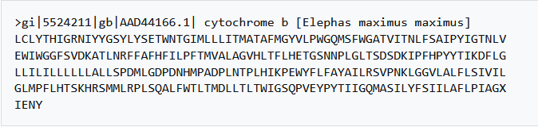
File formats of agricultural data
Standardized and open-source file formats:
  for Excel documents: CSV and ODS are open and widely supported
  raster data: GeoTIFF, netCDF, COGs (Cloud-optimized Geotiffs)
  vector data: ESRI shapefiles, geojson
  genetic sequences: FASTA
FASTA
Illustration: Screenshot from wikipedia is public domain
Prepare your data
Prepare your documentation
Check your data rights
Make your data reusable
Notes:
Note: similar slide to 01-01-06-03
Slide content:
Tabular Data (Excel files)
Many of you work with spreadsheets for field trials or lab measurements.
CSV (Comma-Separated Values)
Simple text format, readable by almost all statistical software (R, Python, etc.).
Ideal for data sharing and archiving.
ODS (OpenDocument Spreadsheet)
Open standard maintained by OASIS.
An open alternative to XLSX.
Recommendation: Even if you work in Excel, export data as CSV for sharing and archiving.
Raster Data (e.g., remote sensing, soil maps, yield maps)
GeoTIFF – Standard format for georeferenced raster data.
netCDF – Suitable for multidimensional data (e.g., climate time series).
COGs (Cloud Optimized GeoTIFFs) – Optimized for cloud-based access to large datasets.
Vector Data (e.g., field boundaries, management zones)
ESRI Shapefile – Widely used GIS standard (though technically older).
GeoJSON – Text-based, web-friendly, and easy to share.
Genetic Sequences
FASTA – Internationally established text-based standard used in bioinformatics.

Slide 18
File formats of agricultural data
Text | Adobe PDF /A (filename extension: ".pdf") Text (filename extensions: ".txt", ".asc", ".sts") | OpenDocument - text (" .fodt", ".odt") Microsoft Word XML (".docx")
Tabular data | Comma separated values (CSV) (".csv") Tab separated values (" .tsv", ".tab") | OpenDocument - spreadsheet (".fods", ".ods") Microsoft Excel XML (".xlsx")
Images | JPEG 2000 (".jpxml", ".jp3d", ".jpf", ".jpm", ".jpx", ".jp2") TIFF (".tiff", ".tif") | PNG (".png") Scalable Vector Graphics (SVG) (".svg")
Audio/Video | AIFF (".aiff", ".aif", ".aifc") WAV (".wav") Free Lossless Audio Codec (FLAC) (".flac") | MPEG-4 (".m4v", ".m4r", ".m4b", ".m4p", ".m4a", ".mp4") Motion JPEG2000 (".mjp2", ".mj2")
Geo-spatial data | raster data: GeoTIFF netCDF COGs (Cloud-optimized Geotiffs) | vector data: ESRI shapefiles (“.shp”) geojson
Genotyping data | FASTA FASTQ | Variant Call Format (“.VCF”)
Source: modified from the University of Edinburgh - Information Services - Research Data Service, Publisso - by FAIRagro 2024
Prepare your data
Prepare your documentation
Check your data rights
Make your data reusable
Notes:
Note: similar slide to 01-01-06-03
Slide content:
this slide shows a collections of recommended file formats for different agricultural file types.

Slide 19
Step 2 - Prepare your documentation
Have you prepared documentation files for your dataset(s)?
Have you spelled out acronyms and explained the labels of your variables and values?
Have you included research methodology reports and any other relevant information?
Have you chosen a meaningful title?
Source: modified from the University of Edinburgh - Information Services - Research Data Service by FAIRagro 2024
Prepare your data
Prepare your documentation
Check your data rights
Make your data reusable
Notes:
Slide content:
when your data is ready to be published, you need to prepare your documentation:
have you already prepared documentation files for your dataset(s)? -> in the best case scenario, data documentation should be done right at the time, you are collecting and processing your data.
when it comes to publishing your data, it is especially important, that others (and maybe your future self) are able to understand where your data comes from, how it was processed and what it contains: therefor make sure you have explanations of all variable, values and used abbreviations and codes included.
one very important metadata about your data is the title. Put some thoughts into it, to make sure your title describes the most important aspects of your dataset in a meaningful way!

Slide 20
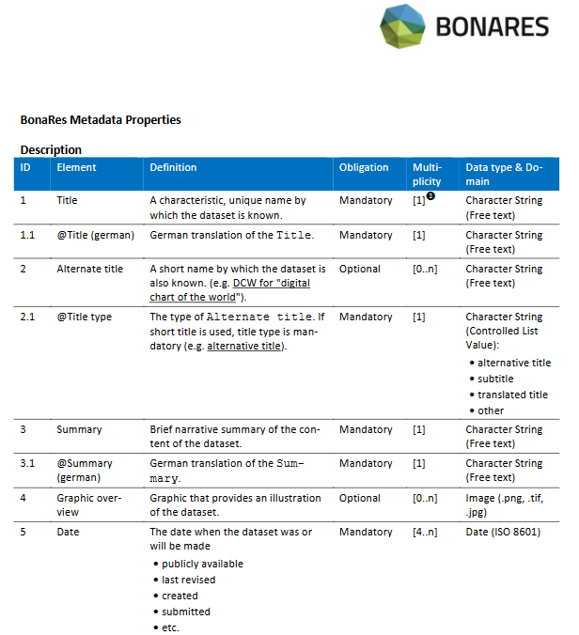
Have your Metadata ready
What type of metadata is mandatory for your repository?
Illustration: Gärtner et al. The BonaRes Metadata Schema licensed under CC BY 4.0
Prepare your data
Prepare your documentation
Check your data rights
Make your data reusable
Notes:
Slide content:
Besides data documentation such as README files and codebooks, you need to have your metadata ready. Find out what metadata your repository requires; most repositories have their metadata schema available, such as this one from the BonaRes Repository. You need to have all the mandatory metadata elements available when uploading your data. Additionally, there are often multiple optional and/or recommended metadata elements that should be added to make your dataset as findable and understandable as possible to potential reusers.

Slide 21
Step 2 - Prepare your documentation
Have you prepared documentation files for your dataset(s)?
Have you spelled out acronyms and explained the labels of your variables and values?
Have you included research methodology reports and any other relevant information?
Have you chosen a meaningful title?
Source: modified from the University of Edinburgh - Information Services - Research Data Service by FAIRagro 2024
Prepare your data
Prepare your documentation
Check your data rights
Make your data reusable
Notes:
Slide content:
one very important metadata about your data is the title. Put some thoughts into it, to make sure your title describes the most important aspects of your dataset in a meaningful way!

Slide 22

Good titles - Bad titles
Which of these titles are good titles ✓ and which ones are bad x? Use zoom annotation function!
SugarBeetsUniBonn
Pheno4D: A spatio-temporal dataset of maize and tomato plant point clouds for phenotyping and advanced plant analysis
NRW DOP 10cm spatial res
BreedFACE Experimental data: Field Phenotyping of Ten Wheat Cultivars under Elevated CO2 Shows Seasonal Differences in Chlorophyll Fluorescence, Plant Height and Vegetation Indices
DND-Diko-WWWR: RGB images of winter wheat and winter rye for nutrient deficiency recognition
Illustration: Screenshot Zoom
use zoom annotation function!
Prepare your data
Prepare your documentation
Check your data rights
Make your data reusable
Notes:
Slide content:
We have brought along some real examples of data titles from the PhenoRoam repository (a repository of the DFG-funded excellence cluster PhenoRob).
Which of these titles do you think are good examples, and which could be improved?

Slide 23
Good titles - Bad titles: Solution
Which of these titles are good titles ✓ and which ones are bad x? Use zoom annotation function!
SugarBeetsUniBonn x
Pheno4D: A spatio-temporal dataset of maize and tomato plant point clouds for phenotyping and advanced plant analysis ✓
NRW DOP 10cm spatial res x
BreedFACE Experimental data: Field Phenotyping of Ten Wheat Cultivars under Elevated CO2 Shows Seasonal Differences in Chlorophyll Fluorescence, Plant Height and Vegetation Indices x
DND-Diko-WWWR: RGB images of winter wheat and winter rye for nutrient deficiency recognition✓
Illustration: Screenshot Zoom
use zoom annotation function!
Prepare your data
Prepare your documentation
Check your data rights
Make your data reusable
Notes:
Slide content:
this title includes to less information - e.g. no information about experiments or the included file types
good example with proper information about file typ, crop, purpose and name of the project
no information on the project, the crop, abbreviations used, that are not common to everyone
this title refers to results and conclusions. This is not suitable for a data publication because the data itself cannot show anything without interpretation. It seems like this is the title of a related scientific paper. Make sure you find a title that describes the data itself, rather than the paper based on this data!
good title that describes the project, the file types, the crop and the purpose of the experiment

Slide 24
Step 3 - Check your data rights
01
Copyrights of third parties
Joint research
Research subject to instructions
Reuse of third party content
Source: modified from forschungsdaten.info by FAIRagro 2025
Prepare your data
Prepare your documentation
Check your data rights
Make your data reusable
Notes:
Slide content:
before you publish research data, you need to check, if you have the right to do so. Therefore think about the data rights. There are different things to consider:
01 Copyright (of third parties) -> not all research data is protected by copyright. Nevertheless, when checking, if you are allowed to use the data, pretend the data is protected - with this, you are save in any cases. In addition, think of the following:
Do you have all the rights to make the data available?
In case your research bound by instructions (you are not a professor, but working under instruction of your PI) - This can mean, that your institution holds usage rights on your data: check if iyour/ the employer's authorisation available?
Joint research
in case you are working in team with other researchers - Have you received permission from all other right-holders?
Have project partners given their consent?
Re-use of third-party content - do I have the permission of the rights holder?
Do you have data citations ready for any underlying "source" data?

Slide 25
Data Rights Definition
images
Data
measurement data, etc.
text publications
software code
Notes:
Slide content:
to define data rights we first have to define what types of data can be created
in the scientific context, data can be measurement data, images, text publications, software code, etc. for example.
data rights in this context refer to the rights resulting from certain data.

Slide 26
Data Rights Definition
images
possible protection:
trademark law
patent law
copyright law
Data
measurement data, etc.
text publications
software code
Notes:
Slide content:
depending on the type of data, it can be protected by different legal orders.
German law names three legal orders specifically, under which a protection of research data is possible:
trademark law
patent law
and copyright law
outside of the protection of these legal orders, data is public domain and should be freely accessible.

Slide 27
Data Rights Definition
images
Public Domain Mark.
CC BY
CC0
Data
measurement data, etc.
text publications
CC BY-NC
software code
GPLv3
Notes:
Slide content:
This slide visualises the types of data and how legal labels like licenses are “floating” around them
when data is “floating” around, it is often labelled in a certain way. These labels give information about the data, as in: who is the creator and what can happen with the data

Slide 28
Copyright Definition
Is it copyright protected?
Copyright
“Work” (Werk in German)
facts, information
protected
not protected
Notes:
Slide content:
the question of what is and isn’t copyright protected is answered by the copyright act -> these basic understandings are internationally the same
only so called works are protected.
The following rule applies to copyright protection: protected is only the shape of a creation, not its content.

Slide 29
Copyright Definition
perceptible shape
personal creation
intellectual content
personal character
Not only ideas, they need to be perceptible (e.g. Text on Paper, Harddrive, etc.)
not machine/animal created works
-> AI-generated material is not protected under the UrhG
Creation of a world of thoughts or feelings that has some kind of stimulating effect on the viewer.
Minimum degree of originality, so-called “sufficient degree of creative originality”
BGH GRUR 1988, 533 (535)
aka: Threshold of originality (dt. Schöpfungshöhe)
Notes:
Slide content:
This slide illustrates the definition of a “work” with four pillars.
What is a work?
A creation needs to meet the four following criteria to be considered a copyright protected work:
perceptible shape: on paper, on screen, not just in your head
personal creation: not AI, not from animals
intellectual content: “glue” between the idea and the expression
personal character: so called threshold of originality -> sufficient degree of creative originality

Slide 30
Copyright Definition
Scope of originality
Utilizing the scope in a creative manner
Threshold of originality
is there room to be creative?
-> not when strict technical specifications
does the creator use that room in a creative way?
the creation is considered a “work” according to copyright law.
Notes:
Slide content:
when is the threshold of originality reached?
you can check if the threshold of originality is reached by an addition of the scope of originality and the utilization of this scope in a creative manner.
the scope of originality means: is there room to be creative?
utilizing that scope in a creative manner means: not if you limit yourself to the technical, scientific requirements of your domain
Result: copyright protection meaning: the creator can decide if and how other people can use their work and she can also legally enforce that

Slide 31
Copyright: Shape vs. Content
Protectable aka licenseable
Non-protectable
1
Research Paper (wording)
Findings presented in paper
2
Report on a case study (wording)
Data generated in Research
3
Software (program code)
Programming Language, algorithms, conceptual approach
4
Database (structure)
Content of databank
Notes:
Slide content:
This slide visualises examples of copyright protection according to the principle of content vs. shape

Slide 32
Step 3 - Check your data rights
01
Copyrights of third parties
Joint research
Research subject to instructions
Reuse of third party content
02
Data Protection
Is personal data present?
Is the data properly anonymised?
Source: modified from forschungsdaten.info by FAIRagro 2025
Prepare your data
Prepare your documentation
Check your data rights
Make your data reusable
Notes:
Slide content:
02 Data Protection - if your data has personal information, you need to think about data protection issues:
Have you sufficiently anonymised your data, or obtained explicit consent from any data subjects whose identity could be revealed from the data (including images)?

Slide 33
Step 3 - Check your data rights
01
Copyrights of third parties
Joint research
Research subject to instructions
Reuse of third party content
02
Data Protection
Is personal data present?
Is the data properly anonymised?
What applies regarding agricultural data?
personal data = data that identifies natural persons, not companies!!
BUT Careful! agricultural farms are often not just companies,
but homes of natural persons!
AND Careful! If name of the farm = name of the farmer
Source: modified from forschungsdaten.info and modified from Lea Singson by FAIRagro 2025
Prepare your data
Prepare your documentation
Check your data rights
Make your data reusable
Notes:
Slide content:
02 Data Protection - if your data has personal information, you need to think about data protection issues:
Have you sufficiently anonymised your data, or obtained explicit consent from any data subjects whose identity could be revealed from the data (including images)?
This slide shows some examples of the categories of agricultural research data that can be protected by the GDPR.
Data relating to a farm is not necessarily personal data because a farm is a company, not a natural person.
However, there are two important exceptions:
When the company name reveals the name of a natural person (e.g. the farmer), such as in the case of "Brigitte-Maier GmbH".
when the farm is the home address of a natural person (e.g. the farmer and their family live on the farm).

Slide 34
Step 3 - Check your data rights
01
Copyrights of third parties
Joint research
Research subject to instructions
Reuse of third party content
02
Data Protection
Is personal data present?
Is the data properly anonymised?
03
Business secrets
e.g. company data, customer and supplier lists, cultivation methods of farms
Source: modified from forschungsdaten.info by FAIRagro 2025
Prepare your data
Prepare your documentation
Check your data rights
Make your data reusable
Notes:
Slide content:
If your data relates to one or more agricultural farms, ensure that it does not contain any business secrets that you are not permitted to share or publish. This could include company data, customer and supplier lists, the farms' cultivation methods, the secret recipe of a fertiliser, and so on.

Slide 35
Step 3 - Check your data rights
01
Copyrights of third parties
Joint research
Research subject to instructions
Reuse of third party content
02
Data Protection
Is personal data present?
Is the data properly anonymised?
03
Business secrets
e.g. company data, customer and supplier lists, cultivation methods of farms
04
Patenting
Does the publication affect a planned patent?
Source: modified from forschungsdaten.info by FAIRagro 2025
Prepare your data
Prepare your documentation
Check your data rights
Make your data reusable
Notes:
Slide content:
Is there a planned patent that relies on this data? If so, you could consider an embargo to prevent the data from being made available before the patent is filed.

Slide 36
Step 3 - Check your data rights
Are you aware of, and are you comfortable with what rights you are passing on to the repository?
01
Copyrights of third parties
Joint research
Research subject to instructions
Reuse of third party content
02
Data Protection
Is personal data present?
Is the data properly anonymised?
03
Business secrets
e.g. company data, customer and supplier lists, cultivation methods of farms
04
Patenting
Does the publication affect a planned patent?
Source: modified from the University of Edinburgh - Information Services - Research Data Service by FAIRagro 2024
Prepare your data
Prepare your documentation
Check your data rights
Make your data reusable
Notes:
Slide content:
All in all you should make sure, that you are aware of all the right you have, you need and what rights you are passing on to the repository.

Slide 37
Step 4 - Make your data reusable
Decide if an embargo is needed before making your data open access
Consider an open licence
  Have you considered the use of an open licence for your data?
  Are you prepared to fill in a rights statement, if the "No licence" option is chosen?
Source: modified from the University of Edinburgh - Information Services - Research Data Service by FAIRagro 2024
Prepare your data
Prepare your documentation
Check your data rights
Make your data reusable
Notes:
Slide content:
Now, make sure that your data is reusable by others. Therefore, don’t forget to add a licence or a public domain mark (if you are sure your data is not protected by copyright) to your data, so that everyone knows how they can use it.
Be aware that if you don't want to use a pre-formatted licence, such as Creative Commons, you will need to write your own rights statement.

Slide 38
Copyright Consequences
The creator can decide IF and HOW other people can interact with her work!
she can prohibit it
she can limit it
she can legally enforce it!
Notes:
Slide content:
If a creation is copyright protected, the creator can decide if and how other people can use her work and she can also legally enforce that. This means that the author can grant licences for the work to regulate its use by third parties.

Slide 39

Importance of Copyright Law
License
Legal restriction of use
?
?
?
?
?
?
?
?
?
?
?
?
Copyright Protection
?
Notes:
Slide Content:
This slide visualises that copyright protection is the basis for the creators ability to legally restrict the use of their data or set the conditions for the use. This restriction or usage condition can be set via a license.
How we are able or unable to label data depends on it’s legal status. For example: only if data is protected by copyright, the creator of the data can restrict it’s use legally, e.g. with a license.

Slide 40
Importance of Copyright Law
License
Legal restriction of use
basis for applying a CC-License!
Copyright Protection
Notes:
Slide Content:
This slide visualises that copyright protection is the basis for the creators ability to legally restrict the use of their data or set the conditions for the use. This restriction or usage condition can be set via a license.
Only when data is protected by copyright law, a CC License can be applied!

Slide 41
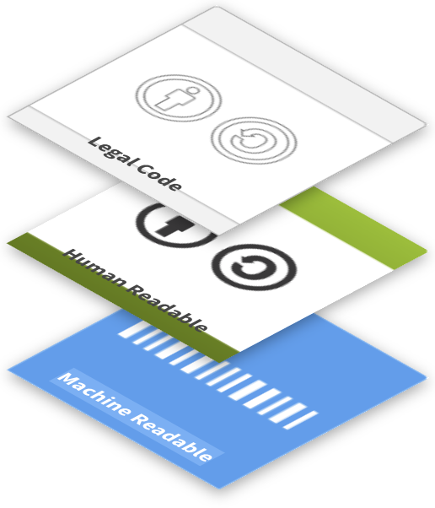
How do I license my data?
Use standardised licence contracts
  Standardized
  Available in an easy-to-read version
  No transfer of exclusive rights
  Compatible with many jurisdictions
  Common
Key question: What should others be allowed to do with my data? (And does this apply to all components, such as metadata, full texts, images, etc.?)
Source: modified from Brettschneider et al. 2021 and forschungsdaten.info by Bobrov et al. 2021, ZB MED 2022 and FAIRagro 2025;
Illustration: image from CC copyright licenses is licensed under CC BY 4.0
Notes:
Slide content:
Licensing your data creates legal certainty in terms of usability. This usability is even increased when using standardized license contracts that are internationally well known and can therefore be easily adhered to by potential users of your data.
Standardized license contracts often offer different modules with certain permissions. Therefore you have to ask yourself, what you want others to be able to do with your data, when choosing a license module.
Sometimes, funders, institutions, repositories, or research projects mandate or recommend specific licenses. Check whether a specific licence is recommended or mandatory for you

Slide 42
License Application
refer to license on website landing page
attach license to meta data of research data
set up a Read Me file with license
attach license on data source, like presentation, image, poster, publication
General rule: apply as closely to the source as possible.
Notes:
Slide content:
Because a licenses’ intend is to clarify the usage conditions, it needs to be applied as closely to the licensed object as possible.
Depending on the object, that can look differently.

Slide 43

CC copyright licenses: five components
Attribution (BY): author/creator must always be credited
Non-Commercial (NC): must not be used for commercial purposes
Share Alike (SA): redistribution/adaptations only under the same conditions
No Derivatives (ND): no adaptations or derivatives are permitted
Public domain: none of the above limitations
Source: Bobrov et al. 2021, Cozatl et al. 2021 and Rathmann et al. 2021 modified by ZB MED 2022
Notes:
Slide content:
this slide shows the different components of CC licenses. The first four components can be combined in different ways as you can see on the following slide

Slide 44







CC license components and combinations
most open
CC 0 Public Domain
CC BY Name author
CC BY-SA Name author - Share under same license
CC BY-ND Name author - No changes
CC BY-NC Name author - No commercial use
CC BY-NC-SA Name author - No commercial use - Share under same licence
CC BY-NC-ND Name author - No commercial use - No changes
least open
Source: Rathmann et al. 2021 and Rice 2020 modified by ZB MED 2022
Notes:
Slide content:
Creative Commons has different license modules depending on the conditions under which creators want to make their data available.
CC0 enables the creator to give up any copyright (as far as possible) on their data. It puts the work into the public domain. CC0 enables reusers to distribute, remix, adapt, and build upon the material in any medium or format, with no conditions. This also includes the obligation to cite the creator. However, scientists still need to cite due to the Good Research Practice.
CC BY enables reusers to distribute, remix, adapt, and build upon the material in any medium or format, so long as attribution is given to the creator.
CC BY-NC enables reusers to distribute, remix, adapt, and build upon the material in any medium or format for noncommercial purposes only, and only so long as attribution is given to the creator. Non-commercial means, not primarily aimed at a business advantage or monetary compensation, in this context.
CC BY-ND enables reusers to copy and distribute the material in any medium or format in unadapted form only, and only so long as attribution is given to the creator.
CC BY-SA allows the same reuse as with the CC BY. If you remix, adapt, or build upon the material, you must license the modified material under identical terms.
Listed here are all the modules, as well as the possible combinations.
Not every CC license can be recommended equally. The CC BY-NC and the CC-BY-ND are not compatible with the Open Access principles and should therefore not be used.

Slide 45
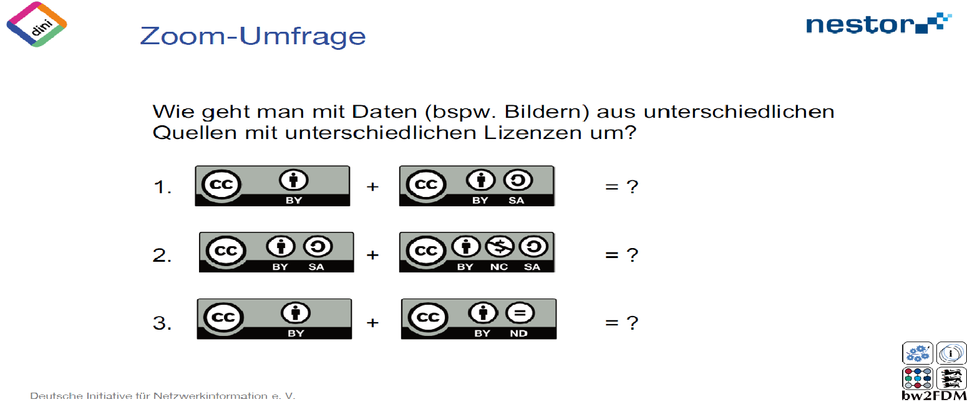
Exercise: Combining Licenses
You would like to combine datasets with different licenses. What is the resulting license?
<Foliennummer>
Source: Bobrov et al. 2021
Notes:
Note: Register for a free account on mentimeter.com or a similar tool and create slide with the questions you find in 11-01-03-04-03b. Generate a QR Code to your menti and add it, together with the Menti Code, into this slide. For online training you could also consider creating a poll in your videoconference tool.
! for this exercise, we pretend, that both datasets are protected by copyright - what is not very likely, to be honest. If wanted, you can discuss this with your participants as well !

Slide 46
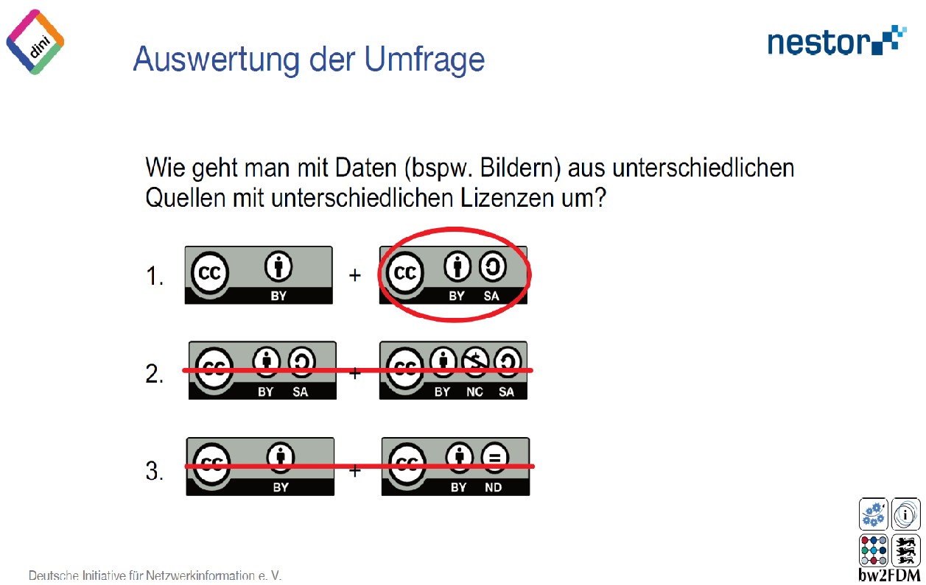
Exercise: Combining Licenses - Solution
You would like to combine datasets with different licenses. What is the resulting license?
<Foliennummer>
Source: Bobrov et al. 2021
Notes:
Note: Register for a free account on mentimeter.com or a similar tool and create slide with the questions you find in 11-01-03-04-03b. Generate a QR Code to your menti and add it, together with the Menti Code, into this slide. For online training you could also consider creating a poll in your videoconference tool.
Slide content:
Since the second dataset needs to be republished under the same licence (SA = Share Alike), the combined dataset must also have this licence. The first dataset does not provide any information on how the derivative should be licensed. The authors of both datasets need to be named.
! for this exercise, we pretend, that both datasets are protected by copyright - what is not very likely, to be honest. If wanted, you can discuss this with your participants as well !

Slide 47
Exercise: Combining Licenses
You would like to combine datasets with different licenses. What is the resulting license?
<Foliennummer>
Source: Bobrov et al. 2021
Notes:
Note: Register for a free account on mentimeter.com or a similar tool and create slide with the questionns you find in 11-01-03-04-03b. Generate a QR Code to your menti and add it, together with the Menti Code, into this slide. For online training you could also consider creating a poll in your videoconference tool.
! for this exercise, we pretend, that both datasets are protected by copyright - what is not very likely, to be honest. If wanted, you can discuss this with your participants as well !

Slide 48
Exercise: Combining Licenses - Solution
You would like to combine datasets with different licenses. What is the resulting license?
<Foliennummer>
Source: Bobrov et al. 2021
Notes:
Note: Register for a free account on mentimeter.com or a similar tool and create slide with the questions you find in 11-01-03-04-03b. Generate a QR Code to your menti and add it, together with the Menti Code, into this slide. For online training you could also consider creating a poll in your videoconference tool.
Slide content:
Since both datasets' licences require derivatives to be published under the same licence as the original, we have the problem that both original datasets aren't licensed alike. This means that the derivative of the first dataset must be licensed under CC BY SA; it cannot be licensed under CC BY NC SA, as would be required for the derivative of the second dataset. Therefore, combining both datasets is not possible!
! for this exercise, we pretend, that both datasets are protected by copyright - what is not very likely, to be honest. If wanted, you can discuss this with your participants as well !

Slide 49
Exercise: Combining Licenses
You would like to combine datasets with different licenses. What is the resulting license?
<Foliennummer>
Source: Bobrov et al. 2021
Notes:
Note: Register for a free account on mentimeter.com or a similar tool and create slide with the questions you find in 11-01-03-04-03b. Generate a QR Code to your menti and add it, together with the Menti Code, into this slide. For online training you could also consider creating a poll in your videoconference tool.
! for this exercise, we pretend, that both datasets are protected by copyright - what is not very likely, to be honest. If wanted, you can discuss this with your participants as well !

Slide 50
Exercise: Combining Licenses - Solution
You would like to combine datasets with different licenses. What is the resulting license?
<Foliennummer>
Source: Bobrov et al. 2021
Notes:
Note: Register for a free account on mentimeter.com or a similar tool and create slide with the questions and you find in 11-01-03-04-03b. Generate a QR Code to your menti and add it, together with the Menti Code, into this slide. For online training you could also consider creating a poll in your videoconference tool.
Slide content:
As the licence for the second dataset does not permit derivatives, you are not permitted to modify this dataset or combine it with others (as long as the combination leads to modification of the CC BY ND dataset).
! for this exercise, we pretend, that both datasets are protected by copyright - what is not very likely, to be honest. If wanted, you can discuss this with your participants as well !

Slide 51
Data Repositories
Data Sharing and Publishing

Slide 52
What are Data Repositories?
Locations where digital (and physical) objects are stored and documented, and which enable the separate publication and archiving of these objects. Data access can be either open or restricted to a group of users.
Source: Modified from Engelhardt et al. 2022 and Rathmann et al. 2021 by ZB MED 2022; “definition” by Dewi Novita Sari fron Noun Project is licensed under CC BY 3.0
Notes:
Slide content: definition of the term “data repository”.

Slide 53
Data Repositories: Classification
 | Institutional | Interdisciplinary | Discipline-specific
Range | All of the institution’s own subject area | Interdisciplinary and/or heterogeneous datasets | Visibility within the research community
Services | Research Data Management (RDM) service | Data curation and quality control not guaranteed | RDM expertise and specialised tools
Restrictions | Unrestricted access for staff members | Unsuitable for sensitive data which might have to remain in their country of origin | Data from scholars from different institutions
Examples | Apollo, ETH Zurich’s Research Collection, DepositOnce, DaKS | DRYAD, Figshare, RADAR, TIB AV-Portal, Zenodo | BonaRes, e!dal
Source: Modified from Cozatl et al. 2021 and Engelhardt et al. 2022 by ZB MED 2023
Notes:
Slide content: There are multiple different data repositories available.
institutional repositories - some institutions offer repositories, where employes can or must deposit their research data
interdisciplinary repositories - this repositories can contain a wide range of very heterogeneous research data. One of the most popular interdisciplinary repositories is zenodo
discipline-specific repositories - for data from a specific research domain, or for a specific file typ (e.g. genetic data)

Slide 54

Data Repositories Benefits
Backup
Increased data discoverability and accessibility, and thus reuse
Possibility to harvest repositories by web-based search engines, increasing visibility and citations
  BASE
  DataCite Commons
  Google Dataset Search
  LIVIVO - ZB MED Search Portal for Life Sciences
  FAIRagro Search Hub
Source: Modified from Bobrov et al. 2021 and Engelhardt et al. 2022 by ZB MED 2022, Illustration: „benefit“ by Keyy Creative is licensed under CC BY 3.0
Notes:
Slide content: Data repositories offer three main benefits.
First, they provide secure long-term storage. So your data is safely preserved.
Second, they make your data discoverable and accessible to other researchers, which enables reuse.
And third, they increase visibility: many repositories are indexed by search engines like BASE, DataCite Commons, Google Dataset Search, or LIVIVO.
This means more people can find and cite your data, which can ultimately increase your research impact.

Slide 55
Choosing a Repository

Slide 56
General recommendations for choosing a repository
A well-established repository in your discipline
Your institution’s repository (if available)
Repository recommended by your funding organization
A cost-free interdisciplinary repository
Source: modified from OpenAIRE, Rathmann et al. 2021 by FAIRagro 2025
Notes:
Slide content: When choosing a repository, there are a few general recommendations.
First, prefer a well-established repository in your discipline – these are usually best suited to your data and community standards.
If that’s not available, you can use your institution’s repository, which often ensures long-term access.
You can also check whether your funder recommends a specific repository.
And if none of these options fit, you can use an interdisciplinary repository like Zenodo.
If you’re unsure where to go, registries like re3data or FAIRsharing can help you find suitable options.
In general, a good repository should support long-term preservation and be appropriate for your research community.

Slide 57
Key questions to consider
Does the repository provide:
  Open Access to its data?
  The terms of use and licenses of the data?
  A policy to help researchers determine whether their data needs will be met?
  A persistent identifier system such as assigning a digital object identifier?
Further criteria: costs, metadata to be provided, repository size, data upload restriction(s), landing pages, guidance on data citation, long-term sustainability
Further Resource: Guide “Where to keep Research Data
institutional policy
publisher requirements
community conventions
security obligations
Source: modified from Engelhardt et al. 2022, OpenAIRE, Rathmann et al. 2021, Lindlar et al. 2020 and Australian Research Data Commons by ZB MED 2023 and FAIRagro 2025
Notes:
Slide content: When evaluating a repository, there are a few key questions to consider.
Is the data openly accessible?
Are the terms of use and licenses clearly defined?
Does the repository have clear policies, so you know whether it fits your needs?
And does it assign persistent identifiers like DOIs, so your data can be reliably cited?
Beyond that, there are some practical aspects: for example, costs, metadata requirements, or upload restrictions.
And finally, external requirements also play a role, such as institutional policies, publisher requirements, community standards, or data security obligations.
So in the end, it’s not just about storing data, but choosing a repository that really supports reuse and compliance.

Slide 58

Exercise: finding a repository
Think about your specific requirements for a repository
  you can use our Checklist
  take about 4 minutes for that
Search for a suitable repository in the FAIRagro Search Hub or in re3data
  take 5 minutes for that
Source: Picture by Andrew Ridley licensed under the Unsplash license
Notes:
Note: provide the checklist (10-02-05_Repositories_FindingAgrosystemRepos_Checklist) as a handout or downloadable file as well as the links for the Search Hub: https://repositories.search-hub.fairagro.net/ and re3data: https://www.re3data.org/ to the participants.
Slide content: For this exercise, you’ll first define your requirements for a suitable repository using the checklist provided.
Think about what your data needs in terms of access, metadata, or disciplinary fit.
Then, use these criteria to search for a repository – for example via the FAIRagro Search Hub or re3data.
Take a few minutes for each step and see what options you find.

Slide 59
Where to share agrosystem research data?
BonaRes-Repository - ZALF
  Agricultural, soil and landscape ecology datasets
GFZ Data Services - GFZ German Research Centre for Geosciences
  Geodata-specific repository
e!DAL-PGP Repository - IPK Gatersleben
  Phenotyping and genotyping plant research data
OpenAgrar
  repository of the federal authorities
Notes:
Slide content: In agricultural and environmental research, choosing a discipline-specific repository can improve visibility, reuse, and compliance with community standards.
Here are some relevant examples:
BonaRes Repository – at ZALF: Focus: Agricultural, soil, and landscape ecology datasets.
GFZ Data Services – at GFZ German Research Centre for Geosciences: Focus: Geoscientific and geodata-specific datasets.
e!DAL-PGP Repository – at Leibniz Institute of Plant Genetics and Crop Plant Research: Focus: Phenotyping and genotyping data in plant research.
OpenAgrar: Repository of German federal authorities within the portfolio of the Federal Ministry of Food and Agriculture (BMLEH).

Slide 60
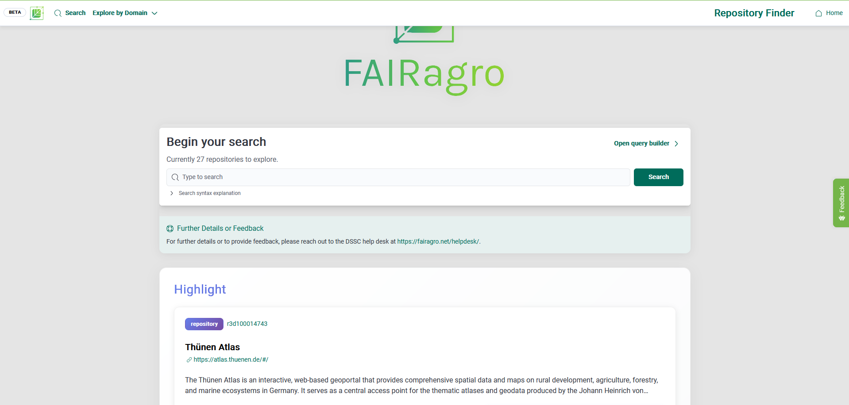
Where to find a fitting repository?
FAIRagro Search Hub - Repository Search
Resource for finding data repositories for agricultural research data
Illustration: Screenshot FAIRagro Search Hub taken on 24.04.2026
Notes:
Slide content: the FAIRagro Search Hub offers - besides the Dataset Search - the possibility to search for data repositories, that are of interest for agricultural research data and closely related domains.

