Slide 1

Kickstart Your Data Publication:
Hands-On Guide to Life Science Repositories
Helena Schnitzer and Daniel Wibberg in the name of de.NBI, Sophie Boße in the name of the FAIRagro consortium
Marcus Schmidt, Wahib Sahwan (BONARES); Lars Möller (PANGAEA); Daniel Arend, Elena Rey Mazón (e!DAL-PGP)
Notes:
To Prepare: add title, date and names of trainers (including ORCID) as well as logos. Check if you can apply CC BY license (all copyright holder of slides, illustrations etc. must agree to it) before sharing or publishing the slides.

Slide 2
Agenda
Part I (10:00 - 11:00)
Welcome & Introduction
de.NBI (ELIXIR Germany)
FAIRagro
Introducing SearchHub (Sophie Boße)
Repository Spotlights
BONARES (Marcus Schmidt, Wahib Sahwan)
PANGAEA (Lars Möller)
e!DAL-PGP (Daniel Arend, Elena Rey Mazón)
Part II (11:00-13:00)
Repository Sessions (Breakout Rooms)
Demos, Use Cases, Hands-on, Discussion
Notes:
First example: detailed structure including coffee breaks
To Prepare: add your content

Slide 3


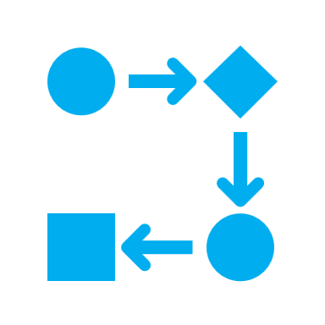

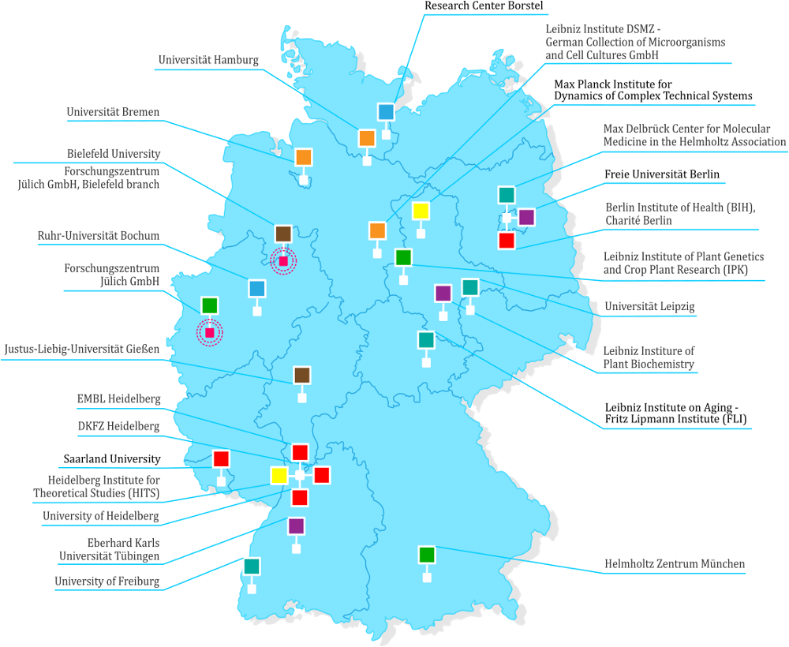


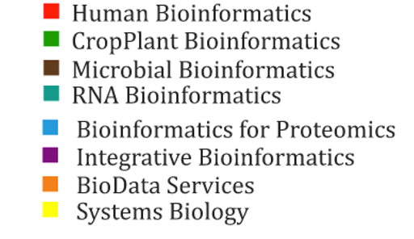
de.NBI & ELIXIR Germany
de.NBI and its Services:
Federated academic research infrastructure since 2015
Bioinformatics services & training for life sciences
Compute resources for academia in Germany
Transfer of expertise between academia and industry
ELIXIR-DE: national Node of ELIXIR Europe
24 contractual partners
8 Service Centers
Scientific expertise in various bioinformatics topics
Notes:
This slides introduces de.NBI and ELIXIR Germany.

Slide 4








What is FAIRagro?
FAIRagro is the NFDI consortium for the agrosystem research community and their data
With the FAIR principles, we aim to enhance collaboration, accelerate research progress, and address global challenges related to food security, climate change, and sustainable agriculture
Data categories
time-series
geo data
farming 4.0
sensitive data
legacy data
omics data
…
Source: “time series chart“” by I Putu Dicky Adi Pranatha, “GPS“” by Desi Ratna, “wifi“” by El Maestro Design, “Tractor“” by parkjisun, “critical data“” by Icon Designer,
“sheet“” by Hary Murdiono JS and “DNA“” by karl from Noun Project (CC BY 3.0)
Notes:
Slide content: description of the consortium and explain the data categories involved within the agrosystems research.
Extra content:
What is FAIRagro? Is a community-driven initiative within the National Research Data Infrastructure (NFDI) and focuses on the agrosystem domain needed to develop sustainable crop production and agroecosystems.
It aims to advance agrosystem research by strengthening linkages across disciplines, scales and methods through collaborative RDM and provide an integrated research data infrastructure for the agrosystem research community and their data.

Slide 5
Data Publication
Why and how to publish Research Data

Slide 6
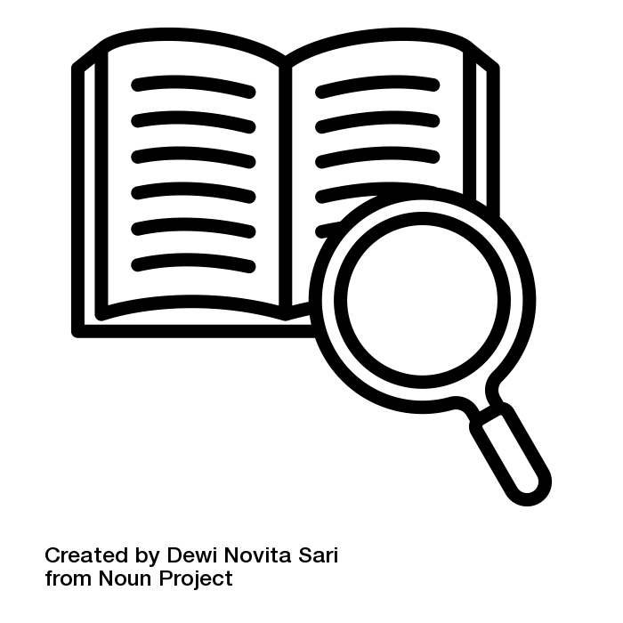
What is Data Publication?
Is the citable documentation of a dataset that makes it generally accessible.
Through data publication, research data and their descriptive metadata are publicly accessible and can be clearly referenced by assigning a persistent identifier such as a DOI or handle.
[translated from forschungsdaten.org]
Sources: forschungsdaten.org modified by FAIRagro 2025; “Definition” by Dewi Novita Sari from Noun Project licensed under CC BY 3.0
Notes:
Slide content:
When we talk about data publication, we mean more than just uploading data somewhere. It means making a dataset publicly available in a citable and structured way.
That includes good metadata, and a persistent identifier like a DOI, so others can find, reference, and reuse your data.

Slide 7

Key Features of Data Publication
Persistent Identifier (DOI): Data can be cited and tracked
Long-term Availability: Guaranteed preservation for future research
Structured Metadata: Complete, standardized documentation required
Formal Recognition: Treated as independent scientific output
Sources: forschungsdaten.org modified by FAIRagro 2025, „repository“ by Geni Alando from Noun Project licensed under CC BY 3.0
Notes:
Slide content:
From our perspective, the most recommended option for sharing data is to publish it in a data repository.
This slide illustrates the key features of proper data publication in contrast to an unstructured approach to data sharing.

Slide 8

Benefits of publishing your research data
Focus: Sustainability, Reuse & Recognition
Making data available over the long-term, reusable, citable
Making data an independent scientific result
Giving the possibility for meta-analyses
Increasing visibility, transparency, accountability
Source: Rathmann et al. 2021 modified by ZB MED 2023 and FAIRagro 2025; Illustration: Photo by Sara Kurfeß licensed under the Unsplash license
Notes:
Slide content: Why should we publish our research data?
Sustainability & Reuse: Long-term access and reuse of data
Recognition: Citation and acknowledgment as a research output
Scientific Value: Basis for meta-analyses and new discoveries
Integrity: Greater visibility, transparency, and accountability

Slide 9
Key Features of Data Publication
Once published, no further effort is needed: the dataset is available with clear rights and metadata, eliminating concerns about inquiries or licensing - it’s all set!
Source: Jordan 2025
Notes:
Slide content:
Once the data is published, access, rights, and documentation are already clarified. So you don’t have to deal with repeated requests.
Reduces follow-up effort
Provides clear rights and licensing
Ensures proper documentation through metadata
Makes data readily accessible for others

Slide 10
Components of a data publication
Dataset
Docu-
ment-
ation
Meta-
data
License
Source: Jordan 2025 modified by FAIRagro 2026
Notes:
Slide content: A proper data publication consists of four key components.
First, the dataset itself – that’s the actual data.
Second, metadata – this makes the dataset findable and citable.
Third, documentation – this explains how the data was created and how to work with it.
And finally, a license – this clarifies what others are allowed to do with the data.
Only when all four are in place, the data is not just available, but actually understandable and reusable.

Slide 11
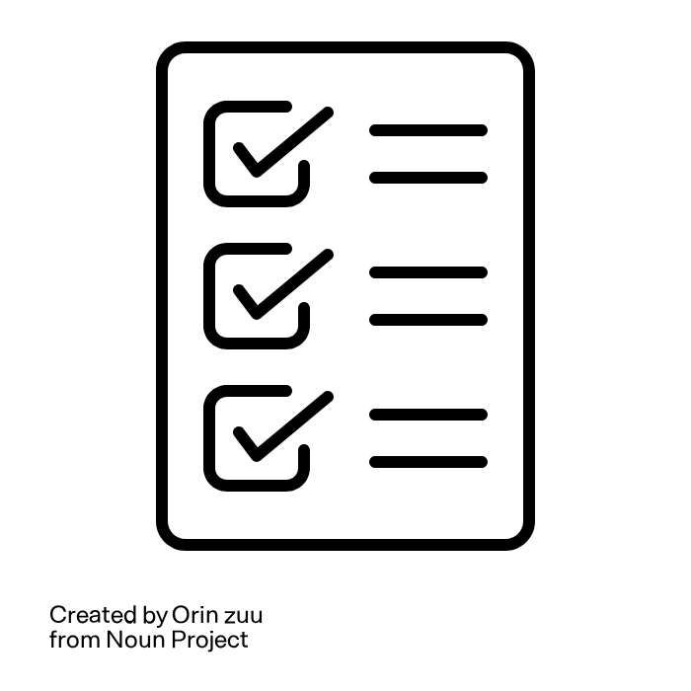
Checklist for deposit (1/2)
Step 1 - Group your files into datasets: you have individual or multiple dataset(s)?
Step 2 - Prepare your data:
Have you structured & labelled your data in a consistent manner?
Which format(s) will you deposit to help ensure the broadest accessibility by others now and in the future?
Are there any discipline-specific data formats?
Have your data been created, edited or compressed with a specific software?
Step 3 - Prepare your documentation:
Have you prepared documentation files for your dataset(s)?
Have you spelled out acronyms and explained the labels of your variables and values?
Have you included research methodology reports and any other relevant information?
Source: modified from the University of Edinburgh - Information Services - Research Data Service by FAIRagro; Illustration: “Checklist” by Orin zuu is licensed under CC BY 3.0
Notes:
Slide content:
checklist with six steps to take for preparing your data for publication.

Slide 12
Checklist for deposit (2/2)
Step 4 - Permission and rights:
Do you have all the rights to make the data available?
Have you received permission from all other right-holders?
Do you have data citations ready for any underlying "source" data?
Have you sufficiently anonymised your data, or obtained explicit consent from any data subjects whose identity could be revealed from the data (including images)?
Are you aware of, and are you comfortable with what rights you are passing on to the repository?
Step 5 - Decide if an embargo is needed before making your data open access
Step 6 - Consider an open licence:
Have you considered the use of an open licence for your data?
Are you prepared to fill in a rights statement, if the "No licence" option is chosen?
Source: modified from the University of Edinburgh - Information Services - Research Data Service by FAIRagro; Illustration: “Checklist” by Orin zuu is licensed under CC BY 3.0
Notes:
Slide content:
checklist with six steps to take for preparing your data for publication.

Slide 13
Data Repositories
Where to publish Research Data

Slide 14
What are Data Repositories?
Locations where digital (and physical) objects are stored and documented, and which enable the separate publication and archiving of these objects. Data access can be either open or restricted to a group of users.
Source: Modified from Engelhardt et al. 2022 and Rathmann et al. 2021 by ZB MED 2022; “definition” by Dewi Novita Sari fron Noun Project is licensed under CC BY 3.0
Notes:
Slide content: definition of the term “data repository”.

Slide 15
Data Repositories Classification
 | Institutional | Interdisciplinary | Discipline-specific
Range | All of the institution’s own subject area | Interdisciplinary and/or heterogeneous datasets | Visibility within the research community
Services | Research Data Management (RDM) service | Data curation and quality control not guaranteed | RDM expertise and specialised tools
Restrictions | Unrestricted access for staff members | Unsuitable for sensitive data which might have to remain in their country of origin | Data from scholars from different institutions
Examples | Apollo, ETH Zurich’s Research Collection, DepositOnce, DaKS | DRYAD, Figshare, RADAR, TIB AV-Portal, Zenodo | BonaRes, e!dal
Source: Modified from Cozatl et al. 2021 and Engelhardt et al. 2022 by ZB MED 2023
Notes:
Slide content: There are multiple different data repositories available.
institutional repositories - some institutions offer repositories, where employes can or must deposit their research data
interdisciplinary repositories - this repositories can contain a wide range of very heterogeneous research data. One of the most popular interdisciplinary repositories is zenodo
discipline-specific repositories - for data from a specific research domain, or for a specific file typ (e.g. genetic data)

Slide 16

Data Repositories Benefits
Backup
Increased data discoverability and accessibility, and thus reuse
Possibility to harvest repositories by web-based search engines, increasing visibility and citations
  BASE
  DataCite Commons
  Google Dataset Search
  LIVIVO - ZB MED Search Portal for Life Sciences
  FAIRagro Search Hub
Source: Modified from Bobrov et al. 2021 and Engelhardt et al. 2022 by ZB MED 2022, Illustration: „benefit“ by Keyy Creative is licensed under CC BY 3.0
Notes:
Slide content: Data repositories offer three main benefits.
First, they provide secure long-term storage. So your data is safely preserved.
Second, they make your data discoverable and accessible to other researchers, which enables reuse.
And third, they increase visibility: many repositories are indexed by search engines like BASE, DataCite Commons, Google Dataset Search, or LIVIVO.
This means more people can find and cite your data, which can ultimately increase your research impact.

Slide 17
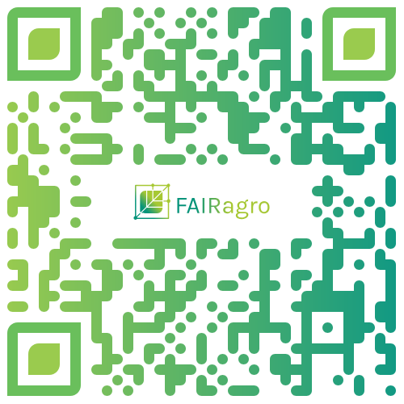
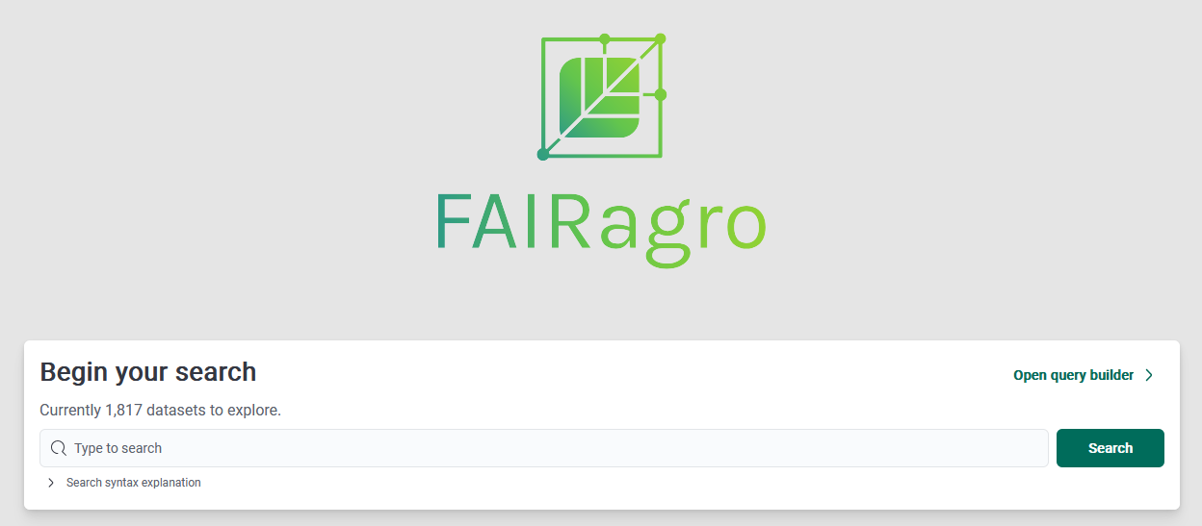
FAIRagro Search Hub
Searching multiple agricultural repositories at a time!
various search & filter functions, e.g. based on crop species or soil type
Source: FAIRagro Search Hub
Notes:
Note: This slide can be supplemented with showing the short tutorial (08-03-03-04v)
Slide content:
short presentation of the FAIRagro Search Hub, with the QR code to access it and some information about the repositories that are already integrated.
Here is also the link: https://datasets.search-hub.fairagro.net/
Search Hub provides easy findability of datasets from multiple sources like
BonaRes
OpenAgrar
e!DAL
PUBLISSO - Repository for Life Sciences
Thünen-Atlas
The FAIRagro Search Hub brings together datasets from all across the different areas of agrosystem research (mainly plants, soil and environment). The aim is to foster the implementation of the FAIR principles (Findability, Accessibility, Interoperability and Reusability) in the agricultural research domain. The FAIRagro Search Hub is not a repository itself, but harmonises metadata from many associated research data infrastructures (RDIs) such as BonaRes, OpenAgrar, and e!DAL. The metadata are automatically harvested by the FAIRagro Middleware and transformed into a standardised metadata schema. The FAIRagro Search Hub provides various search and filter functions, e.g. based on crop species or soil type. Additional options are currently under development.

Slide 18

FAIRagro Search Hub
Source: Video by Julian Schneider 2025

Slide 19
General recommendations for choosing a repository
A well-established repository in your discipline
Your institution’s repository (if available)
Repository recommended by your funding organization
A cost-free interdisciplinary repository
Source: modified from OpenAIRE, Rathmann et al. 2021 by FAIRagro 2025
Notes:
Slide content: When choosing a repository, there are a few general recommendations.
First, prefer a well-established repository in your discipline – these are usually best suited to your data and community standards.
If that’s not available, you can use your institution’s repository, which often ensures long-term access.
You can also check whether your funder recommends a specific repository.
And if none of these options fit, you can use an interdisciplinary repository like Zenodo.
If you’re unsure where to go, registries like re3data or FAIRsharing can help you find suitable options.
In general, a good repository should support long-term preservation and be appropriate for your research community.

Slide 20
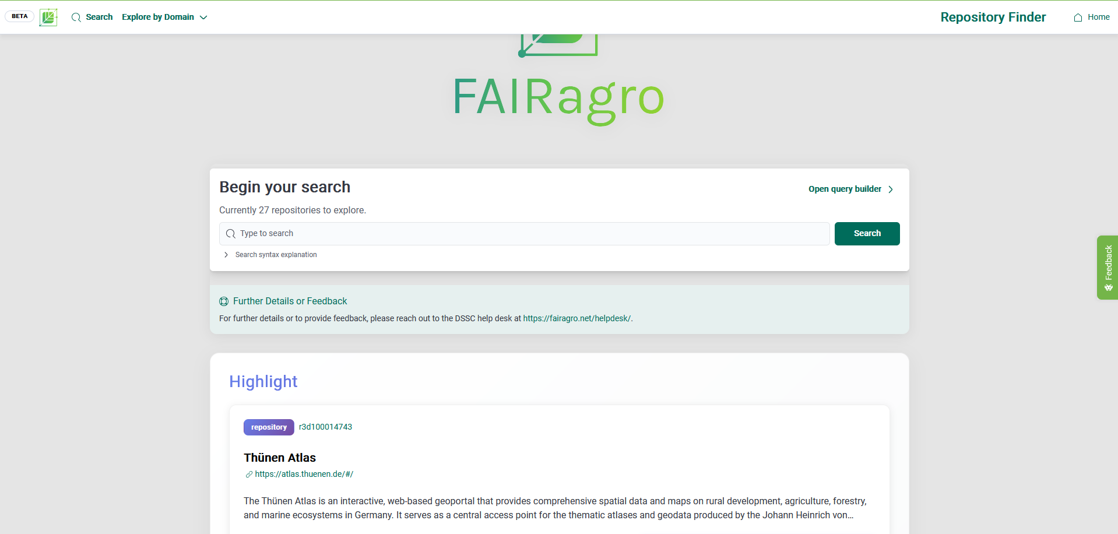
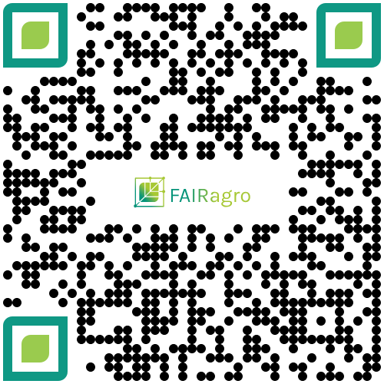
Where to find a fitting repository?
FAIRagro Search Hub - Repository Search
Resource for finding data repositories for agricultural research data
Illustration: Screenshot FAIRagro Search Hub taken on 24.04.2026
Notes:
Slide content: the FAIRagro Search Hub offers - besides the Dataset Search - the possibility to search for data repositories, that are of interest for agricultural research data and closely related domains.

Slide 21
Key questions to consider
Does the repository provide:
  Open Access to its data?
  The terms of use and licenses of the data?
  A policy to help researchers determine whether data needs will be met?
  A persistent identifier system such as assigning a digital object identifier?
Further criteria: costs, metadata to be provided, repository size, data upload restriction(s), landing pages, guidance on data citation, long-term sustainability
institutional policy
publisher requirements
community conventions
security obligations
Source: modified from Engelhardt et al. 2022, OpenAIRE, Rathmann et al. 2021, Lindlar et al. 2020 and Australian Research Data Commons by ZB MED 2023 and FAIRagro 2025
Notes:
Slide content: When evaluating a repository, there are a few key questions to consider.
Is the data openly accessible?
Are the terms of use and licenses clearly defined?
Does the repository have clear policies, so you know whether it fits your needs?
And does it assign persistent identifiers like DOIs, so your data can be reliably cited?
Beyond that, there are some practical aspects: for example, costs, metadata requirements, or upload restrictions.
And finally, external requirements also play a role, such as institutional policies, publisher requirements, community standards, or data security obligations.
So in the end, it’s not just about storing data, but choosing a repository that really supports reuse and compliance.

Slide 22
Choosing a Repository
Things to think about when looking for a repository for your data
1. What research domain belongs your data to?
2. Do you have specific data types (e.g. genetic data, geospatial data)?
3. Do you have specific file formats or big file sizes?
4. Do you have (legal) restrictions regarding the storing location of the data (e.g. european union)?
5. Do you have good reasons to publish your data with restricted access (e.g. sensitive data)?
6. Do you need an embargo to your data (e.g. for publishing a paper first)?
7. Do you want to use a specific licence for your data?
Guide: “Where to keep Research Data”
Illustration: “Checklist” by Orin zuu is licensed under CC BY 3.0

