Slide 1
Licenses

Slide 2
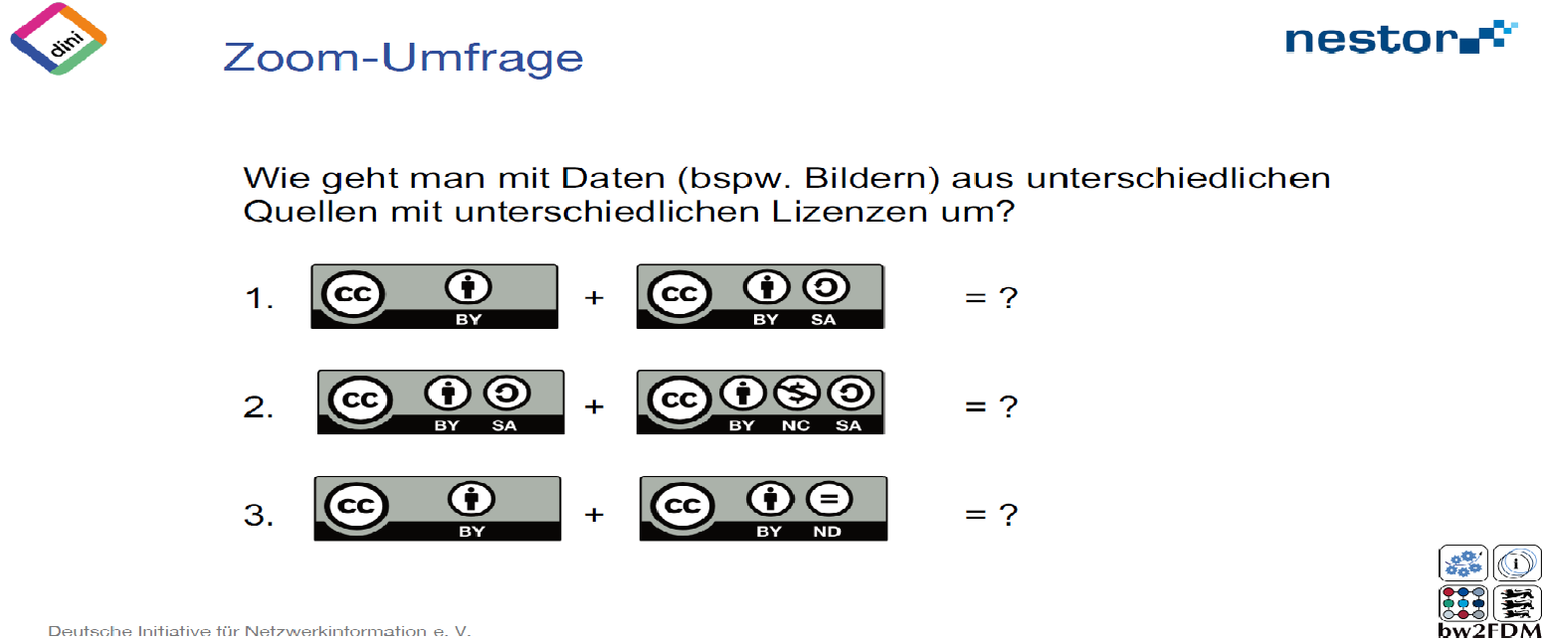
Exercise: Combining Licenses
You would like to combine datasets with different licenses. What is the resulting license?
<Foliennummer>
Source: Bobrov et al. 2021
Notes:
Note: Register for a free account on mentimeter.com or a similar tool and create slide with the questions you find in 11-01-03-04-03b. Generate a QR Code to your menti and add it, together with the Menti Code, into this slide. For online training you could also consider creating a poll in your videoconference tool.
! for this exercise, we pretend, that both datasets are protected by copyright - what is not very likely, to be honest. If wanted, you can discuss this with your participants as well !

Slide 3
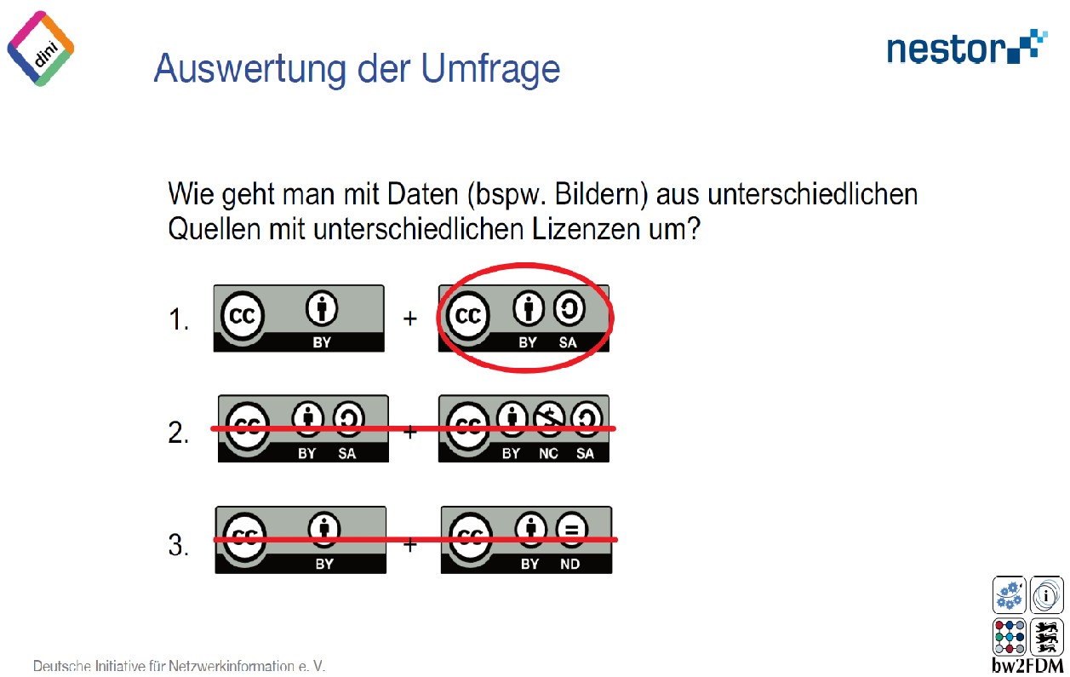
Exercise: Combining Licenses - Solution
You would like to combine datasets with different licenses. What is the resulting license?
<Foliennummer>
Source: Bobrov et al. 2021
Notes:
Note: Register for a free account on mentimeter.com or a similar tool and create slide with the questions you find in 11-01-03-04-03b. Generate a QR Code to your menti and add it, together with the Menti Code, into this slide. For online training you could also consider creating a poll in your videoconference tool.
Slide content:
Since the second dataset needs to be republished under the same licence (SA = Share Alike), the combined dataset must also have this licence. The first dataset does not provide any information on how the derivative should be licensed. The authors of both datasets need to be named.
! for this exercise, we pretend, that both datasets are protected by copyright - what is not very likely, to be honest. If wanted, you can discuss this with your participants as well !

Slide 4
Exercise: Combining Licenses
You would like to combine datasets with different licenses. What is the resulting license?
<Foliennummer>
Source: Bobrov et al. 2021
Notes:
Note: Register for a free account on mentimeter.com or a similar tool and create slide with the questionns you find in 11-01-03-04-03b. Generate a QR Code to your menti and add it, together with the Menti Code, into this slide. For online training you could also consider creating a poll in your videoconference tool.
! for this exercise, we pretend, that both datasets are protected by copyright - what is not very likely, to be honest. If wanted, you can discuss this with your participants as well !

Slide 5
Exercise: Combining Licenses - Solution
You would like to combine datasets with different licenses. What is the resulting license?
<Foliennummer>
Source: Bobrov et al. 2021
Notes:
Note: Register for a free account on mentimeter.com or a similar tool and create slide with the questions you find in 11-01-03-04-03b. Generate a QR Code to your menti and add it, together with the Menti Code, into this slide. For online training you could also consider creating a poll in your videoconference tool.
Slide content:
Since both datasets' licences require derivatives to be published under the same licence as the original, we have the problem that both original datasets aren't licensed alike. This means that the derivative of the first dataset must be licensed under CC BY SA; it cannot be licensed under CC BY NC SA, as would be required for the derivative of the second dataset. Therefore, combining both datasets is not possible!
! for this exercise, we pretend, that both datasets are protected by copyright - what is not very likely, to be honest. If wanted, you can discuss this with your participants as well !

Slide 6
Exercise: Combining Licenses
You would like to combine datasets with different licenses. What is the resulting license?
<Foliennummer>
Source: Bobrov et al. 2021
Notes:
Note: Register for a free account on mentimeter.com or a similar tool and create slide with the questions you find in 11-01-03-04-03b. Generate a QR Code to your menti and add it, together with the Menti Code, into this slide. For online training you could also consider creating a poll in your videoconference tool.
! for this exercise, we pretend, that both datasets are protected by copyright - what is not very likely, to be honest. If wanted, you can discuss this with your participants as well !

Slide 7
Exercise: Combining Licenses - Solution
You would like to combine datasets with different licenses. What is the resulting license?
<Foliennummer>
Source: Bobrov et al. 2021
Notes:
Note: Register for a free account on mentimeter.com or a similar tool and create slide with the questions and you find in 11-01-03-04-03b. Generate a QR Code to your menti and add it, together with the Menti Code, into this slide. For online training you could also consider creating a poll in your videoconference tool.
Slide content:
As the licence for the second dataset does not permit derivatives, you are not permitted to modify this dataset or combine it with others (as long as the combination leads to modification of the CC BY ND dataset).
! for this exercise, we pretend, that both datasets are protected by copyright - what is not very likely, to be honest. If wanted, you can discuss this with your participants as well !

