Slide 1
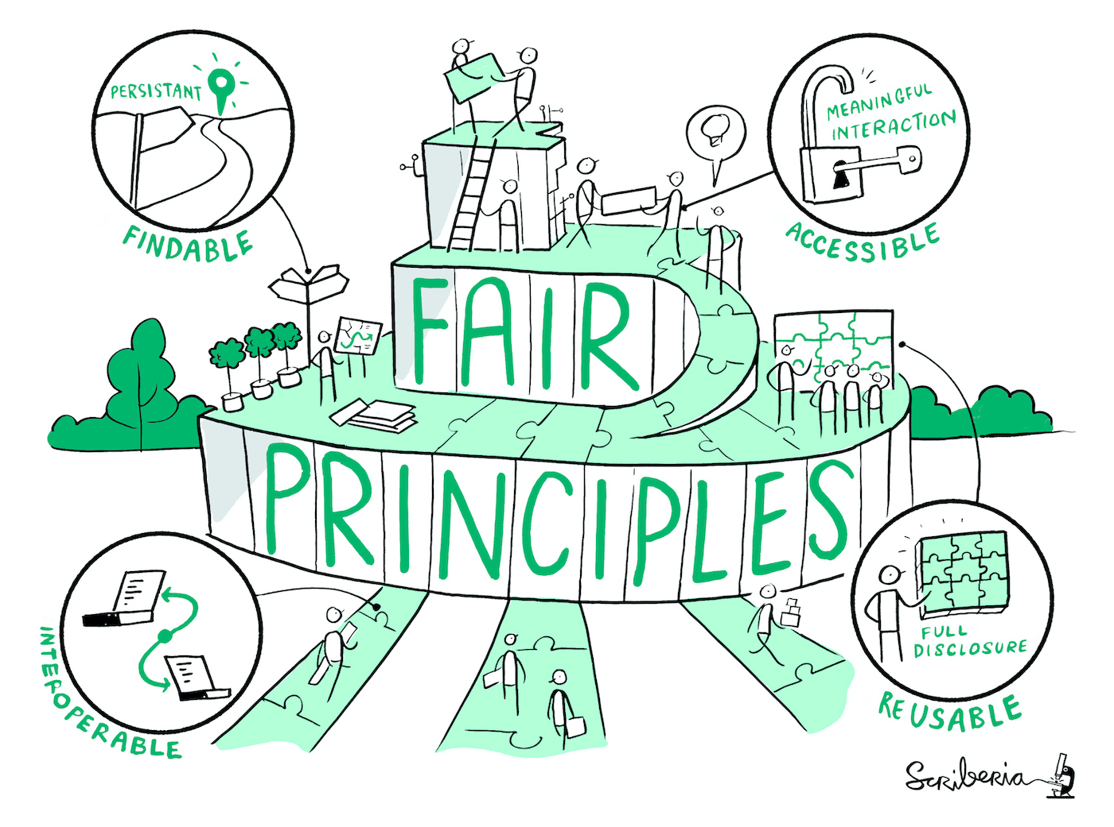
Importance of Metadata
Makes data:
  Findable, Accessible, Interoperable and Reusable (FAIR)
  Readable and understandable
  Citable
  More easily shareable across an organisation
  Consistent
Facilitates the long-term archiving of data
Makes your data more reproducible
Source: Lomax 2019 modified by ZB MED 2022 and FAIRagro,; Illustration: Image by The Turing Way Community & Scriberia (2023) is licensed under CC BY 4.0
Notes:
Slide content:
It aids in the long-term preservation of data by providing essential information needed to understand and use the data in the future.
Metadata is the backbone of effective data management, ensuring that research data is discoverable, understandable, interoperable, and reusable. It enhances the value and impact of data by facilitating its use in future research, fostering collaboration, and ensuring compliance with standards and regulations.
Findable: The first step in (re)using data is to find them. Metadata and data should be easy to find for both humans and computers. Machine-readable metadata are essential for automatic discovery of
datasets and services, so this is an essential component of the FAIRification process
Accessible: Once the user finds the required data, she/he/they need to know how they can be accessed, possibly including authentication and authorisation.
Interoperable: The data usually needs to be integrated with other data. In addition, the data needs to interoperate with applications or workflows for analysis, storage, and processing
Reusable: The ultimate goal of FAIR is to optimise the reuse of data. To achieve this, metadata and data should be well-described so that they can be replicated and/or combined in different settings

Slide 2
Types of metadata
Bibliographic | Administrative | Process | Content-describing/descriptive
Identifier of the resource, title, author, date of publication, subject, publisher, … | File types, file names, formats, location (file path), unique ID, access rights, licence, … | Used methods, used sensors, wavelength, depth of measurement, … | Crop, genotype information, variety, breeding line or variation, environmental conditions of the study, type of climate, type of soil, time of year, Geolocation, Treatment - Abiotic (e.g. light, temperature, soil, …) - Biotic (e.g. animals, fungi, …) - Crop management (e.g. application of chemicals, crop rotation, density, …), (Observed) Traits, …
Source: Engelhardt et al. 2022 and forschungsdaten.info modified by FAIRagro 2024
Notes:
Slide content:
Bibliographic metadata. Enable the citation of data and code. Help with findability and thematic delimitation.
Bibliographic metadata such as title, authors, description or keywords enable the citation of data and code and help with findability and thematic localisation.
Administrative metadata. Help with the management, reuse and long-term preservation of data.
Administrative metadata on file types, locations, access rights and licences help with the management and long-term preservation of data.
Process metadata. Describe the methods and tools used to generate and process the data.
Process metadata describes the steps and actions with the methods and tools used to create and process the data.
Content-describing or descriptive metadata. Additional information on the content and origin of the data - differentiate between discipline and data types.
Content-describing or descriptive metadata can be structured very differently depending on the discipline and provide additional information on the content and origin of the data.

Slide 3

Practical Advice
Where to add metadata during the project?
In Excel (e.g. with Colectica or Swate)
In a README file
…
Where to add metadata in publication process?
Input forms of repositories
  make sure you collect required metadata during your project
Source: Assmann et al. 2022, ZB MED 2022, ZB MED 2024,; Illustration: icon from Kücklich 2020, licensed under CC0
Notes:
Slide content:
There are different ways to collect metadata, depending on whether you are working on your project or in the publication process.

Slide 4
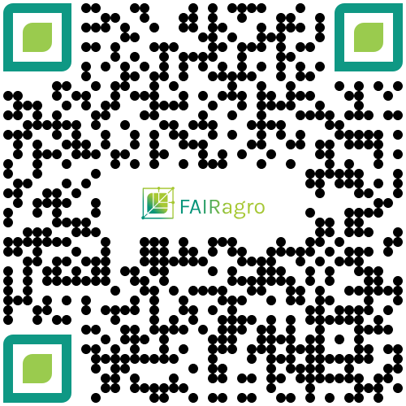
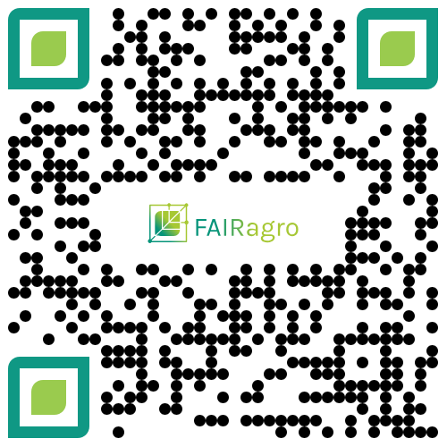
How to generate Metadata in Practice
The metadata decision tree guides you through the key questions for data documentation.
It helps you identify suitable data management practices according to your specific needs.
What will be your next steps in documenting your data?
interactive tool
practical guide
Notes:
Slide content:
The FAIRagro Metadata Decision Tree is available as interactive tool as well as practical guide in PDF format.
It guides you through the key questions for data documentation and helps you identify suitable data management practices according to your specific needs.
You can also copy the following links to the chat:
Interactive Tool: https://fairagro.github.io/metadata_decision_tree/
Practical Guide: https://doi.org/10.4126/FRL01-006490238

Slide 5
Metadata Standards

Slide 6
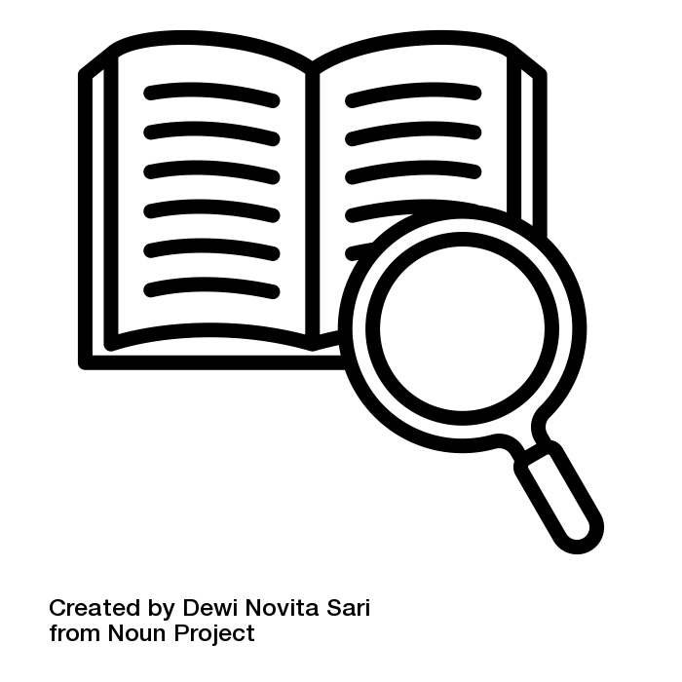
Definition of Metadata Standards
Collections of metadata elements that are used for a specific purpose (e.g. description of digital objects, description of books, …)
They are also “formal and machine-readable structure that has been established by the large research community or by an international standard organization” [KU Leuven 2022].
Source: KU Leuven 2022 modified by ZB MED 2024; Illustration: “definition” by Dewi Novita Sari is licensed under CC BY 3.0
Notes:
Slide content:
Metadata standards are established protocols and guidelines for describing, managing, and exchanging metadata. They are a collection of metadata elements used for a specific purpose.
They are machine-readable thus enhance interoperability.

Slide 7
Importance of Metadata Standards
Agreement on a standardised definition of terms leading to a common understanding
  Promoting integration in the community that follow the standard you choose
Making data Findable, Accessible, Interoperable and Reusable (FAIR)
Source: Modified from KU Leuven 2022 by ZB MED 2024
Notes:
Slide content:
This slide shows the general relevance of Metadata Standards. Metadata standards are crucial for ensuring that research data is discoverable, interoperable, and reusable. By adhering to these standards, researchers and institutions can improve the management and sharing of their data, fostering greater collaboration and innovation across disciplines.
They provide our data with Consistency, Interoperability, Quality and Discoverability.
Source: https://www.kuleuven.be/rdm/en/faq/faq-metadata-documentation#What%20is%20metadata

Slide 8
Benefits and Drawbacks of Metadata Standards
Agreement on a standardised definition of terms leading to a common understanding
Data can be more easily combined and exchanged
Guidance on what information is important in documenting your data
Time and know-how needed to understand and apply a metadata standard
Less flexibility in documenting your data as you have to follow the principles of a standard
Source: Modified from KU Leuven 2022 by ZB MED 2024
Notes:
Slide Content:
This slide shows some the direct benefits and also some the drawbacks of using Metadata Standards.

Slide 9
Metadata standards & documentation
ISO 19115 - international standard for geographic information
INSPIRE - european standard for geographic information
Darwin Core - standard for information about biological diversity
MIAPPE - Minimum Information About Plant Phenotyping Experiments
BrAPI - enables interoperability among agricultural databases and tools
Crop Ontology - supports the standardization of breeding databases
Source: RDA Metadata Standards Catalog
Notes:
Slide content:
ISO 19115-1:2014 defines the schema required for describing geographic information and services by means of metadata. It provides information about the identification, the extent, the quality, the spatial and temporal aspects, the content, the spatial reference, the portrayal, distribution, and other properties of digital geographic data and services.
The INSPIRE Directive aims to create a European Union spatial data infrastructure for the purposes of EU environmental policies and policies or activities which may have an impact on the environment. This European Spatial Data Infrastructure will enable the sharing of environmental spatial information among public sector organisations, facilitate public access to spatial information across Europe and assist in policy-making across boundaries. European states are obligated to implement de INSPIRE Directive.
Darwin Core is a metadata standard that was designed for the description of mbiological diversity
MIAPPE is an open, community driven, data standard designed to harmonize data from plant phenotyping experiments.
MIAPPE provides a specification including a checklist and a data model of metadata required to adequately describe plant phenotyping experiments.
BrAPI and the Crop Ontology are not directly standards, but help with the documentation within those.

Slide 10
Discipline-specific Metadata Standards
Check if the Data Repository you will be using has its own Metadata Schema
BonaRes Metadata scheme - for the BonaRes Repository
Check if you can use controlled vocabularies, thesauri or terminologies when collecting your metadata
AGROVOC - Thesauri which offers structured collection of agricultural concepts, terms, definitions and relationships
Source: RDA Metadata Standards Catalog
Notes:
Slide content:
This slide is like a how-to when working with discipline-specific metadata. The questions are ment as a rhetorical entry point to the topic.
AGROVOC is a relevant Linked Open Data set about agriculture available for public use and facilitates access and visibility of data across domains and languages. It offers a structured collection of agricultural concepts, terms, definitions and relationships which are used to unambiguously identify resources, allowing standardized indexing processes and making searches more efficient.
AGROVOC uses semantic web technologies, linking to other multilingual knowledge organization systems and building bridges between datasets.

Slide 11
Taking it one step further:
How to increase metadata interoperability

Slide 12

Machine understandability of metadata
The metadata description of a dataset includes a keyword “Triticum aestivum“”
X
X
Wheat
Triticum aestivun
Source: Gabriel Schneider 2024 modified by FAIRagro in 2024
Notes:
Slide content:
The metadata description of a dataset includes a keyword “Triticum aestivum”
What if someone searches for a dataset including data on common wheat but doesn’t use the scientific name?
What if the data creator produced a typo during metadata creation and typed “Triticum aestivun”?
We as humans can probably understand what is meant, but machines cannot
Therefore we need the semantic web.

Slide 13
Machine understandability of metadata
The metadata description of a dataset includes a keyword “Triticum aestivum“”
semantic web
Wheat
Triticum aestivun
Source: Gabriel Schneider 2024 modified by FAIRagro in 2024
Notes:
Slide content:
The metadata description of a dataset includes a keyword “Triticum aestivum”
What if someone searches for a dataset including data on common wheat but doesn’t use the scientific name?
What if the data creator produced a typo during metadata creation and typed “Triticum aestivun”?
We as humans can probably understand what is meant, but machines cannot
Therefore we need the semantic web.

Slide 14
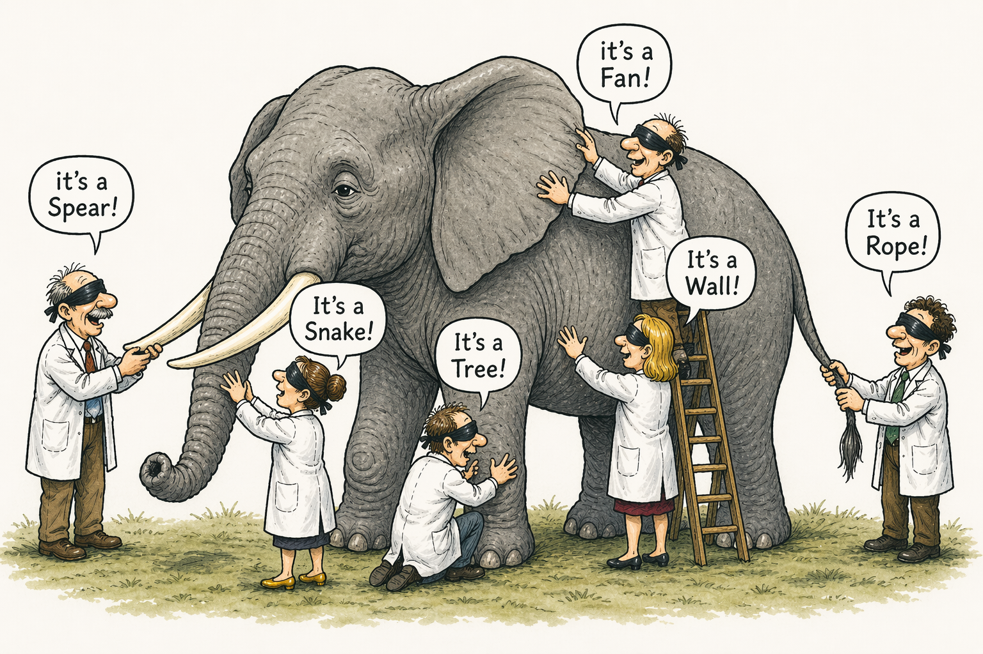
Definition of Semantic Web
Is the aim to add meaning to the available digital data in a human- and machine-readable way
Where do we find the meaning of something?
Dictionaries, encyclopedias
How can a machine read these?
Controlled vocabularies, terminologies, ontologies
Using Semantic Web concepts helps to make Metadata FAIR!
Illustration: Created by ChatGPT is public domain
Notes:
Slide content:
Look at the picture. Without proper context, identification and description may be difficult. Semantic Web aims at giving (machine-readable) context.

Slide 15


How to document?
Standards for suitable documentation:
Controlled vocabularies such as AGROVOC
Soil classification systems -> Bodensystematik, FAO's World Reference Base, USDA's Soil Classification
Gene classification -> Gene Ontology
Agricultural Data -> Crop Ontology
Illustrations: Logos of Gene Ontology, Crop Ontology are licensed under CC BY 4.0
Notes:
Slide content:
Using Semantic Web concepts is also possible within data documentation: Use controlled vocabularies (like AGROVOC) or common classification systems when ever possible.

Slide 16
AGROVOC
Multilingual semantic resource collecting concepts, terms, definitions and relationships between them
Coordinated by the Food and Agriculture Organization of the United Nations (FAO) since the 1980s
International editor cooperation
+41 200 concepts
+1 177 000 terms
up to 42 languages
Source: AGROVOC
Notes:
Slide content:
AGROVOC is a multilingual semantic resource collecting concepts, terms, definitions and relationships between them, coordinated by the FAO.
Note: The numbers may be updated before usage.

Slide 17
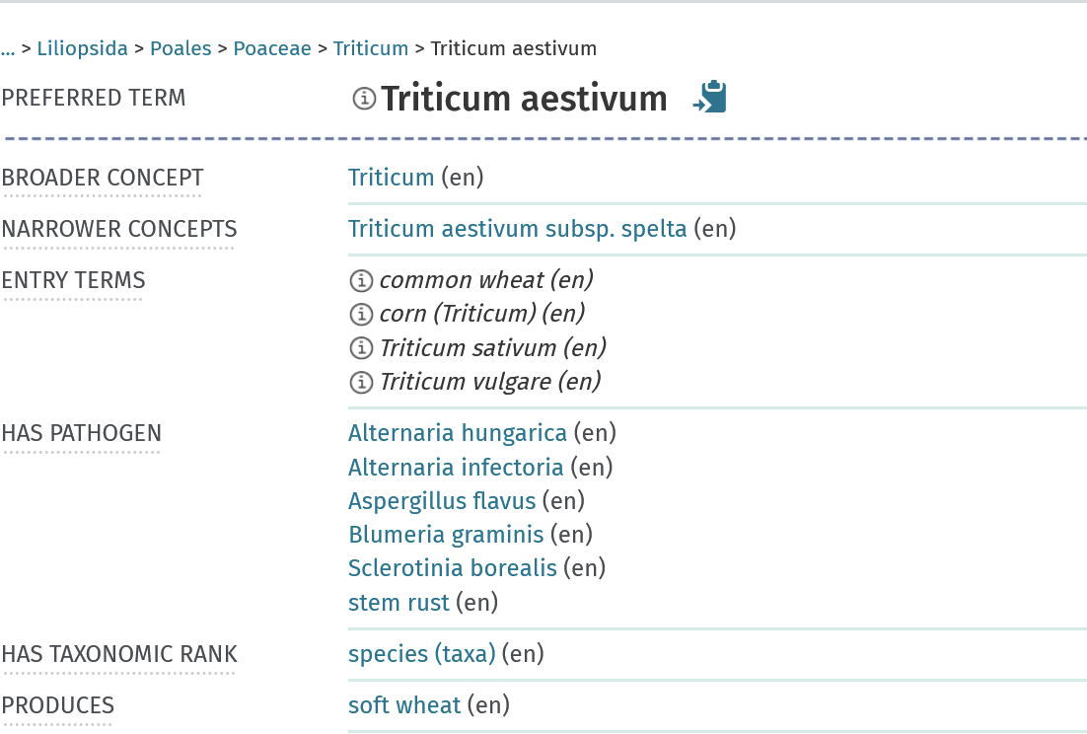
AGROVOC
Relations to other concepts and terms in AGROVOC → enables searches like “show me all pathogens related to Triticum aestivum”
Illustration: Screenshot AGROVOC from 23.04.2026, public domain
Notes:
Slide content:
AGROVOC defines relationships between terms. Example: “has pathogen”

Slide 18
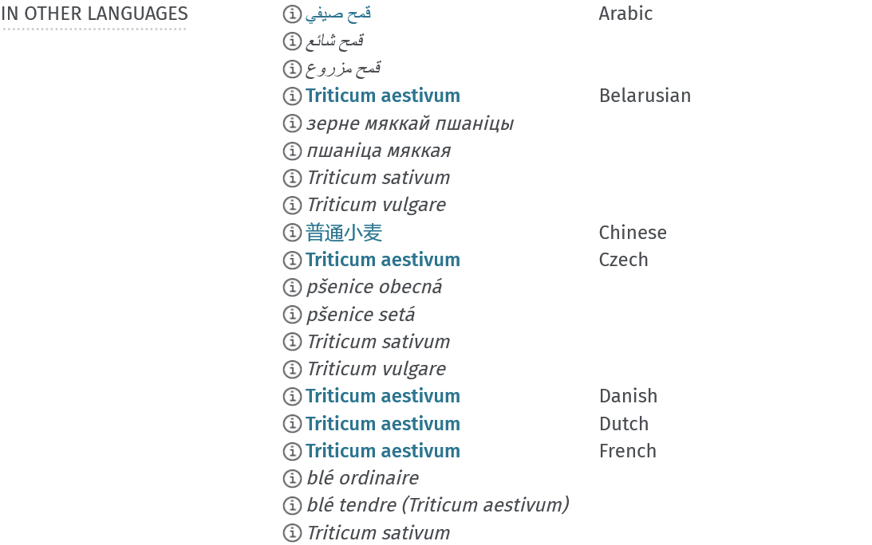
AGROVOC
Names of the same concept in different languages → enables multilingual searches
Illustration: Screenshot AGROVOC from 23.04.2026, public domain
Notes:
Slide content:
AGROVOC is avalable in many different languages

Slide 19

AGROVOC
Persistent identifier of the term
Mappings to other semantic resources
Illustration: Screenshot AGROVOC from 23.04.2026, public domain
Notes:
Slide content:
AGROVOC provides an persistent identifier (URI) for its terms and mapping to other semantic resources.

Slide 20

Exercise - Can we improve the interoperability?
Imagine a dataset with the following keywords. Can you find the fitting terms in AGROVOC? Please collect the persistent identifiers and add them to this slide with the Zoom annotation.
Triticum aestivum →
Field trial →
Fertilisation →
Irrigation →
Black rust →
use zoom annotation function!
Illustration: Screenshot Zoom from 23.04.2026, public domain
Notes:
Slide content:
Let the participants use AGROVOC. Provide the link in the chat: https://agrovoc.fao.org/browse/agrovoc/en/
Solutions see next slide.

Slide 21
Exercise - Can we improve the interoperability?
Imagine a dataset with the following keywords. Can you find the fitting terms in AGROVOC? Please collect the persistent identifiers and add them to this slide with the Zoom annotation.
Triticum aestivum →
Field trial →
Fertilisation →
Irrigation →
Black rust →
http://aims.fao.org/aos/agrovoc/c_7951
http://aims.fao.org/aos/agrovoc/c_33990
http://aims.fao.org/aos/agrovoc/c_10795
http://aims.fao.org/aos/agrovoc/c_3954
http://aims.fao.org/aos/agrovoc/c_855676a8
use zoom annotation function!
Illustration: Screenshot Zoom from 23.04.2026, public domain
Notes:
Slide content:
Exercise solution

