Slide 1
Licenses
Application

Slide 2
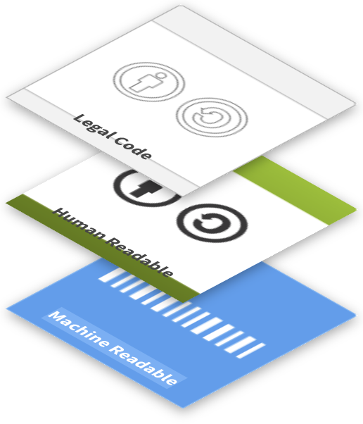
How do I license my data?
Use standardised licence contracts
  Standardized
  Available in an easy-to-read version
  No transfer of exclusive rights
  Compatible with many jurisdictions
  Common
Key question: What should others be allowed to do with my data? (And does this apply to all components, such as metadata, full texts, images, etc.?)
Source: modified from Brettschneider et al. 2021 and forschungsdaten.info by Bobrov et al. 2021, ZB MED 2022 and FAIRagro 2025;
Illustration: image from CC copyright licenses is licensed under CC BY 4.0
Notes:
Slide content:
Licensing your data creates legal certainty in terms of usability. This usability is even increased when using standardized license contracts that are internationally well known and can therefore be easily adhered to by potential users of your data.
Standardized license contracts often offer different modules with certain permissions. Therefore you have to ask yourself, what you want others to be able to do with your data, when choosing a license module.
Sometimes, funders, institutions, repositories, or research projects mandate or recommend specific licenses. Check whether a specific licence is recommended or mandatory for you

Slide 3
License Application
refer to license on website landing page
attach license to meta data of research data
set up a Read Me file with license
attach license on data source, like presentation, image, poster, publication
General rule: apply as closely to the source as possible.
Notes:
Slide content:
Because a licenses’ intend is to clarify the usage conditions, it needs to be applied as closely to the licensed object as possible.
Depending on the object, that can look differently.

