Slide 1
Policies and Guidelines
Notes:
Sophie

Slide 2
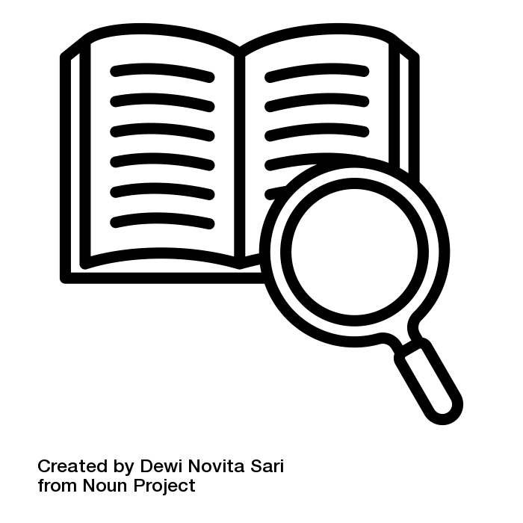
Definition of Research Data Policies
“Guidelines which apply to all members of an institution (e.g. a university) and govern how research data are to be managed.” [Forschungsdaten.info 2024]
institutional policies are legally binding for their employees
not just at academic institutions, but also funding organisations and journals
can be the legal basis for a scientists right to be cited
Illustration: “definition” by Dewi Novita Sari is licensed under CC BY 3.0
Notes:
Slide content:
RD Policies are guidelines, that set standards for RDM and apply to all members of an institution.
Often it's “just” a basic self-commitment.
They usually include the principles of open access, the FAIR principles or the rules of good scientific practice.
This is necessary for quality control within the framework of peer review.
If the policy contains regulations of the good scientific practice regarding the obligation to cite the creator of scientific data, these regulations can lead to a legal right of the creator to be cited.
Not just universities and other academic institutions have implemented RD Policies, but also many funding organisations and even some Journals and repositories.
Many journal data policies require access to the data a publication is based on for example.

Slide 3
Definition of Research Data Policies
can be discipline specific
can be implemented on institutional level
can be implemented for specific research project
can be implemented by journals
Illustration: “definition” by Dewi Novita Sari is licensed under CC BY 3.0
Notes:
Slide content:
Not just universities and other academic institutions have implemented RD Policies, but also many funding organisations and even some Journals and repositories.
Many journal data policies require access to the data a publication is based on for example.

