Slide 1
FAIR Principles

Slide 2
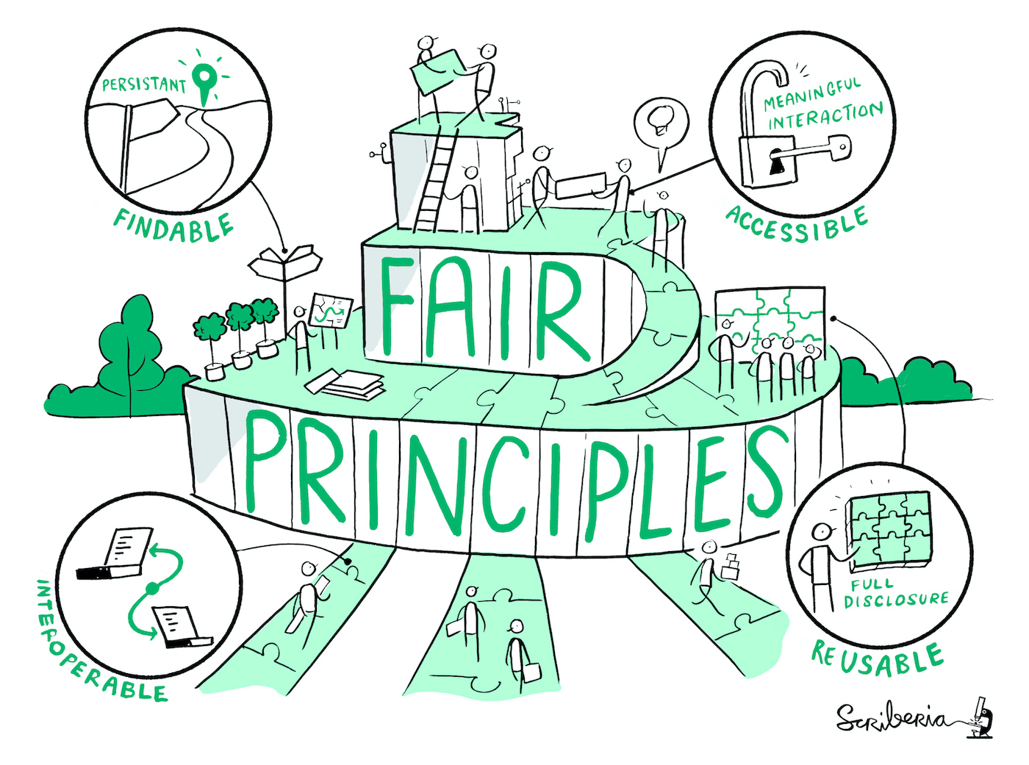
What are the FAIR data principles?
Set of principles that may act as a guideline for those wishing to enhance the reusability of their data holdings.
FAIR stands for:
Findability
Accessibility
Interoperability
Reusability
Source: Wilkinson et al. 2016 modified by ZB MED 2022, Illustration: Image by The Turing Way Community & Scriberia (2023) is licensed under CC BY 4.0
Notes:
Slide Content:
Principles that must be fulfilled when dealing with sustainably reusable research data (human and machine)
Principles that should be taken into account when setting up services or research data infrastructures
Given the multiple aspects of FAIR, data is not either FAIR or UNFAIR. FAIR is more a spectrum. In other words, data can be FAIR to a greater or lesser extent.
Findable
The first step in (re)using data is to find them. Metadata and data should be easy to find for both
humans and computers. Machine-readable metadata are essential for automatic discovery of
datasets and services, so this is an essential component of the
FAIRification process
Accessible
Once the user finds the required data, she/he/they need to know how they can be accessed,
possibly including authentication and authorisation.
Interoperable
The data usually needs to be integrated with other data. In addition, the data needs to interoperate
with applications or workflows for analysis, storage, and processing
Reusable
The ultimate goal of FAIR is to optimise the reuse of data. To achieve this, metadata and data
should be well-described so that they can be replicated and/or combined in different settings
Sources: Wilkinson et al.: The FAIR Guiding Principles for scientific data management and stewardship https://doi.org/10.1038/sdata.2016.18
European Union document: Cost-benefit analysis for FAIR research data - https://data.europa.eu/doi/10.2777/02999

Slide 3
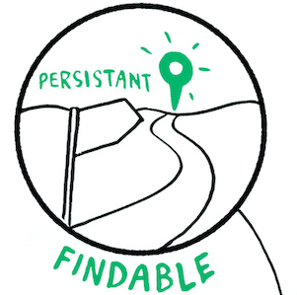
What makes your data Findable?
Assign a globally unique and persistent identifier (e.g. DOI) to your (meta)data
Describe your data with rich metadata
Metadata include the identifier of the data it describes
Register the (meta)data in a searchable resource (e.g. data repository)
Source: Modified from Wilkinson et al. 2016 by Vandendorpe & Lindstädt 2020, Image by The Turing Way Community & Scriberia (2023) is licensed under CC BY 4.0
Notes:
Slide content: In order to improve findability, we enunciate some steps to make research data more findable.
First, it means that '(Meta)data are assigned a globally unique and persistent identifier.' This is often a DOI (Digital Object Identifier), but there are other types as well. The key is that it's a unique and lasting address for your data, making it easy to locate."
Second, 'Data are described with rich metadata.' essential here to mention is, that Good metadata provide information that helps others to find data.
And third, 'Metadata clearly and explicitly include the identifier of the data it describes.' This creates a clear link between the metadata and the actual data, ensuring that there's no confusion."
Finally, '(Meta)data are registered or indexed in a searchable resource (e.g., a data repository).' This means that your data should be deposited in a place where others can search for it, like a database or online archive."
If I want to use data - first of all I must find it.
Therefore the data and/or its Metadata must be indexed in a searchable resource - and this resource needs enough information about the data that I find it by searching for suitable parameters.
When I once found it, I should be able to find it again and again by using its identifier.
We will talk about all the things that are important for that later on today: repositories, metadata, pids

Slide 4
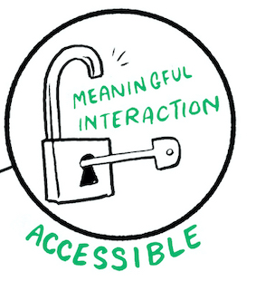
What makes your data Accessible?
Access without special or proprietary tools
Use a standardized communications protocol for your (meta)data:
  The protocol is open(-sourced), free (no-cost), and universally implementable (e.g. HTTP, FTP, ...)
  The protocol allows for an authentication and authorization procedure, where necessary
Metadata are accessible, even when the data are no longer available
Source: Modified from Wilkinson et al. 2016 GO FAIR by Vandendorpe & Lindstädt 2020 and Rathmann et al. 2021,
Image by The Turing Way Community & Scriberia (2023) is licensed under CC BY 4.0
Notes:
Slide content: once i found the data, i need access to it - by using an open, free and universally implementable standardized communication protocol.
Important: FAIR data is often, but not always open. 'FAIR ≠ FOIR (O = Open). FAIR is broader than just Open Data. Data can be FAIR without being completely open to everyone. So even if you can’t make your data openly available/ downloadable for everyone, you can still make your data FAIR by making your metadata (means the information about your data) openly available - so I can find, that this data, I really need exists, and I know, whom I need to write an email for asking for the data.
Being Accessible doesn't necessarily mean that everyone can immediately download your data, but it does mean that there are clear ways to access it.
Standardized…: This means that if someone has the identifier, they can use a standard web protocol to find information about the data (metadata).
The 'protocol is open… : This ensures that access isn't restricted by special software or expensive tools.
And 'Metadata are accessible… : Even if the data itself is removed (for legal or ethical reasons, for example), the metadata should remain. This is important for transparency and reproducibility.

Slide 5
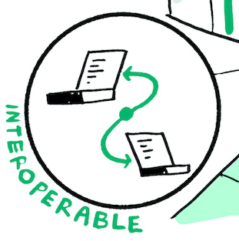
What makes your data Interoperable*?
Use for your (meta)data:
  vocabularies & thesauri
  language for knowledge representation (ontologies)
Include in your (meta)data qualified references to other (meta)data
* Data interoperability is the ability of a dataset to work with other datasets or systems without special effort on the part of the user.
Source: Modified from Wilkinson et al. 2016, GO FAIR and Open Data MOOC by ZB MED 2022, Image by The Turing Way Community & Scriberia (2023) is licensed under CC BY 4.0
Notes:
Slide content:
Imagine trying to combine data from two different spreadsheets where the columns are labelled differently – that's a lack of interoperability.
(Meta)data use vocabularies that follow FAIR principles. Controlled vocabularies and ontologies help ensure that terms are used consistently
The data usually needs to be integrated with other data
Interaction/integration of data with applications/workflows for analysis, storage and processing
Therefore, datasets should be compatible with other datasets or systems without special effort on the part of the user.
(Meta-)data include qualified references to other (meta-)data
This means linking your data to related datasets, allowing for a network of interconnected information
Readable data for computers:
Commonly used vocabulary, ontologies, thesauri (PID)
Good data model (defined framework for describing and structuring (meta-)data)
So, after finding and downloading the data, I need to be able to open it. So that means, the data needs to be interoperable - it works with other datasets or systems without special effort. So if the Data is in a common and open format, I don’t need to buy 20 licenses for special software.

Slide 6
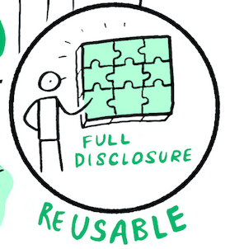
What makes your data Reusable?
Describe your (meta)data with accurate & relevant attributes
Release your (meta)data with a clear and accessible data usage license
Associate your (meta)data with detailed provenance
A good example:
Papoutsoglou, E. A. (2022) „A case-study for improved reusability of plant phenotyping data with MIAPPE“. Zenodo. doi: 10.5281/zenodo.5572772
Source: Modified from Wilkinson et al. 2016, GO FAIR by ZB MED 2022, Image by The Turing Way Community & Scriberia (2023) is licensed under CC BY 4.0
Notes:
Slide content:
(Meta-)Data are associated with detailed information of origin.
Detailed description of the (meta-)data:
Context were the data generated (experimental protocols, etc.)
Special features or limitations of the data
Generation of the data: when, under what circumstances, who, parameter settings, name and version of software used
Is it raw data or processed data?
Variable names should be explained or self-explanatory (i.e., defined in the controlled vocabulary of the research domain)
Link data to licenses (under what conditions may data be reused)
Provenance is the history of the data – how it was collected, processed, and modified. This helps others assess its quality and reliability.
…data usage license
Once I found the data, I downloaded it and I opened it, I still need two things for being able to reuse the data: I need to know, if I am allowed to reuse the data (therefore it needs to be properly licensed), and I need to understand the data - therefor I need enough information about the data - it must be properly documented.

Slide 7
FAIR Data = Open Data?
Data may be consistent with FAIR principles, but may have limited access.
If you have sensitive data, you have to think about:
  Ethical, legal and technical issues
  Pay special attention to data collection, processing, handling, & storage
As open as possible, as closed as necessary
Source: Modified from de.NBi (2025)
Notes:
Slide content:
here we talk about the difference between FAIRa data and Open Data.
There are multiple reasons why data can not be shared openly:
We have to think about the ethical issues of our (meta-)data before we think about publishing them
This is especially important when it comes to sensitive or confidential data
What are sensitive (meta-)data?
Personal data (name, ID number, physical, physiological, genetic, mental, economic, cultural or social characteristics), biological characteristics/data.
What are confidential (meta-)data?
Financial, passwords, trade secrets, …
Nevertheless: Data that is not openly available can still be FAIR, if comprehensive metadata is available.
So therefore we would recommend: make your data as open as possible, but as closed as necessary

Slide 8
Exercise: FAIR or not FAIR?
Case 1: The results of a study for which interviews were conducted among farmers on their pest management interactions has been published in a professional journal. The associated data are located on a relevant repository and are appropriately tagged with metadata and linked to the article.
One of the farmers withdraws their consent for the publication of the data for personal reasons. Therefore, all data are deleted from the repository, but the metadata remain and are supplemented by an explaining note.
Source: Adapted from Bobrov et al. 2021 by FAIRagro
Notes:
Note: participants must read the texts and decide (giving reasons) why the cases presented can be considered FAIR or NOT FAIR.
This slide block are a quiz to help the audience understand with real examples how to apply the FAIR principles for a given situation.
The solutions to every case are given always afterwards and if needed, there should be some time for an open discussion, so the main points are clear to the audience.

Slide 9
Exercise: FAIR or not FAIR?
Case 1: The results of a study for which interviews were conducted among farmers on their pest management interactions has been published in a professional journal. The associated data are located on a relevant repository and are appropriately tagged with metadata and linked to the article.
One of the farmers withdraws their consent for the publication of the data for personal reasons. Therefore, all data are deleted from the repository, but the metadata remain and are supplemented by an explaining note.
→ Solution: FAIR
Source: Adapted from Bobrov et al. 2021 by FAIRagro
Notes:
Slide content:
solution: the (meta)data will always be findable, if anyone wants to know more about this study, the can always contact the researcher listed in the (meta)data information.

Slide 10
Exercise: FAIR or not FAIR?
Case 2: For a master's thesis in agricultural science, soil samples are analyzed by a machine. The student compiles extensive metadata for the publication of the data. To be sure that the correct version of the experimental protocol of the analyzing machine is used, they take a photo of the type plate and provide it under the name "protocol used".
Source: Adapted from Bobrov et al. 2021 by FAIRagro
Notes:
Note: participants must read the texts and decide (giving reasons) why the cases presented can be considered FAIR or NOT FAIR.
This slide block are a quiz to help the audience understand with real examples how to apply the FAIR principles for a given situation.
The solutions to every case are given always afterwards and if needed, there should be some time for an open discussion, so the main points are clear to the audience.

Slide 11
Exercise: FAIR or not FAIR?
Case 2: For a master's thesis in agricultural science, soil samples are analyzed by a machine. The student compiles extensive metadata for the publication of the data. To be sure that the correct version of the experimental protocol of the analyzing machine is used, they take a photo of the type plate and provide it under the name "protocol used".
→ Solution: not very FAIR
Source: Adapted from Bobrov et al. 2021 by FAIRagro
Notes:
Slide content:
Solution: the way to publish the machine protocol is not interoperable. The picture taken will not be readable by a machine.

Slide 12
Exercise: FAIR or not FAIR?
Case 3: An international group of several universities is working closely with a company from the agricultural engineering industry to develop a new field robot. The findings from this collaboration are presented in overview articles and the data are stored and made accessible in a repository set up specifically for this project. The data is only accessible to people within the group, as several patent cases are pending. Externals can only access the metadata referencing this item.
Source: Adapted from Bres et al. 2022 by FAIRagro
Notes:
Note: participants must read the texts and decide (giving reasons) why the cases presented can be considered FAIR or NOT FAIR.
This slide block are a quiz to help the audience understand with real examples how to apply the FAIR principles for a given situation.
The solutions to every case are given always afterwards and if needed, there should be some time for an open discussion, so the main points are clear to the audience.

Slide 13
Exercise: FAIR or not FAIR?
Case 3: An international group of several universities is working closely with a company from the agricultural engineering industry to develop a new field robot. The findings from this collaboration are presented in overview articles and the data are stored and made accessible in a repository set up specifically for this project. The data is only accessible to people within the group, as several patent cases are pending. Externals can only access the metadata referencing this item.
→ Solution: FAIR
Source: Adapted from Bres et al. 2022 by FAIRagro
Notes:
Slide content:
Solution: since the metadata is accessible for everybody, the study is findable not only for the participants but also for external users.

Slide 14
Data Management Plan

Slide 15


What is a data management plan (DMP)?
A DMP is a living document
It is created at the beginning of a research project
It is updated regularly as the project progresses
It defines the strategy for managing, storing, documenting, and sharing research data
What
How
Who
Source: by Daniel Wibberg, Helena Schnitzer (de.NBi), RDMkit modified by FAIRagro 2026; Illustration: from RDMkit by Elixir is licensed under CC BY 4.0
Notes:
Slide content: A Data Management Plan (or DMP) is a formal and living document describing the data, their generation and processing during the project, as well as how the data and research results will be archived afterwards to remain available, usable and comprehensible.
It’s written at the start of your research project, before starting to collect data,
and you should update it as your project evolves. But it's not like you write it at the beginning, put it in the box and never look at it again.
The DMP helps you define how you’ll handle, document, store, and share your data throughout the research lifecycle.
Some key questions are: What data will be collected? How will it be stored? Who will have access?

Slide 16
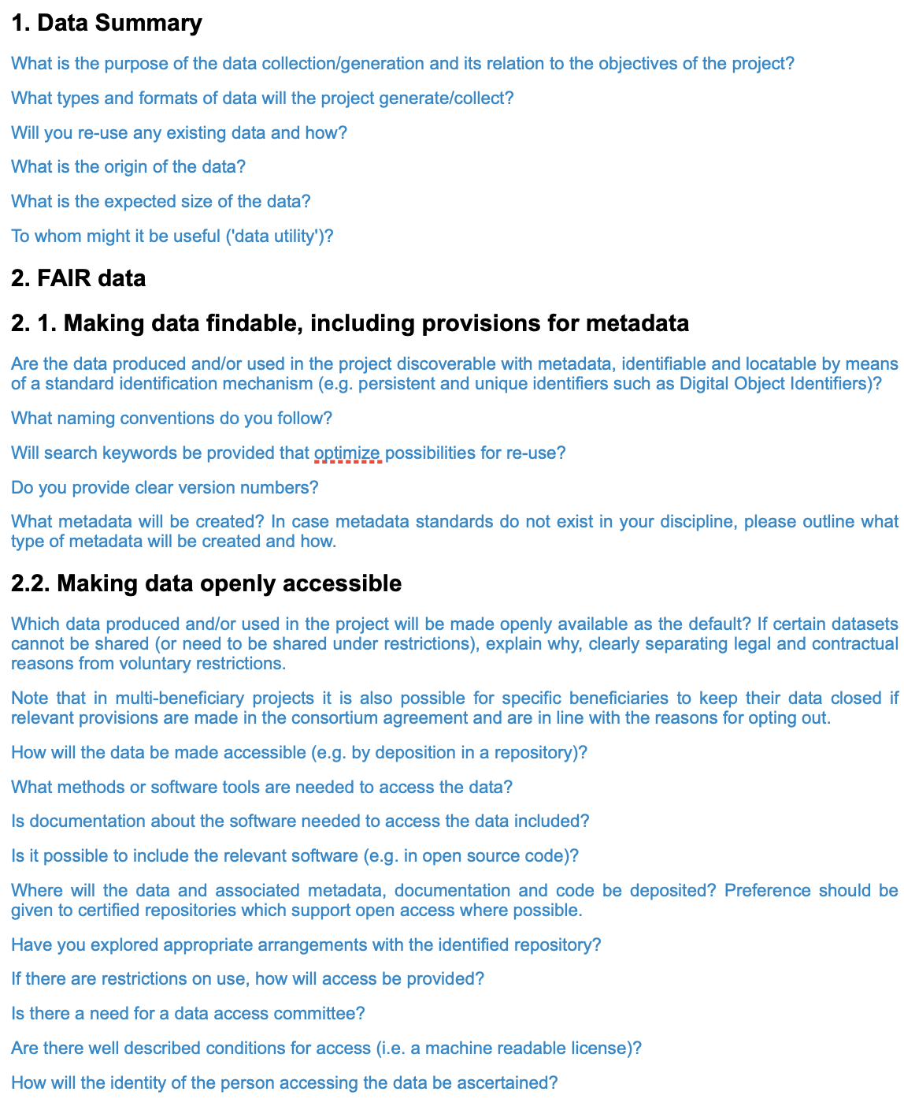
Purpose and Practical Use of a DMP
A formal but flexible document: describes the data, how it is collected, processed, stored, shared, and preserved
Covers both short-term and long-term data handling
A DMP is not just for funders: it helps you plan, save time, and avoid problems later
You don’t need to start from scratch – use templates and tools
Example on the right: EU Horizon 2020 DMP Template
Source: by PUBLISSO by ZB MED 2023 modified by FAIRagro; Illustration: Screenshot from European Commission taken on 24.07.2025
Notes:
Slide content: A DMP is both a formal requirement and a very practical tool.
The DMP outlines the long-term and short-term handling of all data generated in the course of the research project. From collection and storage to sharing and long-term preservation.
-> more and more funders require a DMP in the proposal
-> but its not just bureaucracy - it can really help you to save time, nerves and money in the long run, if you have invested time in planning out your rdm strategy in the beginning. It helps you to avoid mistakes, and plan your work more effectively.
The good news is: you don’t have to start from scratch. There are plenty of helpful templates — like the one from Horizon 2020, which you can see here on the right. It contains key questions that a DMP should address.

Slide 17


Importance of DMPs
please go to menti.com
enter Code: XXX XXX
or scan the QR Code
replace me!
Illustration: photo by John is licensed under the Unsplash license
Notes:
Note: Register for a free account on mentimeter.com or a similar tool and create slide with the question "Why do you think DMPs are important?". Generate a QR Code to your menti and add it, together with the Menti Code, into this slide.
Slide content: Let’s hear from you now.
Please go to menti.com and enter the code you see on the slide.
I’d like you to answer this short question: Why do you think DMPs are important?
Don’t worry about getting it ‘right’. Just write what comes to mind. We’ll look at your answers together in a moment.

Slide 18
Data management plan
Why Create a Data Management Plan (DMP)?
Required by many research funders
Helps avoid problems and unexpected costs
Enables re-use and reproducibility of your data
Increases the long-term impact of your research
Makes your work more efficient with FAIR principles and support tools
Source: Daniel Wibberg, Helena Schnitzer (de.NBi) modified by FAIRagro 2025; RDMkit by FAIRagro 2026; Illustration: from RDMkit is licensed under CC BY 4.0
Notes:
Slide content: Even though we’ve already looked at what a DMP is and how to write one, it’s worth asking: Why is it actually important?
First of all, many funders require a DMP. It’s simply expected.
But even more importantly, a good DMP helps you avoid surprises, manage your data better, and increase the long-term impact of your research.
It also makes your work more efficient, because you plan early how to use tools, services, and store or share your data in a FAIR way.

Slide 19
Funder Requirements
Funder | Requirements | Submit with proposal | Content | Update | Link
EC Horizon 2020 | DMP | No; first plan is needed within the first 6 months of the project. | According to H2020 Template | Yes, in case of significant changes and end of the project. | Online Manual
DFG | Information about handling with scientific data | Yes | According to the DFG Codex on Data Management | No | Principles of DFG Funding
BMBF | Depending on the project | Yes (depending on the project) | Depending on the project | Depending on the project | Aktionsplan Forschungsdaten
Source: Daniel Wibberg, Helena Schnitzer (de.NBi) and RDMkit modified by FAIRagro 2025
Notes:
Slide content: Let’s take a quick look at how some major funders handle data management plans.
the European Commission (Horizon 2020 and Horizon Europe) requires a DMP, but you don’t have to submit it with the proposal, the first version is due within the first 6 months.
The DFG expects you to explain how you’ll handle research data already in the proposal, following their codex.
The BMBF varies more. Some calls include strict requirements, others don’t.
So, always check the specific call text and guidelines, and remember: even if it’s not mandatory, a DMP can still be a great help in structuring your project and preparing your proposal.

Slide 20
Why Data Management?
Goal: Reproducibility !!
Requirements
Good scientific practice
Institutional guidelines
Requirements from funding agencies
Legal and ethical frameworks
Benefits
Saves time and resources
Improves data security (less risk of data loss)
Enables reproducibility of experiments
Makes data reusable by others (and yourself!)
Source: by Daniel Wibberg, Helena Schnitzer (de.NBi) and RDMkit modified by FAIRagro 2026
Notes:
Slide content: There are two main reasons why good data management matters
First, the requirements: data management is part of good scientific practice, it's often required by your institution, your funder, and even by law, especially when personal or sensitive data is involved.
But the benefits go far beyond compliance:
A clear data strategy helps you save time, avoid data loss, and makes your research more reproducible and reusable (for others and for yourself later on).
So even if no one forces you to do it — it’s worth doing well.

Slide 21
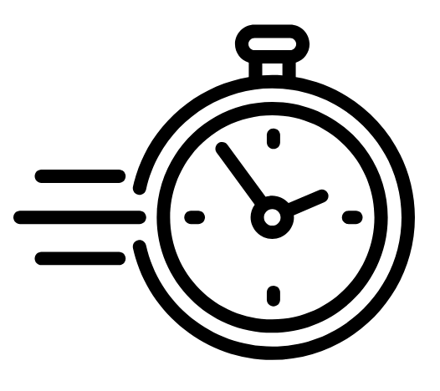
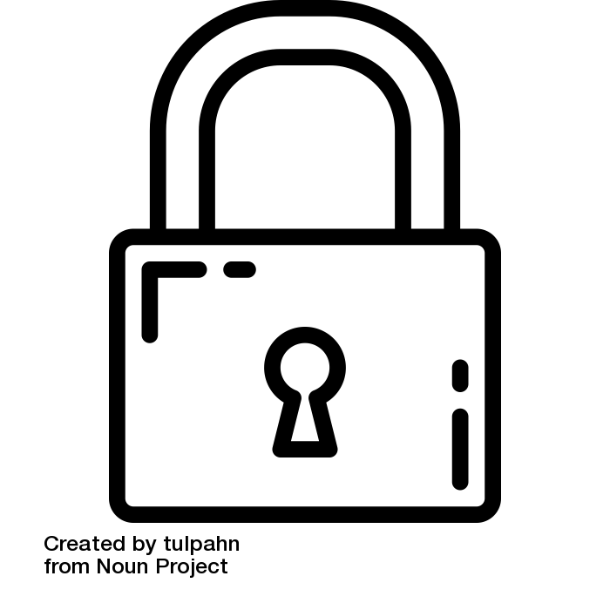

Importance of DMPs
Saving time for your future self.
Identifying time and money costs to be included in the proposal.
Regulate access rights and preventing security holes.
Facilitating data reuse.
Ensuring ethical and legal requirements are fulfilled.
Enabling verification and control.
Supporting research integrity.
Part of the funder requirements.
Source: Modified from ZB MED by FAIRagro 2026; Illustration: “Time” by Rena Putri, “Lock” by tulpahn, “legal” by Creative Mahira are licensed under CC BY 3.0
Notes:
Slide content: Here’s a summary of why DMPs really matter (not just for funders, but for your own research).
A good DMP can save your future self a lot of stress, help you plan costs and responsibilities, and ensure you're not overlooking ethical, legal, or security issues.
It also increases the impact and reusability of your data and supports transparency and scientific integrity (all essential aspects of good research).
And of course, in many cases, it’s a mandatory part of the funding process.

Slide 22
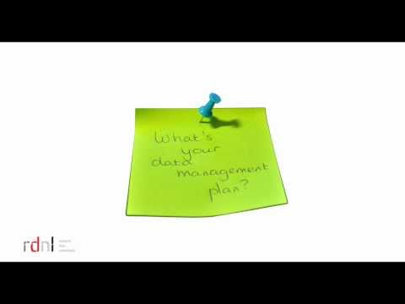
The what, why and how of data management planning
Video: research data netherlands is licensed under Youtube License
Notes:
Note:
If wanted, you can watch this short video with the participants. Plan 5 minutes more time for that.
Slide content: To wrap up this section, here’s a short video that nicely summarizes the what, why, and how of data management planning.
It’s part of an open course developed in the Netherlands and gives you a quick and practical overview, especially helpful if you're new to the topic.

Slide 23
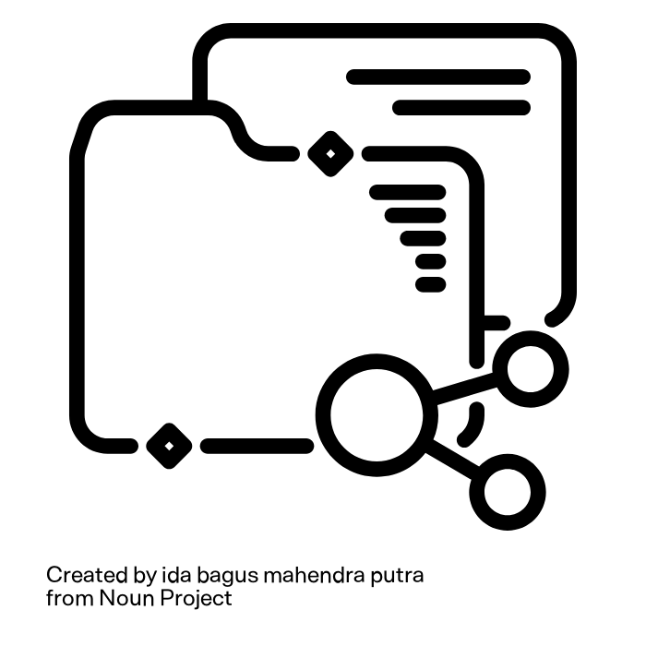
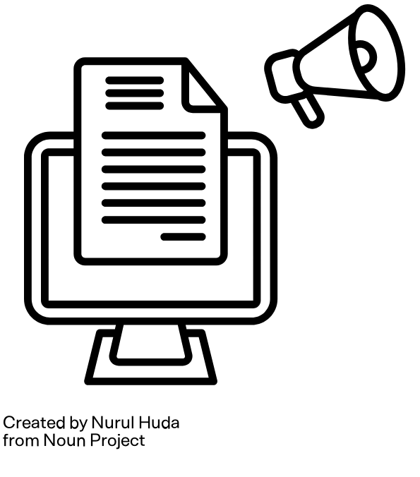

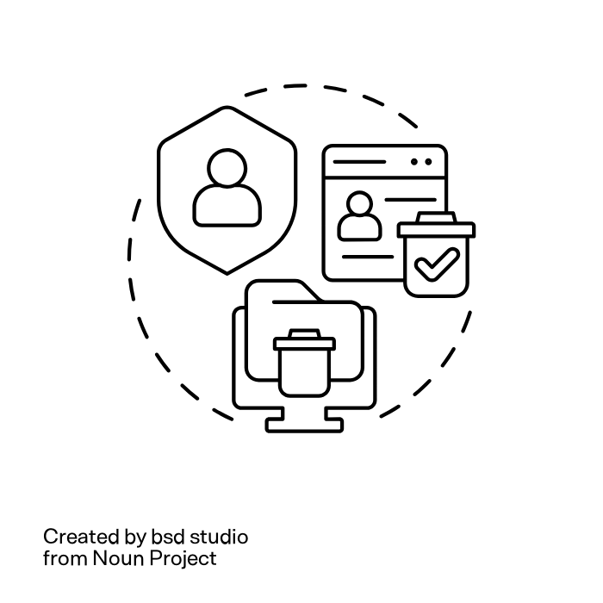

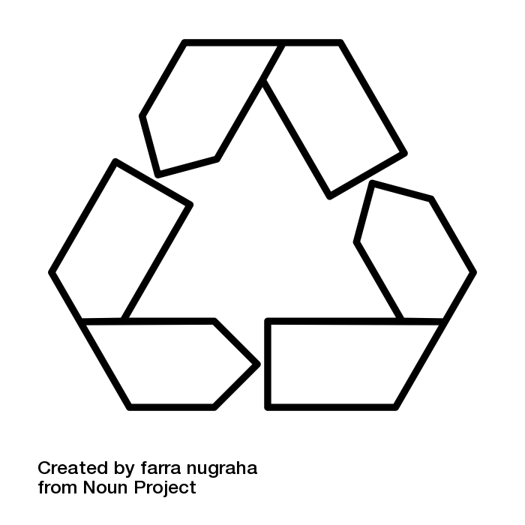
Content of a Data Management Plan (DMP)
Documentation and metadata
Secure storage and backup
Publication
Data sharing
Reusable data
Digital preservation and deletion
Legal aspects
Costs and resources
Source: by openscience.cuni.cz modified by FAIRagro; Illustrations: “Document” by Hanbai, “Lock” by tulpahn, “Sharing” by ida bagus mahendra putra,
“publication” by Nurul Huda, “reusable” by farra nugraha, “Data deletion” by IMG visuals icons, “legal” by Creative Mahira, “costs” by Adrien Coquet are licensed under CC BY 3.0
Notes:
Slide content: A Data Management Plan, or DMP, describes how research data is handled throughout its entire lifecycle (from collection to long-term preservation).
It typically covers several key areas.
First, documentation and metadata: what kind of data is collected, and how it is described so others can understand and reuse it.
Second, storage and security: how the data is stored, backed up, and protected during the project.
Third, data sharing and publication: which data will be shared, with whom, and in which repositories.
Then, long-term aspects: which data should be preserved, which can be deleted, and what has reuse potential.
Legal aspects are also essential, for example data protection, ethical considerations, and licensing.
And finally, a DMP addresses costs, resources, and responsibilities.
So it’s clear who is responsible for what, and what is needed to manage the data properly. So a DMP is not just a document, but a structured plan for handling data responsibly.

Slide 24
Creating a Data Management Plan
What to consider?
Define clear responsibilities
Follow relevant guidelines and standards (depending on your institution or funder)
Use helpful DMP templates and tools
Get support from experts:
  IT department
  Library or data managers
  Data protection officers
  Research Data Service of the University/institution
  Helpdesk of the FAIRagro Data Steward Service Centre
  etc.
Source: Daniel Wibberg, Helena Schnitzer (de.NBi) modified by FAIRagro 2025; Illustration: from RDMkit by Elixir is licensed under CC BY 4.0
Notes:
Slide Content: Finally, when you start working on your Data Management Plan, keep a few things in mind.
First: Define responsibilities clearly. Who takes care of what in your data workflow?
Then: Check if there are guidelines or requirements from your funding organization, research infrastructure, or university. These can influence how your DMP should be structured.
Don’t start from scratch, there are many DMP templates and online tools that guide you through the process.
And most importantly: Get support. You don’t have to do this alone. Talk to your IT department, library, data protection officer, or a data steward. At your University or institution, you can also contact the Research Data Service. And for projects in the agricultural sciences, the FAIRagro Helpdesk can assist you with FAIR data and DMP writing.

