Slide 1
Data Documentation

Slide 2

What is Documentation?
“Document or documents included with your data that describe(s) the details of the data and how it was generated” [KU Leuven 2022].
Illustration: “definition” by Dewi Novita Sari is licensed under CC BY 3.0
Notes:
slide content:
Definition of data documentation:
“Document or documents included with your data that describe(s) the details of the data and how it was generated” [KU Leuven 2022].

Slide 3
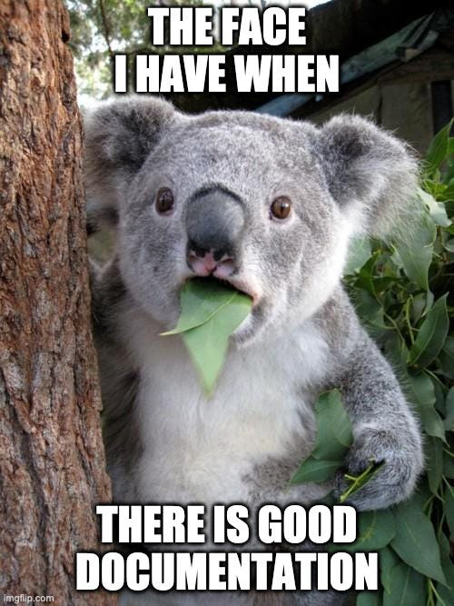
Importance of data documentation
For reusing research data, it must be described in a meaningful way and in as much detail as possible:
for other researchers
for other team members
for your future self
It is good to document how, when and for what purpose the data was created as soon as it is created.
Source: forschungsdaten.info, Illustration: image from imgflip.com - free to use acc. to copyright exeptions
Notes:
slide content:
Why is data documentation important for data re-use? → reproducibility, comprehensibility
How to document? → in a meaningful way, in as much detail as possible
For whom? → other researchers or team members and you future self
The documentation of the “how”, “when” and “for what purpose” is a lot easier to do as soon as data is created instead of waiting until the end of the project
This slide highlights the importance of documentation for data re-use.

Slide 4
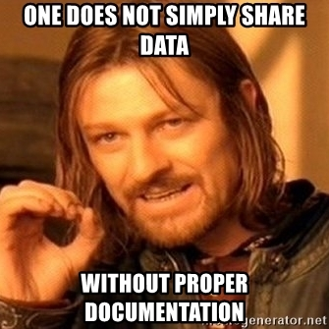
Importance of data documentation
Without documentation, you risk:
Not being able to find data again
No longer being able to trace the origin of data
No longer being able to interpret data due to missing context information
Mixing up files (outdated or competing versions)
Not being able to exchange data with other people or merge it with data from other sources
<Foliennummer>
Source: forschungsdaten.info, Illustration: image from Meme Generator- free to use acc. to copyright exeptions
Notes:
silde content:
Why is data documentation important? What do you loose without it? Some of the risks are listed on this slide.

Slide 5
Benefits of Documentation
Making data:
  understandable
  reusable
Guarantee the reproducibility of research
!! Adequate documentation is part of
good scientific practice!
(Guideline 12, Guidelines for Safeguarding Good Research Practice, DFG)
Source: Modified from Engelhardt et al. 2022 and KU Leuven 2022 by ZB MED 2023,; Illustration: image from Meme Generator - free to use acc. to copyright exeptions
Notes:
Slide Content:
Without documentation, you run the risk of not being able to retrieve data:
no longer being able to trace the origin of data,
no longer being able to interpret data due to a lack of contextual information,
confusing files (outdated or competing versions),
not being able to exchange data with other people or merge it with data from other sources
🡪🡪Adequate documentation is part of good scientific practice!

Slide 6

Content of Documentation
Description of the research project
Project goals
Hypotheses
Information on data collection
Measures for data cleaning and steps of data processing
Structure of the data and relationship of files to each other
Explanation of variables, labels and codes
Differences between different versions
Information on access and terms of use
Source: Modified from Biernacka et al. 2022 by ZB MED 2022,; Illustration: icon from Kücklich 2020 is licensed under CC0
Notes:
slide content:
What is the content of (good) data documentation? There are several elements that should be considered for good documentation. Some may also differ with different context.

Slide 7
Levels of data documentation
Study-level documentation
overall context of the research
1
Data-level documentation
describes individual data files
2
Metadata
standardised, structured data about the data
3
Source: Wolff, Musloff 2024 (FDM-BB Zertifikatskurs) modified by FAIRagro 2024
Notes:
Slide content:
Study-level documentation, which provides the overall context of the research.
At the first level, basic information about a study is collected to provide context to the methodology and data collection.
Data-level documentation, which describes individual data files.
The second level includes further descriptions of individual data files or folders within the data collection and provides detailed information about individual data at a glance (e.g. collected characteristics, variables).
Metadata
Metadata, i.e. standardised, structured data about the collection, which is often used to catalogue and locate objects in the collection.

Slide 8
Study-level Documentation
1
WHY was the data generated?
  Research project description, goals, hypotheses…
WHAT is the content of the data?
  Structure & relationship of the files to each other
HOW, WHERE and WHEN was the data generated? & WHO generated the data?
  Data collection information
HOW was the data processed?
  Describe data processing
  Versioning
Information on access and terms of use.
2
3
Tools to use:
  DMP
  Lab/Field Notebooks
  README file
  SOPs
  Lab Protocols
  User Guides
Source: UK Data Service and Wolff, Musloff (FDM-BB Zertifikatskurs) 2024 modified by FAIRagro
Notes:
Note: The illustration refers to the overview of the level of data documentation (06-02-02)
Slide Content:
Study-level documentation for a data collection or dataset provides high-level information on the research context and design, the data collection methods used, any data preparations and manipulations, plus summaries of findings based on the data.
Purpose for which data was created: Project history, aims, objectives and hypotheses, investigators, funders and publications from the data.
Content of the dataset: Kind of data (e.g. interviews, images, survey responses), the structure of data files, with the number of cases, records, files and variables, as well as any relationships among such items
How the data was collected: Data collection methodology and protocols, sampling design, sample structure and representation, workflows, instruments used, hardware and software used, data scale and resolution, digitisation or transcription methods used, secondary data sources used.
Who collected the data, where and when: Data collectors, geographic coverage of the data collection, date of data collection (temporal coverage).
How data was processed: Tools, instruments, procedures, hardware/software or protocols used to edit, clean, code and classify the data.
Any modifications done to the data: Anonymisation, for time series or longitudinal surveys changes made to methodology, variable content, question text, variable labelling, measurements or sampling.
Quality assurance procedures: Data validation, checking, proofing, cleaning and other quality assurance procedures carried out, such as checking for equipment and transcription errors, calibration procedures, data capture resolution and repetitions, or editing, proofing or quality control of materials.
How can data be accessed: Where is the dataset available from, persistent identifier, access conditions, use conditions, licence, copyright, information on data confidentiality, citation
Source: UK Data Service https://ukdataservice.ac.uk/learning-hub/research-data-management/document-your-data/study-level-documentation/

Slide 9
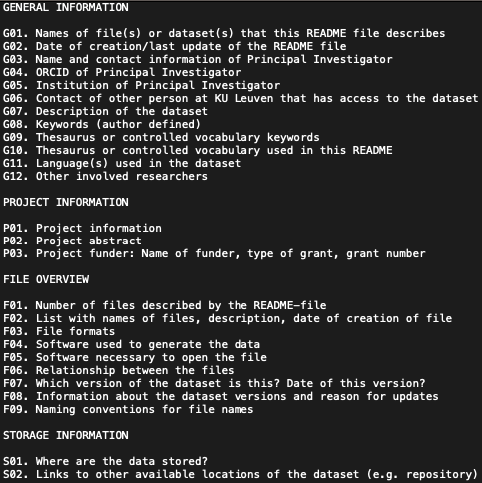
Data-level Documentation
1
Information on the data files:
  Data & file type, format, size, data processing scripts ...
Explanation of variables, labels and codes:
  Names, labels, values …
Tools to use:
  README file
  Data dictionary
  Codebooks
  Commented Code
  Lab/ Field Notebooks
2
3
Source: UK Data Service and CESSDA Training Team (2017 - 2022) modified by FAIRagro 2024,; Illustration: Screenshot template from KU Leuven 2024 (public domain)
Notes:
Note: The upper illustration refers to the overview of the level of data documentation (06-02-02).
Slide content:
Data-level documentation provides information about individual databases or data files. This could be, for example, interview transcripts or pictures, as well as documentation for elements within the files, for example describing variables within an SPSS file.
Source: https://ukdataservice.ac.uk/learning-hub/research-data-management/document-your-data/data-level/
Information about the data file: Data type, file type, and format, size, data processing scripts.
Information about the variables in the file: The names, labels and descriptions of variables, their values, a description of derived variables or, if applicable, frequencies, basic contingencies etc.
Source: https://dmeg.cessda.eu/Data-Management-Expert-Guide/2.-Organise-Document/Documentation-and-metadata

Slide 10

Types of Documentation
Metadata
Data dictionary
Codebook
Lab/ Field Notebooks
Commented Code
README file
Standard Operating Procedures (SOPs)
Lab Protocols
User Guides
<Foliennummer>
Source: Modified from KU Leuven 2022 by ZB MED 2023;, Illustration: Photo by Hannah Olinger licensed under the Unsplash license
Notes:
slide content:
What types of data documentation do exist? → highlight some of the given list

Slide 11

How to attach Documentation to my data
Within the data file or database
In a README file
In file headers
In a codebook
In a lab notebook
GitLab or OSF to document data processing and for versioning files
In a peer-reviewed data journal
In a wiki
Source: Modified from KU Leuven 2022 by ZB MED 2023,; Illustration:“attach“” by iconixar is licensed under CC BY 3.0
Notes:
slide content:
How to attach documentation to data? There are multiple ways to do so. Highlight common ones like eg. README files

Slide 12
Metadata
Notes:
Data Documentation

Slide 13
Metadata
1
"Data about data" -> differentiation from primary data!
Standardised & structured information
Human- and machine-readable
Goals:
  describes, explains, locates
  makes it easier to retrieve, use & manage
2
3
Source: Wolff, Musloff 2024 (FDM-BB Zertifikatskurs) modified by FAIRagro 2024
Notes:
Note: The illustration refers to the overview of the level of data documentation (06-02-02); alternatively could the next slides illustration be used for this one as well.
Slide content:
Metadata is “data about data”
Standardised and Structured information
Subset of documentation :
describes, explains, locates an information resources
makes it easier to retrieve, use, manage the resource
Human- and machine-readable (enhancing the “I” in FAIR)

Slide 14

Examples of Metadata Elements
Title
Topic
Description of input and output
Address/geospatial information
Licensing information
Source: Bres et al. 2022, RfII and Voigt et al. 2022 modified by ZB MED 2023,; Illustration: “meta tag“” by Vectors Market is licensed under CC BY 3.0
Notes:
Slide content:
Some examples of common metadata elements are listed on this slide.

Slide 15
Lego Game

Slide 16
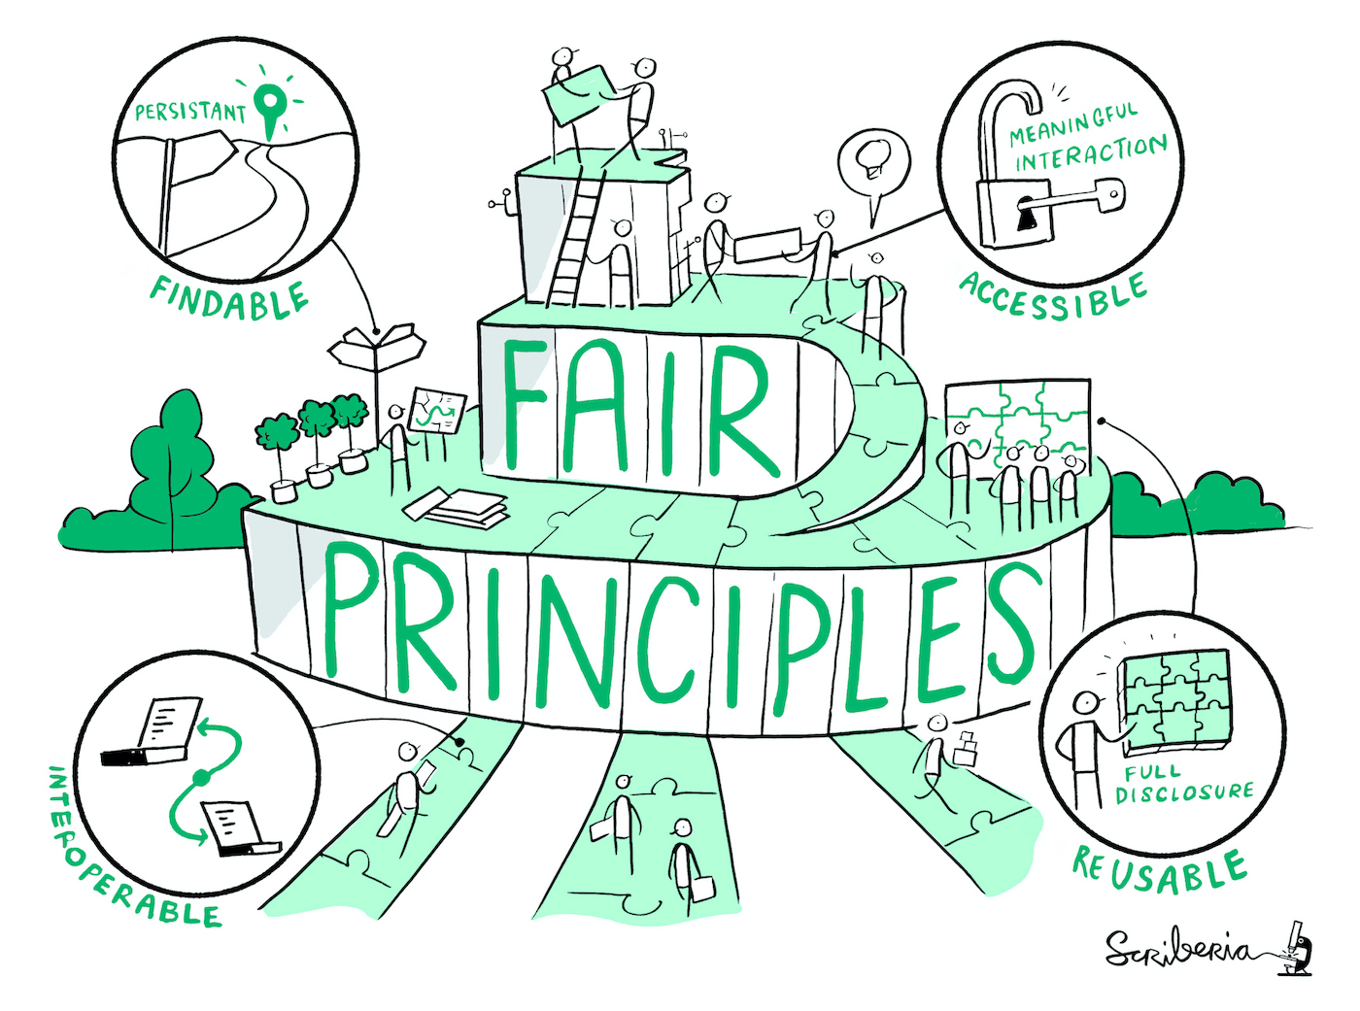
Importance of Metadata
Makes data:
  Findable, Accessible, Interoperable and Reusable (FAIR)
  Readable and understandable
  Citable
  More easily shareable across an organisation
  Consistent
Facilitates the long-term archiving of data
Makes your data more reproducible
Source: Lomax 2019 modified by ZB MED 2022 and FAIRagro,; Illustration: Image by The Turing Way Community & Scriberia (2023) is licensed under CC BY 4.0
Notes:
Slide content:
It aids in the long-term preservation of data by providing essential information needed to understand and use the data in the future.
Metadata is the backbone of effective data management, ensuring that research data is discoverable, understandable, interoperable, and reusable. It enhances the value and impact of data by facilitating its use in future research, fostering collaboration, and ensuring compliance with standards and regulations.
Findable: The first step in (re)using data is to find them. Metadata and data should be easy to find for both humans and computers. Machine-readable metadata are essential for automatic discovery of
datasets and services, so this is an essential component of the FAIRification process
Accessible: Once the user finds the required data, she/he/they need to know how they can be accessed, possibly including authentication and authorisation.
Interoperable: The data usually needs to be integrated with other data. In addition, the data needs to interoperate with applications or workflows for analysis, storage, and processing
Reusable: The ultimate goal of FAIR is to optimise the reuse of data. To achieve this, metadata and data should be well-described so that they can be replicated and/or combined in different settings

Slide 17
Types of metadata
Bibliographic | Administrative | Process | Content-describing/descriptive
Identifier of the resource, title, author, date of publication, subject, publisher, … | File types, file names, formats, location (file path), unique ID, access rights, licence, … | Used methods, used sensors, wavelength, depth of measurement, … | Crop, genotype information, variety, breeding line or variation, environmental conditions of the study, type of climate, type of soil, time of year, Geolocation, Treatment - Abiotic (e.g. light, temperature, soil, …) - Biotic (e.g. animals, fungi, …) - Crop management (e.g. application of chemicals, crop rotation, density, …), (Observed) Traits, …
Source: Engelhardt et al. 2022 and forschungsdaten.info modified by FAIRagro 2024
Notes:
Slide content:
Bibliographic metadata. Enable the citation of data and code. Help with findability and thematic delimitation.
Bibliographic metadata such as title, authors, description or keywords enable the citation of data and code and help with findability and thematic localisation.
Administrative metadata. Help with the management, reuse and long-term preservation of data.
Administrative metadata on file types, locations, access rights and licences help with the management and long-term preservation of data.
Process metadata. Describe the methods and tools used to generate and process the data.
Process metadata describes the steps and actions with the methods and tools used to create and process the data.
Content-describing or descriptive metadata. Additional information on the content and origin of the data - differentiate between discipline and data types.
Content-describing or descriptive metadata can be structured very differently depending on the discipline and provide additional information on the content and origin of the data.

Slide 18
Practical Advice
Where to add metadata during the project?
In Excel (e.g. with Colectica or Swate)
In a README file
…
Where to add metadata in publication process?
Input forms of repositories
  make sure you collect required metadata during your project
Source: Assmann et al. 2022, ZB MED 2022, ZB MED 2024,; Illustration: icon from Kücklich 2020, licensed under CC0
Notes:
Slide content:
There are different ways to collect metadata, depending on whether you are working on your project or in the publication process.

Slide 19
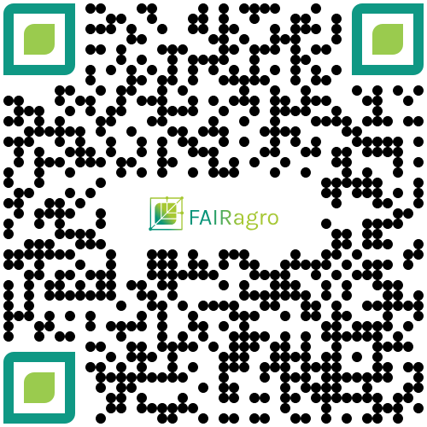
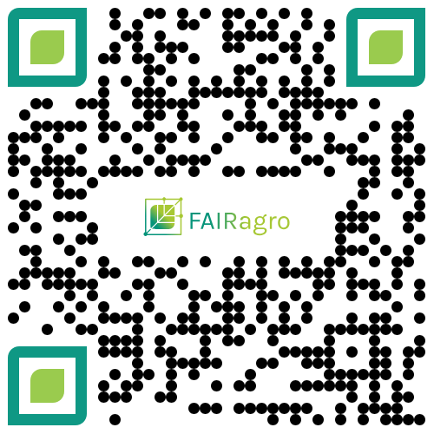
How to generate Metadata in Practice
The metadata decision tree guides you through the key questions for data documentation.
It helps you identify suitable data management practices according to your specific needs.
What will be your next steps in documenting your data?
interactive tool
practical guide
Notes:
Slide content:
The FAIRagro Metadata Decision Tree is available as interactive tool as well as practical guide in PDF format.
It guides you through the key questions for data documentation and helps you identify suitable data management practices according to your specific needs.
You can also copy the following links to the chat:
Interactive Tool: https://fairagro.github.io/metadata_decision_tree/
Practical Guide: https://doi.org/10.4126/FRL01-006490238

Slide 20
Metadata Standards

Slide 21
Definition of Metadata Standards
Collections of metadata elements that are used for a specific purpose (e.g. description of digital objects, description of books, …)
They are also “formal and machine-readable structure that has been established by the large research community or by an international standard organization” [KU Leuven 2022].
Source: KU Leuven 2022 modified by ZB MED 2024; Illustration: “definition” by Dewi Novita Sari is licensed under CC BY 3.0
Notes:
Slide content:
Metadata standards are established protocols and guidelines for describing, managing, and exchanging metadata. They are a collection of metadata elements used for a specific purpose.
They are machine-readable thus enhance interoperability.

Slide 22
Importance of Metadata Standards
Agreement on a standardised definition of terms leading to a common understanding
  Promoting integration in the community that follow the standard you choose
Making data Findable, Accessible, Interoperable and Reusable (FAIR)
Source: Modified from KU Leuven 2022 by ZB MED 2024
Notes:
Slide content:
This slide shows the general relevance of Metadata Standards. Metadata standards are crucial for ensuring that research data is discoverable, interoperable, and reusable. By adhering to these standards, researchers and institutions can improve the management and sharing of their data, fostering greater collaboration and innovation across disciplines.
They provide our data with Consistency, Interoperability, Quality and Discoverability.
Source: https://www.kuleuven.be/rdm/en/faq/faq-metadata-documentation#What%20is%20metadata

Slide 23
Benefits and Drawbacks of Metadata Standards
Agreement on a standardised definition of terms leading to a common understanding
Data can be more easily combined and exchanged
Guidance on what information is important in documenting your data
Time and know-how needed to understand and apply a metadata standard
Less flexibility in documenting your data as you have to follow the principles of a standard
Source: Modified from KU Leuven 2022 by ZB MED 2024
Notes:
Slide Content:
This slide shows some the direct benefits and also some the drawbacks of using Metadata Standards.

Slide 24
Metadata standards & documentation
ISO 19115 - international standard for geographic information
INSPIRE - european standard for geographic information
Darwin Core - standard for information about biological diversity
MIAPPE - Minimum Information About Plant Phenotyping Experiments
BrAPI - enables interoperability among agricultural databases and tools
Crop Ontology - supports the standardization of breeding databases
Source: RDA Metadata Standards Catalog
Notes:
Slide content:
ISO 19115-1:2014 defines the schema required for describing geographic information and services by means of metadata. It provides information about the identification, the extent, the quality, the spatial and temporal aspects, the content, the spatial reference, the portrayal, distribution, and other properties of digital geographic data and services.
The INSPIRE Directive aims to create a European Union spatial data infrastructure for the purposes of EU environmental policies and policies or activities which may have an impact on the environment. This European Spatial Data Infrastructure will enable the sharing of environmental spatial information among public sector organisations, facilitate public access to spatial information across Europe and assist in policy-making across boundaries. European states are obligated to implement de INSPIRE Directive.
Darwin Core is a metadata standard that was designed for the description of mbiological diversity
MIAPPE is an open, community driven, data standard designed to harmonize data from plant phenotyping experiments.
MIAPPE provides a specification including a checklist and a data model of metadata required to adequately describe plant phenotyping experiments.
BrAPI and the Crop Ontology are not directly standards, but help with the documentation within those.

Slide 25
Discipline-specific Metadata Standards
Check if the Data Repository you will be using has its own Metadata Schema
BonaRes Metadata scheme - for the BonaRes Repository
Check if you can use controlled vocabularies, thesauri or terminologies when collecting your metadata
AGROVOC - Thesauri which offers structured collection of agricultural concepts, terms, definitions and relationships
Source: RDA Metadata Standards Catalog
Notes:
Slide content:
This slide is like a how-to when working with discipline-specific metadata. The questions are ment as a rhetorical entry point to the topic.
AGROVOC is a relevant Linked Open Data set about agriculture available for public use and facilitates access and visibility of data across domains and languages. It offers a structured collection of agricultural concepts, terms, definitions and relationships which are used to unambiguously identify resources, allowing standardized indexing processes and making searches more efficient.
AGROVOC uses semantic web technologies, linking to other multilingual knowledge organization systems and building bridges between datasets.

Slide 26
Taking it one step further:
How to increase metadata interoperability

Slide 27

Machine understandability of metadata
The metadata description of a dataset includes a keyword “Triticum aestivum“”
X
X
Wheat
Triticum aestivun
Source: Gabriel Schneider 2024 modified by FAIRagro in 2024
Notes:
Slide content:
The metadata description of a dataset includes a keyword “Triticum aestivum”
What if someone searches for a dataset including data on common wheat but doesn’t use the scientific name?
What if the data creator produced a typo during metadata creation and typed “Triticum aestivun”?
We as humans can probably understand what is meant, but machines cannot
Therefore we need the semantic web.

Slide 28
Machine understandability of metadata
The metadata description of a dataset includes a keyword “Triticum aestivum“”
semantic web
Wheat
Triticum aestivun
Source: Gabriel Schneider 2024 modified by FAIRagro in 2024
Notes:
Slide content:
The metadata description of a dataset includes a keyword “Triticum aestivum”
What if someone searches for a dataset including data on common wheat but doesn’t use the scientific name?
What if the data creator produced a typo during metadata creation and typed “Triticum aestivun”?
We as humans can probably understand what is meant, but machines cannot
Therefore we need the semantic web.

Slide 29
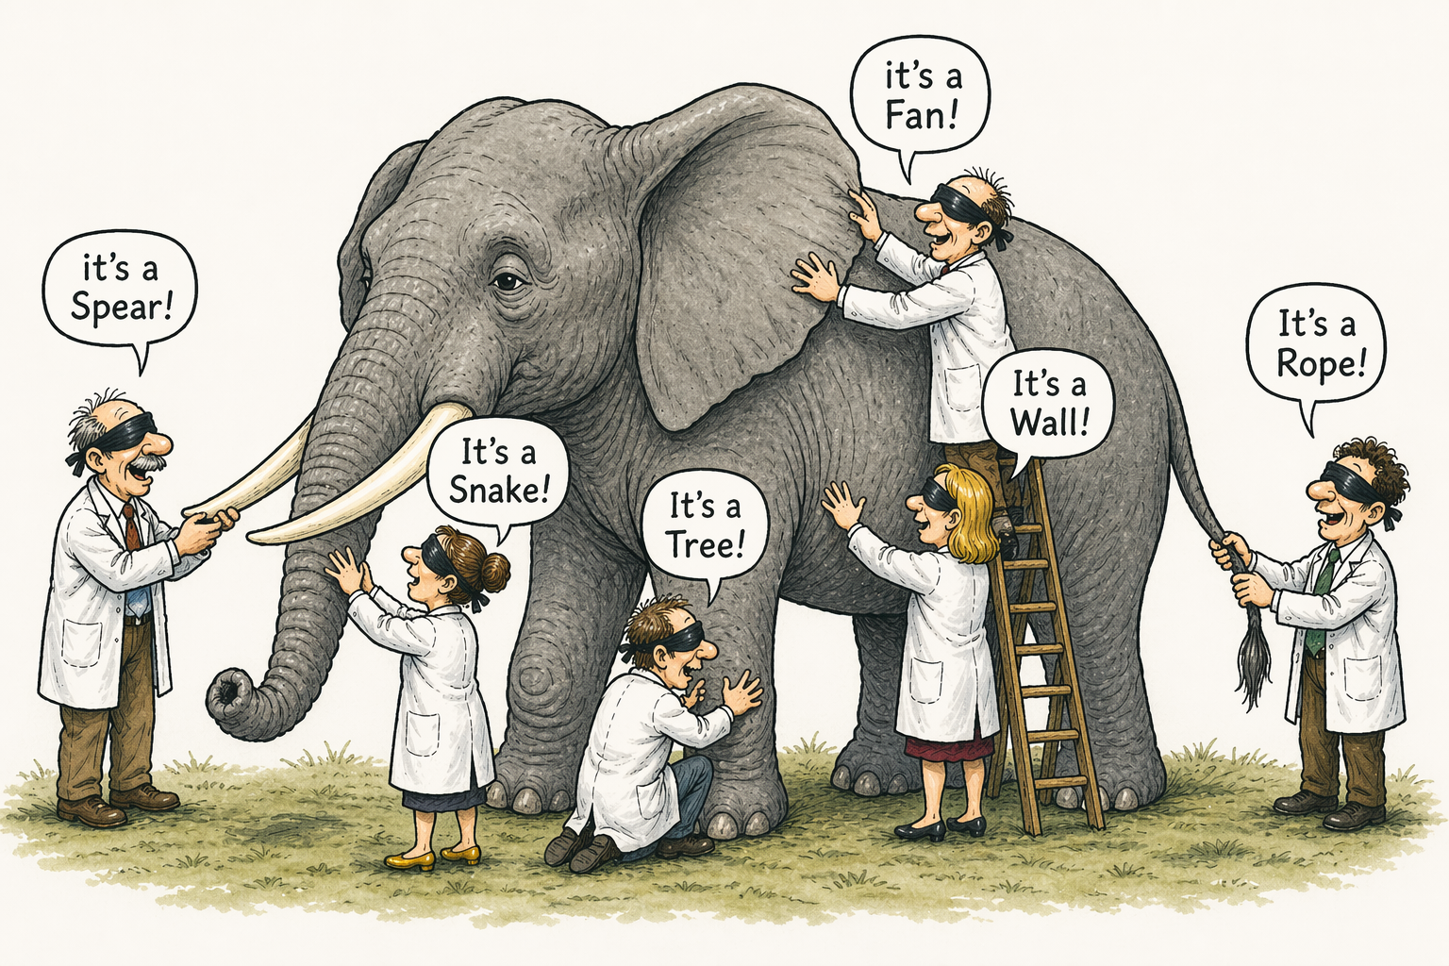
Definition of Semantic Web
Is the aim to add meaning to the available digital data in a human- and machine-readable way
Where do we find the meaning of something?
Dictionaries, encyclopedias
How can a machine read these?
Controlled vocabularies, terminologies, ontologies
Using Semantic Web concepts helps to make Metadata FAIR!
Illustration: Created by ChatGPT is public domain
Notes:
Slide content:
Look at the picture. Without proper context, identification and description may be difficult. Semantic Web aims at giving (machine-readable) context.

Slide 30


How to document?
Standards for suitable documentation:
Controlled vocabularies such as AGROVOC
Soil classification systems -> Bodensystematik, FAO's World Reference Base, USDA's Soil Classification
Gene classification -> Gene Ontology
Agricultural Data -> Crop Ontology
Illustrations: Logos of Gene Ontology, Crop Ontology are licensed under CC BY 4.0
Notes:
Slide content:
Using Semantic Web concepts is also possible within data documentation: Use controlled vocabularies (like AGROVOC) or common classification systems when ever possible.

Slide 31
AGROVOC
Multilingual semantic resource collecting concepts, terms, definitions and relationships between them
Coordinated by the Food and Agriculture Organization of the United Nations (FAO) since the 1980s
International editor cooperation
+41 200 concepts
+1 177 000 terms
up to 42 languages
Source: AGROVOC
Notes:
Slide content:
AGROVOC is a multilingual semantic resource collecting concepts, terms, definitions and relationships between them, coordinated by the FAO.
Note: The numbers may be updated before usage.

Slide 32
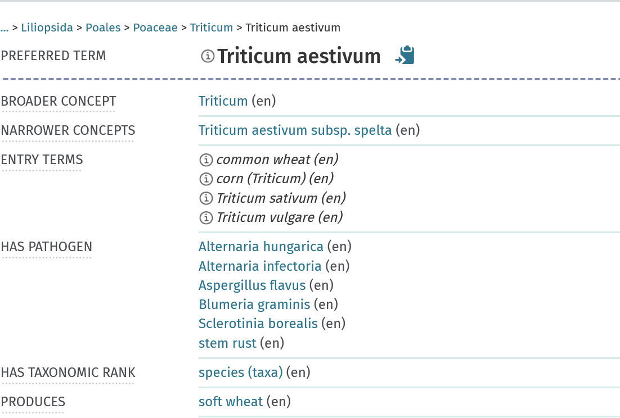
AGROVOC
Relations to other concepts and terms in AGROVOC → enables searches like “show me all pathogens related to Triticum aestivum”
Illustration: Screenshot AGROVOC from 23.04.2026, public domain
Notes:
Slide content:
AGROVOC defines relationships between terms. Example: “has pathogen”

Slide 33
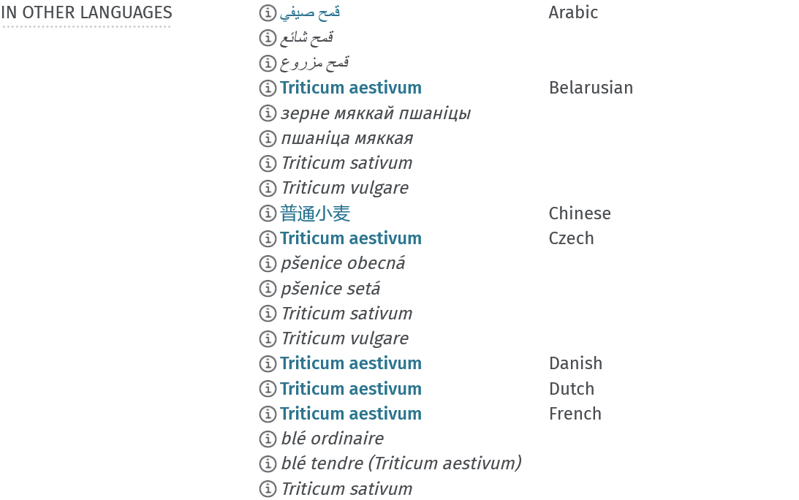
AGROVOC
Names of the same concept in different languages → enables multilingual searches
Illustration: Screenshot AGROVOC from 23.04.2026, public domain
Notes:
Slide content:
AGROVOC is avalable in many different languages

Slide 34

AGROVOC
Persistent identifier of the term
Mappings to other semantic resources
Illustration: Screenshot AGROVOC from 23.04.2026, public domain
Notes:
Slide content:
AGROVOC provides an persistent identifier (URI) for its terms and mapping to other semantic resources.

Slide 35

Exercise - Can we improve the interoperability?
Imagine a dataset with the following keywords. Can you find the fitting terms in AGROVOC? Please collect the persistent identifiers and add them to this slide with the Zoom annotation.
Triticum aestivum →
Field trial →
Fertilisation →
Irrigation →
Black rust →
use zoom annotation function!
Illustration: Screenshot Zoom from 23.04.2026, public domain
Notes:
Slide content:
Let the participants use AGROVOC. Provide the link in the chat: https://agrovoc.fao.org/browse/agrovoc/en/
Solutions see next slide.

Slide 36
Exercise - Can we improve the interoperability?
Imagine a dataset with the following keywords. Can you find the fitting terms in AGROVOC? Please collect the persistent identifiers and add them to this slide with the Zoom annotation.
Triticum aestivum →
Field trial →
Fertilisation →
Irrigation →
Black rust →
http://aims.fao.org/aos/agrovoc/c_7951
http://aims.fao.org/aos/agrovoc/c_33990
http://aims.fao.org/aos/agrovoc/c_10795
http://aims.fao.org/aos/agrovoc/c_3954
http://aims.fao.org/aos/agrovoc/c_855676a8
use zoom annotation function!
Illustration: Screenshot Zoom from 23.04.2026, public domain
Notes:
Slide content:
Exercise solution

