Slide 1
Data Reuse

Slide 2
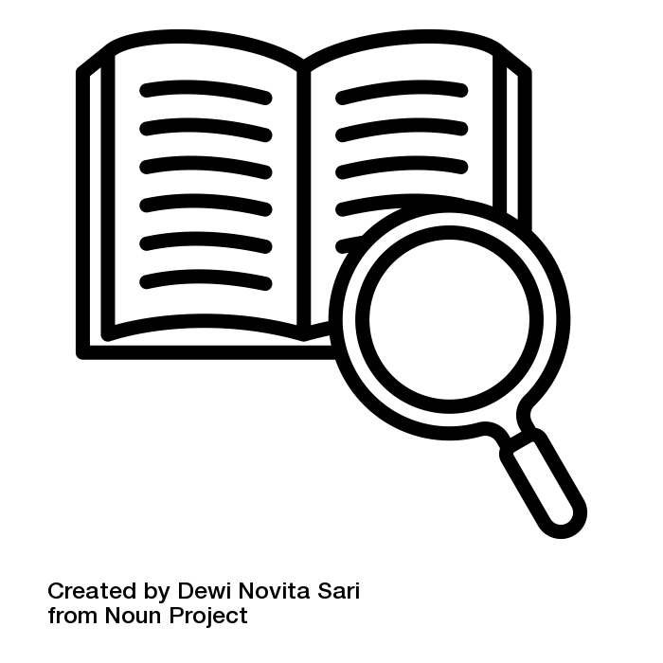
What does reusing data really mean?
Using data for purposes other than those for which it was originally collected for.
Some benefits:
obtain reference data for your research
avoid doing new or unnecessary experiments
aggregating results obtained from different methods or samples
connecting and meta-analysing datasets for novel insights
Illustration: “definition” by Dewi Novita Sari is licensed under CC BY 3.0
Notes:
Slide content:
Data reuse is particularly important in science, as it allows different researchers to analyse and publish findings based on the same data independently of one another.
Reusability is one key component of the FAIR principles.
Why is data reuse important?
By reusing existing data you can:
obtain reference data for your research;
avoid doing new, unnecessary experiments -> save time and money!
make research more robust
by aggregating results obtained from different methods or samples;
by running analyses to verify that reported findings are correct
gain novel insights by connecting and meta-analysing datasets.
Source: RDMkit Elixir

Slide 3
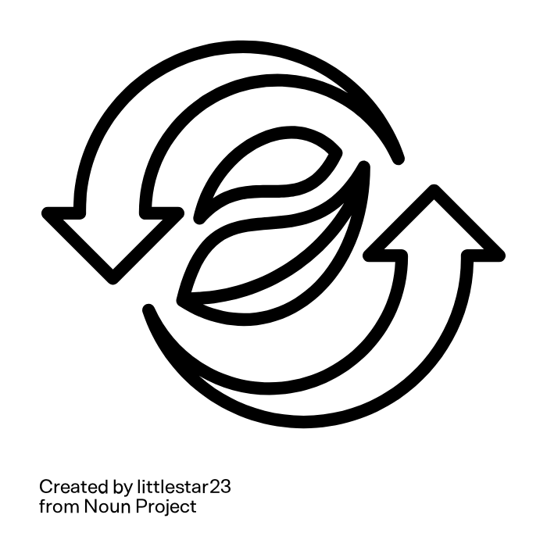
Difficulties in reusing agricultural research data
Data complexity.
Data quality standards differ across disciplines.
Data handling since size and number of datasets rises.
Datasets are useful for original producer, but reuse ist difficult
Epistemologically problems: ambiguities, missing documentation, …
Logistic problems: undiscoverable data, different data types, …
Notes:
Slide content:
Data complexity
because of the many species involved
new high-throughput technologies
Plant phenotyping has undergone an explosion in the size and number of datasets that can lead to data handling problems.
Data quality standards differ across disciplines, so, even if datasets are useful for the original producer, it may be difficult to reuse them for meta-analyses, for example:
due to epistemologically problems like ambiguities, missing documentation, …
due to logistic problems like different data types, oder undiscoverable data, …
We can all contribute to make it easier!
FAIRagro will try to solve all this problems :)
An example about Phenotipic Data Reuse from a researcher:
“The complexity of phenotypic data is a hindrance to reuse. Like most domains of science, though perhaps to an even greater extend because of the many species involved as well as new high-throughput technologies, plant phenotyping has undergone an explosion in the size and number of datasets.
However useful each of them may be to the original producer, their potential to deepen our understanding of plant biology remains unmaterialized because meta-analyses across independently generated datasets are difficult, both epistemologically (ambiguities, missing documentation) and logistically (undiscoverable data, different data types)”

Slide 4
Finding Data
for Reuse

Slide 5
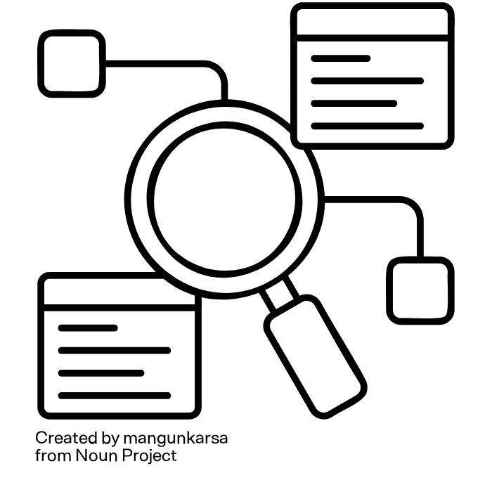
Finding Data of interest
What do you want?
Which search query do you use?
Where do you search?
Source: modified from “Finding Data” by The Turing Way Community; “Research” by mangunkarsa is licensed under CC BY 3.0
Notes:
Slide content:
There is an enormous amount of research data now out there online, either openly available or restricted.
Despite the amount of data available, finding the right data for your research project/question is often difficult.
The tips on the next slide may help you in finding data suitable for your project.
Source: The Turing Way Community

Slide 6
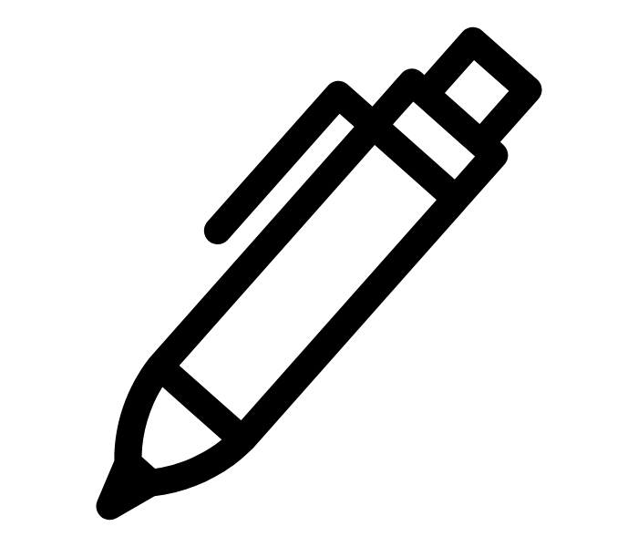
What Data you need and why you need them?
Characteristics of the required data:
data format?
spatial or temporal coverage?
availability?
author or research group?
What do you want?
Before starting to search for data
how will you use the desired data in the context of your overall research question?
for comparison or validation?
as basis for a new study?
Source: modified from Gregory et al. (2018); “pen” by ArashDesign is licensed under CC BY 3.0
Notes:
Slide content:
make the participants aware of the important aspects to take in consideration when searching for data to reuse.
Start with the question: “What data you want/need?”
how will you use the desired data in the context of your overall research question?
for comparison or validation?
as basis for a new study?
all these questions may influence, which data may be suitable for your purpose.
before starting searching for data, it may help to make yourself clear, what data you are looking for.
what are the characteristics of the required data?

Slide 7
Select the most appropriate resource
Where do you search?
Literature search
(Discipline Specific) Repository
Special Data Aggregators
Discipline Specific Databases
Data Article
Find an interesting article, hopefully the data is provided as supplement or the author responds and provides it
Find a suitable repository via re3data, FAIRasharing or the FAIRagro Repository Finder
Data aggregators like the FAIRagro Search Hub enable searching multiple data repositories or collections through a single search interface
Have a look at Databases that are dedicated to specific species (listed here: AgBioData)
Have a look in data journals like Open Data Journal for Agricultural Research
1
2
3
4
5
Source: modified from Gregory et al. (2018), “Finding Data” by The Turing Way Community
Notes:
Slide content:
Steps to follow when you want to search research data to reuse in your project.
You first choide can be to make a literature search, to see if you find an interesting article.
The second possibility is to search in a Repository (if it is discipline specific, better!). We give some examples for the agricultural sciencies in the slide.
The third way is to search in data aggregators, because like this you search in multiple repositories at the same time.
There is another way, to search in Discipline Specific Databases.
And last but not least, to search in Data Articles.
Another approach: One of the most effective ways to identify new data submissions is to monitor the latest literature, as many journals such as Nature, PLOS, Science, and others require that the data underlying a publication also be published in a public (e.g., Dataverse https://dataverse.org, Dryad http://datadryad.org, or Zenodo https://zenodo.org) or discipline-based repository (e.g., EASY from Data Archiving and Networked Services [DANS] https://easy.dans.knaw.nl/, GenBank https://www.ncbi.nlm.nih.gov/genbank/, or PubChem https://pubchem.ncbi.nlm.nih.gov).

Slide 8
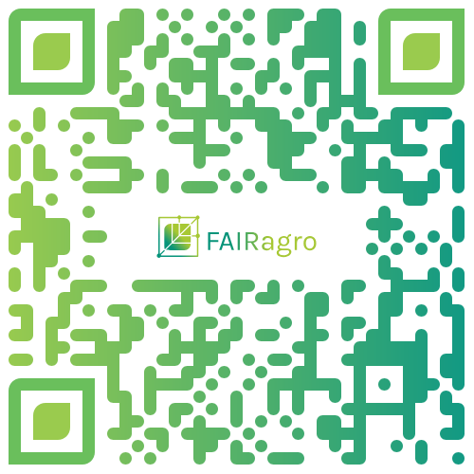
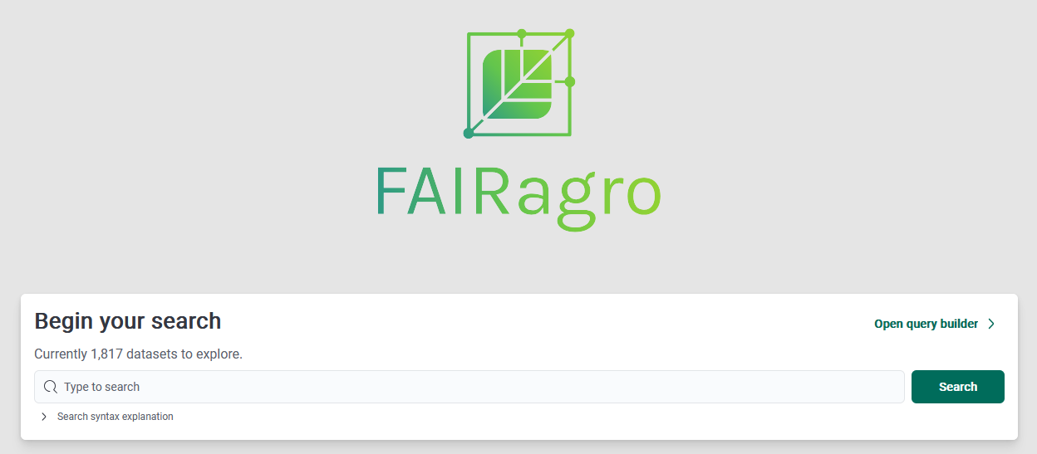
Data aggregators
Domain-agnostic data search:
B2FIND data search
BASE
DataCite Metadata Search
Europäisches Datenportal
Google Dataset Search
Data Catalogue at EOSC Portal
Life Science data search:
LIVIVO - ZB MED Search Portal for Life Sciences
Agricultural Science data search:
FAIRagro Search Hub
Source: modified from “Finding Data” by The Turing Way Community; FAIRagro Search Hub
Notes:
Slide content:
some aggregators to search for data in different locations

Slide 9
FAIRagro Search Hub
Searching multiple agricultural repositories at a time!
various search and filter functions, e.g. based on crop species or soil type
Source: FAIRagro Search Hub
Notes:
Note: This slide can be supplemented with showing the short tutorial (08-03-03-04v)
Slide content:
short presentation of the FAIRagro Search Hub, with the QR code to access it and some information about the repositories that are already integrated.
Here is also the link: https://datasets.search-hub.fairagro.net/
Search Hub provides easy findability of datasets from multiple sources like
BonaRes
OpenAgrar
e!DAL
PUBLISSO - Repository for Life Sciences
Thünen-Atlas
The FAIRagro Search Hub brings together datasets from all across the different areas of agrosystem research (mainly plants, soil and environment). The aim is to foster the implementation of the FAIR principles (Findability, Accessibility, Interoperability and Reusability) in the agricultural research domain. The FAIRagro Search Hub is not a repository itself, but harmonises metadata from many associated research data infrastructures (RDIs) such as BonaRes, OpenAgrar, and e!DAL. The metadata are automatically harvested by the FAIRagro Middleware and transformed into a standardised metadata schema. The FAIRagro Search Hub provides various search and filter functions, e.g. based on crop species or soil type. Additional options are currently under development.

Slide 10
FAIRagro Search Hub
Searching multiple agricultural repositories at a time!
various search and filter functions, e.g. based on crop species or soil type
Your feedback is more than welcome!
Source: FAIRagro Search Hub
Notes:
Slide content:
feedback is asked for the people using the search hub to improve it.

Slide 11
How to search for data?
Describing your desired data effectively is key to communicating with the search system.
Your description will determine if relevant data are retrieved and may inform the order of the hits in the results list.
Which search query do you use?
Source: modified from Gregory et al. (2018)
Notes:
Slide content:
Make the repository work for you
Repository developers invest significant time and energy organizing data in ways to make them more discoverable; use their work to your advantage. Familiarize yourself with the controlled vocabularies, subject categories, and search fields used in particular repositories. Searching for and successfully locating data is dependent on the information about the data, termed metadata, that are contained in these fields; this is particularly true for numeric or nontextual data. Browsing subject categories can also help to gauge the appropriateness of a resource, home in on an area of interest, or find related data that have been classified in the same category.
Researchers can also register or create profiles with many data repositories. By registering, you may be able to indicate your general research data interests which can be utilized in subsequent searches or receive alerts about datasets that you have previously downloaded.
Link to the search hub: https://datasets.search-hub.fairagro.net/

Slide 12
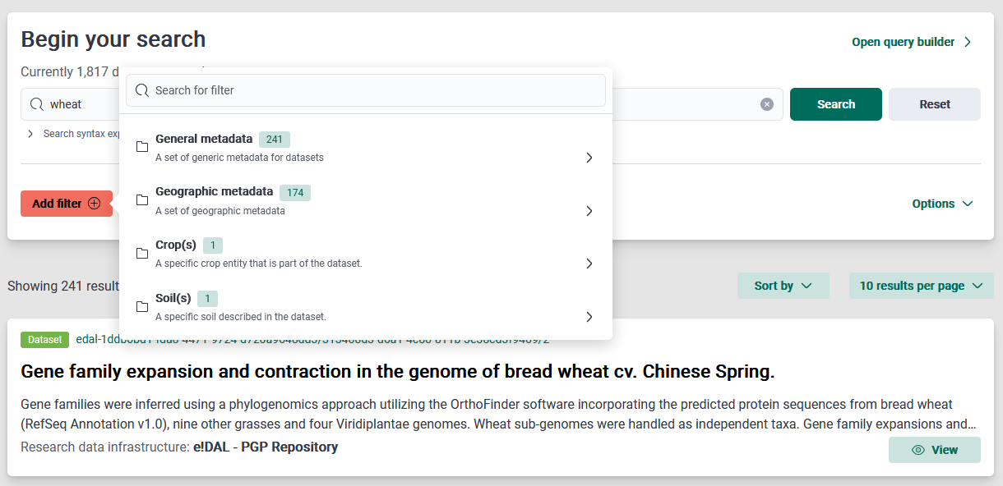
Step 1: use the filters
Use filters to refine your search
Which search query do you use?
Source: Screenshot from FAIRagro Search Hub taken on 24.07.25
Notes:
Slide content:
how to use the search in the most efficient way. In this case, use filters to refine what are you looking for.
The image show how to search for an specific word in your search.

Slide 13
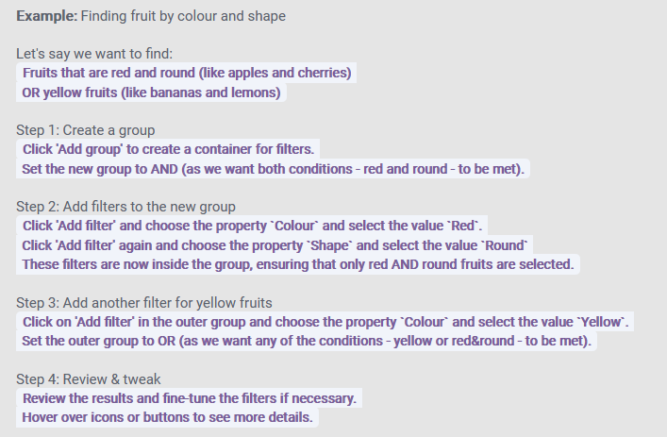
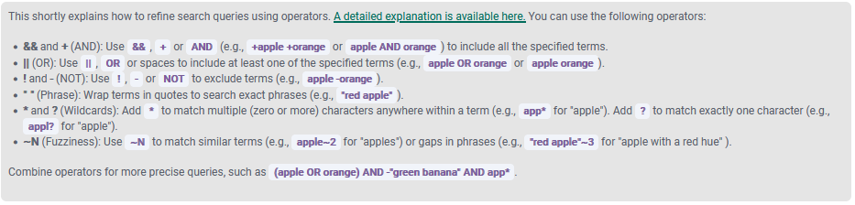
Step 2: build your query
Use operators to build your query
Which search query do you use?
Detailed explanations available here
Source: Screenshot from FAIRagro Search Hub taken on 24.07.25
Notes:
Slide content:
Short explanation on how to write a query to make your search better.
The Search Hub provides an explanation of Operators that can be uses, as well as a tutorial and a step by step guide.

Slide 14
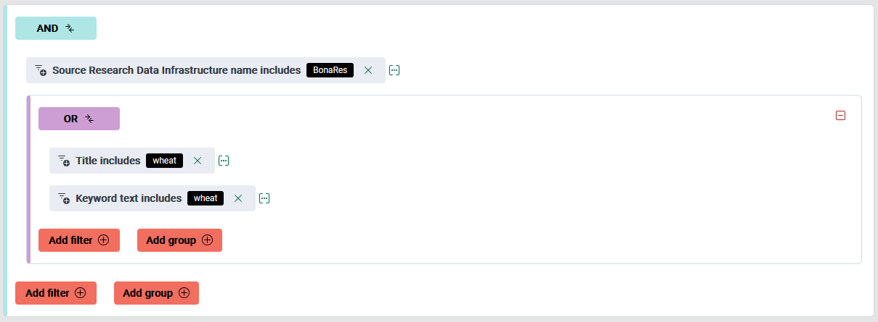
Step 3: use the query builder
The query builder may help you!
Which search query do you use?
On the website you will find a pre-build example, a “how to build the example” tour and a tutorial explain the query builder!
Source: Screenshot from FAIRagro Search Hub taken on 24.07.25
Notes:
Slide content:
The query builder can be used to create complex search queries

Slide 15
Step 4: refine your search
Repositories and Data Aggregators use different strategies to make the data more discoverable
  familiarize yourself with the controlled vocabularies, subject categories and search field of your resource
Refine your search after first try
  broaden or narrow your approach based on the retrieved results
Explore interesting looking results
  these can link to related ones (e.g., from the data provider, from different time series, …)
Source: modified from Gregory et al. (2018)
Notes:
Slide content:
Refine your search
In many cases, your initial search may not retrieve relevant data or all of the data that you need. Based on the retrieved results, you may need to broaden or narrow your approach. Apart from rephrasing your search query and using search operators, as discussed in Tip 3, facets or filters specific to individual repositories can be used to narrow the scope of your results. Refinements such as data format, types of analysis, and data availability allow users to quickly find usable data.
Examining results that look interesting (for example, by clicking on links for ‘more information’) can be a signal of the type of information that you find relevant. These results can then be linked to related ones (e.g., from the data provider, from different time series), and in subsequent searches, other results algorithmically determined to be related will be brought to the top of the results list.
Save your search and data-source details
Record the data source and data version if you access or download a data product. This may be accomplished by noting the persistent identifier, such as a digital object identifier (DOI) or another Global Unique Identifier (GUID) assigned to the data. Recording the URL from which you obtained the data can be a quick way of returning to it but should not be trusted in the long term for providing access to the data, as URLs can change. It is also a good practice to save a copy of any original data products that you downloaded. You may, for example, need to go back to original data sources and check if there have been any changes or corrections to data. Registering with the data portal (as described in Tip 3) or registering as a user of a specific data product allows the repository to contact you when necessary. Such information may be needed when you publish a paper that builds on the data you accessed. If there are any errors found in the original data, registering with the data service allows them to contact you to see if there is an impact on any research conclusions that you have drawn from this data.
If you have registered with a portal, it may also be possible to save your searches, allowing you to resume your data search at a later time with all previously defined search criteria. Some portals use RESTful search interfaces, which means you can bookmark a results set or dataset and return to it later simply by going to the bookmark.
Gregory et al. (2018)

Slide 16
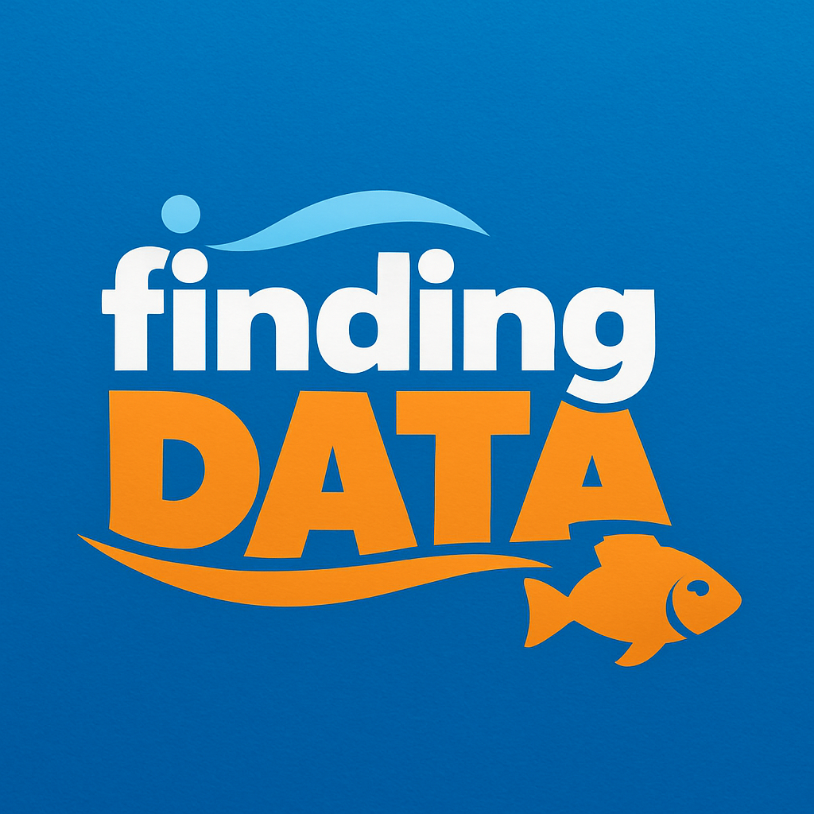
Finding Data
Open the FAIRagro Search Hub.
How many datasets on winter wheat do you find?
https://search-hub.fairagro.net/
Illustration: Created by ChatGPT (public domain)
Notes:
Link: https://search-hub.fairagro.net/

Slide 17


Finding Data
How many datasets on winter wheat do you find?
278 Datasets with “winter” OR “wheat”
149 Datasets on “winter wheat”
150 Datasets with “winter wheat” OR “winter” AND “wheat” in the title
(24.04.2026)
Illustration: Screenshots Search Hub taken on 24.07.25, Image created by ChatGPT (public domain)
Notes:
Note: Update the numbers before use!
Slide content:
When searching for -winter wheat- you will find 278 Datasets that include the term winter or the term wheat in any field, this may not all be datasets on winter wheat
When searching for -”winter wheat”- you will find less datasets, namely 149. They all include the term “winter wheat” in any field - they should all have data about winter wheat.
But you can’t be sure, that with this, you found all datasets about winter wheat… if you search for datasets that include the term “winter” and the term “wheat” in the title OR “winter wheat” in any fields, you’ll find one more dataset - this one speaks of “winter and summer wheat” in the title and is therefore not found, when searching for datasets including the term “winter wheat”.

Slide 18
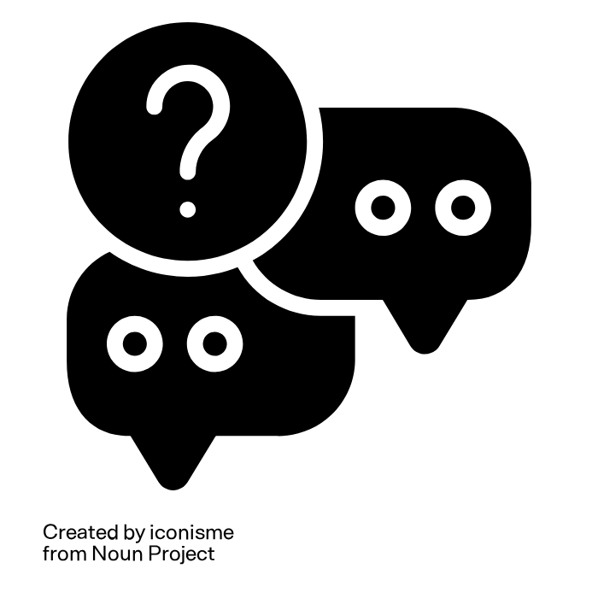
Check the license
§
Am I allowed to use that data?
Am I allowed to alter it/combine it with other data?
Am I allowed to republish it?
Do I need to name the author?
?
?
§
§
?
Illustration: “question” by iconisme from the Noun Project is licensed under CC BY 3.0
Notes:
Slide content:
questions the researchers have to ask themselves when they want to reuse data from others.
Note: you can combine this slides with more slides on data rights (11-01) and licenses (11-01-03).

Slide 19
Give back!
1
Cite the data properly:
Following the good scientific practice, you must cite sources regardless of license or copyright protection!
Data availability statement examples:
  Using the Digital Object Identifier (DOI):
  “The data that support the findings of this study are openly available in [repository name] at http://doi.org/[doi].”
  If no DOI is issued:
  “The data that support the findings of this study are openly available in [repository name] at [URL], reference number [reference number].”
Source: modified from Gregory et al. (2018), “Finding Data” by The Turing Way Community
Notes:
Slide content:
Proper attribution benefits both data creators/providers and data seekers/users. Data creators/providers receive credit for their work, and their practice of sharing data is thus further encouraged. Data seekers/users make their own work more transparent and, potentially, reproducible by uniquely identifying and citing data used in their research.

Slide 20
Give back!
Provide feedback to data creators or the data repository about any issues associated with data accessibility, data quality, interoperability or metadata completeness
Share your own data!
2
3
Source: modified from Gregory et al. (2018), “Finding Data” by The Turing Way Community
Notes:
Slide Content:
Communication is crucial for a good reuse. Inform the creators or the Repo about any problem you may have had with the data so they can make changes for the better.
It is also recommended to share your own data, like this more people (and science) will benefit from it.

