Slide 1
Fair Clustering

Slide 2
Outline
Introduction to clustering and algorithmic fairness
Demographic (group) fairness in clustering
Individual fairness in clustering
The two-stage approach for solving fair clustering
Overlooked issues in fair clustering.

Slide 3
Clustering: Motivation
Clustering (ML + Data Analysis)

Slide 4
Clustering: Motivation
Clustering (ML + Data Analysis)
Explore the data, Reveal existing structure, group similar points to one another, etc

Slide 5
Clustering: Motivation
Clustering (ML + Data Analysis)
Explore the data, Reveal existing structure, group similar points to one another, etc
Given Set of Data Points:

Slide 6


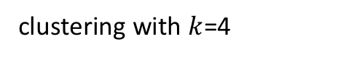


Clustering: Motivation
Clustering (ML + Data Analysis)
Explore the data, Reveal existing structure, group similar points to one another, etc
Given Set of Data Points:
$$C_{1}$$
$$C_{2}$$
clustering with $k$=4
$$C_{3}$$
$$C_{4}$$

Slide 7
Clustering: Motivation
Clustering (ML + Data Analysis)
Explore the data, Reveal existing structure, group similar points to one another, etc
Clustering (Operations Research)

Slide 8
Clustering: Motivation
Clustering (ML + Data Analysis)
Explore the data, Reveal existing structure, group similar points to one another, etc
Clustering (Operations Research) ‘
Allocating a collection of facilities or fire stations to serve a collection of users

Slide 9
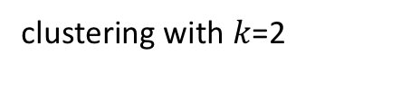
Clustering: Motivation
Clustering (ML + Data Analysis)
Explore the data, Reveal existing structure, group similar points to one another, etc
Clustering (Operations Research) ‘
Allocating a collection of facilities or fire stations for a collection of users
Set of Possible Locations:
clustering with $k$=2

Slide 10
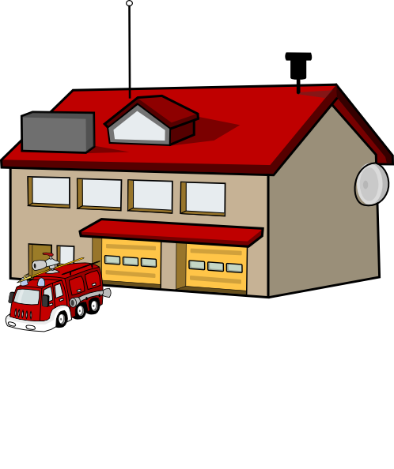
Clustering: Motivation
Clustering (ML + Data Analysis)
Explore the data, Reveal existing structure, group similar points to one another, etc
Clustering (Operations Research) ‘
Allocating a collection of facilities or fire stations for a collection of users
Set of Possible Locations:
clustering with $k$=2

Slide 11
Types of Clustering

Slide 12
Types of Clustering
Center-Based Clustering
Spectral Clustering
Correlation Clustering
Hierarchical Clustering

Slide 13

Center-Based Clustering
the cluster is decided by choosing $k$ centers → each point is then assigned to its closest center
Includes $k$-means, $k$-median, and $k$-center clustering

Slide 14

Formalizing Center-Based Clustering
Input:
Set of points: $𝒞$
Distance between points: $∀i,j∈𝒞$we have $d\left(i,j\right)$(which is a Metric)
Number of Clusters: $k$

Slide 15
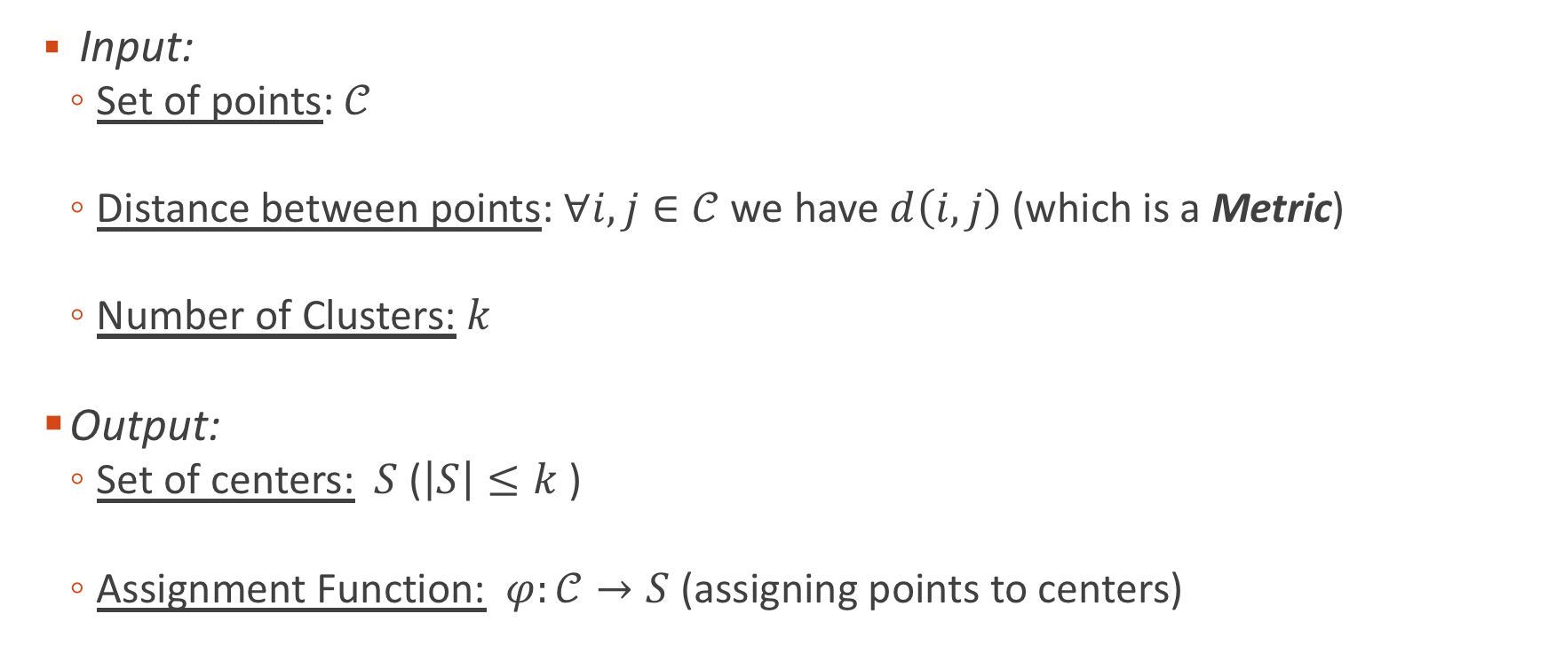
Formalizing Center-Based Clustering
Input:
Set of points: $𝒞$
Distance between points: $∀i,j∈𝒞$we have $d\left(i,j\right)$(which is a Metric)
Number of Clusters: $k$
Output:
Set of centers: $S$ ($\left|S\right|≤k$ )
Assignment Function: $φ:𝒞→S$ (assigning points to centers)

Slide 16

Formalizing Center-Based Clustering
Objective Functions:
$k$-center: $\min_{S, φ}\max_{j∈𝒞}$ $d(j,φ(j))$

Slide 17

Formalizing Center-Based Clustering
Objective Functions:
$k$-center: $\min_{S, φ}\max_{j∈𝒞}$ $d(j,φ(j))$
Minimizes the maximum distance (sensitive to outliers)

Slide 18

Formalizing Center-Based Clustering
Objective Functions:
$k$-center: $\min_{S, φ}\max_{j∈𝒞}$ $d(j,φ(j))$
Minimizes the maximum distance (sensitive to outliers)
$k$-median: $\min_{S, φ} \sum_{j∈𝒞}{d(j,φ(j))}$

Slide 19

Formalizing Center-Based Clustering
Objective Functions:
$k$-center: $\min_{S, φ}\max_{j∈𝒞}$ $d(j,φ(j))$
Minimizes the maximum distance (sensitive to outliers)
$k$-median: $\min_{S, φ} \sum_{j∈𝒞}{d(j,φ(j))}$
Minimizes the sum of the distances (more noise-tolerant)

Slide 20
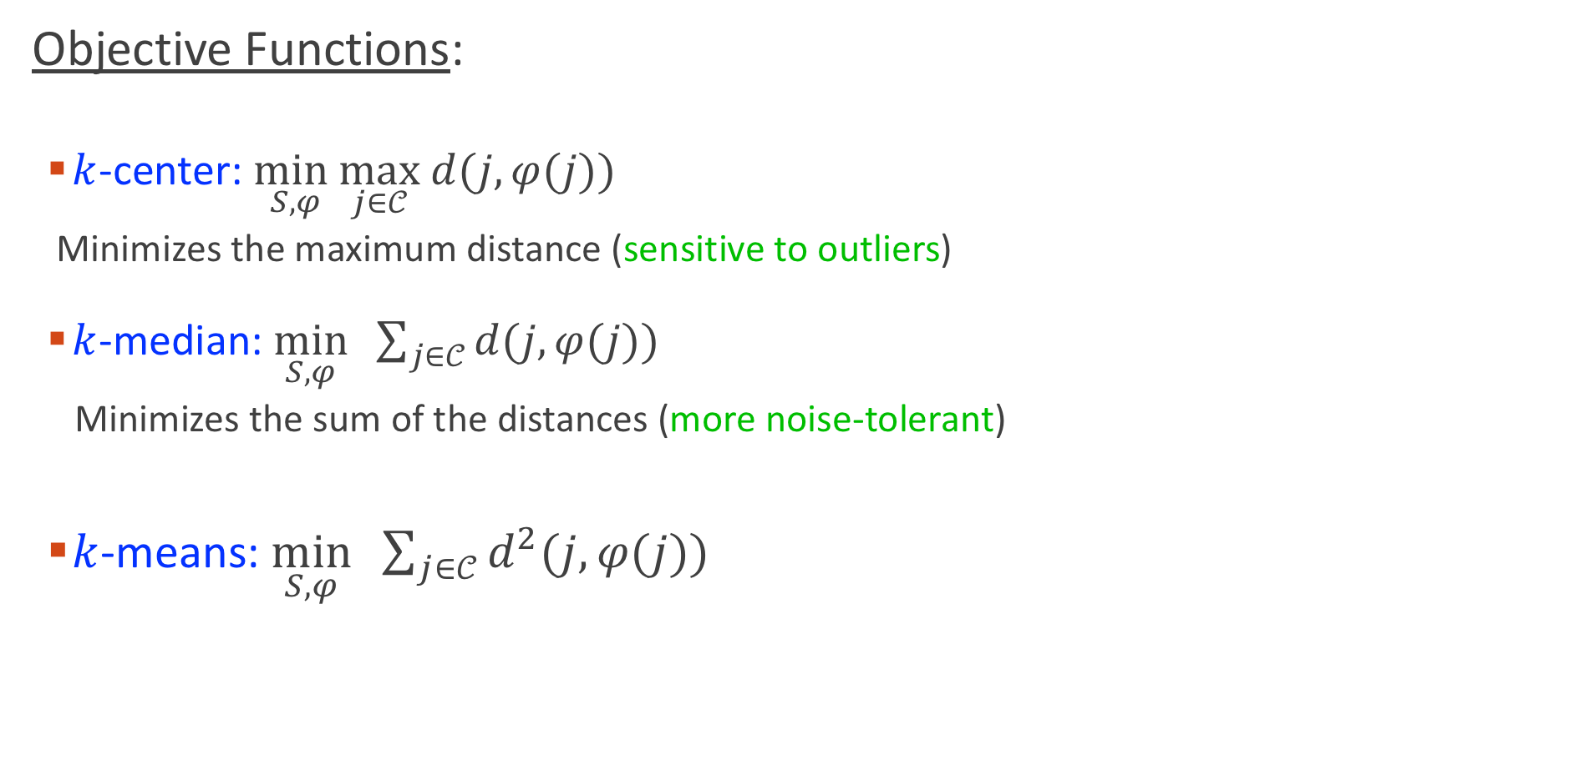
Formalizing Center-Based Clustering
Objective Functions:
$k$-center: $\min_{S, φ}\max_{j∈𝒞}$ $d(j,φ(j))$
Minimizes the maximum distance (sensitive to outliers)
$k$-median: $\min_{S, φ} \sum_{j∈𝒞}{d(j,φ(j))}$
Minimizes the sum of the distances (more noise-tolerant)
$k$-means: $\min_{S, φ} \sum_{j∈𝒞}{d^{2}(j,φ(j))}$

Slide 21
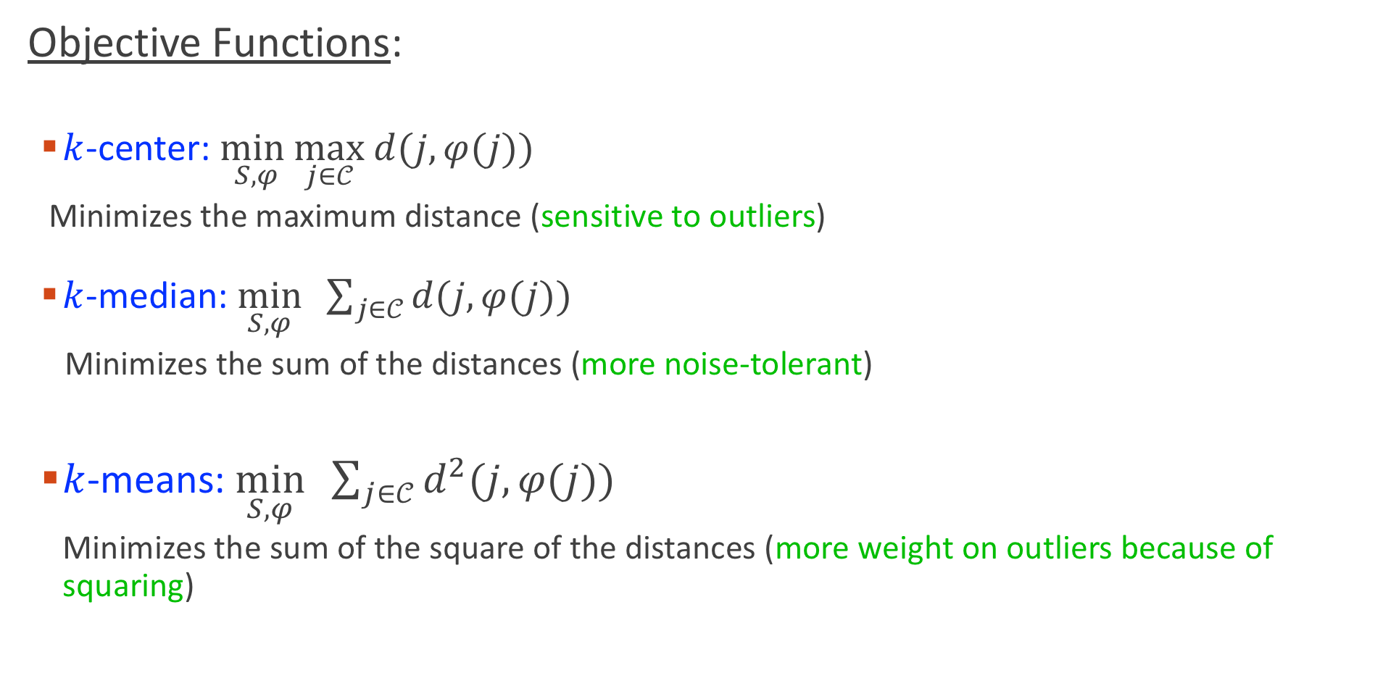
Formalizing Center-Based Clustering
Objective Functions:
$k$-center: $\min_{S, φ}\max_{j∈𝒞}$ $d(j,φ(j))$
Minimizes the maximum distance (sensitive to outliers)
$k$-median: $\min_{S, φ} \sum_{j∈𝒞}{d(j,φ(j))}$
Minimizes the sum of the distances (more noise-tolerant)
$k$-means: $\min_{S, φ} \sum_{j∈𝒞}{d^{2}(j,φ(j))}$
Minimizes the sum of the square of the distances (more weight on outliers because of squaring)

Slide 22
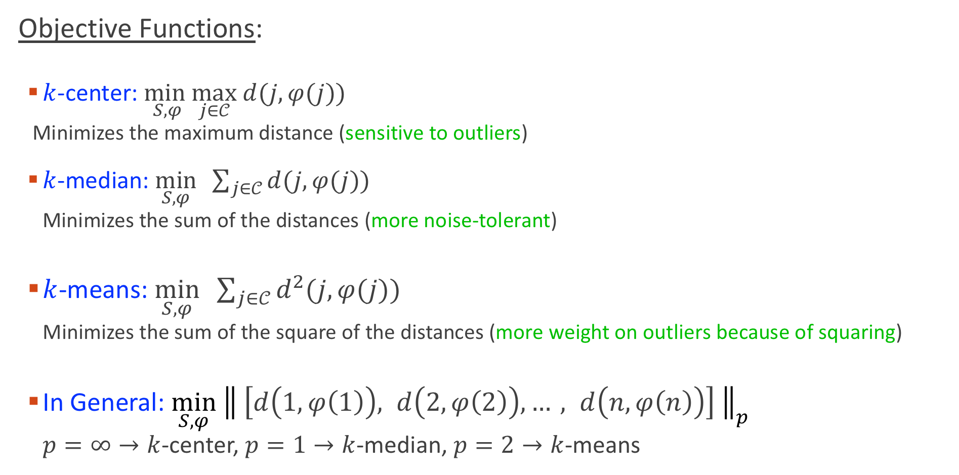
Formalizing Center-Based Clustering
Objective Functions:
$k$-center: $\min_{S, φ}\max_{j∈𝒞}$ $d(j,φ(j))$
Minimizes the maximum distance (sensitive to outliers)
$k$-median: $\min_{S, φ} \sum_{j∈𝒞}{d(j,φ(j))}$
Minimizes the sum of the distances (more noise-tolerant)
$k$-means: $\min_{S, φ} \sum_{j∈𝒞}{d^{2}(j,φ(j))}$
Minimizes the sum of the square of the distances (more weight on outliers because of squaring)
In General: $\min_{S, φ}{ \left\| \left[d\left(1,φ\left(1\right)\right), d\left(2,φ\left(2\right)\right),…, d\left(n,φ\left(n\right)\right)\right] \right\|}_{p}$
$p=∞→k$-center, $p=1→k$-median, $p=2→k$-means

Slide 23

Spectral Clustering
Points are vertices in a graph $G=(V,E)$
$∀i,j:w_{ij}≥0$, $w_{ij}$ is the similarity between $i$ and $j$

Slide 24
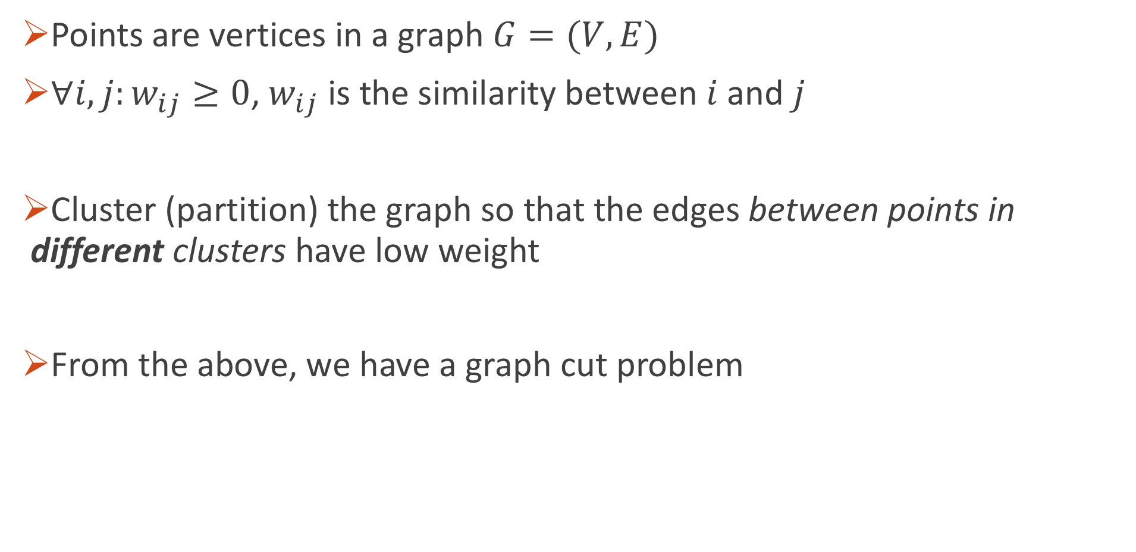
Spectral Clustering
Points are vertices in a graph $G=(V,E)$
$∀i,j:w_{ij}≥0$, $w_{ij}$ is the similarity between $i$ and $j$
Cluster (partition) the graph so that the edges between points in different clusters have low weight
From the above, we have a graph cut problem

Slide 25
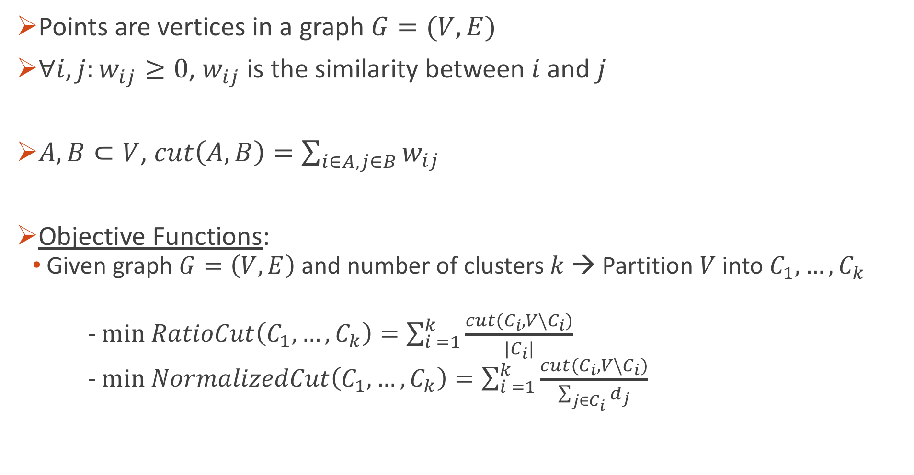
Spectral Clustering: Formal Definition
Points are vertices in a graph $G=(V,E)$
$∀i,j:w_{ij}≥0$, $w_{ij}$ is the similarity between $i$ and $j$
$A,B⊂V$, $cut\left(A,B\right)=\sum_{i∈A,j∈B}{w_{ij}}$
Objective Functions:
Given graph $G=\left(V,E\right)$ and number of clusters $k$ → Partition $V$ into $C_{1}, …,C_{k}$
- $min RatioCut\left(C_{1}, …,C_{k}\right)=\sum_{i =1}^{k}{\frac{cut(C_{i},{V\backslash C}_{i})}{|C_{i}|}}$
- $min NormalizedCut\left(C_{1}, …,C_{k}\right)=\sum_{i =1}^{k}{\frac{cut(C_{i},{V\backslash C}_{i})}{\sum_{j∈C_{i}}{d_{j}}}}$

Slide 26

Correlation Clustering
Points are vertices in a graph $G=(V,E)$
$∀i,j:w_{ij}^{+}≥0,w_{ij}^{−}≥0$,
-$w_{ij}^{+}$ is the degree to which $i$ and $j$ are similar
-$w_{ij}^{−}$ is the degree to which $i$ and $j$ are different

Slide 27

Correlation Clustering
Points are vertices in a graph $G=(V,E)$
$∀i,j:w_{ij}^{+}≥0,w_{ij}^{−}≥0$,
-$w_{ij}^{+}$ is the degree to which $i$ and $j$ are similar
-$w_{ij}^{−}$ is the degree to which $i$ and $j$ are different
Cluster (partition) the graph so that you get:
-large $w_{ij}^{+}$ edges within a cluster
-large $w_{ij}^{−}$edges between different clusters

Slide 28
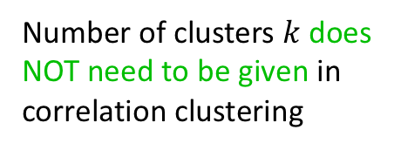

Correlation Clustering
Points are vertices in a graph $G=(V,E)$
$∀i,j:w_{ij}^{+}≥0,w_{ij}^{−}≥0$,
-$w_{ij}^{+}$ is the degree to which $i$ and $j$ are similar
-$w_{ij}^{−}$ is the degree to which $i$ and $j$ are different
Cluster (partition) the graph so that you get
-low weight edges between different clusters -high weight edges within a cluster
Objective Function:
Given graph $G=\left(V,E\right)$ → Partition $V$ into $C_{1}, …,C_{k}$
$max \sum_{i,j:same cluster}{w_{ij}^{+}}+ \sum_{i,j: different clusters}{w_{ij}^{−}}$
Number of clusters $k$ does NOT need to be given in correlation clustering

Slide 29

Hierarchical Clustering
Like correlation clustering, you don’t need to set $k$ (the number of clusters)
The output groups the points in a tree, giving groupings at different levels
agglomerative clustering (common traditional method):
-bottom-up approach, group similar points together forming a cluster, then group similar clusters and so on.

Slide 30

Hierarchical Clustering
Like correlation clustering, you don’t need to set $k$ (the number of clusters)
The output groups the points in a tree, grouping points at different levels
agglomerative clustering (common traditional method):
-bottom-up approach: group similar points together forming a cluster, then group similar clusters and so on.

Slide 31
Hierarchical Clustering
agglomerative clustering has is NOT optimizing an objective function
→ Makes it hard to know the quality

Slide 32

Hierarchical Clustering
agglomerative clustering has is NOT optimizing an objective function
→ Makes it hard to know the quality
[Dasgupta, 2016] defines a cost function for hierarchical clustering:
-Given $G=(V,E)$ with $w_{ij}$ specifiying the similarity between $i$ and $j$
Objective Function:
$\min{\sum_{i,j}{w_{ij} × (\#of descendents of lowest commen ancestor of i and j) }}$
-the objective places higher penalty when separating points higher in the tree
Further objectives for hierarchical clustering were also introduced [Moseley & Wang, 2017 ; Cohen-Addad et al, 2018].

Slide 33
Algorithmic Fairness
Much of decision making is done at least partly using algorithms.

Slide 34
Algorithmic Fairness
Much of decision making is done at least partly using algorithms.
Examples: ML for recidivism prediction, loan approval

Slide 35
Algorithmic Fairness
Much of decision making is done at least partly using algorithms.
Examples: ML for recidivism prediction, loan approval
Documented cases of algorithmic bias [O’Neil 2016; Kearns & Roth 2019].
Substantial progress and interest in algorithmic fairness.

Slide 36

Some Considerations for Fairness in Clustering
For a point $i,$ its distance from the center $d(i,φ(i))$:
-closer to the center →more represented by the center (ML)
-closer to the center →less travel distance (OR)
→ points want to be closer the center
How does a fairness guarantee over the distance look like? How can we achieve that?

Slide 37

Some Considerations for Fairness in Clustering
Clustering partitions the set of points $𝒞$ into clusters $C_{1},C_{2},…,C_{k}$
-different clusters will be processed differently, enjoy different outcomes, etc
-suppose one demographic is under-represented in a cluster or over-represented in another.
-suppose clustering assigns points which are not faraway from one another to different clusters.
How do avoid the above situations and guarantee fairness?

