Slide 1
Individual Fairness in Clustering

Slide 2
High-Level Motivation
Demographic Fairness: Treat each group of points fairly, with respect to how other groups are being treated or with respect to the specific needs of the group at hand.
Individual Fairness: Treat each individual point fairly, with respect to how other points are being treated or with respect to its specific needs.
Does demographic fairness imply individual fairness?
View each point as a singleton group.
The concepts of group fairness become vague or ill-defined in this case:
Balance: Leads to a single cluster solution
Proportionality: Each point is entitled to each its own cluster?
Socially fair k-clustering: Reduces to k-center
Demographic fairness cannot adequately capture any individual needs of points.

Slide 3
The Seminal Work of Dwork et al.
A very important work in the area of Individual Fairness
Dwork et al. (“Fairness Through Awareness” – ITCS 2012) introduced a ground breaking concept of individual fairness in the context of classification.
Similar individuals should be treated similarly
It will help us in our taxonomy of individually fair notions for clustering
Definitions that follow the Dwork et al. paradigm
Definitions that diverge from it

Slide 4
Individually-Fair Clustering Models that Follow the Dwork et al. Paradigm

Slide 5
The Dwork et al. Paradigm in Clustering
Similar individuals should be treated similarly
Two questions that need to be answered:
How can we define similarity in the context of clustering?
What constitutes similar treatment in a clustering setting?
The first question is not really important.
The second question is of much more significance.

Slide 6
Similar treatment in terms of same cluster placement
Motivational Example:
Suppose a company wants to cluster its employees into k groups
People in the first cluster will receive the highest amount of raise, the people in the second cluster the second highest raise, and so on.
Suppose that employee X is very similar to employee Y.
If Y is placed in a cluster that receives a better amount of raise, then X would arguably feel unfairly treated.
In such cases, similar points should be placed in the same cluster

Slide 7
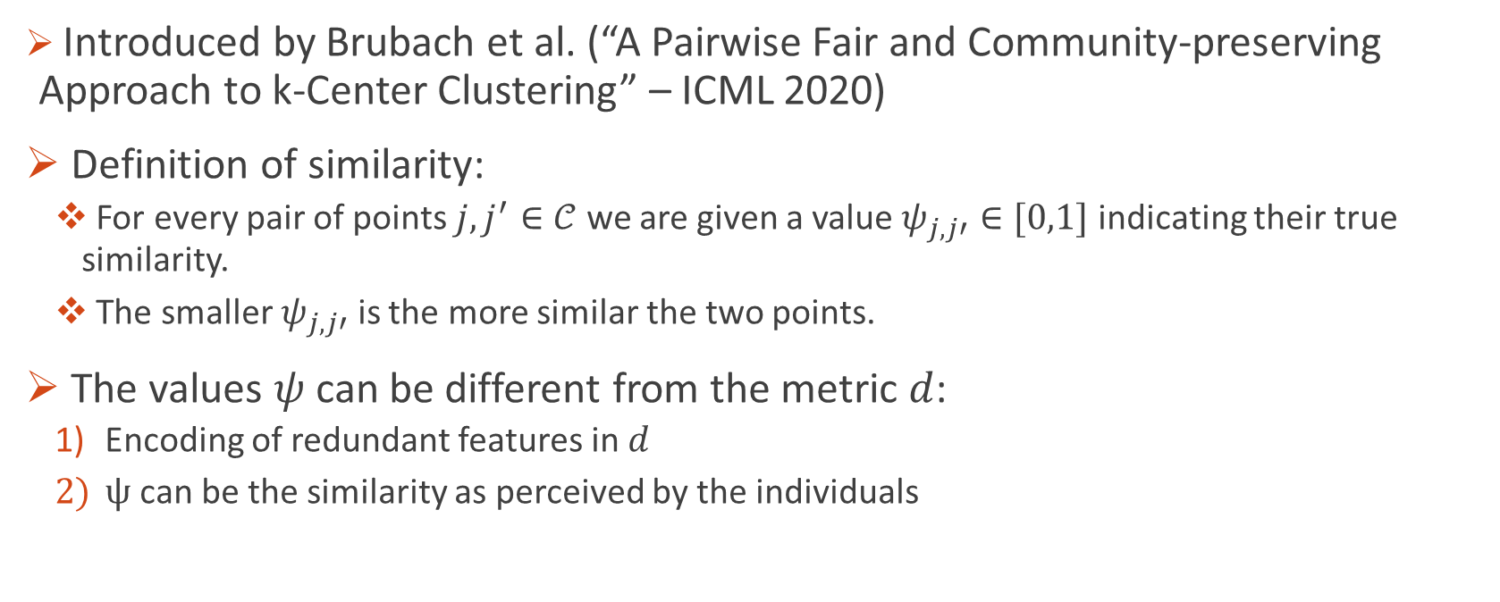
Probabilistic Pairwise Fairness – Definition of Similarity
Introduced by Brubach et al. (“A Pairwise Fair and Community-preserving Approach to k-Center Clustering” – ICML 2020)
Definition of similarity:
For every pair of points $j,j^{′}∈𝒞$ we are given a value $ψ_{j,j′}∈[0,1]$ indicating their true similarity.
The smaller $ψ_{j,j′}$ is the more similar the two points.
The values $ψ$ can be different from the metric $d$:
Encoding of redundant features in $d$
$ψ$ can be the similarity as perceived by the individuals

Slide 8
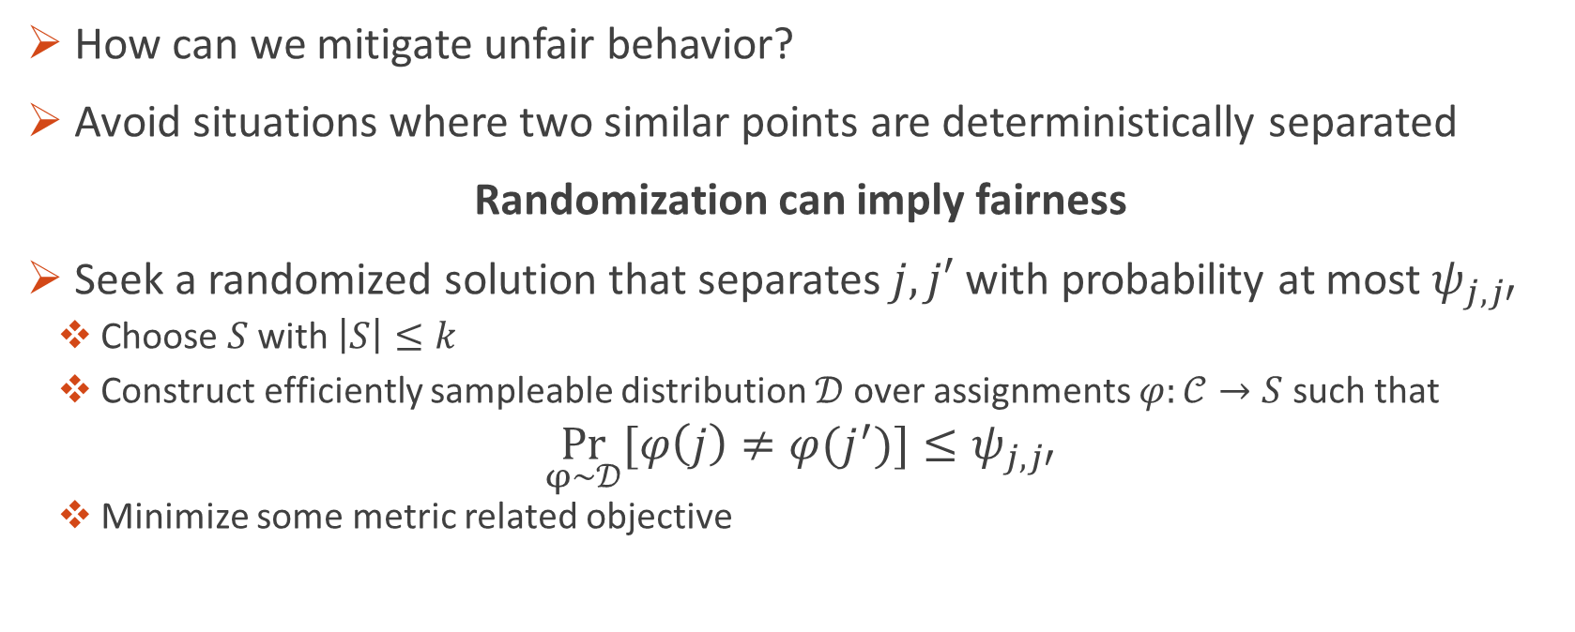
Probabilistic Pairwise Fairness – Definition of Similar Treatment
How can we mitigate unfair behavior?
Avoid situations where two similar points are deterministically separated
Randomization can imply fairness
Seek a randomized solution that separates $j,j′$ with probability at most $ψ_{j,j′}$
Choose $S$ with $\left|S\right|≤k$
Construct efficiently sampleable distribution $𝒟$over assignments $φ:𝒞→S$ such that
$$\underset{φ\sim 𝒟}{Pr}[φ\left(j\right)≠φ(j^{′})]≤ψ_{j,j′}$$
Minimize some metric related objective

Slide 9
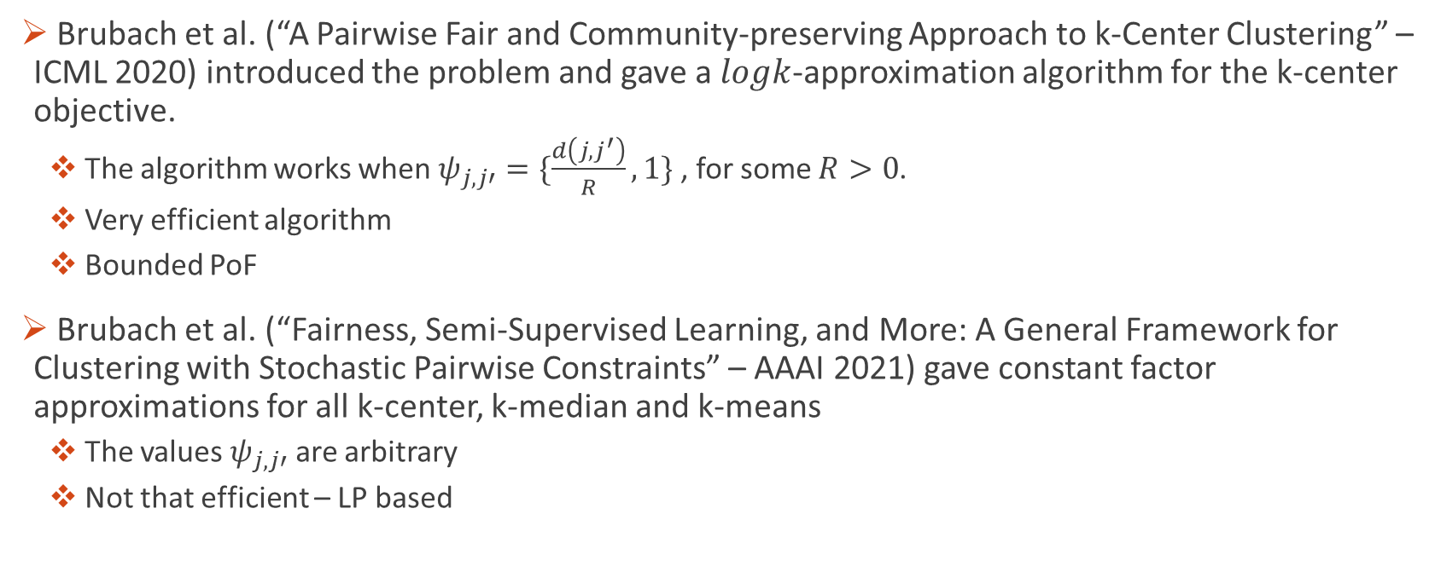
Probabilistic Pairwise Fairness - Results
Brubach et al. (“A Pairwise Fair and Community-preserving Approach to k-Center Clustering” – ICML 2020) introduced the problem and gave a $logk$-approximation algorithm for the k-center objective.
The algorithm works when $ψ_{j,j′}=\{\frac{d\left(j,j^{′}\right)}{R},1\}$ , for some $R>0$.
Very efficient algorithm
Bounded PoF
Brubach et al. (“Fairness, Semi-Supervised Learning, and More: A General Framework for Clustering with Stochastic Pairwise Constraints” – AAAI 2021) gave constant factor approximations for all k-center, k-median and k-means
The values $ψ_{j,j′}$ are arbitrary
Not that efficient – LP based

Slide 10
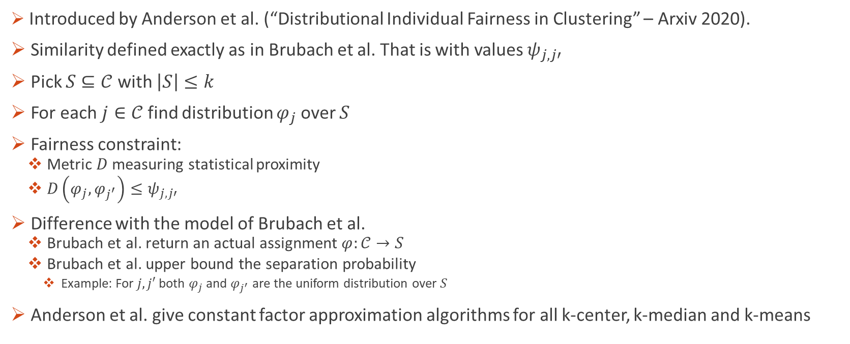
Distributional Individual Fairness
Introduced by Anderson et al. (“Distributional Individual Fairness in Clustering” – Arxiv 2020).
Similarity defined exactly as in Brubach et al. That is with values $ψ_{j,j′}$
Pick $S⊆𝒞$ with $\left|S\right|≤k$
For each $j∈𝒞$ find distribution $φ_{j}$ over $S$
Fairness constraint:
Metric $D$ measuring statistical proximity
$D\left(φ_{j},φ_{j^{′}}\right)≤ψ_{j,j′}$
Difference with the model of Brubach et al.
Brubach et al. return an actual assignment $φ:𝒞→S$
Brubach et al. upper bound the separation probability
Example: For $j,j′$ both $φ_{j}$ and $φ_{j^{′}}$ are the uniform distribution over $S$
Anderson et al. give constant factor approximation algorithms for all k-center, k-median and k-means

Slide 11
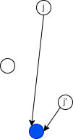
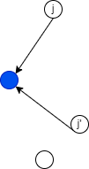

Similar Treatment is Terms of the Assignment Distance
In many applications the quantity $d\left(j,φ\left(j\right)\right)$ (assignment distance) is what really matters
Clustering: It measures how representative $φ\left(j\right)$ is for $j$.
Facility Location: It represents the distance $j$ needs to travel in order to reach its service provider $φ\left(j\right)$.
The smaller $d\left(j,φ\left(j\right)\right)$ is the more satisfied the point $j$.
Suppose $j′$ is similar to $j$ and $d\left(j^{′},φ\left(j^{′}\right)\right)≪d\left(j,φ\left(j\right)\right).$
$j$ is justified to feel unfairly treated

Slide 12
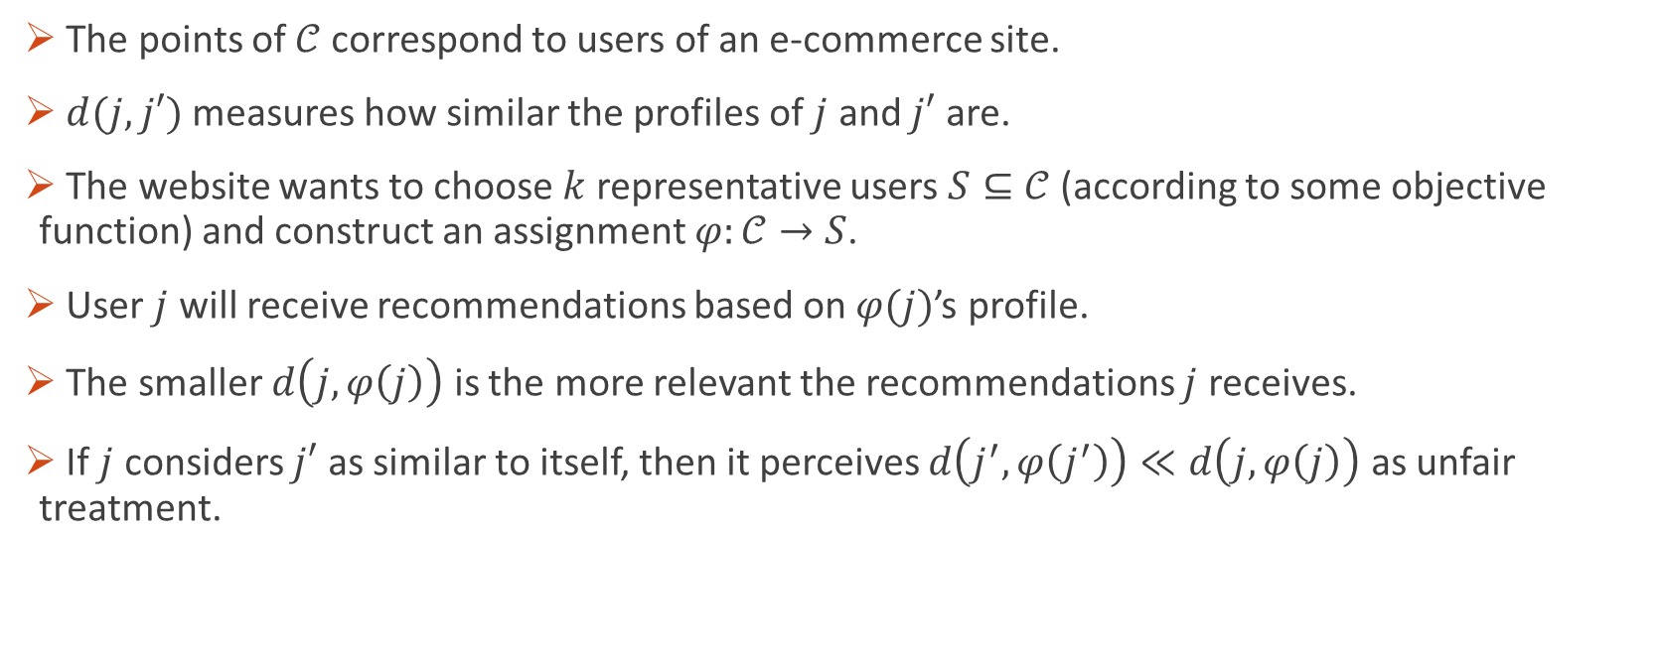
Motivational Example
The points of $𝒞$ correspond to users of an e-commerce site.
$d(j,j′)$ measures how similar the profiles of $j$ and $j′$ are.
The website wants to choose $k$ representative users $S⊆𝒞$ (according to some objective function) and construct an assignment $φ:𝒞→S$.
User $j$ will receive recommendations based on $φ(j)$’s profile.
The smaller $d\left(j,φ\left(j\right)\right)$ is the more relevant the recommendations $j$ receives.
If $j$ considers $j′$ as similar to itself, then it perceives $d\left(j^{′},φ\left(j^{′}\right)\right)≪d\left(j,φ\left(j\right)\right)$ as unfair treatment.

Slide 13
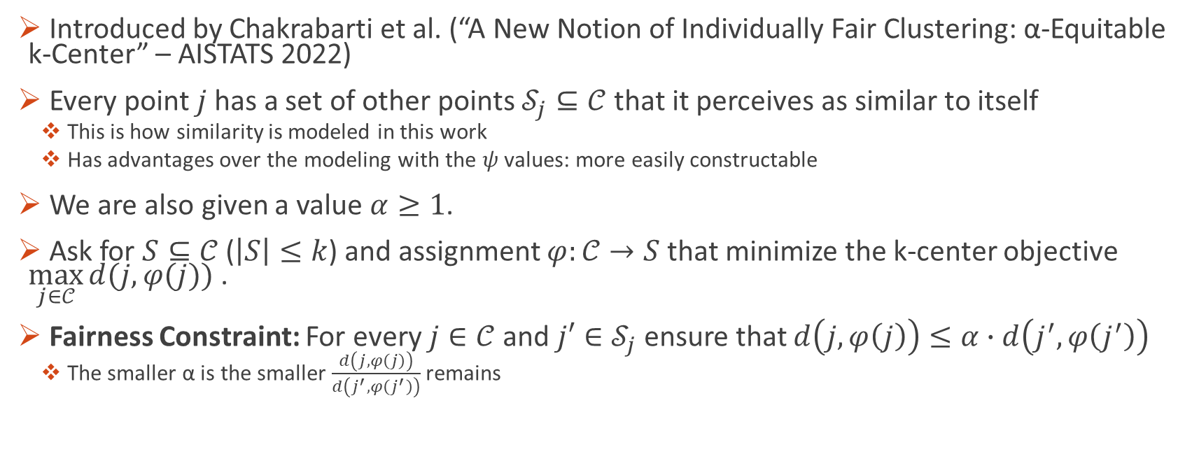
α-Equitable k-Center
Introduced by Chakrabarti et al. (“A New Notion of Individually Fair Clustering: α-Equitable k-Center” – AISTATS 2022)
Every point $j$ has a set of other points $𝒮_{j}⊆𝒞$ that it perceives as similar to itself
This is how similarity is modeled in this work
Has advantages over the modeling with the $ψ$ values: more easily constructable
We are also given a value $α≥1$.
Ask for $S⊆𝒞$ ($\left|S\right|≤k$) and assignment $φ:𝒞→S$ that minimize the k-center objective $\max_{j∈𝒞}{d(j,φ(j))}$ .
Fairness Constraint: For every $j∈𝒞$ and $j′∈𝒮_{j}$ ensure that $d\left(j,φ\left(j\right)\right)≤α∙d\left(j^{′},φ\left(j^{′}\right)\right)$
The smaller α is the smaller $\frac{d\left(j,φ\left(j\right)\right)}{d\left(j^{′},φ\left(j^{′}\right)\right)}$ remains

Slide 14
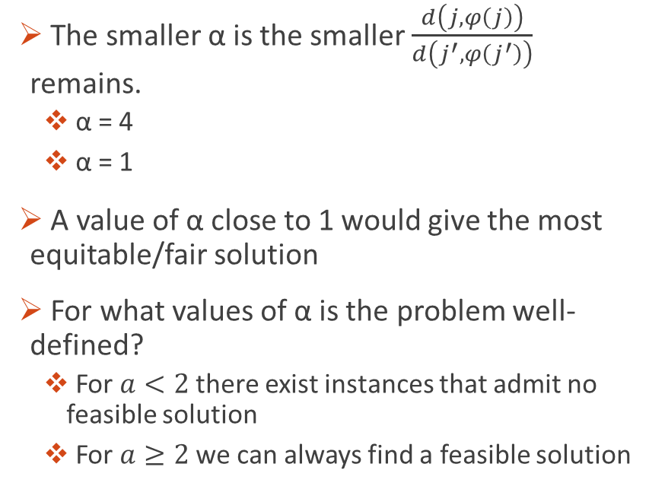
The parameter α
The smaller α is the smaller $\frac{d\left(j,φ\left(j\right)\right)}{d\left(j^{′},φ\left(j^{′}\right)\right)}$ remains.
α = 4
α = 1
A value of α close to 1 would give the most equitable/fair solution
For what values of α is the problem well-defined?
For $a<2$ there exist instances that admit no feasible solution
For $a≥2$ we can always find a feasible solution

Slide 15
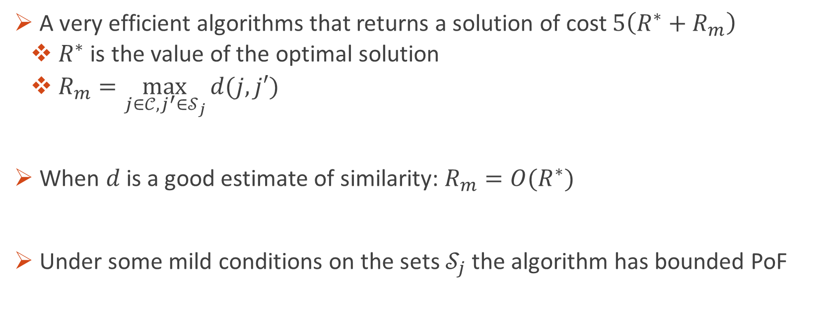
The results of Chakrabarti et al.
A very efficient algorithms that returns a solution of cost $5\left(R^{∗}+R_{m}\right)$
$R^{∗}$ is the value of the optimal solution
$R_{m}=\max_{j∈𝒞, j^{′}∈𝒮_{j}}{d(j,j′)}$
When $d$ is a good estimate of similarity: $R_{m}=O(R^{∗})$
Under some mild conditions on the sets $𝒮_{j}$ the algorithm has bounded PoF

Slide 16
Notions of Individual Fairness in Clustering that do not follow the Dwork et al. paradigm

Slide 17
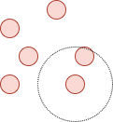
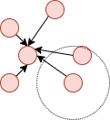
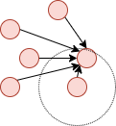
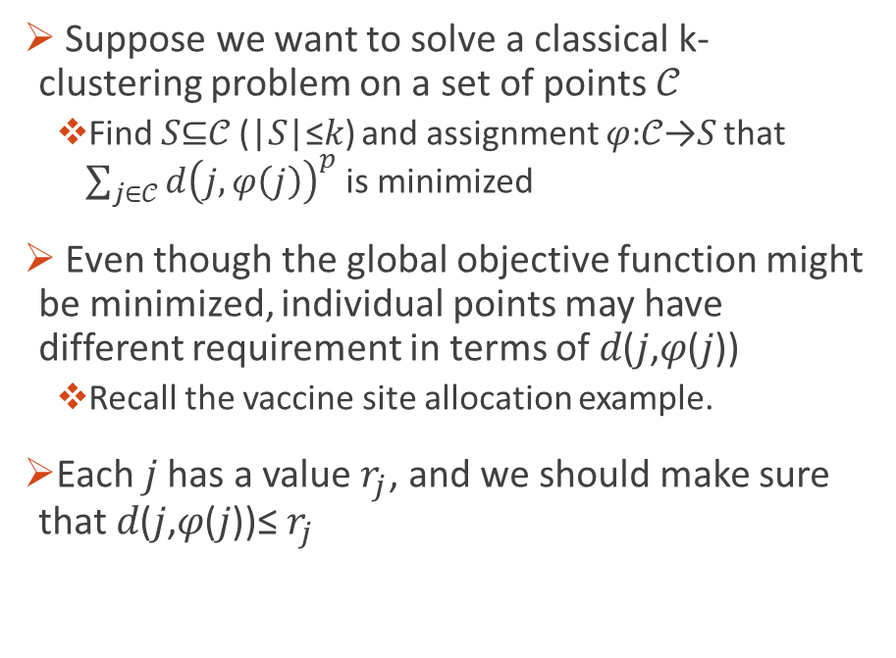
A Center in my Neighborhood
Suppose we want to solve a classical k-clustering problem on a set of points 𝒞
Find 𝑆⊆𝒞 (|𝑆|≤𝑘) and assignment 𝜑:𝒞→𝑆 that ${\sum_{j∈𝒞}{d\left(j,φ\left(j\right)\right)}}^{p}$is minimized
Even though the global objective function might be minimized, individual points may have different requirement in terms of 𝑑(𝑗,𝜑(𝑗))
Recall the vaccine site allocation example.
Each 𝑗 has a value $r_{j}$, and we should make sure that 𝑑(𝑗,𝜑(𝑗))≤ $r_{j}$

Slide 18
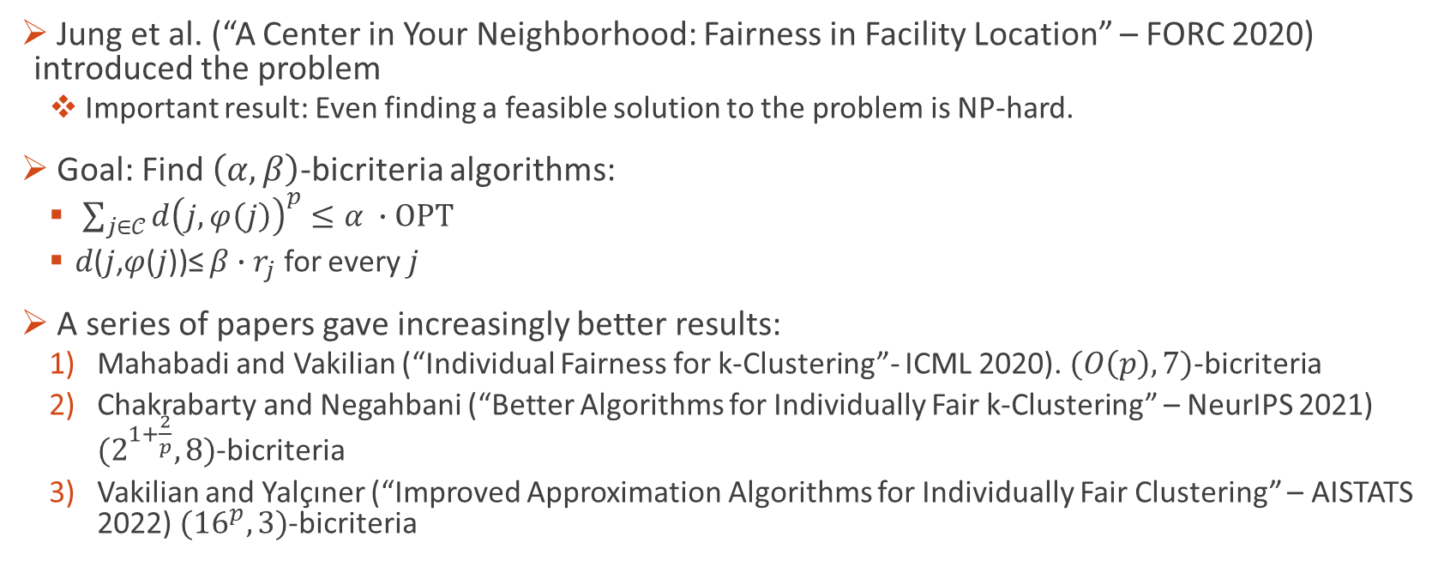
Results
Jung et al. (“A Center in Your Neighborhood: Fairness in Facility Location” – FORC 2020) introduced the problem
Important result: Even finding a feasible solution to the problem is NP-hard.
Goal: Find $\left(α,β\right)$-bicriteria algorithms:
${\sum_{j∈𝒞}{d\left(j,φ\left(j\right)\right)}}^{p}≤α ∙OPT$
𝑑(𝑗,𝜑(𝑗))≤ ${β∙r}_{j}$ for every $j$
A series of papers gave increasingly better results:
Mahabadi and Vakilian (“Individual Fairness for k-Clustering”- ICML 2020). $(O\left(p\right),7)$-bicriteria
Chakrabarty and Negahbani (“Better Algorithms for Individually Fair k-Clustering” – NeurIPS 2021) $(2^{1+\frac{2}{p}},8)$-bicriteria
Vakilian and Yalçıner (“Improved Approximation Algorithms for Individually Fair Clustering” – AISTATS 2022) $({16}^{p},3)$-bicriteria

Slide 19
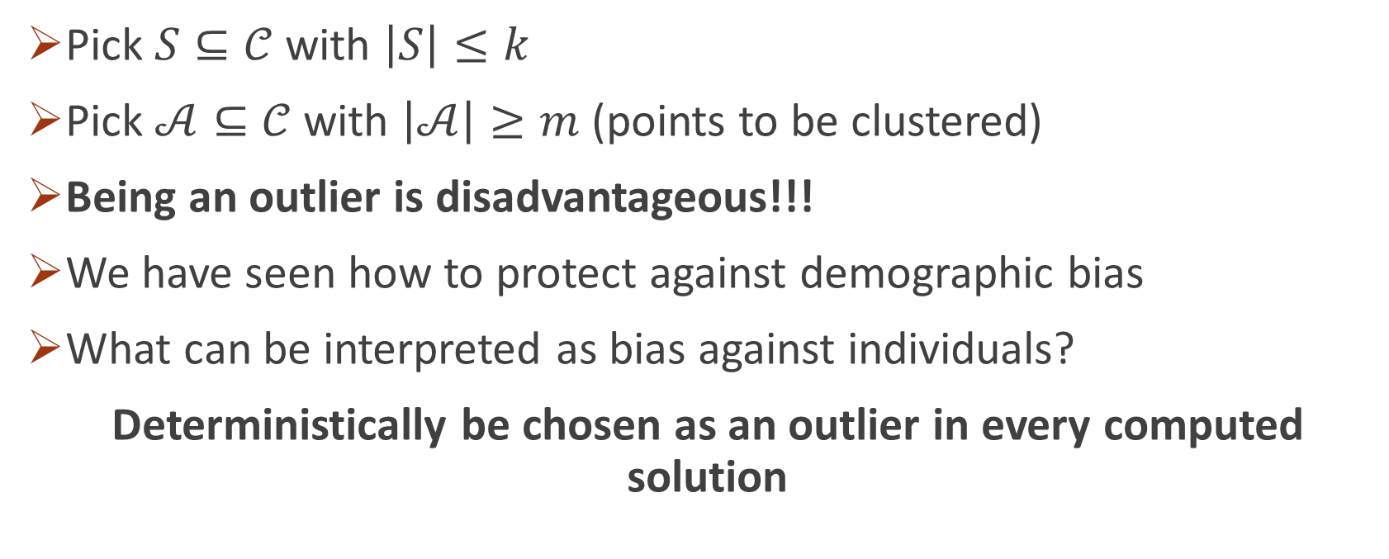
Individual Fairness in Clustering with Outliers
Pick $S⊆𝒞$ with $\left|S\right|≤k$
Pick $𝒜⊆𝒞$ with $\left|𝒜\right|≥m$ (points to be clustered)
Being an outlier is disadvantageous!!!
We have seen how to protect against demographic bias
What can be interpreted as bias against individuals?
Deterministically be chosen as an outlier in every computed solution

Slide 20
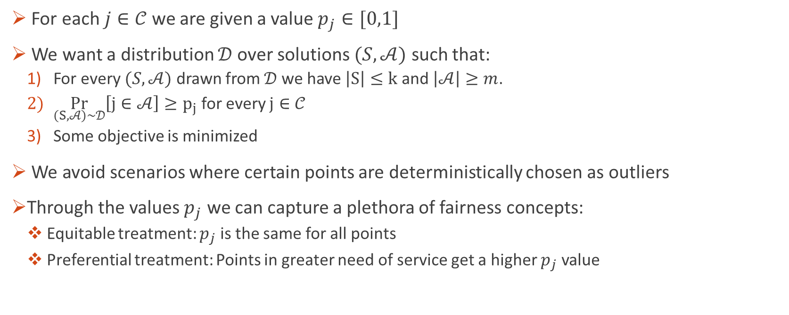
Randomization saves the day: A lottery model for individually fair clustering with outliers
For each $j∈𝒞$ we are given a value $p_{j}∈[0,1]$
We want a distribution $𝒟$over solutions $(S,𝒜)$ such that:
For every $(S,𝒜)$ drawn from $𝒟$ we have $\left|S\right|≤k$ and $\left|𝒜\right|≥m$.
$\underset{\left(S,𝒜\right)\sim 𝒟}{Pr}\left[j∈𝒜\right]≥p_{j}$ for every $j∈𝒞$
Some objective is minimized
We avoid scenarios where certain points are deterministically chosen as outliers
Through the values $p_{j}$ we can capture a plethora of fairness concepts:
Equitable treatment: $p_{j}$ is the same for all points
Preferential treatment: Points in greater need of service get a higher $p_{j}$ value

Slide 21
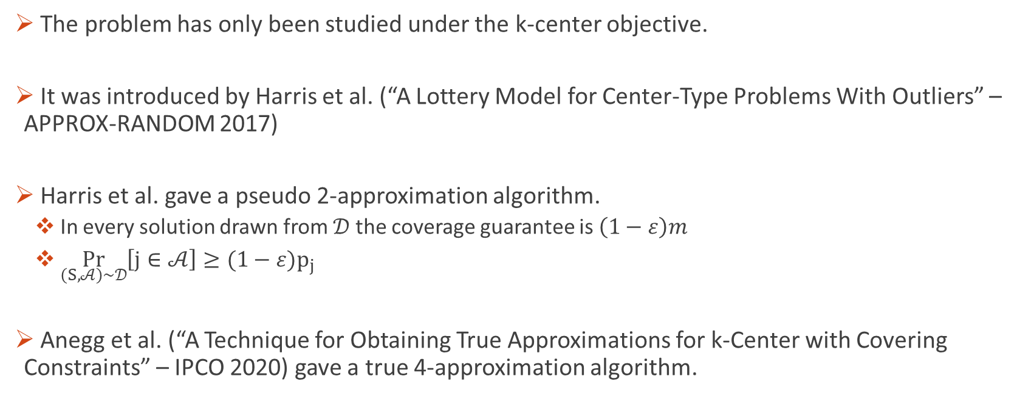
Results
The problem has only been studied under the k-center objective.
It was introduced by Harris et al. (“A Lottery Model for Center-Type Problems With Outliers” – APPROX-RANDOM 2017)
Harris et al. gave a pseudo 2-approximation algorithm.
In every solution drawn from $𝒟$ the coverage guarantee is $\left(1−ε\right)m$
$\underset{\left(S,𝒜\right)\sim 𝒟}{Pr}\left[j∈𝒜\right]≥{(1−ε)p}_{j}$
Anegg et al. (“A Technique for Obtaining True Approximations for k-Center with Covering Constraints” – IPCO 2020) gave a true 4-approximation algorithm.

Slide 22
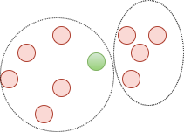
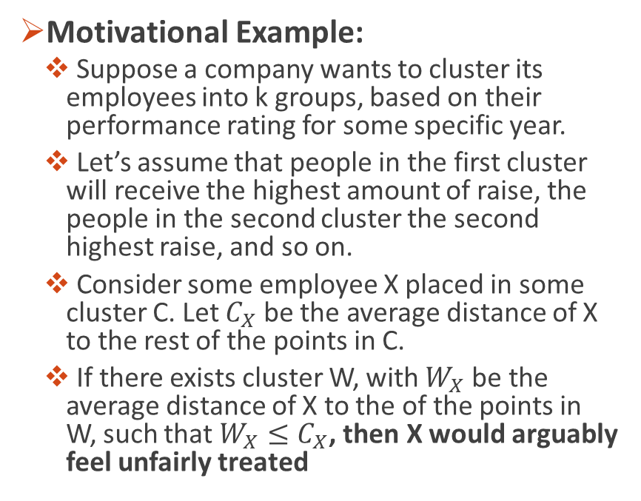
Fairness based on average distance to the points in your cluster
Motivational Example:
Suppose a company wants to cluster its employees into k groups, based on their performance rating for some specific year.
Let’s assume that people in the first cluster will receive the highest amount of raise, the people in the second cluster the second highest raise, and so on.
Consider some employee X placed in some cluster C. Let $C_{X}$ be the average distance of X to the rest of the points in C.
If there exists cluster W, with $W_{X}$ be the average distance of X to the of the points in W, such that $W_{X}≤C_{X}$, then X would arguably feel unfairly treated

Slide 23
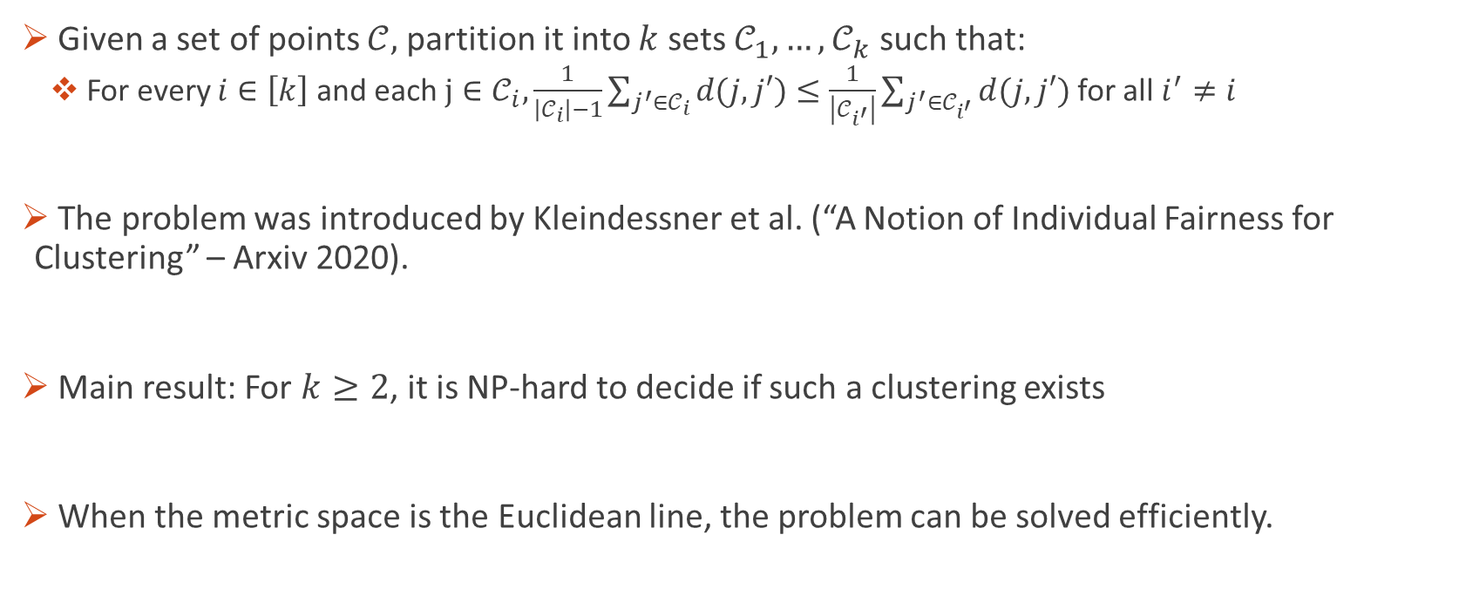
Formal Definition and Results
Given a set of points $𝒞,$ partition it into $k$ sets $𝒞_{1},…, 𝒞_{k}$ such that:
For every $i∈\left[k\right]$ and each $j∈𝒞_{i}, \frac{1}{\left|𝒞_{i}\right|−1}\sum_{j^{′}∈𝒞_{i}}{d(j,j′)}≤$ $\frac{1}{\left|𝒞_{i^{′}}\right|}\sum_{j^{′}∈𝒞_{i^{′}}}{d(j,j′)}$ for all $i^{′}≠i$
The problem was introduced by Kleindessner et al. (“A Notion of Individual Fairness for Clustering” – Arxiv 2020).
Main result: For $k≥2$, it is NP-hard to decide if such a clustering exists
When the metric space is the Euclidean line, the problem can be solved efficiently.

