Slide 1
Demographic Fairness: Balance

Slide 2
Inspiration
Disparate Impact [FFMSV 15]
Griggs vs Duke Power Co.: used non-racial features (notably, employee testing) as a proxy for race in order to discriminate against black employees in promotion
Duke Power Co. lost in the Supreme court, and this was deemed unlawful
This ruling and general philosophy helped promote affirmative action and anti-discrimination laws
Why is this bad:
It had a “disproportionate and adverse impact on certain individuals.”
In other words, disparate impact.
Applied to ML: Ensure that the impact of a system across protected groups is proportionate.
Applied to Clustering:
The impact on a group is measured by how many individuals of that group are in each cluster.
Thus, we must ensure that the number of individuals from each group in each cluster is proportional to group size

Slide 3












Demographic Fairness - Balance
Before: $balance\left(S\right)=1/2$
After: $balance\left(S\right)=1$
Recall: we are given points $𝒞$ in a metric space. We pick centers $S⊆𝒞$ and create a map $φ:𝒞→S$. We also represent the clustering as a partitioning of points S.
Assume the points in $𝒞$ are given colors red or blue, representing protected classes.
For a cluster $C$:
$$balance\left(C\right)=min⁡\left(\frac{\#red(C)}{\#blue(C)}, \frac{\#blue(C)}{\#red(C)}\right)$$
For a clustering $S$:
$$balance\left(S\right)=\min_{C∈S}{balance(C)}$$
We want balance to be high (close to 1).
$$balance\left(C_{1}\right)=1$$
$$balance\left(C_{2}\right)=1$$
$$balance\left(C_{3}\right)=1$$
$$balance\left(C_{2}\right)=1$$
$$balance\left(C_{4}\right)=1/2$$
$$balance\left(C_{4}\right)=1$$
$$balance\left(C_{3}\right)=1/2$$

Slide 4







Results for Balance [CKLV 18]
Lemma: Let $balance\left(𝒞\right)≥b/r$ for minimum integral $b$ and $r$. Then we can find a clustering $S$ with balance at least $b/r$ and maximum cluster size $b+r$.
7 red, 10 blue
$balance\left(𝒞\right)≥3/5$
Method: Using the previous lemma, create a fairlet decomposition $Y$, which is a fair clustering with small (but possibly too many) clusters. Run a vanilla clustering algorithm on the fairlets centers as points duplicated to equal the size of the fairlet, call this set $Y′$. The clustering is $S$.
Structural result: for k-median and k-center, let the objective value be ψ:
$\text{ψ}\left(𝒞,S\right)\text{=}\text{ψ}(𝒞,Y) +\text{ψ}(Y′\text{,}\text{S}\text{)}$
$$×2$$
$$×5$$
$$×8$$
$$×2$$
$$Y$$
$$Y′$$

Slide 5

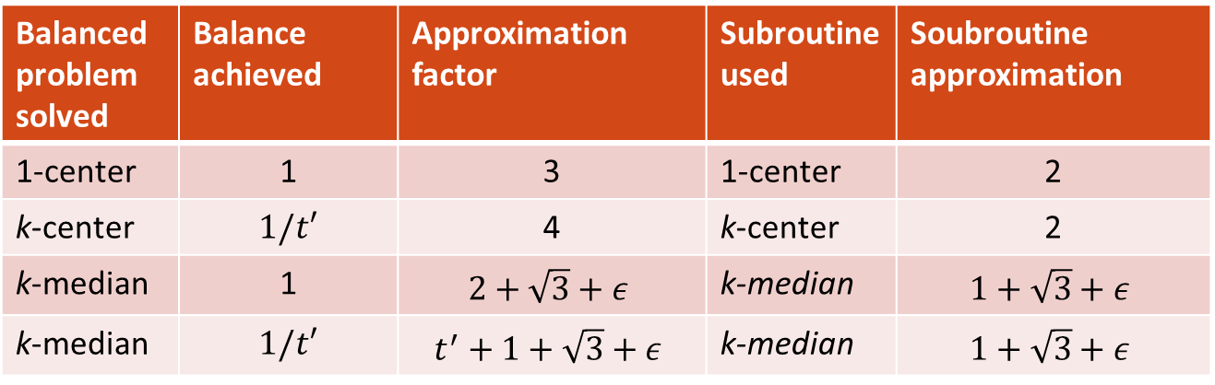
Further Results for Balance [CKLV 18]
Hardness: it is NP-hard to optimally find a $1/t′$-balanced k-median clustering.
Balanced problem solved | Balance achieved | Approximation factor | Subroutine used | Soubroutine approximation
1-center | 1 | 3 | 1-center | 2
k-center | $1/t′$ | 4 | k-center | 2
k-median | 1 | $$2+\sqrt{3}+ε$$ | k-median | $$1+\sqrt{3}+ε$$
k-median | $1/t′$ | $$t^{′}+1+\sqrt{3}+ε$$ | k-median | $$1+\sqrt{3}+ε$$

Slide 6
Fairness and Privacy [RS 18]
General fairness results
Finds a 12-approximate fairlet decomposition on any number of colors
Implies:
14-approximation for k-center
15-approximationfor k-supplier
Fair and private clustering
Privacy: lower bounds on the size of clusters
Results:
40-approximate private and fair k-center
41-approximate private and fair k-supplier
Strongly private clustering
Strong privacy: lower bounds on number of points of a color per cluster
Results
4-approximate strongly private k-center
5-approximate strongly private k-supplier
Notes:
Fairlets: uses capacitated k’-center on some color c. Then for each other color d, try to find the best way to match “b_d” of d to each cluster (i.e., same amount). Implication: Basically leverages Chierichetti et al, and notes it applies to k-suppliers too
Privacy - > anonymity

Slide 7
Fairness and Essential Fairness [BGKKRSS 19]
General fairness results
5-approximate fair k-center
7-approximate fair k-supplier
Essentially fair results
Clusterings with only additive fairness violations:
E.g., you can have one extra red point in a cluster
Results:
3-approximate essentially fair k-center
5-approximate essentially fair k-supplier
3.488-approximate essentially fair facility location
4.675-approximate essentially fair k-median
62.856-approximate essentially fair k-means
Fair
Essentially Fair
4 red, 8 blue: r/b = 1/2
Relaxed LP solution to fair clustering
Network flow
Fractional assignment to vanilla centers
Round the fractional assignment
Vanilla clustering approximation

Slide 8
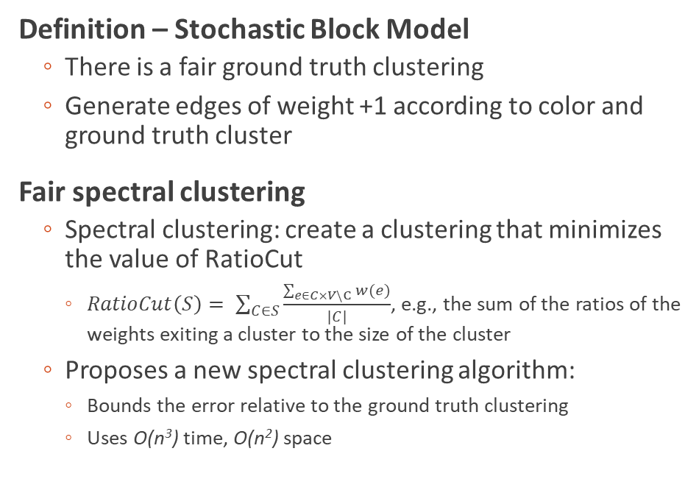
Fair Spectral Clustering [KSAM 19]
Definition – Stochastic Block Model
There is a fair ground truth clustering
Generate edges of weight +1 according to color and ground truth cluster
Fair spectral clustering
Spectral clustering: create a clustering that minimizes the value of RatioCut
$RatioCut\left(S\right)= \sum_{C∈S}{\frac{\sum_{e∈C×V\backslash C}{w(e)}}{|C|}}$, e.g., the sum of the ratios of the weights exiting a cluster to the size of the cluster
Proposes a new spectral clustering algorithm:
Bounds the error relative to the ground truth clustering
Uses O(n³) time, O(n²) space
Note: many edges omitted
Same color, same cluster: prob a
Same color, different cluster: prob b
Same cluster, different color: prob c
Different cluster, different color: prob d
a > b > c > d
Notes:
Since ground truth is fair, that means they are close to a fair ground truth clustering

Slide 9
Summary - Balance
First introduced as a concept in 2018 [CKLV 18]
They also developed the “fairlet decomposition“ technique and came up with initial results
Many of the best approximations are from [BGKKRSS 19], who studied many clustering problems.
Variants explored:
With privacy [RS 18]
Spectral Clustering [KSAM 19]
Essential fairness [BGKKRSS 19]

Slide 10
Demographic Fairness: Bounded Representation

Slide 11


Demographic Fairness – Bounded Representation [BGKKRSS 19]
Instead of requiring perfect balance, we are only constrained by given bounds. There are multiple versions studied:
α-bounded for constant α:
Every color must represent at most an α fraction of any cluster
α, β-bounded, for vectors α, β:
For any color $i∈\left\{1,…,c\right\}$, color $i$ must represent at most an α_{i} fraction of any cluster and at least a β_{i} fraction of any cluster
A clustering is fair if every cluster satisfies the bounded representation constraint.
α_{red}
α_{blue}
α_{green}
Fair down to α=3/8
Fair down to α_{red}=3/8, α_{blue}=3/8, α_{green}=1/4
Fair up to β_{red}=3/8, β_{blue}=3/8, β_{green}=1/4
3/8
3/8
1/4
β_{red}
β_{blue}
β_{green}

Slide 12
Mitigating Over-Representation [AEKM 19]
Fairness constraint: general upper bound α
Important technique: create a threshold graph on bichromatic edges of weight ≤ ꚍ
Results
General α: 3-approximation with violation 2
α=1/t: 3-approximation with violation 1
α=1/2: 12-approximation with no violation
Solve an LP relaxation on weights ≤ 3OPT
Filter facilities: only select distant ones
Merge caplets into a fair clustering
Round to an integral solution
Here we lose some approximation factor and fairness
Caplet decomp. on threshold graph (exists)

Slide 13
Fair Correlation Clustering [AEKM 20]
Fairness constraint: general upper bound α (also generalizes further)
Definition – correlation clustering
Edges are all +1 or -1
Minimize: the (weighted) sum of the +1 edges between clusters and -1 edges within clusters
Fair correlation clustering (on c colors)
α=1/2: 256-approximation
α=1/c: (16.48c²)-approximation
α=1/t: O(tρ)-approximation for ρ-approximate median cost fairlet decomposition
Low cost fairlet decomposition
Reduces to median costs fairlets with bounded size
Transform decomposition to weighted corr clust
Edge sign/weight depends on majority cut edges
Solve weighted corr clust
Expand for final clust

Slide 14
Fair Hierarchical Clustering [AEKKMMPVW 20]
Fairness constraint: general upper bound α (also generalizes further)
Hierarchical clustering objectives
Cost: initial objective, APX-hard
Revenue: dual to cost, const-approximable
Value: cost variant, const-approximable
Results
Cost: O(n^{5/6}log^{5/4}n)-approximation (highly combinatorial methods)
Revenue: (1/3-o(1))-approximation if α=1/t or 2 colors
Value: (2/3-ε)(1-o(1))-approximation
Find a fairlet decomposition
revenue
Extend previous methods
value
Extend previous methods to find arbitrary decomp
Run a blackbox vanilla hierarchical clustering
Attempt swapping points until found local approx. densest cut

Slide 15
General Bounds, Overlapping Groups [BCFN 19]
Fairness constraint: specific lower and upper bound vectors α, β, also vertices can be in multiple groups (bounded by Δ)
Fair assignment problem: given a set of centers, what is the best way to create a fair clustering by assigning points to the centers?
Results
Given a ρ-approximate vanilla k-clustering for the p-norm, gives a ρ+2 approximation with additive fairness violation 4Δ+3
Find centers from a vanilla clustering
Solve the fair assignment relaxed LP
Round using min degree bounded matroid methods
Notes:
Restricted dominance and minority protection

Slide 16

Probabilistic Fair Clustering [EBTD 20]
Fairness constraint: specific lower and upper bound vectors α, β
Probabilistic setting
Colors are not given. Each point has a probability of being assigned some color
We guarantee that the expected number of each color in each cluster is bounded above/below
Addresses any p-norm
Results
Given a vanilla ρ-approximation, there is a ρ+2-approximation with +1 violation (2 colors)
Given a vanilla ρ-approximation, there is a ρ+2-approximation with +1 violation (FPT, large clusters)
p_{blue} +p_{red} +p_{green} = 1
p_{blue}
p_{red}
p_{green}
For every cluster C, guarantee:
$${\text{α}}_{i}\left|C\right|≤E\left[i\left(C\right)\right]≤{\text{β}}_{i}\left|C\right|$$
Frequency of color i in cluster C
Notes:
Second result has exponential dependence on k

Slide 17
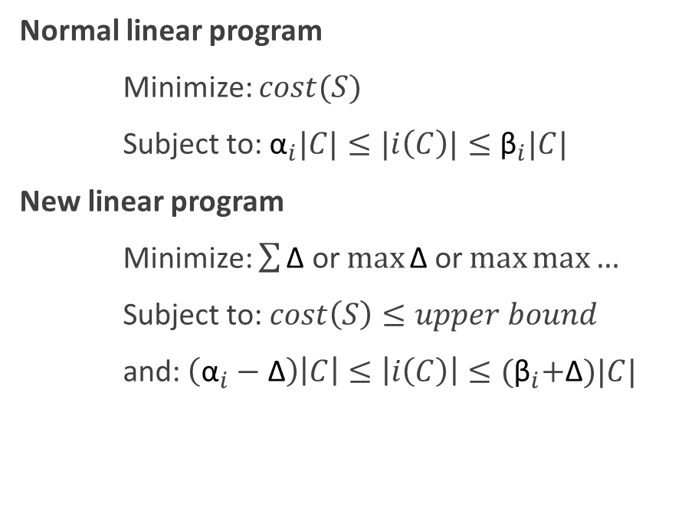
Fixing a Bounded Cost [EBSD 21]
Fairness constraint: specific lower and upper bound vectors α, β
Fair clustering under bounded cost
Fix an upper bound for the clustering cost
Minimize the degree of unfairness for any color (i.e., the proportional violation Δ of upper and lower bounds)
Utilitarian: minimize the sum of Δs
Egalitarian: minimize the maximum Δ
Leximin: minimize the maximum Δ, then second largest Δ, …
Results
Fair clustering (or assignment) under bounded cost is NP-hard
Given a vanilla approximation, there are approximations for the fair bounded cost problem
Normal linear program
Minimize: $cost(S)$
Subject to: ${\text{α}}_{i}|C|≤|i\left(C\right)|≤{\text{β}}_{i}|C|$
New linear program
Minimize: $\sum{\text{Δ}}$ or $\max{\text{Δ}}$ or $\max{\max{…}}$
Subject to: $cost\left(S\right)≤upper bound$
and: $\left({\text{α}}_{i}−\text{Δ}\right)\left|C\right|≤\left|i\left(C\right)\right|≤{\text{(}\text{β}}_{i}+\text{Δ})|C|$

Slide 18
Summary: Bounded Representation
Two versions:
α-capped clustering
Solved with very little to no additive fairness violation [AEKM 19]
α, β-bounded, with upper and lower bound vectors
Solved with additive fairness violation [BCFN 19]
Variants explored:
α-capped correlation clustering
α-capped hierarchical clustering
α, β-bounded probabilistic clustering
α, β-bounded clustering with bounded cost
However, both are stated in terms of “union closed” constraints

Slide 19
Demographic Fairness: Bounds on Chosen Centers

Slide 20
Demographic Fairness – Bounds on Chosen Centers
Let k_{red} = k_{blue} = k_{green} = 1
This clustering is not fair.
However this alternate clustering is fair
Data summarization: do a k-clustering. The resulting centers are then outputted as representatives of the data set.
Fairness: for every color i, there must be at least k_{i} centers of color i.

Slide 21
Data Summarization [KAM 19, JNN 20]
First introduced the fairness with regards to bounds on chosen centers.
Results [KAM 19]
Fair data summarization for k-center has a 5-approximation on 2 colors (tight) that runs in time O(kn)
Fair data summarization for k-center has a (3×2^{c-1} – 1) approximation on c colors that runs in time O(kc²n + kc⁴)
Results [JNN 20]
Fair data summarization for k-center has a 3-approximation on c colors (tight) that runs in time O(kn)

Slide 22
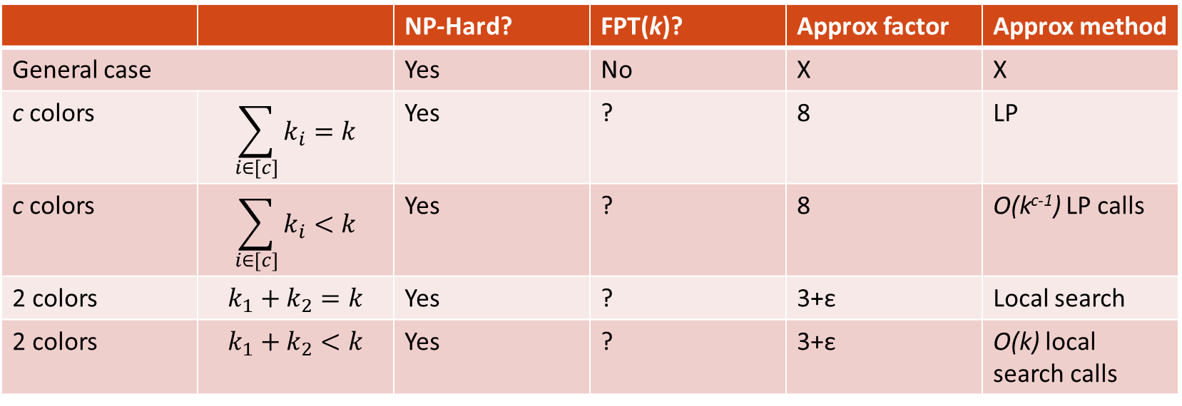
Diversity-Aware k-Means [TOG 21]
 |  | NP-Hard? | FPT(k)? | Approx factor | Approx method
General case |  | Yes | No | X | X
c colors | $$\sum_{i∈[c]}{k_{i}}=k$$ | Yes | ? | 8 | LP
c colors | $$\sum_{i∈[c]}{k_{i}}<k$$ | Yes | ? | 8 | O(k^{c-1}) LP calls
2 colors | $$k_{1}+k_{2}=k$$ | Yes | ? | 3+ε | Local search
2 colors | $$k_{1}+k_{2}<k$$ | Yes | ? | 3+ε | O(k) local search calls

Slide 23
Demographic Fairness: Proportionality

Slide 24
Demographic Fairness – Proportionality
Idea: Every set of at least n/k points is entitled to its own cluster.
Blocking coalition: a set of ρn/k points such that we can add a center that is closer to all points in the set than their assigned center.
“ρ-proportional”
Benefits
Pareto optimality: Let X and X’ be two proportional solutions. Then there is some point that X “treats” at least as well as X’.
Oblivious: Independent of sensitive attributes.
Robust: Outliers cannot form coalitions.
Scale invariant

Slide 25
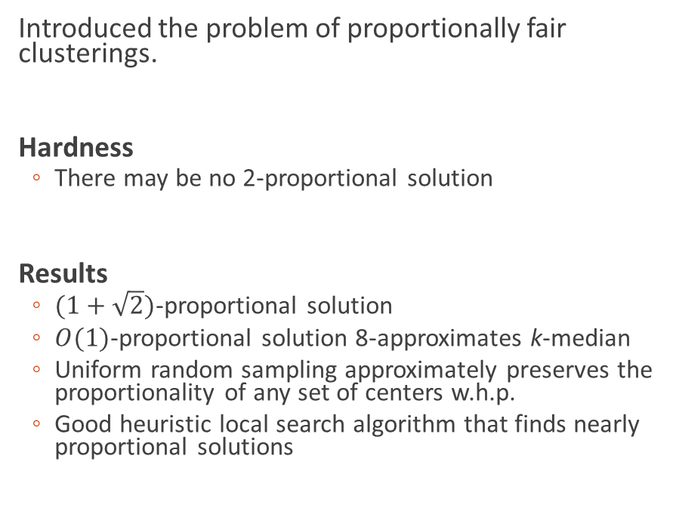
Proportionally Fair Clustering [CFLM 19]
Introduced the problem of proportionally fair clusterings.
Hardness
There may be no 2-proportional solution
Results
$(1+\sqrt{2})$-proportional solution
$O(1)$-proportional solution 8-approximates k-median
Uniform random sampling approximately preserves the proportionality of any set of centers w.h.p.
Good heuristic local search algorithm that finds nearly proportional solutions

Slide 26
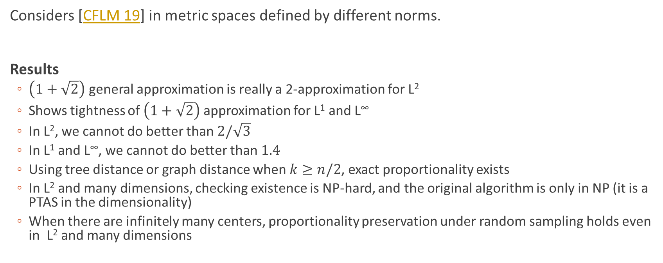
More Proportionally Fair Clustering [MS 20]
Considers [CFLM 19] in metric spaces defined by different norms.
Results
$\left(1+\sqrt{2}\right)$ general approximation is really a 2-approximation for L²
Shows tightness of $\left(1+\sqrt{2}\right)$ approximation for L¹ and L∞
In L², we cannot do better than $2/\sqrt{3}$
In L¹ and L∞, we cannot do better than $1.4$
Using tree distance or graph distance when $k≥n/2$, exact proportionality exists
In L² and many dimensions, checking existence is NP-hard, and the original algorithm is only in NP (it is a PTAS in the dimensionality)
When there are infinitely many centers, proportionality preservation under random sampling holds even in L² and many dimensions

Slide 27
Demographically Fair Clustering with Outliers

Slide 28
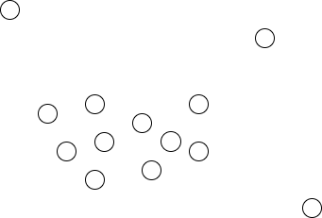
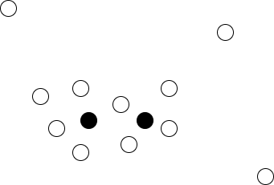
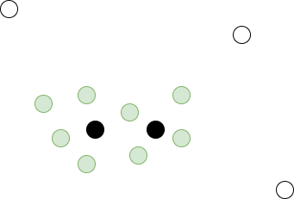
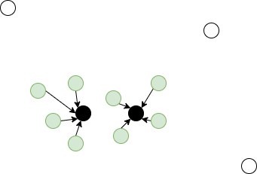

k-Clustering with Outliers
Points $𝒞$ in metric space with distance $d:𝒞^{2}→ℝ_{≥0}$
Pick $S⊆𝒞$ with $\left|S\right|≤k$
Pick $𝒜⊆𝒞$ with $\left|𝒜\right|≥m$
Construct $φ:𝒜→S$ such that some objective is minimized
Allowed to exclude a certain number of points from the optimization objective:
Robustness: Avoid noise in the data
Scarce resources: Servicing only a certain fraction of the population is acceptable

Slide 29
Motivational Examples
Clustering Setting:
The points are users of a website.
The website wants to cluster its users in groups of high similarity, so that it offers relevant recommendations.
The cluster center is thought of as the most representative point of the cluster.
Points with unique profiles might be excluded.
Facility Location Setting:
Points correspond to cities/towns/counties.
A state wants to place vaccination sites in a metric space.
Each point should have a vaccination center in close vicinity.
Due to scarce resources, it may be acceptable to provide a good covering guarantee to only a fraction of the population.

Slide 30
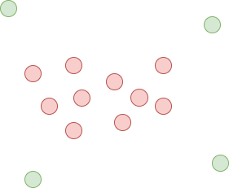
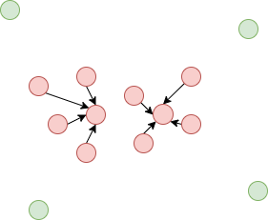

Bias in Clustering with Outliers
Being an outlier is disadvantageous!!!
Example 1: Outliers will not receive any recommendations
Example 2: Outliers will not enjoy close access to a vaccination center
Suppose the points of $𝒞$ come from $γ$ demographic groups $𝒞_{1}, …, 𝒞_{γ}$.
A solution can be biased if it disproportionately views points from certain groups as outliers.

Slide 31
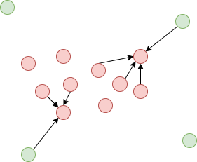
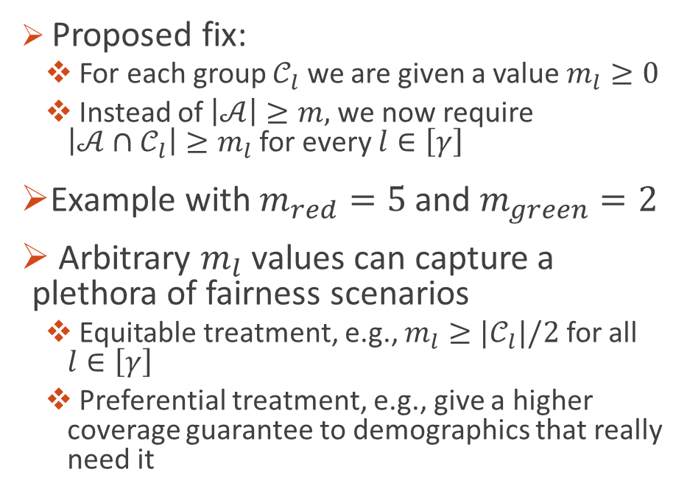
Fair Clustering with Outliers
Proposed fix:
For each group $𝒞_{l}$ we are given a value $m_{l}≥0$
Instead of $\left|𝒜\right|≥m,$we now require $\left|𝒜∩𝒞_{l}\right|≥m_{l}$ for every $l∈\left[γ\right]$
Example with $m_{red}=5$ and $m_{green}=2$
Arbitrary $m_{l}$ values can capture a plethora of fairness scenarios
Equitable treatment, e.g., $m_{l}≥{|𝒞}_{l}|/2$ for all $l∈\left[γ\right]$
Preferential treatment, e.g., give a higher coverage guarantee to demographics that really need it

Slide 32
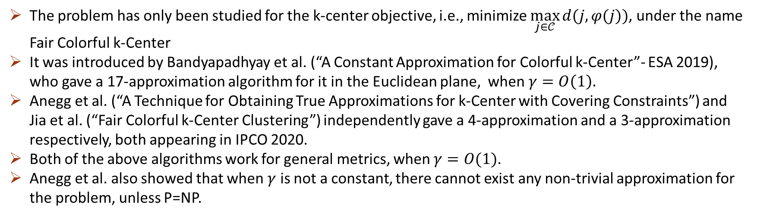
Results
The problem has only been studied for the k-center objective, i.e., minimize $\max_{j∈𝒞}{d(j,φ(j))}$, under the name Fair Colorful k-Center
It was introduced by Bandyapadhyay et al. (“A Constant Approximation for Colorful k-Center”- ESA 2019), who gave a 17-approximation algorithm for it in the Euclidean plane, when $γ=O\left(1\right).$
Anegg et al. (“A Technique for Obtaining True Approximations for k-Center with Covering Constraints”) and Jia et al. (“Fair Colorful k-Center Clustering”) independently gave a 4-approximation and a 3-approximation respectively, both appearing in IPCO 2020.
Both of the above algorithms work for general metrics, when $γ=O(1)$.
Anegg et al. also showed that when $γ$ is not a constant, there cannot exist any non-trivial approximation for the problem, unless P=NP.

Slide 33
Socially Fair k-Clustering

Slide 34
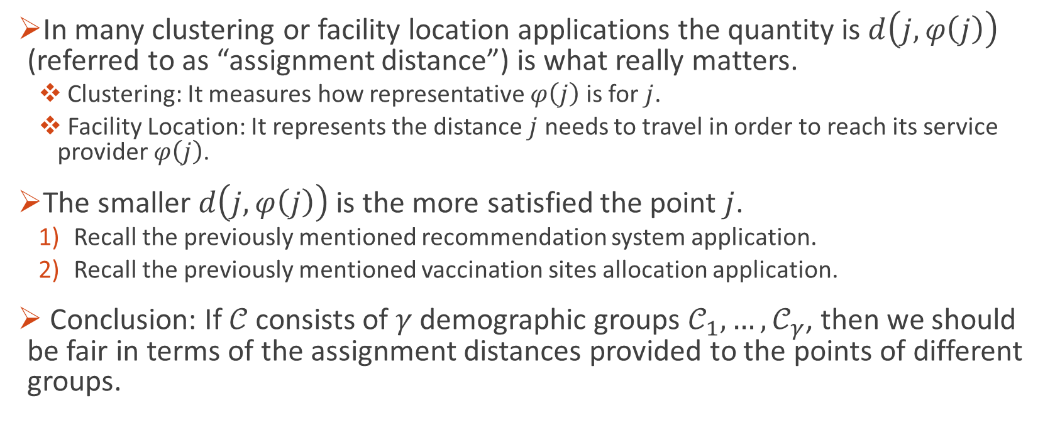
Motivation
In many clustering or facility location applications the quantity is $d\left(j,φ\left(j\right)\right)$ (referred to as “assignment distance”) is what really matters.
Clustering: It measures how representative $φ\left(j\right)$ is for $j$.
Facility Location: It represents the distance $j$ needs to travel in order to reach its service provider $φ\left(j\right)$.
The smaller $d\left(j,φ\left(j\right)\right)$ is the more satisfied the point $j$.
Recall the previously mentioned recommendation system application.
Recall the previously mentioned vaccination sites allocation application.
Conclusion: If 𝒞 consists of 𝛾 demographic groups $𝒞_{1},…, 𝒞_{γ}$, then we should be fair in terms of the assignment distances provided to the points of different groups.

Slide 35
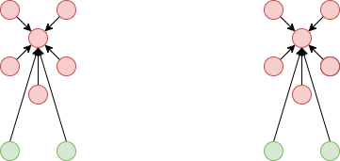
Example of a Biased Solution

Slide 36
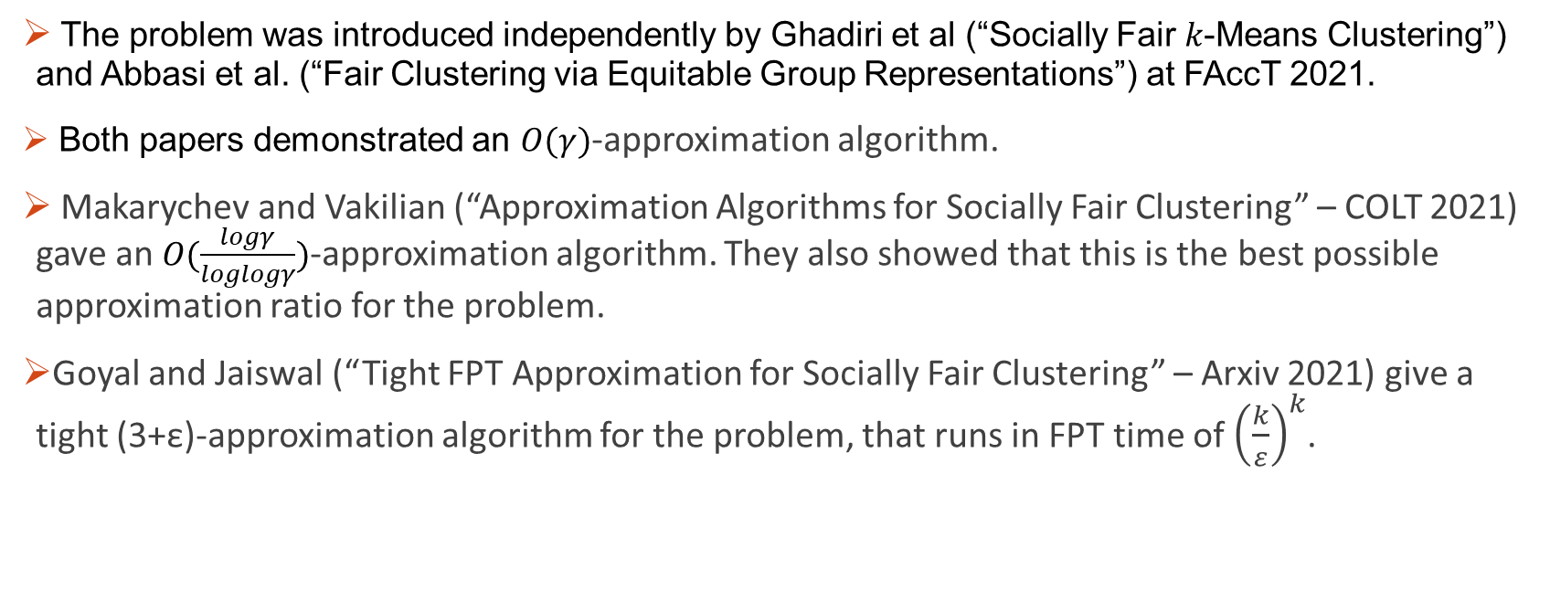
Results
The problem was introduced independently by Ghadiri et al (“Socially Fair 𝑘-Means Clustering”) and Abbasi et al. (“Fair Clustering via Equitable Group Representations”) at FAccT 2021.
Both papers demonstrated an $O(γ)$-approximation algorithm.
Makarychev and Vakilian (“Approximation Algorithms for Socially Fair Clustering” – COLT 2021) gave an $O(\frac{logγ}{loglogγ})$-approximation algorithm. They also showed that this is the best possible approximation ratio for the problem.
Goyal and Jaiswal (“Tight FPT Approximation for Socially Fair Clustering” – Arxiv 2021) give a tight (3+ε)-approximation algorithm for the problem, that runs in FPT time of ${\left(\frac{k}{ε}\right)}^{k}$.

