Slide 1
Fair Clustering Tutorial

Slide 2
Outline
Clustering paradigms + short introduction to algorithmic fairness
Demographic (group) fairness in clustering
Individual fairness in clustering
Algorithmic Aspect: The two-stage approach for solving fair clustering
Overlooked issues in fair clustering.

Slide 3
Clustering Paradigms

Slide 4
Clustering: Motivation
Clustering (ML + Data Analysis)

Slide 5
Clustering: Motivation
Clustering (ML + Data Analysis)
Explore the data, Reveal existing structure, group similar points to one another, etc

Slide 6
Clustering: Motivation
Clustering (ML + Data Analysis)
Explore the data, Reveal existing structure, group similar points to one another, etc
Given Set of Data Points:

Slide 7


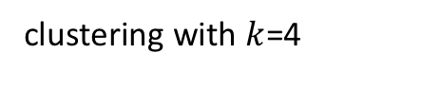


Clustering: Motivation
Clustering (ML + Data Analysis)
Explore the data, Reveal existing structure, group similar points to one another, etc
Given Set of Data Points:
$$C_{1}$$
$$C_{2}$$
clustering with $k$=4
$$C_{3}$$
$$C_{4}$$

Slide 8
Clustering: Motivation
Clustering (ML + Data Analysis)
Explore the data, Reveal existing structure, group similar points to one another, etc
Clustering (Operations Research)

Slide 9
Clustering: Motivation
Clustering (ML + Data Analysis)
Explore the data, Reveal existing structure, group similar points to one another, etc
Clustering (Operations Research) ‘
Allocating a collection of facilities or fire stations to serve a collection of users

Slide 10
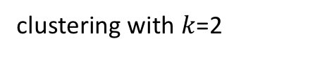
Clustering: Motivation
Clustering (ML + Data Analysis)
Explore the data, Reveal existing structure, group similar points to one another, etc
Clustering (Operations Research) ‘
Allocating a collection of facilities or fire stations for a collection of users
Set of Possible Locations:
clustering with $k$=2

Slide 11
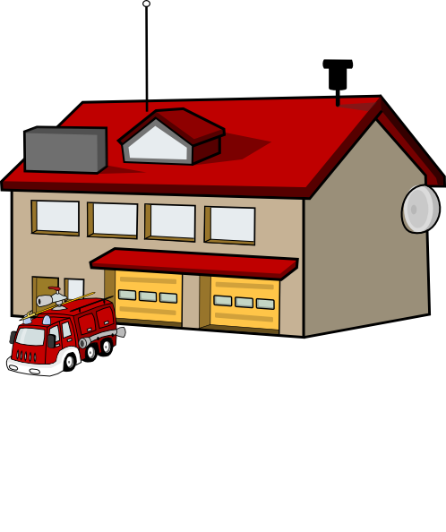
Clustering: Motivation
Clustering (ML + Data Analysis)
Explore the data, Reveal existing structure, group similar points to one another, etc
Clustering (Operations Research) ‘
Allocating a collection of facilities or fire stations for a collection of users
Set of Possible Locations:
clustering with $k$=2

Slide 12
Clustering Paradigms

Slide 13
Clustering Paradigms
Center-Based Clustering
Spectral Clustering
Correlation Clustering
Hierarchical Clustering

Slide 14

Center-Based Clustering
the cluster is decided by choosing $k$ centers → each point is then assigned to its closest center
Includes $k$-means, $k$-median, and $k$-center clustering

Slide 15

Formalizing Center-Based Clustering
Input:
Set of points: $𝒞$
Distance between points: $∀i,j∈𝒞$we have $d\left(i,j\right)$(which is a Metric)
Number of Clusters: $k$

Slide 16
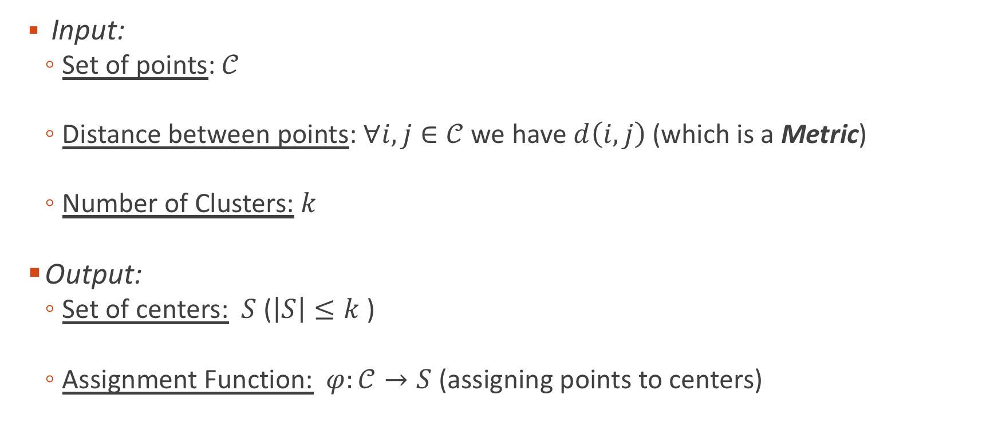
Formalizing Center-Based Clustering
Input:
Set of points: $𝒞$
Distance between points: $∀i,j∈𝒞$we have $d\left(i,j\right)$(which is a Metric)
Number of Clusters: $k$
Output:
Set of centers: $S$ ($\left|S\right|≤k$ )
Assignment Function: $φ:𝒞→S$ (assigning points to centers)

Slide 17

Formalizing Center-Based Clustering
Objective Functions:
$k$-center: $\min_{S, φ}\max_{j∈𝒞}$ $d(j,φ(j))$

Slide 18

Formalizing Center-Based Clustering
Objective Functions:
$k$-center: $\min_{S, φ}\max_{j∈𝒞}$ $d(j,φ(j))$
Minimizes the maximum distance (sensitive to outliers)

Slide 19

Formalizing Center-Based Clustering
Objective Functions:
$k$-center: $\min_{S, φ}\max_{j∈𝒞}$ $d(j,φ(j))$
Minimizes the maximum distance (sensitive to outliers)
$k$-median: $\min_{S, φ} \sum_{j∈𝒞}{d(j,φ(j))}$

Slide 20

Formalizing Center-Based Clustering
Objective Functions:
$k$-center: $\min_{S, φ}\max_{j∈𝒞}$ $d(j,φ(j))$
Minimizes the maximum distance (sensitive to outliers)
$k$-median: $\min_{S, φ} \sum_{j∈𝒞}{d(j,φ(j))}$
Minimizes the sum of the distances (more noise-tolerant)

Slide 21
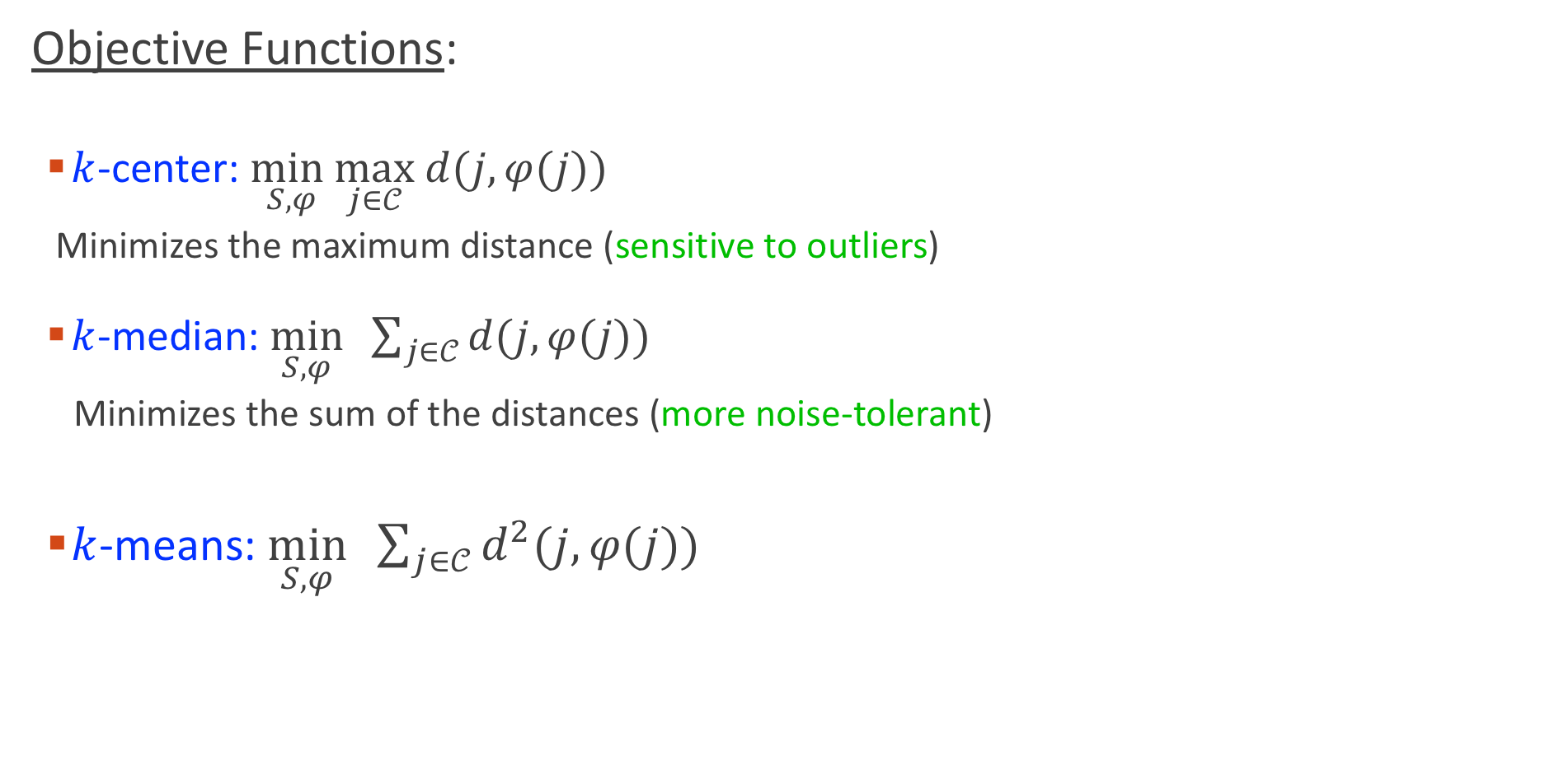
Formalizing Center-Based Clustering
Objective Functions:
$k$-center: $\min_{S, φ}\max_{j∈𝒞}$ $d(j,φ(j))$
Minimizes the maximum distance (sensitive to outliers)
$k$-median: $\min_{S, φ} \sum_{j∈𝒞}{d(j,φ(j))}$
Minimizes the sum of the distances (more noise-tolerant)
$k$-means: $\min_{S, φ} \sum_{j∈𝒞}{d^{2}(j,φ(j))}$

Slide 22
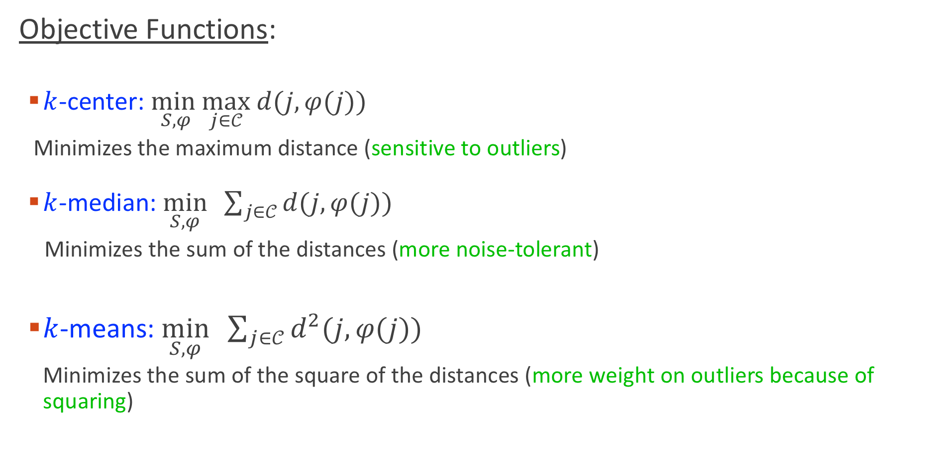
Formalizing Center-Based Clustering
Objective Functions:
$k$-center: $\min_{S, φ}\max_{j∈𝒞}$ $d(j,φ(j))$
Minimizes the maximum distance (sensitive to outliers)
$k$-median: $\min_{S, φ} \sum_{j∈𝒞}{d(j,φ(j))}$
Minimizes the sum of the distances (more noise-tolerant)
$k$-means: $\min_{S, φ} \sum_{j∈𝒞}{d^{2}(j,φ(j))}$
Minimizes the sum of the square of the distances (more weight on outliers because of squaring)

Slide 23
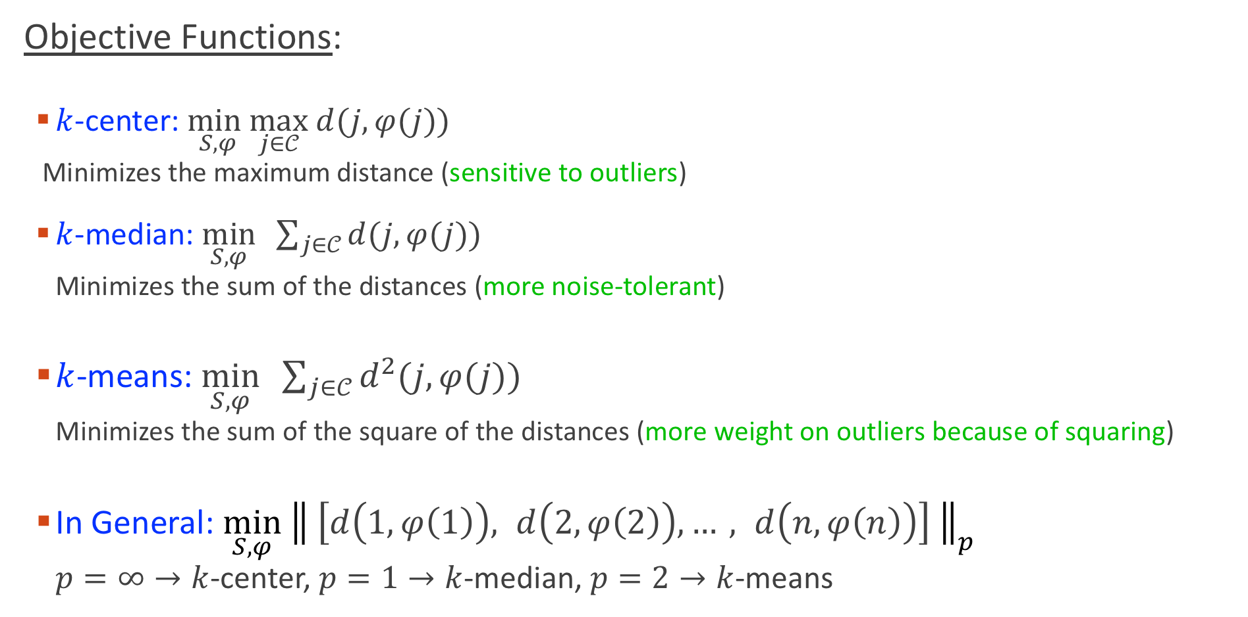
Formalizing Center-Based Clustering
Objective Functions:
$k$-center: $\min_{S, φ}\max_{j∈𝒞}$ $d(j,φ(j))$
Minimizes the maximum distance (sensitive to outliers)
$k$-median: $\min_{S, φ} \sum_{j∈𝒞}{d(j,φ(j))}$
Minimizes the sum of the distances (more noise-tolerant)
$k$-means: $\min_{S, φ} \sum_{j∈𝒞}{d^{2}(j,φ(j))}$
Minimizes the sum of the square of the distances (more weight on outliers because of squaring)
In General: $\min_{S, φ}{ \left\| \left[d\left(1,φ\left(1\right)\right), d\left(2,φ\left(2\right)\right),…, d\left(n,φ\left(n\right)\right)\right] \right\|}_{p}$
$p=∞→k$-center, $p=1→k$-median, $p=2→k$-means

Slide 24
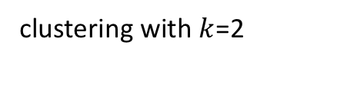
In the absence of constraints, the assignment function is trivial (assign each point to its nearest center)
clustering with $k$=2

Slide 25
In the absence of constraints, the assignment function is trivial (assign each point to its nearest center)
clustering with $k$=2

Slide 26
In the absence of constraints, the assignment function is trivial (assign each point to its nearest center)
Constraints can make the assignment non-trivial
clustering with $k$=2
Constraint: at least 3 points in each cluster

Slide 27
In the absence of constraints, the assignment function is trivial (assign each point to its nearest center)
Constraints can make the assignment non-trivial
clustering with $k$=2
Constraint: at least 3 points in each cluster

Slide 28
In the absence of constraints, the assignment function is trivial (assign each point to its nearest center)
Constraints can make the assignment non-trivial
Most Fair Clustering = Clustering subject to fairness constraints → Assigning points to centers is not trivial
clustering with $k$=2
Constraint: at least 3 points in each cluster

Slide 29

Spectral Clustering
Points are vertices in a graph $G=(V,E)$
$∀i,j:w_{ij}≥0$, $w_{ij}$ is the similarity between $i$ and $j$

Slide 30

Spectral Clustering
Points are vertices in a graph $G=(V,E)$
$∀i,j:w_{ij}≥0$, $w_{ij}$ is the similarity between $i$ and $j$
Cluster (partition) the graph so that the edges between points in different clusters have low weight
From the above, we have a graph cut problem

Slide 31



Spectral Clustering: Formal Definition
Points are vertices in a graph $G=(V,E)$
$∀i,j:w_{ij}≥0$, $w_{ij}$ is the similarity between $i$ and $j$
$A,B⊂V$, $cut\left(A,B\right)=\sum_{i∈A,j∈B}{w_{ij}}$
$$B$$
$$A$$

Slide 32
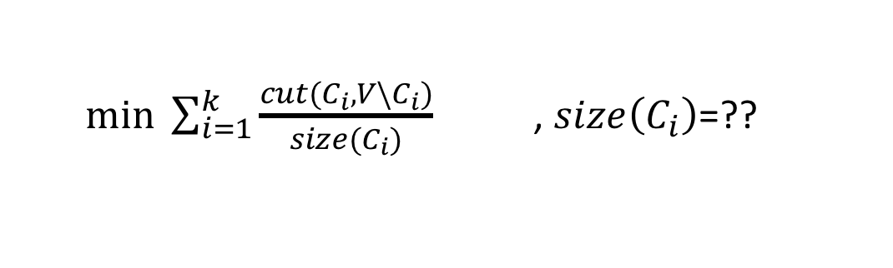

Spectral Clustering: Formal Definition
Points are vertices in a graph $G=(V,E)$
$∀i,j:w_{ij}≥0$, $w_{ij}$ is the similarity between $i$ and $j$
Objective Functions:
Given graph $G=\left(V,E\right)$ and number of clusters $k$ → Partition $V$ into $C_{1}, …,C_{k}$
$min \sum_{i=1}^{k}{\frac{cut(C_{i},{V\backslash C}_{i})}{size(C_{i})}}$, $size\left(C_{i}\right)$=??

Slide 33
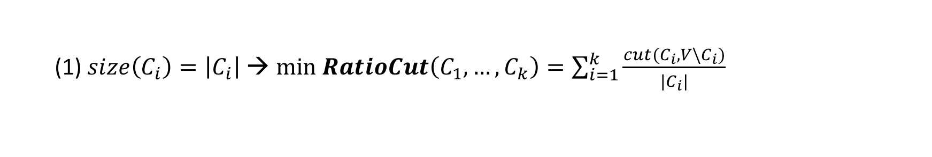
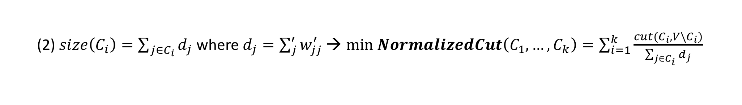
Spectral Clustering: Formal Definition
Points are vertices in a graph $G=(V,E)$
$∀i,j:w_{ij}≥0$, $w_{ij}$ is the similarity between $i$ and $j$
Objective Functions:
Given graph $G=\left(V,E\right)$ and number of clusters $k$ → Partition $V$ into $C_{1}, …,C_{k}$
$min \sum_{i=1}^{k}{\frac{cut(C_{i},{V\backslash C}_{i})}{size(C_{i})}}$, $size\left(C_{i}\right)$=??
(1) $size\left(C_{i}\right)=\left|C_{i}\right|$ → $min RatioCut\left(C_{1}, …,C_{k}\right)=\sum_{i=1}^{k}{\frac{cut(C_{i},{V\backslash C}_{i})}{|C_{i}|}}$
(2) $size\left(C_{i}\right)=\sum_{j∈C_{i}}{d_{j}}$ where $d_{j}=\sum_{j}^{′}{w_{jj}^{′}}$→ $min NormalizedCut\left(C_{1}, …,C_{k}\right)=\sum_{i=1}^{k}{\frac{cut(C_{i},{V\backslash C}_{i})}{\sum_{j∈C_{i}}{d_{j}}}}$

Slide 34

Correlation Clustering
Points are vertices in a graph $G=(V,E)$
$∀i,j:w_{ij}^{+}≥0,w_{ij}^{−}≥0$,
-$w_{ij}^{+}$ is the degree to which $i$ and $j$ are similar
-$w_{ij}^{−}$ is the degree to which $i$ and $j$ are different

Slide 35

Correlation Clustering
Points are vertices in a graph $G=(V,E)$
$∀i,j:w_{ij}^{+}≥0,w_{ij}^{−}≥0$,
-$w_{ij}^{+}$ is the degree to which $i$ and $j$ are similar
-$w_{ij}^{−}$ is the degree to which $i$ and $j$ are different
Cluster (partition) the graph so that you get:
-large $w_{ij}^{+}$ edges within a cluster
-large $w_{ij}^{−}$edges between different clusters

Slide 36
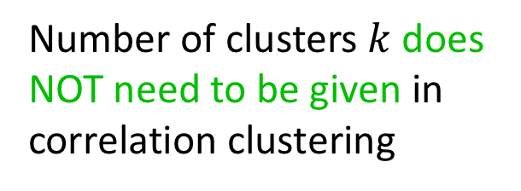

Correlation Clustering
Points are vertices in a graph $G=(V,E)$
$∀i,j:w_{ij}^{+}≥0,w_{ij}^{−}≥0$,
-$w_{ij}^{+}$ is the degree to which $i$ and $j$ are similar
-$w_{ij}^{−}$ is the degree to which $i$ and $j$ are different
Cluster (partition) the graph so that you get
-low weight edges between different clusters -high weight edges within a cluster
Objective Function:
Given graph $G=\left(V,E\right)$ → Partition $V$ into $C_{1}, …,C_{k}$
$max \sum_{i,j:same cluster}{w_{ij}^{+}}+ \sum_{i,j: different clusters}{w_{ij}^{−}}$
Number of clusters $k$ does NOT need to be given in correlation clustering

Slide 37

Hierarchical Clustering
Like correlation clustering, you don’t need to set $k$ (the number of clusters)
The output groups the points in a tree (dendrogram), grouping points at different levels
Given Set of Data Points:

Slide 38
Hierarchical Clustering
Like correlation clustering, you don’t need to set $k$ (the number of clusters)
The output groups the points in a tree (dendrogram), grouping points at different levels
Hierarchical Clustering Output:

Slide 39

Hierarchical Clustering
Like correlation clustering, you don’t need to set $k$ (the number of clusters)
The output groups the points in a tree (dendrogram), grouping points at different levels
agglomerative clustering (common traditional method):
-bottom-up approach: group similar points together forming a cluster, then group similar clusters and so on.

Slide 40
Hierarchical Clustering
agglomerative clustering has is NOT optimizing an objective function
→ Makes it hard to know the quality

Slide 41

Hierarchical Clustering
agglomerative clustering has is NOT optimizing an objective function
→ Makes it hard to know the quality
[Dasgupta, 2016] defines a cost function for hierarchical clustering:
-Given $G=(V,E)$ with $w_{ij}$ specifiying the similarity between $i$ and $j$
Objective Function:
$\min{\sum_{i,j}{w_{ij} × (\#of descendents of lowest commen ancestor of i and j) }}$
-the objective places higher penalty when separating points higher in the tree
Further objectives for hierarchical clustering were also introduced [Moseley & Wang, 2017 ; Cohen-Addad et al, 2018].

Slide 42
Clustering Paradigms
Center-Based Clustering
Spectral Clustering
Correlation Clustering
Hierarchical Clustering
-All are NP-hard

Slide 43
Clustering Paradigms
Center-Based Clustering
Spectral Clustering
Correlation Clustering
Hierarchical Clustering
-All are NP-hard
-In polynomial time we can only approximate the optimal objective:

Slide 44

Clustering Paradigms
Center-Based Clustering
Spectral Clustering
Correlation Clustering
Hierarchical Clustering
-All are NP-hard
-In polynomial time we can only approximate the optimal objective:
min objective value is $OPT$
→ solve for $\hat{OPT}$,
$$\hat{OPT}≤αOPT$$
$α$ is the approximation ratio (clearly $α>1$)

Slide 45
Algorithmic Fairness
Much of decision making is done at least partly using algorithms.

Slide 46
Algorithmic Fairness
Much of decision making is done at least partly using algorithms.
Examples:
-loan approval [Leo et al, 2018].
-recidivism prediction[Goel et al, 2018]
-health care: receiving limited resources [Wilder et al, 2018],
kidney exchange [Dickerson et al, 2018]

Slide 47
Algorithmic Fairness
Much of decision making is done at least partly using algorithms.
Documented cases of algorithmic bias [O’Neil 2016; Kearns & Roth 2019].
Substantial progress and interest in algorithmic fairness.

Slide 48

Some Considerations for Fairness in Clustering
For a point $i,$ its distance from the center $d(i,φ(i))$:
-closer to the center →better represented by the center (ML)
-closer to the center →less travel distance to the facility (OR)
→ points want to be closer the center
How does a fairness guarantee over the distance look like? How can we achieve that?
- what if a group is consistently away from the center?

Slide 49

Some Considerations for Fairness in Clustering
Clustering partitions the set of points $𝒞$ into clusters $C_{1},C_{2},…,C_{k}$
-different clusters will be processed differently, enjoy different outcomes, etc
-suppose one demographic is under-represented in a cluster or over-represented in another.

Slide 50
Some Considerations for Fairness in Clustering
Clustering partitions the set of points $𝒞$ into clusters $C_{1},C_{2},…,C_{k}$
-different clusters will be processed differently, enjoy different outcomes, etc
-suppose one demographic is under-represented in a cluster or over-represented in another.
Clustering
???

Slide 51


Some Considerations for Fairness in Clustering
Clustering partitions the set of points $𝒞$ into clusters $C_{1},C_{2},…,C_{k}$
-different clusters will be processed differently, enjoy different outcomes, etc
-suppose one demographic is under-represented in a cluster or over-represented in another.
$$C_{1}$$
$$C_{2}$$
Clustering

Slide 52

Some Considerations for Fairness in Clustering
Clustering partitions the set of points $𝒞$ into clusters $C_{1},C_{2},…,C_{k}$
-different clusters will be processed differently, enjoy different outcomes, etc
-suppose one demographic is under-represented in a cluster or over-represented in another.
-suppose the clustering assigns points which are not faraway from one another to different clusters.
$$C_{1}$$
$$C_{2}$$
Clustering
Clustering
???

Slide 53


Some Considerations for Fairness in Clustering
Clustering partitions the set of points $𝒞$ into clusters $C_{1},C_{2},…,C_{k}$
-different clusters will be processed differently, enjoy different outcomes, etc
-suppose one demographic is under-represented in a cluster or over-represented in another.
-suppose the clustering assigns points which are not faraway from one another to different clusters.
$$C_{1}$$
$$C_{2}$$
Clustering
$$C_{1}$$
$$C_{2}$$

Slide 54
THANK YOU!

