Slide 1
The Two-Stage Approach for Solving Fair Clustering Problems

Slide 2
How to solve fair clustering problems?
We are looking for algorithms with theoretical guarantees:
1-Clustering Objective:
2-The Fairness Constraint:

Slide 3
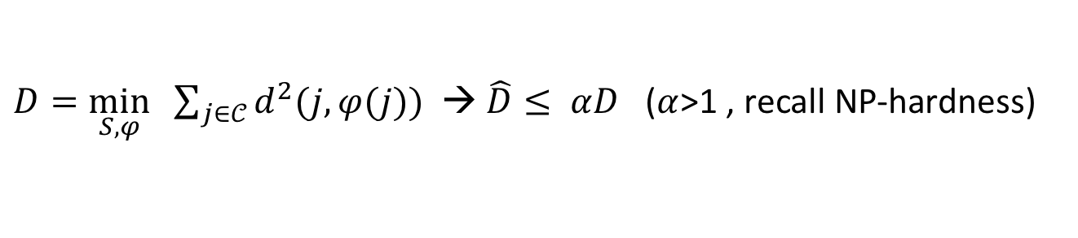

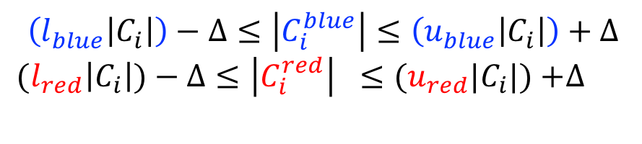
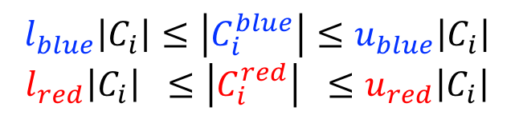
How to solve fair clustering problems?
We are looking for algorithms with theoretical guarantees:
1-Clustering Objective:
2-The Fairness Constraint:
-relax by $Δ>0$
$D=\min_{S, φ} \sum_{j∈𝒞}{d^{2}(j,φ(j))}$ → $\hat{D}≤ αD$ ($α$>1 , recall NP-hardness)
$$l_{blue}\left|C_{i}\right|≤\left|C_{i}^{blue}\right|≤u_{blue}\left|C_{i}\right|$$
$$l_{red}\left|C_{i}\right| ≤\left|C_{i}^{red}\right| ≤u_{red}\left|C_{i}\right|$$
$$\left(l_{blue}\left|C_{i}\right|\right)−Δ≤\left|C_{i}^{blue}\right|≤\left(u_{blue}\left|C_{i}\right|\right)+Δ$$
$(l_{red}\left|C_{i}\right|)−Δ≤\left|C_{i}^{red}\right| ≤{(u}_{red}|C_{i}|)$ $+Δ$
→

Slide 4
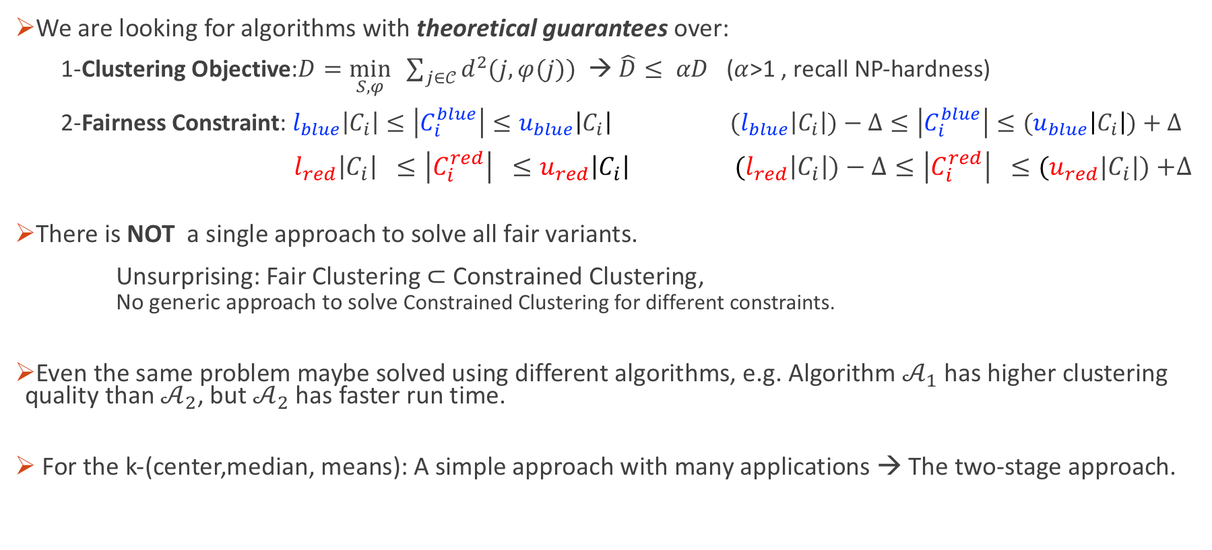
How to solve fair clustering problems?
We are looking for algorithms with theoretical guarantees over:
1-Clustering Objective:$D=\min_{S, φ} \sum_{j∈𝒞}{d^{2}(j,φ(j))}$ → $\hat{D}≤ αD$ ($α$>1 , recall NP-hardness)
2-Fairness Constraint: $l_{blue}\left|C_{i}\right|≤\left|C_{i}^{blue}\right|≤u_{blue}\left|C_{i}\right| (l_{blue}\left|C_{i}\right|)−Δ≤\left|C_{i}^{blue}\right|≤(u_{blue}\left|C_{i}\right|)+Δ$
$l_{red}\left|C_{i}\right| ≤\left|C_{i}^{red}\right| ≤u_{red}\left|C_{i}\right| (l_{red}\left|C_{i}\right|)−Δ≤\left|C_{i}^{red}\right| ≤{(u}_{red}|C_{i}|)$ $+Δ$
There is NOT a single approach to solve all fair variants.
Unsurprising: Fair Clustering $⊂$ Constrained Clustering,
No generic approach to solve Constrained Clustering for different constraints.
Even the same problem maybe solved using different algorithms, e.g. Algorithm $𝒜_{1}$ has higher clustering quality than $𝒜_{2}$, but $𝒜_{2}$ has faster run time.
For the k-(center,median, means): A simple approach with many applications → The two-stage approach.
→

Slide 5
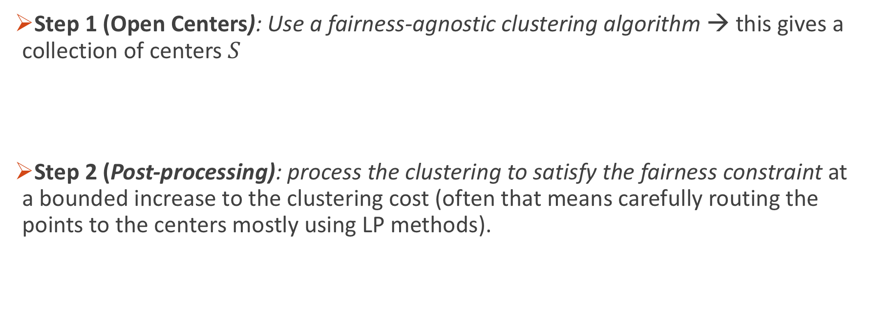
Two-Stage Approach
Step 1 (Open Centers): Use a fairness-agnostic clustering algorithm → this gives a collection of centers $S$
Step 2 (Post-processing): process the clustering to satisfy the fairness constraint at a bounded increase to the clustering cost (often that means carefully routing the points to the centers mostly using LP methods).

Slide 6

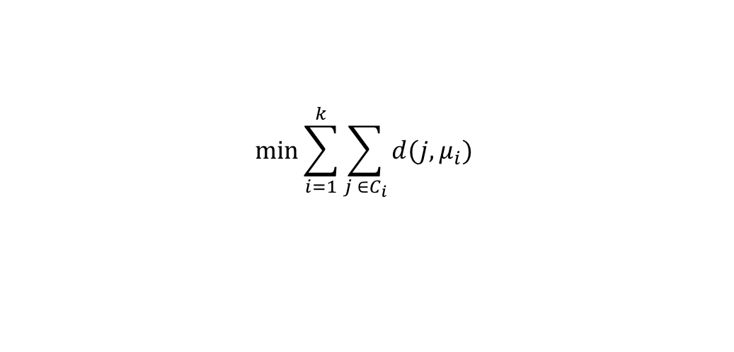

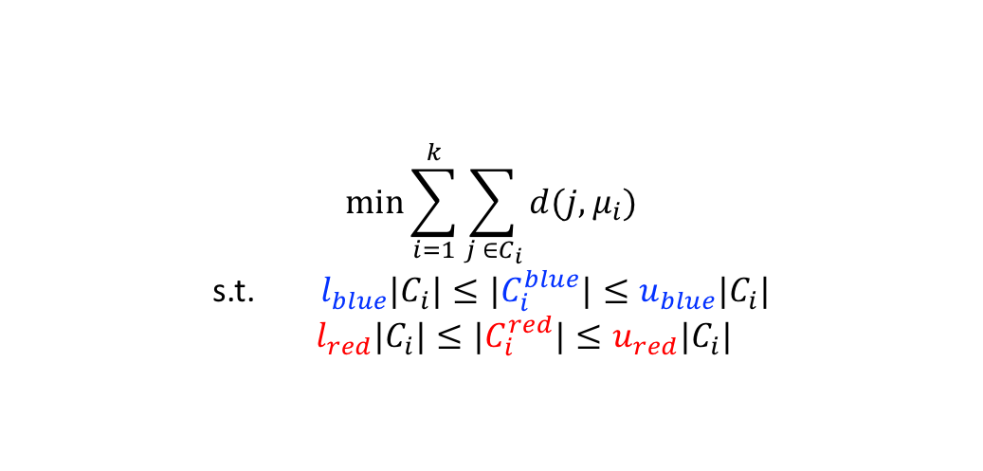


Two-Stage Approach: Group Fairness Example
Recall Group (demographic) Fairness
$$C_{1}$$
$$C_{1}$$
$$C_{2}$$
$$C_{2}$$
Group Fair Clustering
Agnostic Clustering
$$\min_{}{\sum_{i=1}^{k}{\sum_{j ∈C_{i}}{d(j,μ_{i})}}}$$
s.t. $l_{blue}|C_{i}|≤|C_{i}^{blue}|≤u_{blue}|C_{i}|$
$l_{red}|C_{i}|≤|C_{i}^{red}|≤u_{red}|C_{i}|$
$$\min_{}{\sum_{i=1}^{k}{\sum_{j ∈C_{i}}{d(j,μ_{i})}}}$$

Slide 7
Two-Stage Approach: Group Fairness Example
Given Instance:

Slide 8


Two-Stage Approach: Group Fairness Example
Given Instance:
$$c_{1}$$
Step 1
$$c_{2}$$

Slide 9


Two-Stage Approach: Group Fairness Example
Centers are now open!
How to assign points to centers??
$$c_{1}$$
$$c_{2}$$

Slide 10




Two-Stage Approach: Group Fairness Example
Centers are now open!
How to assign points to centers??
Cost minimizing assignment is unfair (clusters don’t mix colors)
Cluster 1
Cluster 2
$$c_{1}$$
$$c_{1}$$
Cost Minimizing
Assignment
$$c_{2}$$
$$c_{2}$$

Slide 11

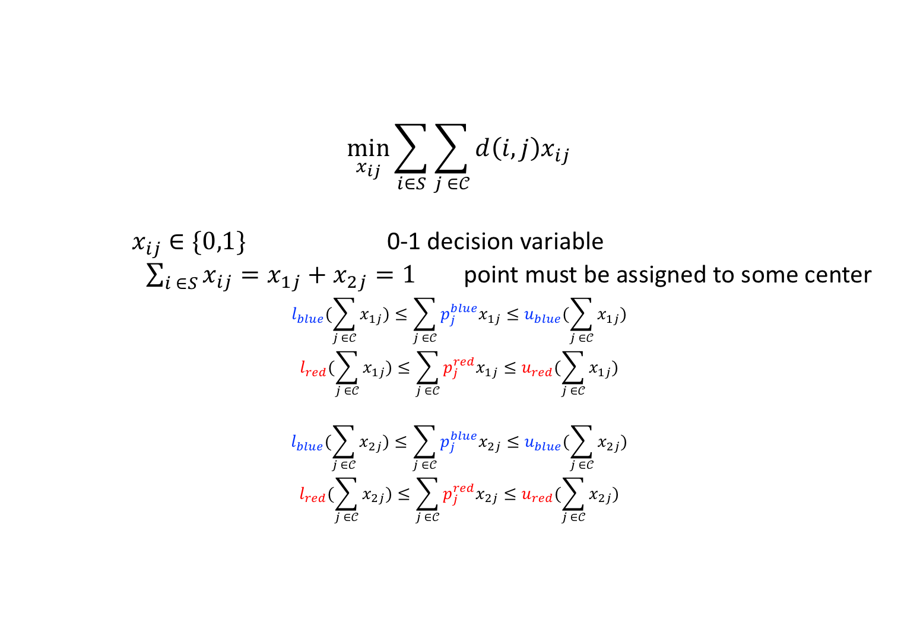

Two-Stage Approach: Group Fairness Example
How to assign points to centers??
(Step 2) Route points so as to minimize clustering cost
subject to satisfying color-proportional (fairness) → Setup an integer program
$$\min_{x_{ij}}{\sum_{i∈S}{\sum_{j ∈𝒞}{d\left(i,j\right)x_{ij}}}}$$
$x_{ij}$ $∈\{0,1\}$ 0-1 decision variable
$\sum_{i ∈S}{x_{ij}}=x_{1j}+x_{2j}=1$ point must be assigned to some center
$$l_{blue}(\sum_{j ∈𝒞}{x_{1j})}≤\sum_{j ∈𝒞}{p_{j}^{blue}x_{1j}}≤u_{blue}(\sum_{j ∈𝒞}{x_{1j})}$$
$$l_{red}(\sum_{j ∈𝒞}{x_{1j})}≤\sum_{j ∈𝒞}{p_{j}^{red}x_{1j}}≤u_{red}(\sum_{j ∈𝒞}{x_{1j})}$$
$$l_{blue}(\sum_{j ∈𝒞}{x_{2j})}≤\sum_{j ∈𝒞}{p_{j}^{blue}x_{2j}}≤u_{blue}(\sum_{j ∈𝒞}{x_{2j})}$$
$$l_{red}(\sum_{j ∈𝒞}{x_{2j})}≤\sum_{j ∈𝒞}{p_{j}^{red}x_{2j}}≤u_{red}(\sum_{j ∈𝒞}{x_{2j})}$$
Integer Program:
$$c_{1}$$
$$c_{2}$$

Slide 12
Two-Stage Approach: Group Fairness Example
How to assign points to centers??
(Step 2) Route points so as to minimize clustering cost
subject to satisfying color-proportional (fairness) → Setup an integer program
$$\min_{x_{ij}}{\sum_{i∈S}{\sum_{j ∈𝒞}{d\left(i,j\right)x_{ij}}}}$$
$x_{ij}$ $∈\{0,1\}$ 0-1 decision variable
$\sum_{i ∈S}{x_{ij}}=x_{1j}+x_{2j}=1$ point must be assigned to some center
$$l_{blue}(\sum_{j ∈𝒞}{x_{1j})}≤\sum_{j ∈𝒞}{p_{j}^{blue}x_{1j}}≤u_{blue}(\sum_{j ∈𝒞}{x_{1j})}$$
$$l_{red}(\sum_{j ∈𝒞}{x_{1j})}≤\sum_{j ∈𝒞}{p_{j}^{red}x_{1j}}≤u_{red}(\sum_{j ∈𝒞}{x_{1j})}$$
$$l_{blue}(\sum_{j ∈𝒞}{x_{2j})}≤\sum_{j ∈𝒞}{p_{j}^{blue}x_{2j}}≤u_{blue}(\sum_{j ∈𝒞}{x_{2j})}$$
$$l_{red}(\sum_{j ∈𝒞}{x_{2j})}≤\sum_{j ∈𝒞}{p_{j}^{red}x_{2j}}≤u_{red}(\sum_{j ∈𝒞}{x_{2j})}$$
Integer Programs Generally Take Exponential Time!
Integer Program:
$$c_{1}$$
$$c_{2}$$

Slide 13
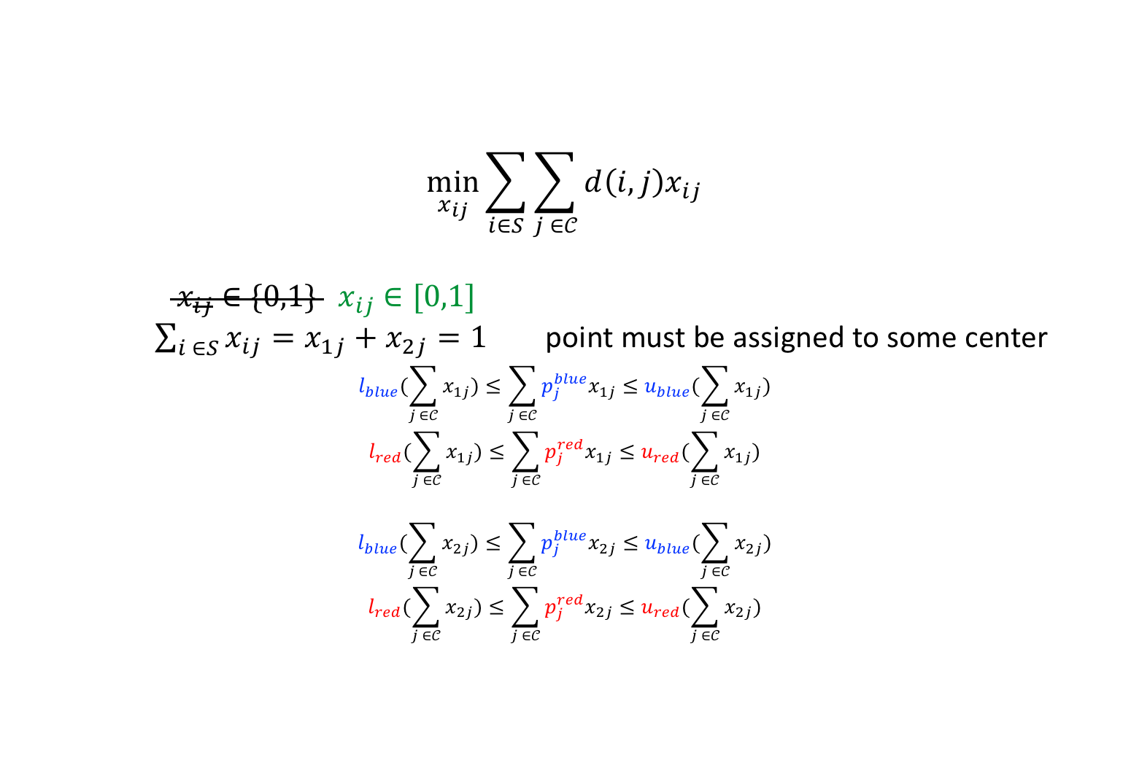
Two-Stage Approach: Group Fairness Example
How to assign points to centers??
(Step 2) Route points so as to minimize clustering cost
subject to satisfying color-proportional (fairness) → Setup an integer program → Relax to LP
$$\min_{x_{ij}}{\sum_{i∈S}{\sum_{j ∈𝒞}{d\left(i,j\right)x_{ij}}}}$$
${ x}_{ij}$ $∈\{0,1\}$ $x_{ij}$ $∈[0,1]$
$\sum_{i ∈S}{x_{ij}}=x_{1j}+x_{2j}=1$ point must be assigned to some center
$$l_{blue}(\sum_{j ∈𝒞}{x_{1j})}≤\sum_{j ∈𝒞}{p_{j}^{blue}x_{1j}}≤u_{blue}(\sum_{j ∈𝒞}{x_{1j})}$$
$$l_{red}(\sum_{j ∈𝒞}{x_{1j})}≤\sum_{j ∈𝒞}{p_{j}^{red}x_{1j}}≤u_{red}(\sum_{j ∈𝒞}{x_{1j})}$$
$$l_{blue}(\sum_{j ∈𝒞}{x_{2j})}≤\sum_{j ∈𝒞}{p_{j}^{blue}x_{2j}}≤u_{blue}(\sum_{j ∈𝒞}{x_{2j})}$$
$$l_{red}(\sum_{j ∈𝒞}{x_{2j})}≤\sum_{j ∈𝒞}{p_{j}^{red}x_{2j}}≤u_{red}(\sum_{j ∈𝒞}{x_{2j})}$$
Linear Program:
$$c_{1}$$
$$c_{2}$$

Slide 14

Two-Stage Approach: Group Fairness Example
Resulting solution $x_{ij}$ is possibly fractional (not 0 or 1)

Slide 15



Two-Stage Approach: Group Fairness Example
Resulting solution $x_{ij}$ is possibly fractional (not 0 or 1)
→ Applying a rounding technique
Cluster 1
$$c_{1}$$
Cluster 2
$$c_{2}$$

Slide 16

Two-Stage Approach: Group Fairness Example
Resulting solution $x_{ij}$ is possibly fractional (not 0 or 1)
→ Applying a rounding technique
Choice of rounding technique is non-trivial and often the most difficult step.

Slide 17
Two-Stage Approach
Previous was for demographic fairness [Bera et al 2019; Bercea et al 2019; Esmaeili 2020].
Other post processing approaches:
-Combinatorial approach [Chakrabarti et al, AISTATS 2022]
-Randomized approach [Brubach et al, ICML 2020]

Slide 18
THANK YOU!

