Slide 1


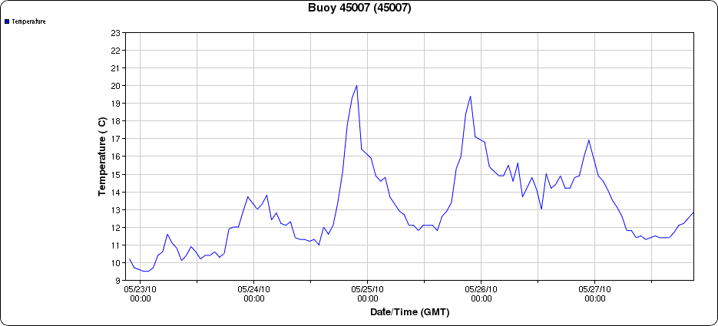
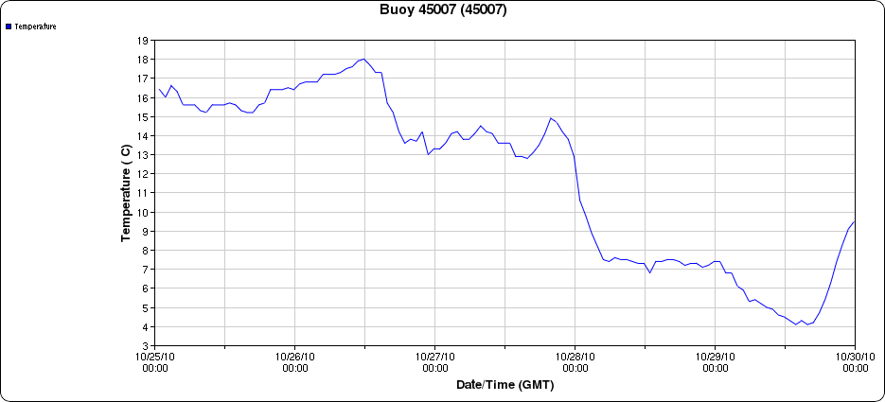
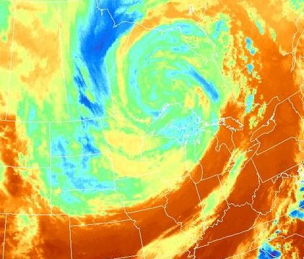
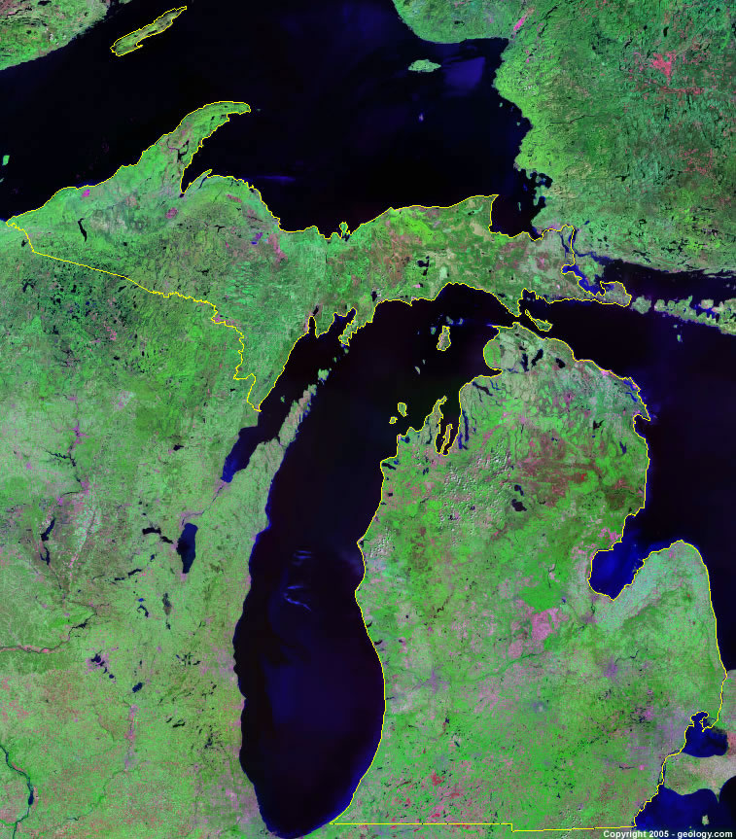
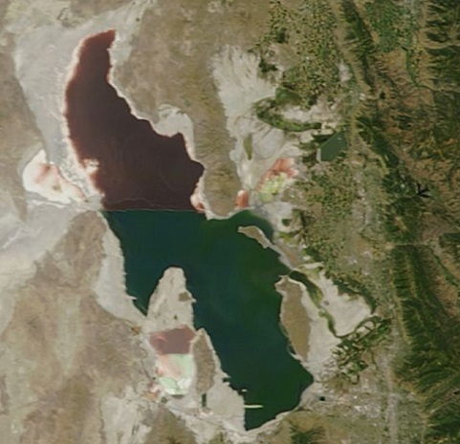
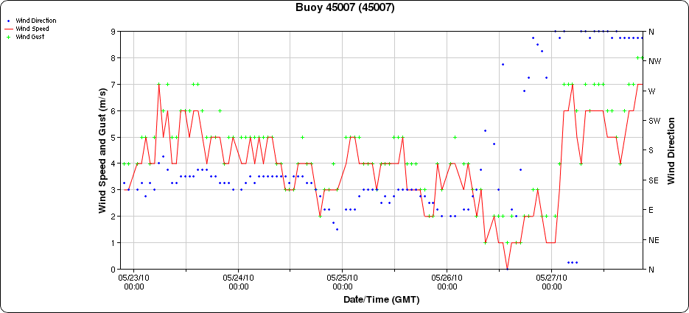
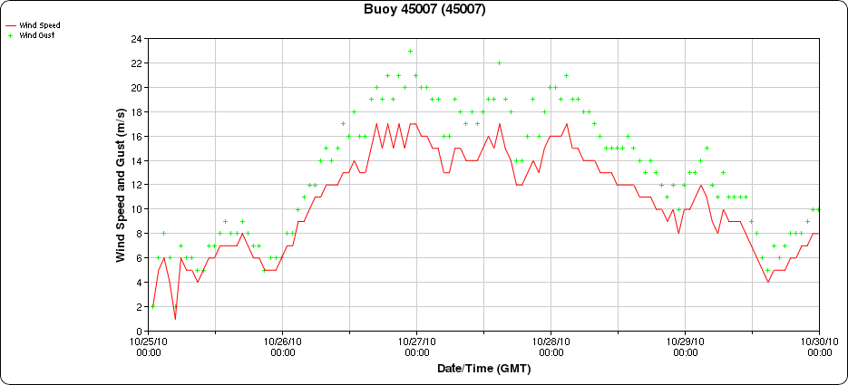
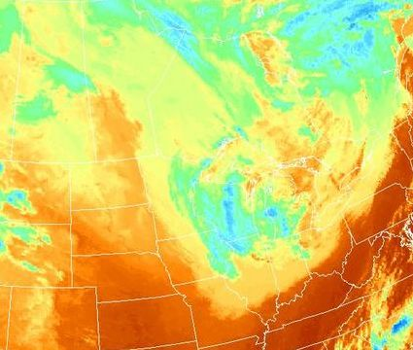
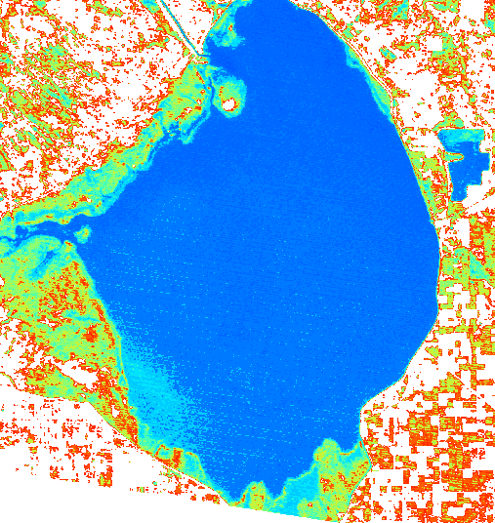
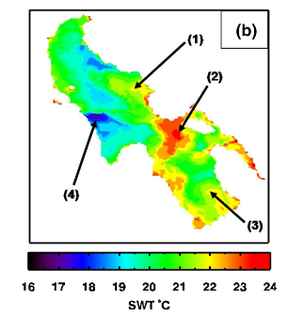
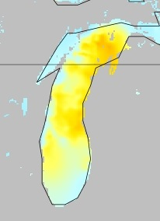
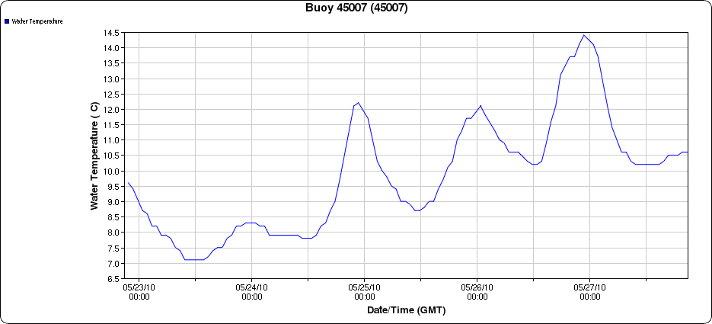
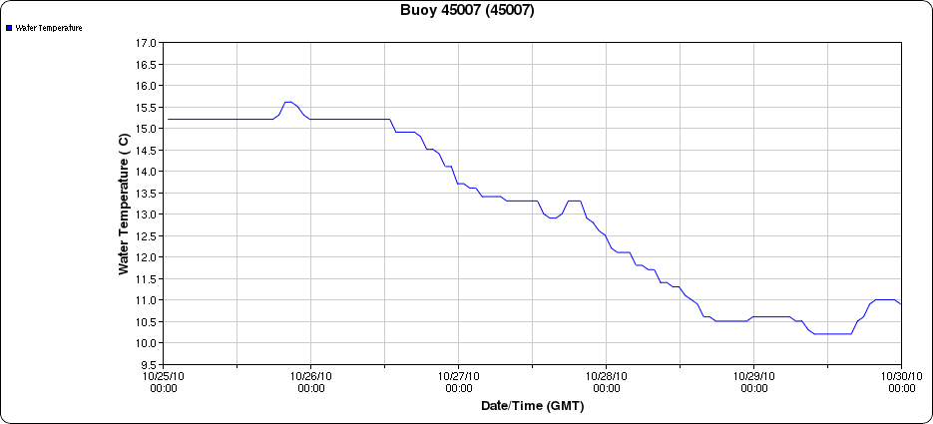
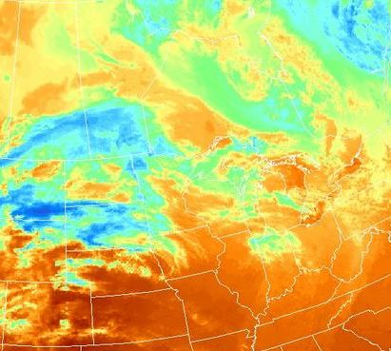
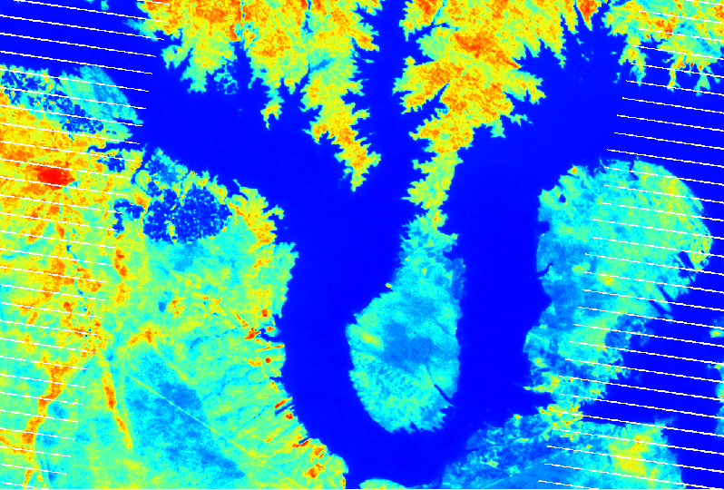
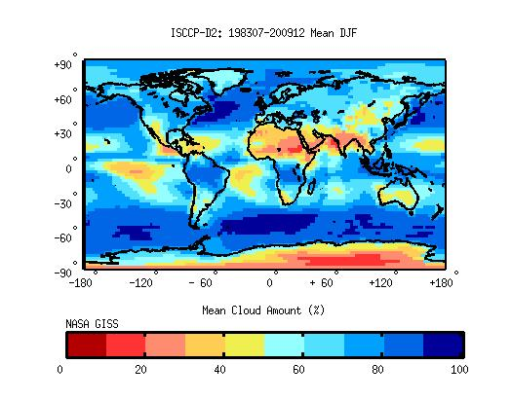
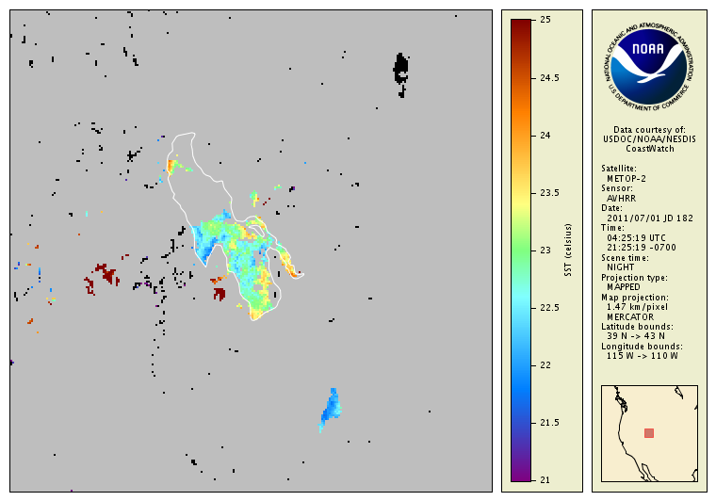
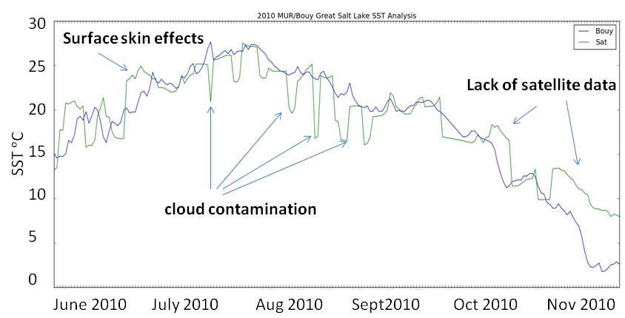
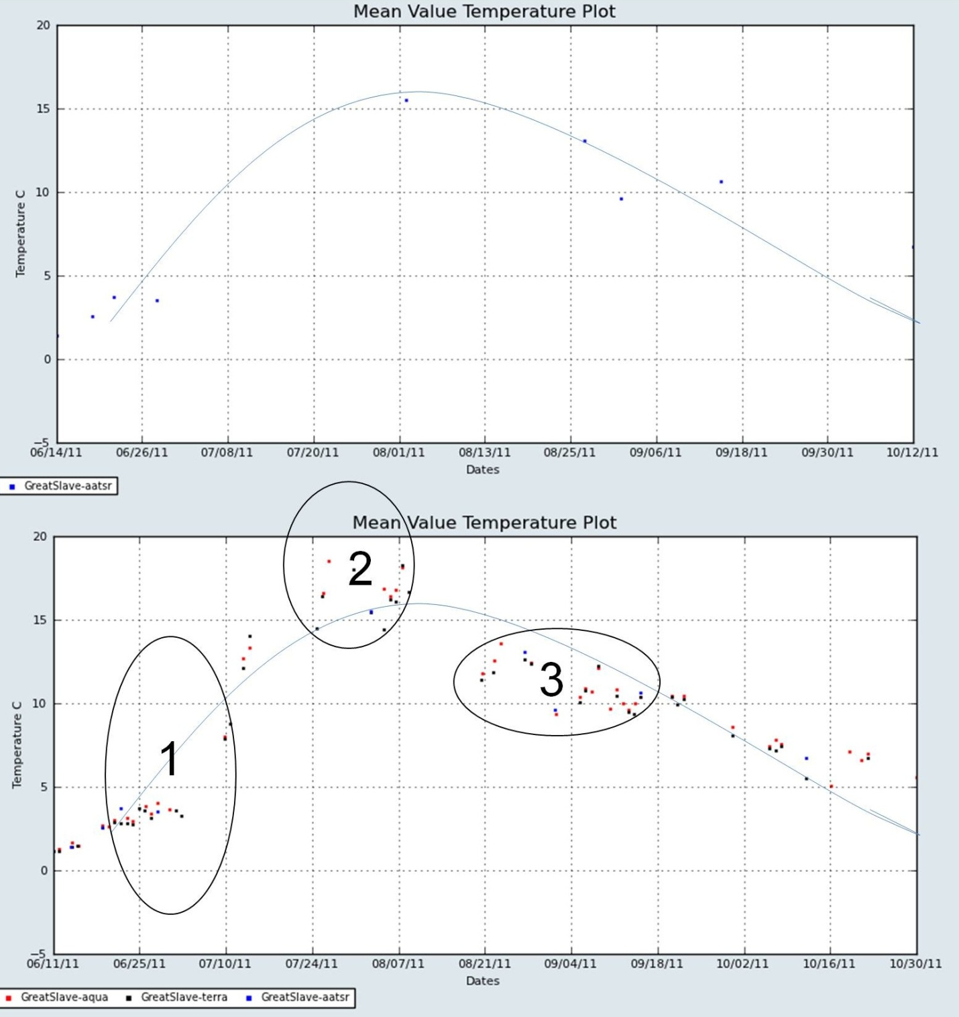
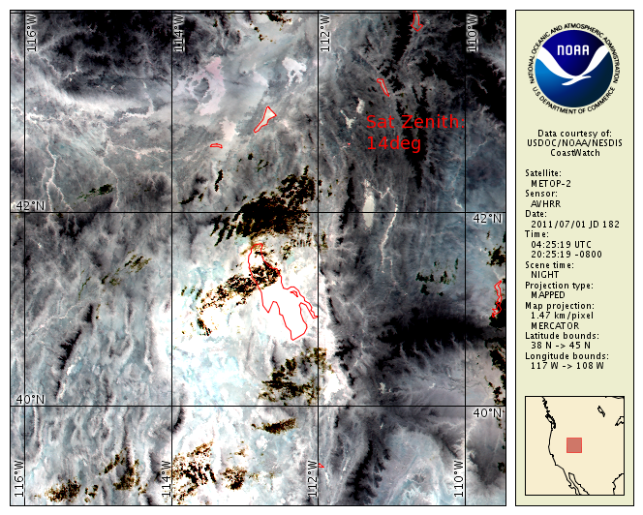
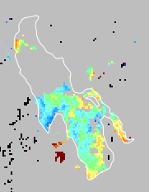

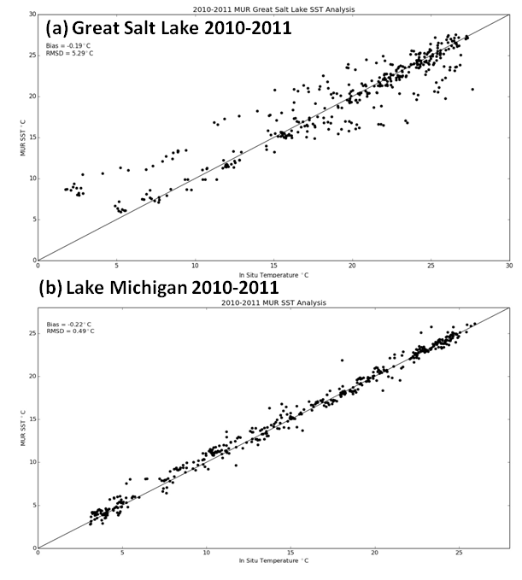
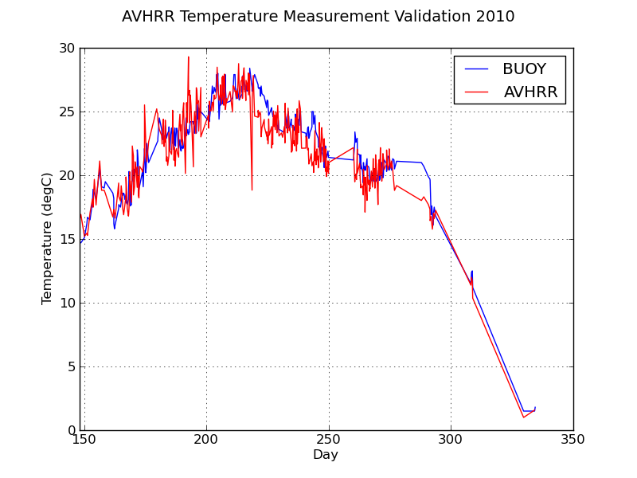
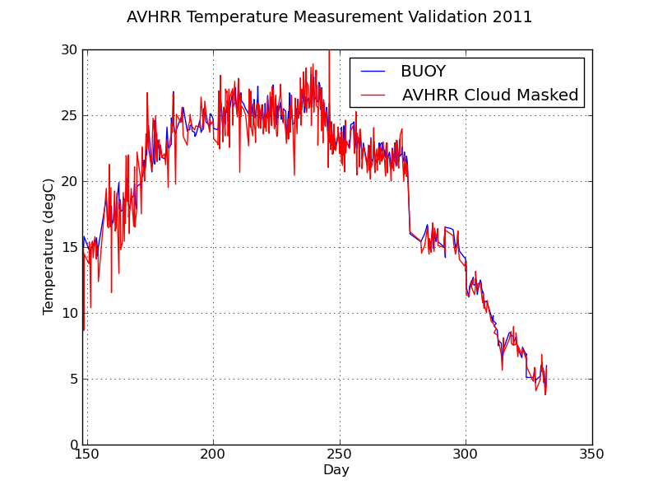
Validation of Satellite-derived Lake Surface Temperatures
Erik Crosman, John Horel, Nate Larsen, Will Howard
Department of Atmospheric Sciences, University of Utah
Background
Case Studies
Satellite LST and In Situ Data
Lake surface temperature (LST) is a critical parameter for lake ecosystems, climate change, and numerical weather prediction
In situ data is limited (Sharma et al. 2014), and obtaining sufficiently accurate and timely satellite-derived LST a challenge
LST errors associated with clouds, sub-pixel and shoreline contamination, geolocation, temporal averaging, warm skin and cool layers, surface emissivity, and atmospheric correction algorithms
Goals:
1. Document issues associated with satellite-derived LST and compare algorithms presented in literature
2. Validate multiple satellite LST products to further understanding of error sources
3. Provide recommendations
Lake Michigan
Satellite LST and buoy data 2010-2011
NASA Multi-scale Ultra-high Resolution (MUR) Sea Surface Temperature (SST) http://mur.jpl.nasa.gov/index.php
NASA LST http://modis.gsfc.nasa.gov/data/dataprod/nontech/MOD11.php
NOAA AVHRR COASTWATCH http://coastwatch.glerl.noaa.gov/
USGS Great Salt Lake Buoy and Lake Michigan NOAA buoy 45007
23-28 May 2010
25-29 October 2010
27 October 2010
Air temperature
Air temperature
Winds
Winds
28 October 2010
Sources of Error
Summary
1.
2.
3.
--Buoy 0.5 m temperature
--NASA MUR SST
29 October 2010
Product | Great Salt Lake, Utah |  |  |  | Lake Michigan
 | RMSE 2010 | RMSE 2011 | Bias ᵒC 2010 | Bias ᵒC 2011 | RMSE 2010 | RMSE 2011 | Bias ᵒC 2010 | Bias ᵒC 2011
NASA MUR SST | 8.53 | 2.0 | -0.44 | 0.06 | 0.27 | .0.60 | -.09 | -0.32
NOAA Coast watch | 1.75 | 1.146 | -0.65 | -0.177 | --- | ---- | ---- | ----
--Buoy 0.5 m temperature
--NASA MUR SST
4.
5.
Great Salt Lake
Table 1. Summary of validation RMSE and Bias statistics
Thin cirrus cloud
contamination
Great Salt Lake LST retrievals are of lower quality than over Lake Michigan
Both Great Salt Lake and Lake Michigan suffer from cloud contamination issues
Temporal representativeness issues (long cloud periods)
Rapid surface warming during light winds
Rapid surface cooling during cloudy conditions
Interannual variations in bias and RMSE a concern for climate trend studies
0
Sources of error in satellite-derived LST: 1) and 4): surface emissivity, shoreline contamination, and geolocation errors; 1) and 2): warm skin and cool layers; 3), 5), and 6): cloud contamination, temporal averaging
http://isccp.giss.nasa.gov/climanal3.html
6.
Recommendations and Future Work
Source: http://largelakes.jpl.nasa.gov/
Validation
Better cloud masks and first-guess and climatological background
Improved land masking, bias-correction, quality-control, temporal compositing, spatial hole filling and spatial smoothing techniques as outlined in Grim et al. (2013)
Multi-sensor approach to increase temporal coverage
Full radiative transfer models such as Hulley et al. (2011) and McCallum and Merchant (2012)
Ascertain additional LST products to validate
Expand to other lakes
Literature Review 1980-2014
Over 50 studies of satellite-derived LST reviewed
http://home.chpc.utah.edu/~u0198116/MISST2/
The bias and RMSE decrease for larger lakes
Mean biases (~0.45) and RMSE (~1.7) associated with the AVHRR instrument are higher than MODIS (bias ~ 0.1; RMSE ~ 0.7) or the AATSR (bias ~-0.05; RMSE~0.5)
Night biases and RMSE are reported to be significantly lower than during daytime, supporting other findings that suggest using only nighttime satellite retrievals over lakes
A lack of in situ data (lake buoy temperature and atmospheric profiles) over many lakes results in using split-window coefficients developed for the oceans and that are inappropriate for lakes
Acknowledgements and References
We gratefully acknowledge discussions with all members of the the GHRSST Near Shore Water Working Group (NSWWG), and helpful discussions with Jorge Vazquez, Ed Armstrong, Mike Chin, Simon Hook, and John D. Lenters and discussions with the Global Lake Temperature Collaboration (http://www.laketemperature.org/). Funding for this work is through NASA grant #NNH13CH09C entitled “Multi-sensor Improved Sea Surface Temperature (MISST) for IOOS.” We also are grateful to Chelle L. Gentemann and Remote Sensing Systems for the opportunity to collaborate with this work.
Crosman, E., and J. Horel, 2009: MODIS-derived surface temperature of the Great Salt
Lake, Remote Sensing of Environment., 113, 73-81
Grim, J.A., J.C. Knievel, and E. Crosman, 2013: Techniques for Using MODIS Data to
Remotely Sense Lake Water Surface Temperatures. J. Atmos. Oceanic Technol., 30,
2434–2451
Hulley, G.C., S.J. Hook & P. Schneider, 2011, Optimized split-window coefficients for
deriving surface temperatures from inland water bodies, Remote Sensing of
Environment, 115, 3758-3769
MacCallum, S.N., and C.J. Merchant, 2012. Surface Water Temperature Observations of
Large Lakes by Optimal Estimation. MacCallum. Can J Remote Sensing, 38(1), 25 –
45
Sharma, S, and coauthors, 2014: Globally distributed lake surface water temperatures
collected in situ and by satellites; 1985-2009. Long Term Ecological Research
Network
Observed biases (a, c) and RMSE (b, d) reported in lake SST studies between 1980-2013 as a function of lake area (a-b) and satellite platform (c-d).
Oct 28 2010
May 26 2010
Scatter plots of NASA MUR daily SST vs in situ measurements for (a) Great Salt Lake and (b) Lake Michigan 2010-2011.
Scatter plots of NOAA Coastwatch SST vs in situ measurements for (a) 2010 and (b) 2011.

