Slide 1
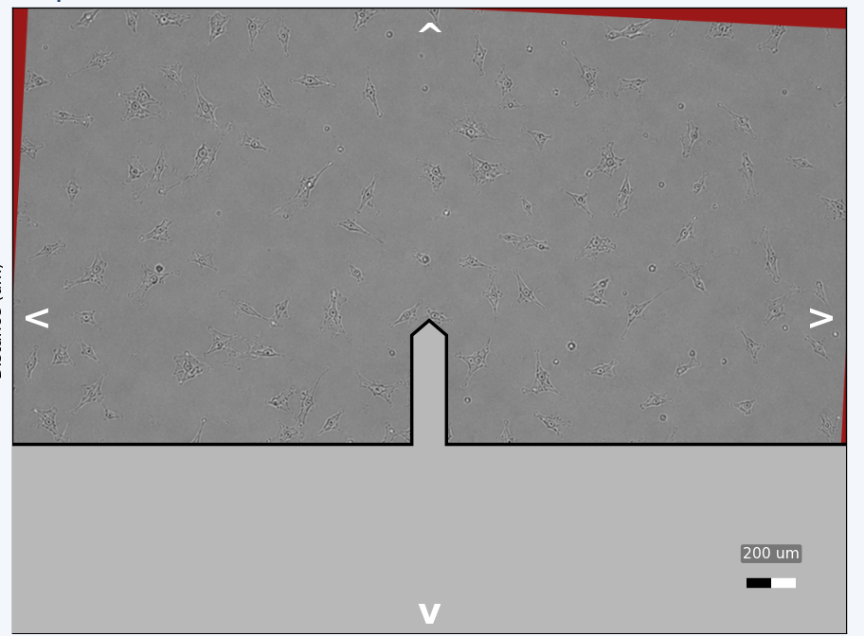
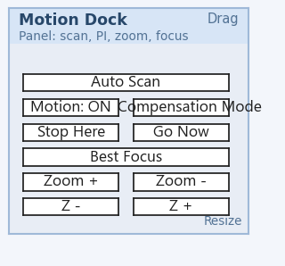
Features added
Cantilever center begins at random position (at center image)- because sample placement on sample stage is random
Surface image begin at random tiltness (-10 to 10 degree) – because sample placement may be rotated
Stop moving cantilever
Move cantilever immediately

Slide 2
Machine recall the last measurement region (shape of surrounding)
AI recognize the current surrounding pattern and rotation angle will be calculated from previous shape recognition and the distance from the origin
Cantilever moves to that new origin based on click to that position.
Verify the location of the cantilever tip based on the recognition (multiple distances)-if not correct, move based on click to that position
2
Current
2
Current
recognize some rotation
Previous
2
3
Current
2
Current

Slide 3
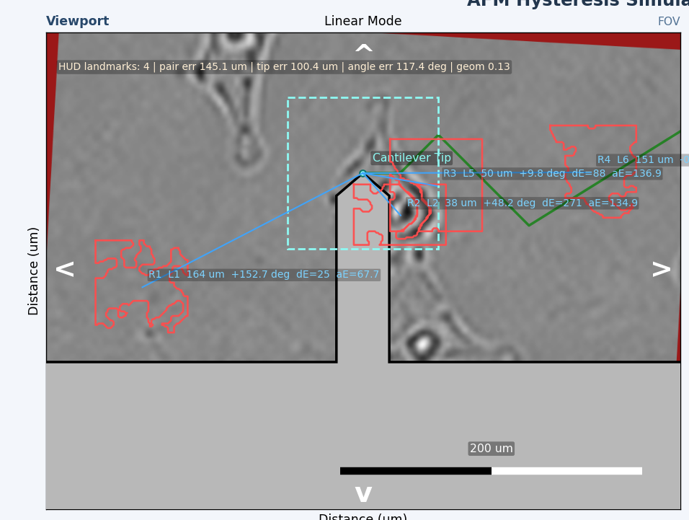
Machine recall the last zoom value, then AI zoom it.
AI recognize the current surrounding pattern (in the image below, my recognition of shape is poor, please improvise)
If not recognize, then the search will begin and will involve zoom out and zoom in.
If recognize, cantilever moves to that new origin based on click to that position.
Verify the location of the cantilever tip based on the recognition (multiple distances)-if not correct, move based on click to that position

