Slide 1
Reconstruction Autoencoder

Slide 2
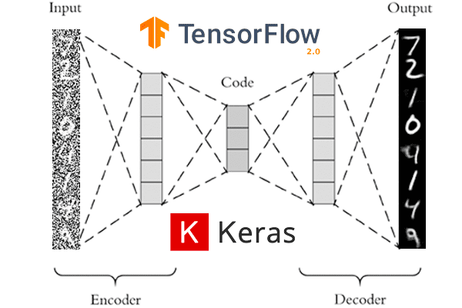
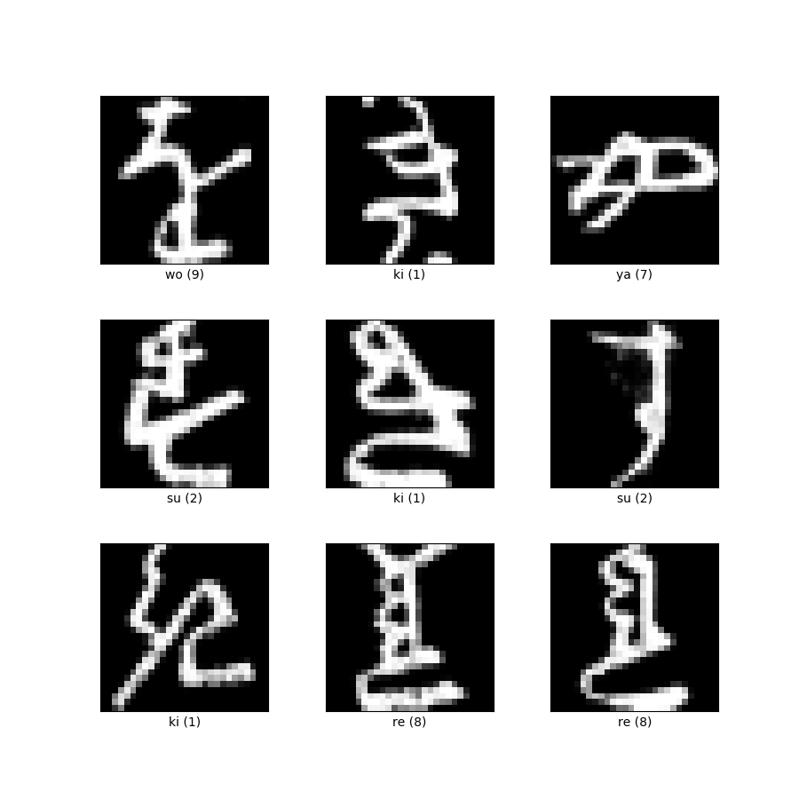
Introduction
Training with Kuzushiji-MNIST dataset:
28x28 grayscale pixels
70.000 samples
10 different classes
What is an autoencoder?
https://laptrinhx.com/denoising-autoencoders-with-keras-tensorflow-and-deep-learning-4086106458/
https://www.tensorflow.org/datasets/catalog/kmnist

Slide 3
Training & model architectures
Perturbations
black squares
brightness
rotations
flipping
gaussian noise
Models
19 models
vertical layer stacks
regularizations
best model
Key findings
”deeper” is better
low latent space dimensions work best

Slide 4
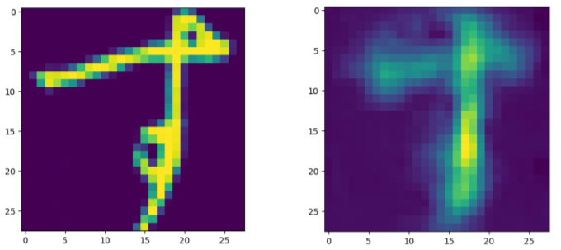
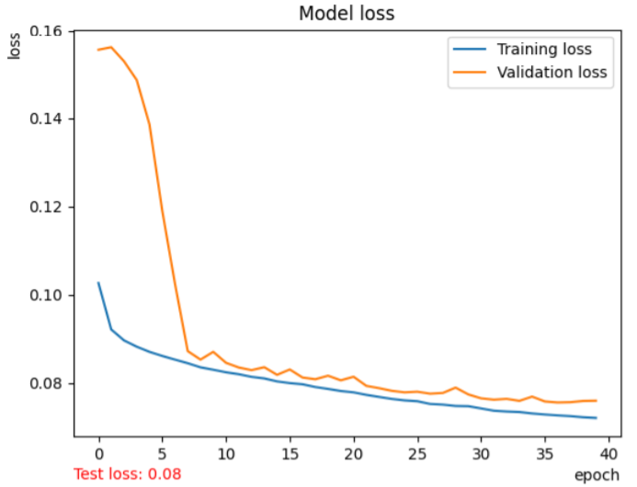
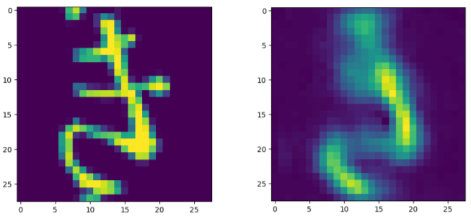
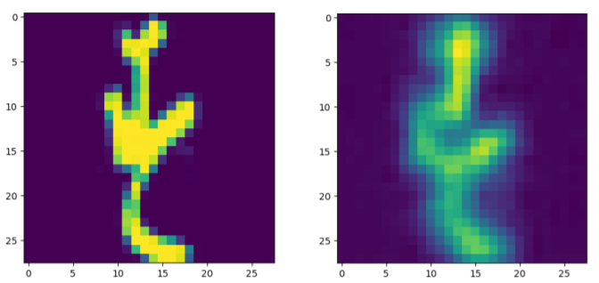
Results
Best loss
Average loss
Training loss: 0.0717
Validation loss: 0.0756
Training time: 2-3 hours
Worst loss

Slide 5
5
Questions
Group 10

