Slide 1
Reconstruction Autoencoder

Slide 2
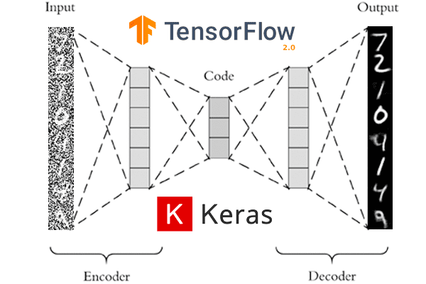
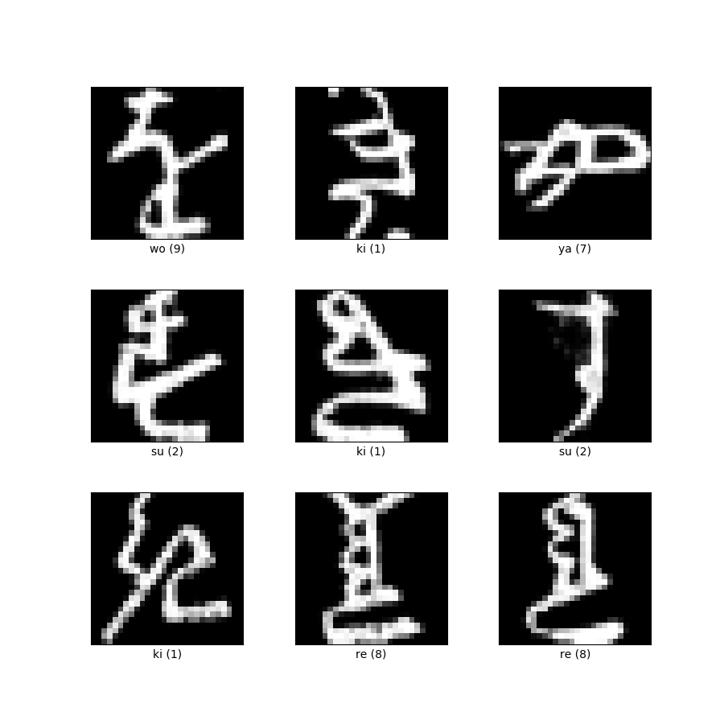
Introduction
Training with Kuzushiji-MNIST dataset:
28x28 grayscale pixels
70.000 samples
10 different classes
What is an autoencoder?
https://laptrinhx.com/denoising-autoencoders-with-keras-tensorflow-and-deep-learning-4086106458/
https://www.tensorflow.org/datasets/catalog/kmnist

Slide 3
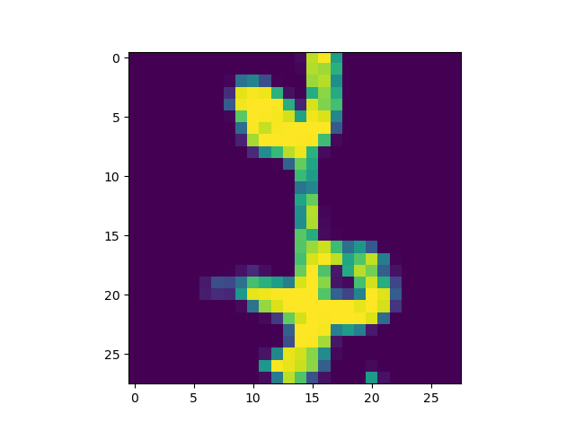
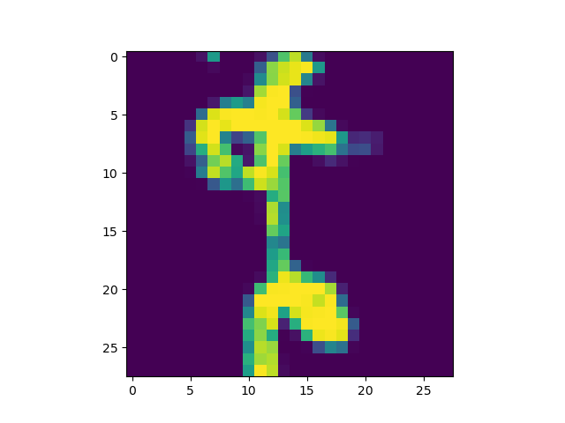
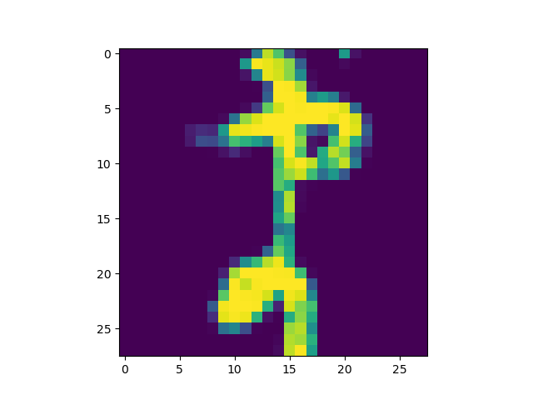
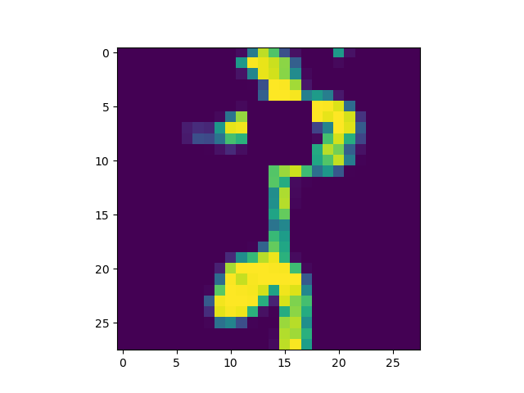
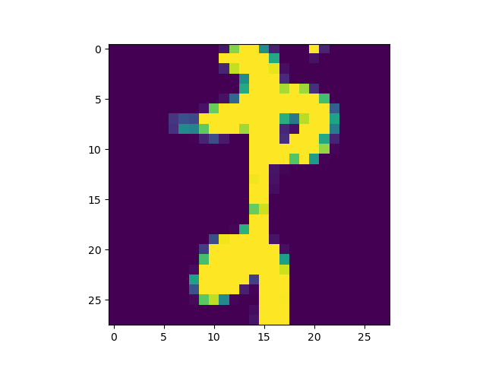
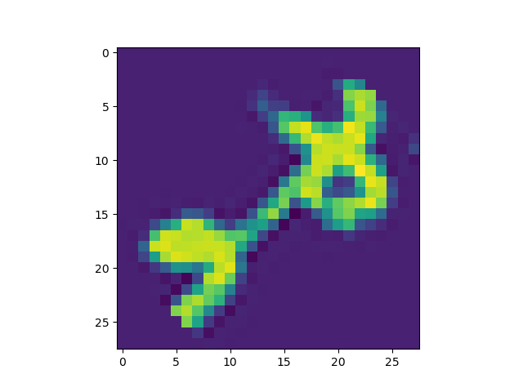
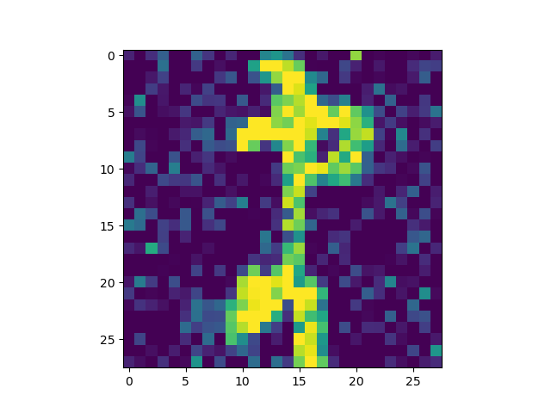
Training & model architectures
Perturbations
black squares
brightness
rotations
flipping
gaussian noise
Models
19 models
vertical layer stacks
regularizations
best model
Key findings
”deeper” is better
latent space dimensions

Slide 4
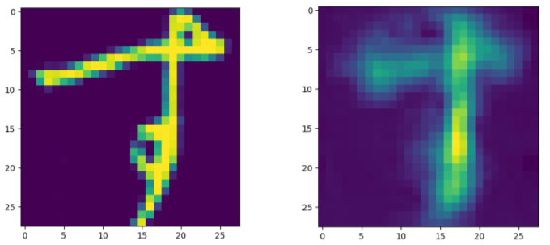
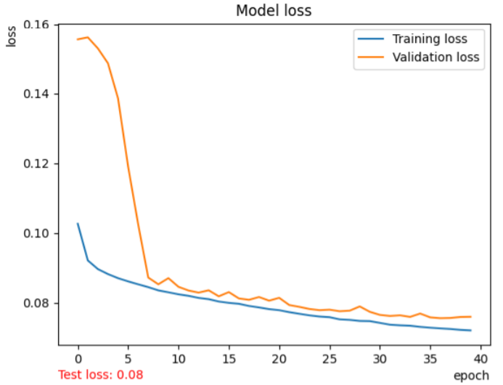
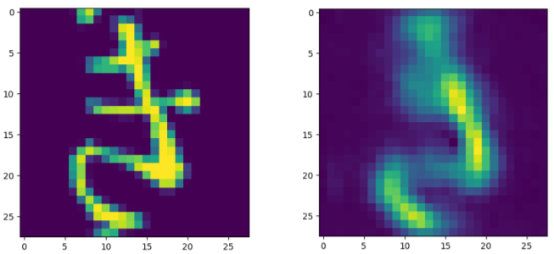
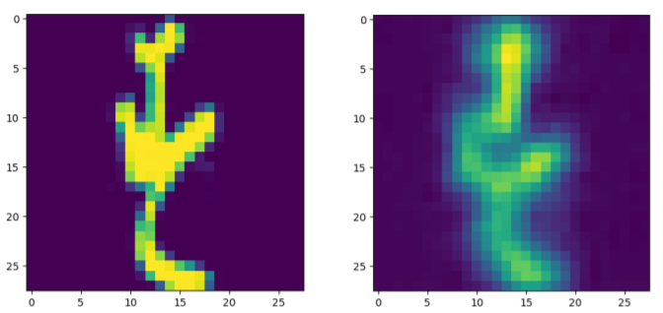
Results
Best loss
Average loss
Training loss: 0.0717
Validation loss: 0.0756
Training time: 2-3 hours
Worst loss

Slide 5
5
Questions
Group 10

