Slide 1
SDC_cuda
Alex Keng
kensl@cs.unc.edu
May, 17, 2010

Slide 2
Overview
SVN path
  https://svn-rc.unc.edu/minion/SDCMPI/SDC_cuda
  run_particle.m
    Entry point (generating towers.txt, GMRES)
  particleHex.m
    Main program (SDC loop, velocity_t_xyz_final.raw, drawing figures)
  build_hex_tower.m
    Build hexagonal tower
  generate_hex_layout.m
    Generate towers according to the ‘hexagonal’ layout
  StokesletEval_CUDA.cu
    CUDA implementation

Slide 3
Demo
Run run_particles.m
How to Change Parameters
  Layout of towers
    Run_particles.m, line 12
    Generate_hex_layout.m
      Test data, one line, three lines
  Velocity grid
    particleHex.m, line 145
    Note if grid size is changed (ex: 32 -> 64), paraview files need to be updated accordingly
  CPU or GPU
    particleHex.m, line 322
    StokesSelf.m, line 56
  One line tracing particles
    particleHex.m, line 86

Slide 4
Towers.txt
One row in the file represents one tower: type x y z height level
type
  0:hexagonal tower
  1:triangle tower
  2:line tower
x y z
  The bottom of the tower
height
  Height of the tower
level
  How many levels the tower has

Slide 5
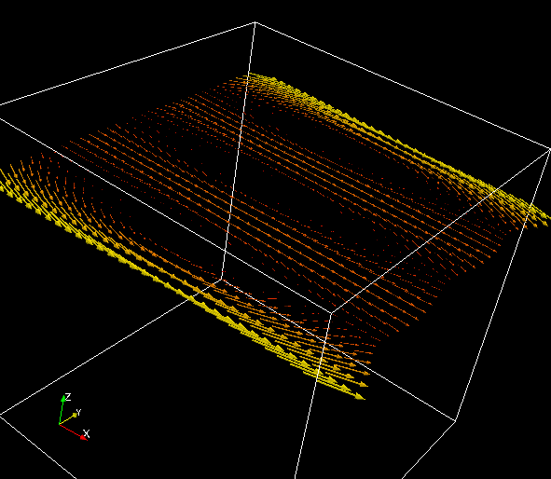
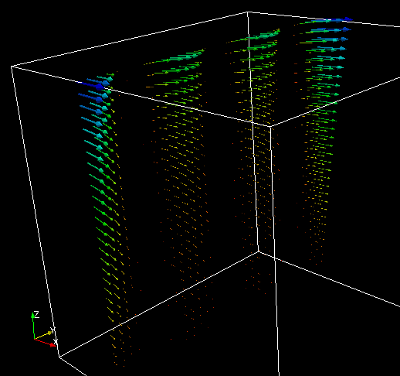
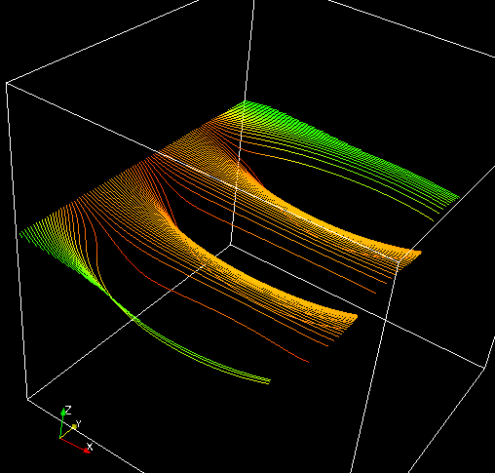
ParaView
velocity_32x32x32_xy_plane.pvsm
  Visualize velocity grid in xy plane
velocity_32x32x32_yz_plane.pvsm
  Visualize velocity grid in yz plane
velocity_32x32x32_stream.pvsm
  Visualize velocity using Stream Tracer
Magnify z values by 15 times
  velocity_32x32x32_xy_plane_zscale.pvsm
  velocity_32x32x32_yz_plane_zscale.pvsm

Slide 6
Bass
lam9@bass.cs.unc.edu
xnc)ym21Tq
Ssh –X lam9@bass.cs.unc.edu
qlogin -now n -l gpus=1,gpu_host
Matlab &
/home/lam9/amath-frg/branches/miller/SDC_cuda/matlab

Slide 7
Inside run_particles
Matlab2vts -> makes velocity grid
Matlab2vtu -> make forces and positions
When changing velocity grid, also change in run_particles the compute velocity function.

