Slide 1

AT&T Big Data Fall Competition Round 2
AT&T Customer Service Insights via Social Media Analytics Hua Guo Chao Li

Slide 2
AT&T Competition Inputs
AT&T Customer Service Insights via Social Media Analytics
Competition Problem Statement
Understand customer sentiment towards store experience in social media
Explore customer service insights
Social Media platforms to be analyzed:
Google Review
Yelp
Facebook
Twitter
Others
Geo preference:
Dallas area

Slide 3
AT&T Customer Service Insights via Social Media Analytics
Analysis Objective
Learn what’s been said in the context of AT&T through social media. Some of aspects related to customer service analyzed are:
–Technician dispatch
–Product installation
–Customer experience across various channels (store, live chat, service line)
–Satisfaction around product usage
–Billing issues
–Responsiveness
–Quality (Network/Coverage etc.)
–Reasons for churn
–Reasons for staying with the network
Perform location analysis to see if the services and product experience vary by zones or zip codes.
Explore main competitors to see if the sentiment vary by companies.
Investigate things like location based demographics to see if that plays a role in AT&T’s overall customer sentiment.
Difference between social media platforms or AT&T authorized retailers versus corporate retail stores.

Slide 4
Scope
AT&T Customer Service Insights via Social Media Analytics
Elements | Scope
Brands | AT&T, and 3 competitors (T-Mobile, Verizon, Sprint)
Topic of Interest | Installation, Channel, Billing, Responsiveness, Quality, Prices, Churn, Retention
Sources | Social media platforms, United States Census Bureau
Geography | Dallas, US
Language | English

Slide 5
Data
AT&T Customer Service Insights via Social Media Analytics
This analysis is based on a collection of 50805 data covering:
 | Yelp | Google | Facebook | Twitter
AT&T Data of Dallas Area | 206 | 532 | 183 | 188
AT&T Data National Wide | 0 | 7786 | 0 | 5434
Sprint Data | 119 | 8138 | 0 | 3045
Verizon Data | 98 | 7716 | 40 | 4291
T-Mobile Data | 86 | 8290 | 36 | 4560
Total | 509 | 32462 | 259 | 17518
Other websites (such as Angie’s list, foursquare, yellow pages, judysbook) have very limited help for this project. So, we’ll focus on the 4 main social media platforms.

Slide 6
Executive Summary
AT&T Customer Service Insights via Social Media Analytics
AT&T has a 3.1/5.0 average rank of all retail store in Dallas area. Ranks 2nd among 4 main telecom companies (Sprint 3.3, Verizon 2.9, and T-Mobile 2.6).

Slide 7
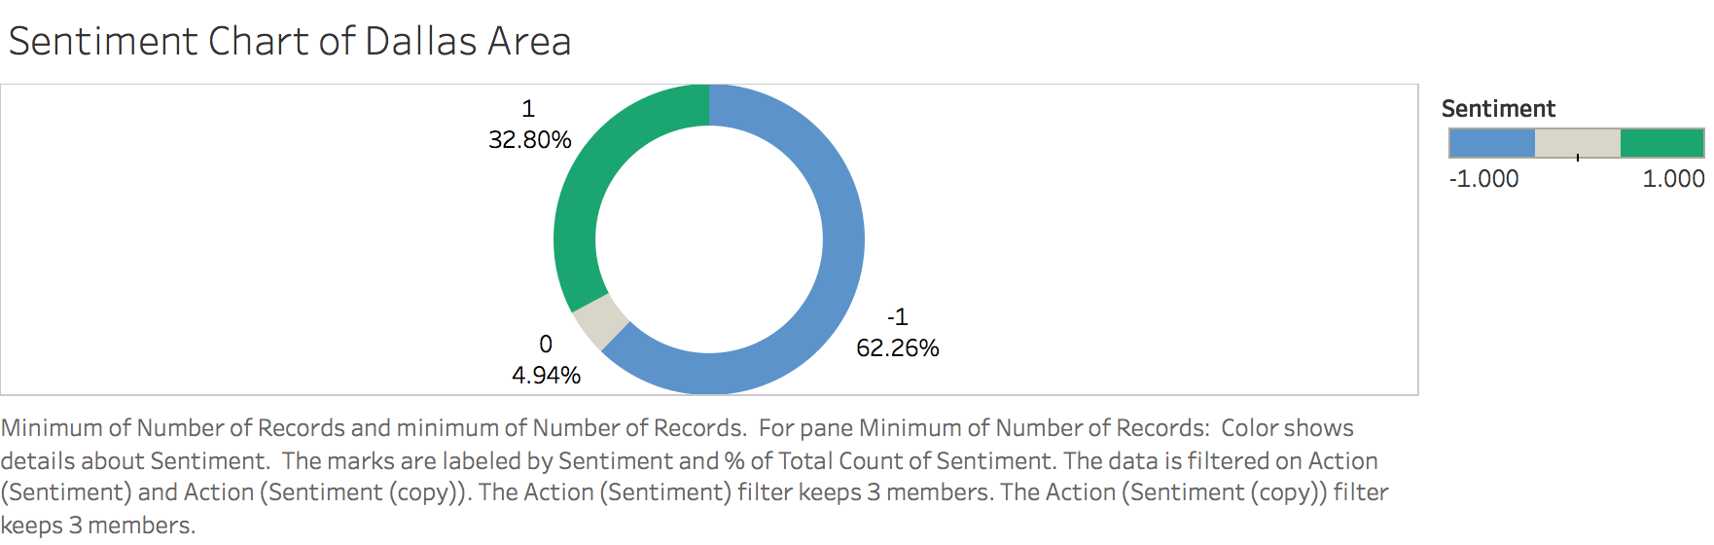
Sentiment Distribution (Dallas)
AT&T Customer Service Insights via Social Media Analytics
AT&T retail store in Dallas area has a overall negative share of voice (62.3%) among its customers. The sentiment lower than national wide, and lower than the sentiment of other 3 competitors. While the overall buzz for AT&T is similar to the buzz for main competitors.

Slide 8
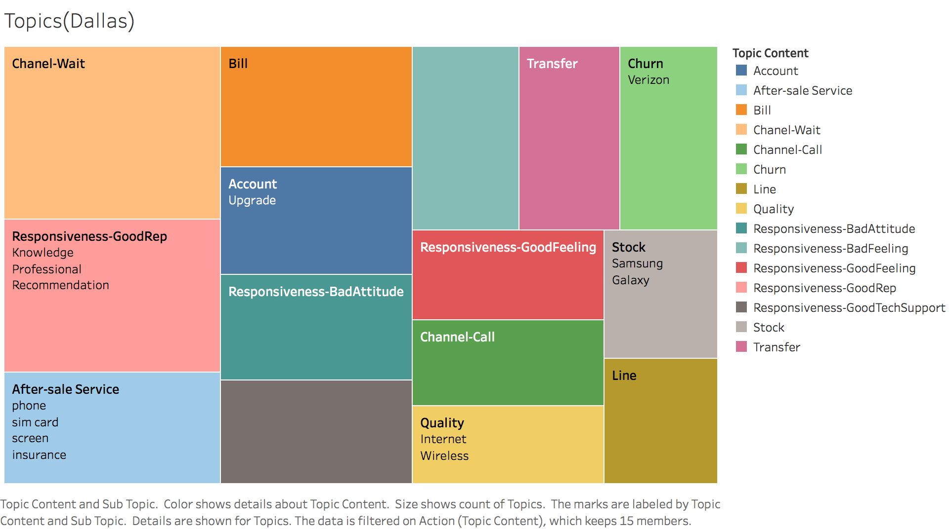
Topic Drill Down
AT&T Customer Service Insights via Social Media Analytics

Slide 9
Topics Drill Down
AT&T Customer Service Insights via Social Media Analytics
We used the conversations on social media generated top 15 topics. Customers are focused largely around Wait time, Reps’ Knowledge, after-sale customer service, bill, and account. While waiting time is largely complained by customers, Rep’s professional is praised as they will actively promoting/recommending AT&T on social media. For after-sale service, customers concern more about sim card, screen, and insurance.
The overall buzz on AT&T in relation to Attitude, Tech support are in the 2nd hot place, as customers are hoping reps have good attitude, and can help them fix issue.
Customers also have affinity towards Quality of the network with conversations focusing on lack of signal indoors, lack of LTE data despite coverage claims etc., had a affinity towards Channels of interaction with phone support being disparaged for long waiting time, transferring too many times, and giving inaccurate/vague information to customers
Churn and Stock also in the top topic rank. AT&T customers mentioned a lot times of competitor Verizon. And complained lack of stock.

Slide 10
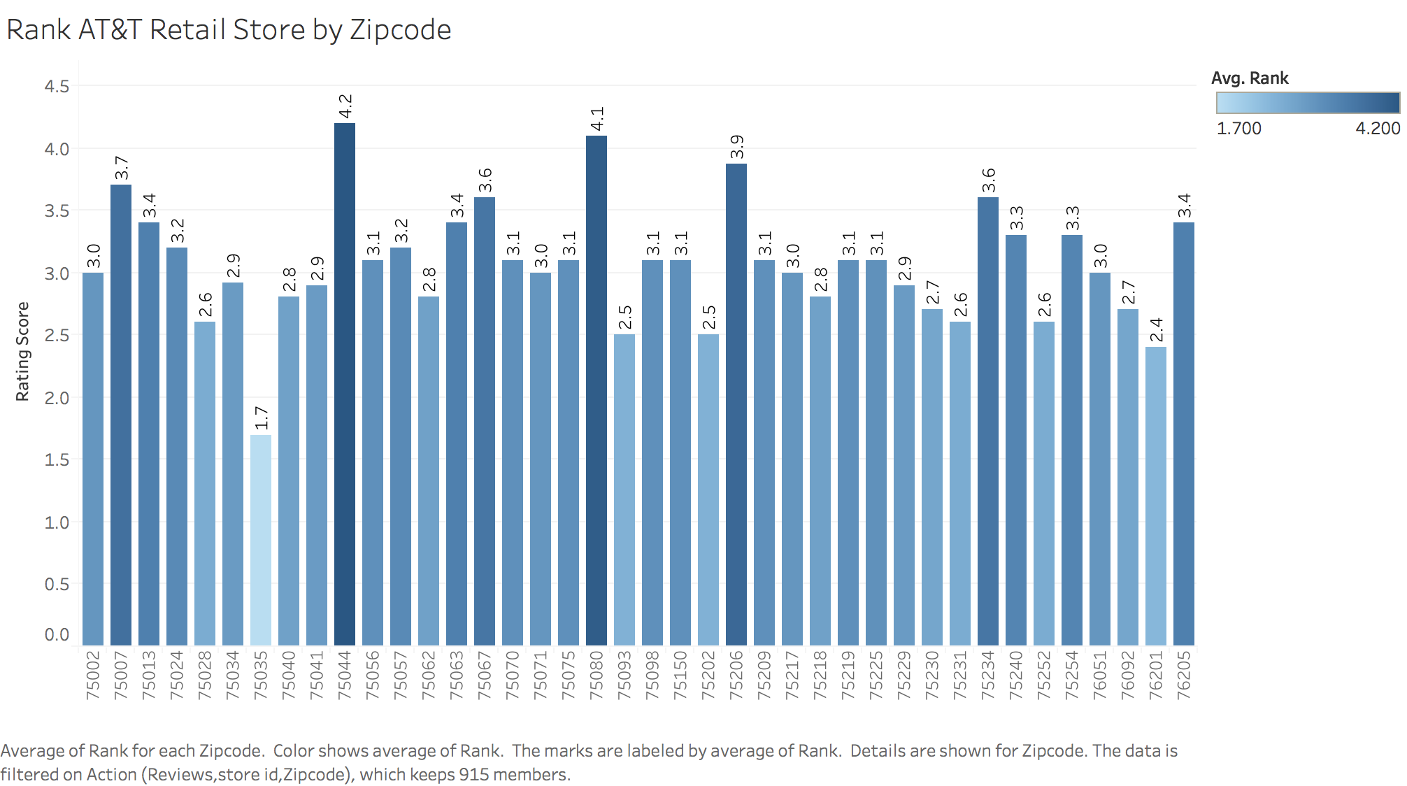
Rank by zipcode
AT&T Customer Service Insights via Social Media Analytics

Slide 11
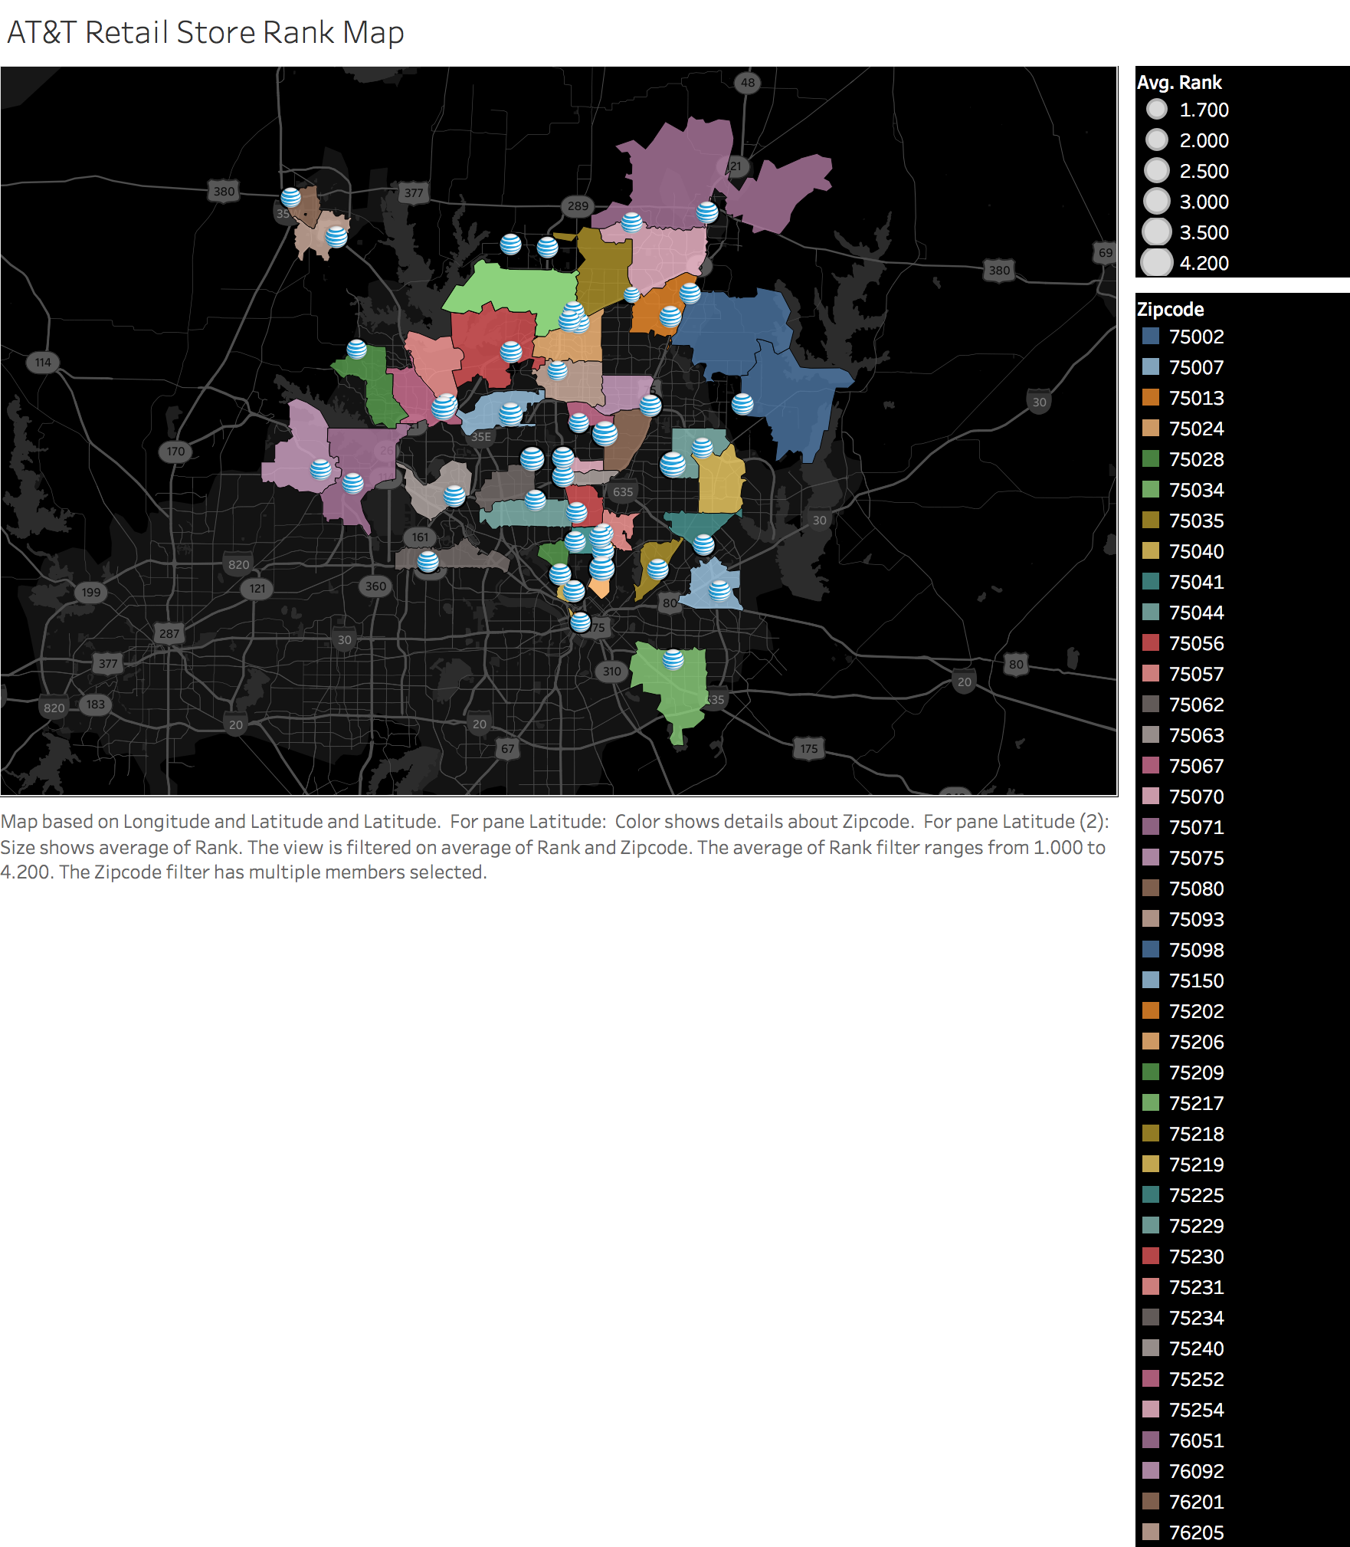
Rank by zipcode
AT&T Customer Service Insights via Social Media Analytics

Slide 12
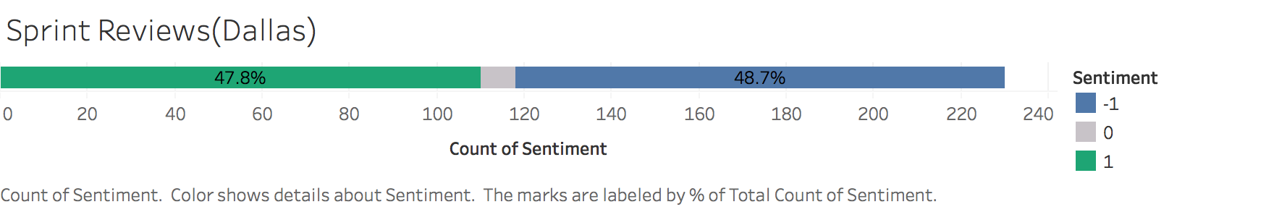
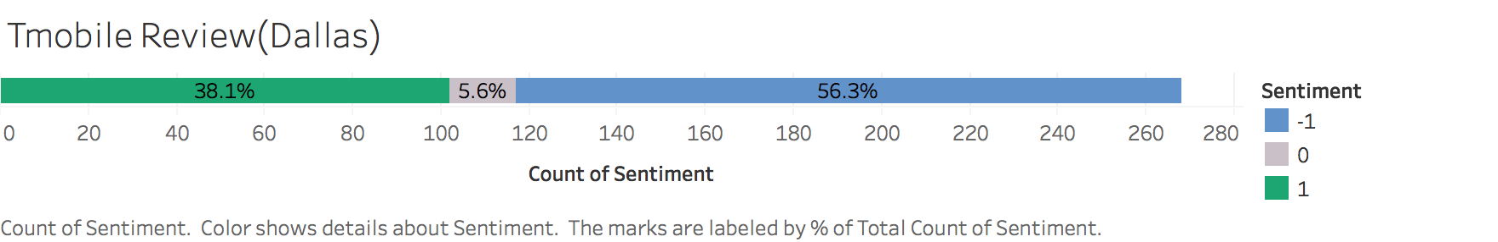
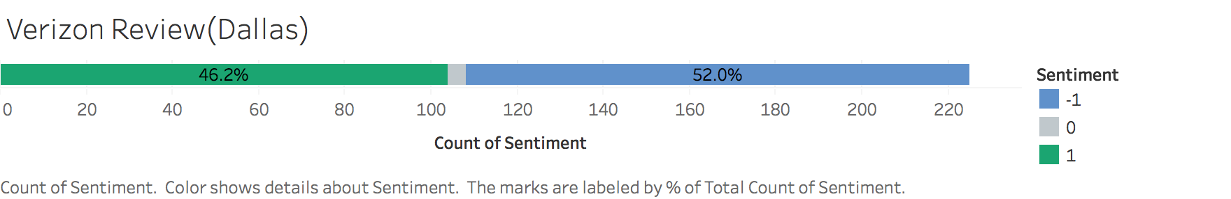
Comparison with competitors
AT&T Customer Service Insights via Social Media Analytics

Slide 13
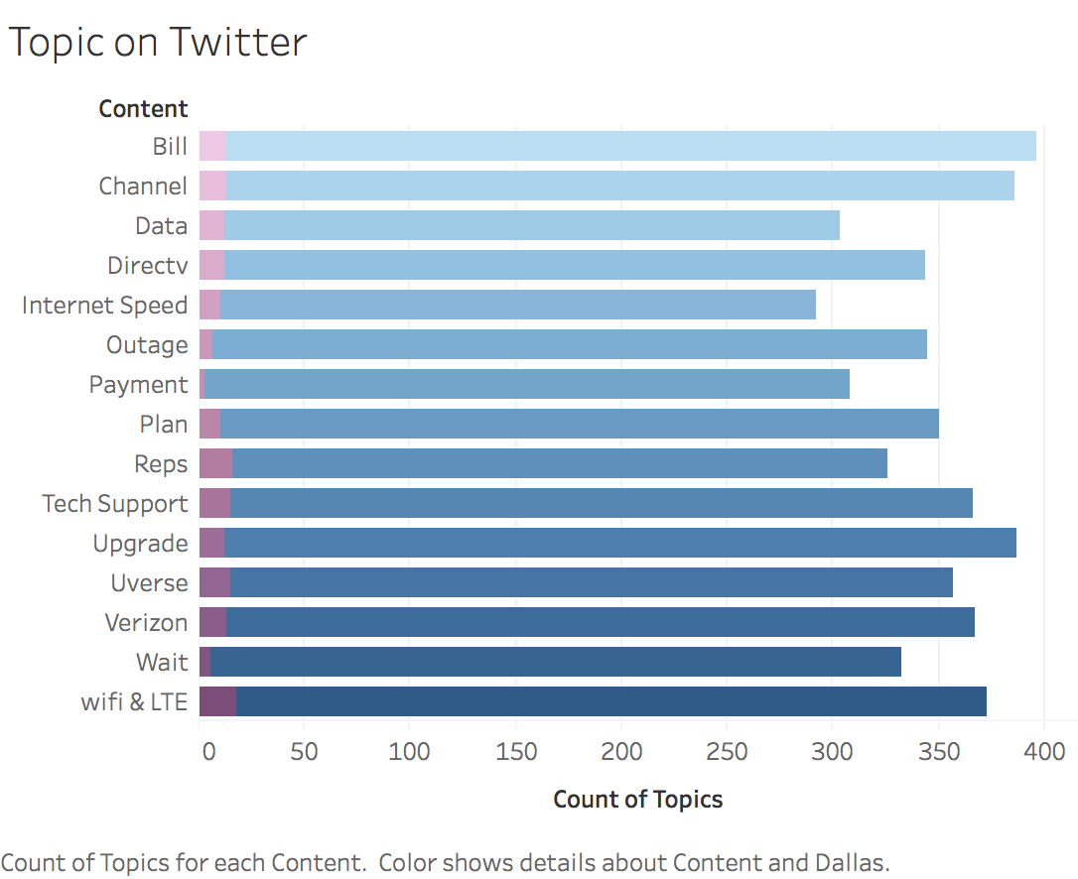
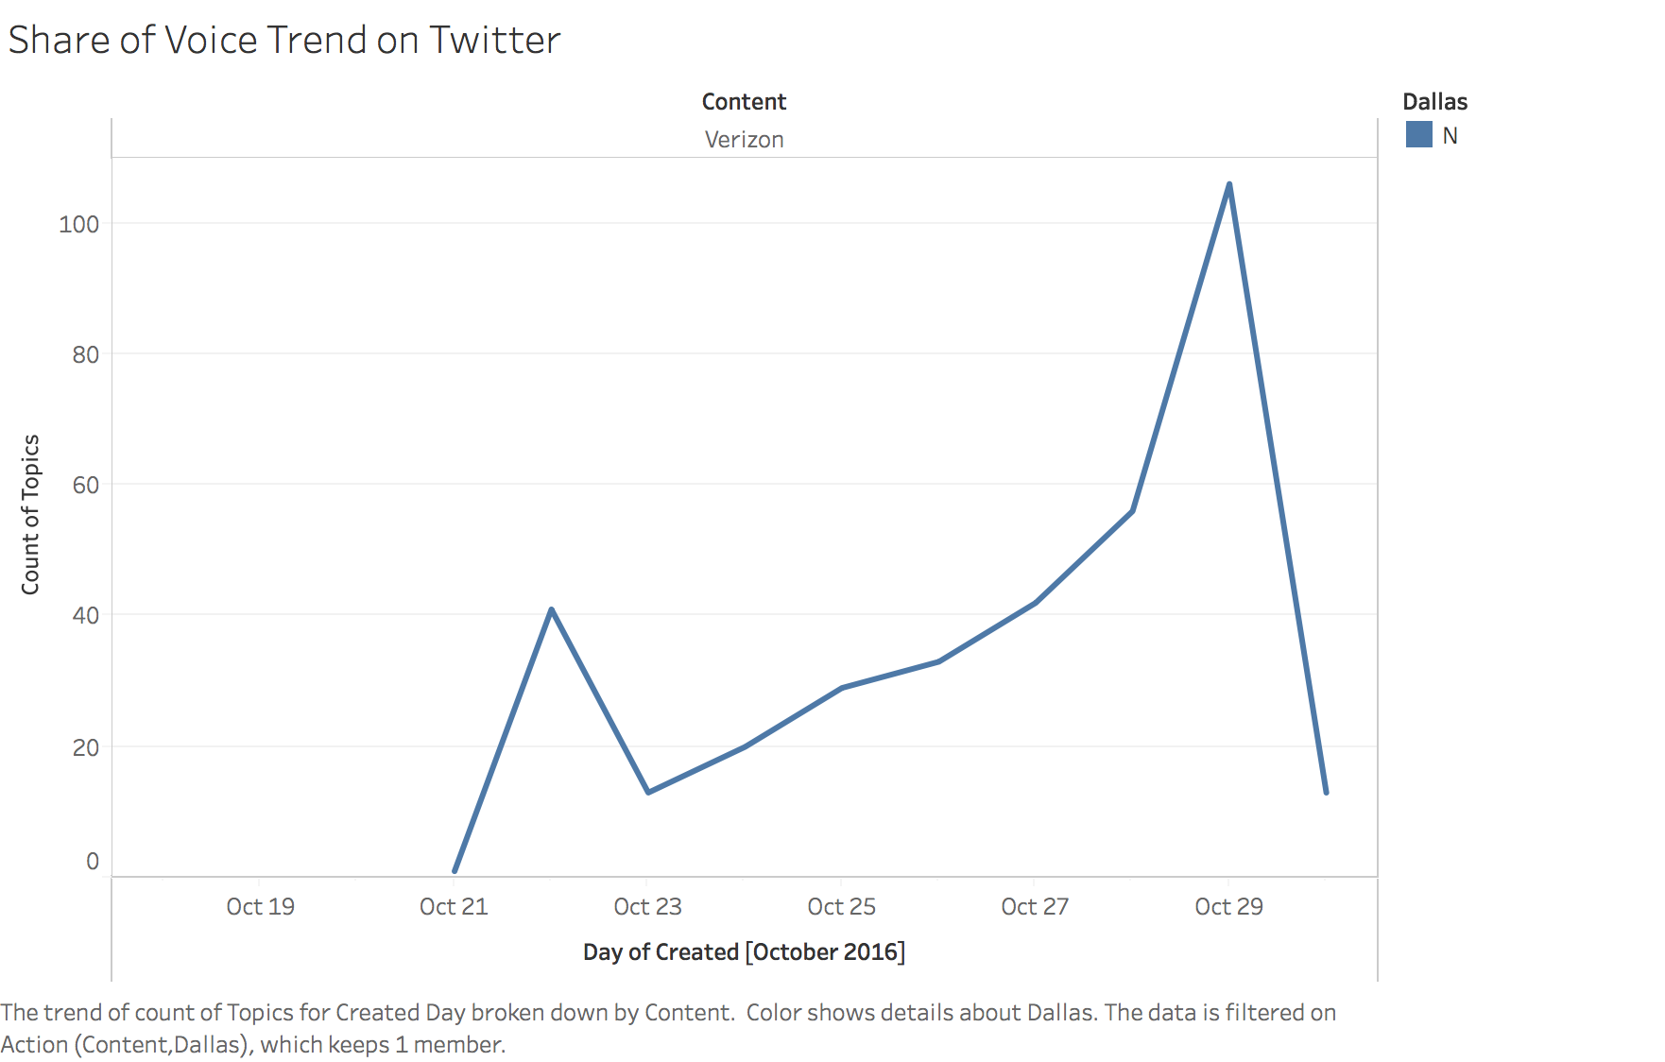
Twitter trend
AT&T Customer Service Insights via Social Media Analytics

Slide 14
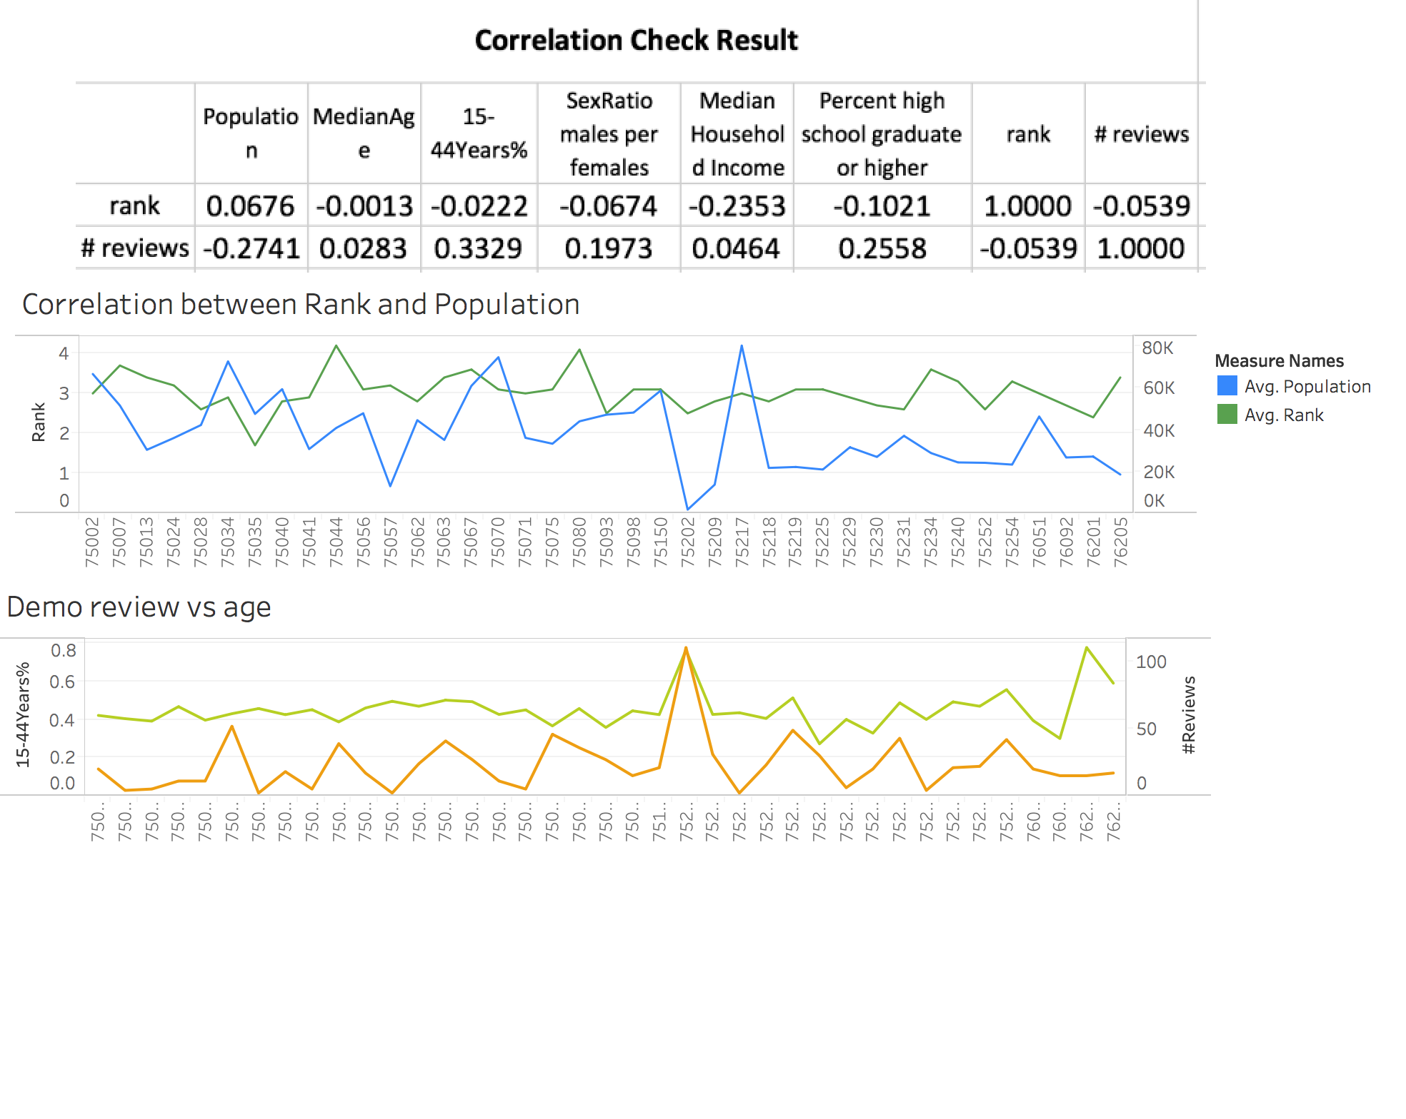
Demographics Impact
AT&T Customer Service Insights via Social Media Analytics

Slide 15
Technique Tools
AT&T Customer Service Insights via Social Media Analytics
R
Python
Google APIs
Yelp APIs
Twitter APIs

Slide 16
Data preprocess
AT&T Customer Service Insights via Social Media Analytics
Tweet
Remove unimportant words
Convert to lower case
Tokenize

Slide 17
Topics extraction
AT&T Customer Service Insights via Social Media Analytics
Latent Dirichlet Allocation (LDA)
Suppose we have the following set of sentences:
I eat fish and vegetables.
Fish are pets.
My kitten eats fish.
LDA is a technique that automatically discovers topics that these documents contain.
Given the above sentences, LDA might classify the red words under the Topic F, which we might label as “food”. Similarly, blue words might be classified under a separate Topic P, which we might label as “pets”.

Slide 18
Sentiment prediction
AT&T Customer Service Insights via Social Media Analytics
Support Vector Machine (SVM)
Original tweet text | sentiment
@ATT your TV is aids, and your internet is cancer. Let me know when you get your pathetic shit together. Retarded fucks. | -1
RT @ATT: @ajanata Who doesn't love a happy surprise like that? Enjoy your new place and the great speeds, Andy! https://t.co/mmGN7TEbVS | 1
Sweet. Thanks @ATT. Almost feel like it's a smarter risk/reward to just not buy a case now for my new iPhone https://t.co/sSYPM8vvR6 | 0
@ATTCares Worst customer service ever! You will be losing a long time customer very shortly. #att #attsucks | -1

Slide 19
Name based gender prediction
AT&T Customer Service Insights via Social Media Analytics
Request: https://api.genderize.io/?name=Jeremy
Response: {"name":"Jeremy","gender":"male","probability":0.99,"count":1840}.

Slide 20
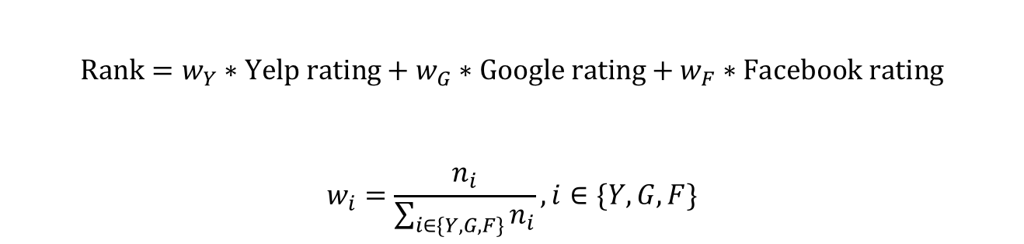
Ranking Strategy
AT&T Customer Service Insights via Social Media Analytics
$$Rank=w_{Y}∗Yelp rating+w_{G}∗Google rating+w_{F}∗Facebook rating$$
$$w_{i}=\frac{n_{i}}{\sum_{i∈\{Y,G,F\}}{n_{i}}}, i∈\{Y,G,F\}$$

