Slide 1

KALSHI
KNOWS
The intelligence layer on top of prediction markets
kalshi-knows.pages.dev
Faisal Nabulsi · Kevin Huang · Dugar
Notes:
Prediction markets know things before you do. We built the layer that reads them.

Slide 2
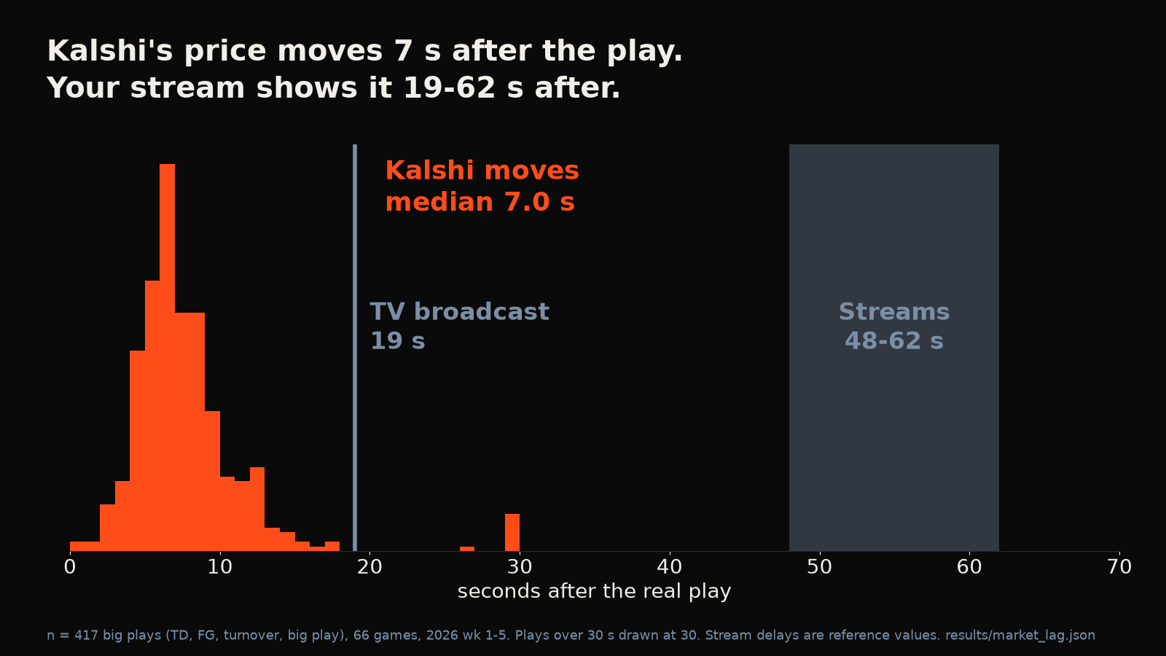
THE PROBLEM
KALSHI MOVES IN 7 SECONDS. YOUR STREAM TAKES 48 TO 62.
7 s
Kalshi price after the play
48–62 s
Peacock to NFL+ (antenna 19, cable 38, YouTube TV 53)
Notes:
Kalshi's price moves about 7 seconds after a play. Your stream shows it 48 to 62 seconds after. Anyone live-betting off a stream is trading against people who already know, and every streaming fan gets spoiled by group chats.

Slide 3
WHO IT'S FOR
THE ANALYTICS LAYER ON TOP OF KALSHI
RETAIL
QUANTS
EXCHANGES
Streaming fans and prediction-market traders
Latency and info-flow data
Regulators: market-integrity monitoring
Spoiler alerts, "market already moved" warnings
Who learns what, and when
See when a price moved before the news
Notes:
We don't compete with Kalshi. We're the analytics layer on top, starting with retail traders and fans.

Slide 4
LIVE DEMO
LIVE
Live board → Receipts → Auto page
Today: 30 alerts · named plays 4 of 4 correct · Steelers TD called 32 s before ESPN's feed
kalshi-knows.pages.dev/?present=1
Notes:
Here's today. Every call is timestamped and graded against ESPN, misses included. When we named the play, we were right 4 of 4. Then the Auto page: the same signals drive an agent that places orders on Kalshi's demo exchange, play money, and it works on any market. Also point at the Kalshi vs Polymarket panel under the game tiles: we watch both venues; Kalshi moves first. (Backup: video/kalshi-knows-demo.mp4, or the ledger backup slide.)

Slide 5
HOW IT WORKS
TWO-STAGE MODEL, 28 SEASONS OF NFL PLAYS
Kalshi public
order book
Jump
detector
Play model
Push + live site
+ auto-bettor
→
→
→
price move ≥ 0.08
pretrained on 28 seasons of NFL plays, fine-tuned on ~8,800 real Kalshi jumps
+11 pts
15% → 3.3%
over a smart fan
wrong labels, before vs after our audit
Notes:
Two-stage model. The 28-season pretraining is the secret sauce: the model beats a smart fan by about 11 points, and without the pretraining it drops to 70%. We audited our own labels, found 15% were wrong, fixed them.

Slide 6
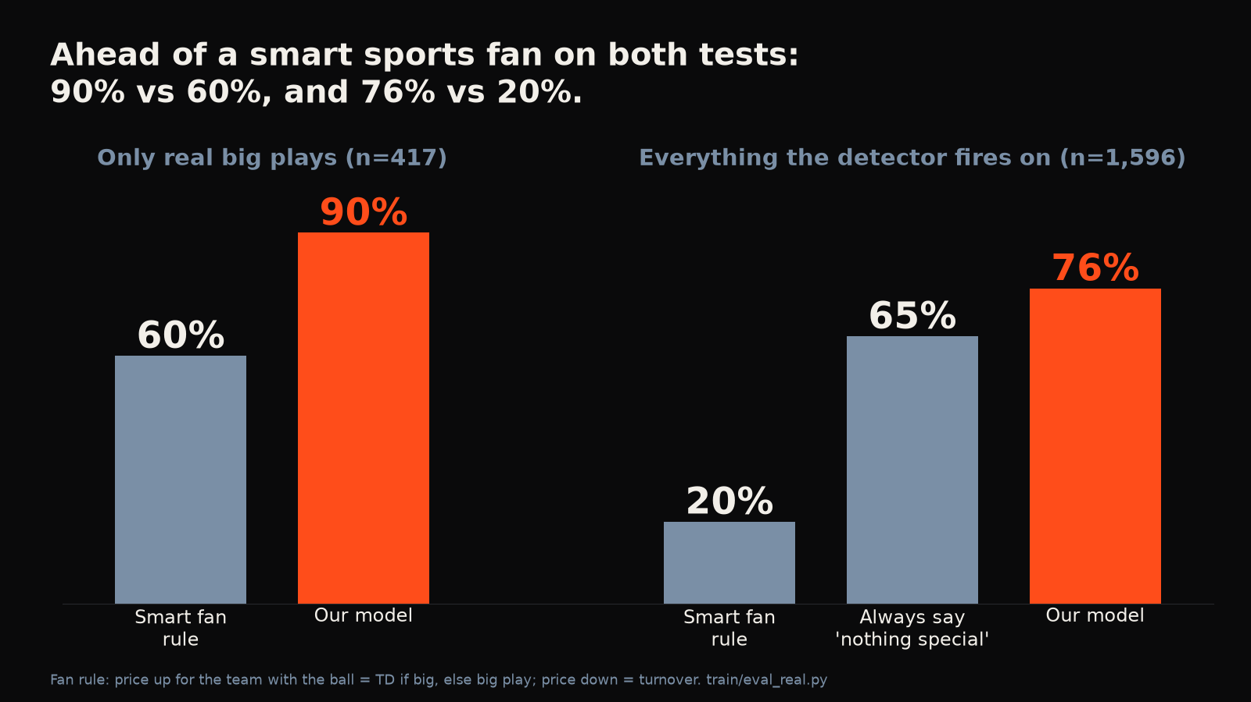
RESULTS
74–75% ON GAMES IT NEVER SAW
Smart fan
63%
Kalshi Knows
74–75%
Always "nothing"
47–50%
Named at 75%+: right ~80%
vs Claude Opus 5.5: ties on accuracy (77 vs 76%), better calibrated, 7 ms
Pre-registered test on today's games: named calls 8 of 9
Notes:
Tested on games it never saw, against a smart fan and against Claude. Always-'nothing' baseline is 47 to 50% on the audited labels. Named calls at 75%+ confidence were right 77 to 81% of the time. Pre-registered test on today's early games: named calls 8 of 9 (small sample, wide interval). Claude Opus 5.5 head-to-head: 77.3% vs 76.0%, a statistical tie on accuracy, clearly better calibrated, 7 ms per call.

Slide 7
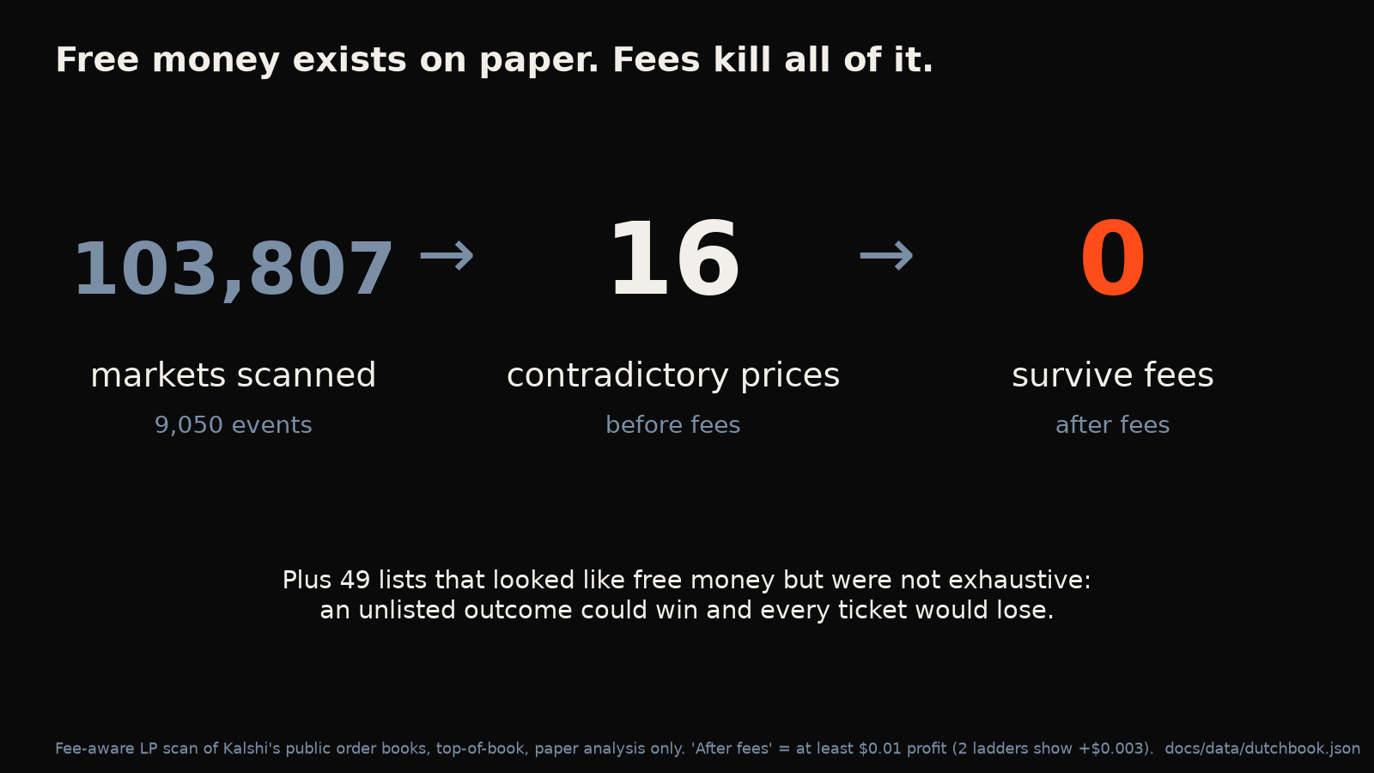
WHAT THE MARKET TAUGHT US
WE TRIED TO BREAK IT. THE MARKET HELD.
1,255
11
0
trading rules tested
passed the stats
survived our skeptics
Weather, injuries, spreads: already priced in
Dutch Book: ~100k markets, 16 arbs before fees, 0 after
The edge is speed
Notes:
We tried hard to find a flaw. The market digests plays in seconds; the only edge is speed, and that's what we sell.

Slide 8
BUSINESS
RETAIL IS THE WEDGE. DATA IS THE BUSINESS.
FREE
PRO
B2B
$0
~$15/mo
Info-flow API
Spoiler alerts + Spoiler Shield + Receipts
Auto-bet rules, "market already moved" warnings, all markets
Integrity monitoring. Princeton rankings moved ~6.8 h before the official release
Comps: Action Network PRO $24.99/mo · OddsJam $199+/mo
Works beyond NFL: trained on 4.36M settled Kalshi markets, beats the raw price on an unseen month by 2.7% (Brier)
Notes:
Retail is the wedge, B2B data is the business. Proof it scales past NFL: the cross-market model trained on 4.36M settled Kalshi markets beats the raw market price on an unseen month (2.7% better Brier). Comps: Action Network PRO $24.99/mo, OddsJam $199+/mo.

Slide 9
KALSHI KNOWS.
NOW YOU DO TOO.
Public data only. No real money.
kalshi-knows.pages.dev
Faisal Nabulsi · Kevin Huang · Dugar
Notes:
Kalshi knows. Now you do too.

Slide 10
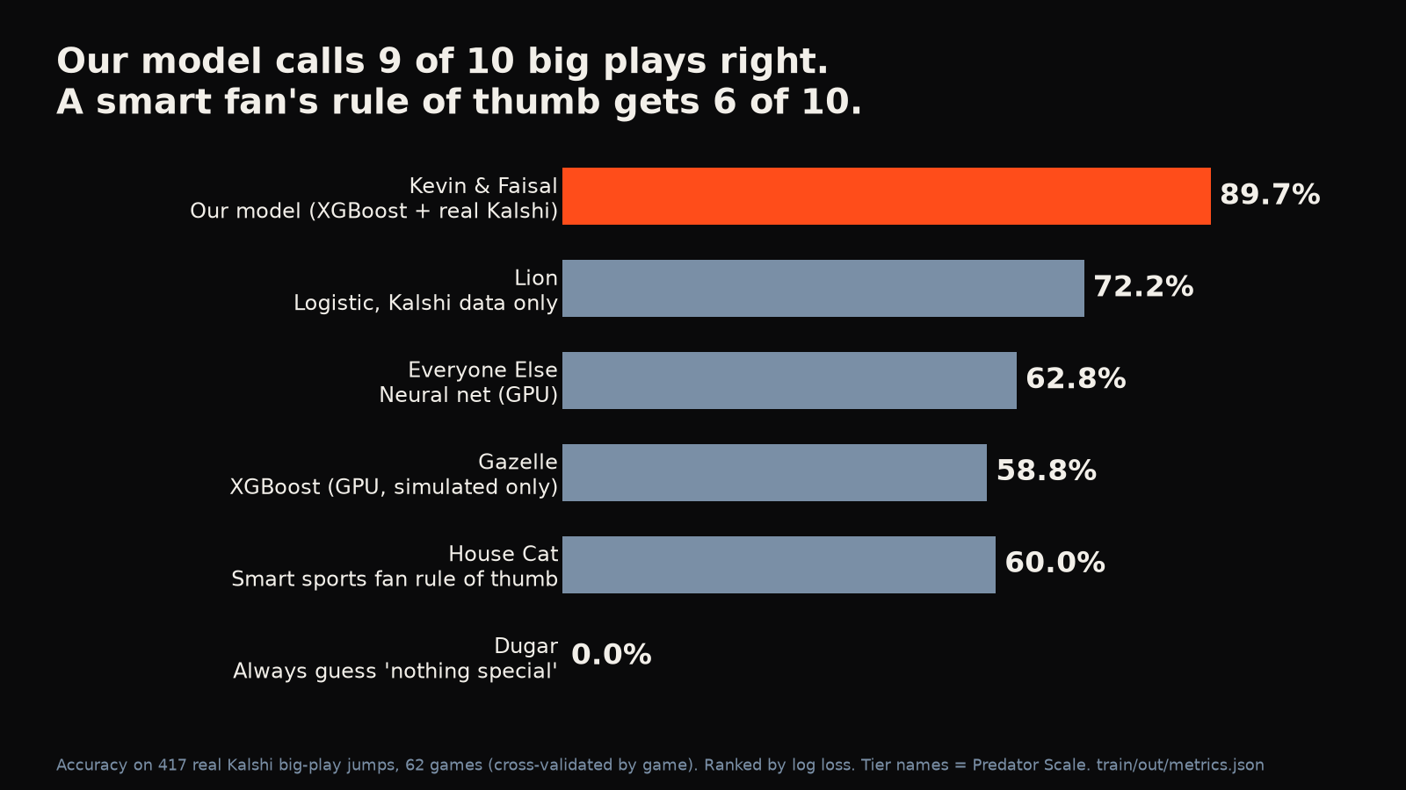
BACKUP
MODEL LEADERBOARD
Notes:
Backup: all model families compared on the same plays (STATS.md section 0). Smart fan 62.8%, XGBoost without pretraining 70.0%, audited-label model 73.8% CV and 75.0% temporal.

Slide 11
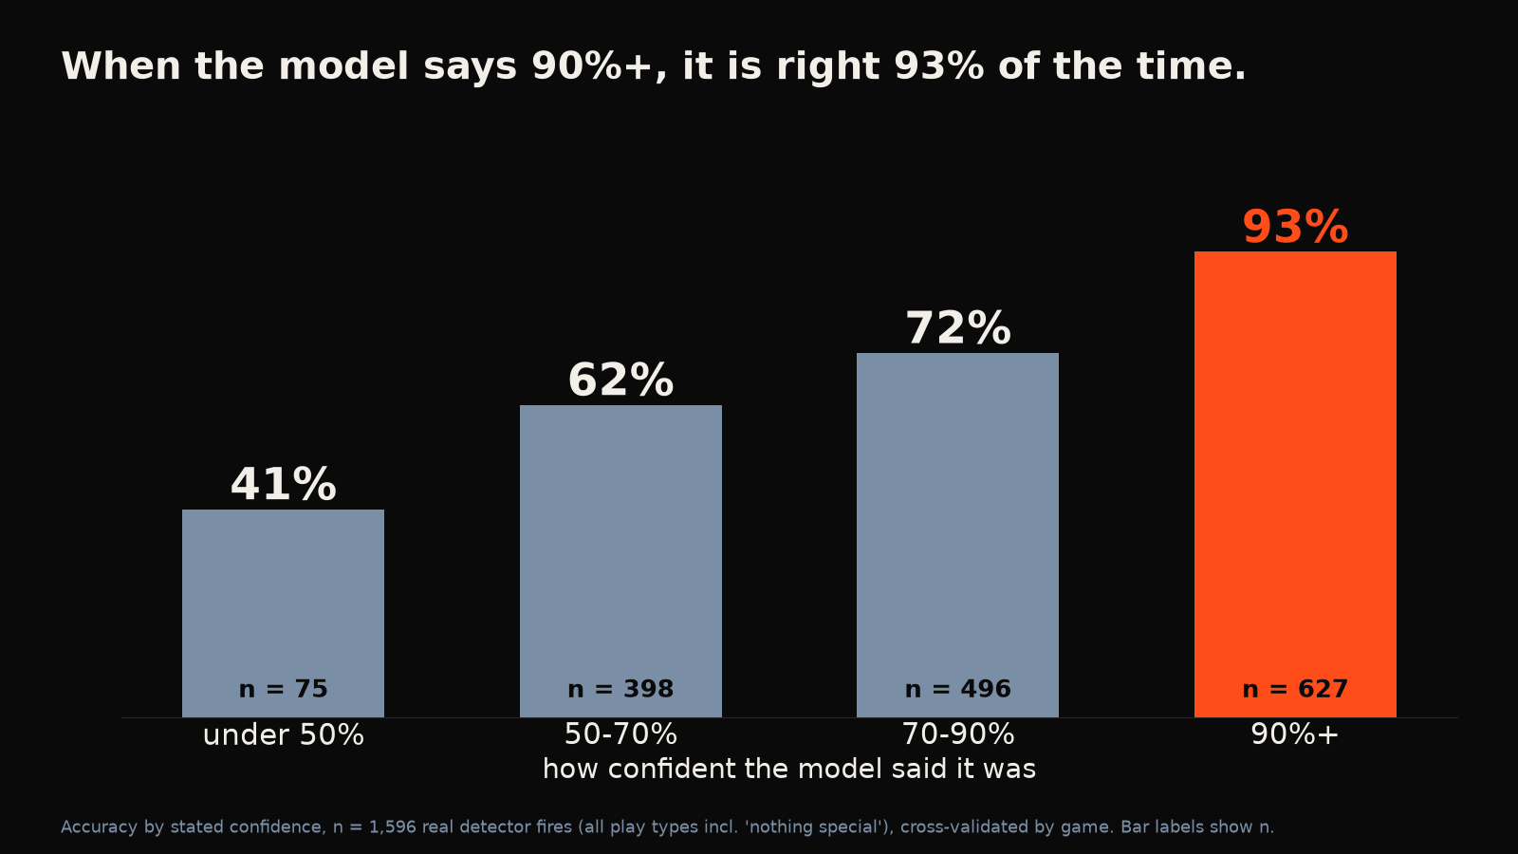
BACKUP
ACCURACY VS CONFIDENCE
Notes:
Backup: named calls at 75%+ confidence were right 76.6% (temporal, 94 calls) to 80.5% (CV, 466 calls) of the time.

Slide 12
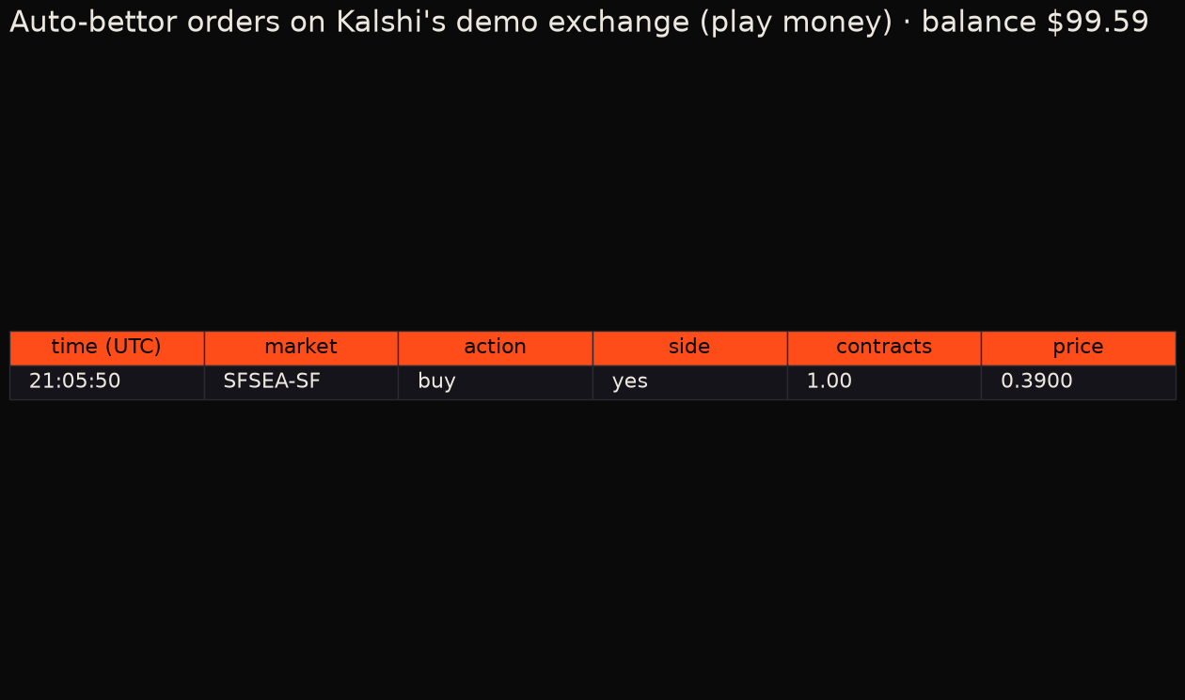
BACKUP
DEMO EXCHANGE LEDGER (PLAY MONEY)
Notes:
Backup: real signed order on Kalshi's demo exchange at 2:05pm, bought 1 YES '49ers win' at $0.39, fee $0.0167. Demo only, no real money. Refresh with results/export_demo.py.

