Slide 1


EVERY MARKET STARTS WITH ONE QUESTION
Who finds out
first?
A few seconds can change what everyone thinks will happen.
KALSHI KNOWS · FAISAL NABULSI · KEVIN HUANG · DUGAR · VSS HACKATHON 2026
Notes:
Start with a question, not a product description: "A game changes, a number moves, and most of us still haven't seen what happened. Who finds out first?" Pause.

Slide 2
KALSHI KNOWS / HOW IT WORKS
25 seasons of NFL plays. ~8,800 real Kalshi price jumps.
We paired game history with market moves, then checked the labels by hand
28
8,800
LIVE
NFL seasons
Kalshi price jumps
Event detector
Every available play, with score, clock, field position and result
Labeled the jumps, then went back through them to check the calls
Spots a jump and predicts the play behind it
Matched Claude Opus 5.5 on accuracy (77% vs 76%), better calibrated, answers in 7 ms
Tested on games the model never saw; labels hand-audited (15% errors found and fixed)
Notes:
Walk the audience through the actual sequence. The median market reaction of ~7 seconds comes from the team matched sample. Streaming times are outside reference observations and not measured in the same sample. An alert is not always a correctly identified play.

Slide 3
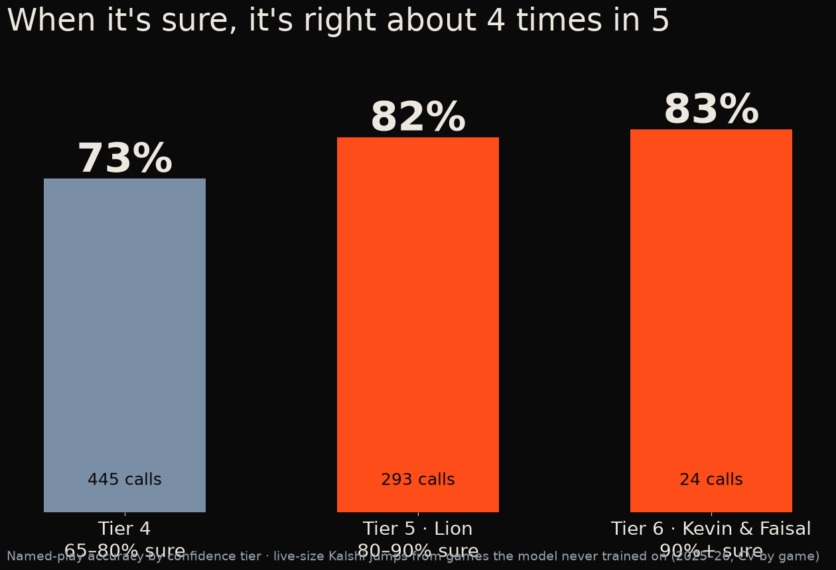
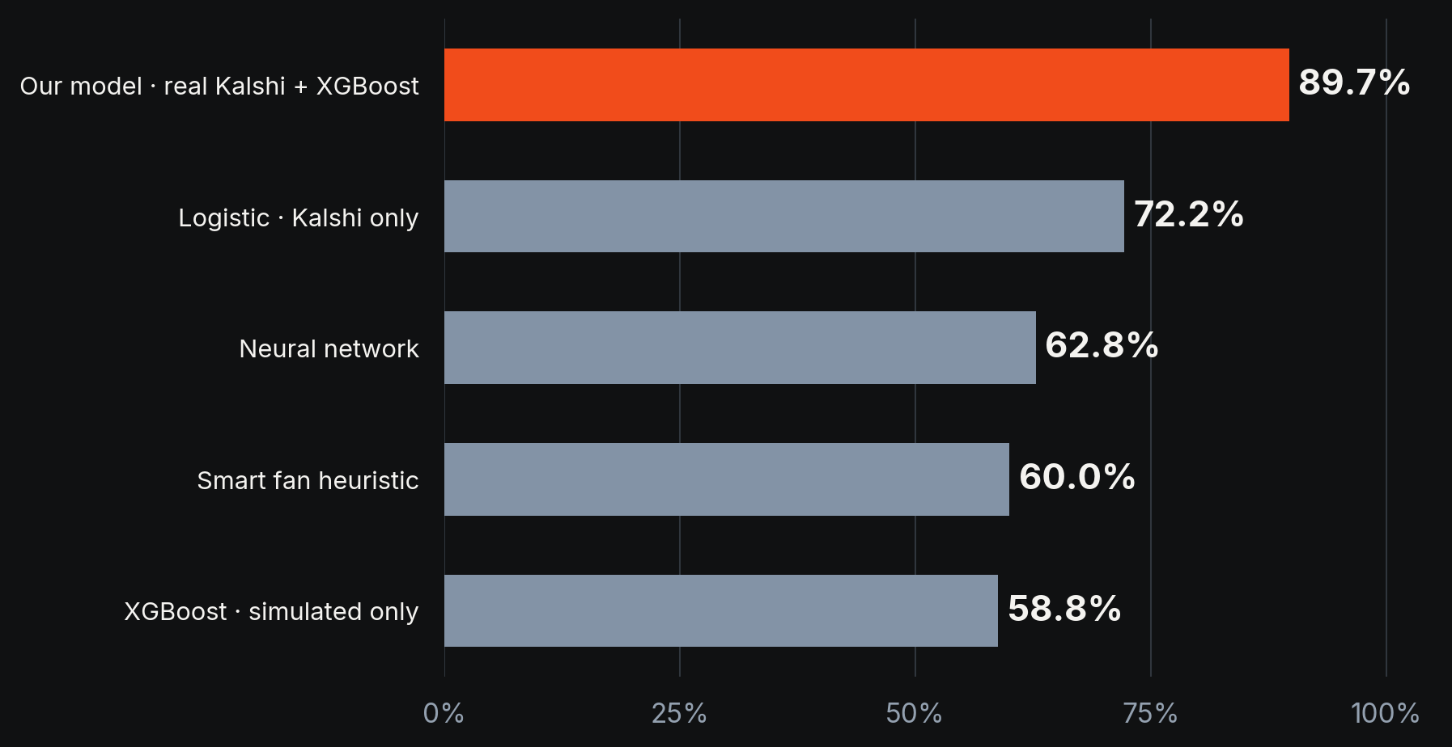
KALSHI KNOWS / EVIDENCE
When it names a play, it's right 87% of the time.
26 of 30 named calls right on unseen 2026 games, live conditions · turnovers 7 of 7
Unseen 2026 games, one-play-late live game state · when it's 80%+ sure: right ~4 in 5 across four tests
KALSHI KNOWS
QUESTION
PROTOTYPE
EVIDENCE
MARKET
EXPANSION
BUSINESS
NEXT
03
Notes:
When the model names a play, it's right 87% of the time: 26 of 30 on 2026 games it never saw, with the game state arriving a play late like it does live; turnovers 7 of 7. When it's at least 80% sure it's right about 4 in 5 across four tests. If asked: the 89.7% figure only holds if you already know a big play happened, so we don't lead with it.

Slide 4
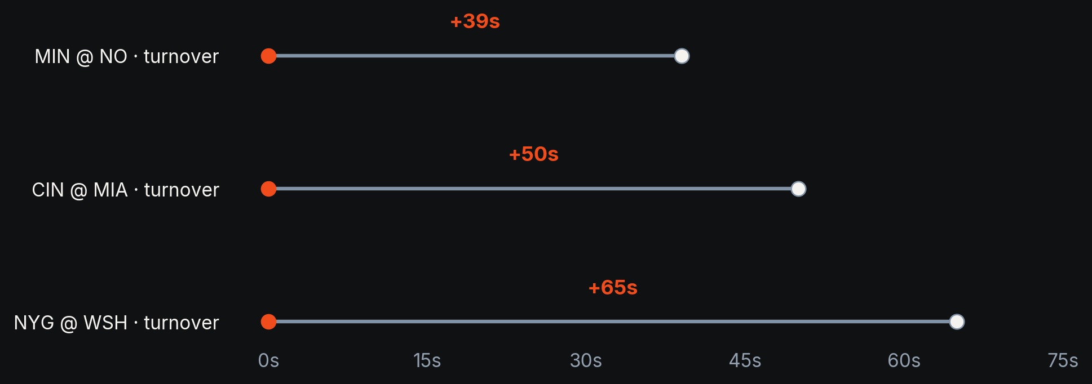
KALSHI KNOWS / EVIDENCE
Live alerts arrived 18–65 seconds before ESPN’s feed.
These timings compare our alerts with ESPN’s public play-by-play feed, not live TV
Live, Oct 11 2026 · real-time Kalshi stream: first buzz ~5 s after the market moves
KALSHI KNOWS
QUESTION
PROTOTYPE
EVIDENCE
MARKET
EXPANSION
BUSINESS
NEXT
04
Notes:
Show the three live alerts matched to ESPN play-by-play, leading by 39, 50 and 65 seconds. This is an ESPN public-feed comparison, NOT measured latency against a synchronized TV stream; it is a small sample of three.

Slide 5
KALSHI KNOWS / LIVE DEMO
The model makes a call. The bot sends a demo order.
We built the whole thing, from a live price jump to an order on Kalshi’s demo exchange
01
WATCH
Live Kalshi prices update
02
DETECT
The model flags a jump and predicts the play
03
ORDER
Our auto-bettor submits a play-money order through Kalshi’s API
04
CHECK
We show the alert, order log and what actually happened
Demo exchange only · No real-money execution or profitability claim
Notes:
Show the working website and notification. Explain: the system watches public Kalshi prices; a sudden move triggers a possible event; the notification gets sent; the play type is verified later when reliable data arrives. Do not claim instant perfect classification.

Slide 6
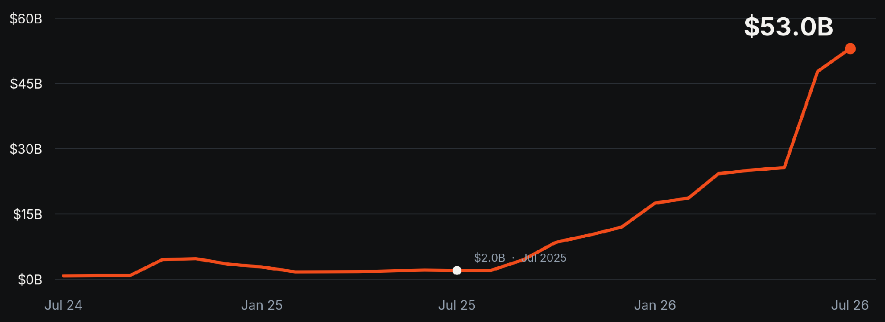
KALSHI KNOWS / MARKET
$53B traded in one month across Kalshi and Polymarket.
July 2026 volume was about 26 times the level a year earlier
Source: Pew Research Center / The Block, September 23 2026 · monthly global notional volume, NOT software TAM
KALSHI KNOWS
QUESTION
PROTOTYPE
EVIDENCE
MARKET
EXPANSION
BUSINESS
NEXT
06
Notes:
"This was a niche curiosity not that long ago. In July, Kalshi and Polymarket handled roughly $53 billion in contracts." Note this is trading volume, not platform revenue and certainly not the addressable software market.

Slide 7
KALSHI KNOWS / EXPANSION
The same approach could work far beyond football.
The signal is a price move. The hard part is finding reliable evidence for what caused it
CATEGORY
WHAT WE CHECK
WHAT USERS GET
WHO WOULD USE IT
SPORTS
Live play-by-play
Alerts before replays
Fans and viewers
ECONOMICS
Economic releases
CPI / rate change alerts
Analysts
POLITICS
Results and poll releases
Odds vs reported results
Journalists / researchers
LEGAL / POLICY
Court orders and new bills
Ruling and policy alerts
Legal / policy teams
WEATHER
Forecasts and weather data
Storm and temperature moves
Insurance / operations
Examples of prospective product categories; existence of tradeable contracts depends on exchange listings and law
KALSHI KNOWS
QUESTION
PROTOTYPE
EVIDENCE
MARKET
EXPANSION
BUSINESS
NEXT
07
Notes:
Point to examples, no claim that one model predicts everything. Economics: CPI and Fed announcements. Politics: certified results/poll releases (neutral monitoring). Law: docket releases or legislation, not claims of tradable court outcomes. Weather: published NWS data. Each case needs its own data and model.

Slide 8
KALSHI KNOWS / BUSINESS
Start with fans. Then build the tools analysts actually need.
Fans want to know what happened. Researchers want to know why prices moved.
01 SPORTS FANS
02 RESEARCHERS
03 MARKET TEAMS
Know before the replay
See why prices moved
Watch many markets
Live alerts, replays and a record of which calls were right
Search past price swings and compare them with the actual news
Flag unusual activity and pull market history through an API
Start with fan communities and watch parties
Test whether teams will pay for historical data
Talk to trading firms and exchanges before building this
Free alerts → Pro ~$15/mo (picks + auto-bet rules) → B2B data/API · Picks model: won 58% of 1,603 unseen bets, +12% after fees (break-even 52.4%, pros ~55%)
KALSHI KNOWS
QUESTION
PROTOTYPE
EVIDENCE
MARKET
EXPANSION
BUSINESS
NEXT
08
Notes:
"For fans it is a notification. For a researcher it is the ability to search what moved a market and what actually happened. Market teams may want aggregated monitoring." These are hypotheses, not signed customers, and the point is to learn if people will pay.

Slide 9
KALSHI KNOWS / NEXT
Next: every market, a decade of data, RL on profit.
Train on 4.36M+ settled markets (Kalshi + Polymarket) with reinforcement learning; today we were limited by compute and training time
NEXT / 2 WEEKS
AFTER THAT / 1–3 MONTHS
LONGER TERM / 3–6 MONTHS
Test on new games
Make the app useful
Try another category
Record every alert, check the timing and count false alarms
Better alerts and replays, then test with actual users
Start with economic or weather releases and compare market reactions
Proposed milestones; dates and KPIs are targets, not currently achieved
KALSHI KNOWS
QUESTION
PROTOTYPE
EVIDENCE
MARKET
EXPANSION
BUSINESS
NEXT
09
Notes:
This is the practical roadmap. Weeks: test on genuinely unseen games and publish the misses. Then build better replay and alert controls with users. Only after that start one new domain with reliable release timestamps.

