Slide 1
Forecasting Energy Consumption in a City Using Temporal Convolutional Networks for Medium-Term Load Prediction
Names---------------------------

Slide 2
Outline
• Problem Formulation
• Data Pre-processing
• ARIMA
• LSTM
• TCN

Slide 3
Smart Grids
Digital communication technologies
• Supply and demand-side managements
• Load-forecasting time series models
• Historical data for future power consumption prediction

Slide 4
Relevant Work
Source | Model(s)
Goswami et Al.l | ARIMA
Lekshmi et Al. | ARIMA
NA et Al. | ANNs
Dehalwar et Al. | ANN, Bagged Regression Trees
Lara-Benitez et Al. | Recurrent Networks (LSTM)

Slide 5
Temporal Convolutional Networks (TCNs)
1-Dimensional Convolutional Networks
● Electric vehicle charging
● Nationwide demand
● Lower computational and memory demand
● More accurate results

Slide 6
Classes of Load Forecasting
Type | Duration
Short-term Forecasting | 1 hour - 1 week
Medium-term Forecasting | 1 week - 1 year
Long-term Forecasting | 1 year +

Slide 7
Gaps in the Literature
● Rare work on medium-term forecasting
● Possible failure of ARIMA models
● Expensive weather data infrastructure

Slide 8
Problem Statement
● develop a multi-step temporal convolutional network forecasting model
● predict the electric power consumption in the next week based on historical data
● compare the model to ARIMA and LSTM models

Slide 9
Contributions
TCNs for medium-term forecasting
City load
Customized TCN architecture

Slide 10
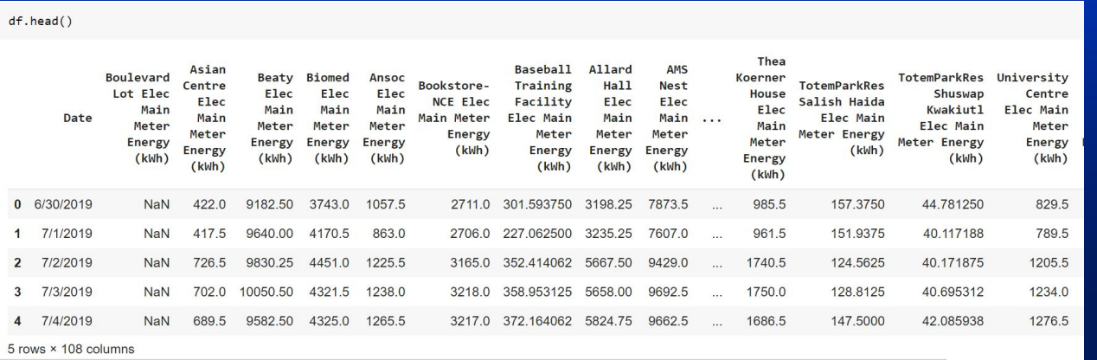
Dataset
● In this dataset, you will find a refactorised version of the data from the London data store, that contains the energy consumption readings for a sample of 5,567 London Households that took part in the UK Power Networks led Low Carbon London project between November 2011 and February 2014. The data from the smart meters seems associated only to the electrical consumption.

Slide 11
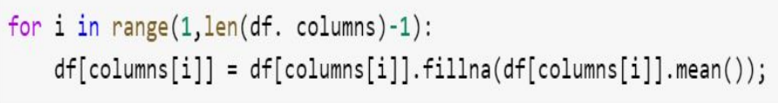

Data Preprocessing
1. Filling NaN values with their corresponding columns’ means
2. Getting the total energy consumption

Slide 12
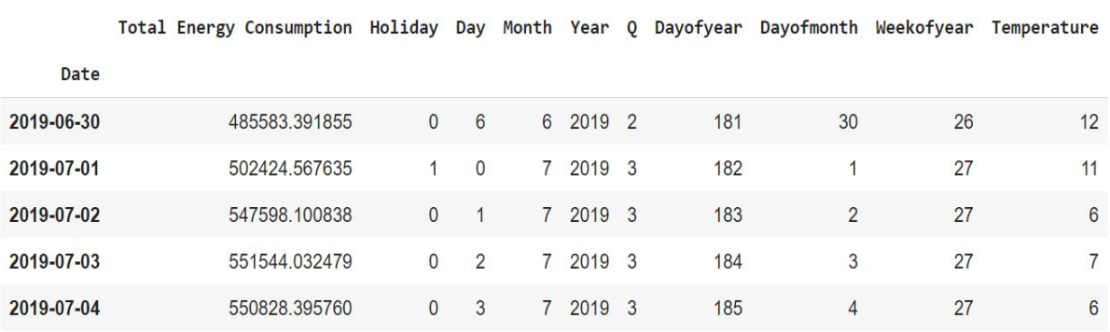
Generating some important features: Day, Month, Year, Day of the year, Month of the Year and Holiday

Slide 13
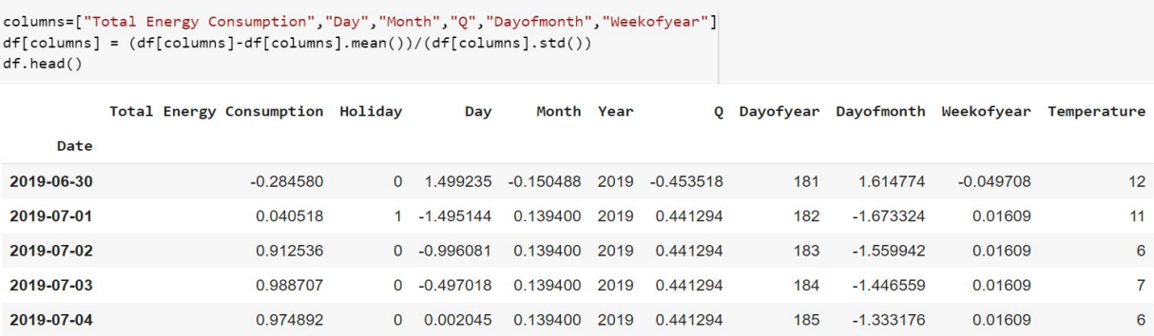
Normalizing the data using the mean and standard deviation

Slide 14
ARIMA Model
An Autoregressive Integrated Moving Average (ARIMA) model uses time series data to forecast future trends. Can be considered as:
Autoregression (AR):
Moving Average (MA):
ARIMA:

Slide 15
An ARIMA Model has 3 parameters:
ARIMA (p,d,q):
● p : lag order
● d : degree of differencing (lower the p-value)
● q : order of the moving averag
ARIMA
p.d.q
P,D,Q,m
Time Series
Forcasts
Only for seasonal ARIMA
Note: p-value can be evaluated using Augmented Dickey Fuller Test - decreases with increase of d

Slide 16
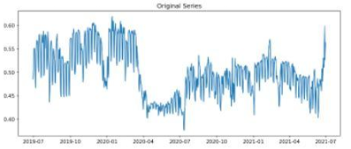
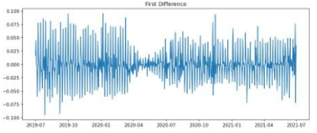
Results of differencing

Slide 17
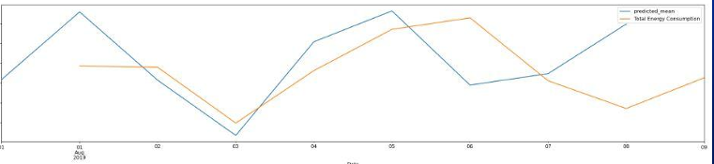
AUTO_ARIMA from PMDARIMA library
● Computes optimal values of parameters on its own by finding the minimum AIC (Akaike’s Information Criterion): AIC=−2log(L)+2(p+q+k+1); L is likelihood of data and k=

Slide 18
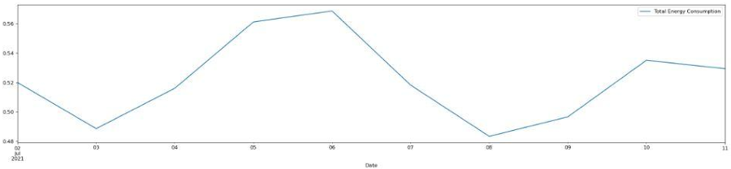
Predictions for the next 10 days using the ARIMA mode

Slide 19
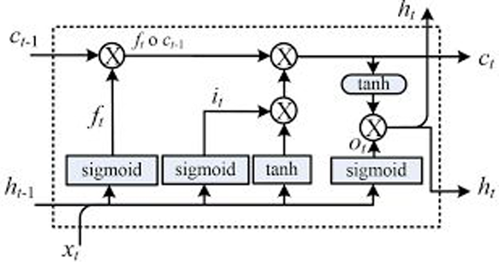
LSTM Model
Long short-term memory (LSTM) is one of the most used RNN architectures for time series predictions. Unlike standard feedforward architectures , LSTM has feedback connections that help identify the importance of new inputs and how much they would impact the next state.

Slide 20
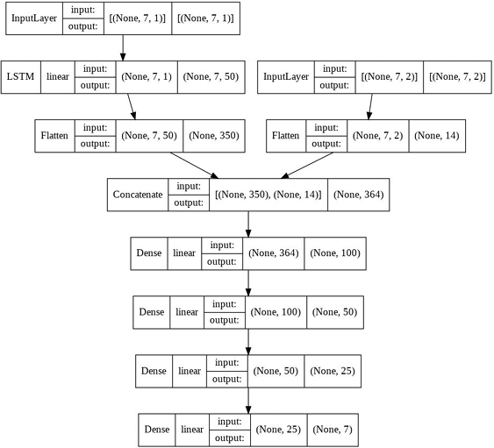
LSTM Model Adapted

Slide 21
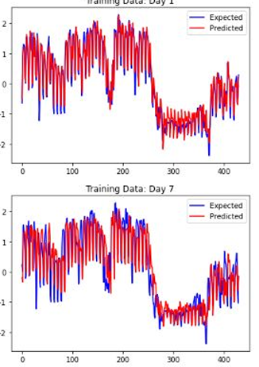
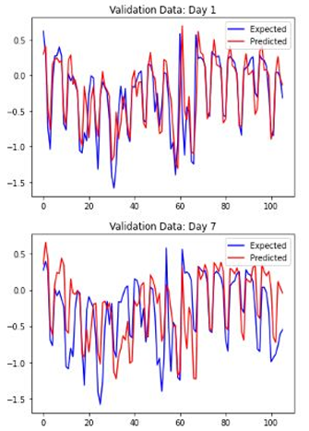
LSTM Model Results(Graphically)

Slide 22
LSTM Model Results(Numerically)
Correlation: 0.626
Mean Absolute Error: 17193.955
Mean Absolute Percentage Error: 0.036
Mean Error: 2310.123
Minmax Error: 0.0349
Mean Percentage Error: 0.006
Root Mean Squared Error: 22092.5

Slide 23
TCN Mode
Temporal Convolutional Network: 1 Dimensional CNN
A rather new alternative to RNN for Time Series Forecasting
Based on Causal Convolution and Dilation (explained next slide) Typical TCN models are multiple blocks of only Convolution layers: → Our model takes other features and combines them with the convolution in an ANN

Slide 24
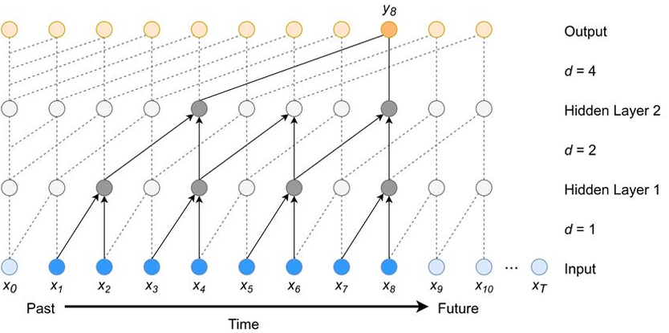
Convolution Block

Slide 25
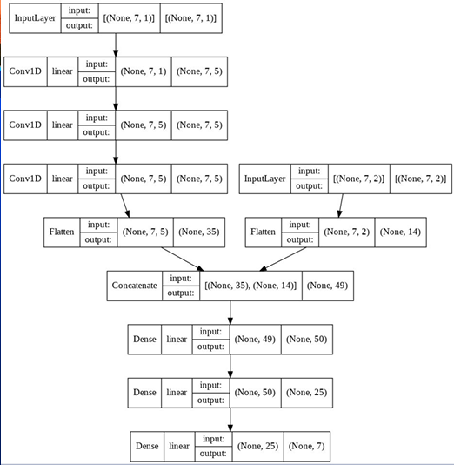
Our Proposed Architecture
Created as a Functional model
keras.models: Model
keras.layers: Concatenate
keras.utils.vis_utils: plot_model

Slide 26
What went wrong
We tested a model with only one convolution layer with no dilation → Gave very similar results!
By taking a closer look at the predictions we concluded that: Our model is a sophisticated way of copying the previous week!
Sudden changes if average from week to week confused the model

Slide 27
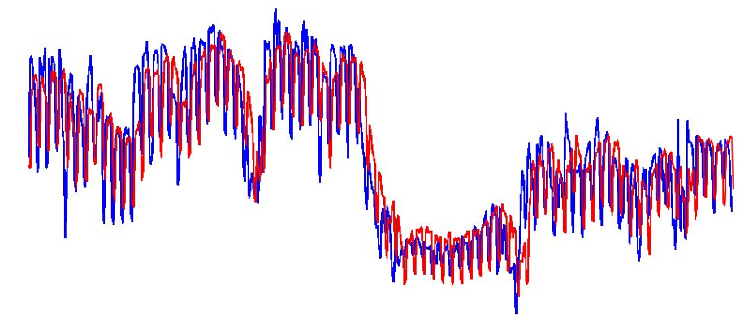
Predictions vs Target

Slide 28
We believe the problem is a missing feature
Proposed Solutions:
Inputting the Calendrical features of the predicted week not the previous
Including Temperature as another feature

Slide 29
TCN Model Results(Numerically)
Correlation: 0.6749
Mean Absolute Error: 17125.758
Mean Absolute Percentage Error: 0.0358
Mean Error: 4964.39
Minmax Error: 0.03447
Mean Percentage Error: 0.011
Root Mean Squared Error: 21684.1

Slide 30
Final Words
For the project final report:
Compare our 3 models with Weighted Absolute Percentage Error (Proposed in one of the referenced publications)
Improve our input data to deal with sharp week to week change

Slide 31

Thank you for your attention! We welcome any comment, suggestion, or question

