Slide 1
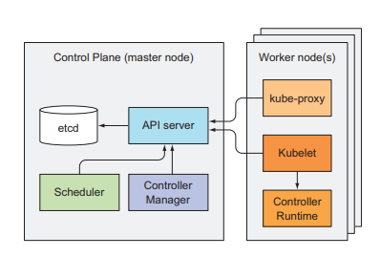
COMPONENTS OVERVIEW
The Cluster is split into two parts:
** The Kubernetes Control Plane.
** The (worker) nodes.
COMPONENTS OF THE CONTROL PLANE
The Control Plane is what controls and makes the whole cluster function. To refresh your memory, the components that make up the Control Plane are :
The ETCD distributed persistent datastore.
The API server.
The Scheduler.
The Controller Manager.
These components store and manage the state of the cluster.
COMPONENTS RUNNING ON THE WORKER NODES
The task of running your containers is up to the components running on each worker node:
The Kubelet.
The Kubernetes Service Proxy (kube-proxy).
The Container Runtime (Docker, rkt, or others).
ADD-ON COMPONENTS
The Kubernetes DNS server.
An Ingress controller.
The Container Network Interface network plugin.

Slide 2
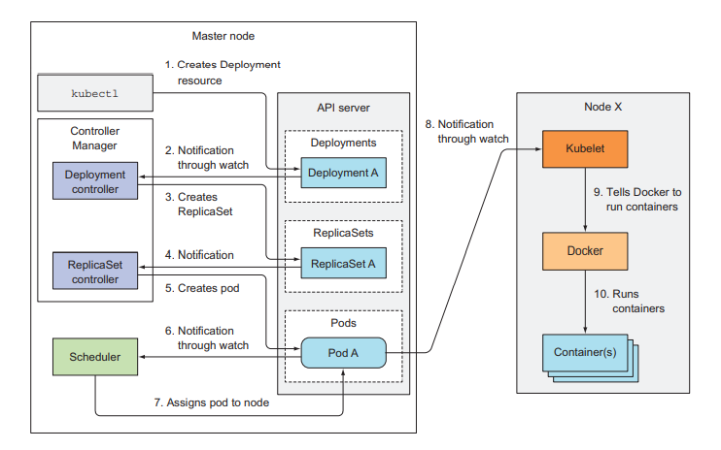
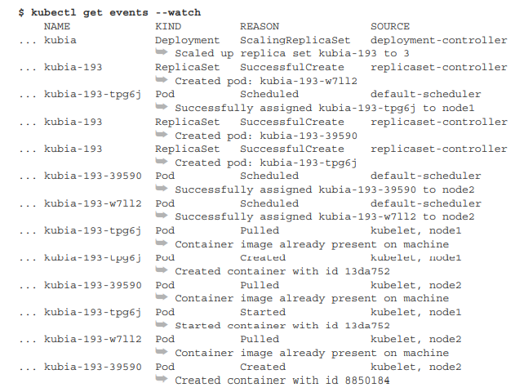
HOW IT WORKS
KUBECTL SENDS THE MANIFEST TO THE KUBERNETES API SERVER IN AN HTTP POST REQUEST.
THE API SERVER VALIDATES THE DEPLOYMENT SPECIFICATION, STORES IT IN ETCD, AND RETURNS A RESPONSE TO KUBECTL. THAT TRIGGERS THE CHAIN OF EVENTS AS MENTIONED BELOW:
THE DEPLOYMENT CONTROLLER THEN CREATES THE REPLICASET.
THE REPLICASET CONTROLLER CREATES THE POD RESOURCES.
THE SCHEDULER ASSIGNS A NODE TO THE NEWLY CREATED PODS.
THE KUBELET RUNS THE POD’S CONTAINERS.
THE KUBELET, WATCHING FOR CHANGES TO PODS ON THE API SERVER, SEES A NEW POD SCHEDULED TO ITS NODE.
IT INSPECTS THE POD DEFINITION AND INSTRUCTS DOCKER, OR WHATEVER CONTAINER RUNTIME IT’S USING, TO START THE POD’S CONTAINERS.
THE CONTAINER RUNTIME THEN RUNS THE CONTAINERS. BOTH THE CONTROL PLANE COMPONENTS AND THE KUBELET EMIT EVENTS TO THE API SERVER AS THEY PERFORM THESE ACTIONS.

Slide 3
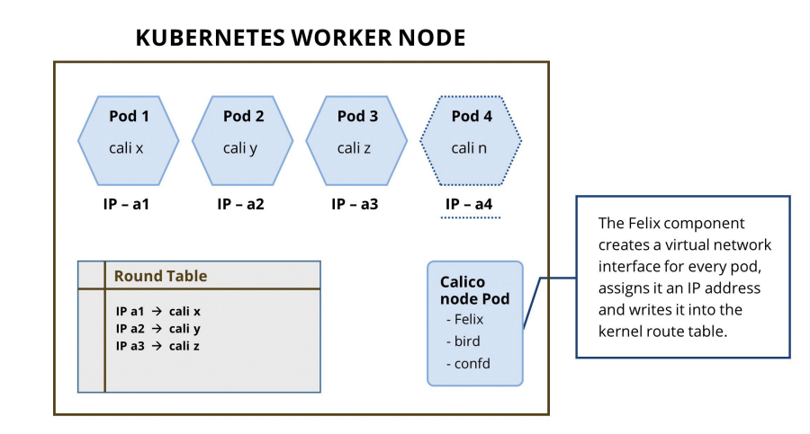
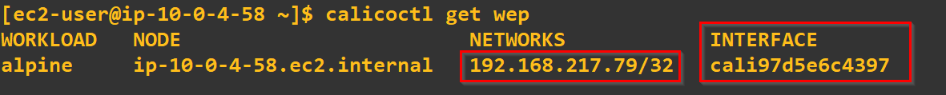
KUBERNETES & CALICO
CALICO CREATES AND MANAGES A LAYER 3 NETWORK THAT PROVIDES INTER-POD COMMUNICATION IN THE KUBERNETES CLUSTER. IT PROVIDES ROUTABLE IP ADDRESSES TO PODS THAT ENABLE EASIER INTEROPERABILITY.
CALICO USES THE FOLLOWING COMPONENTS TO ACHIEVE THIS.
CALICO/NODE: THE AGENT THAT RUNS AS PART OF THE CALICO DAEMONSET POD.
IT MANAGES INTERFACES, ROUTES, AND STATUS REPORTING OF THE NODE AND ENFORCES POLICIES.
BIRD: A BGP CLIENT THAT BROADCASTS ROUTES THAT ARE PROGRAMMED BY FELIX
ETCD: AN OPTIONAL DISTRIBUTED DATASTORE
CALICO CONTROLLER: THE CALICO POLICY CONTROLLER:
WHEN ONE OF THE NGINX PODS IS SCHEDULED ON THE KUBERNETES NODE, FELIX WILL CREATE A VIRTUAL INTERFACE WITH THE CALI PREFIX AND ASSIGNS IT A /32 IP ADDRESS.
THE BIRD BGP DAEMON REALIZES THAT THERE IS A NEW NETWORK INTERFACE THAT HAS COME UP AND IT ADVERTISES THAT TO THE OTHER PEERS.

Slide 4
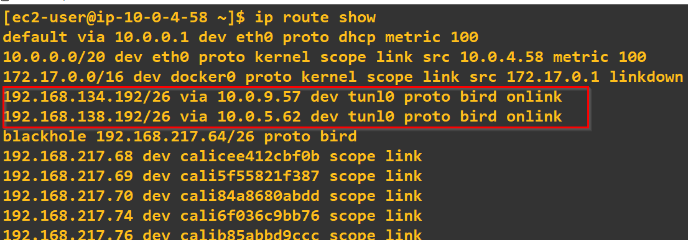
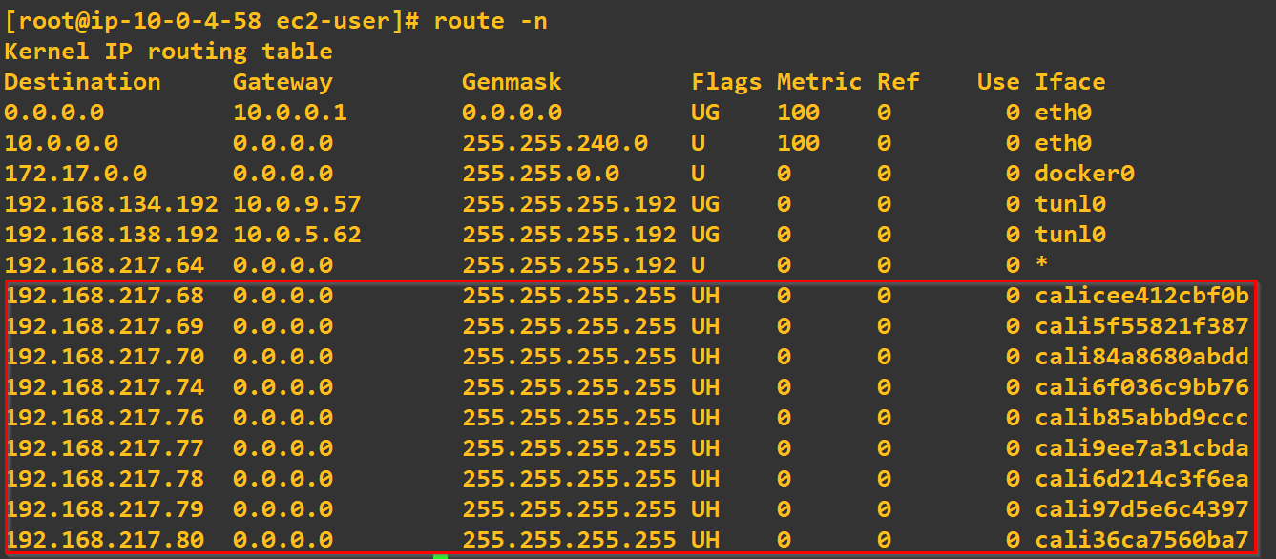
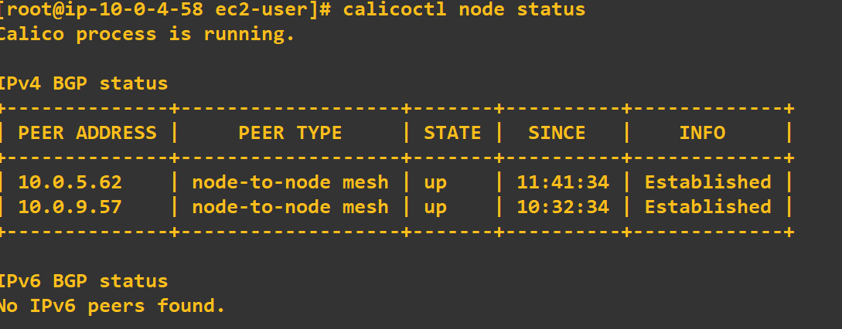
TESTING CALICO SET-UP
THE BIRD BGP DAEMON REALIZES THAT THERE IS A NEW NETWORK INTERFACE THAT HAS COME UP AND IT ADVERTISES THAT TO THE OTHER PEERS.
CALICOCTL NODE STATUS.
ROUTE TABLE WILL SHOW THE CALICO INTERFACE ON THE NODE RUNNING THE PODS WILL.

Slide 5
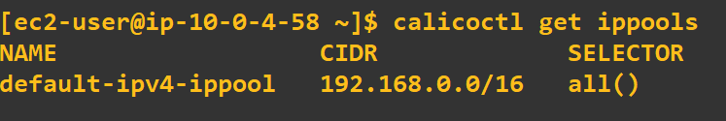
TESTING CALICO SET-UP
THE CALICO IP ADDRESS MANAGEMENT (IPAM) IS RESPONSIBLE FOR IP ADDRESS MANAGEMENT FOR PODS ON EACH NODE OF THE KUBERNETES CLUSTER.
MANAGES IPPOOLS FOR ASSIGNING IP ADDRESSES.
CALICO DOES DYNAMIC ADDRESS MANAGEMENT BY ALLOCATING A /26 ADDRESS BLOCK TO EACH NODE WHEN THE CALICO NODE RUNS SUCCESSFULLY.

Slide 6
IMPLEMENTING SECURITY WITH CALICO
DECLARING NETWORK POLICY AND GLOBAL NETWORK POLICY, CALICO RESOURCES PROVIDE THE FLEXIBILITY TO DEFINE ACCESS RULES FOR AN INDIVIDUAL ENDPOINT OR TO A GROUP OF ENDPOINTS EITHER IN A NAMESPACE OR ACROSS NAMESPACES.
CALICO ENFORCES THESE POLICY RULES AS DEFINED IN THE ABOVE RESOURCES BY TRANSLATING THEM INTO IPTABLE AND IPSET RULES.
THE FELIX AGENT THAT RUNS AS PART OF THE CALICO DAEMONSET ON KUBERNETES READS THE DECLARED NETWORK POLICIES AND TRANSLATES THEM INTO IPTABLE RULES AND IPSETS ON THE HOST WHERE THE POD RUNS.
CALICO POLICIES ARE APPLIED ON WORKLOAD ENDPOINTS. WORKLOAD ENDPOINTS ALREADY HOLD INFORMATION ABOUT THE CALICO INTERFACE, THE POD USING THAT INTERFACE, AND THE NODE ON WHICH THE POD IS SCHEDULED. THIS ENABLES CALICO TO PROVIDE SECURITY AND ISOLATION USING THE NATIVE KERNEL IPTABLE RULES. NO CUSTOM MODULES ARE REQUIRED TO ACHIEVE THIS.
CALICO RUNS A CALICO-KUBE-CONTROLLER POD AS PART OF INSTALLATION. THE CONTROLLER POD HAS SEVERAL CONTROLLER LOOPS, INCLUDING A POLICY CONTROLLER. THE POLICY CONTROLLER WATCHES OVER NETWORK POLICIES AND PROGRAMS CALICO POLICY OBJECTS. REMOVAL OR CHANGES TO THE NETWORK POLICIES ARE REFLECTED BY THE CONTROLLER LOOP WHICH ENSURES THE POLICY CHANGES ARE APPLIED TO WORKLOADS IN REAL TIME.
CALICO ALLOWS ENABLING HOST PROTECTION ON THE INTERFACES OF YOUR VMS WHERE THE KKUBERNETES WORKLOADS RUN WITH POLICY MANAGEMENT FOR THE INGRESS AND EGRESS TRAFFIC.
ROLE-BASED ACCESS CONTROLS ARE ENFORCED ON THE WORKLOADS THAT RUN ON THE CLUSTER.
CALICO NETWORK NETWORK POLICY POLICY ENFORCEMENT PROVIDES AN ABSTRACTION ABOVE IP ADDRESSES OF WORKLOADS THUS PROVIDING DYNAMIC POLICY MANAGEMENT.

Slide 7
EXPOSING THE APPLICATION
SERVICE IS ASSIGNED A VIRTUAL IP ADDRESS, ALSO KNOWN AS THE CLUSTERIP THAT CAN BE USED TO COMMUNICATE TO THE PODS. SERVICES PROVIDE LOAD BALANCING AND ACCESS TO THE UNDERLYING PODS, AND USE AN OBJECT CALLED ENDPOINTS TO TRACK CHANGES IN IP ADDRESSES OF THE PODS. THE ENDPOINTS OBJECT IS UPDATED WHENEVER THE IP ADDRESS OF A POD CHANGES. SERVICES PROVIDE FOUR WAYS TO ACCESS PODS:
1. CLUSTERIP: ALLOWS THE SERVICE TO BE ACCESSIBLE ONLY FROM WITHIN THE CLUSTER. THE SERVICE IS EXPOSED ON THE CLUSTER-IP ADDRESS.
2. NODEPORT: SELECTS A PORT FROM THE RANGE 30000-32767 AND WILL PROXY THIS PORT ON EACH NODE AND UPDATE THE SERVICE ENDPOINT. THE NODEPORT SERVICE IS ACCESSIBLE BY ADDRESSING IT VIA THE NODEIP AND THE NODEPORT.
3. LOADBALANCER: A LOAD BALANCER TYPE ALLOWS THE USE OF AN EXTERNAL LOAD BALANCER TO ROUTE TRAFFIC TO THE PODS. THIS IS TYPICALLY USED WITH PUBLIC CLOUD PLATFORMS.
4. EXTERNALNAME: A SERVICE THAT SPECIFIES AN EXTERNALNAME DEFINES AN ALIAS TO AN EXTERNAL SERVICE OUTSIDE THE CLUSTER. WHEN THE SERVICE IS LOOKED UP, THE CNAME OF THE EXTERNAL SERVICE IS RETURNED. THIS TYPE OF SERVICE DOES NOT HAVE AN ENDPOINTS OBJECT DEFINED.

Slide 8
THANKS AND QUESTIONS

