Slide 1

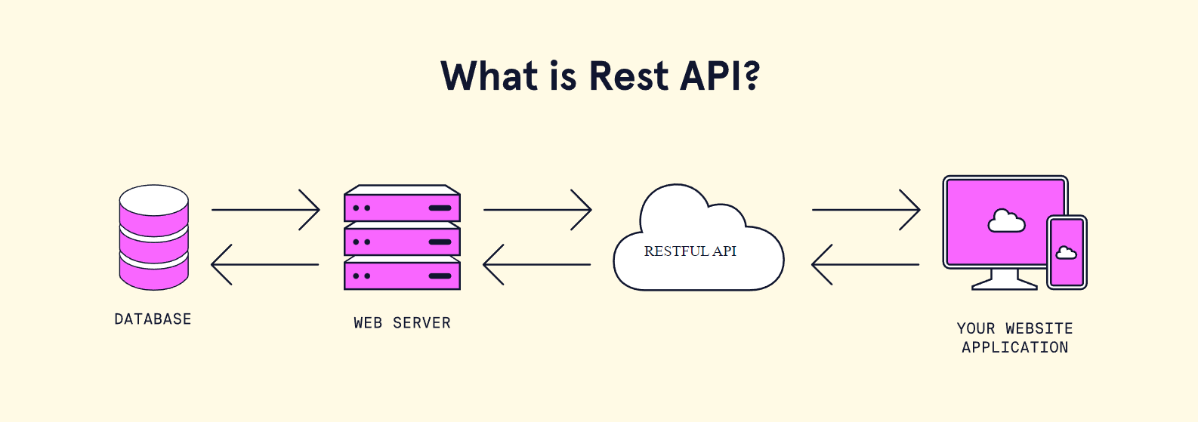
Rest API Best Practices
REST API DEVELOPMENT
Best practices of json
Request response model
Rest API working flow
Rest API auth & security

Slide 2
Http methods Best Practices
REST API DEVELOPMENT
When you're designing a REST API, you should not use verbs in the endpoint paths.
The endpoints should use nouns, signifying what each of them does.
This is because HTTP methods such as GET, POST, PUT, PATCH, and DELETE are already in verb form for performing basic CRUD (Create, Read, Update, Delete) operations.
GET, POST, PUT, PATCH, and DELETE are the commonest HTTP verbs. There are also others such as COPY, PURGE, LINK, UNLINK, and so on.
So, for example, an endpoint should not look like this:
https://mysite.com/getPosts or https://mysite.com/createPost
Instead, it should be something like this: https://mysite.com/posts
In short, you should let the HTTP verbs handle what the endpoints do. So GET would retrieve data, POST will create data, PUT will update data, and DELETE will get rid of the data.

Slide 3
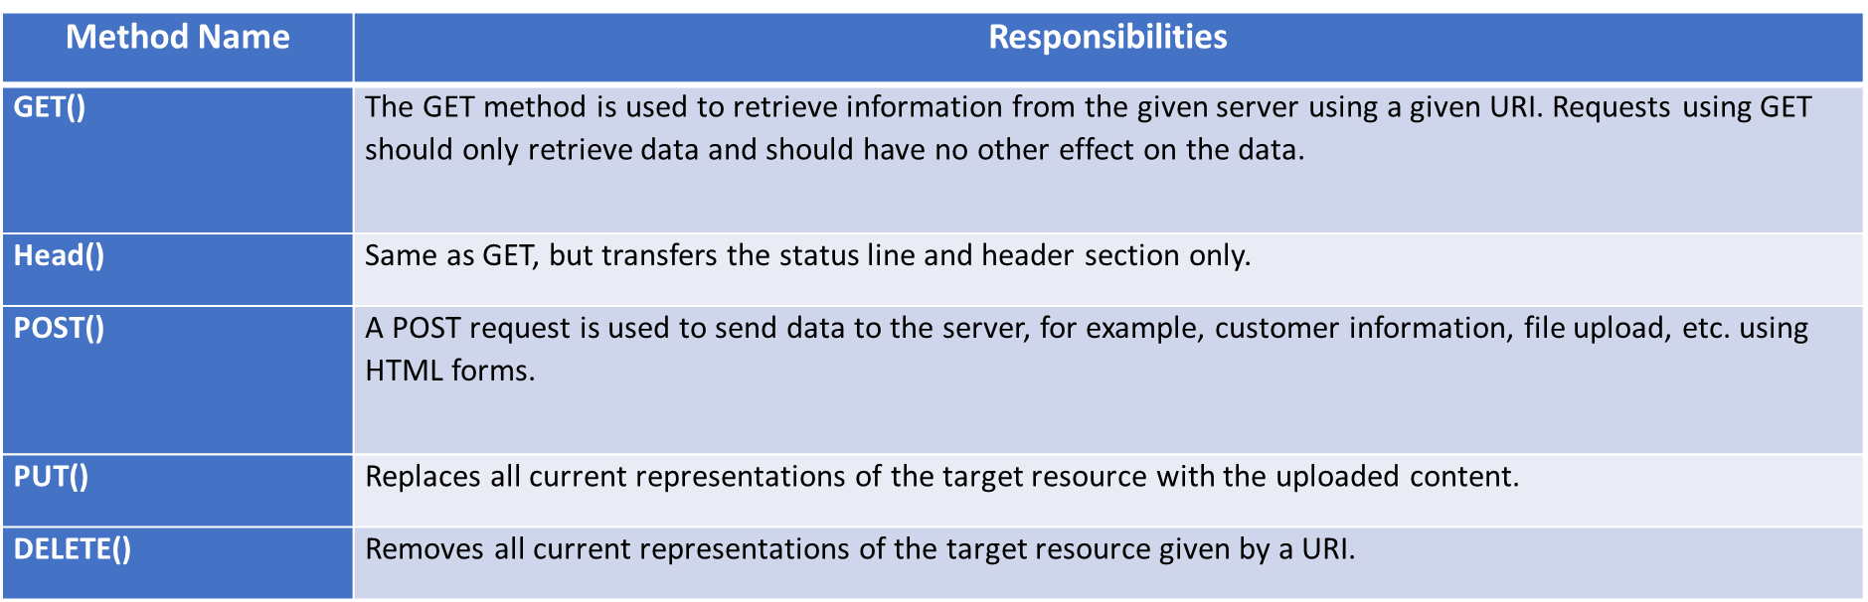
Http methods Best Practices
REST API DEVELOPMENT
HTTP Request Methods:

Slide 4
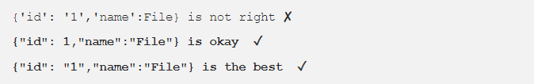
JSON Best Practices
REST API DEVELOPMENT
Enclose within DOUBLE Quotes
Always enclose the Key : Value pair within double quotes. It may be convenient (not sure how) to generate with Single quotes, but JSON parser don’t like to parse JSON objects with single quotes.
For numerical Values, quotes are optional but is a good practice to enclose them in double quote.

Slide 5
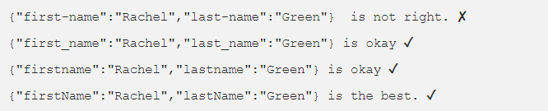
JSON Best Practices
REST API DEVELOPMENT
No Hyphens please
Never Never Never use Hyphens in your Key fields. It breaks python, scala parser and developers have to escape it to use those fields.
Instead of Hyphens use underscores (_). But using alllower case or camel Case is the best. See samples below.

Slide 6
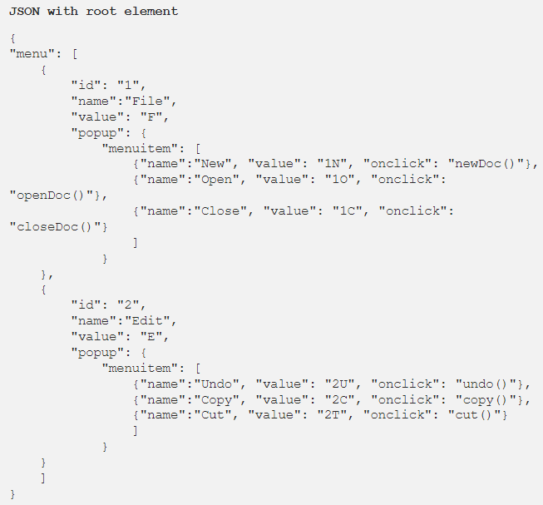
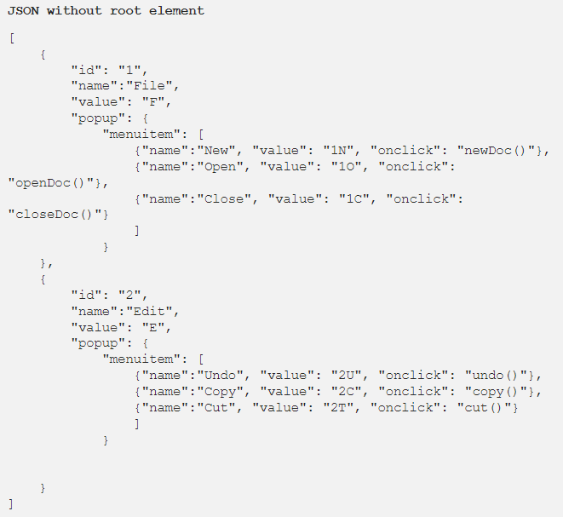
JSON Best Practices
REST API DEVELOPMENT
Always create a Root element.
Creation of Root element is optional, but it helps when you are generating complicated JSON.

Slide 7
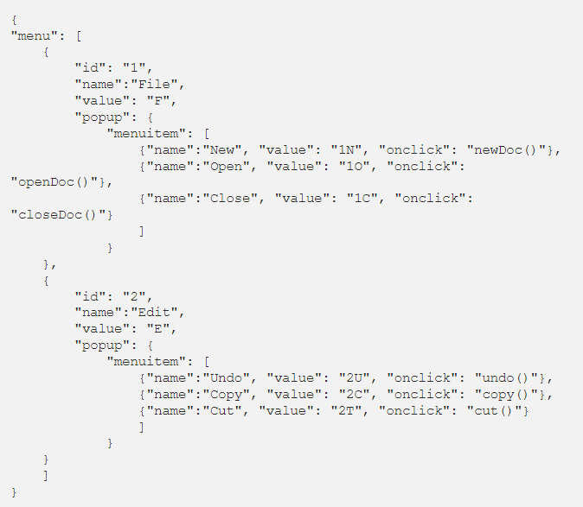
JSON Best Practices
REST API DEVELOPMENT
Provide META sample
The idea of JSON is flexibility so you don’t have to restrict your data feed within few columns.
But at the same time, if you are providing large data set with nested levels, the consumer will go crazy. Provide them with the meta / sample, so it helps them to understand what data to look for and what to skip.

Slide 8
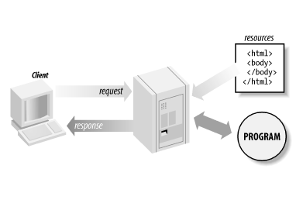
Request - Response Best Practices
REST API DEVELOPMENT
HTTP Client:.
Browser Level Client
Application Level Client

Slide 9

Request - Response Best Practices
REST API DEVELOPMENT
Browser Level Client
Browser is the primary HTTP Client responsible for load the web application.

Slide 10
Request - Response Best Practices
REST API DEVELOPMENT
Application Level Client :
HTTP Client is an application library used in client side application to generate request and receive response.
HTTP Client’s libraries varies from platform to platform
HTTP Client Library | Platform | Language
Axios | Mobile/Web/Desktop | JavaScript

Slide 11
Request - Response Best Practices
REST API DEVELOPMENT
There are a few common codes that developers should start with. They are:
200 — OK
404 — Not found
500 — Internal Server Error
Then you can build upon them if there is a need for a more detailed set of statuses, such as:
201 — Created
204 — No Content
304 — Modified
400 — Bad Request
401 — Unauthorized
403 — Forbidden
501 — Not Implemented

Slide 12
Web Security Practices
REST API DEVELOPMENT
Client Application
API END POINT
Request
API Key Verification
User Agent Verification
CSRF Protection
Response
Rate Limiting
Security Layer
HTTP Secure Headers
Parameter Pollution
Payload Validation
Controller
Data Sanitization
Response Validation
Authentication/Authorization

Slide 13
Web Security Practices
REST API DEVELOPMENT
Output Validation
Output Header:
Provide proper http response status code.
Provide proper content type, file type if any.
Provide cache status if any.
Authentication token should provide via response header.
Only string data is allowed for response header.
Provide content length if any.
Provide response date and time.
Follow request-response model described before.
Output Body:
Avoid providing response status, code, message via response body
Use JSON best practices for JSON response body.
For single result, can use String, Boolean directly.
Provide proper JSON encode-decode before writing JSON Body.
Follow discussion on JSON described before.

Slide 14
Web Security Practices
REST API DEVELOPMENT
Request Rate limit- Throttling
We need to make sure our APIs are running as efficiently as possible. Otherwise, everyone using your database
will suffer from slow performance. Performance isn’t the only reason to limit API requests, either. API limiting, which also known
as rate is limiting, is an essential component of Internet security, as DoS attacks can tank a server with unlimited API requests.
Rate limiting also helps make your API scalable. If your API blows up in popularity, there can be unexpected spikes in traffic,
causing severe lag time.
CSRF/XSRF Protection
Cross-site request forgery attacks (CSRF or XSRF for short) are used to send malicious requests from an authenticated user to a web application.
Use request-response header to pass CSRF token
CSRF token should be unique for every session
For self API CSRF token works well.

Slide 15
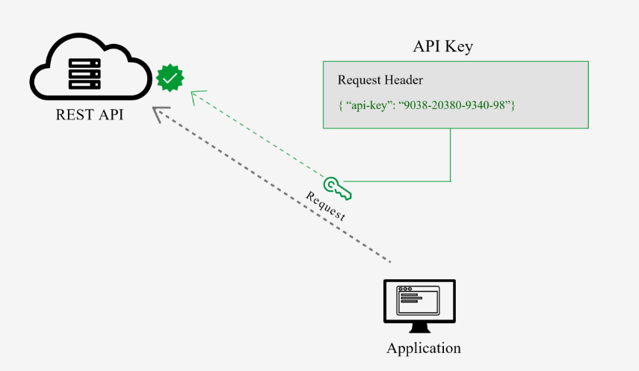
Web Security Practices
REST API DEVELOPMENT
API Key
This is the most straightforward method and the easiest way for auth
With this method, the sender places a username:password/ ID / Keys into the request header.
The credentials are encoded and decode to ensure safe transmission.
This method does not require cookies, session IDs, login pages, and other such specialty solutions

