Slide 1
What is HTML?
Hyper Text Markup Language
Markup language for creating Web pages
Describes the structure of a Web page

Slide 2
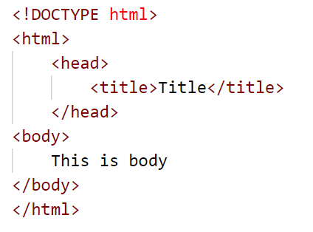
Create Simple HTML Document

Slide 3
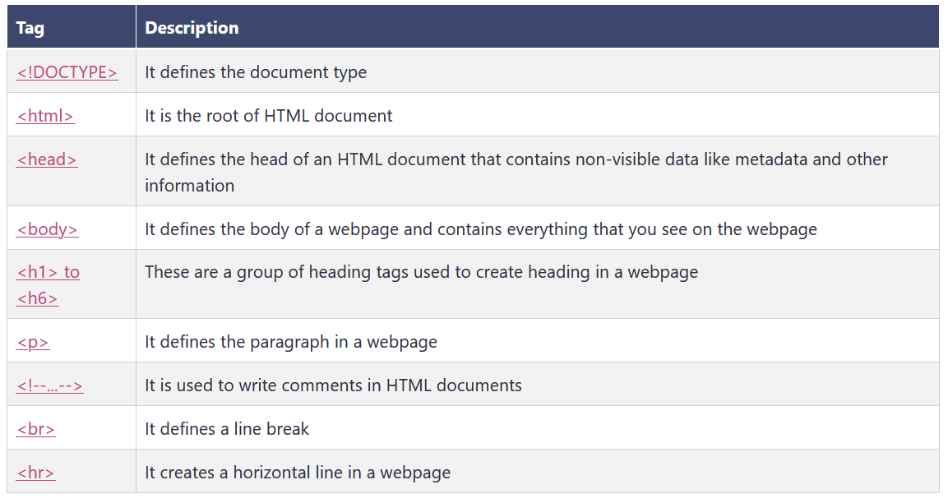
Basic HTML Tags List

Slide 4
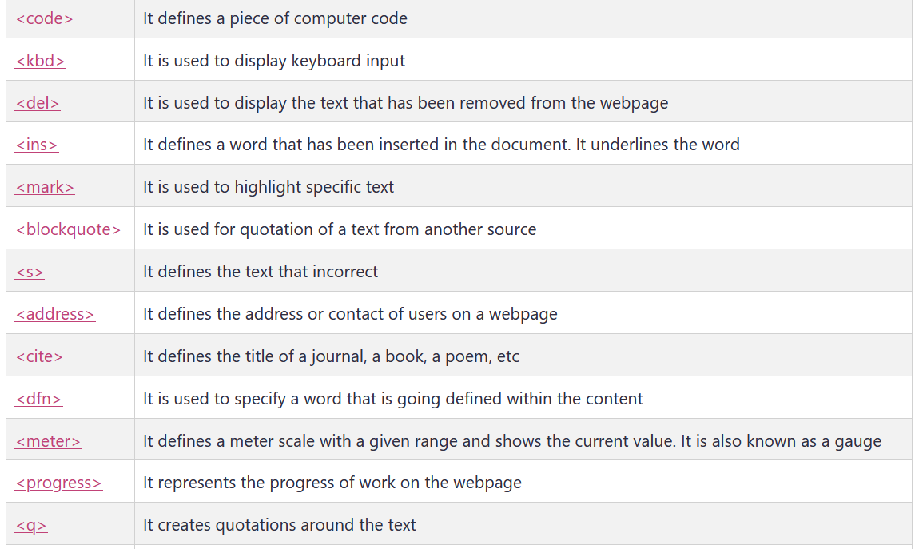
Formatting tags

Slide 5
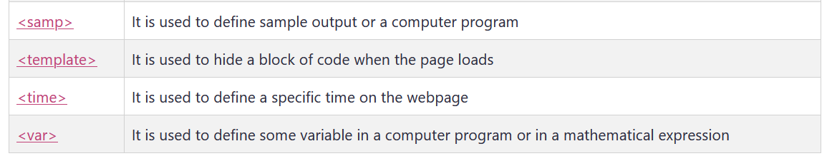
Formatting tags

Slide 6
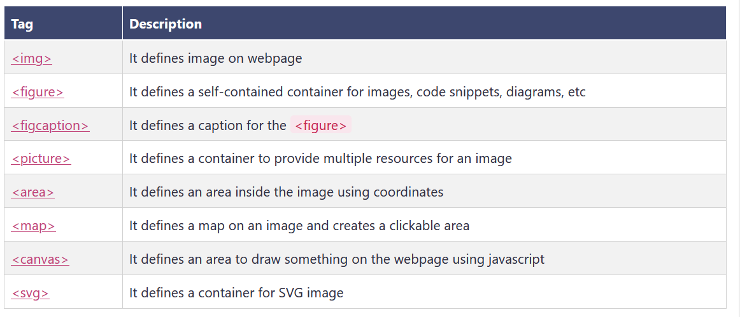
Image tags

Slide 7
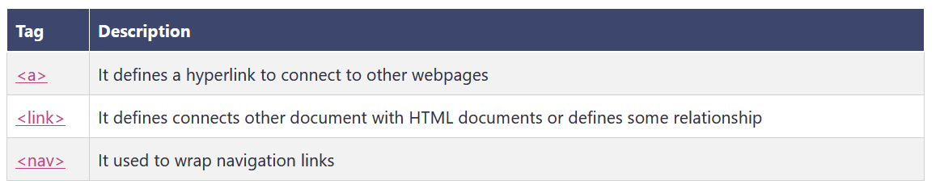
Link or navigation tags

Slide 8
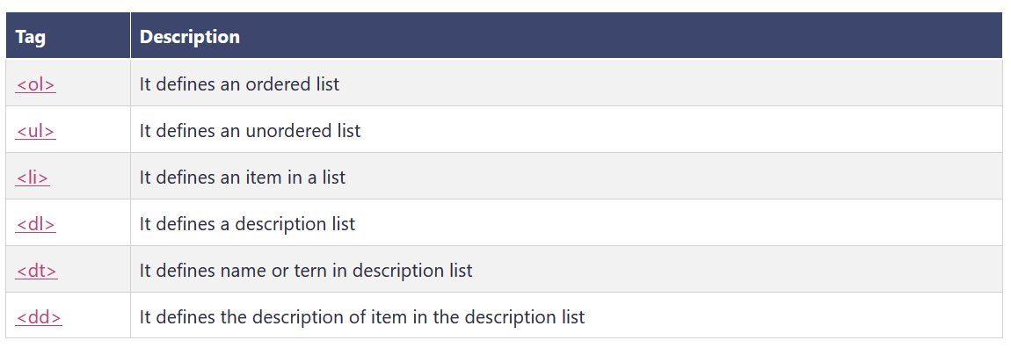
List tags

Slide 9
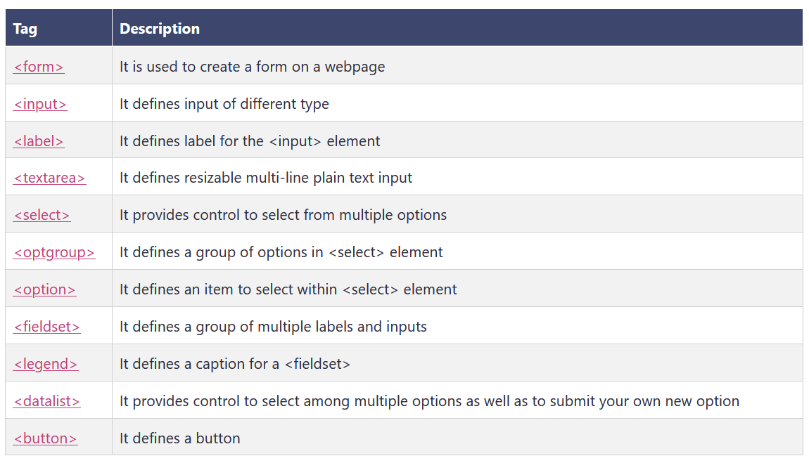
Form and input tags

Slide 10
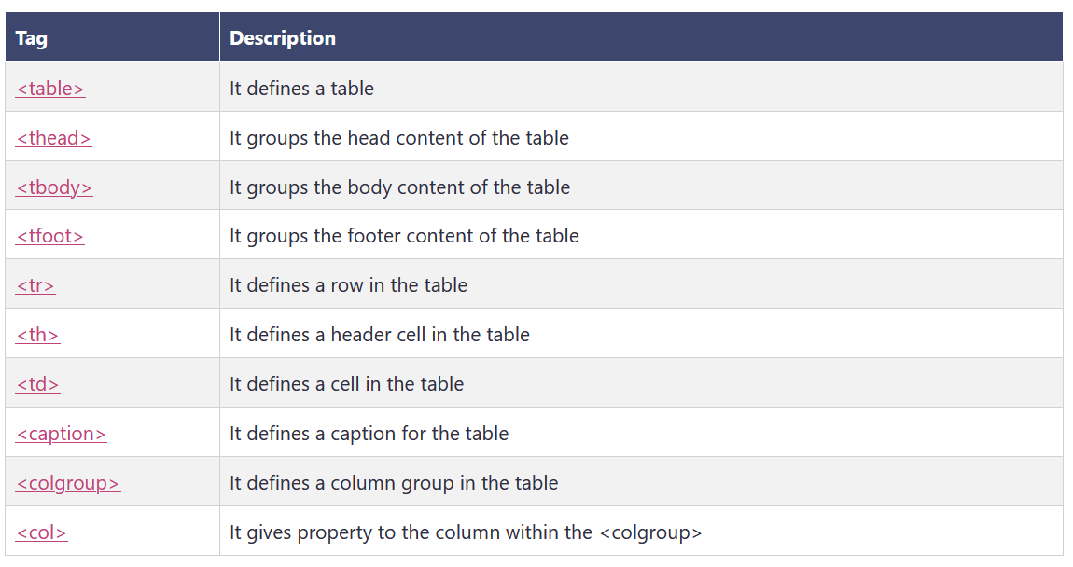
Table tags

Slide 11
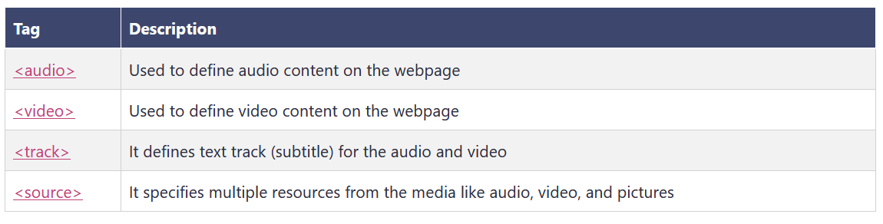
Media tags

Slide 12
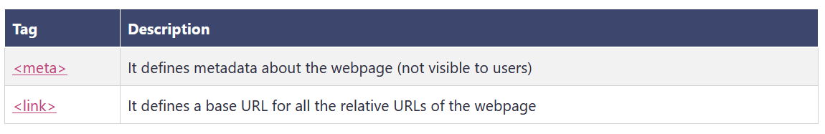
Meta tags

Slide 13
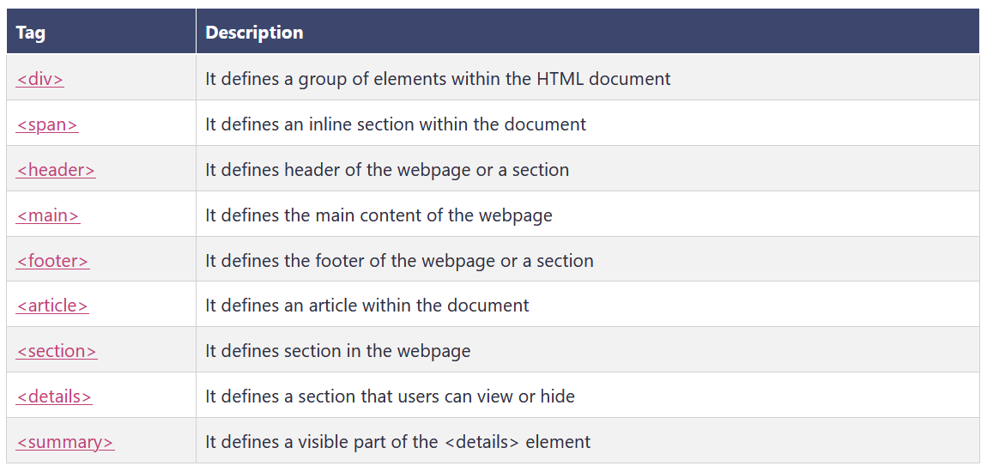
General tags

