Slide 1

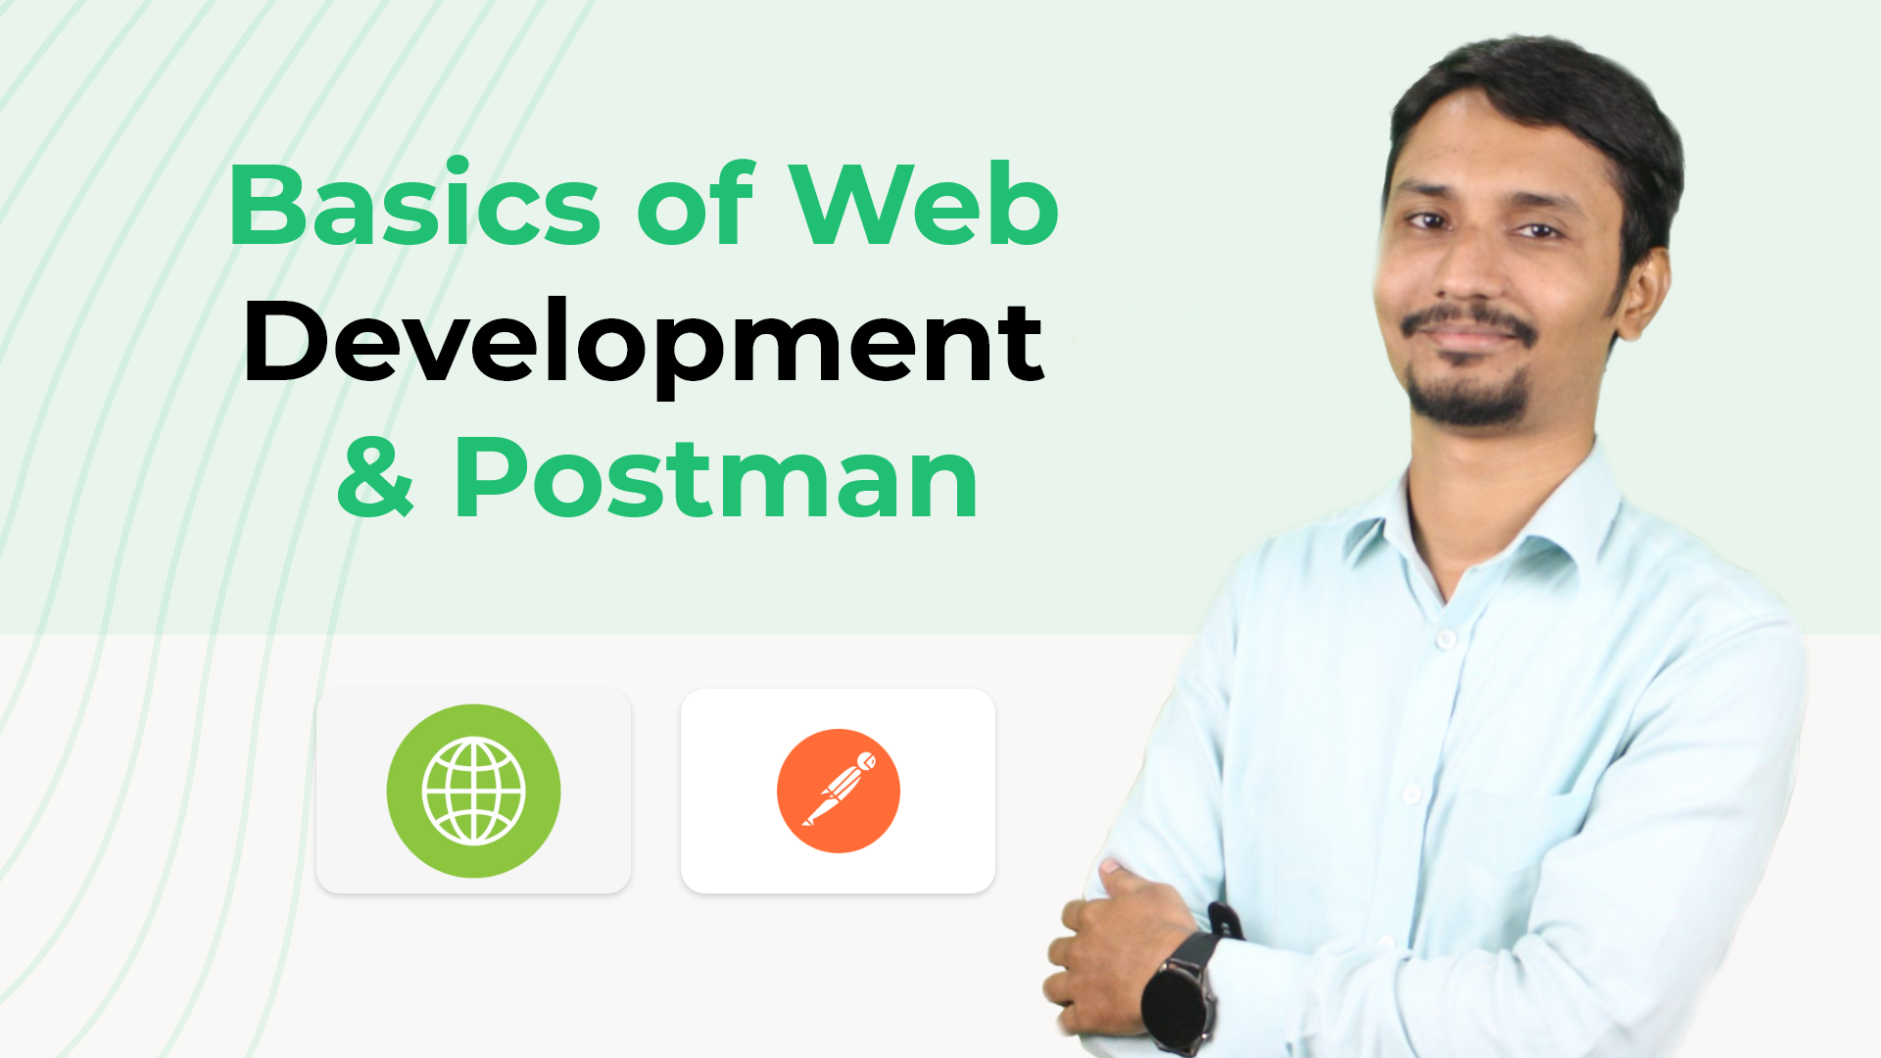

Slide 2
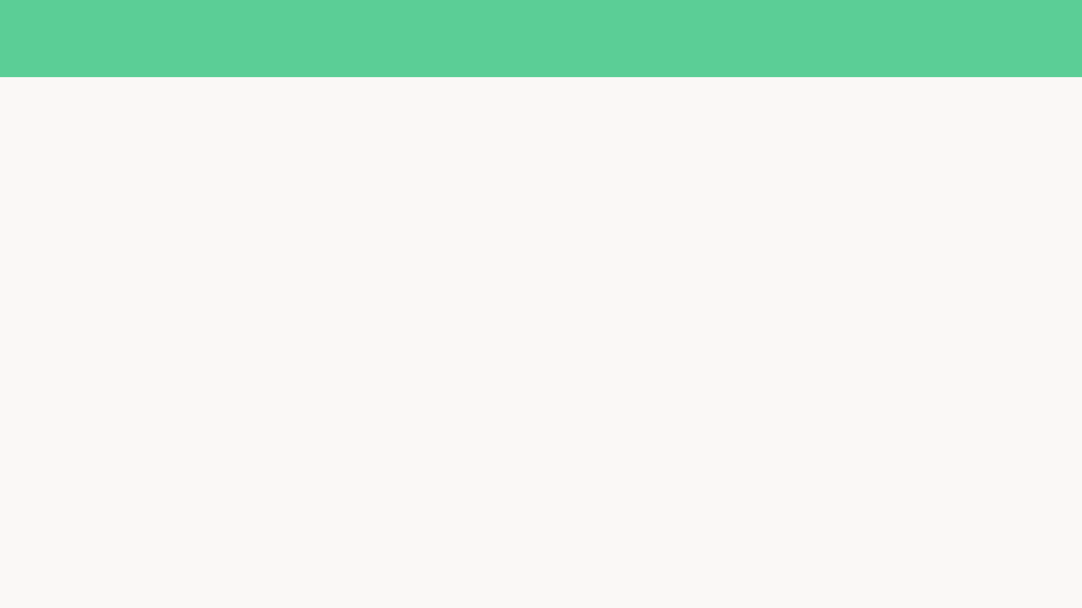
What is Software ?
Software is a set of instructions, data or programs.
Used to operate computers and execute specific tasks.

Slide 3
Types of software
System software: Operating systems like Windows, macOS, Android and iOS
Utility software: Anti-virus software, tools for system clean-up, disk defragmentation,
and file compression
Application software: This is everything else

Slide 4
Application software
Web Application : Runs on web browser
Mobile Application: Runs on android IOS
Desktop Application : Runs on Windows, Mac, Linux

Slide 5
Why Web Application
Low cost
Easy maintenance
Easy deploy
Easy distribution
Easy bug fixing
Huge Resource
Big community

Slide 6


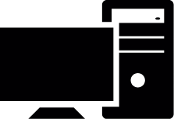

How Web Application Works
Database Server
Server-Side
Client – Side
Client Side
Server-Side
Database-Server

Slide 7
What Technology Used ? What We Should Learn
MongoDB
MSSQL
PLSQL
MYSQL
PostgreSQL
Database-Server

Slide 8
What Technology Used ? What We Should Learn
Node-Express JS
PHP-Laravel
C#- ASP.NET
Python- Django
Server-Side

Slide 9
What Technology Used ? What We Should Learn
HTML,CSS,JavaScript
JS→ React
JS→ Vue
JS→ Angular
Client Side

Slide 10








What types of software our industry building now

Slide 11
Where should we focus more for full-stack development
Server-Side
Database-Server
Client Side

